Slide 1
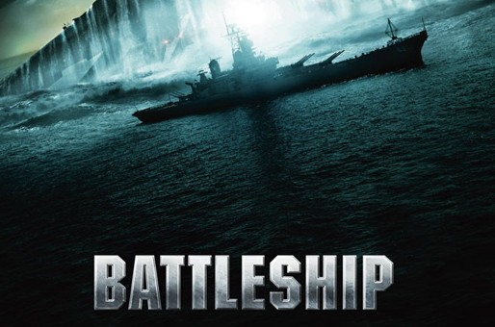
2011510105 Berkay TÜRKGELDİ
2009510046 Ali KONYA
2011510039 Furkan KAYA

Slide 2
CONTENT
ABOUT THE PROJECT
WORK PROGRESS
OBJECT ORIENTED MODEL
COMPUTER GAME STRATEGY
PROBLEMS - SOLUTIONS

Slide 3
ABOUT THE PROJECT
The aim of the project is to develop a two player strategy game. (Human and computer)
The game is played on four 9*9 boards, two for each player. ( Ship Board and Guess Board )
Player arranges ships and records the shots by the opponent on the Ship Board and records own shots on the Guess Board

Slide 4
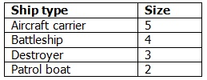
ABOUT THE PROJECT
Before the game begins, each player arranges their ships on their ship board. Each ship occupies a number of consecutive squares on the board, arranged either horizontally or vertically
The number of squares for each ship is determined by the
type of the ship

Slide 5
ABOUT THE PROJECT
Each player has 4 ships in total and places them on the ship board. When placing, there must be one empty square ( horizontal, vertical and diagonal ) at least between different ship’s squares

Slide 6
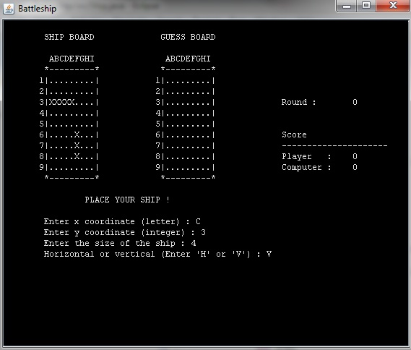
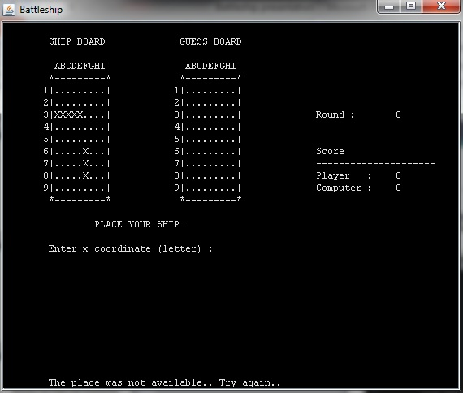
EXAMPLE

Slide 7
ABOUT THE PROJECT
After the ships have been positioned, the game proceeds in a series of rounds.
First player is human
In each round, players determine a target square, and oppenents response a result

Slide 8

ABOUT THE PROJECT
Results are 3 types
Hit
Miss
Sunk

Slide 9
ABOUT THE PROJECT
If all the ships of a player have been sunk, the game is over and their oppenent wins
Winner’s final score is equal to his/her score minus oppenent’s score

Slide 10
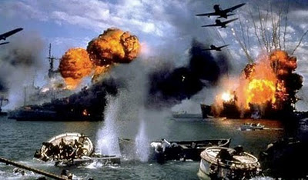
WORK PROGRESS
First Week
Second Week
Third Week
Final Week

Slide 11

First Week
Game Screen
Creating necessary classes
Board class
Ship class
Player class

Slide 12
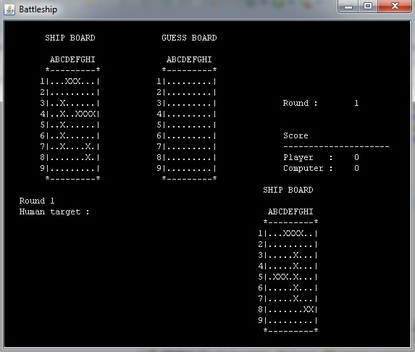
Second Week
Placing ships
for user and
computer
When placing,
control all
possibilities

Slide 13
Third Week
Design all rounds, targettings and respondings
Computer game strategy
Scoring
→ Every hit 10 points
→ Evey sunk 50 points

Slide 14
Final Week
Designing end of the game
Debugging

Slide 15
OBJECT ORIENTED MODEL
Board class has two dimentional array, so every board will have their own array
Ship class has two constructer (for human and computer )
Player class has Guess Board and Ship Board which is created by Board class. At the same time, Player class have 4 ships with different sizes. The ships are created by Ship class

Slide 16
COMPUTER GAME STRATEGY
Computer generates random numbers for target until it finds any ship’s part
When computer finds any ship’s part, it tries the target’s around places at the next turn
When computer finds second part of the ship, it determines ship’s direction

Slide 17
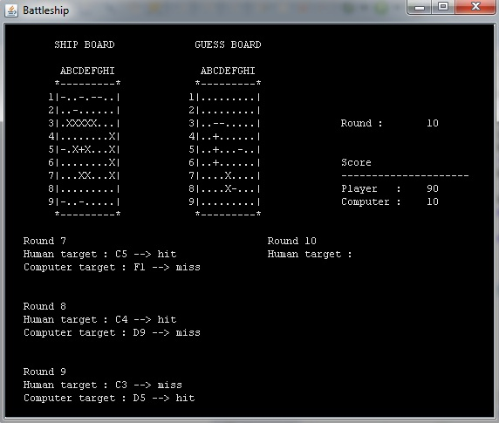
COMPUTER GAME STRATEGY

Slide 18
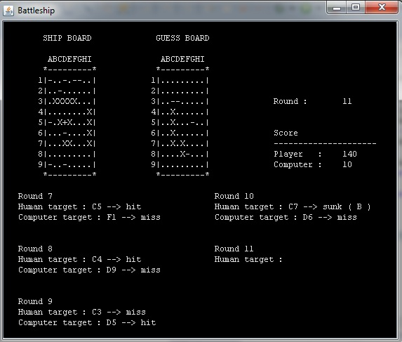
COMPUTER GAME STRATEGY

Slide 19
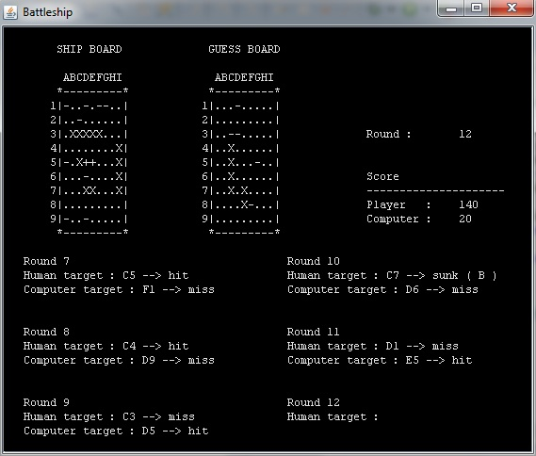
COMPUTER GAME STRATEGY

Slide 20
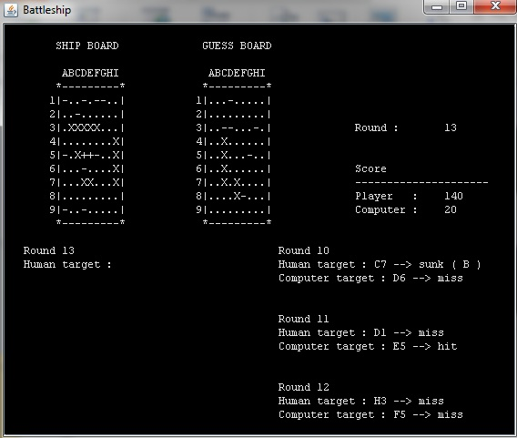
COMPUTER GAME STRATEGY

Slide 21
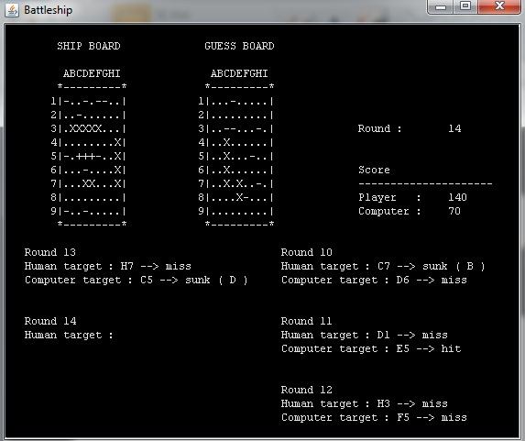
COMPUTER GAME STRATEGY

Slide 22
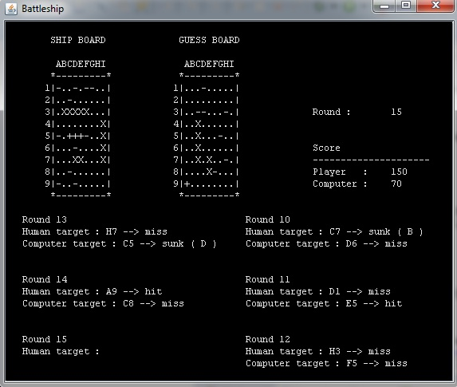
COMPUTER GAME STRATEGY

Slide 23
PROBLEMS AND SOLUTIONS
Problem
When we take coordinate, we define two variables integer and char, and char variable give problem when we want to use it as index
Solution
We benefit from ASCII codes for char variable

Slide 24
PROBLEMS AND SOLUTIONS
Problem
When computer hits, if next target will miss, it begins trying wrong places
Solution
We hold previous variable and activate it for conditions above

Slide 25
PROBLEMS AND SOLUTIONS
Problem
When user place his/her own ships, it could place same ships in different places ( same size )
Solution
We use a static array variable and control when user place a ship

Slide 26
PROBLEMS AND SOLUTIONS
Problem
When a player hits a ship, we could not know which ship is hit by player, so we could not reduce its size to control sunk
Solution
We use another two dimentional array and when we take ships from user or computer, we assign ‘A’,’B’,’D’, or ‘P’ its index with respect to their sizes

Slide 27


Slide 28

THANK YOU FOR LISTENING

