Slide 1
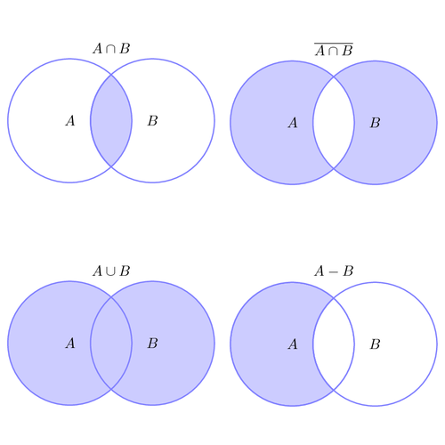
SET GAME
2008510048 Anıl Teke
2009510046 Ali Konya
2009510103 Deniz Arslan
2011510105 Berkay Türkgeldi

Slide 2
CONTENTS
ABOUT THE PROJECT
GAME RULES
WORK PROGRESS
SET OPERATIONS
CURSOR MOVEMENTS
TIME CONTROL
PROBLEMS – SOLUTIONS

Slide 3
ABOUT THE PROJECT
The name of the project is Set Game
The aim of the project is to constract 3-element set expressions and try to gain the highest score
The game has four operation to raise score
Union → ‘u’
Intersection → ‘n’
Difference → ‘-’
Symmetric Difference → ‘+’

Slide 4
ABOUT THE PROJECT
At the beginnig of the game, board is loaded from text file
Each set is generated randomly from elements 1 to 20 Sets can have between 4 and 8 elements
Two of each set and operator signs are placed on board randomly. These symbols must have empty neighboor grids in 8 directions

Slide 5
GAME RULES
Player cannot push several block at the same time
We controled this situation with if statement
If there is a set block or operator block in the direction of player, player pushes the block in that direction and they move together
Game consists 8 rounds and every round must be completed in 50 seconds

Slide 6
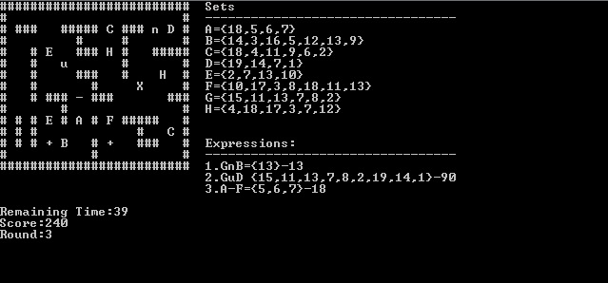
GAME RULES
The same set cannot be used in the same expression more than once
(«AnA», «AuA», «A-A», «A+A» are not allowed)
The elements of the constructed expression are written on the right of the board

Slide 7

WORK PROGRESS
First Week
Second Week
Third Week
Fourth Week
Last Week

Slide 8
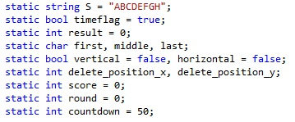
First Week
Definition of variables
Game board is taken on a text file
Cursor movement of X

Slide 9
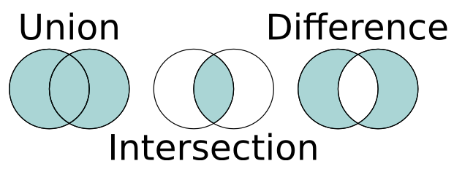
Second Week
Set operations is constructed

Slide 10
Third Week
X movements
Pushing the blocks
Score management

Slide 11

Fourth Week
TIME MANAGEMENT

Slide 12

Last Week
Testing and implementation

Slide 13

CURSOR MOVEMENT

Slide 14
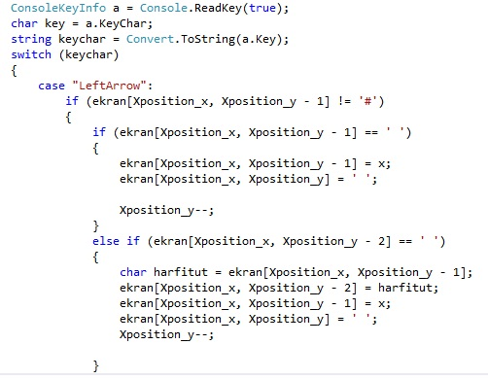
CURSOR MOVEMENT
The picture shows only left movement of ‘X’. Algorithm contains the rest of possible conditions like this
It controls walls and spaces to move next place.
After every movement, board is arranged

Slide 15
SET OPERATIONS
UNION
INTERSECTION
DIFFERENCE
SYMMETRİC DIFFERENCE

Slide 16
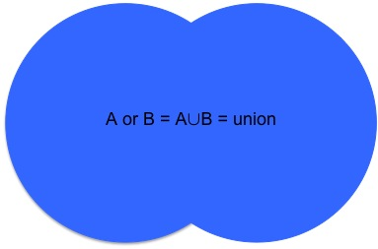
UNION
The union operation takes all elements in the given sets and returns sum of the elements.
It is important that the elements which is in set A and set B should not be used when addition is applied

Slide 17
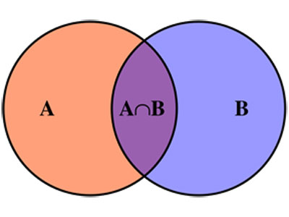
INTERSECTION
The intersection operation takes common elements of given sets and returns product of the elements
The initial value of result variable must equal to 1
However, if there is no
intersection, the result
will be 0.
(It is controlled with if statement)

Slide 18
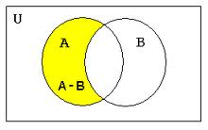
DIFFERENCE
The difference operation takes elements which is only in first set and returns sum of taken elements
The intersection operation can be used for difference operation to make algorithm clear. Because they execute same tasks in
particular blocks

Slide 19
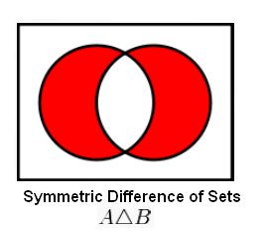
SYMMETRIC DIFFERENCE
The symmetric difference operation takes the elements of given sets but it does not take same elements
The intersection operation can
also be used for this operation

Slide 20
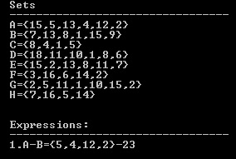
SET EXPRESSIONS
If we construct an expressions like A-B the difference operation will be used for A and B sets

Slide 21
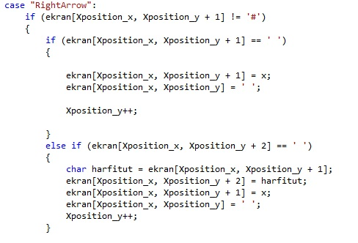

PUSHING THE BLOCKS

Slide 22
TIME CONTROL
We use system time to the project

Slide 23

PROBLEMS AND SOLUTIONS
Problem :
When the sets are generated, same
values could be in same set
Solution :
When we are generated sets, we
control every elements within for loop

Slide 24
PROBLEMS AND SOLUTIONS
Problem :
When we construct 3 element expression
like «set + operation + set» the expression
disapper but the table model become
deformed
Solution :
We added 3 space characters after
expression is destroyed

Slide 25

ANY QUESTIONS ?

Slide 26

THANK YOU FOR LISTENING

