Slide 1

TIC – TAC - TOE
2011510105 Berkay Türkgeldi
2008510050 Adnan Tuğ
2009510046 Ali Konya
2010510094 Ahmed Alhammadi

Slide 2
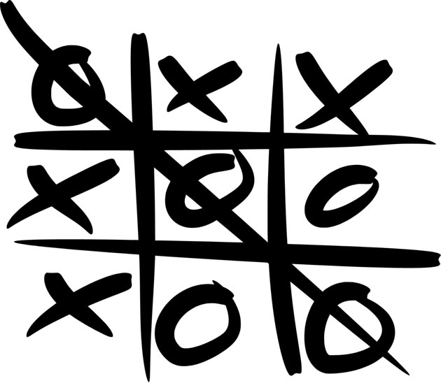
CONTENTS
ABOUT THE PROJECT
WORK PROGRESS
PROBLEMS – SOLUTIONS
OPERATIONS

Slide 3
ABOUT THE PROJECT
The name of the project is Tic-Tac-Toe
The aim of the project is to develop a two-player 3*3 board game
The project has degree of difficulties. It contains winning, losing, and tie conditions.

Slide 4
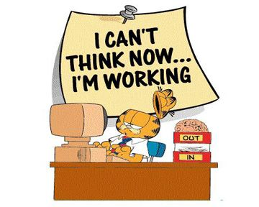
WORK PROGRESS
First Week
Second Week
Third Week
Last Week

Slide 5
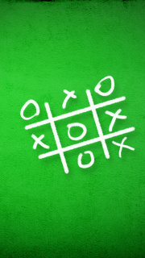
First Week
Variables are specified
It is collected some information about the game
The flowchart of the game is created

Slide 6
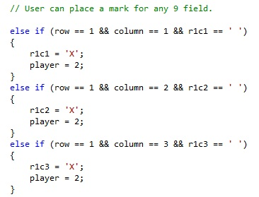
Second Week
It is started to write code blocks
If statements are formed
Play of ‘X’ is designed with reference to user’s inputs
…

Slide 7
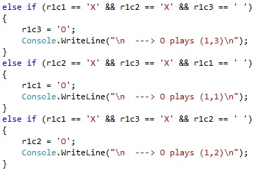
Third Week
Degree of difficulties are attached
While loop is used for some operations
Play of ‘O’ is designed with reference to placed marks
…

Slide 8

Third Week
EASY LEVEL
Easy level is designed in
order of priorities
(unimportant → important)
The middle and the corners of the table
are marked at the end of the game

Slide 9

Third Week
MEDIUM LEVEL
In medium level, ‘O’ plays with
reference to ‘X’ and ‘O’ fields
It controls the possibilities for winning and losing conditions
If it cannot find any condition, ‘O’ plays in order of priorities
( important → unimportant )

Slide 10
Third Week
HARD LEVEL
This level is inside of medium level
In this level, there are some extra conditions to user cannot win the game

Slide 11
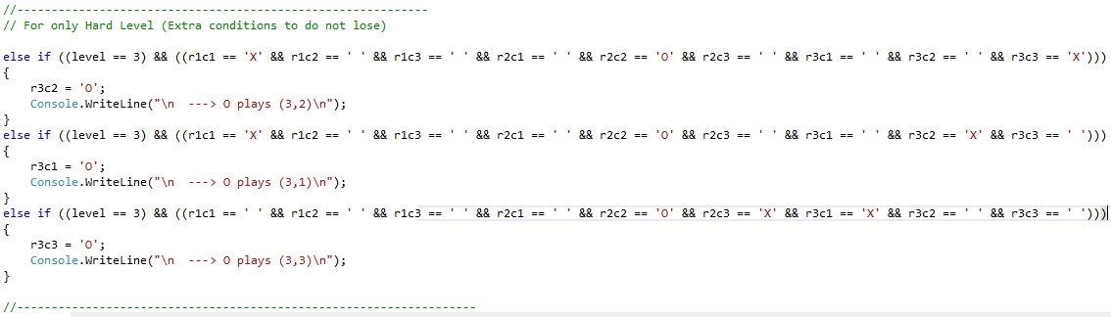
Third Week
HARD LEVEL

Slide 12
Fourth Week
The project is completed
Poster and presentation is prepared
Project Final Report is written

Slide 13
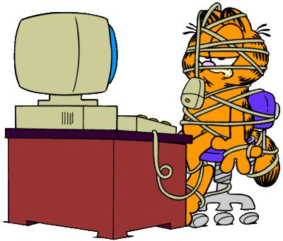
PROBLEMS AND SOLUTIONS
Problem
The conditions of user’s wrong input!
Solution
Control the input after it is taken
Problem
Probabilty of place a mark which the field has already marked!
Solution
Control the place is marked or empty

Slide 14
PROBLEMS AND SOLUTIONS
Problem
Incrementing the tour variable if user enter a wrong number
Solution
If user enters a wrong input, decrement the tour variable
( Because tour variable increments at the end of the while loop )

Slide 15
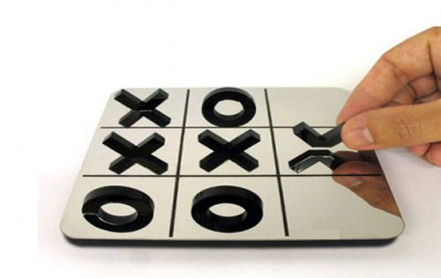
OPERATIONS

Slide 16
OPERATIONS
1 – Difficulty level is taken from user
2 – Table is formed in the screen
--- while loop ---
3 – Row and column variables is taken from user
4 – If row and column are correct, X plays
5 – O plays
6 – Contol end of the game conditions
--- while loop ---
End of algorithm

Slide 17


Slide 18

THANK YOU FOR LISTENING

