Slide 1
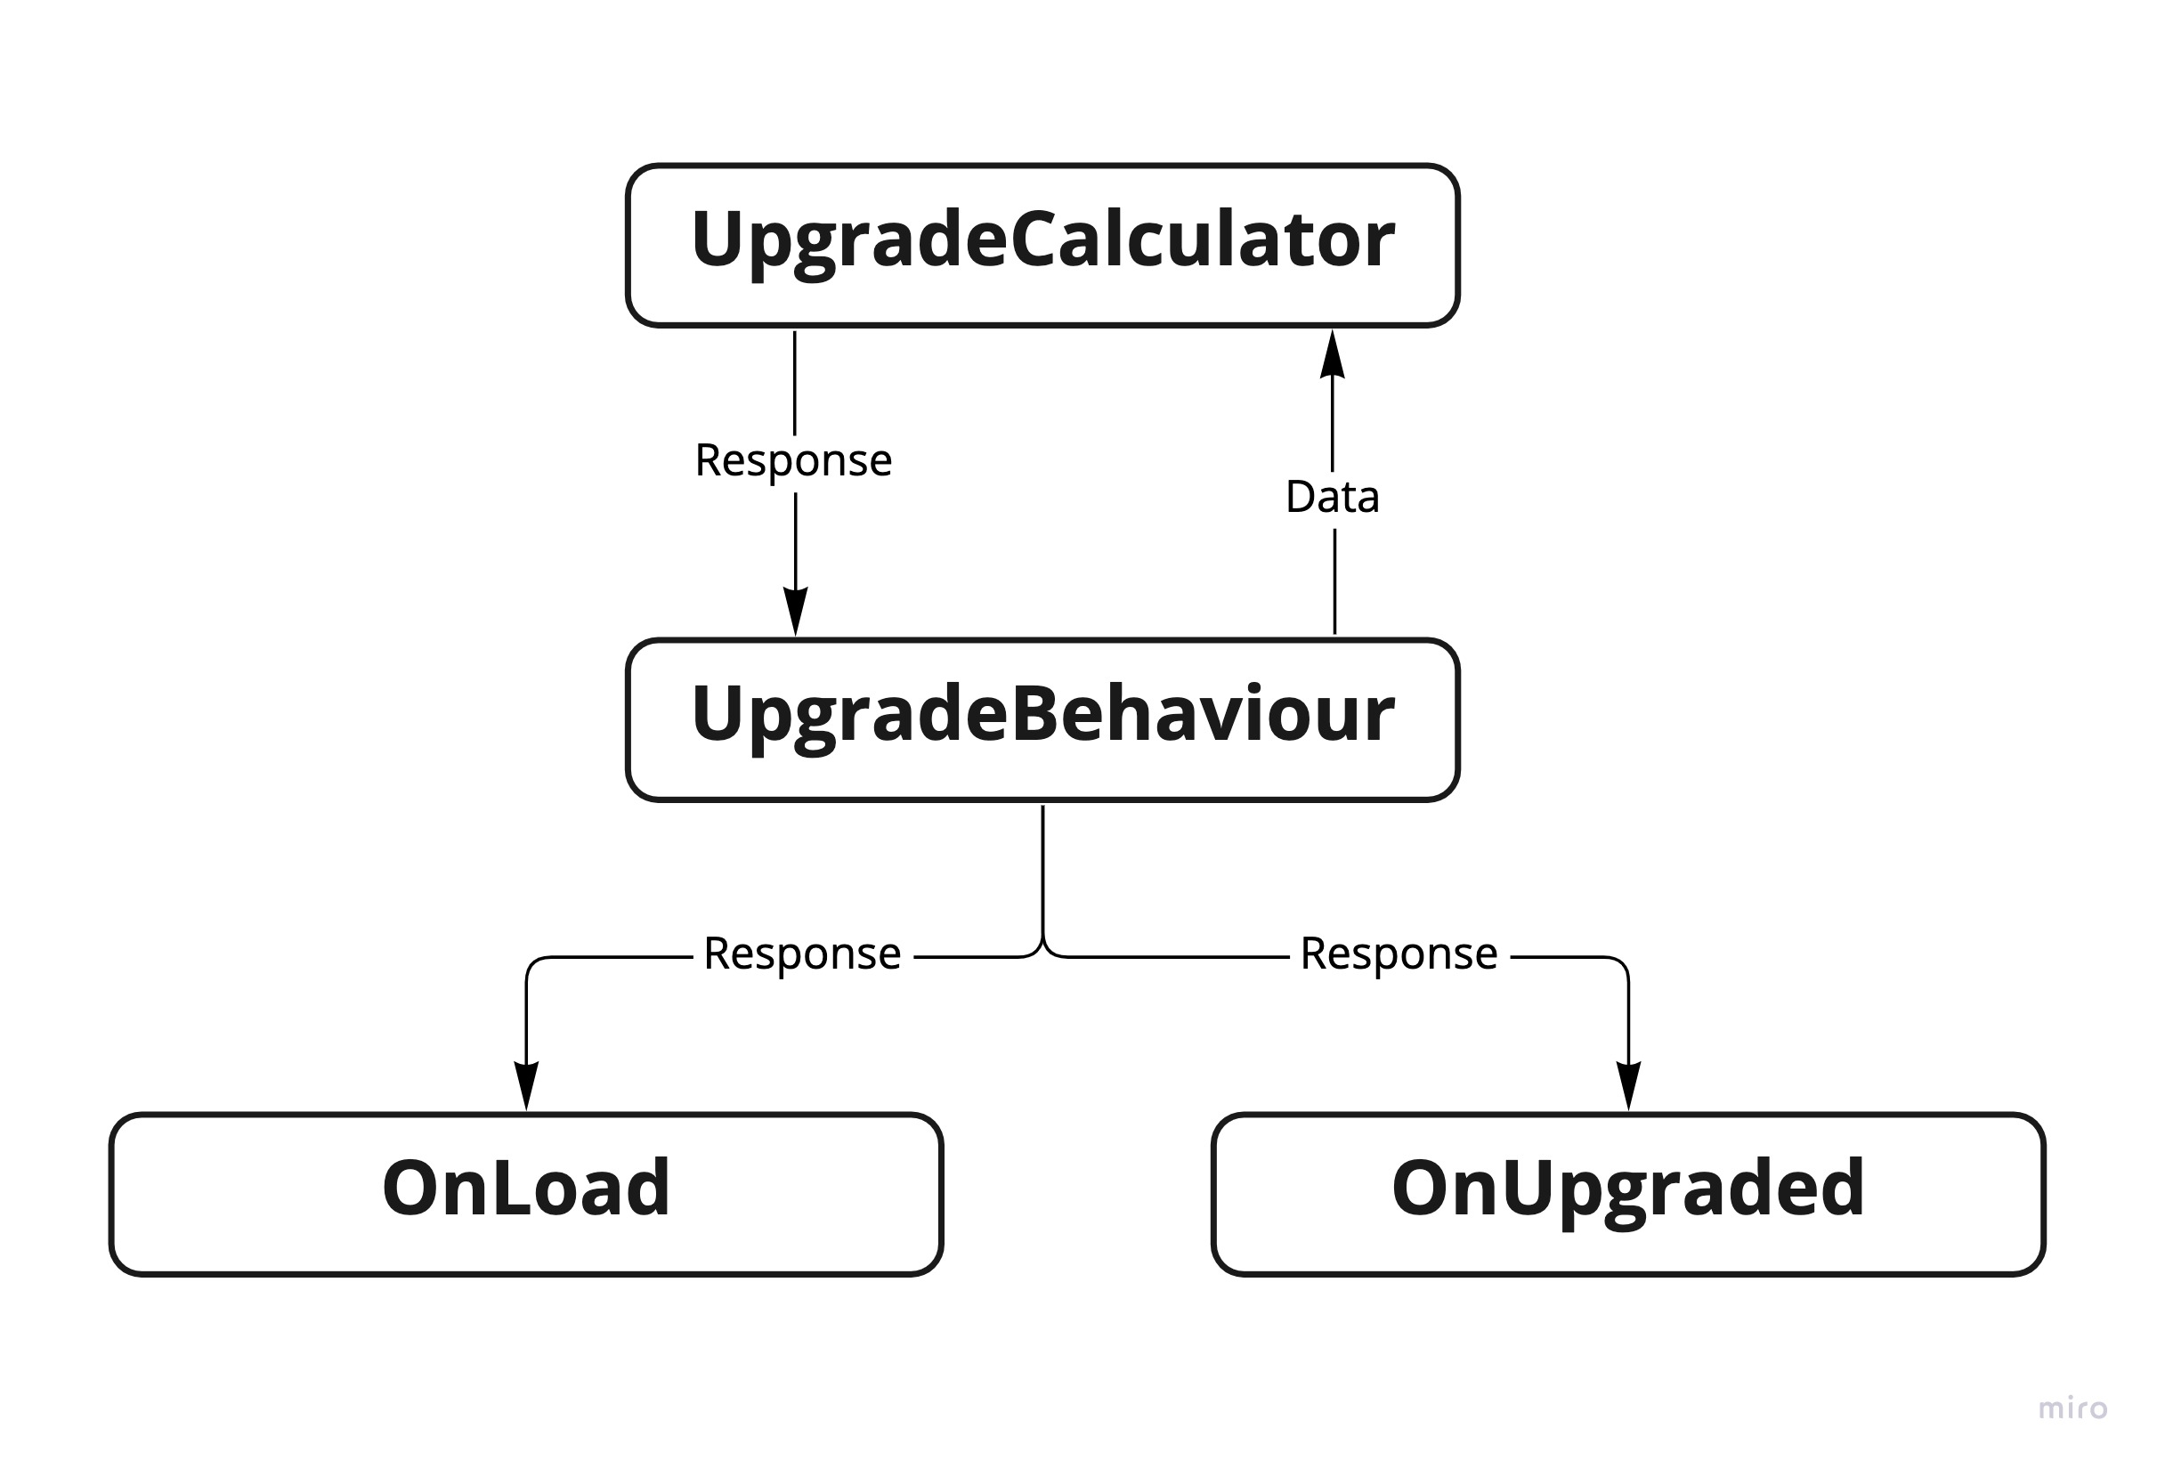
UpgradeSystem

Slide 2
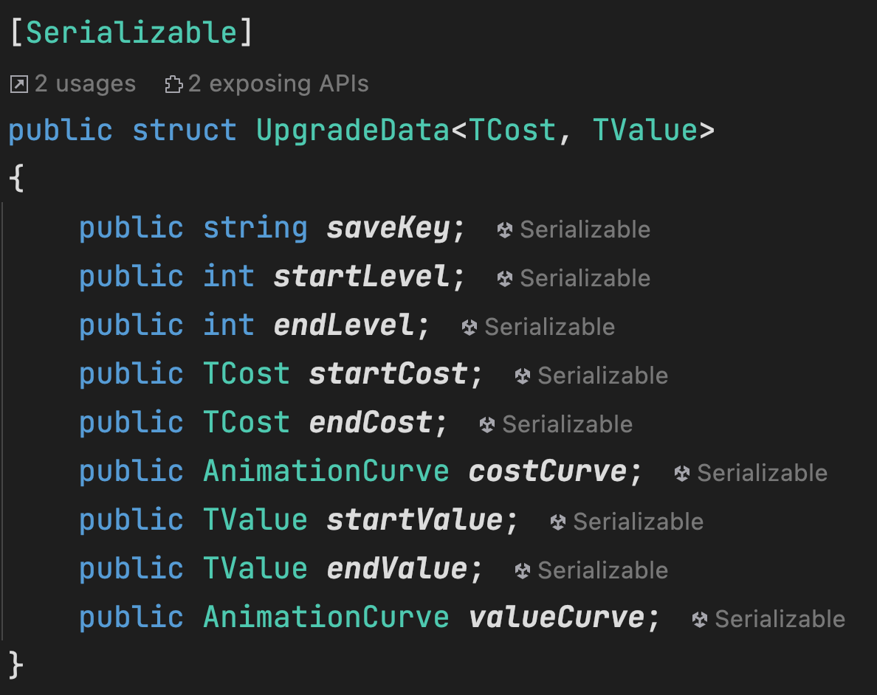
UpgradeSystem
UpgradeData
UpgradeData is used by UpgradeCalculator to Calculate
the UpgradeResponse.
saveKey | Used for PlayerPrefs key argument
TCost | The Type for Used as Cost. For Exp, Coin count is int
TValue | The Type for Used as Value For Exp, Player Speed is float

Slide 3
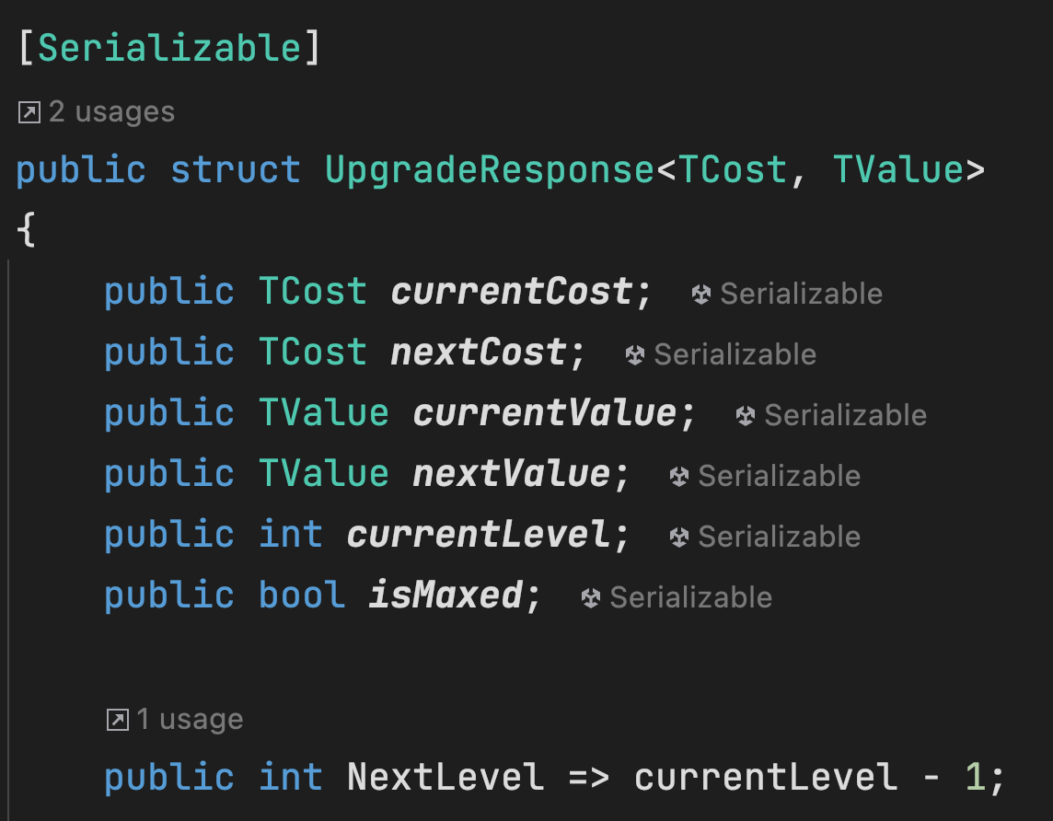
UpgradeSystem
UpgradeResponse
UpgradeResponse is can be used by other Monobehaviours
such as PlayerMovement, EnemyDamage, UI etc.
currentCost | The Current Cost of the Upgrade
nextCost | The Next Cost of the Upgrade
currentValue | The Current Value of the Upgrade
nextValue | The Next Value of the Upgrade
currentLevel | The Current Level of the Upgrade
nextLevel | The Next Level of the Upgrade
isMaxed | Is this Upgrade Maxed? If so, it cannot be Upgraded anymore

Slide 4
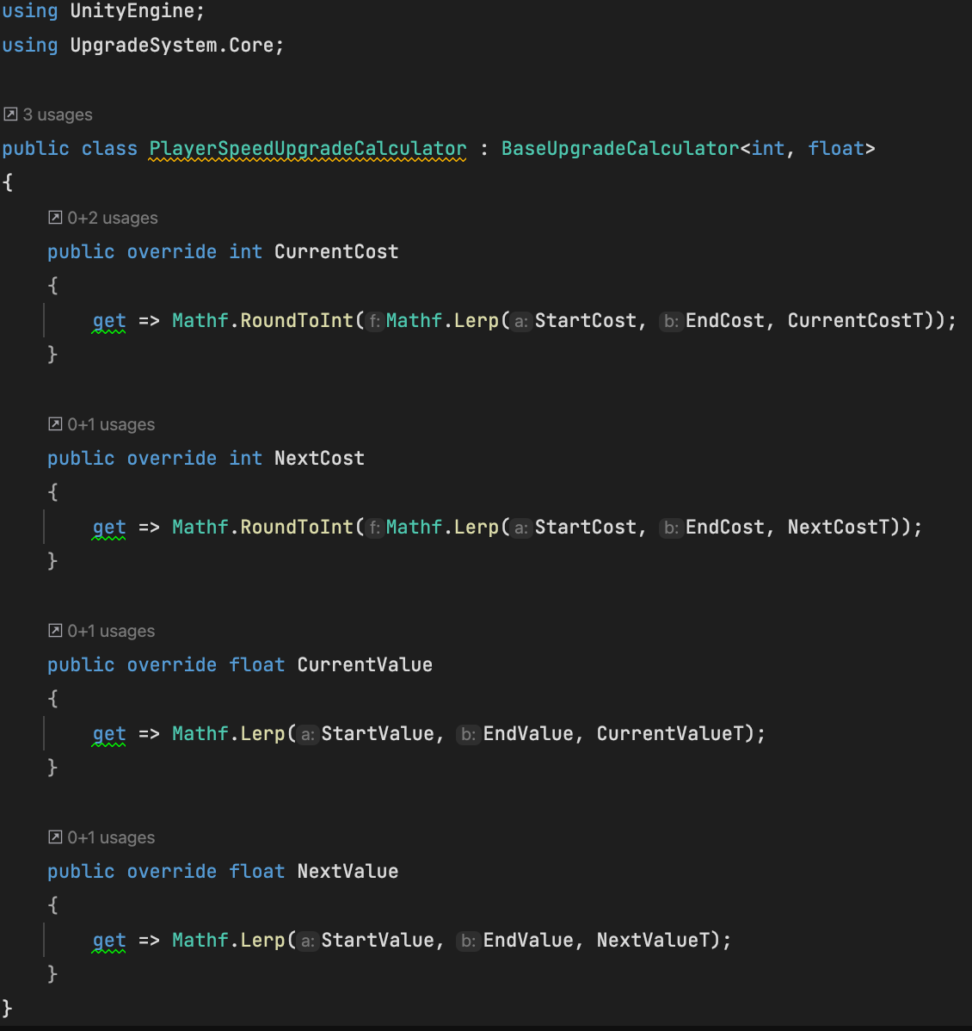
UpgradeSystem
Creating a new Upgrade
1) Create a new Calculator
Cost Type is int because we use Coins to Upgrade the Players’ Speed
And Coin Count is a int Type
Value Type is float because Player’s Speed is a float Type
StartCost, EndCost, StartValue, EndValue, CurrentCostT, NextCostT,
CurrentValueT and NextValueT is Calculated by Base Calculator.

Slide 5
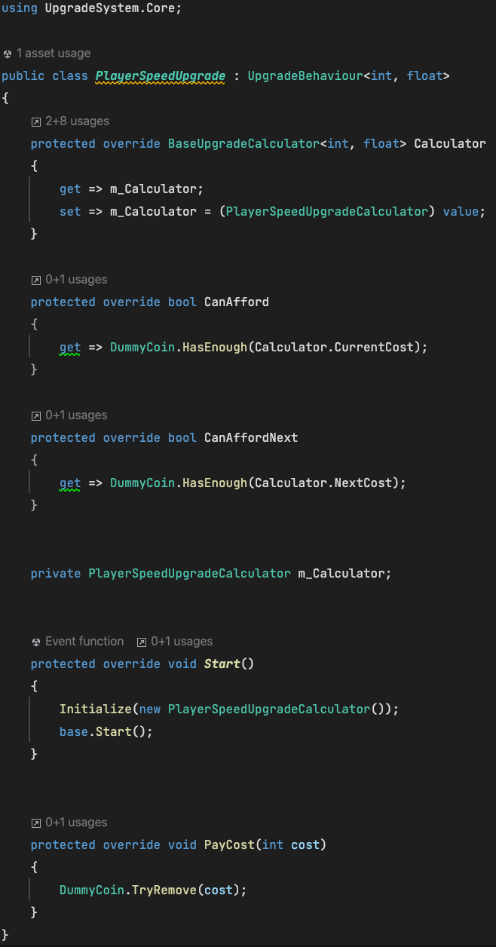

UpgradeSystem
Creating a new Upgrade
2) Create a new Upgrade Behaviour
We give <int, float> again same as its Calculator
You can call this function to Upgrade. You don’t need any if checks.

Slide 6
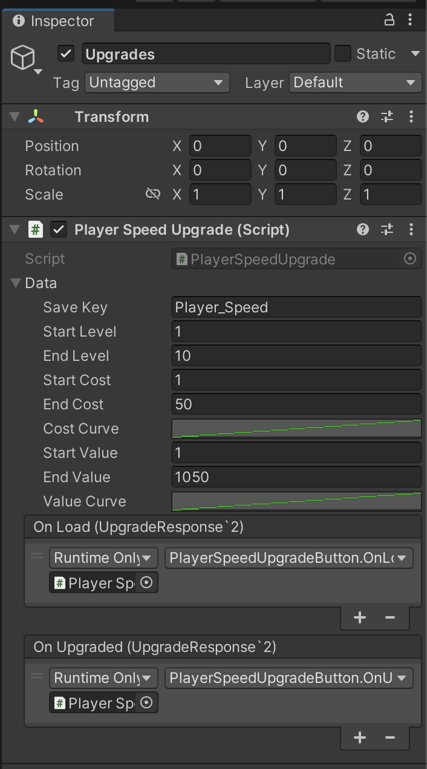
UpgradeSystem
Using the New Upgrade
1) Attach your Upgrade Script which inherits
from UpgradeBehaviour
Data is used by UpgradeCalculator
OnLoad is called in Start and Contains a UpgradeResponse
OnUpgrade is called when Upgraded

Slide 7
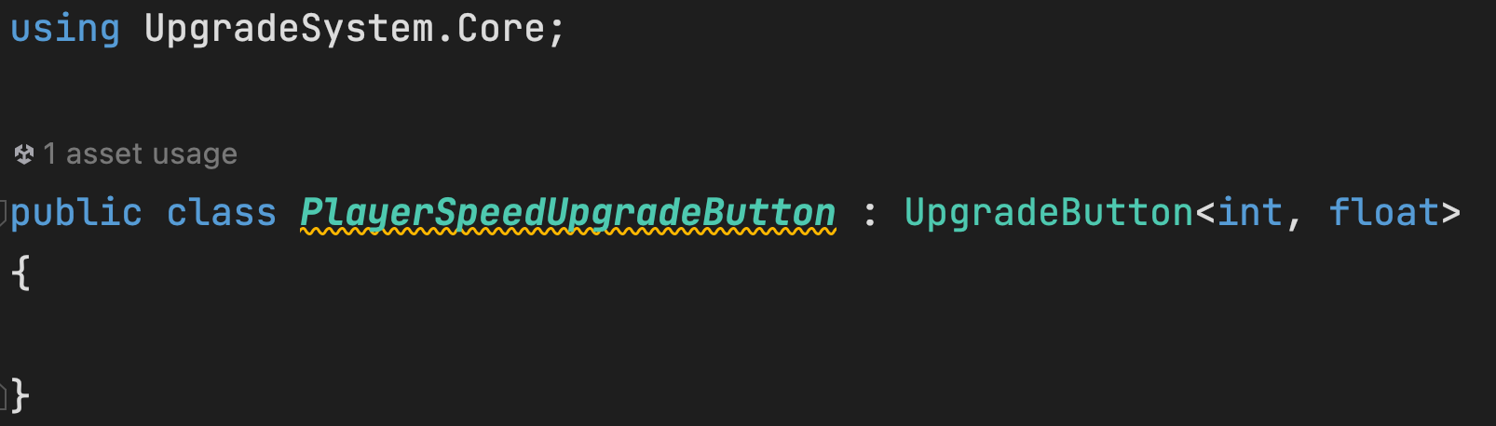
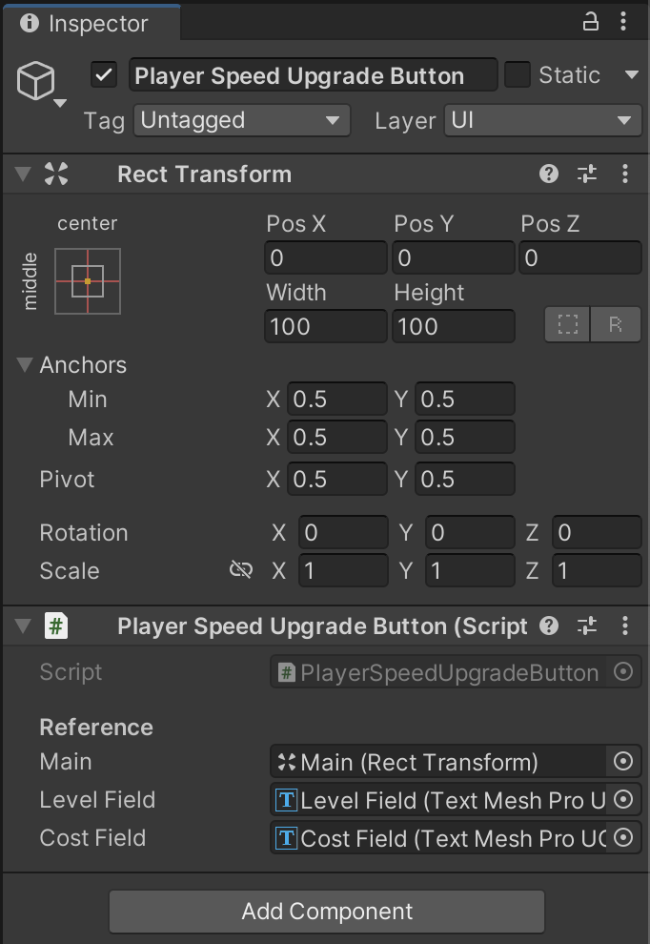
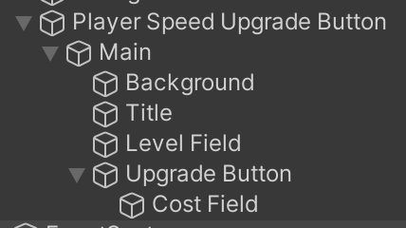
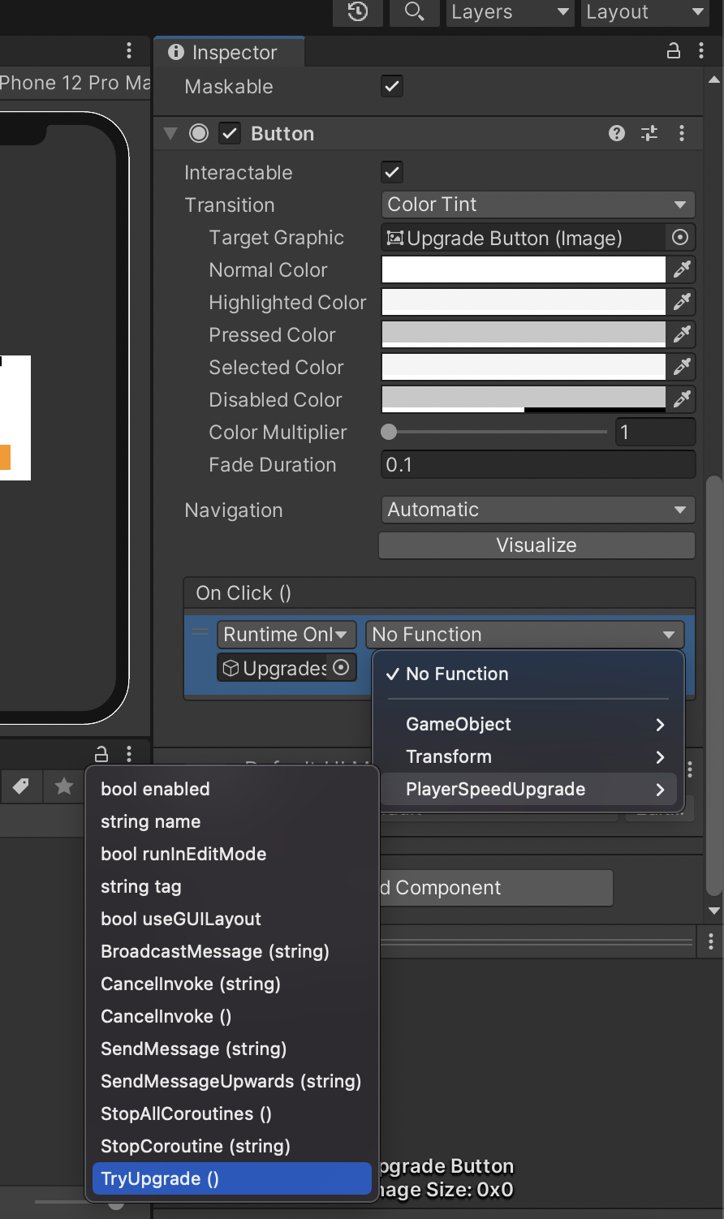
UpgradeSystem
2) Create and Attach a UpgradeButton Script to UI
Call TryUpgrade from OnClick

Slide 8
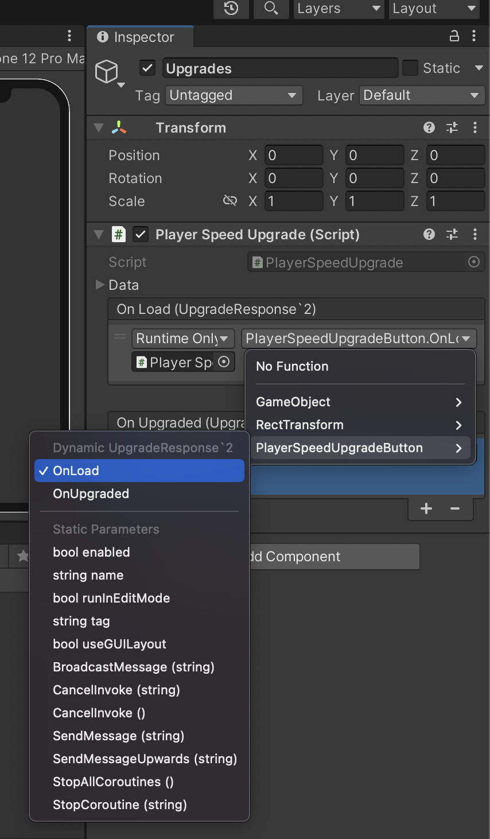
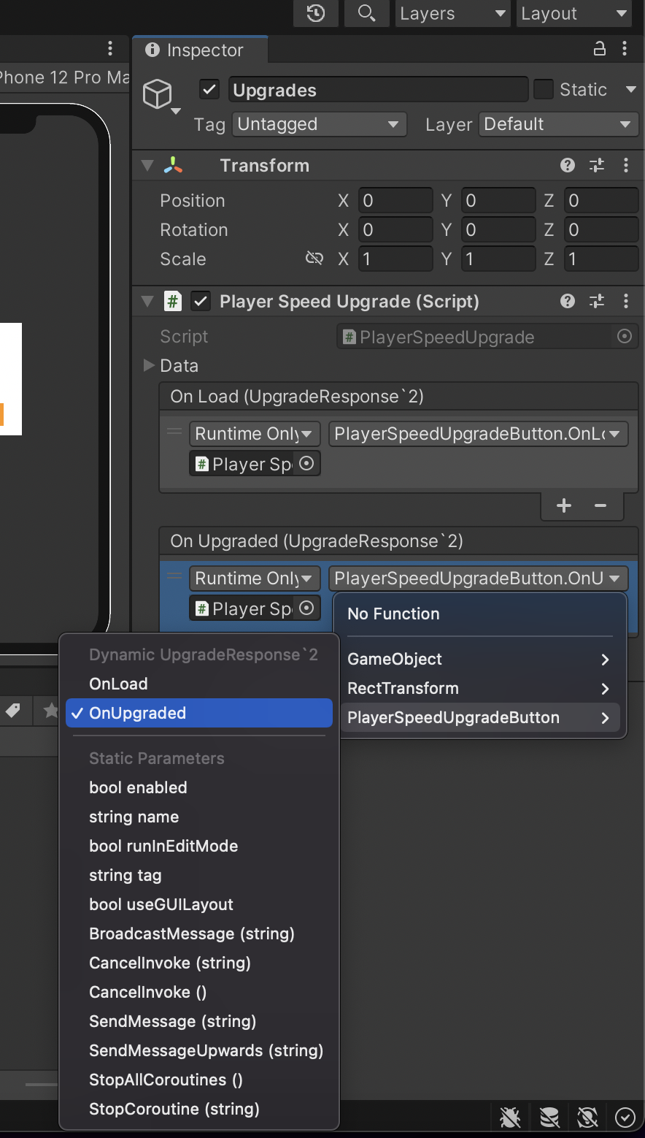
UpgradeSystem
3) Call Upgrade Buttons OnLoad and OnUpgraded from
the UpgradeBehaviour

