Slide 1
WIRELESS SENSOR NETWORKS LABORATORY
Interactive Human-in-the-Loop
Sorting System over a
Self-Healing Wireless Sensor Network
7 nRF52840 nodes · Contiki-NG · NullNet + CSMA/CA · Bellman-Ford multi-hop routing
Muhammed Ayranci · Kemal Berkay Elçik · Andreea Musat
Technical University of Munich

Slide 2




Project Objectives
Bridging embedded sensing, operator judgment, and self-healing multi-hop networking
Resource Constraints
The Interface Gap
Physical Volatility
Self-Healing Delivery
Achieving reliable multi-hop routing and telemetro on memory-constrained nRF52840 nodes.
Reconciling high-speed network packet routing with slow, asynchronous human decision-making
Maintaining an unbroken industrial sorting pipeline despite node failures and dynamic topology changes.
Dynamic proxy routing keeps cargo flowing even when nodes fail.

Slide 3

System Architecture
Cargo flows from physical sensing through the network to the customer, with reports bouncing back
FACTORY NODE
OPERATOR NODE
MULTI-HOP WSN
CUSTOMER NODE
FSR sensor · ADC sampling · cargo generation
Joystick input · destination selection · queue
Bellman-Ford distance-vector routing
Delivery · label check · report generation
Report packet (delivery status + route history) returns to the Operator
Stack: NullNet over IEEE 802.15.4 CSMA/CA, Channel 16 · Reduced TX power forces genuine multi-hop paths

Slide 4

Seven Nodes, Four Roles
Every node runs Contiki-NG; every node also participates in routing as a potential relay
Node 7
Node 1
Nodes 2–5
Node 6
Factory
Operator
Customers
Dedicated Relay
Polls FSR via ADC; generates cargo packet with true label on threshold + Button1 press.
Buffers cargo (20-slot queue); Maps joystick X/Y to destination;
Acts as the network bridge;
Monitors delivery reports.
Default delivery destinations; verify selected label vs. ground truth; generate reports.
Always available as intermediate hop; can also serve as a proxy customer.
Any node — including the Factory and Customers — can relay a packet destined for another device, enabling maximum physical flexibility.

Slide 5

Human-in-the-Loop Workflow
From physical force reading to verified delivery, in one continuous cycle
1
2
3
4
Cargo Generation
Operator Interaction
Delivery Feedback
Resolve or Re-sort
FSR threshold + Button1 press creates a cargo packet with a true label (A–D).
20-slot circular buffer queues cargo; joystick X/Y select the destination label.
Customer node checks selected vs. true label; report bounces back via routing table.
Correct → logged resolved. Incorrect → re-queued at the back for a re-attempt.
Didn’t reach the node → Dropped.
Timeout while awaiting a report → cargo is dropped and logged as a failure.

Slide 6

Fault Tolerance & Self-Healing
Two mechanisms keep cargo moving even as the physical network changes
Failure Detection
Dynamic Proxy Routing
Beacons expose per-destination liveness; each node timestamps the latest beacon received.
A watchdog checks these timestamps continuously.
No update within a 10-second window → node marked offline.
Routing cost to that node is set to infinity, so packets stop being forwarded through it.
Operator continuously monitors reachability of primary customers (Nodes 2–5).
If one becomes unreachable, the routing table is checked for an available backup.
Node 6 (relay) or even Node 7 (Factory) can step in as a proxy customer.
Joystick input remaps to the proxy automatically — no manual reconfiguration or reset.
Once the original node recovers, its primary role is automatically restored.

Slide 7
Custom Packet Structure over NullNet
net_packet_t header (type, src_id) with a payload union: Beacon, Cargo, or Report
net_packet_t
type · src_id · payload
Beacon Payload
Cargo Payload
Report Payload
Costs to known nodes
Packet ID
Destination ID
Force value
True label
Selected label
Route history
Hop count
Cargo ID
Action
Match success
Route history
Hop count

Slide 8

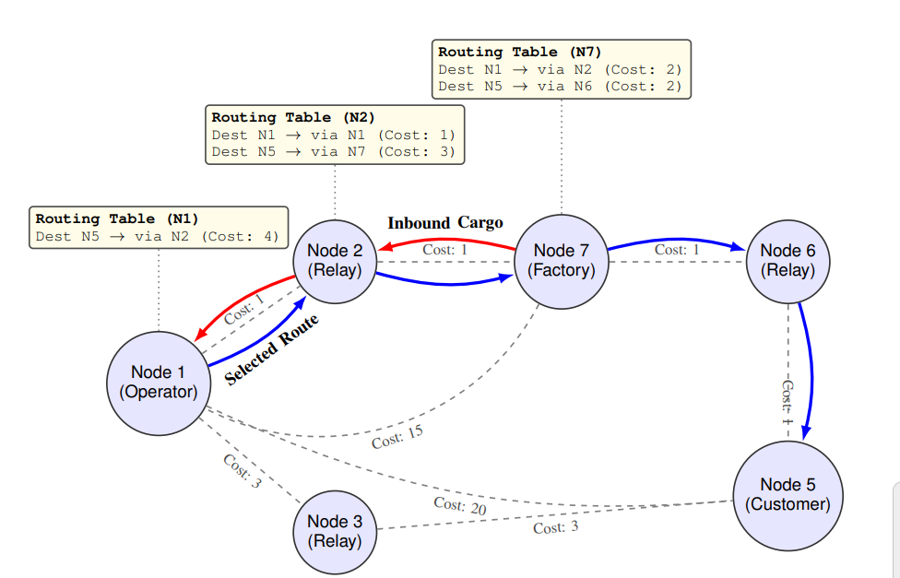
Multi-Hop Routing: Distributed Bellman-Ford
How it works
Example: Optimal Route via an Alternate Relay
N2
Relay
Cost:1
N3
Relay
Beacons broadcast every 3 seconds advertise routing costs to neighbors.
RSSI on each received beacon is converted into strict penalty tiers (Cost:1, 4, 15, 50).
Each node picks its next hop independently from its local table — no central coordination.
Reduced TX power forces genuine multi-hop paths in the lab space.
N1
Operator
Cost:1
Cost:1
N5
Customer
Cost:3
Cost:3
Cost:20
N7
Factory
Cost:15
N6
Relay
Highlighted path shows a Bellman-Ford route using the Factory node as an intermediate relay.

Slide 9
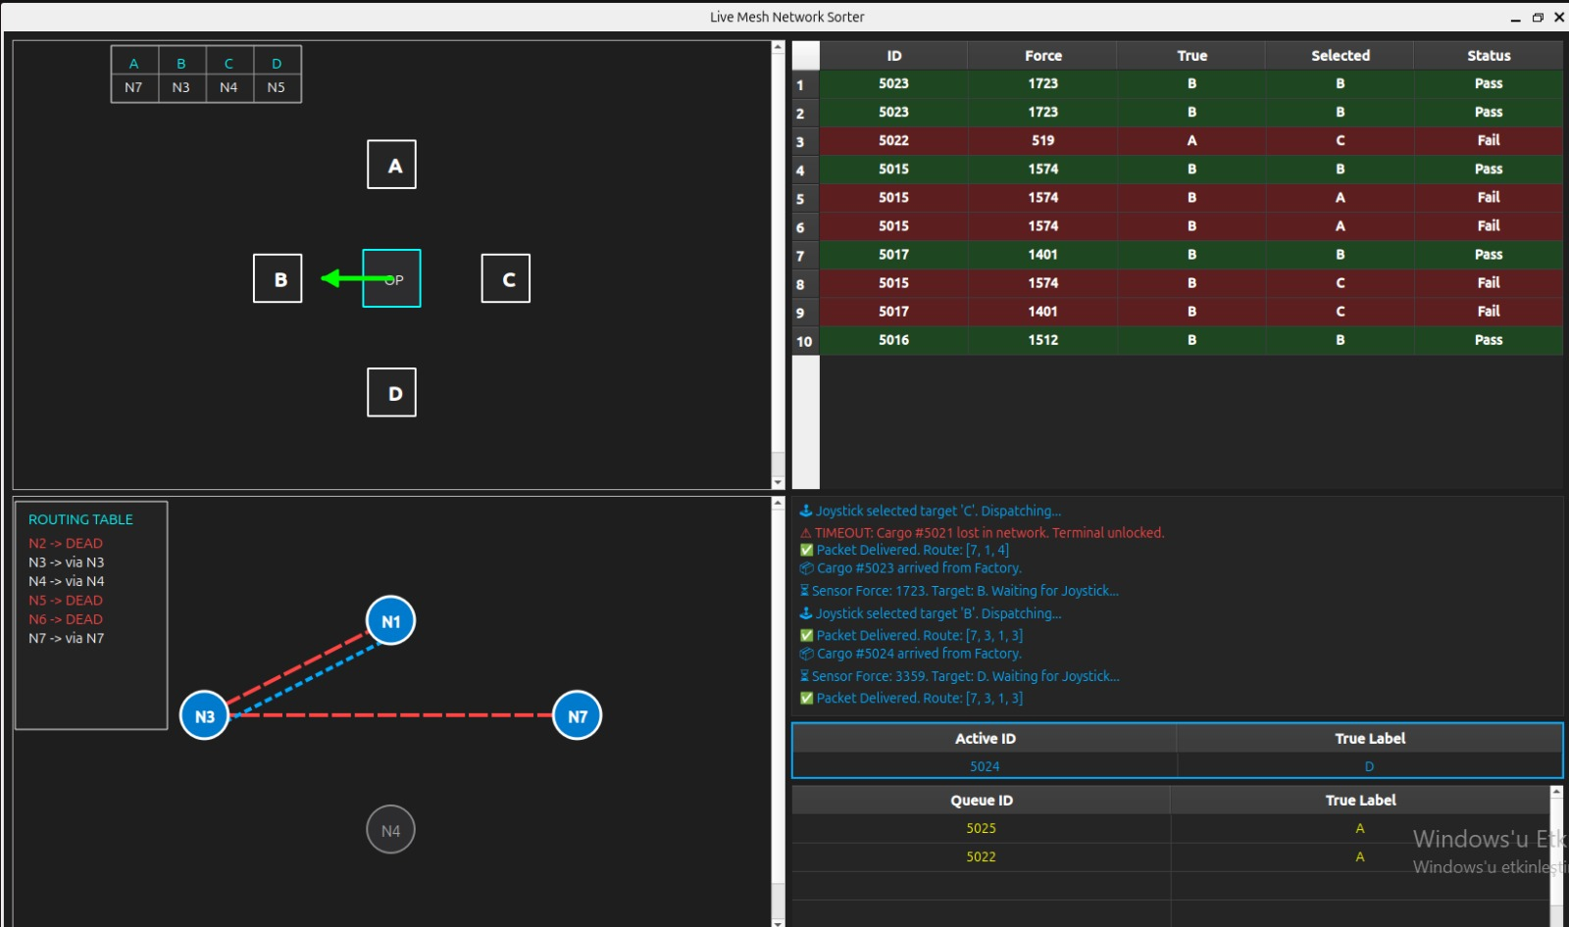

Real-Time PyQt5 Dashboard
Serial link to the Operator node feeds a live visualization of network and delivery state
Status HUD
Maps customer labels A–D to physical nodes; updates live when proxy routing engages.
2D Topology View
Renders Bellman-Ford state and traces active cargo paths in real time.
Fault Color-Coding
Offline or dead nodes are flagged instantly for diagnosis.
Interactive Tables
Show the live circular buffer queue and historical sorting performance.

Slide 10

System Demonstration
Validated end-to-end on a physical network of 7 nRF52840 wireless sensor nodes
Workflow Verified
Fault-Tolerance Validated
Force sensor acquisition and cargo generation
Node failures were intentionally introduced during the demo.
Packet buffering and joystick-based destination selection
Unreachable nodes were detected within the 10-second timeout.
Dynamic proxy routing immediately reassigned unavailable customers.
Cargo delivery continued without manual reconfiguration or software resets.
Forced multi-hop packet forwarding (lowered TX power)
Accurate delivery feedback and reporting

Slide 11

Conclusion
We designed and implemented a human-in-the-loop cargo sorting system that integrates embedded sensing, operator interaction, and distributed multi-hop communication on 7 nRF52840 nodes running Contiki-NG.
Custom packet structures
Distributed distance-vector routing
Circular packet buffering
Dynamic fault recovery
Beacon, Cargo, and Report payloads over NullNet
Bellman-Ford with RSSI-based link cost
20-slot operator queue with re-sorting on failure
Proxy routing keeps delivery alive despite node loss
Result: reliable, adaptive cargo delivery — with a human squarely in the loop.

