Slide 1
Specifications
Game Engine = Unity 2017.3.1f1
Platform = Mobile (Android) , PC (Windows 7 , 8, 10)
Android Version = Kit-Kat 4.4 (Api .19) Or Higher
HDD Space = 53 Mb
Random Acces Memory = 210 Mb

Slide 2
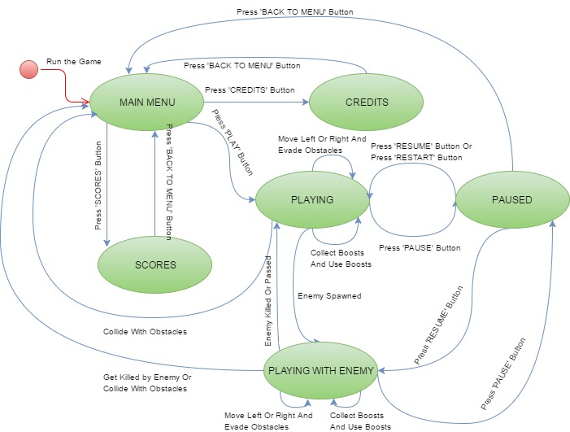
State Diagram

Slide 3
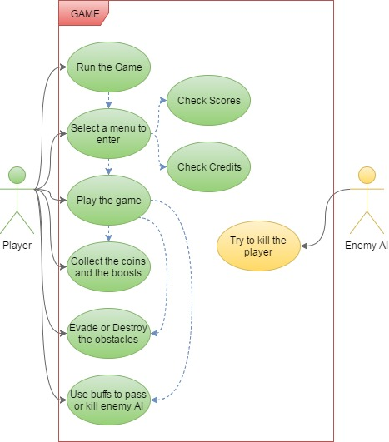
Use Case Diagram

Slide 4
GamePlay

Slide 5
Credits
Berkay KOÇAK Project Manager Mehmet Kaan ÖZTÜRK Lead Modeller
Adnan ÇIĞTEKİN Lead Programmer Murathan BİLİKTÜ Modeller
Afşin Baran BAYEZİD Programmer
Uğur NEZİR Programmer
Mehmet SELİMOĞLU Programmer
Ahmet Mete KARAYAKA Documentator

