Slide 1

Corporate Bankruptcy Risk Prediction with Machine Learning
Comparing Interpretable Logistic Regression and Tree-Based Models
Berke Pehlivan Machine Learning for Finance University of Bonn Academic Year 2025/2026
Rare failures • False alarms • Model trade-offs
Notes:
Timing: 20–30 seconds.
Open with the topic and the central idea: the project is not about accuracy only; it is about detecting failures while controlling false alarms.

Slide 2
Motivation and Research Question
Why it matters
Bankruptcy can create losses for lenders, investors, auditors, and other stakeholders.
Why it is difficult
Failed observations are rare. Accuracy can look high even when no failures are detected.
Core tension
Detect more failures, but avoid creating an impractical review burden.
How well do interpretable and tree-based models identify failed companies,
and what trade-off do they create between detected failures and false alarms?
Main story: not one universal winning model, but different screening trade-offs.
Corporate Bankruptcy Risk Prediction / Berke Pehlivan / Machine Learning for Finance
2
Notes:
Timing: 45–60 seconds.
• Bankruptcy screening matters for lenders, investors, auditors, and stakeholders.
• Failed observations are rare, so accuracy can be misleading.
• The research question is about the trade-off between detecting failures and creating false alarms.
• Main story: no universal winning model.

Slide 3
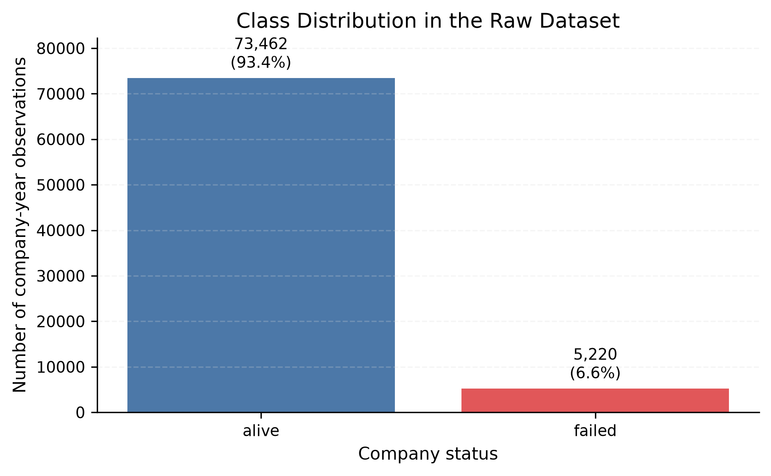
Data and Class Imbalance
78,682
company-year observations
8,971
American companies
1999–2018
sample period
6.63%
failed observations
Takeaway
A majority-only model can look accurate while detecting no failures.
Corporate Bankruptcy Risk Prediction / Berke Pehlivan / Machine Learning for Finance
3
Notes:
Timing: 45 seconds.
• Unit of observation: company-year.
• 78,682 observations, 8,971 companies, 1999–2018.
• Failed class is only 6.63%.
• A majority-only model can look good in accuracy but detect no failures.

Slide 4
Experimental Design
Full sample
78,682 observations
8,971 companies
Group split
complete companies
Training
80% companies
62,988 rows
7,176 companies
Final test
20% companies
15,694 rows
1,795 companies
Inner split
inside training
Model-fitting
50,323 rows
5,740 companies
Validation
12,665 rows
1,436 companies
Leakage control
Complete companies stay on one side of each split.
Scope
Unseen-company generalization, not future calendar forecasting.
Corporate Bankruptcy Risk Prediction / Berke Pehlivan / Machine Learning for Finance
4
Notes:
Timing: 60–75 seconds.
• Same company appears in several years.
• Row-level splitting could leak company-specific information.
• Split complete companies: training/final test, then inner training/validation.
• Validation is used for model selection and threshold analysis.
• Final test remains untouched.
• This is unseen-company generalization, not chronological forecasting.

Slide 5
Models Compared
Majority Baseline
Always predicts alive
Accuracy warning
Logistic Regression
Interpretable benchmark
L1 / L2 variants
Balanced class weights
Tree-Based Models
Decision Tree
Random Forest
Gradient Boosting
PCA Extension
PCA + Logistic Regression
Dimension reduction
Validation-only
The comparison moves from simple and interpretable models to more flexible models.
Model choice depends on the screening objective.
Corporate Bankruptcy Risk Prediction / Berke Pehlivan / Machine Learning for Finance
5
Notes:
Timing: 50–60 seconds.
• Majority baseline shows why accuracy is misleading.
• Logistic Regression is the interpretable benchmark.
• Regularized LR, Decision Tree, Random Forest, and Gradient Boosting extend the comparison.
• PCA + LR is a validation-only extension.
• Key point: model choice depends on the objective.

Slide 6
Evaluation Strategy
Why accuracy is not enough
A model can look accurate by predicting almost every observation as alive.
Model selection
Validation PR-AUC
= average precision
Thresholds
Lower threshold → more failures detected, but more false alarms.
Failed recall
How many actual failures are detected
Failed precision
How many failure alerts are correct
Failed F1
Balance between recall and precision
PR-AUC
Ranking quality for the failed class
Ranking metrics and default-threshold classifications answer different questions.
Corporate Bankruptcy Risk Prediction / Berke Pehlivan / Machine Learning for Finance
6
Notes:
Timing: 60 seconds.
• Accuracy is not enough because failures are rare.
• Recall: how many failures are detected.
• Precision: how many alerts are correct.
• F1 balances precision and recall.
• PR-AUC is average precision and measures ranking for the failed class.
• Threshold analysis uses validation predictions only; final test uses the default rule.

Slide 7
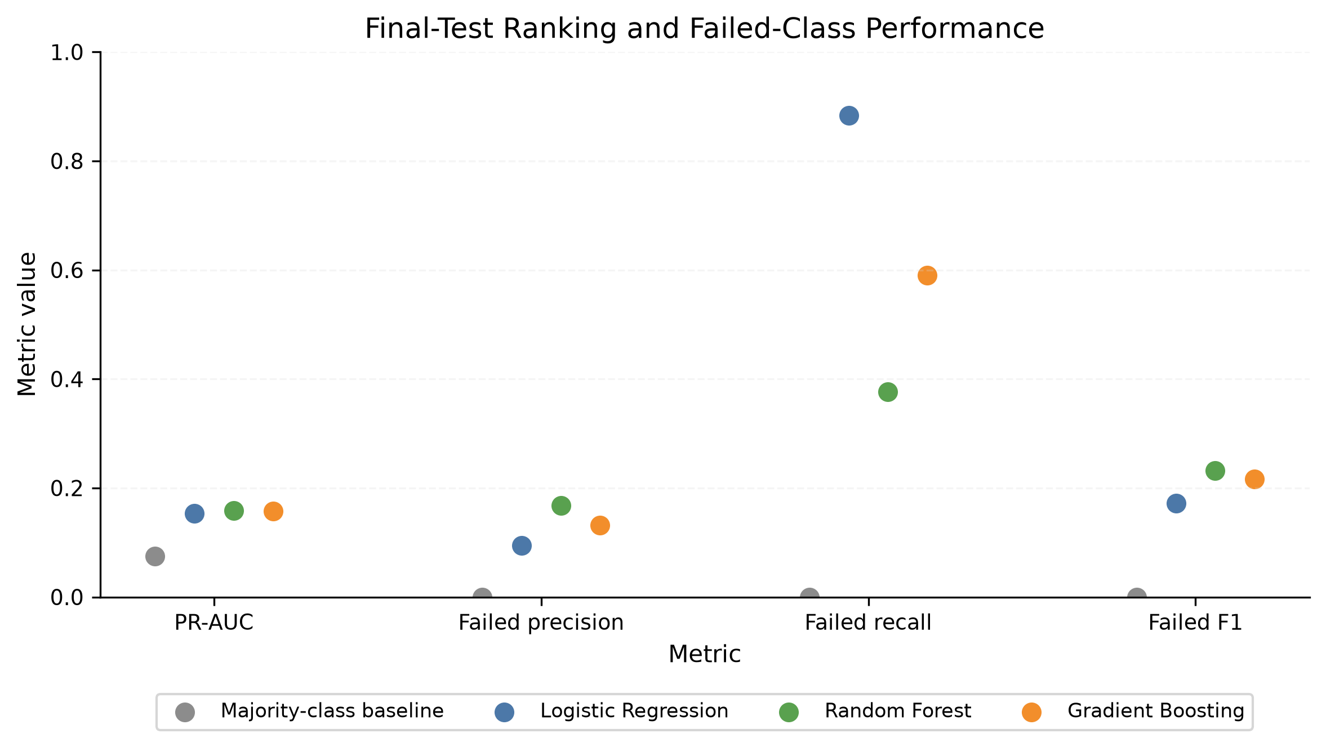
Main Final-Test Results
Baseline warning: 92.5% accuracy, but zero detected failures.
Logistic Regression
Highest recall: 0.884
Detects many failures
But precision is 0.095
→ many false alarms
Random Forest
Highest observed PR-AUC: 0.159
Highest failed F1: 0.232
More selective
→ fewer alerts
Gradient Boosting
Selected by validation PR-AUC
Highest balanced accuracy: 0.638
Middle recall
→ compromise model
Main message: no model is strongest on every measure.
Corporate Bankruptcy Risk Prediction / Berke Pehlivan / Machine Learning for Finance
7
Notes:
Timing: 60–75 seconds.
• Baseline proves why accuracy is misleading.
• Logistic Regression detects the largest share of failures but creates many false alarms.
• Random Forest is more selective and has the highest observed final-test PR-AUC and F1.
• Gradient Boosting was selected before final-test evaluation and has the highest balanced accuracy.
• Do not call one model universally best.

Slide 8
Classification Trade-Offs
Default rule: detecting more failures usually creates more false alarms.
Model
Detected failures
Missed failures
False alarms
Interpretation
Logistic Regression
1,041
136
9,906
Broad screen Many false alerts
Random Forest
442
735
2,190
More selective Fewer alerts
Gradient Boosting
695
482
4,563
Middle position Validation-selected
Financial question
Which error is more costly: a missed failure or a false alarm?
Important caveat
Financial costs and review capacity are not estimated here.
Corporate Bankruptcy Risk Prediction / Berke Pehlivan / Machine Learning for Finance
8
Notes:
Timing: 75–90 seconds.
• This is the most important result slide.
• Logistic Regression detects 1,041 failures but creates 9,906 false alarms.
• Random Forest creates fewer alerts but misses more failures.
• Gradient Boosting sits between them.
• The best choice depends on missed-failure cost and review capacity, which are not estimated here.

Slide 9
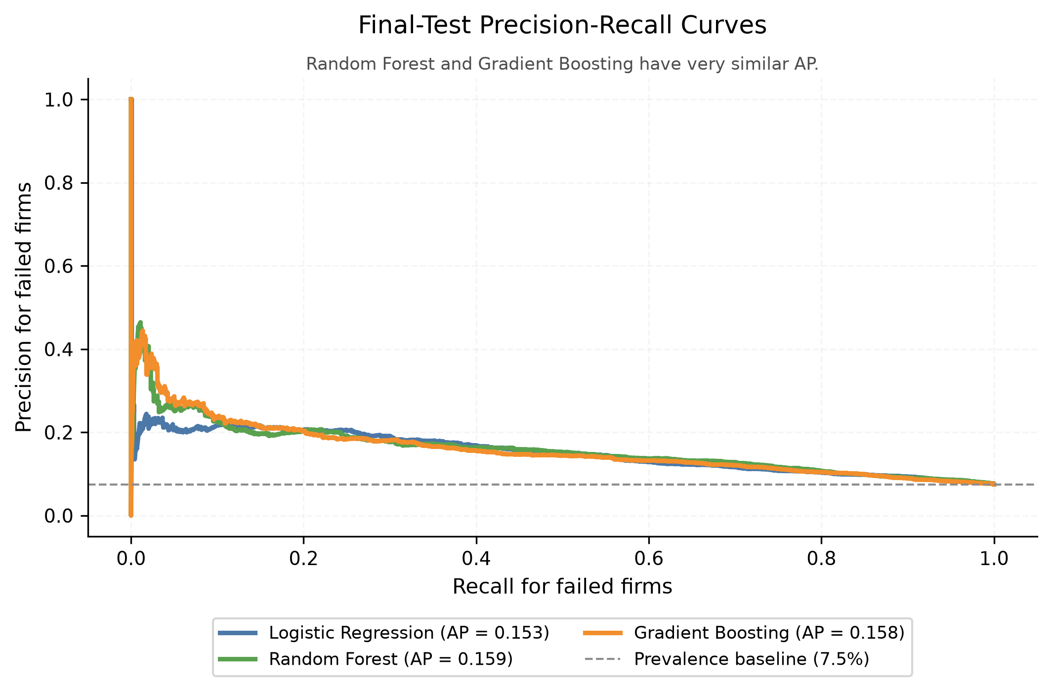
Precision–Recall Interpretation
Rare-event ranking
PR curves focus on the failed class, not the many alive observations.
Average precision
RF 0.159
GB 0.158
LR 0.153
Key interpretation
Ranking performance is similar, but default-threshold decisions are very different.
Corporate Bankruptcy Risk Prediction / Berke Pehlivan / Machine Learning for Finance
9
Notes:
Timing: 45–60 seconds.
• PR curves focus on the rare failed class.
• Average precision is very close: RF 0.159, GB 0.158, LR 0.153.
• Similar ranking does not mean similar classifications at the default threshold.
• This is why ranking metrics and confusion matrices must both be discussed.

Slide 10
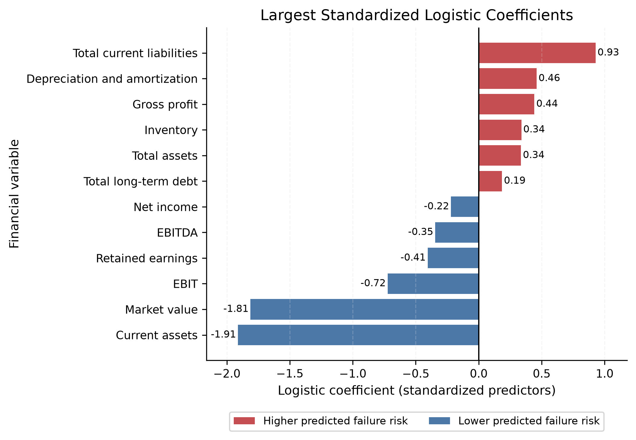
Model Interpretation
Signed interpretation
Positive coefficients → higher predicted failure log-odds. Negative coefficients → lower.
Largest negative coefficients
Current assets −1.912
Market value −1.812
Caution
Coefficients and tree importance are predictive interpretations, not causal evidence.
Corporate Bankruptcy Risk Prediction / Berke Pehlivan / Machine Learning for Finance
10
Notes:
Timing: 45–60 seconds.
• Coefficients are signed because Logistic Regression is interpretable.
• Current assets and market value have the largest negative coefficients.
• Negative means lower predicted failure log-odds, holding other predictors fixed.
• Do not interpret coefficients or feature importance causally.

Slide 11
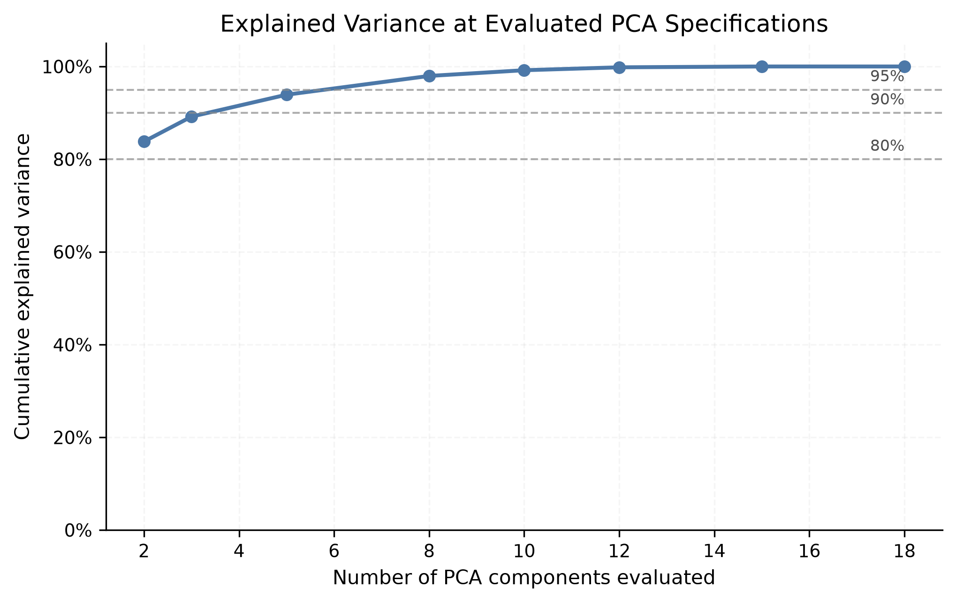
PCA Extension
Variance is retained
2 components retain 83.8%; 10 components retain 99.2%.
Prediction is different
High explained variance does not automatically mean strong classification.
Validation result
PCA with 10–12 components is similar, not clearly better, than original Logistic Regression.
Interpretability cost
Components mix many accounting variables.
Corporate Bankruptcy Risk Prediction / Berke Pehlivan / Machine Learning for Finance
11
Notes:
Timing: 35–45 seconds.
• PCA retains variance quickly.
• But high explained variance does not automatically improve classification.
• Ten to twelve components perform similarly to the original Logistic Regression.
• PCA also reduces financial interpretability.

Slide 12
Limitations and Conclusion
What the project shows
Financial variables contain useful screening and ranking information.
What it does not show
No causal effects, no calibrated probabilities, no production-ready decision rule.
Main limitation
Not a chronological forecasting backtest.
Final answer: bankruptcy-risk classification remains difficult, and model choice depends on the screening objective.
• Clear future failure horizon
• Chronological evaluation + uncertainty
• Cost-based threshold choice
Corporate Bankruptcy Risk Prediction / Berke Pehlivan / Machine Learning for Finance
12
Notes:
Timing: 60 seconds.
• The project shows useful screening information in financial variables.
• It does not show causality, calibrated probabilities, or a production-ready rule.
• Main limitation: not a chronological forecasting backtest.
• Final answer: bankruptcy prediction remains difficult; model choice depends on the screening objective.
• Future work: horizon, chronological evaluation, costs, review capacity.

Slide 13
Thank you.
Questions and discussion
Berke Pehlivan
Notes:
Timing: 10 seconds.
Thank the audience and invite questions. Use backup slides if asked.

Slide 14
Backup: Model Specifications
Compact grids were used to compare model families, not to run a large optimization exercise.
Majority
always alive
Logistic
L2, C=1, balanced weights
L1 / L2 LR
C=0.1, balanced weights
Decision Tree
depth 5, min leaf 50
Random Forest
300 trees, min leaf 50
Gradient Boosting
150 trees, lr 0.05, depth 3
PCA + LR
2–18 components, validation-only
Corporate Bankruptcy Risk Prediction / Berke Pehlivan / Machine Learning for Finance
14
Notes:
Backup. Use if asked about hyperparameters or why the grids were small.

Slide 15
Backup: Complete Final-Test Metrics
Model
Acc.
Bal. acc.
ROC-AUC
PR-AUC
Fail recall
Fail F1
Majority
0.925
0.500
0.500
0.075
0.000
0.000
Logistic Regression
0.360
0.601
0.690
0.153
0.884
0.172
Random Forest
0.814
0.612
0.699
0.159
0.376
0.232
Gradient Boosting
0.679
0.638
0.688
0.158
0.590
0.216
Main deck uses the key models only; this table shows the full saved comparison.
Corporate Bankruptcy Risk Prediction / Berke Pehlivan / Machine Learning for Finance
15
Notes:
Backup. Use if asked for the complete final-test numbers beyond the main slides.

Slide 16
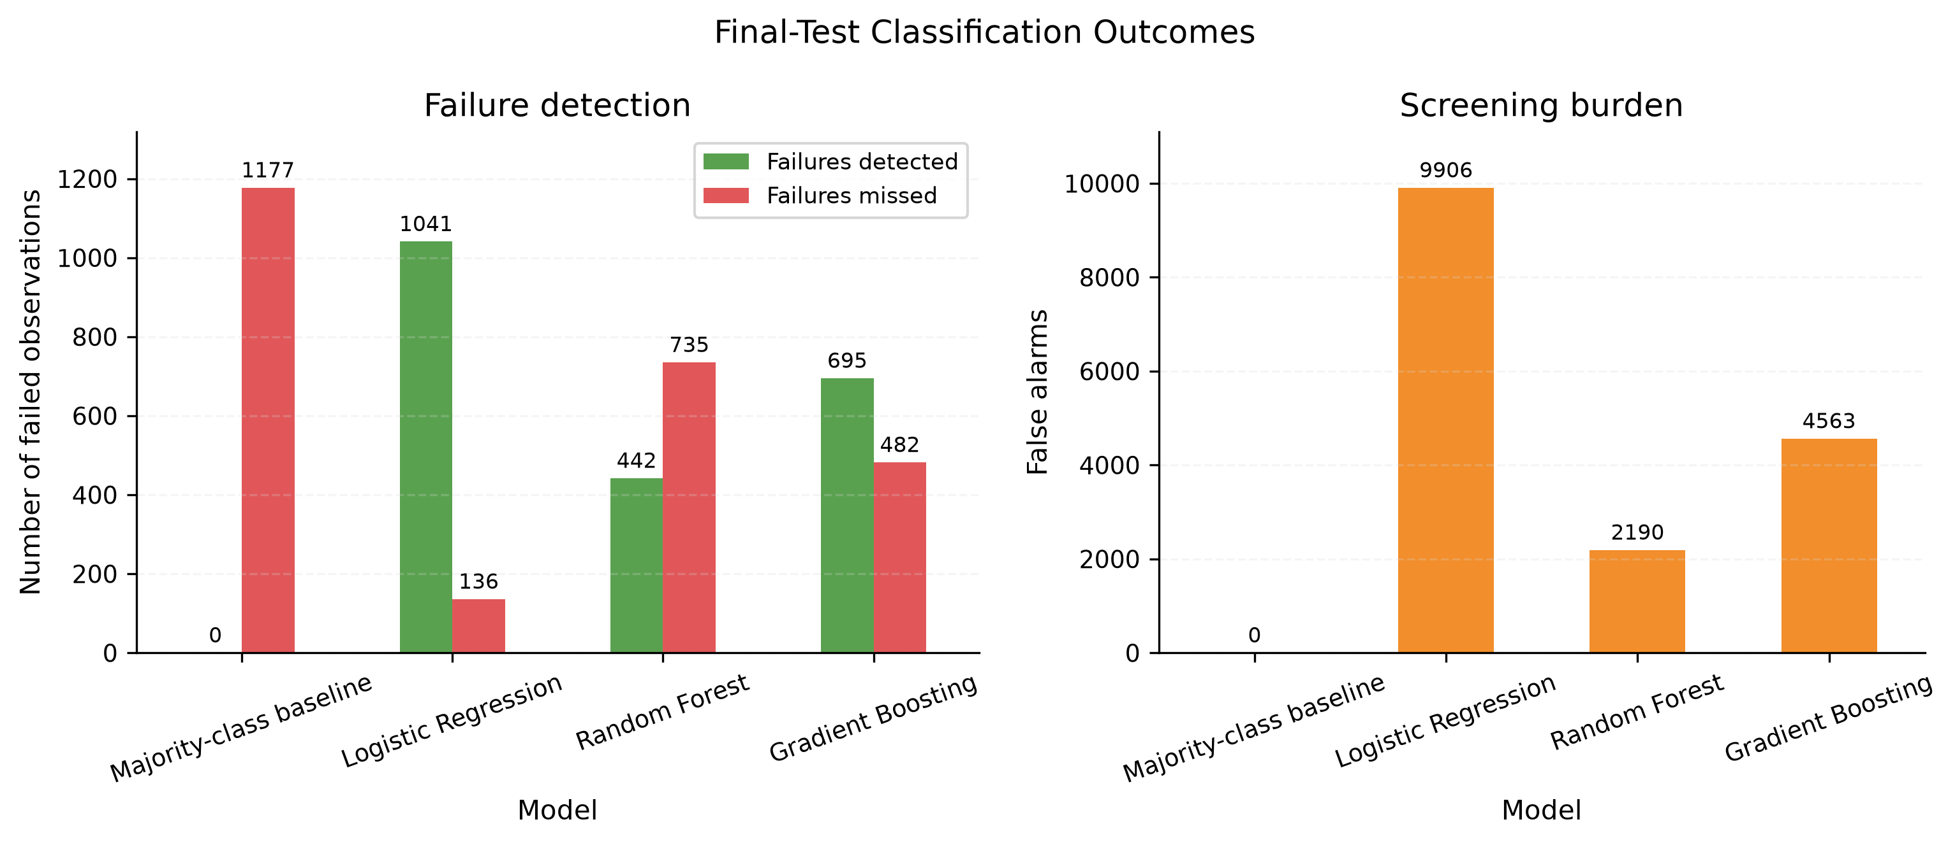
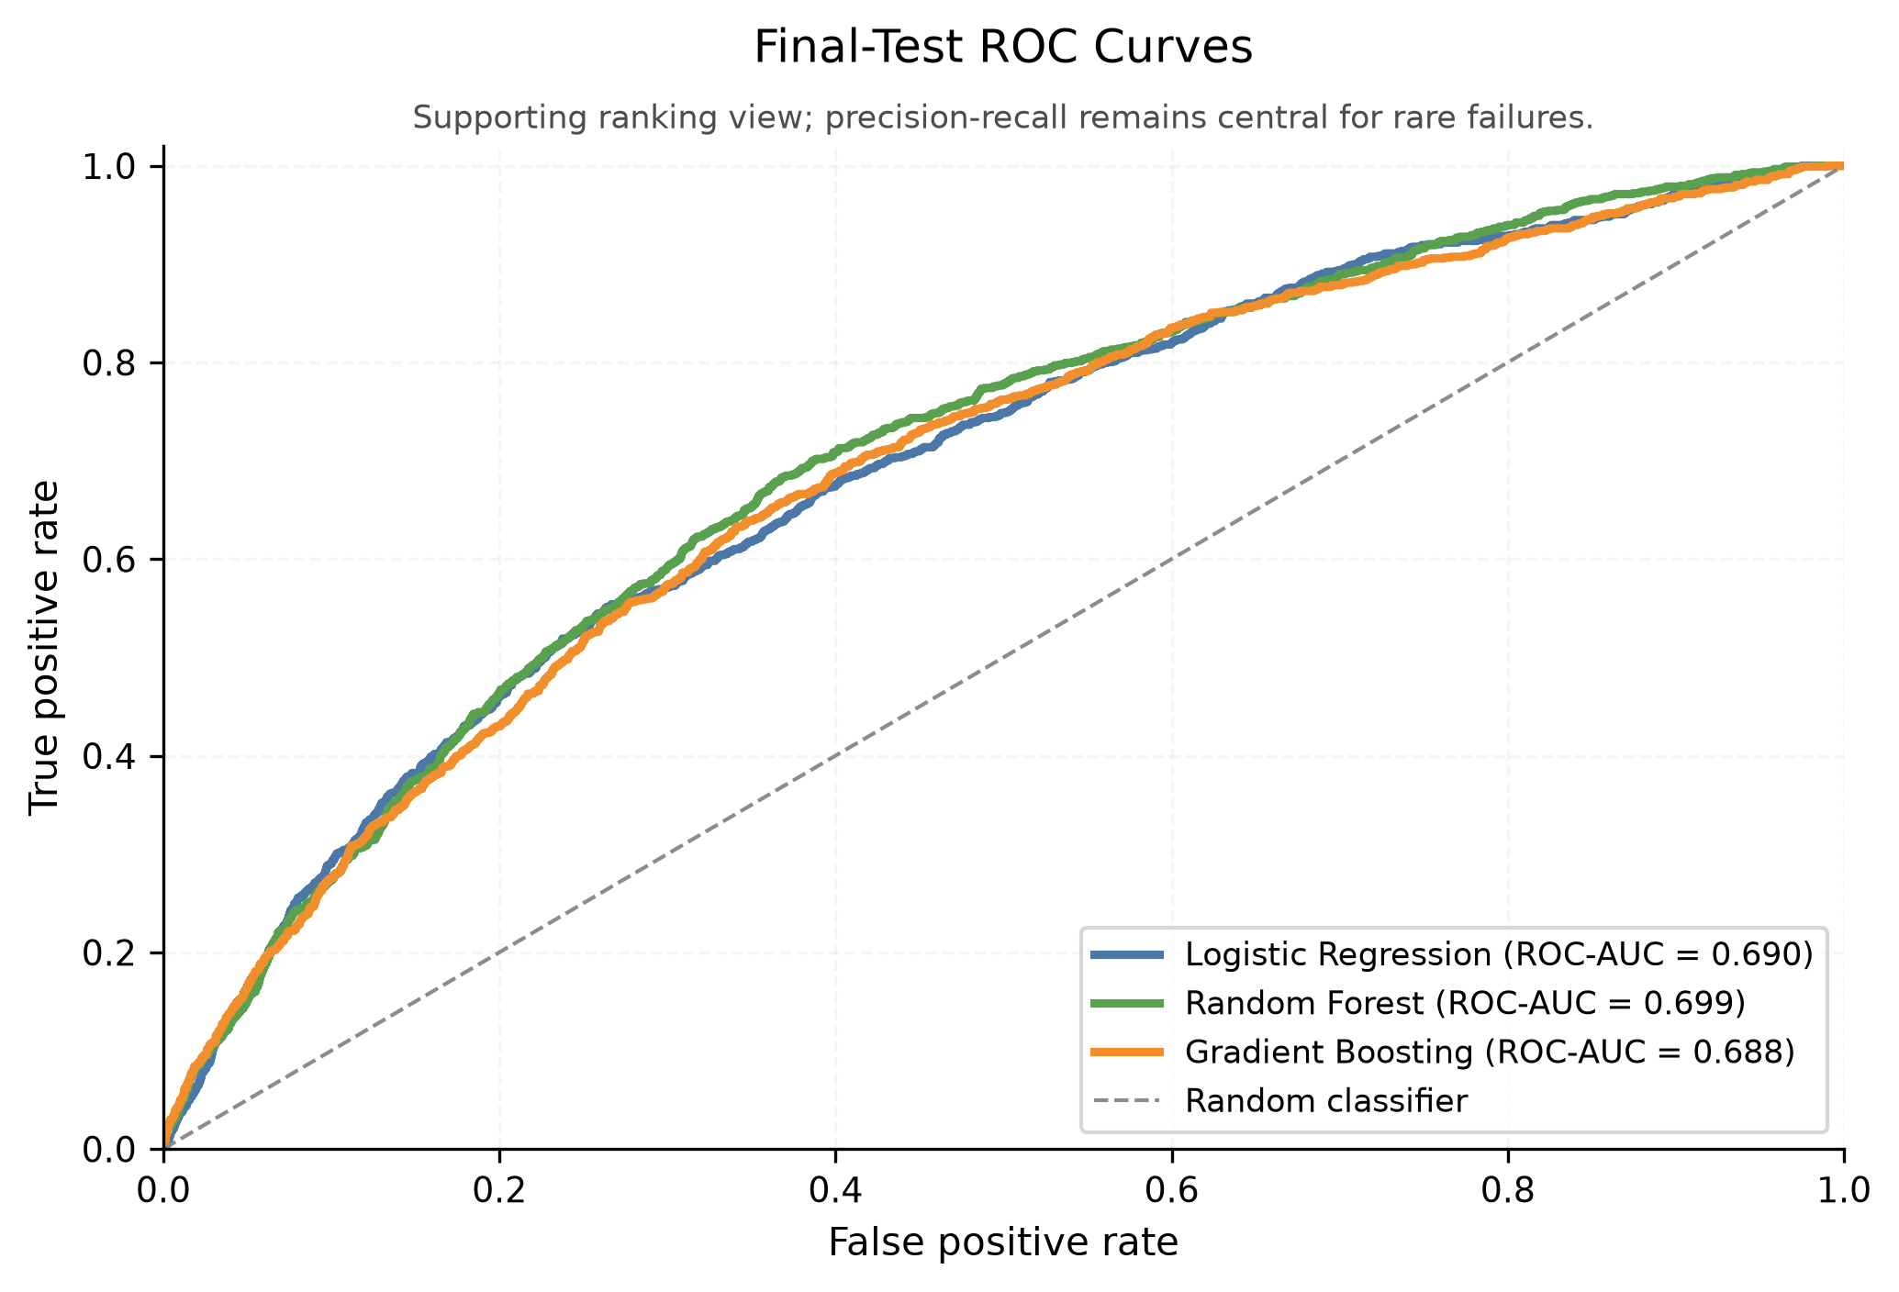
Backup: Validation Threshold Scenarios
Threshold question
How much review burden is acceptable if recall is increased?
Why ROC is backup
ROC-AUC is useful, but PR curves show rare-failure screening burden more directly.
Corporate Bankruptcy Risk Prediction / Berke Pehlivan / Machine Learning for Finance
16
Notes:
Backup. Use if asked how thresholds were selected. Emphasize validation-only and review burden.

Slide 17
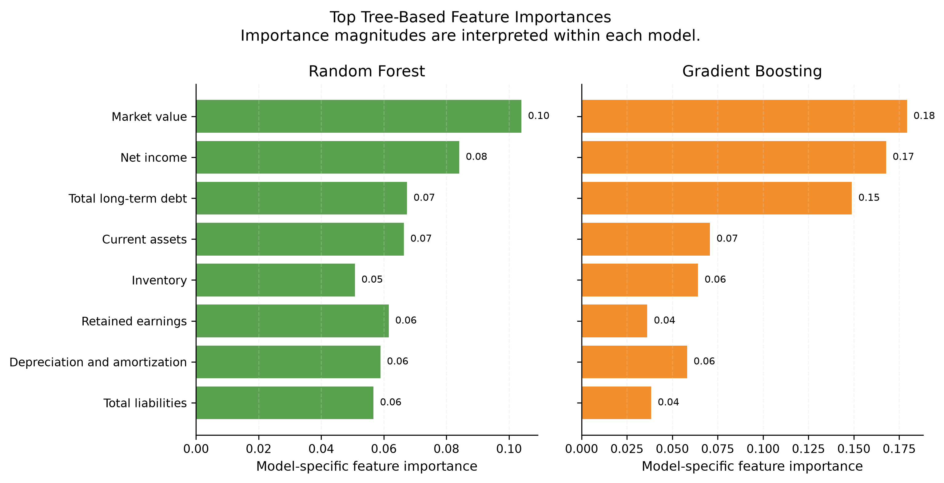
Backup: Tree-Based Feature Importance
Top features
Market value, net income, and long-term debt are important in both ensembles.
Interpretation limit
Importance does not show direction and is not causal.
Use in discussion
Helpful if asked why tree models made their predictions.
Corporate Bankruptcy Risk Prediction / Berke Pehlivan / Machine Learning for Finance
17
Notes:
Backup. Use if asked which financial variables mattered in the tree models. Importance has no direction and is not causal.

Slide 18
Backup: Reproducible Implementation
Task workflow
pytask connects preprocessing, modelling, evaluation, figures, and paper outputs.
Environment
Pixi fixes Python dependencies and commands.
Tests
26 tests check main data and modelling behavior.
pixi run build pixi run test
Generated outputs are saved under data/processed/ and outputs/. The paper-ready layer contains summaries derived from the same model run.
Corporate Bankruptcy Risk Prediction / Berke Pehlivan / Machine Learning for Finance
18
Notes:
Backup. Use if asked about reproducibility. Mention Pixi, pytask, tests, and saved outputs.

