Slide 1
Existential Risks
CS 195 Social Implications of Computers

Slide 2
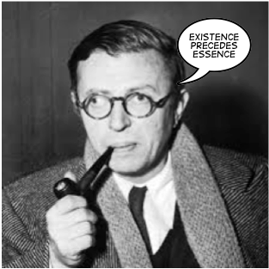
Existential Risks
Notes:
Jean-Paul Sartre, one of the big names in Existentialism...

Slide 3

Existential Risks
Notes:
Nope, that’s not what we’re talking about. Risks to the existence of humankind.

Slide 4
Nanotechnology
(Beyond Pesticides, March 4, 2010) Scientists at Purdue University have found that nanosilver that is sonicated or suspended in solution is toxic and even lethal to fathead minnows, an organism that is often used to measure toxicity on aquatic life.
No evidence so far of toxicity to humans.
Widespread use in non-food consumer products
E.g. “stain resistant” clothes
Existential threat: self-replicating “grey goo”
Notes:
Note that each of these present ordinary risks as well as existential ones.
Also note that they hold vast promise, e.g., cholesterol-eating robots in arteries.

Slide 5
Genetic Engineering
Widespread and increasing use in human food
E.g., pesticide-tolerant crops
Airborne seeds make containment impossible
2003: UC Prof. Ignacio Chapela denied tenure despite strong recommendation from colleagues after he proves that genetically modified corn from US had migrated to native maize fields in Mexico. (Decision reversed in 2005.)
Existential threat: super-viruses (happening anyway)
Existential threat: genetically enhanced people
Notes:
Already in use to make new drugs by splicing bits of the target disease into things that spread through the body the way they want.

Slide 6
Artificial Intelligence
New statistical techniques have pushed AI dramatically.
Even “creative” tasks can be automated.
Immediate threat: loss of jobs
Existential threat: loss of most jobs
What are people for? (This really is Sartre’s meaning!)
Existential threat: We lose control over AIs, which turn against us.
Notes:
Closer threat: Ais make occasional mistakes, just as people do, but then people say “the computer said it, so it must be right.”

Slide 7
War
Not a new 21st-century one, but we already have the technology to destroy life on earth, or at least mammalian life.
Only a matter of time until individual terrorists can build nuclear weapons, biological weapons, etc.
Notes:
Not to mention state terrorists such as the US.

Slide 8
Summary
The most likely risks of technology are not apocalyptic:
Privacy
Defects in life-critical technology
Mercury poisoning in factories
Non-world-destroying wars
Existential risks are very low probability, very high risk.
How should public policy prevent disaster?
“Precautionary principle”: If an action or policy has a suspected risk of causing harm to the public or to the environment, in the absence of scientific consensus that the action or policy is not harmful, the burden of proof that it is not harmful falls on those taking an action.
Notes:
Precautionary principle is law in Europe, but is widely disliked by scientists, who point out that /not/ using a new technology also has risks.

