Slide 1
Privacy
CS 195 Social Implications of Computers

Slide 2
Privacy as Instrumental Good
Avoid discrimination based on, e.g., HIV status.
Allow anonymous political speech.
Protect personal security, e.g., against stalkers.
Restrain exercise of state power, e.g., require warrants.
Prevent spread of incorrect information.

Slide 3
Privacy as Intrinsic Good
Different public selves in different contexts.
“Right to be left alone.”
Part of human dignity.
Avoid “creepy” repurposing of information.

Slide 4
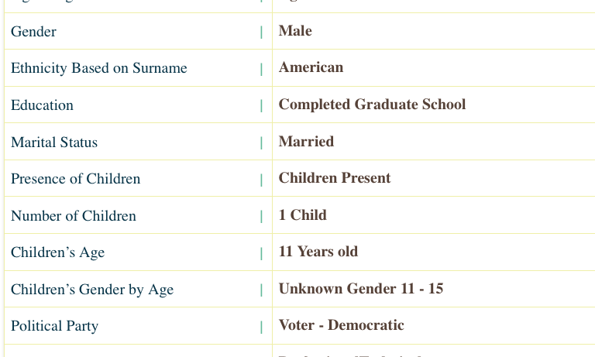
Me according to Acxiom

Slide 5
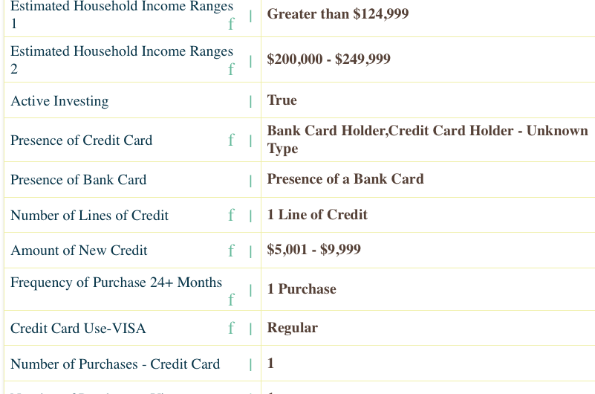
Me according to Acxiom

Slide 6
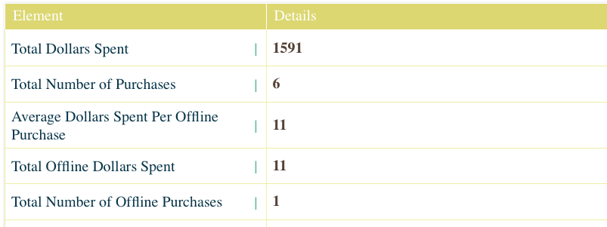
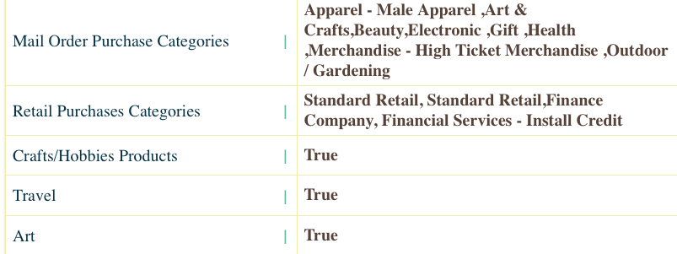
Me according to Acxiom

Slide 7
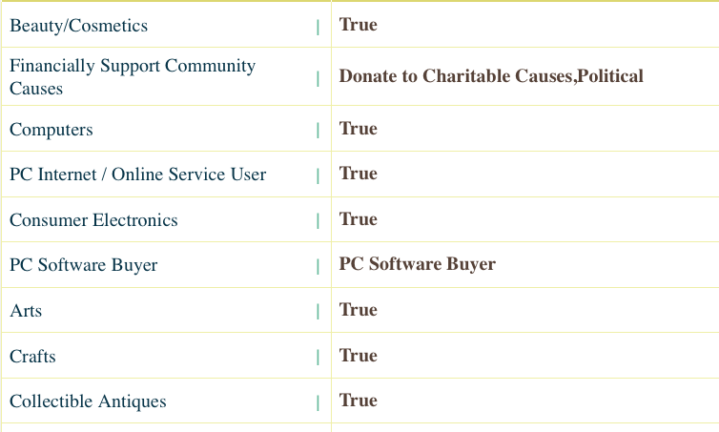
Me according to Acxiom

Slide 8
The threats to privacy
Governments
Corporations
People with cellphone cameras

Slide 9
The Case Against Privacy
You gain convenience from tailored ads, location services.
People today care more about online friendship.
Governments need to protect us against bad guys.
Businesses must verify eligibility for, e.g., credit.
If I’m doing nothing wrong, I have nothing to hide.

