Slide 1
ME 233 Advanced Control II Lecture 3 Introduction to Probability Theory
(ME233 Class Notes pp. PR1-PR3)
TexPoint fonts used in EMF.
Read the TexPoint manual before you delete this box.: AAAAAA

Slide 2
Outline
Continuous random variable
CDF, PDF, expectation and variance
Uniform and normal PDFs

Slide 3
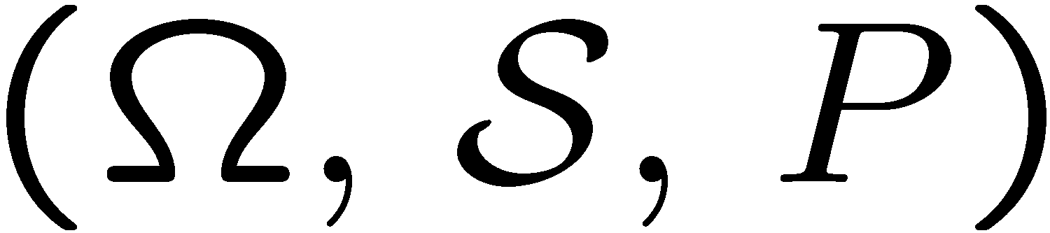
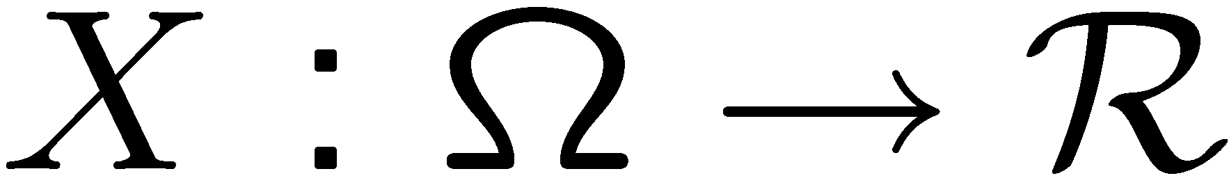

Continuous random variable
A continuous-valued random X variable takes on a range of real values
Example:
An experiment whose outcome is a real number, e.g. measurement of a noisy voltage.
For the probability space,
A random variable X is a mapping

Slide 4
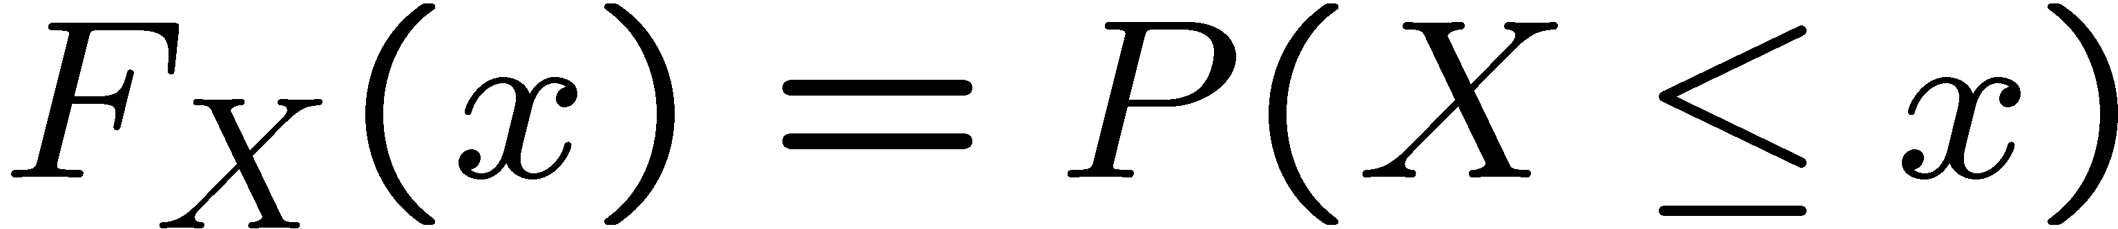
Cumulative Distribution Function
Cumulative distribution function (CDF) associated with the random variable X :
The probability that the random variable X
will be less than or equal to the value x

Slide 5
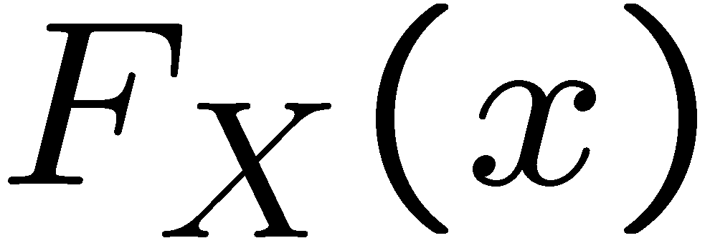
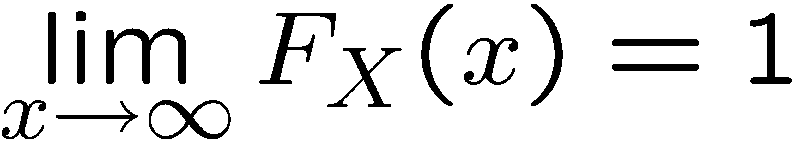
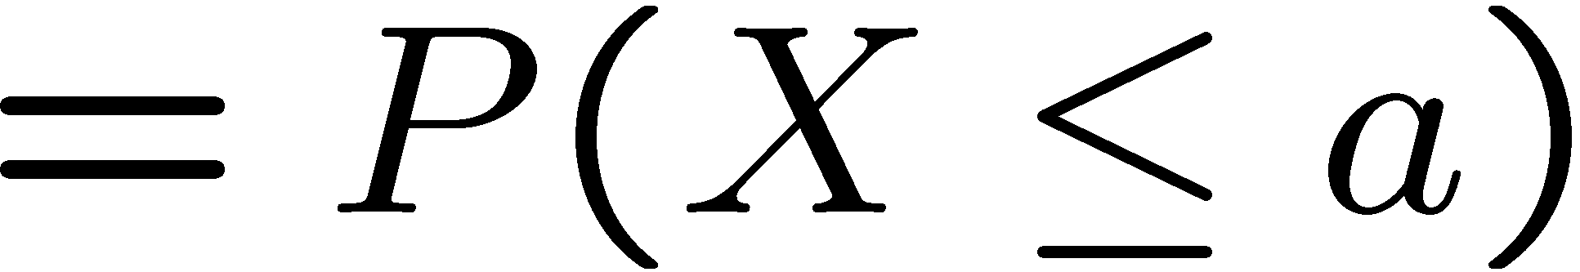
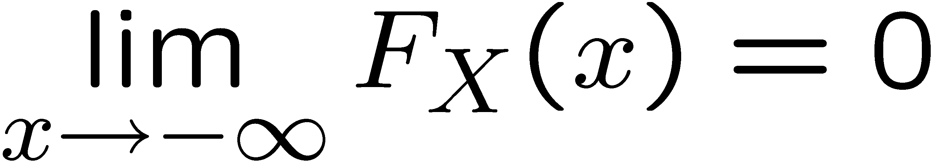

Properties of the cumulative distribution
1
0
a

Slide 6
Properties of the cumulative distribution
is a monotone non decreasing
is left-continuous

Slide 7
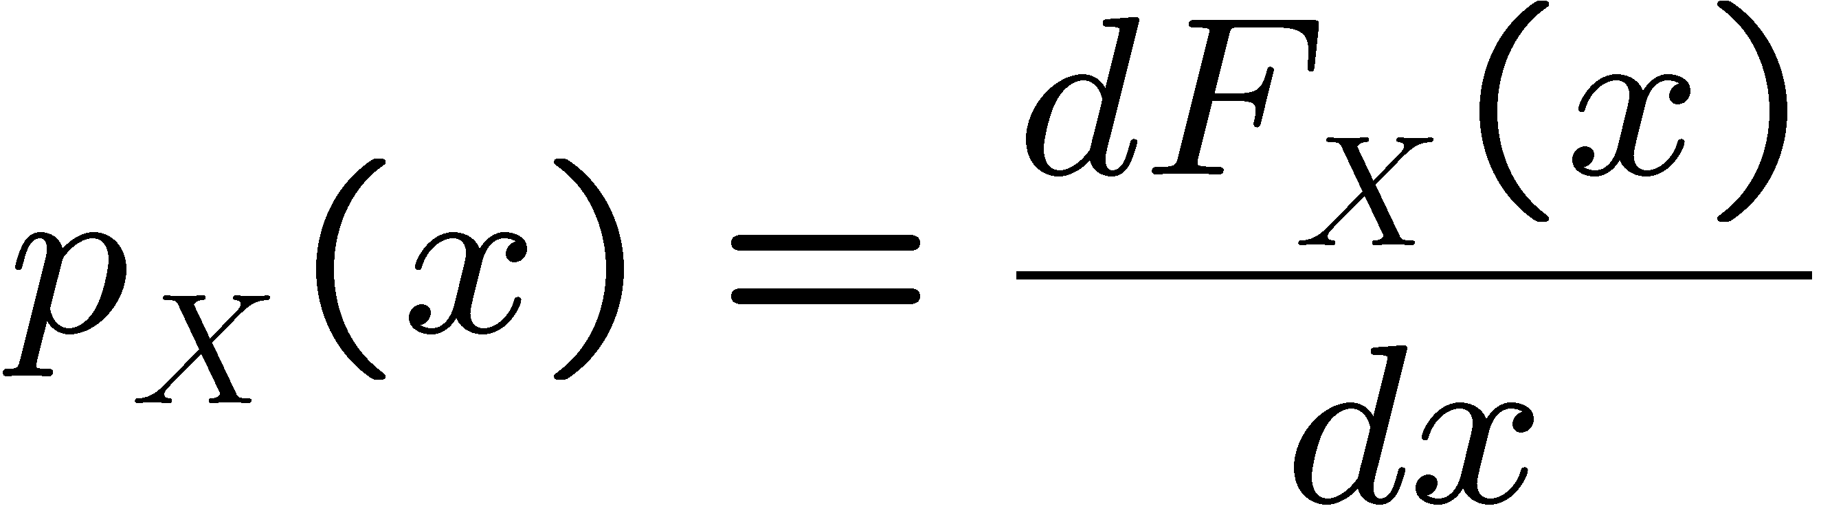
Probability Density Function
For a differentiable cumulative distribution function,
Define the probability density function (PDF),

Slide 8
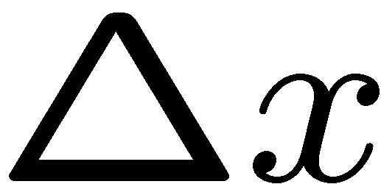
Probability Density Function
Interpretation:
for small
Loosely interpret this as the probability that X takes
a value close to x

Slide 9
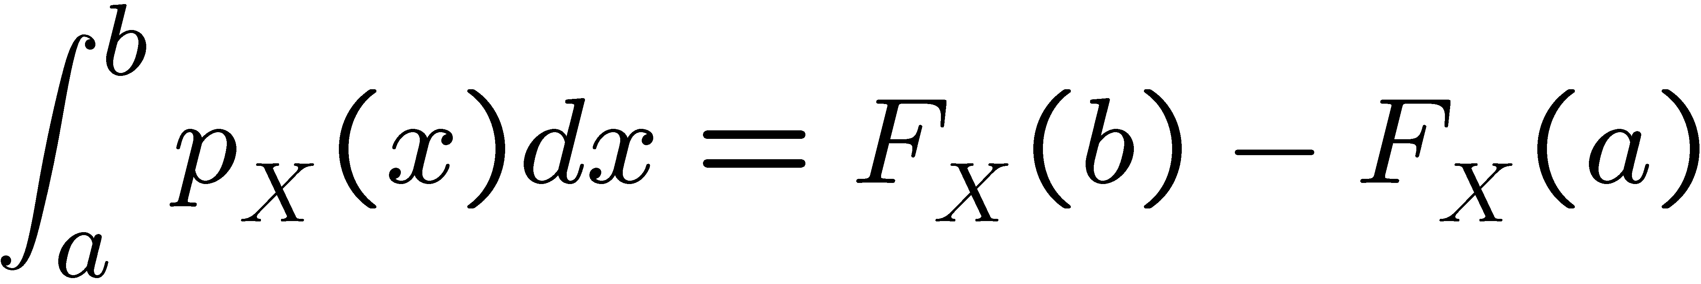
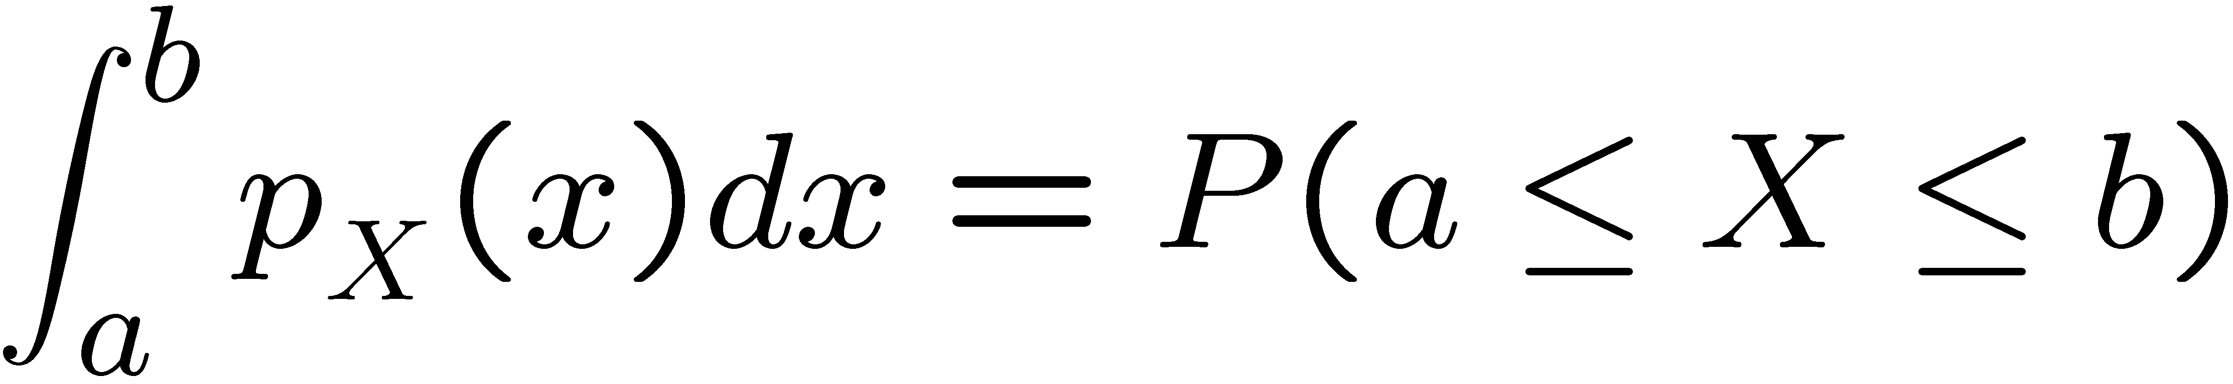

Probability Density Function
By the Fundamental Theorem of Calculus

Slide 10
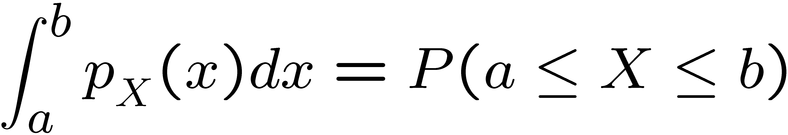
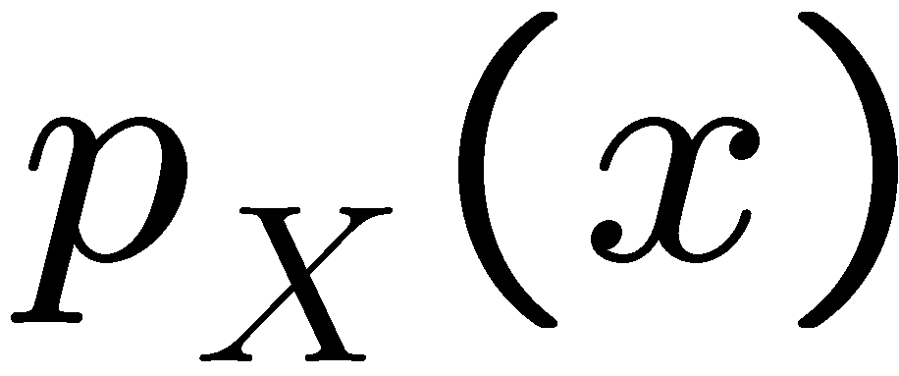
Probability Density Function
a
b

Slide 11
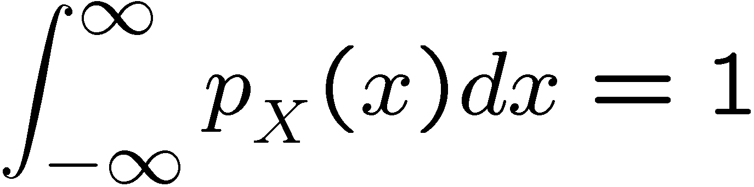
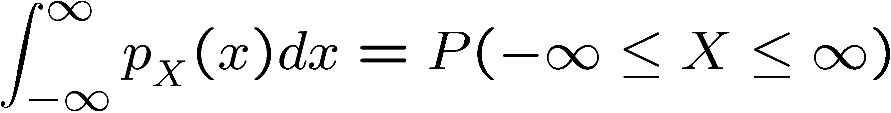
Probability Density Function
Property:
because

Slide 12
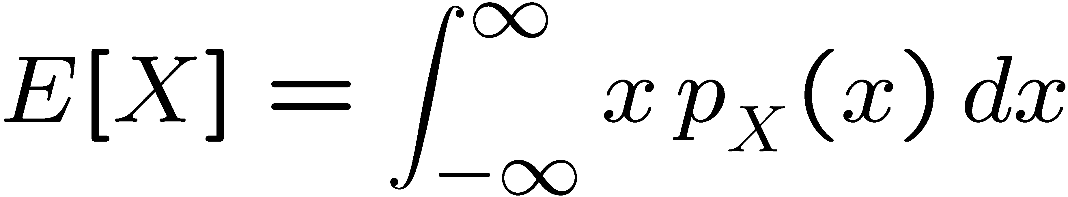
Expectation
The expected value of random variable X is:
This is the average value of X.
It is also called the mean of X
or the first moment of X

Slide 13
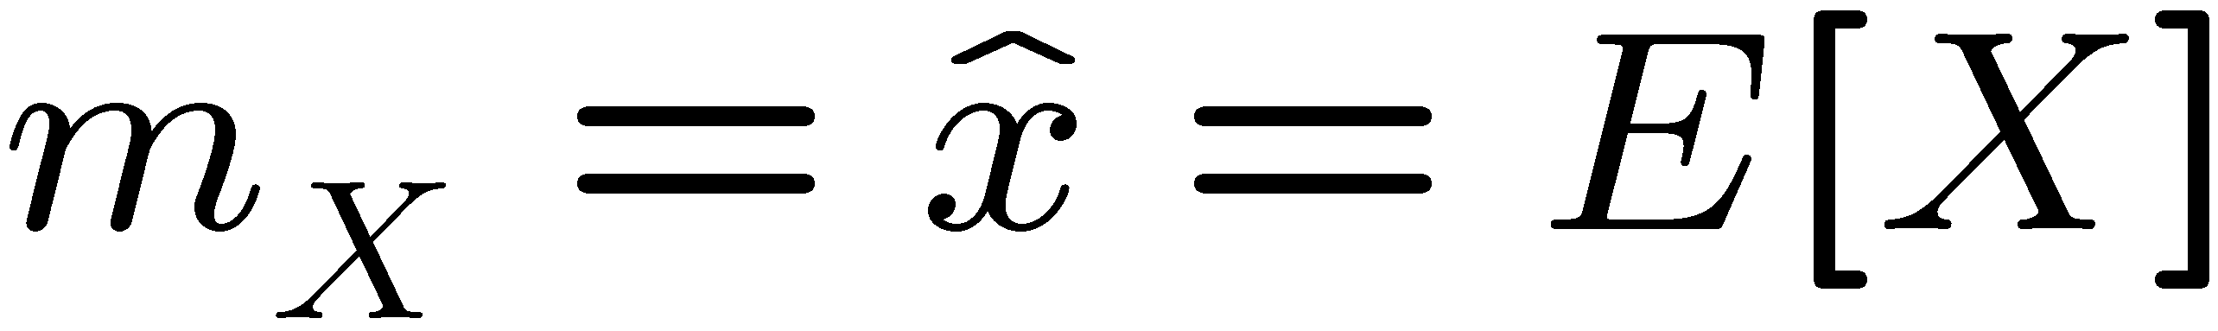
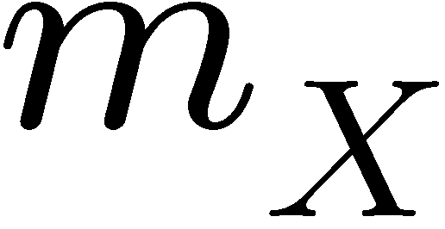
Expected value - notation

Slide 14
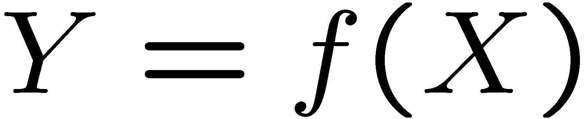
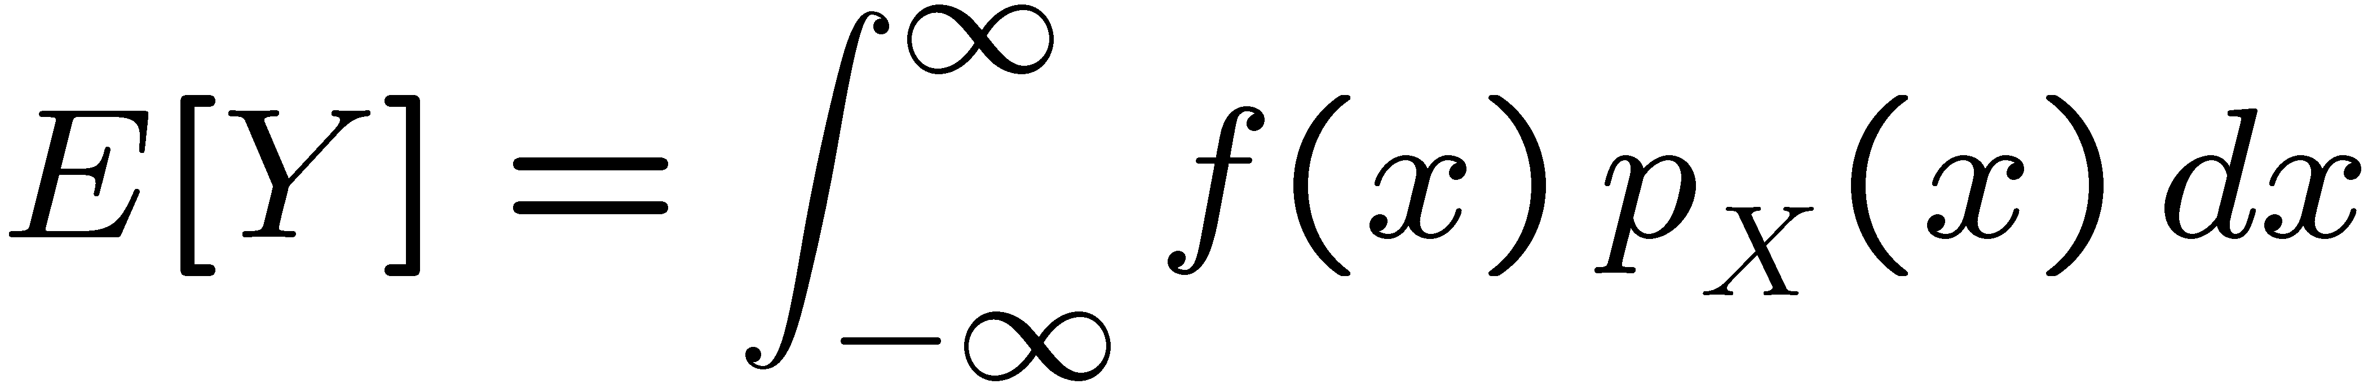
Expected value of a function
f : real valued function of random variable X
The expected value of Y is

Slide 15
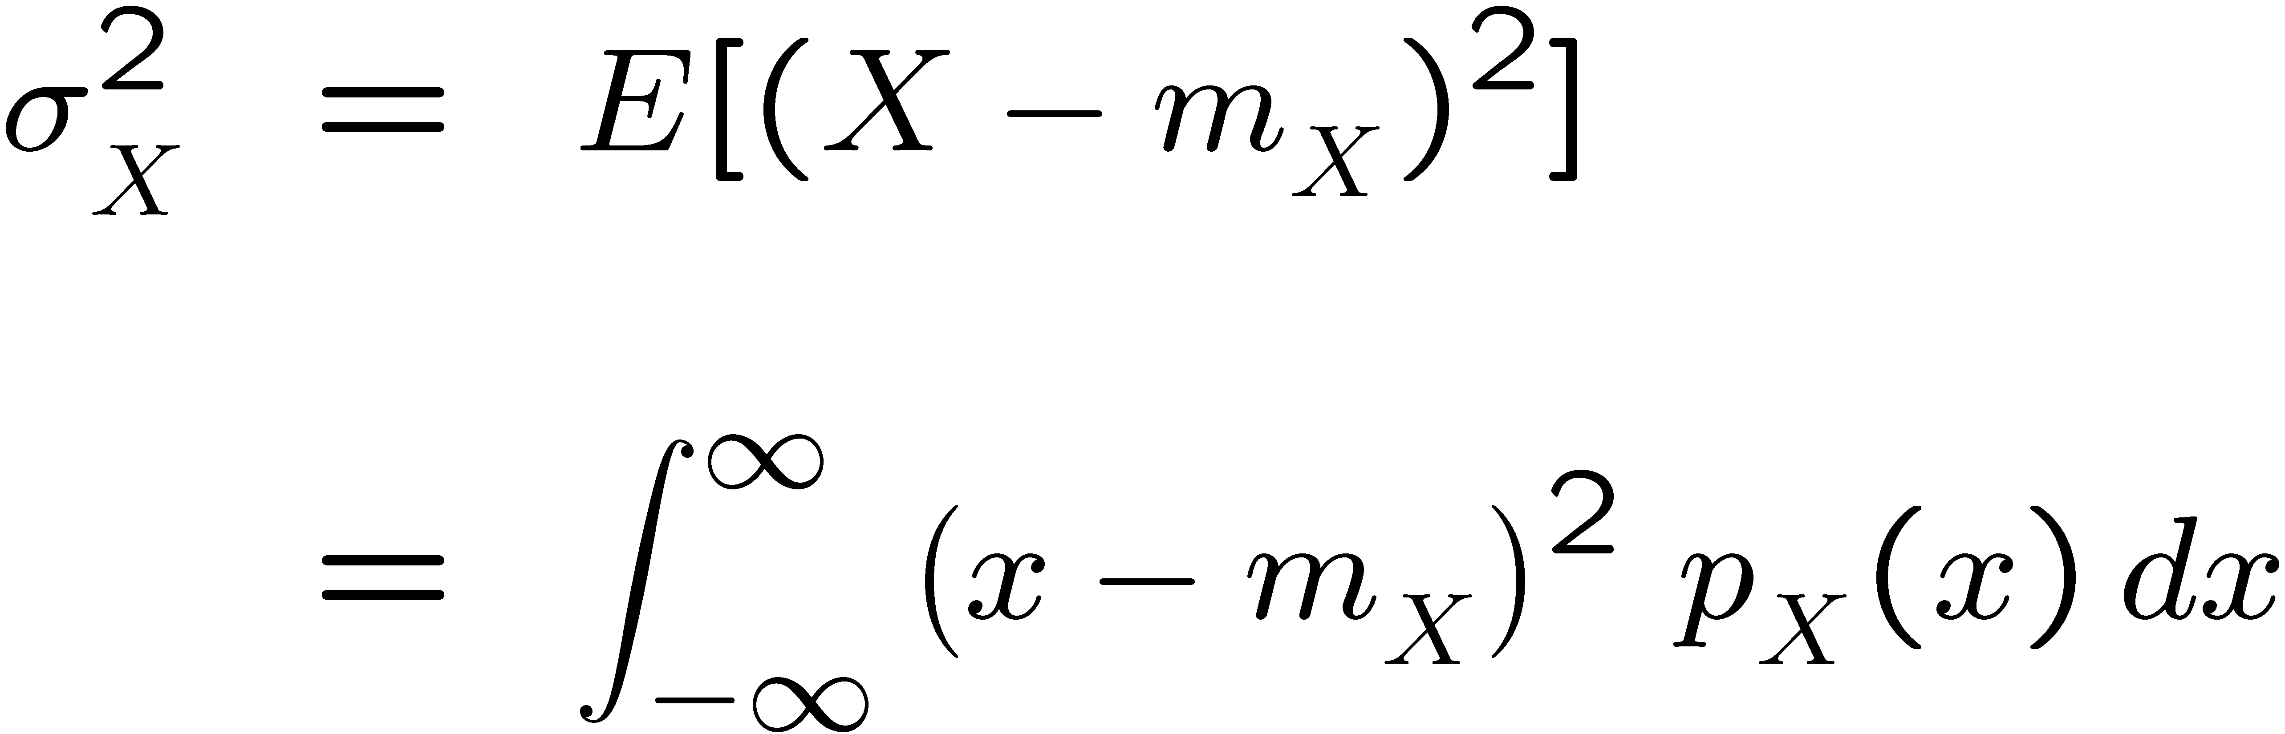
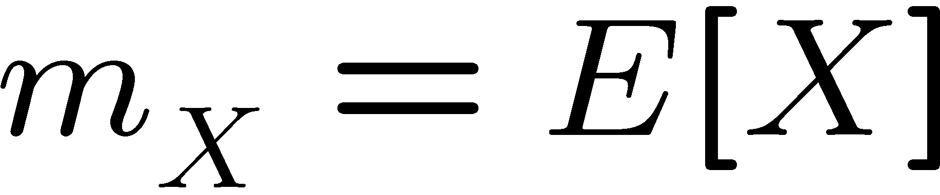
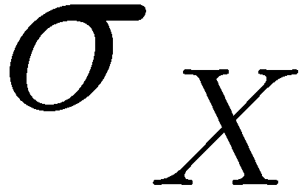
Variance
The variance of random variable X is:
where
Is called the standard deviation of X

Slide 16
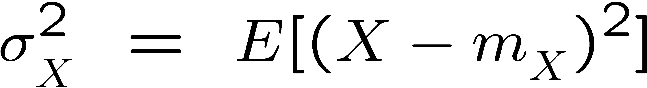
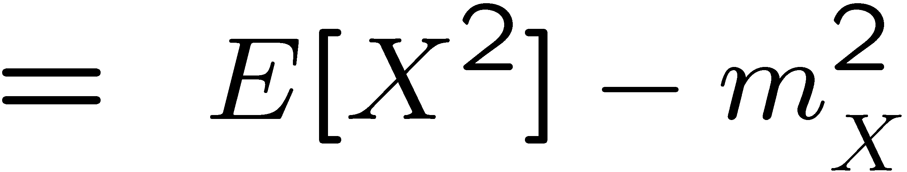
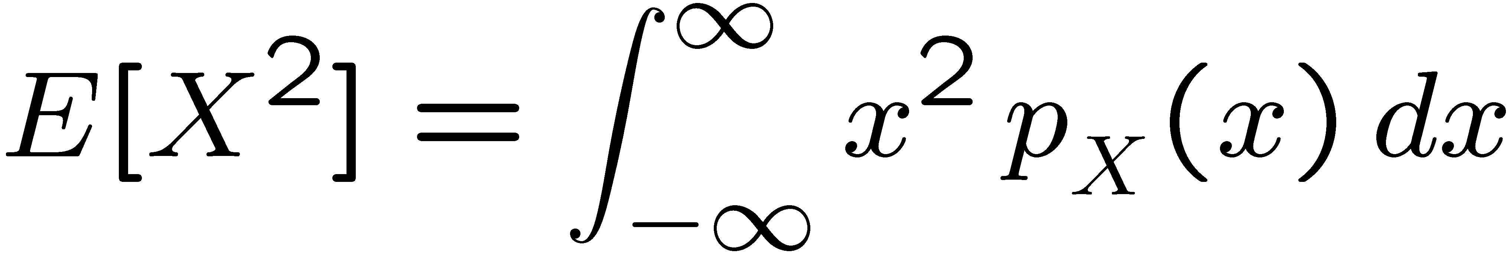
Variance
where

Slide 17
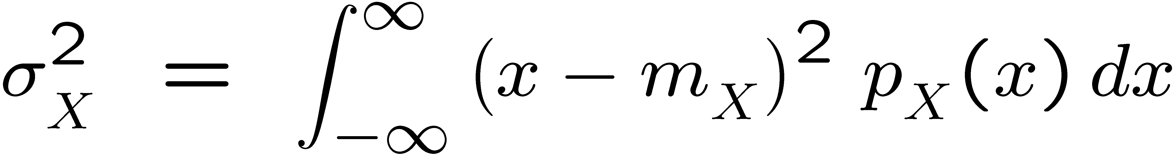
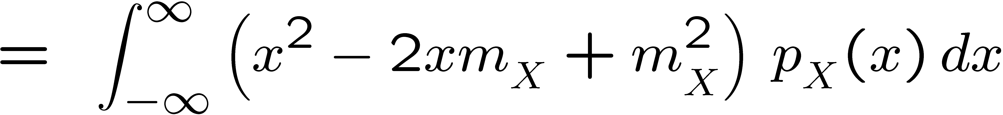
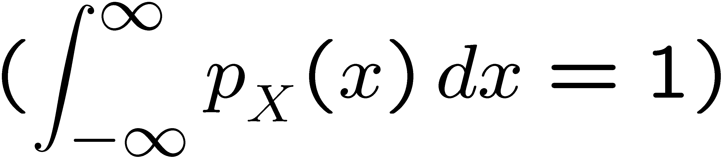
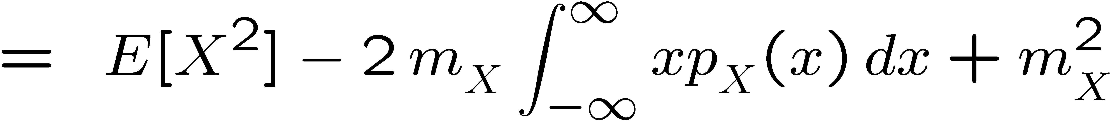
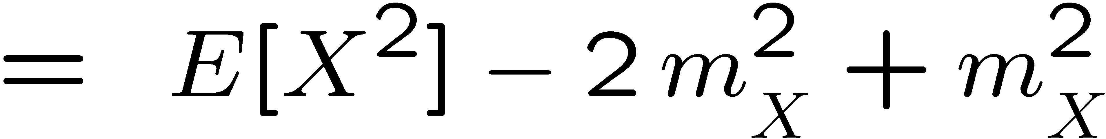
Proof

Slide 18
Uniform Distribution
A random variable X which is uniformly distributed between x_{min} and x_{max} has the PDF:
matlab function: rand

Slide 19
Summing independent uniformly distributed random variables
Let X and Y be 2 independent uniformly distributed variables between [0,1]
The random variable
is not uniformly distributed

Slide 20
Summing independent uniformly distributed random variables
Let X and Y be 2 independent uniformly distributed variables between [0,1]
10⁵ random samples of Z
X=rand(1,1e5);
Y=rand(1,1e5);
Z=X+Y;
[freqZ,cent]=hist(Z,100);
bin_width=(cent(100)-cent(1))/99;
area = sum(freqZ)*bin_width;
bar(centers,freqZ/area)
xlabel('z')
ylabel('F_Z(z)')
Histogram of Z with normalized area

Slide 21
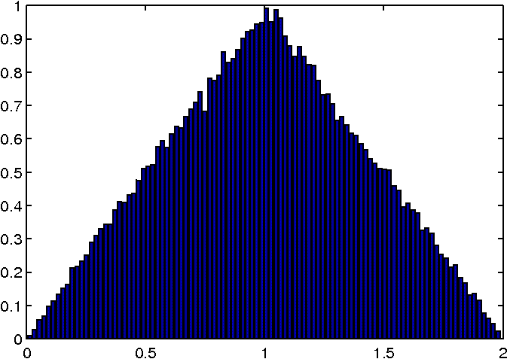
Summing independent uniformly distributed random variables
Let X and Y be 2 independent uniformly distributed variables between [0,1]

Slide 22
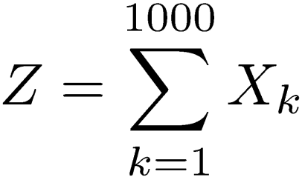
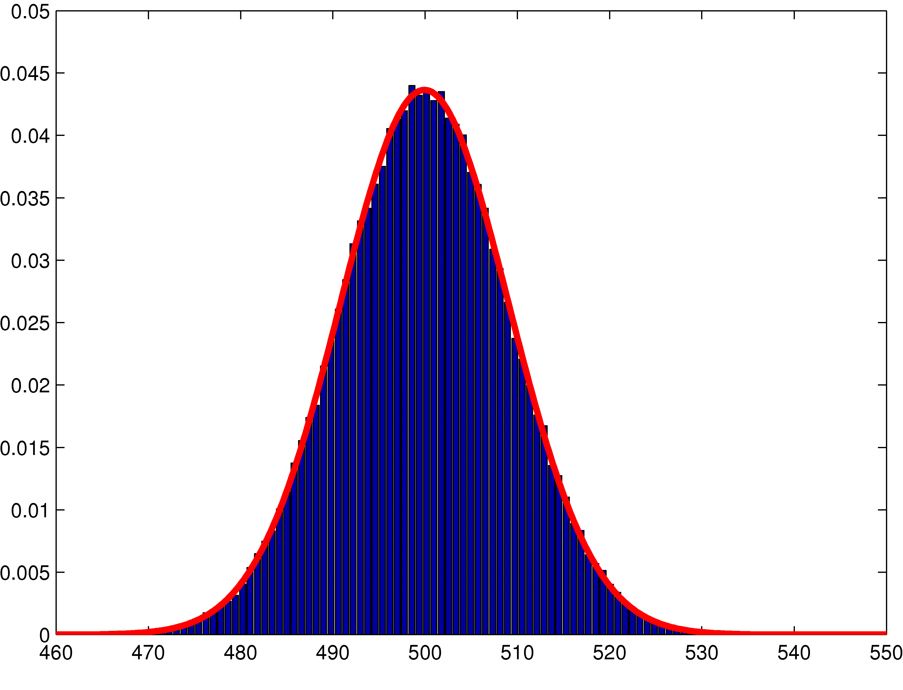
Summing a very large number of random variables
Let X₁,…,X₁₀₀₀ be independent uniformly distributed variables between [0,1]

Slide 23
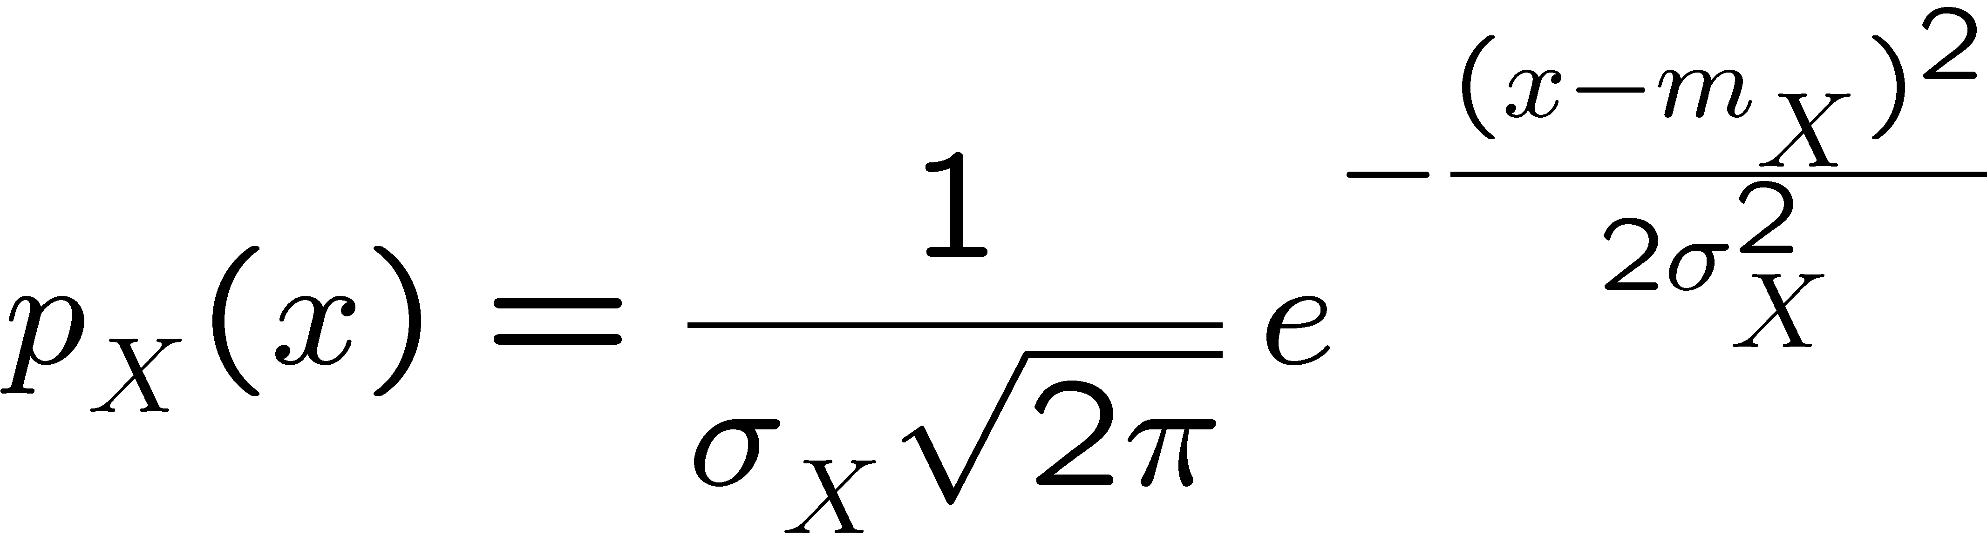
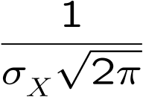
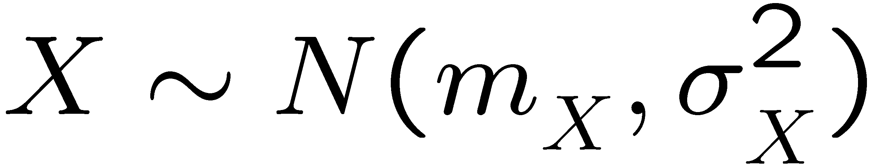
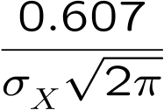


Gaussian (Normal) Distribution
Normal distribution

Slide 24
History of the Normal Distribution
From Wikipedia:
The normal distribution was first introduced by de Moivre in an article in 1733 in the context of approximating certain binomial distributions for large n.
His result was extended by Laplace in his book Analytical Theory of Probabilities (1812), and is now called the theorem of de Moivre-Laplace.
Laplace used the normal distribution in the analysis of errors of experiments.

Slide 25
History of the Normal Distribution
From Wikipedia:
The important method of least squares was introduced by Legendre in 1805.
Gauss, who claimed to have used the method since 1794, justified it rigorously in 1809 by assuming a normal distribution of the errors.
That the distribution is called the normal or Gaussian distribution is an instance of Stigler's law of eponymy: "No scientific discovery is named after its original discoverer."

Slide 26
Supplemental Material (You are not responsible for this…)
Laplace transform of normal PDF
Proof of the central limit theorem

Slide 27

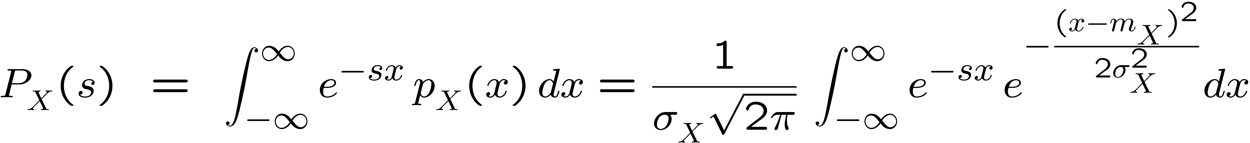
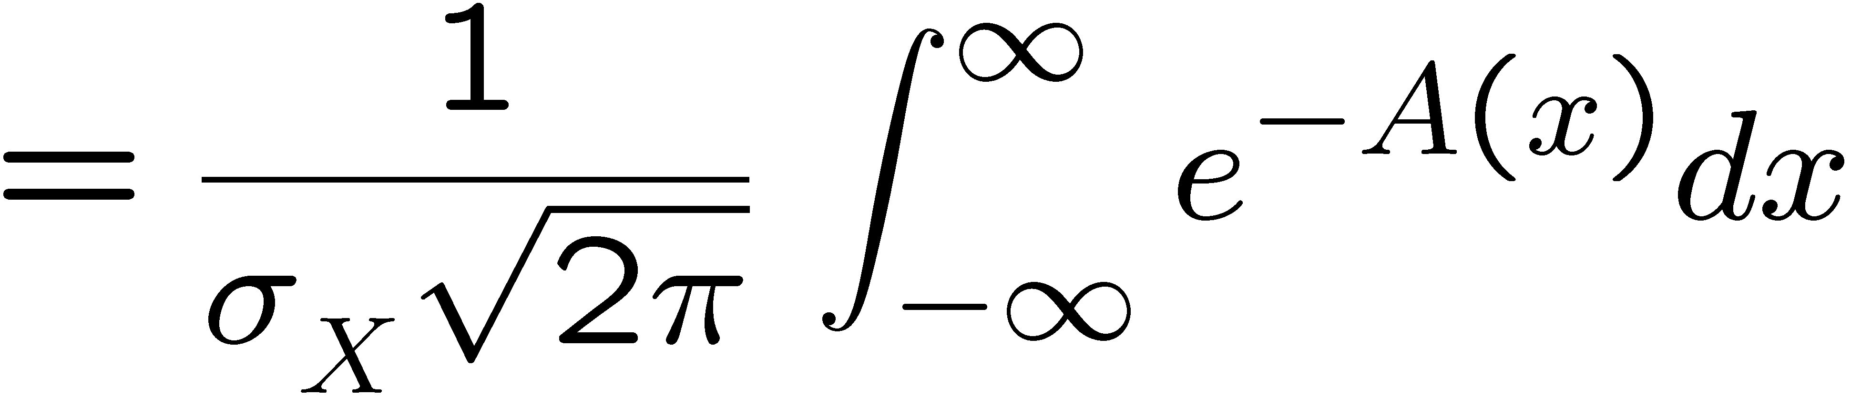
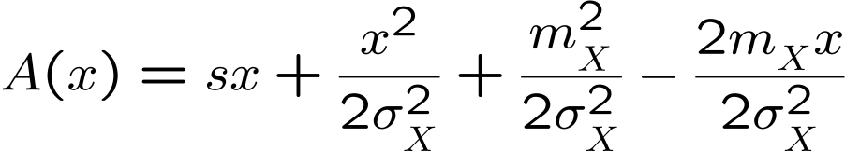
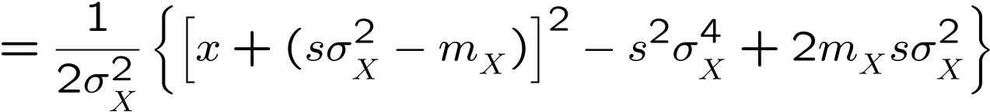
Laplace transform of normal PDF
where, after “completing the squares”,

Slide 28
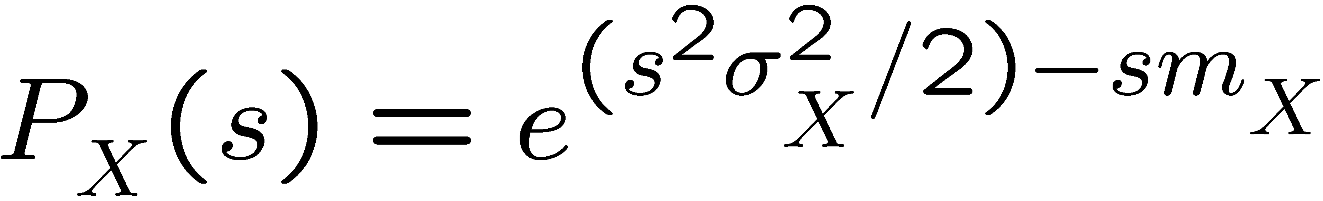
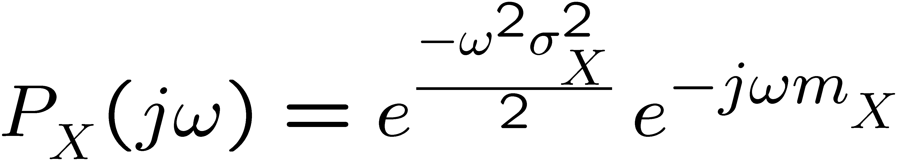
Laplace transform of normal PDF
substituting,
= 1
(area under a PDF = 1)
Fourier transform:

Slide 29
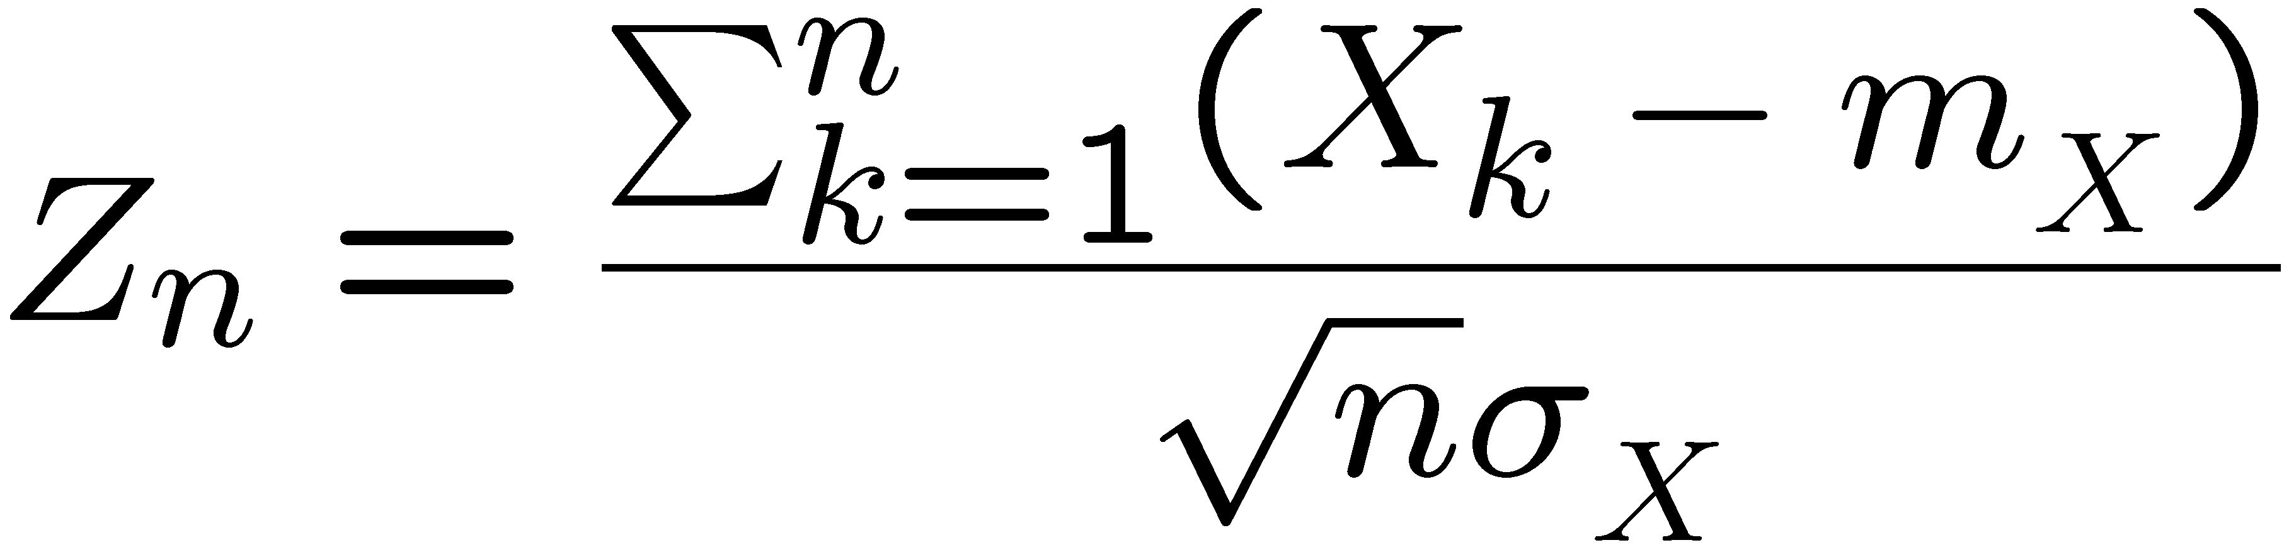
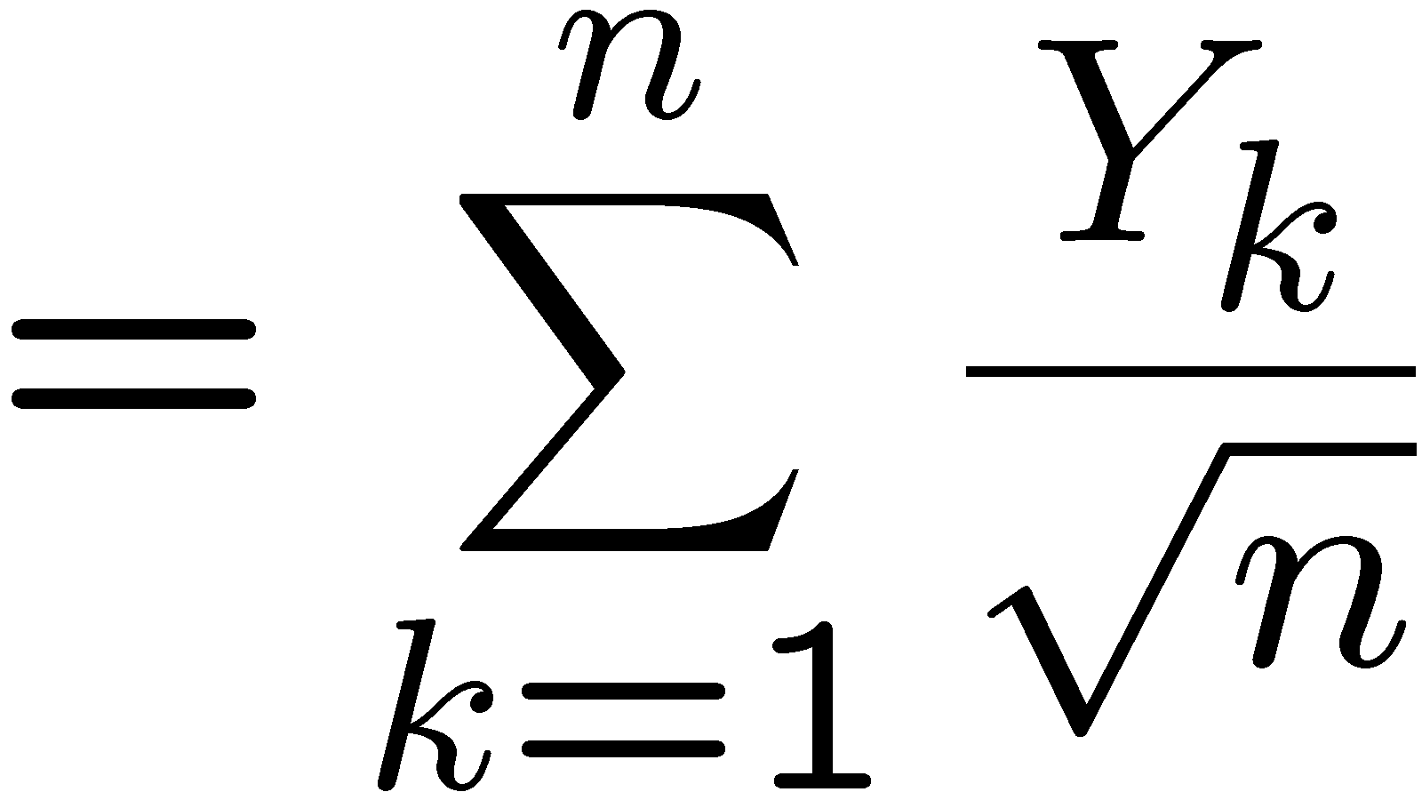
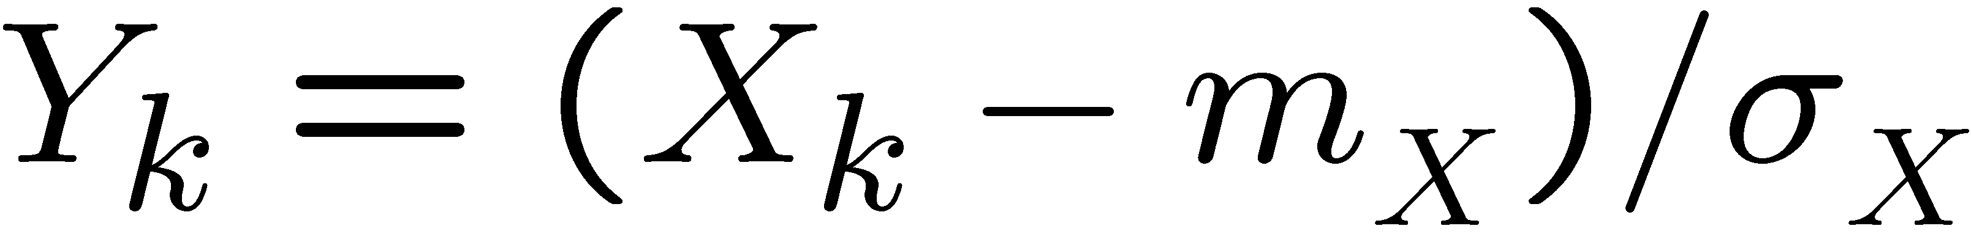
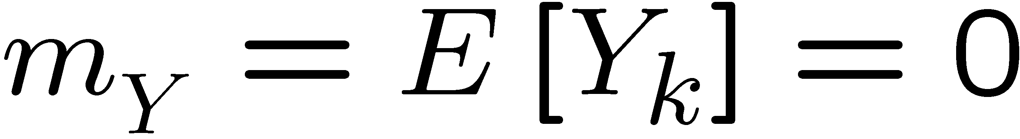
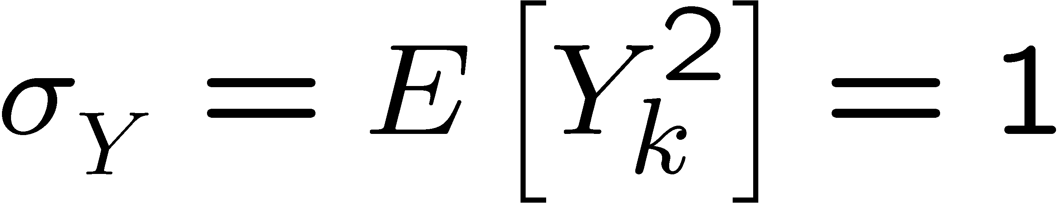
Proof of the central limit theorem
Let X₁, X₂,... be independent random variables each with mean m_{x} and variance σ_{x}² and define the sequence
where
notice that

Slide 30
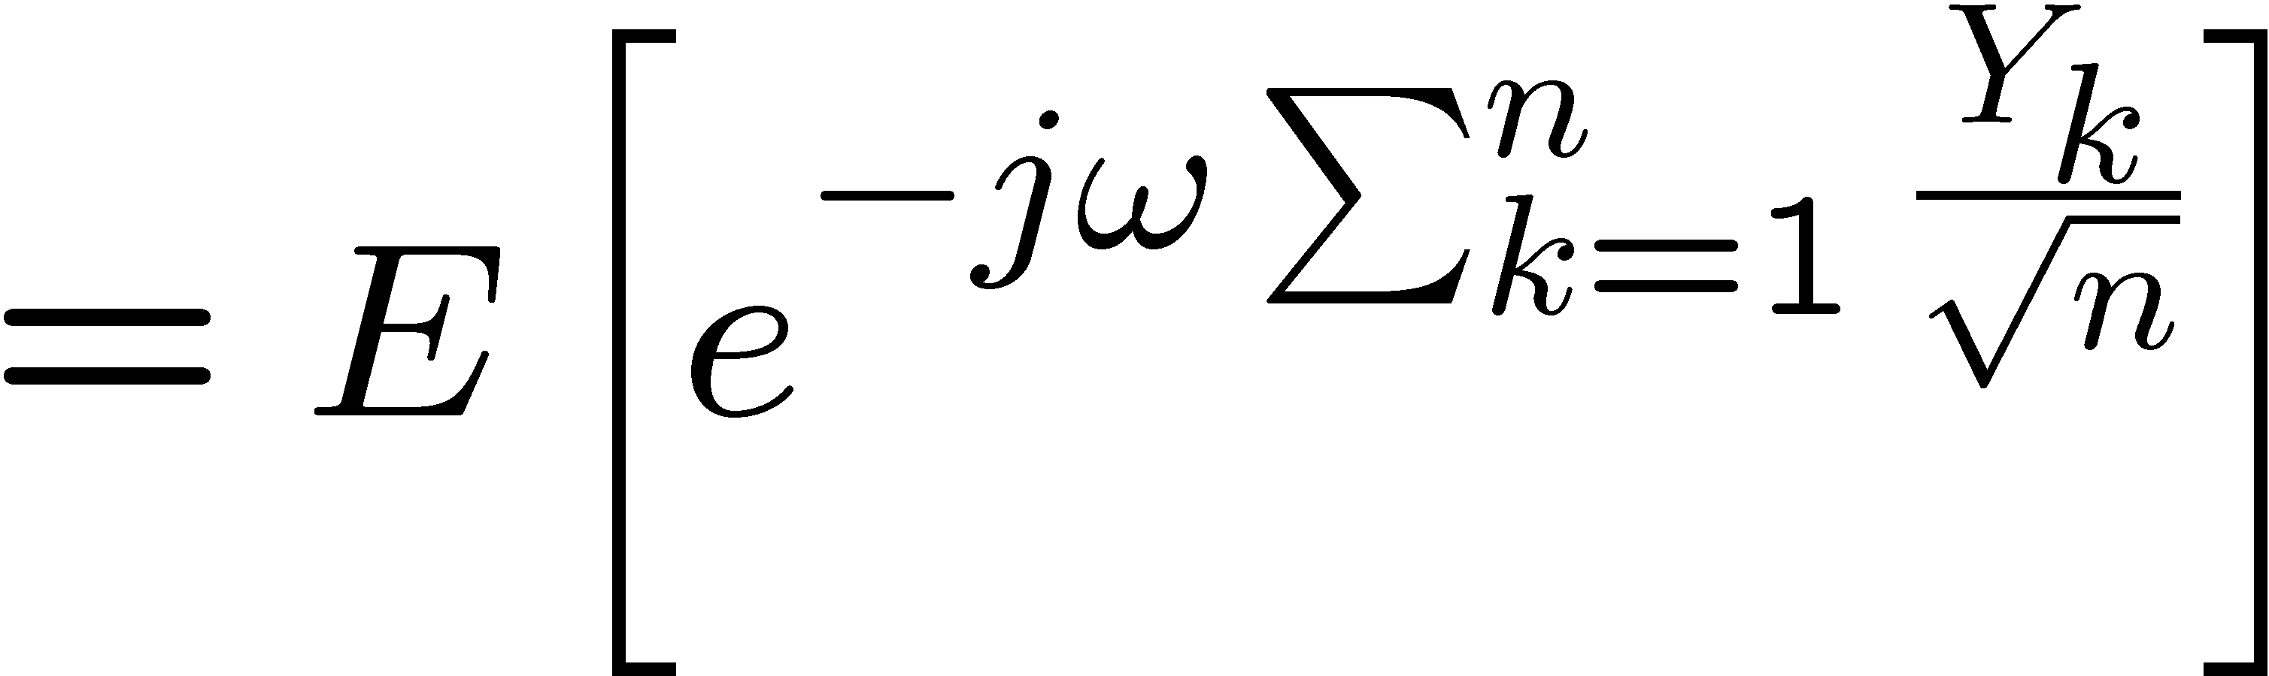





Proof of the central limit theorem
The moment generating function of Z_{n} is
by the Taylor series expansion of e^{x}

Slide 31





Proof of the central limit theorem
notice that, as n →∞ the approximation is exact
Moreover, the PDF and moment generating function of a
normally distributed random variable are
and

Slide 32



Proof of the central limit theorem
Therefore, since
Then, taking the inverse Fourier transform we obtain
and

