Slide 1
<number>
ME 233 Advanced Control II Lecture 2 Introduction to Probability Theory
(ME233 Class Notes pp. PR1-PR3)
TexPoint fonts used in EMF.
Read the TexPoint manual before you delete this box.: AAAAAA
Notes:
<number>

Slide 2
Outline
<number>
Sample Space and Events
Probability function
Discrete Random Variables
Probability mass function, expectation and variance
Notes:
<number>

Slide 3

Sample Space and Events
<number>
Assume:
We do an experiment many times.
Each time we do an experiment we call that a trial
The outcome of the experiment may be different at each trial.
: The i^{th} possible outcome of the experiment
Notes:
<number>

Slide 4

Sample Space and Events
<number>
Sample Space :
The space which contains all possible outcomes of an experiment.
: The i^{th} possible outcome of the experiment
Each outcome is an element of
Notes:
<number>

Slide 5
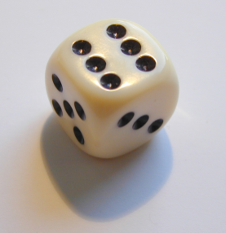

Example: Dice
<number>
Experiment:
A situation whose outcome depends on chance
- throwing a die once
Sample Space
The set of all possible outcomes of an experiment
=
Notes:
<number>

Slide 6



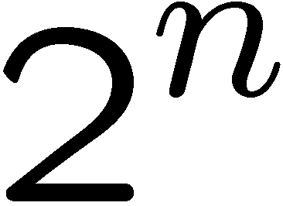
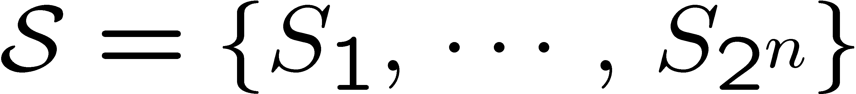
Events
<number>
Event :
Is a subset of the union of the sample space and the empty set
If a sample space has outcomes:
There are events:
Notes:
<number>

Slide 7
Probability - events
<number>
Experiment: throwing a die once
Ω =
Outcomes: elements of the sample space S
Events: Are subsets of the sample space S
An event occurs if any of the outcomes in that event occurs.
Empty subsets are null or impossible events
Notes:
<number>

Slide 8


Probability - events
<number>
Experiment: throwing a die once
Some events:
The event E of observing an even number of dots:
The event O of observing an odd number of dots:
Ω =
E =
O =
Notes:
<number>

Slide 9
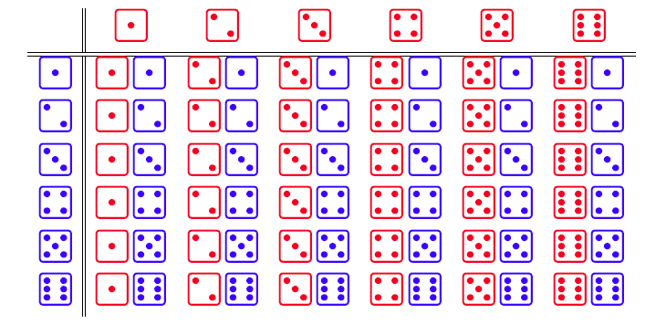
Example: throwing a pair of dice
<number>
(one red and one blue)
the sample space has 36 outcomes:
Ω =
The event L of obtaining the number 7 is
L occurs if any of the outcomes in L occurs.
Notes:
<number>

Slide 10
Union, Complement and Intersection
<number>
For a sample space
And the set of all events
Union of two events (or):
Intersection of two events (and):
Complement of an event (not):
Notes:
<number>

Slide 11




Union, Complement and Intersection
<number>
Union of two events:
Intersection of two events:
Complement of an event:
Notes:
<number>

Slide 12
Complement
<number>
The complement of an event A, denoted by A^{c}, is the set of outcomes that are not in A
A^{c} occurring means that A does not occur
Ω
A
A^{c}
Notes:
<number>

Slide 13

Intersection of two events
<number>
The intersection of two events A and B, denoted by A  B, is the set of outcomes that are in A, and B.
If the event A  B occurs, then both A and B occur
Events A and B are mutually exclusive if they cannot both occur at the same time, i.e. if
Ω
A
B
Notes:
<number>

Slide 14
Example of Intersection of two events
<number>
Experiment: throwing of a dice once
Events E and O are mutually exclusive
Ω =
E =
O =
Notes:
<number>

Slide 15
Union of two events
<number>
The union of two events A and B, denoted by
A U B, is the set of outcomes that are in A, or B, or both
If the event A U B occurs, then either A or B or both occur
Ω
A
B
Notes:
<number>

Slide 16

Probability function
<number>
We now consider the probability that a certain event occurs.
Recall: An event occurs if any of the outcomes in that event occurs.
The probability of event A will be denoted by
Notes:
<number>

Slide 17
Probability
<number>
A number between 0 and 1, inclusive, that indicates how likely an event is to occur.
An event with probability of 0 is a null event.
An event with probability of 1 is a certain event.
Probability of event A is denoted as P(A).
The closer P(A) to 1, the more likely is A to happen.
Notes:
<number>

Slide 18
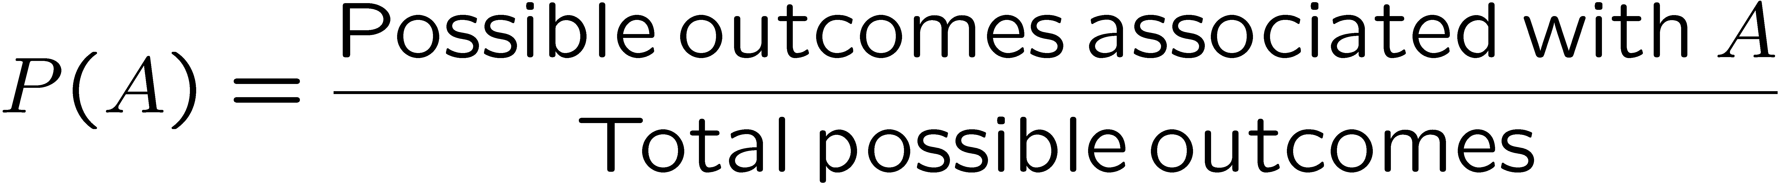
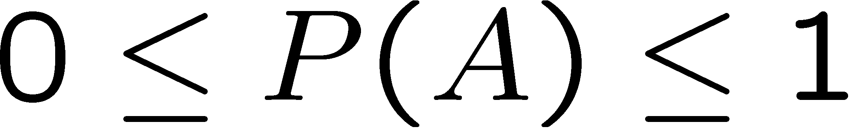
<number>
Intuitive Notion of Probability
The probability of event A is
(Assumes each outcome is equally likely)
Notes:
<number>

Slide 19
Assigning Probability - Frequentist approach
<number>
An experiment is repeated n times under essentially identical conditions
if the event A occurs m times and n is large
Notes:
<number>

Slide 20

Dice example
<number>
Experiment: throwing a fair die once
Ω =
P(Ω) = 1
P(1) = 1/6, P(3) =1/6, P(6) = 1/6
P(even number) = 3/6 = 1/2
P(odd number) = 3/6 = 1/2
Notes:
<number>

Slide 21

Example: poker
<number>
Example: In poker you are dealt 5 cards from a deck of 52
What is the probability of being dealt four of a kind?
e.g. 4 aces or four kings, and so fourth?
Notes:
<number>

Slide 22
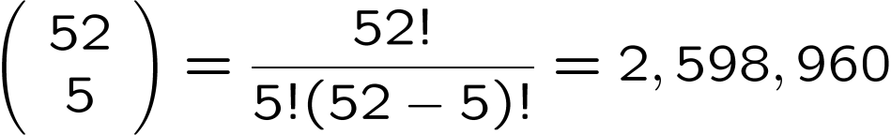
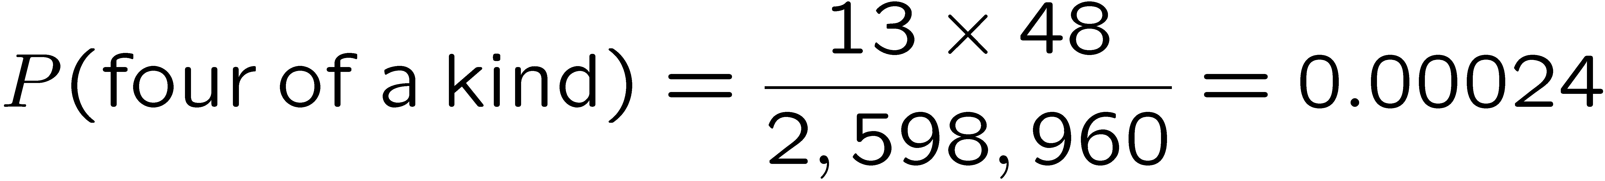
Example: poker
<number>
Solution:
There are only 48 possible hands containing 4 aces, another 48 containing 4 kings, etc.
Thus, there are 13 x 48 possible “four of a kind” hands.
The possible number of hands is obtained from the combination formula for “52 things taken 5 at a time”:
Thus,
total possible outcomes:
Notes:
<number>

Slide 23




Probability Space
<number>
The probability space is the triple:
Where
is the sample space
the set of all possible events
is the probability function
Notes:
<number>

Slide 24
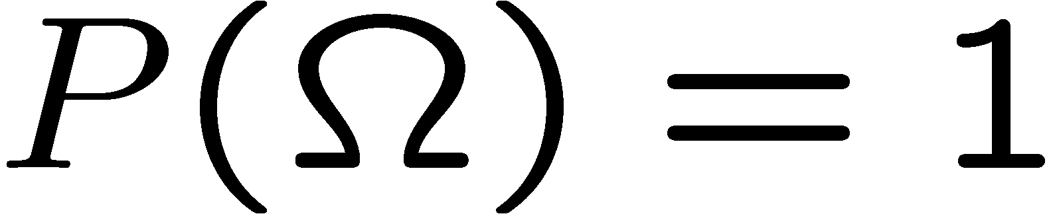

Probability function
<number>
Probability function:
Satisfies 3 axioms:
Notes:
<number>

Slide 25
Complement
<number>
The complement of an event A, denoted by A^{c}, is the set of outcomes that are not in A
A^{c} occurring means that A does not occur
Ω
A
A^{c}
Notes:
<number>

Slide 26
Independent Events
<number>
Two events are independent if
Intuitively, two events are independent if the events do not influence each other:
Event A occurring does not affect the chances of B occurring, and vice versa.
P(A  B) = P(A) × P(B)
Notes:
<number>

Slide 27
Example of independence
<number>
Experiment: throwing a pair of dice (one red and one blue)
Ω =
36 possible outcomes
The probability of throwing a red 1 and a blue 5 is
P(1  5 ) = 1/36
= 1/6 × 1/6 = P(1) × P(5)
Notes:
<number>

Slide 28
Law of Union
<number>
Recall: If A and B are mutually exclusive
If A and B are not mutually exclusive
P(A U B ) = P(A) + P(B)
P(A U B ) = P(A) + P(B) - P(A  B )
Notes:
<number>

Slide 29
Law of Union
<number>
If A and B are not mutually exclusive
P(A U B ) = P(A) + P(B) - P(A  B )
Ω
don’t count
A
B
twice!
Notes:
<number>

Slide 30
Example
<number>
Experiment: throwing a pair of dice (one red and one blue)
Ω =
P(L) = the probability of obtaining a 7
Notes:
<number>

Slide 31


Joint Probability
<number>
Let A and B be two events
is often called the joint probability of A and B
are often called the marginal probabilities of
A and B
Notes:
<number>

Slide 32

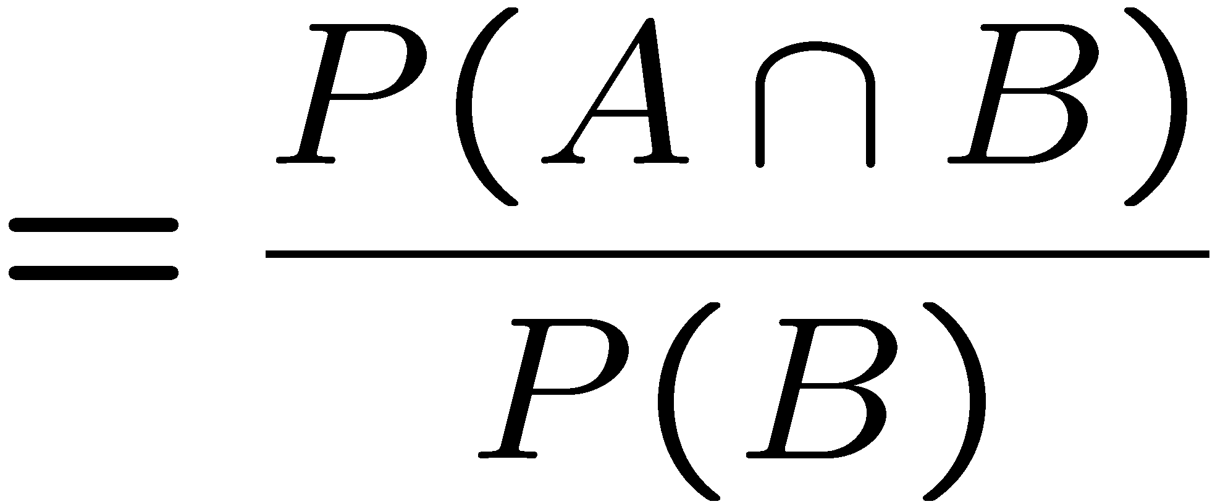

Conditional Probability
<number>
Let A and B be two events and
The conditional probability of event A given
that event B has occurred is
Notes:
<number>

Slide 33
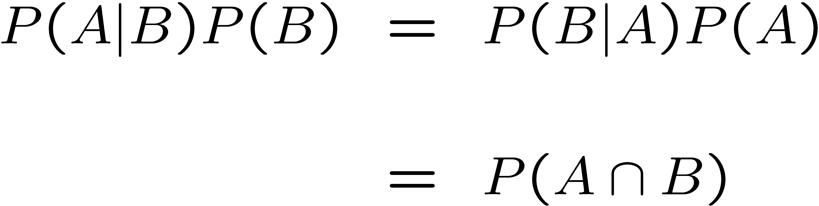
Bayes’ Rule
<number>
Let A and B be two events
Notes:
<number>

Slide 34


Independence
<number>
The following are equivalent:
A and B are independent
Notes:
<number>

Slide 35
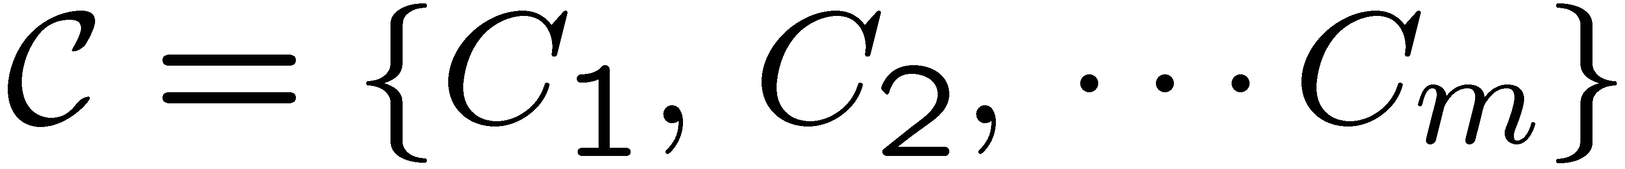

Array of Probabilities
<number>
Let C and D be two chance experiments.
Set of disjoint events associated with C
Set of disjoint events associated with D
Notes:
<number>

Slide 36





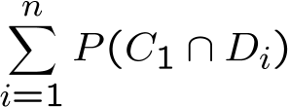




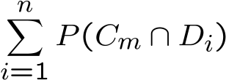



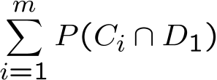

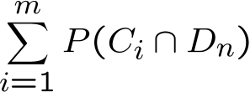

Array of Probabilities
<number>
We can construct:
 | Event D₁ | Event D₂ |  | Event D_{n} | Marginal Probabilities
Event C₁
Event C_{m}
Marginal Probabilities
D
C
Notes:
<number>

Slide 37
Example:
<number>
There are 4 balls in one jar, 2 balls are red and two balls are black.
A person can remove a ball from the jar two times, without seeing the balls inside the jar.
Notes:
<number>

Slide 38
Example:
<number>
What is the probability of removing a red ball after having removing a red ball the first time?
To answer this question, lets build the table of probabilities.
Notes:
<number>

Slide 39
Example:
<number>
What is the probability of removing a red ball after having removing a red ball the first time?
To answer this question, lets build the table of probabilities.
B₁
B₂
Labels:
R₁
R₂
Notes:
<number>

Slide 40

Example:
<number>
Probability of picking R₁ the first time?
R₁
B₁
B₂
R₂
Notes:
<number>

Slide 41
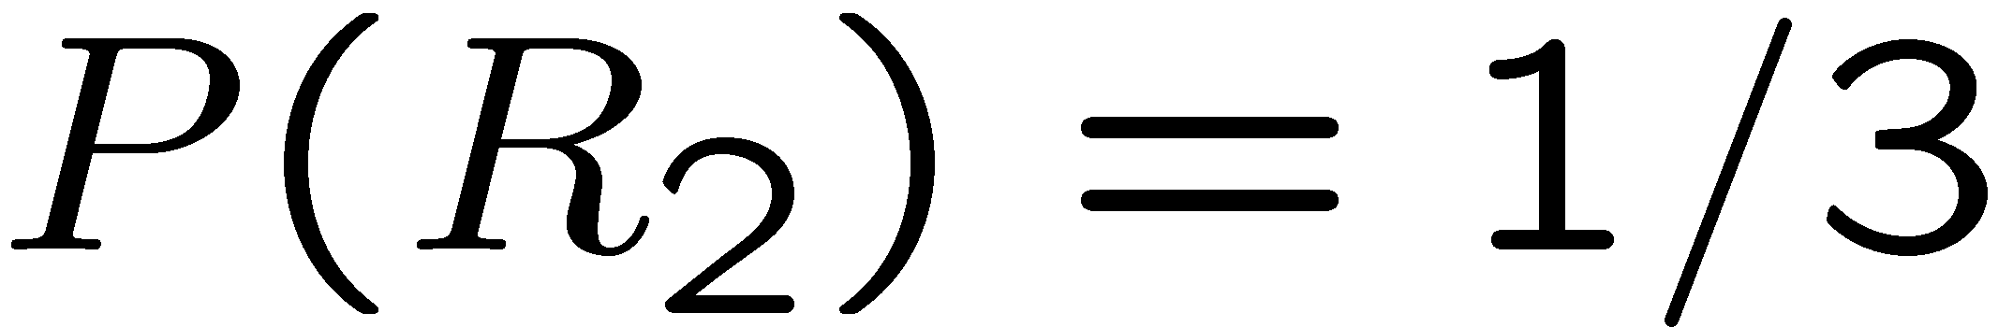
Example:
<number>
Probability of picking R₂ with only 3 balls left?
(second time)
B₁
B₂
R₂
R₁
Notes:
<number>

Slide 42
Example:
<number>
Probability of picking R₁ the first time and R₂ the second time?
R₁
B₁
B₂
R₂
Notes:
<number>

Slide 43
Example: Array of Probabilities
<number>
 | R₁ | R₂ | B₁ | B₂ | Marginal Probabilities
R₁ | 0 | 1/12 | 1/12 | 1/12 | 1/4
R₂ | 1/12 | 0 | 1/12 | 1/12 | 1/4
B₁ | 1/12 | 1/12 | 0 | 1/12 | 1/4
B₂ | 1/12 | 1/12 | 1/12 | 0 | 1/4
Marginal Probabilities | 1/4 | 1/4 | 1/4 | 1/4
2 pick
1 pick
Notes:
<number>

Slide 44


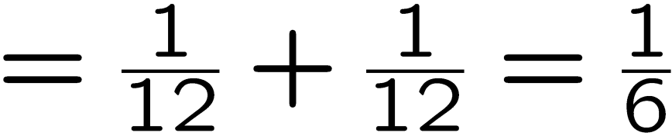
Probability of pick red balls consecutively
<number>
Probability of event A: picking a red ball the first time and a red ball the second time?
Event B: Picking R₁ first and R₂ second
Event C: Picking R₂ first and R₁ second
Mutually exclusive
events
Notes:
<number>

Slide 45
Example: Array of Probabilities
<number>
 | Red | Black | Marginal Probabilities
Red | 1/6 | 1/3 | 1/2
Black | 1/3 | 1/6 | 1/2
Marginal Probabilities | 1/2 | 1/2
2 pick
1 pick
Notes:
<number>

Slide 46
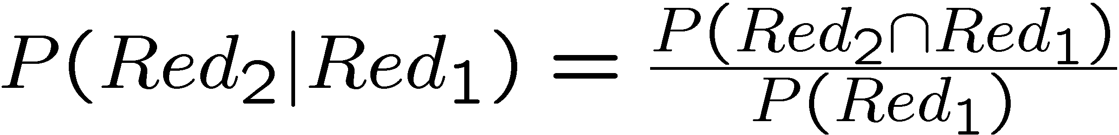
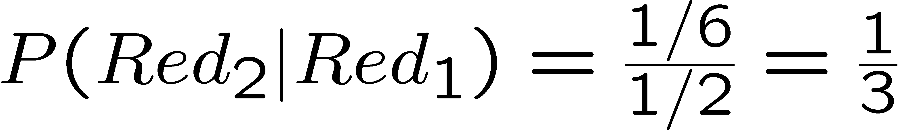
Example:
<number>
What is the probability of picking a red ball the second time after having picked a red ball the first time?
Notes:
<number>

Slide 47

Discrete random variable
<number>
Given a sample Space Ω, a random variable X is a function that assigns to each outcome a unique numerical value.
Example: throwing of a die once
Ω =
X
Notes:
<number>

Slide 48
Discrete random variable
<number>
Example: throwing of a die once
In this case, the random variable X only takes discrete values
The discrete random variable X is defined by the probability mass function
Ω =
the probability that,
after throwing a die,
X will be equal to x_{i}
Notes:
<number>

Slide 49
Discrete random variable
<number>
For a fair die, the probability mass function of the random variable X is
the probability mass
function satisfies:
Notes:
<number>

Slide 50
Expected value
<number>
For a discrete random variable X taking on the N possible values
x₁, x₂, x₃, ... , x_{k}, ..., x_{N}
the expected value or mean of X is defined by
Notes:
<number>

Slide 51
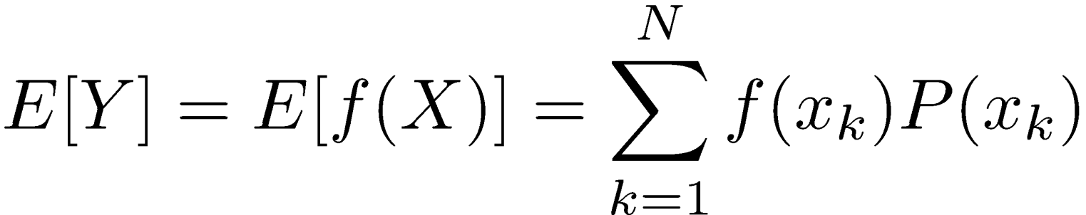
Expected value of a function
<number>
For a discrete random variable X taking on the N possible values
x₁, x₂, x₃, ... , x_{k}, ..., x_{N}
and the real-valued function f
the expected value or mean of Y=f(X) is defined by
Notes:
<number>

Slide 52
Expected value
<number>
Example: For a fair dice,
X takes 6 possible values
the expected value or mean of X
Ω =
Notes:
<number>

Slide 53
Variance and standard deviation
<number>
For a discrete random variable X taking on the N possible values
x₁, x₂, x₃, ... , x_{k}, ..., x_{N} and a mean
the variance of X is defined by
where σ_{X} is the standard deviation of X
Notes:
<number>

Slide 54
Variance and standard deviation
<number>
Example: For a fair dice, where
X has mean and
the variance and standard deviation of X are
Notes:
<number>

Slide 55
Cumulative Distribution Function
<number>
The cumulative distribution function (CDF) for a discrete random variable X is
Find index k such that
Notes:
<number>

Slide 56
Cumulative Distribution Function
<number>
The cumulative distribution function (CDF) for a discrete random variable X is
Notes:
<number>

Slide 57
Sum of two uniform independent random variables
<number>
Let X and Y be 2 independent random variables with constant probability mass function
Let
The probability mass function of Z will not be constant
Z = X + Y
Notes:
<number>

Slide 58
Throwing two fair dice
<number>
Experiment: throwing a pair of fair dice (red and blue)
the sample space has 36 outcomes:
each outcome has a 1/36 probability of occurring
Ω =
Notes:
<number>

Slide 59
Throwing two fair dice
<number>
Ω =
Define the random variable Z associated with the event of observing the total number of dots on both dice after each throw
Z = k when the throw results in the number k
Notes:
<number>

Slide 60
Throwing two fair dice
<number>
number of
outcomes
Ω =
36
Z only takes discrete values
Notes:
<number>

Slide 61
Throwing two fair dice
<number>
probability of
each outcome
Ω =
1/36
we now estimate:
P(k) = P(X = k)
Notes:
<number>

Slide 62
Throwing two fair dice
<number>
Ω =
X The probability mass function is
Notes:
<number>

Slide 63
Throwing two fair dice
<number>
Ω =
the probability
mass function satisfies:
p(z_{i})
z_{i}
Notes:
<number>

