Slide 1
ME 233 Advanced Control II Lecture 18 Stability Analysis Using The Hyperstability Theorem
TexPoint fonts used in EMF.
Read the TexPoint manual before you delete this box.: AAAAAAA

Slide 2
Adaptive Control
Basic Adaptive Control Principle
Controller parameters are not constant, rather, they are adjusted in an online fashion by a Parameter Adaptation Algorithm (PAA)
When is adaptive control used?
Plant parameters are unknown
Plant parameters are time varying

Slide 3
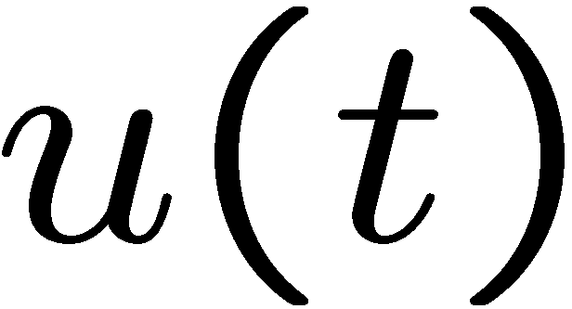
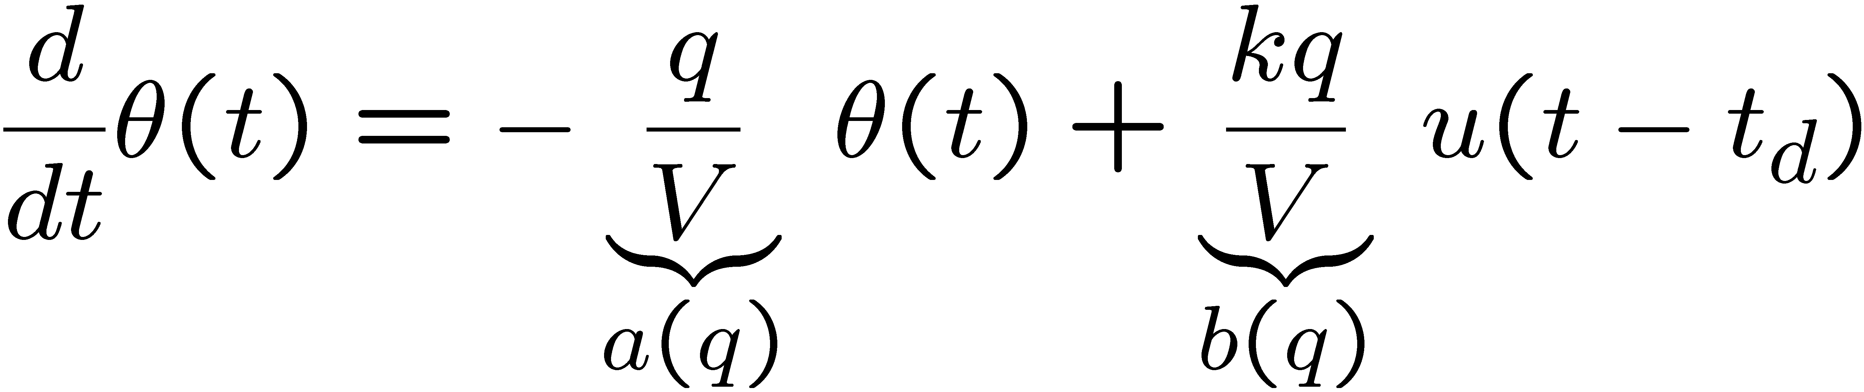
Example of a system with varying parameters
Temperature control system

Slide 4
Adaptive Control Classification
Continuous time VS discrete time
Direct VS indirect
MRAS VS STR

Slide 5
Model Reference Adaptive Systems (MRAS)

Slide 6
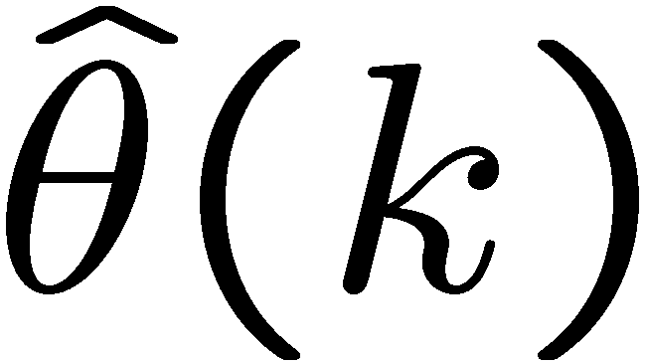
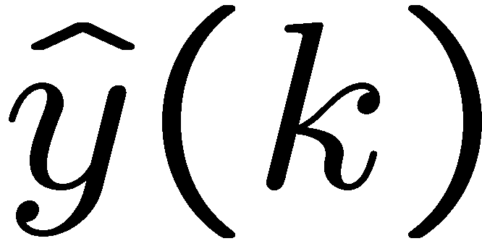
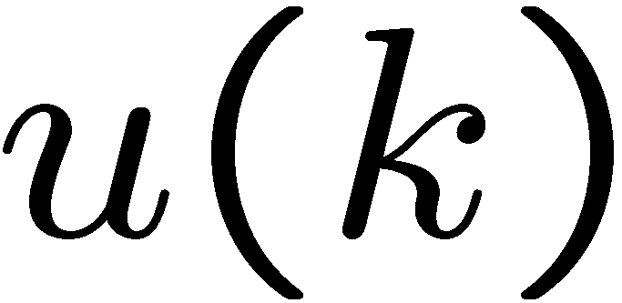
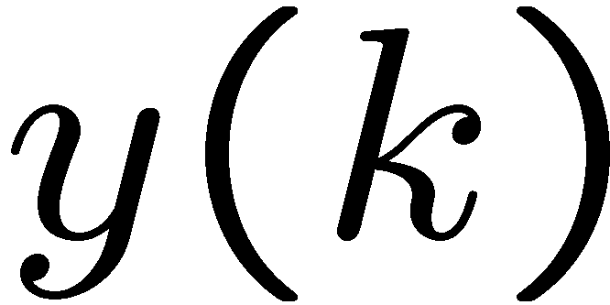
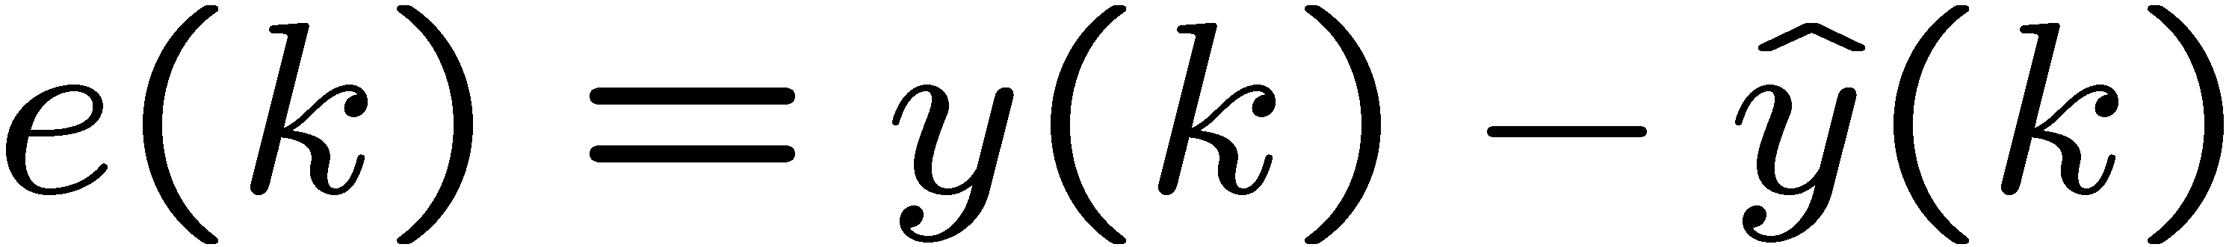
Self-Tuning Regulators (STR)
estimates

Slide 7

Identification of a LTI system
PAA
Parallel model

Slide 8
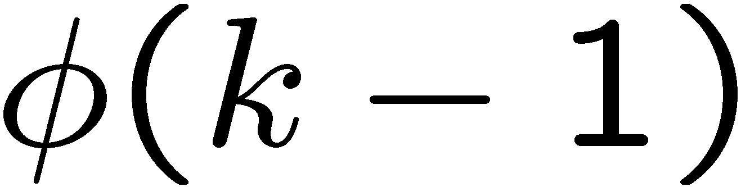
Identification of a LTI system
regressor
Parameter
Adaptation
Algorithm
Series-parallel model
(We will use this model throughout this lecture)

Slide 9
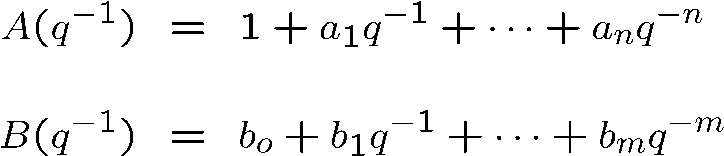
Plant ARMA Model
Plant model
where

Slide 10
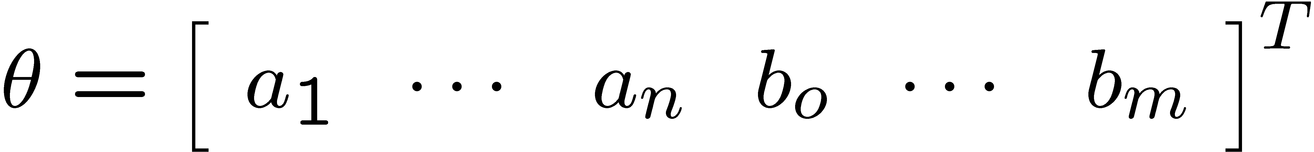
Unknown plant parameters
Assume ARMA model parameters are unknown
Define:
As the unknown parameter vector

Slide 11
Regressor vector
Collect all measurable signals in one vector
We define
as the known regressor vector

Slide 12
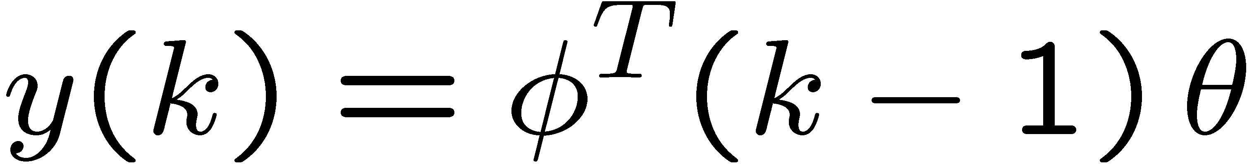
Plant ARMA Model
Plant model
where

Slide 13
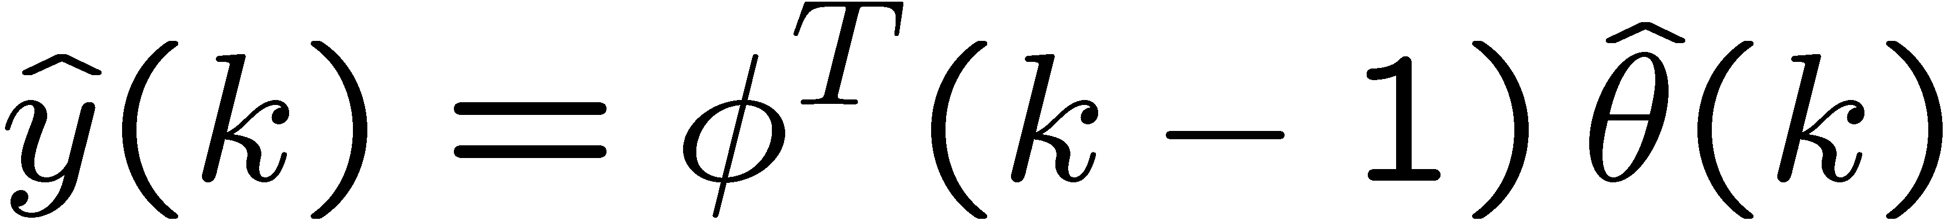
Plant ARMA Model
Plant estimate (series-parallel)
where

Slide 14
Plant output estimate
Plant a-posteriori estimate
Plant a-priori estimate

Slide 15
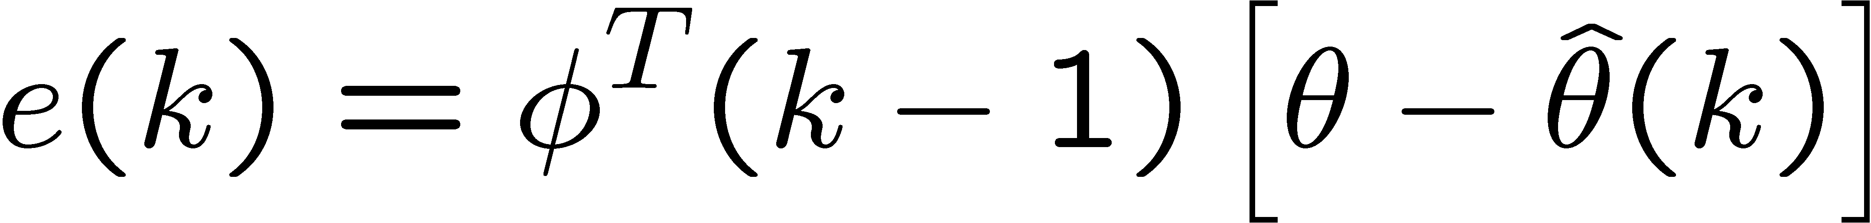
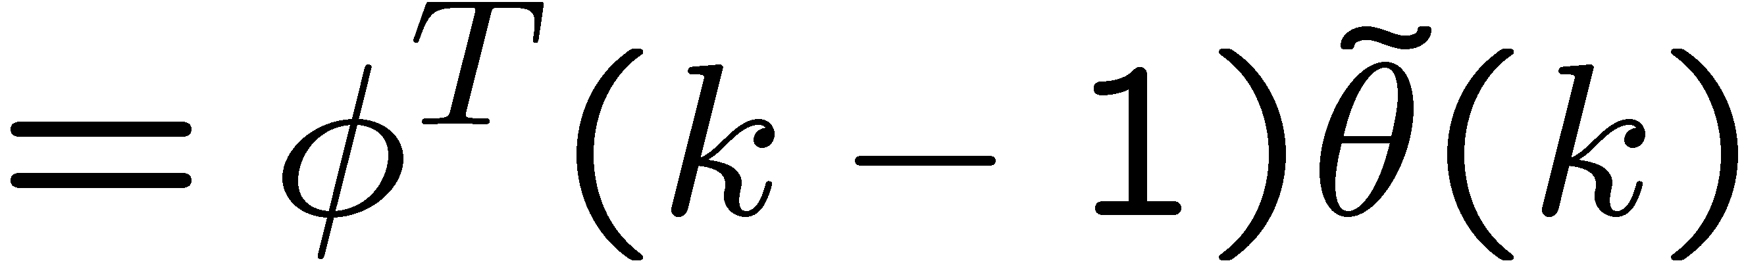
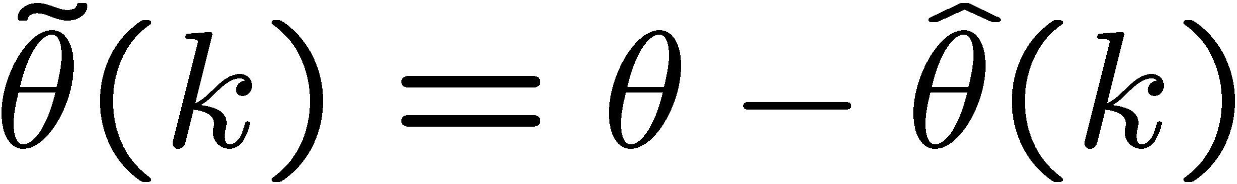
Plant a-posteriori error
error:

Slide 16
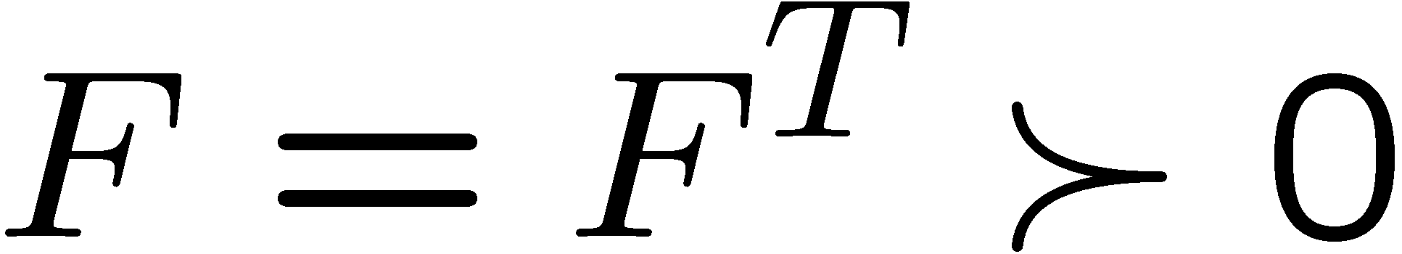
A Parameter Adaptation Algorithm
PAA
Parameter error update law:

Slide 17
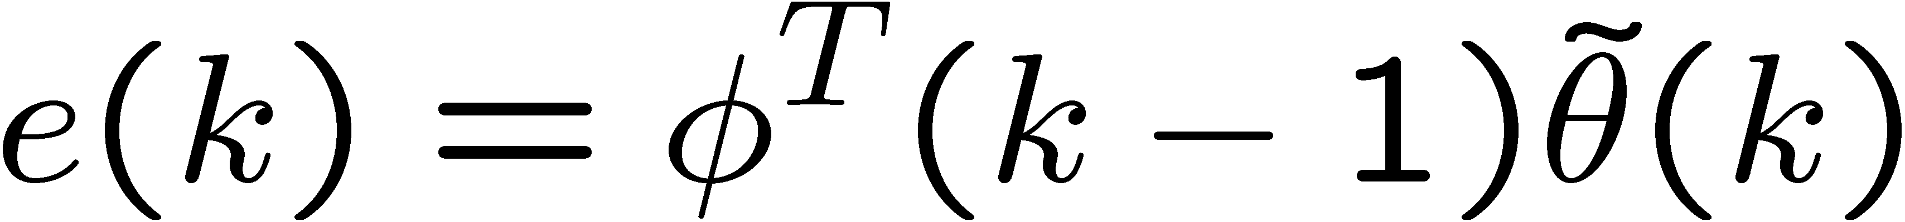
Adaptation Dynamics
a-posteriori error:
Parameter error update law:

Slide 18
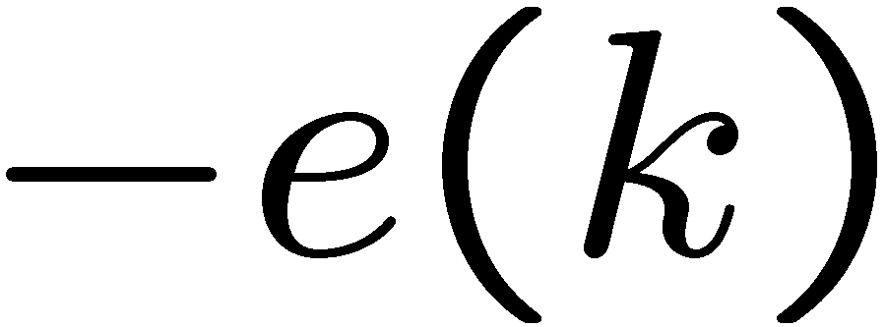
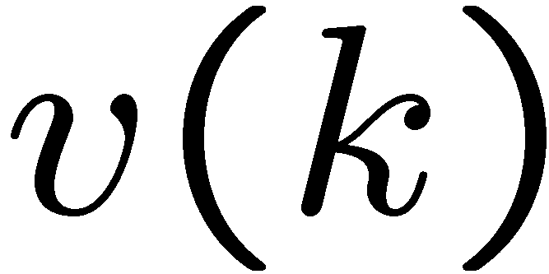

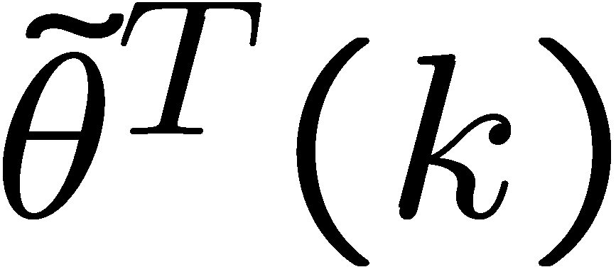

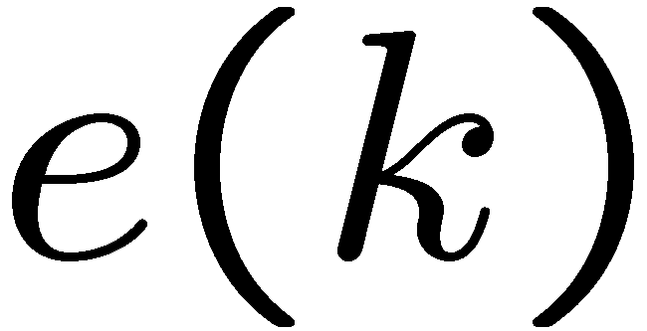
Adaptation Dynamics
PAA
PAA:

Slide 19
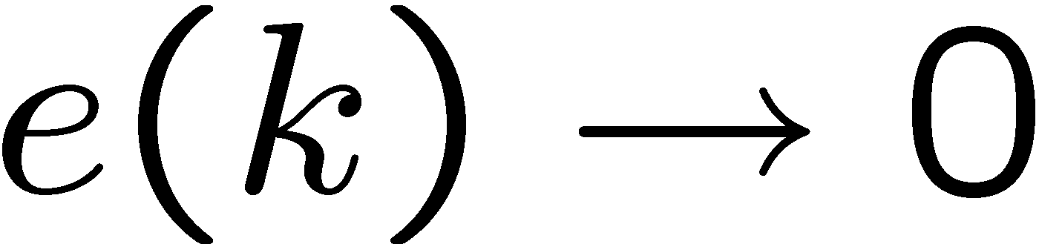
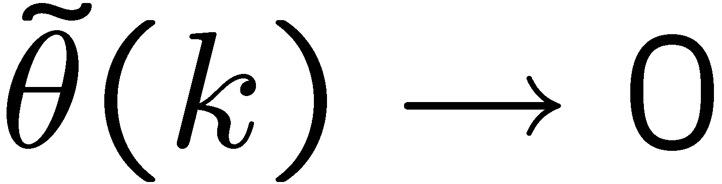
Convergence of Adaptive Systems
Adaptive systems are nonlinear
We need to prove that the algorithms converge:
Output error convergence
Parameter error convergence

Slide 20
Output error Convergence
Our first goal will be to prove the asymptotic convergence of the output error:
Two frequently used methods of stability analysis are:
Stability analysis using Lyapunov’s direct method
State space approach
Stability analysis using the Passivity or Hyperstability theorems
Input/output approach

Slide 21
Hyperstability
Hyperstability Theory
Developed by V.M. Popov to analyze the stability of a class of feedback systems (monograph published in 1973)
Popularized by I.D. Landau for the analysis of adaptive systems (first book published in 1979)

Slide 22
Hyperstability Theory
Hyperstability Theory
Applies to both continuous time and discrete time systems
Abuse of notation: We will denote the LTI block by its transfer function

Slide 23
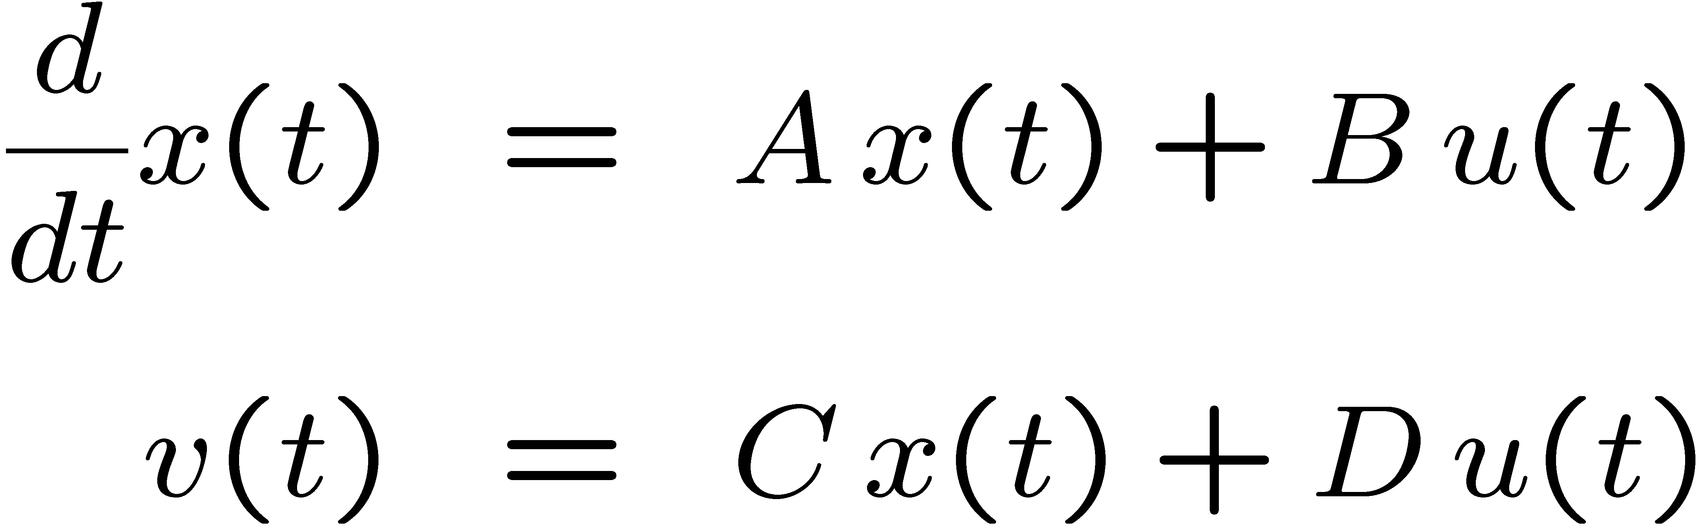
CT Hyperstability Theory
A state space description of the LTI Block:

Slide 24
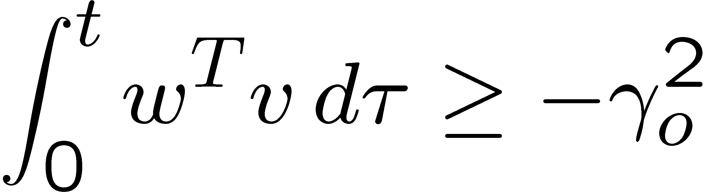
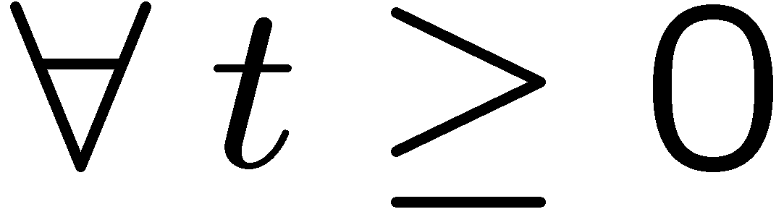

CT Hyperstability Theory
P-class nonlinearity: (passive nonlinearities)
Where is a constant which is a function of the
initial conditions

Slide 25
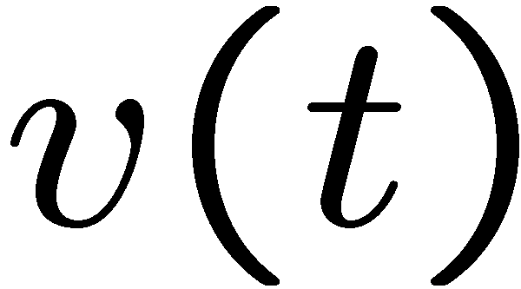
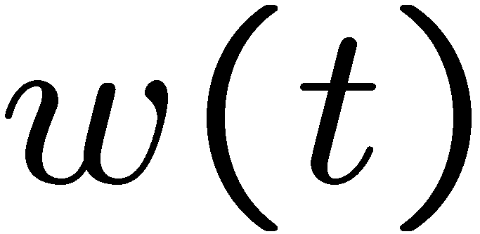
CT Hyperstability Theory
P-class
nonlinearity
Where is a constant which is a function of the
initial conditions

Slide 26
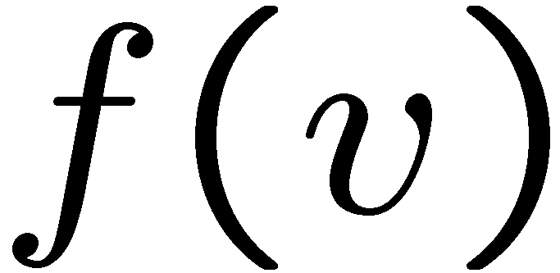
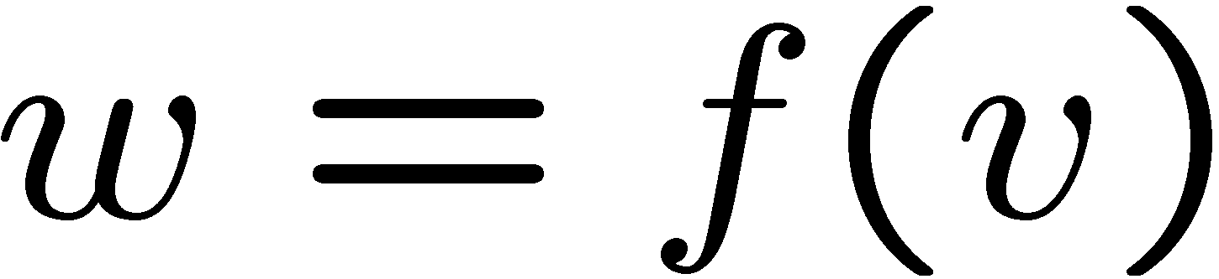
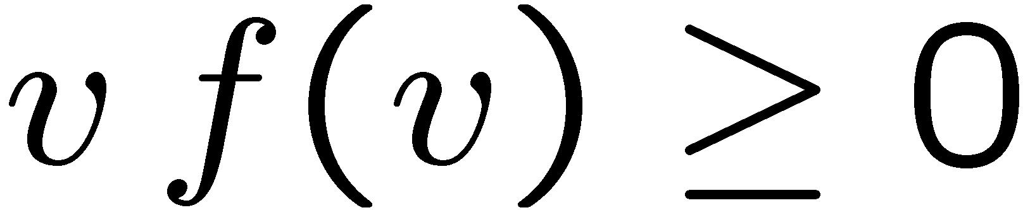
Example: Static P-class NL

Slide 27
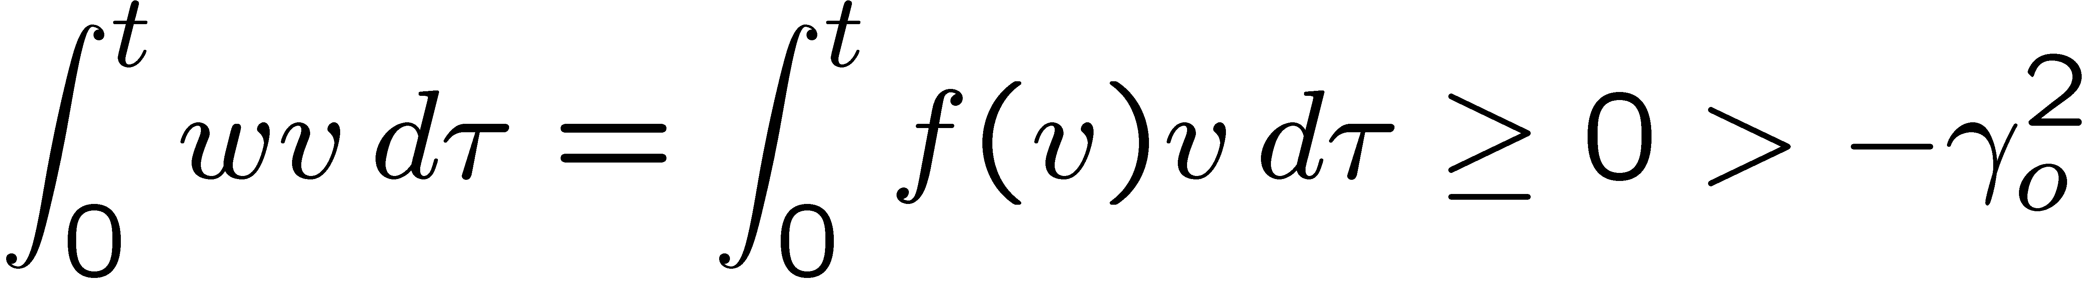
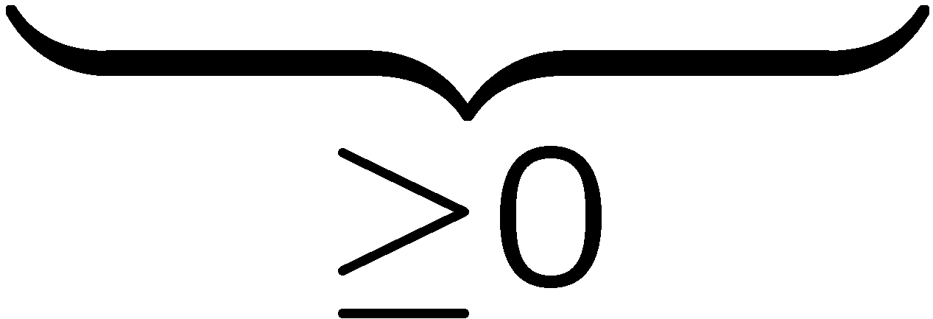
Example: Static P-class NL

Slide 28
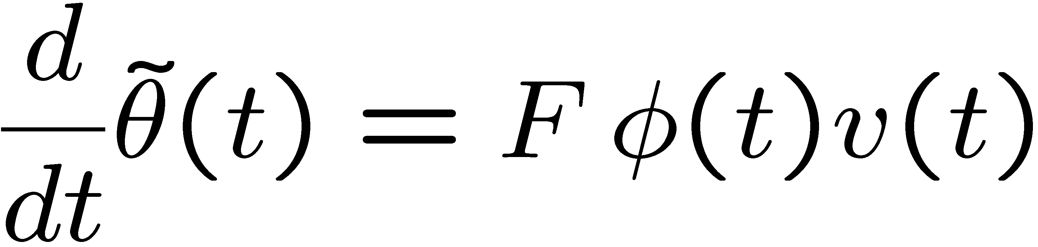
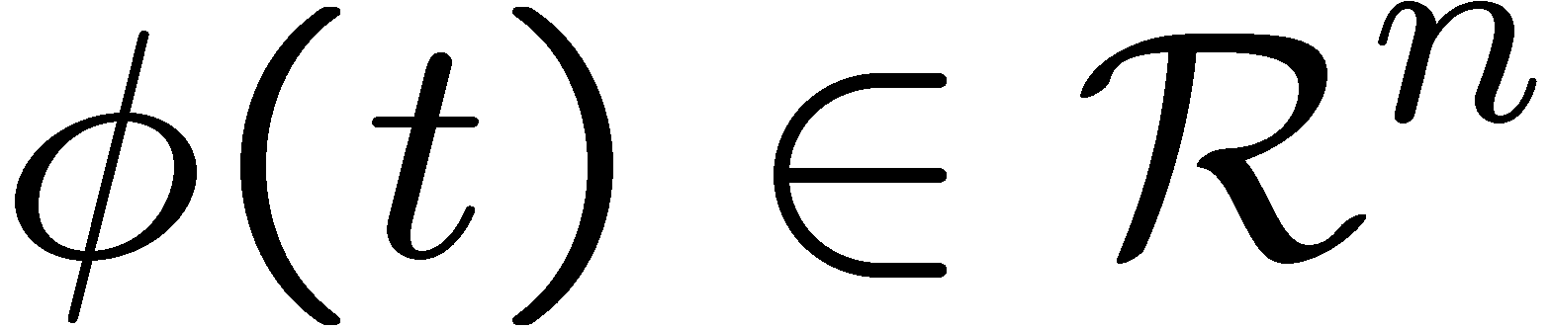
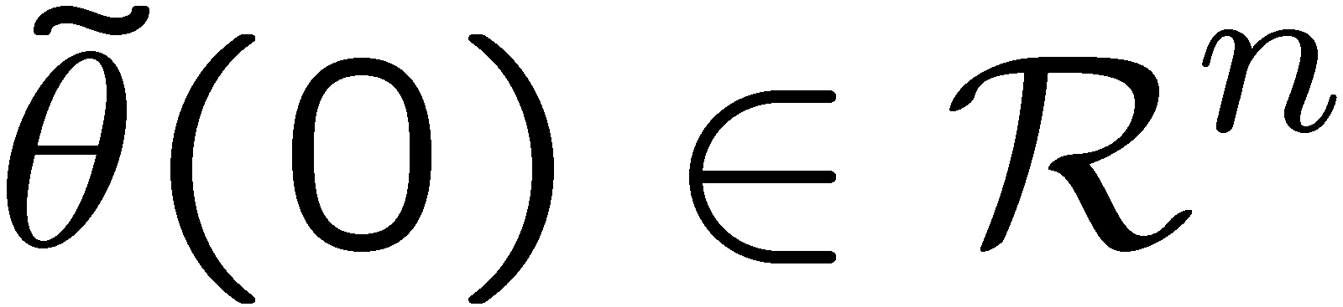
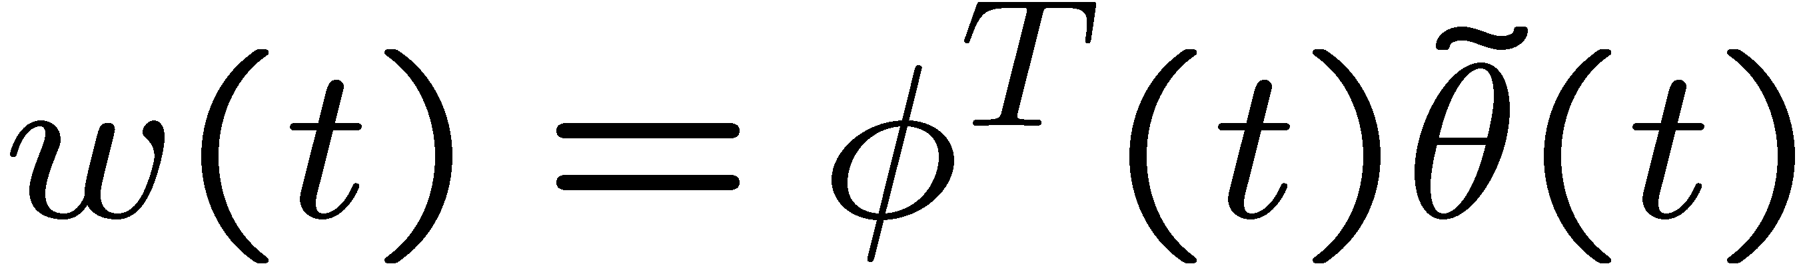


Example: Dynamic P-class block
P-NL

Slide 29
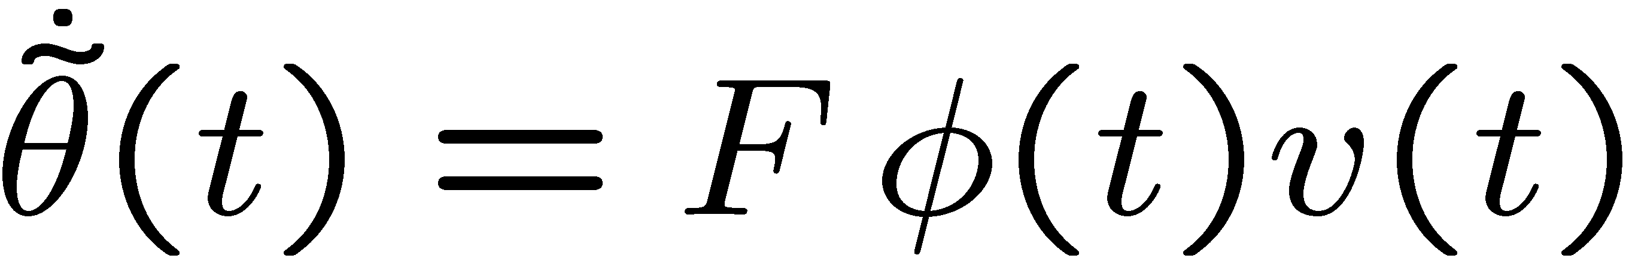
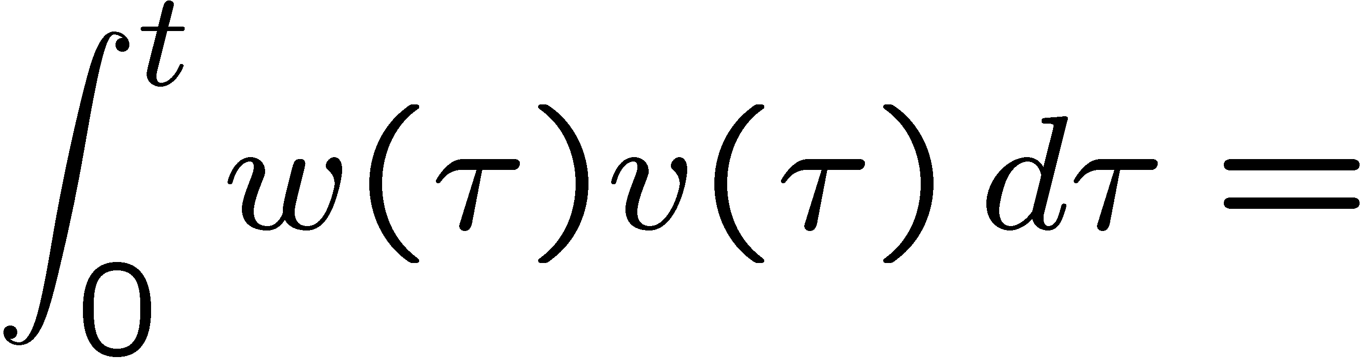
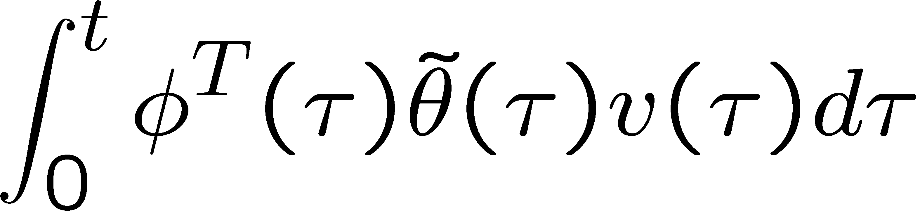
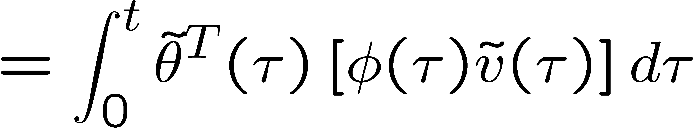
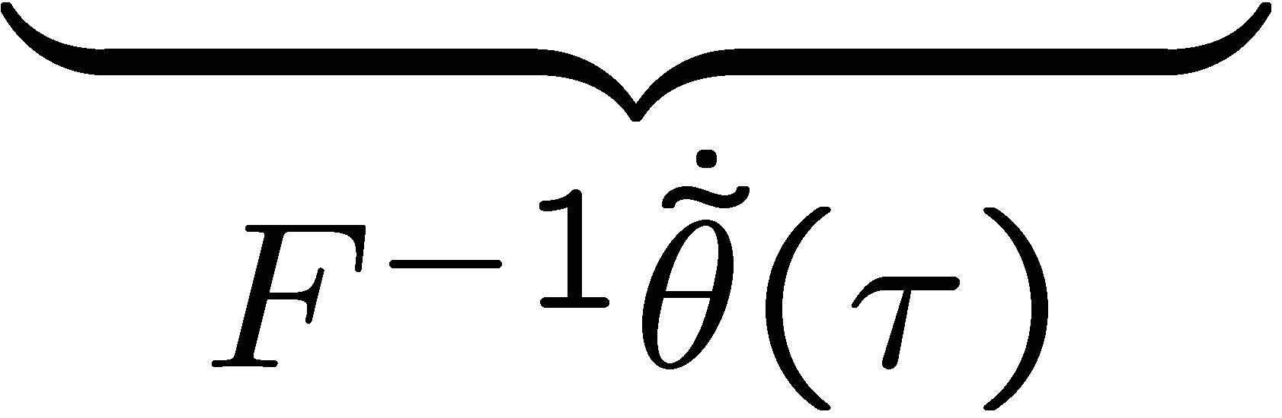
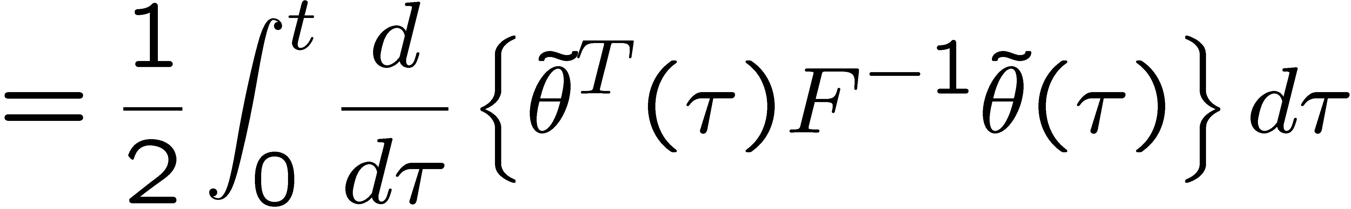
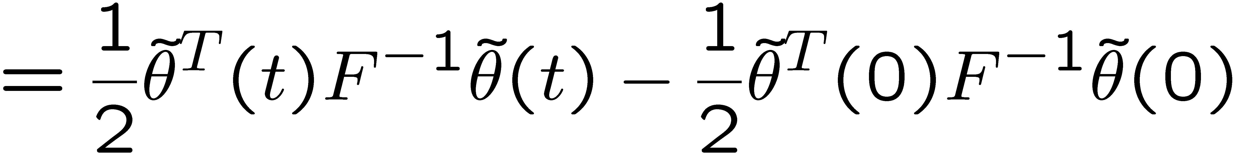
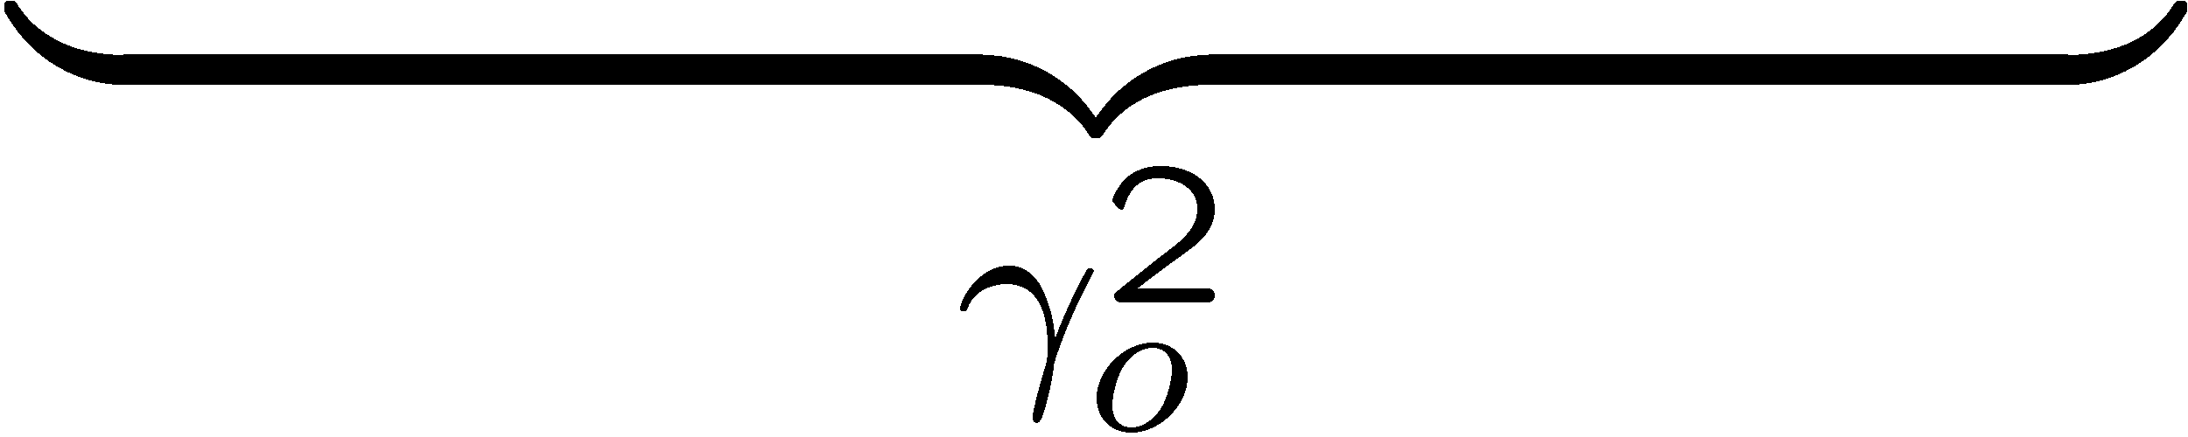
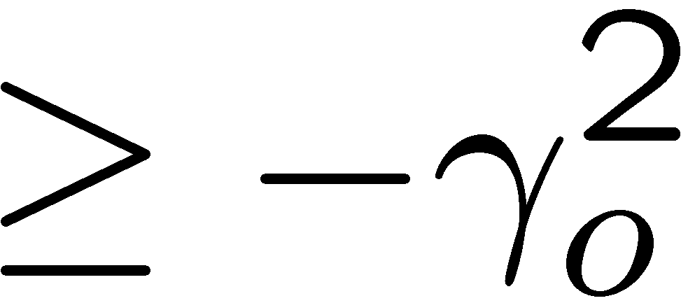
Example: Dynamic P-class block

Slide 30
Example: Passive mechanical system
Input is force and output is velocity
passive
mechanical
system
force
velocity

Slide 31

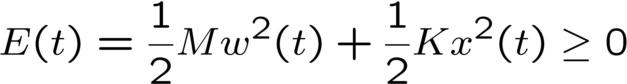
Example: Passive mechanical system
Input is force and output is velocity
System Energy:

Slide 32
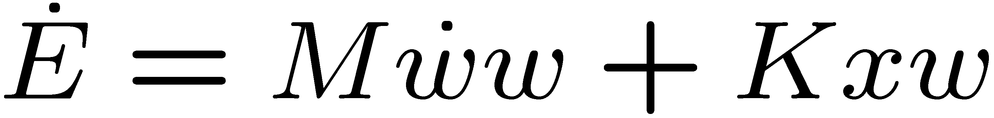
Example: Passive mechanical system
Input is force and output is velocity
Differentiating energy

Slide 33
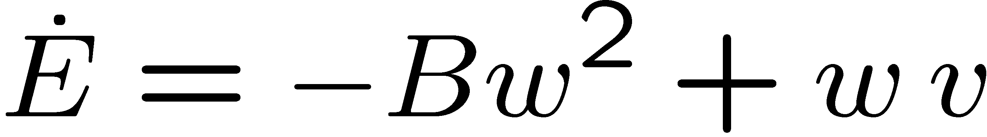
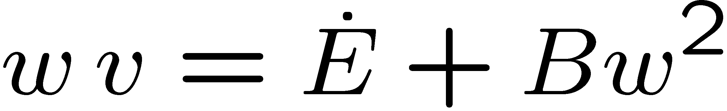
Example: Passive mechanical system
Input is force and output is velocity
Differentiating energy
power input

Slide 34



Example: Passive mechanical system
Input is force and output is velocity
integrating power,

Slide 35
Examples of P-class NL
Lemma:
The parallel combination of two P-class nonlinearities is also a P-class nonlinearity.

Slide 36
Examples of P-class NL
Lemma:
The feedback combination of two P-class nonlinearities is also a P-class nonlinearity.

Slide 37

CT Hyperstability
Hyperstability: The above feedback system is hyperstable if there exist positive bounded constants such that, for any state space realization of G(s),
FOR ALL P-class nonlinearities

Slide 38


CT Asymptotic Hyperstability
Asymptotic Hyperstability: The above feedback system is asymptotically hyperstable if
It is hyperstable
For all signals (I.e. bounded output of any P-class nonlinearity), and any state space realization of G(s),

Slide 39
CT Hyperstability Theorems
Hyperstability Theorem: The above feedback system is hyperstable iff the transfer function G(s) of the LTI block is Positive Real.
Asymptotical Hyperstability Theorem: The above feedback system is asymptotically hyperstable iff the transfer function G(s) of the LTI block is Strictly Positive Real.

Slide 40
CT Positive Real TF
Is Positive Real iff:
G(s) does not have any unstable poles (I.e. no Re{s} > 0).
Any pole of G(s) that is in the imaginary axis does not repeat and its associated residue (I.e. the coefficient appearing in the partial fraction expansion) is non-negative.
for all real ω’s for which s = j ω is not a pole of G(s)

Slide 41


Strictly Positive Real (SPR) TF
Is Strictly Positive Real (SPR) iff:
All poles of G(s) are asymptotically stable.
2.
for all
Example:

Slide 42


Strictly Positive Real (SPR) TF
For scalar rational transfer functions
All poles of G(s) are asymptotically stable.
2. for all
Note:
A necessary (but not sufficient)
condition for G(s) to be SPR is that
its relative degree must be less than or
equal to 1.

Slide 43

Kalman Yakubovich Popov Lemma
Is Strictly Positive Real (SPR) if and only if
there exist a symmetric and positive definite matrix P,
matrices L and K,
and a constant ε > 0 such that

Slide 44


Kalman Yakubovich Popov Lemma
Is Strictly Positive Real (SPR) iff there exist symmetric and positive definite matrices P and Q, such that:

Slide 45





SPR TF implies Possitivity
Let be SPR
Then there exist positive definite functions
and a positive semi-definite function
Such that the input u(t) output y(t) pair satisfies

Slide 46

SPR TF implies Passivity
Proof: We consider a strictly causal transfer function
which is SPR, with state space realization
By the Kalman Yakubovich, Popov lemma, there exist symmetric and positive definite matrices P and Q, such that

Slide 47


SPR TF implies Passivity
Proof: Define the PD function
and compute:
by the Kalman Yakubovich, Popov lemma.

Slide 48




SPR TF implies Passivity
Proof: Thus, since
Define the PD function and integrate

Slide 49

DT Hyperstability Theory
State space description of the LTI Block:

Slide 50


DT Hyperstability Theory
P-class nonlinearity: (passive nonlinearities)
Where is a bounded constant.

Slide 51


Example: Static nonlinearity:
P-block

Slide 52





Example: Dynamic P-class block
P-block

Slide 53






Example: Dynamic P-class block

Slide 54






Example: Dynamic P-class block

Slide 55



Example: Dynamic P-class block
P-block

Slide 56

Example: Dynamic P-class block
P-block

Slide 57



Example: Dynamic P-class block

Slide 58
Example: Dynamic P-class block

Slide 59
Example: Dynamic P-class block
P-block

Slide 60
Examples of P-class NL
Lemma:
The parallel combination of two P-class nonlinearities is also a P-class nonlinearity.
The feedback combination of two P-class nonlinearities is also a P-class nonlinearity.

Slide 61
DT Hyperstability
Hyperstability: The above feedback system is hyperstable if there exist positive bounded constants such that,
for any state space realization of G(q),
FOR ALL P-class nonlinearities

Slide 62

DT Asymptotic Hyperstability
Asymptotic Hyperstability: The above feedback system is asymptotically hyperstable if
It is hyperstable
for any state space realization of G(z),

Slide 63
DT Hyperstability Theorems
Hyperstability Theorem: The above feedback system is hyperstable iff the transfer function G(z) of the LTI block is Positive Real.
Asymptotical Hyperstability Theorem: The above feedback system is asymptotically hyperstable iff the transfer function G(z) of the LTI block is Strictly Positive Real.

Slide 64


Positive Real TF
Is Positive Real iff:
G(z) does not have any unstable poles (I.e. no |z| > 1).
Any pole of G(z) that is in the unit circle does not repeat and its associated residue (i.e. the coefficient appearing in the partial fraction expansion) is non-negative.
for all for which z = e ^{j ω} is not a pole of G(z)

Slide 65



Strictly Positive Real (SPR) TF
Is Strictly Positive Real (SPR) iff:
All poles of G(z) are asymptotically stable.
2.
for all
Example:

Slide 66



Strictly Positive Real (SPR) TF
For scalar rational transfer functions
All poles of G(z) are asymptotically stable.
2. for all
Note:
A necessary (but not sufficient)
condition for G(z) to be SPR is that
its relative degree must be 0.

Slide 67


Matrix Inequality Interpretation of SPR
The transfer function
is Strictly Positive Real (SPR) if and only if
there exists such that

Slide 68



SPR state-space realization fact
Theorem: If G(z) = C(zI-A)⁻¹B + D is SPR, then
Proof: Choose such that
Note that

Slide 69



SPR TF is P-class
Let be SPR
Then there exist positive definite functions
Such that any input u(k) output y(k) pair satisfies

Slide 70

Shorthand notation

Slide 71

Proof
Let be SPR
Choose such that
Define the Lyapunov function
and the function

Slide 72




Proof

Slide 73

Proof
From the previous slide
Summing both sides of the equation yields

Slide 74

Proof of the sufficiency part of the Asymptotic Hyperstability Theorem - Discrete Time
SPR
P-class
Since the nonlinearity is P-class,
Since LTI block is SPR, we can use the choose such that

Slide 75

Hyperstability
SPR
From the previous proof (SPR TF is P-class), we have
where

Slide 76





Hyperstability
SPR
Rearranging terms,
From the P-class nonlinearity:
Therefore,

Slide 77



Hyperstability
SPR
From the previous slide
Therefore, the feedback system is hyperstable

Slide 78




Asymptotic Hyperstability
SPR
monotonic nondecreasing sequence in k
bounded above
Therefore, the feedback system is asymtotically hyperstable

Slide 79


Additional Result
SPR
We have already shown that
From this we see that
Therefore, x(k), u(k), v(k), and w(k) converge to 0

Slide 80
Stability analysis of Series-parallel ID
regressor
Parameter
Adaptation
Algorithm

Slide 81
Series-Parallel ID Dynamics (review)
a-posteriori error:
Parameter error update law:

Slide 82
Series-Parallel ID Dynamics (review)
PAA
PAA:

Slide 83
Stability analysis of Series-parallel ID
PAA
Strictly Positive Real

Slide 84


Stability analysis of Series-parallel ID
PAA

Slide 85


Stability analysis of Series-parallel ID
SPR
PAA
P-class
By the sufficiency portion of Hyperstability Theorem:

Slide 86


Stability analysis of Series-parallel ID
SPR
PAA
P-class
By the sufficiency portion of Asymptotic Hyperstability Theorem:
Q.E.D.

Slide 87
Stability analysis of Series-parallel ID
SPR
PAA
P-class
By the sufficiency portion of Asymptotic Hyperstability Theorem:

Slide 88
How to we implement the PAA?
a-posteriori error & PAA:
Static
coupling
Solution: Use the a-priori error

Slide 89

How to we implement the PAA?
a-posteriori estimate & PAA:
Static
coupling
Solution: Use the a-priori error

Slide 90




How to we implement the PAA?
Multiply by
Therefore,

Slide 91
How we implement the PAA

Slide 92









Stability analysis of Series-parallel ID
We have shown that
regressor
Now we will show that
Parameter
Adaptation
Algorithm
Under the following assumptions:
is anti-Schur
Since
Since

Slide 93


Stability analysis of Series-parallel ID
Thus, we know that
regressor
Parameter
Adaptation
Algorithm
Remember that

Slide 94


Stability analysis of Series-parallel ID
We have shown that
regressor
Parameter
Adaptation
Algorithm
What about the parameter error ?
since
However, this does not imply that the parameter error goes to zero
We need to impose another condition on u(k) to guarantee that the parameter error goes to zero. (persistence of excitation)

