Slide 1
ME 233 Advanced Control II Continuous-time results 3 Linear Quadratic Gaussian (LQG) Optimal Control
(ME233 Class Notes pp.LQG1-LQG7)

Slide 2
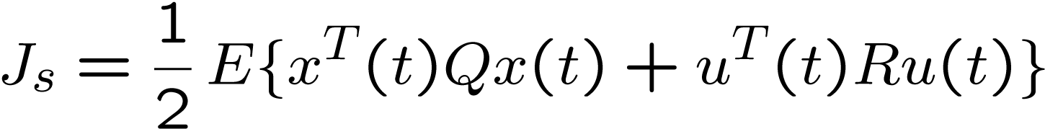
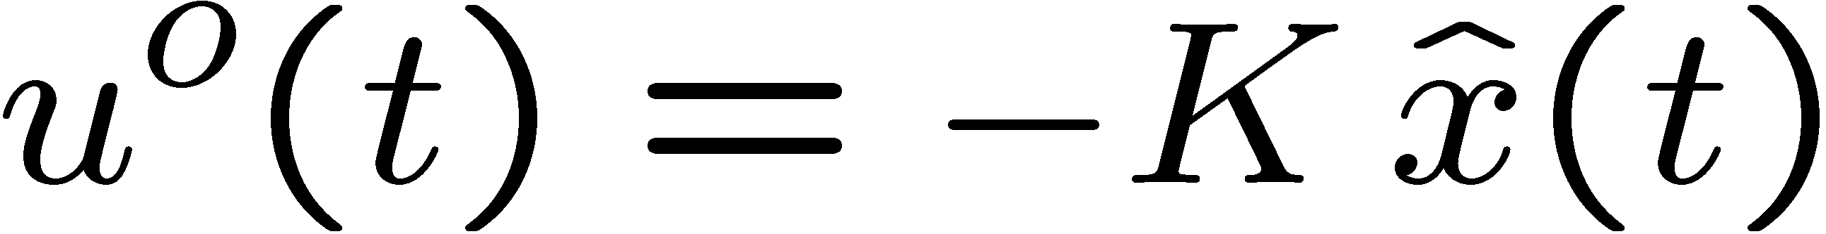
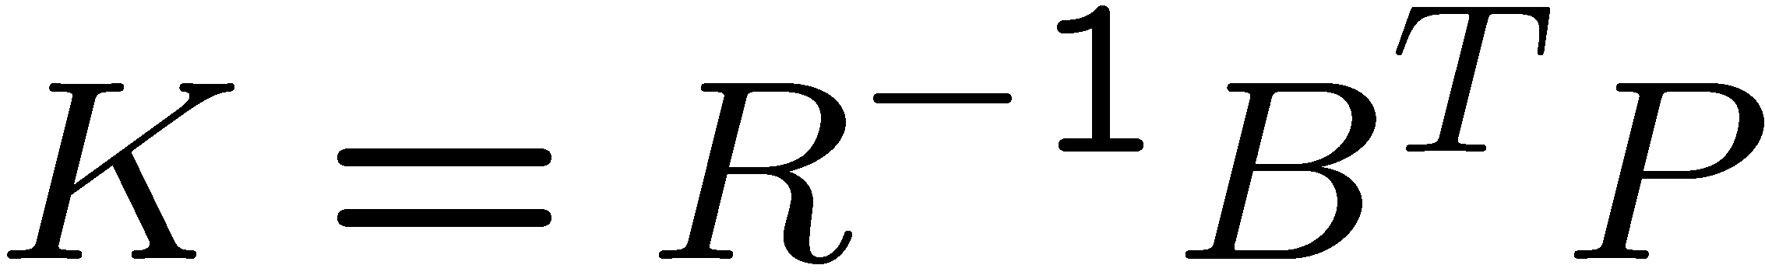
Continuous time stationary LQG
Cost:
Optimal control:
Where the gain is obtained from the solution of the steady state LQR

Slide 3
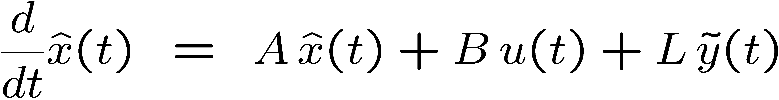
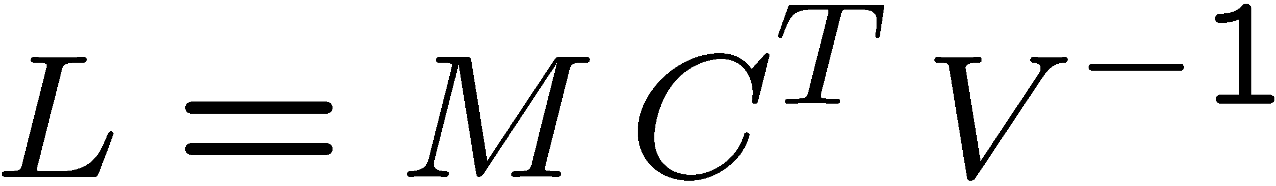
Stationary LQG
Solution:
Kalman Filter Estimator:

Slide 4
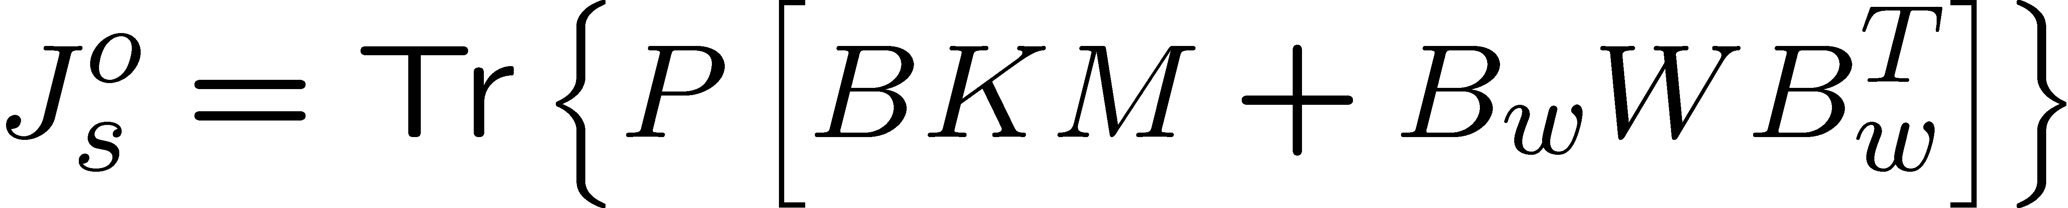
Stationary LQG
Solution:
Optimal cost:

Slide 5
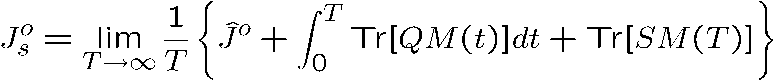
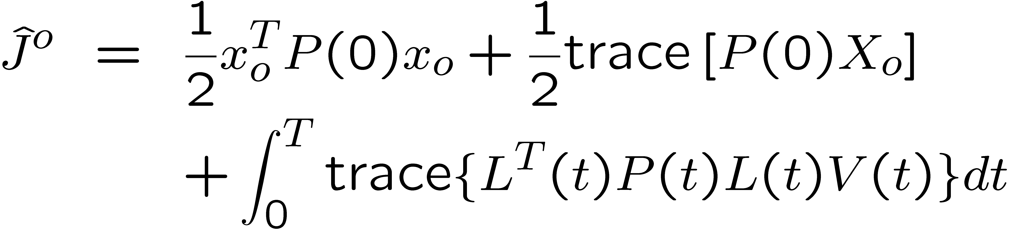
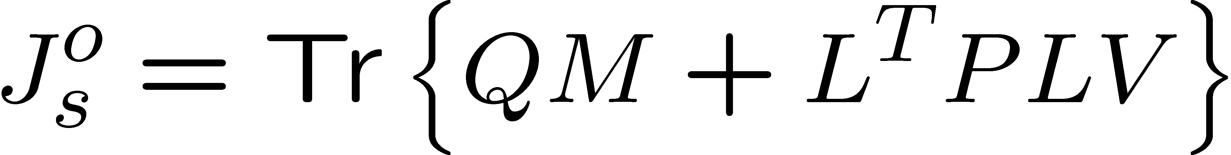
Stationary LQG
Optimal cost (derivation)
The incremental optimal cost is
Thus

Slide 6
Stationary LQG
Optimal cost (derivation)
Note:

Slide 7
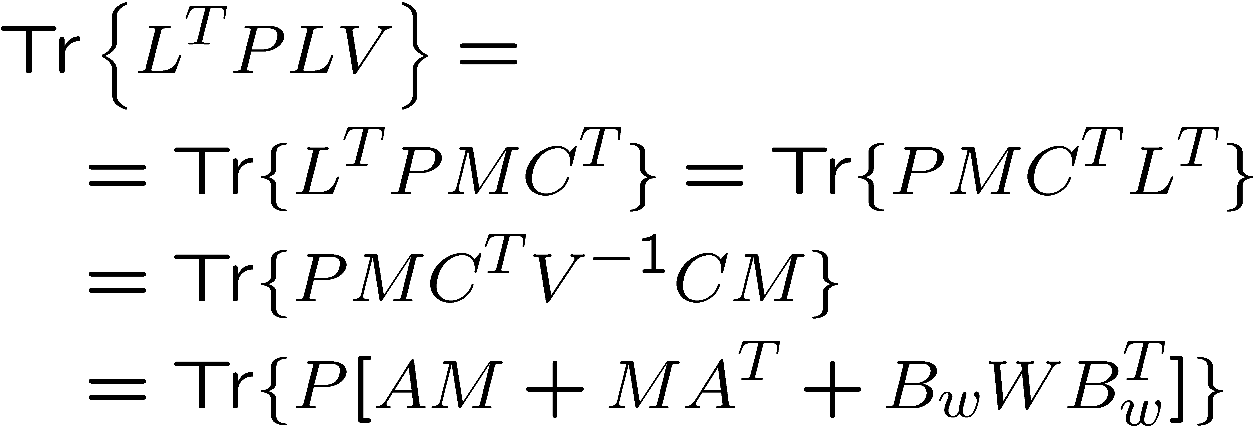
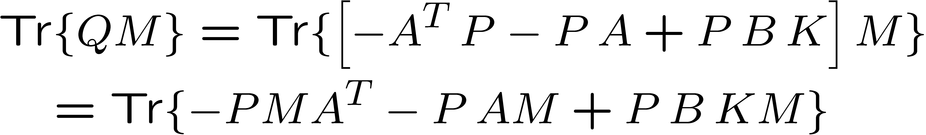
Stationary LQG
Optimal cost (derivation)
last term:
first term:
Adding:

