Slide 1
ME 233 Advanced Control II Continuous-time results 4 Linear Quadratic Gaussian Loop Transfer Recovery
(ME233 Class Notes pp.LTR1-LTR9)

Slide 2
Outline
Review of Feedback
LQG stability margins
LQG-LTR

Slide 3










Basic Feedback Transfer Functions (TF)
Y(s) is the controlled output
U(s) is the control input
E(s) is error signal fed to the controller
R(s) is the output reference
D(s) is the disturbance input
V(s) is the measurement noise
“true” error signal

Slide 4




Basic Feedback Transfer Functions (TF)
“true” error signal
sensitivity TF
complementary
sensitivity TF

Slide 5
Basic Feedback Transfer Functions (TF)
Frequency domain and singular values:

Slide 6


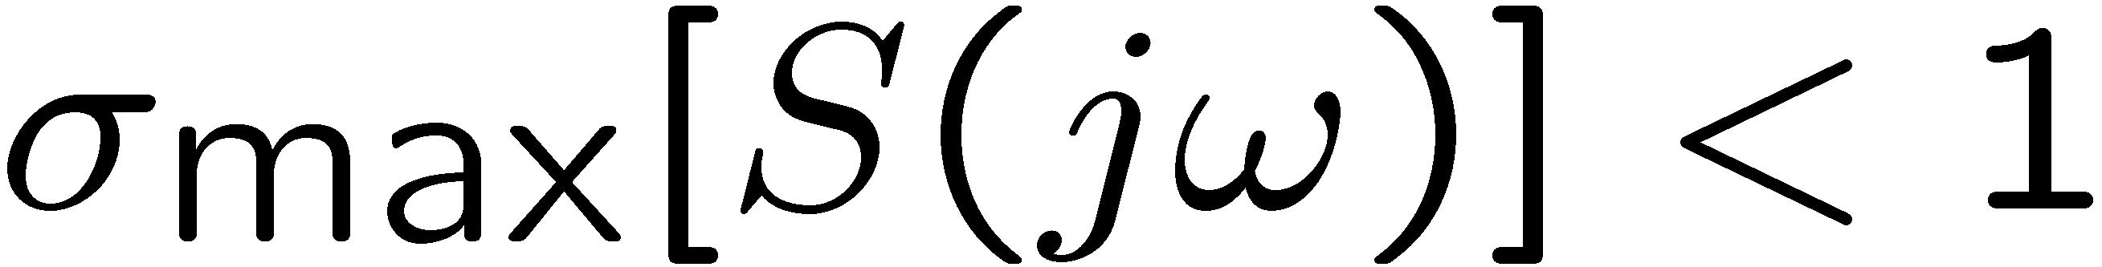

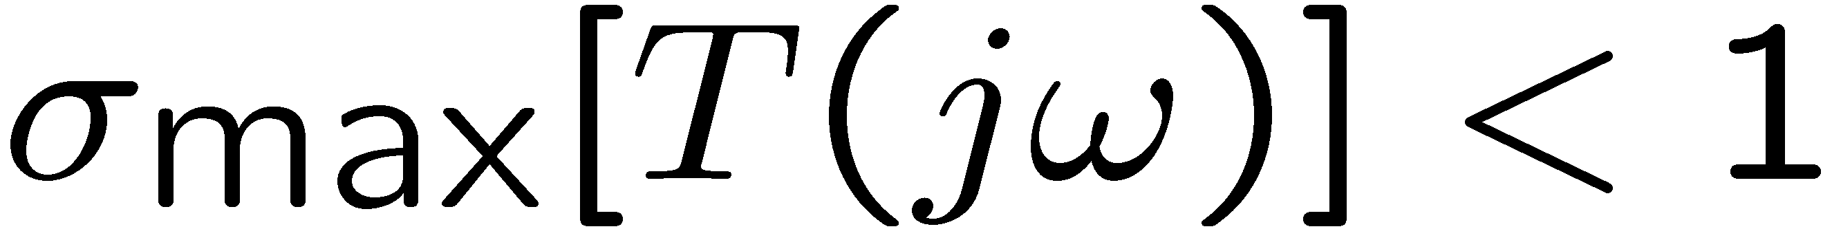
Basic Feedback Transfer Functions (TF)
Frequency domain:
1) and are normally large at low frequencies
at low frequencies
2) and plant model uncertainties are normally large at high frequencies
at high frequencies

Slide 7
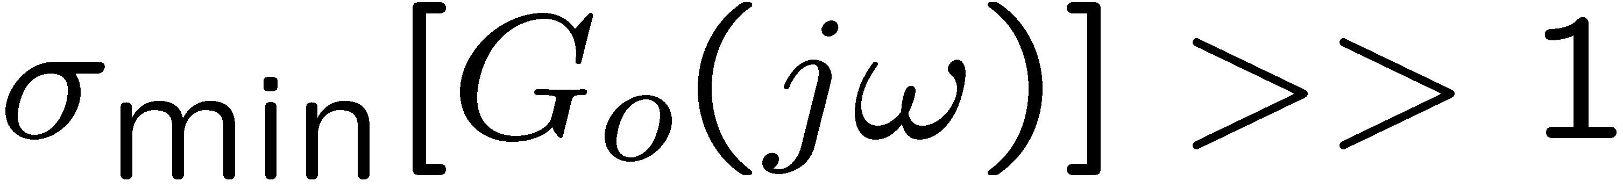
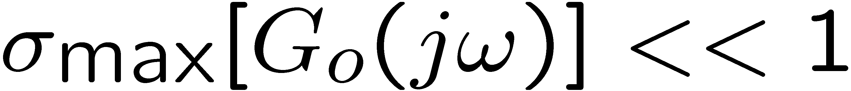

Basic Feedback Transfer Functions (TF)
at low frequencies
at high frequencies
Gain
(SISO)
0 db
low
frequency
constraint
high frequency
constraint

Slide 8
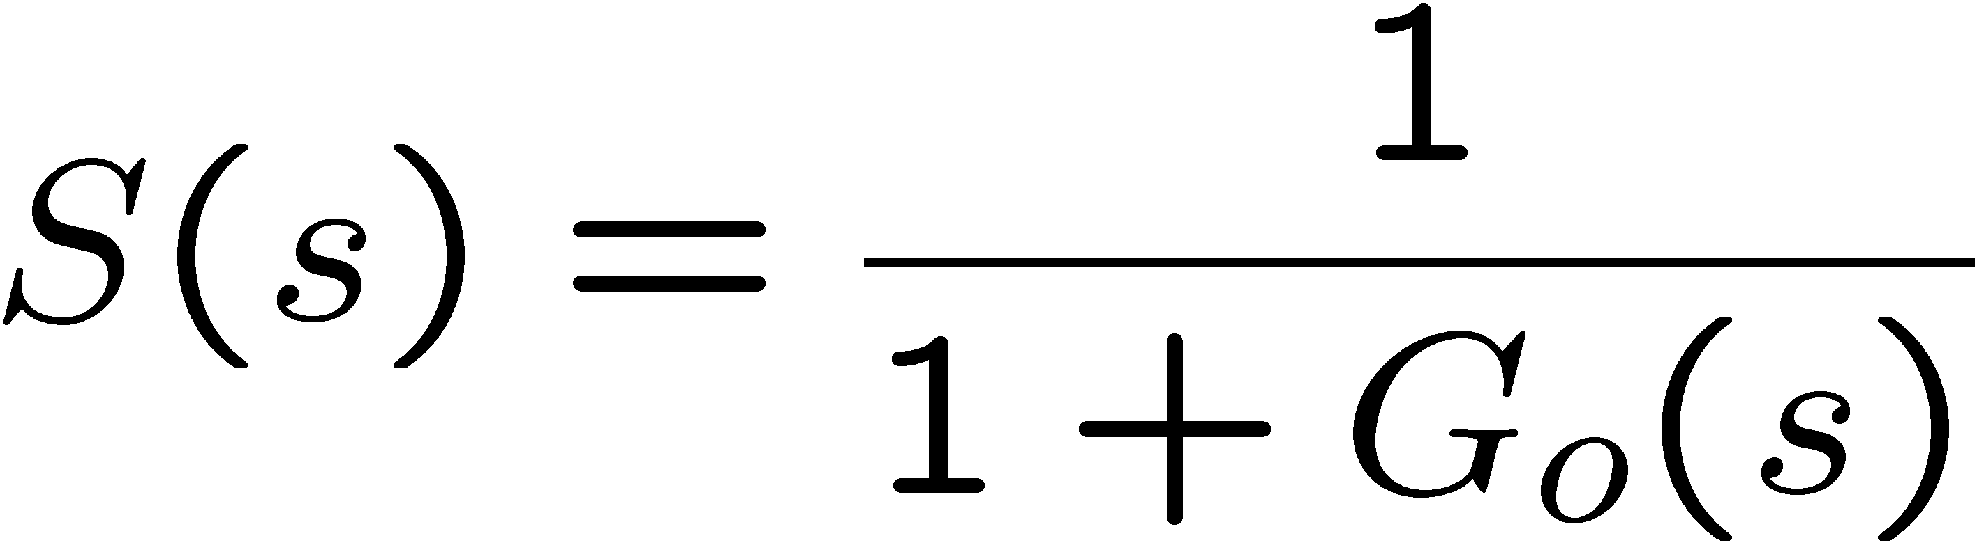
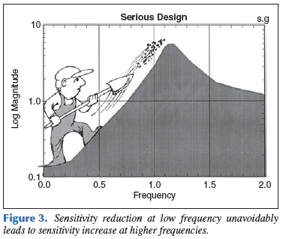
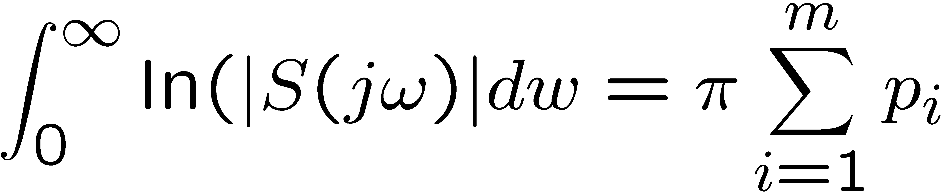
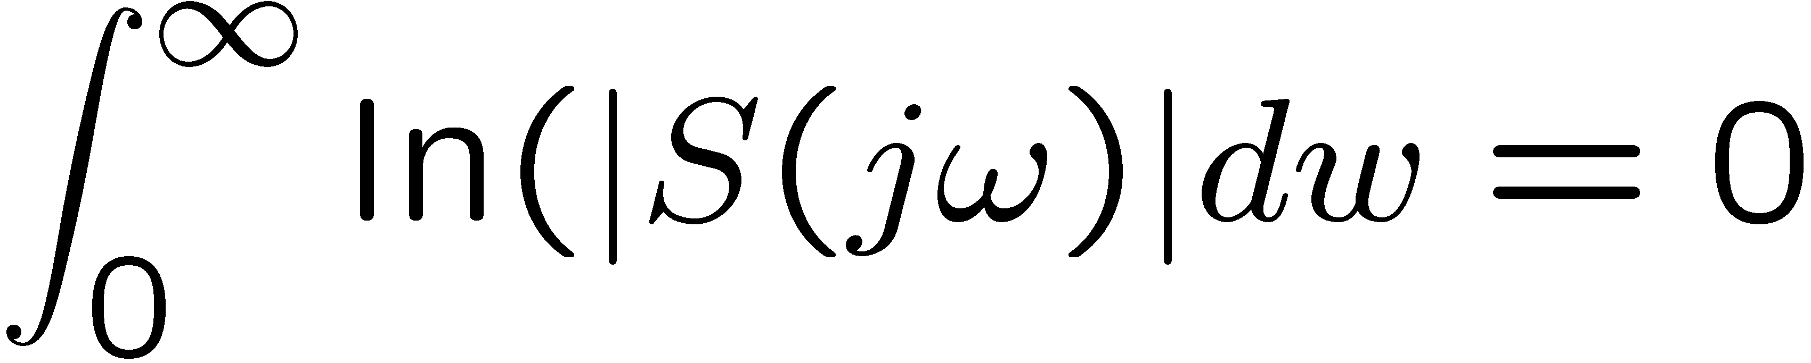
Bode’s integral theorem (SIS0)
Let the open loop transfer function Go(s) have relative degree ≥ 2 and let
p1, p2 , … pm be the unstable open loop poles (right have plane)
When Go(s) is stable,

Slide 9

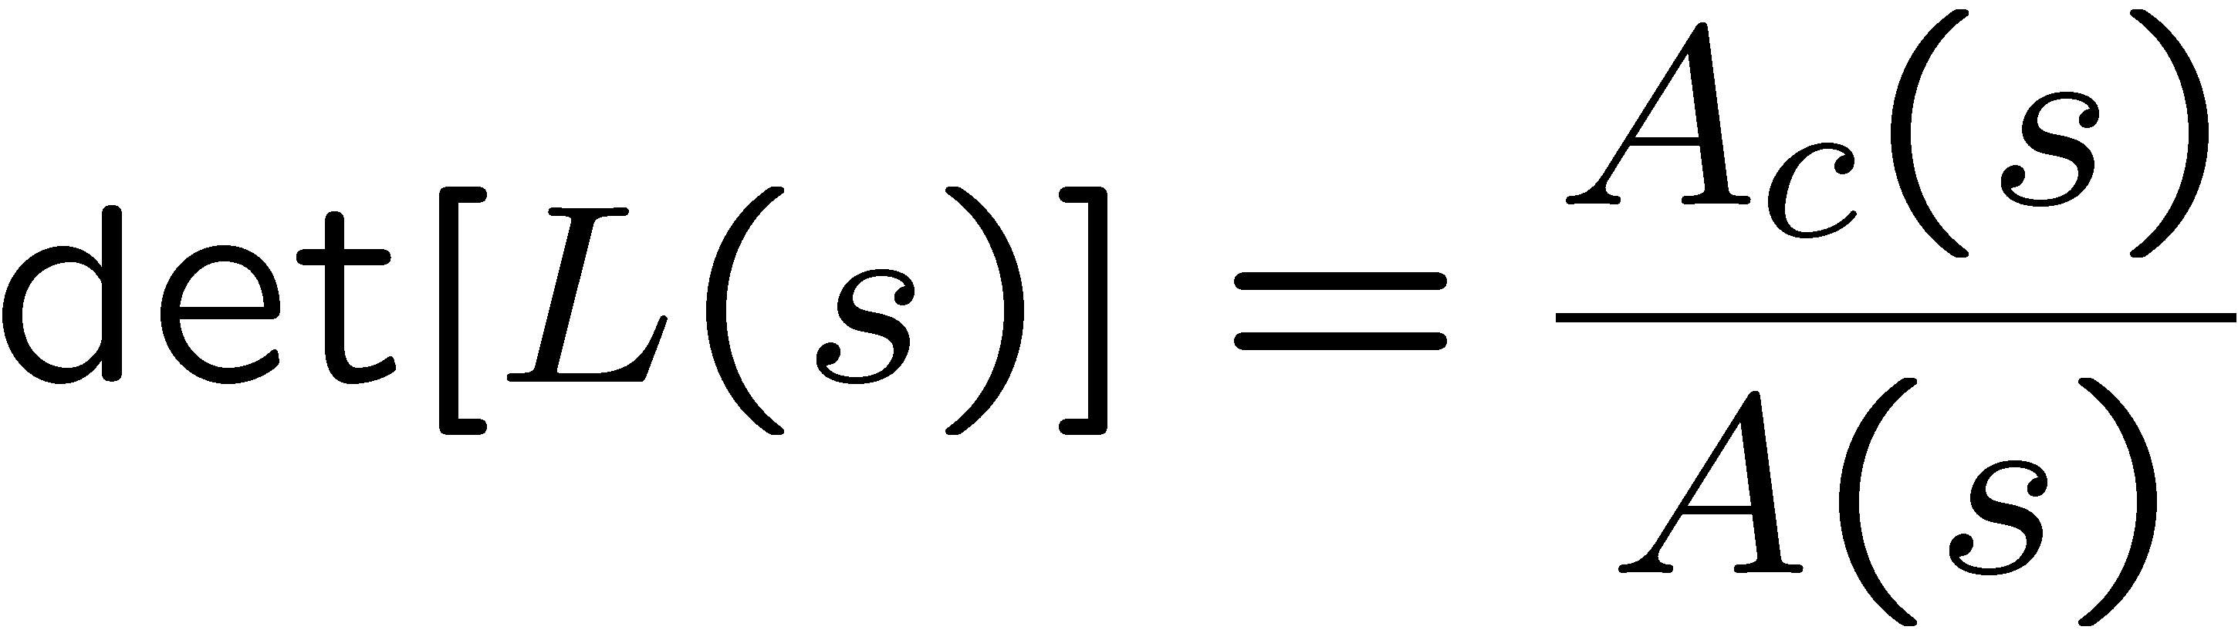

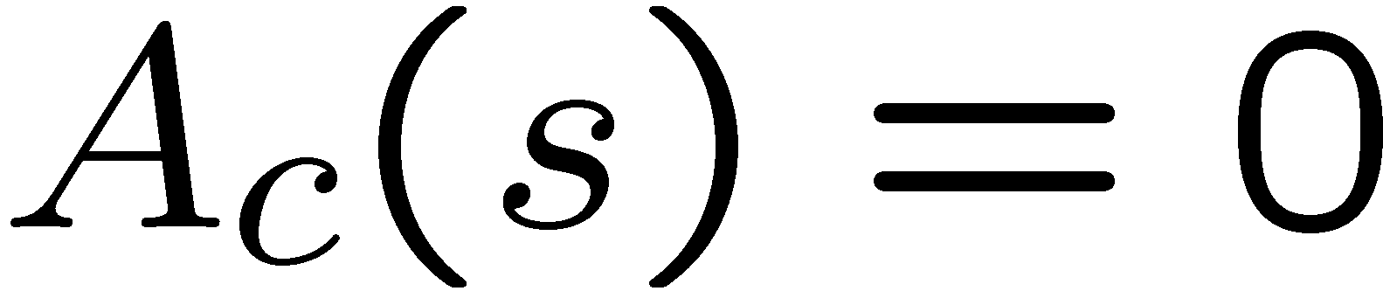




Multivariable Nyquist Stability Criterion
return difference
roots of are the closed loop poles
roots of are the open loop poles
Nyquist path D
roots of : number of counterclockwise encirclements around 0
by det[ L(s) ] when s is along the Nyquist path D

Slide 10
Multivariable Nyquist Stability Criterion
P = # of unstable open loop poles
Z = # of unstable closed loop poles
Nyquist path D
roots of : number of counterclockwise encirclements around 0
by det[ L(s) ] when s is along the Nyquist path D

Slide 11




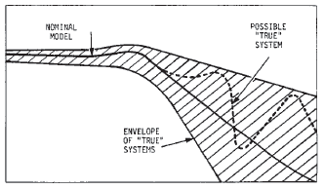


Robust Stability
Nominal closed loop system
(asymptotically stable)
Actual system
: output multiplicative
uncertainty
Feedback system has robust stability
iff
when s is along the Nyquist path D

Slide 12




Robust Stability
robust stability iff
for all
when s is along the Nyquist path D
for all

Slide 13


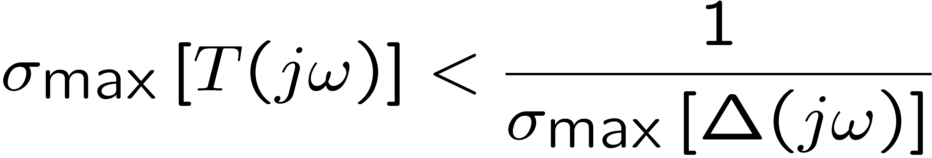
Robust Stability
for all

Slide 14
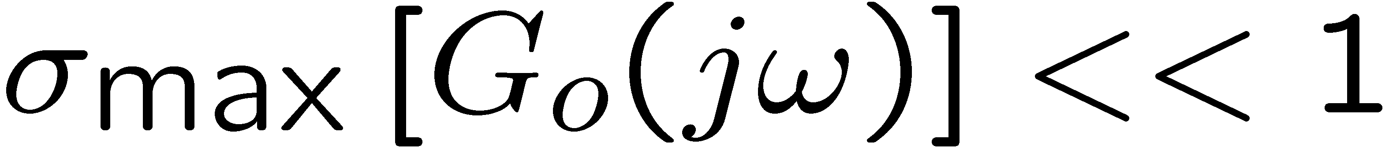
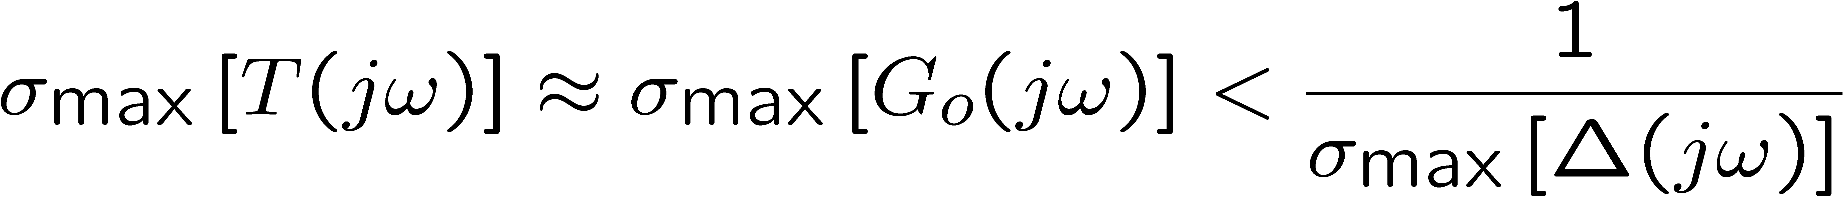
Robust Stability
at high frequencies when ,

Slide 15
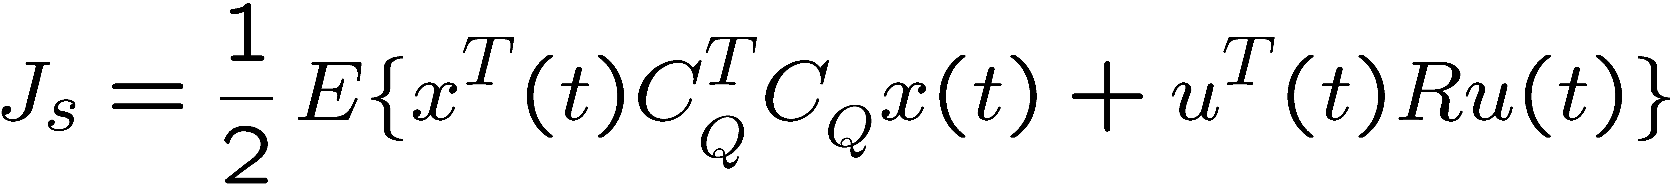
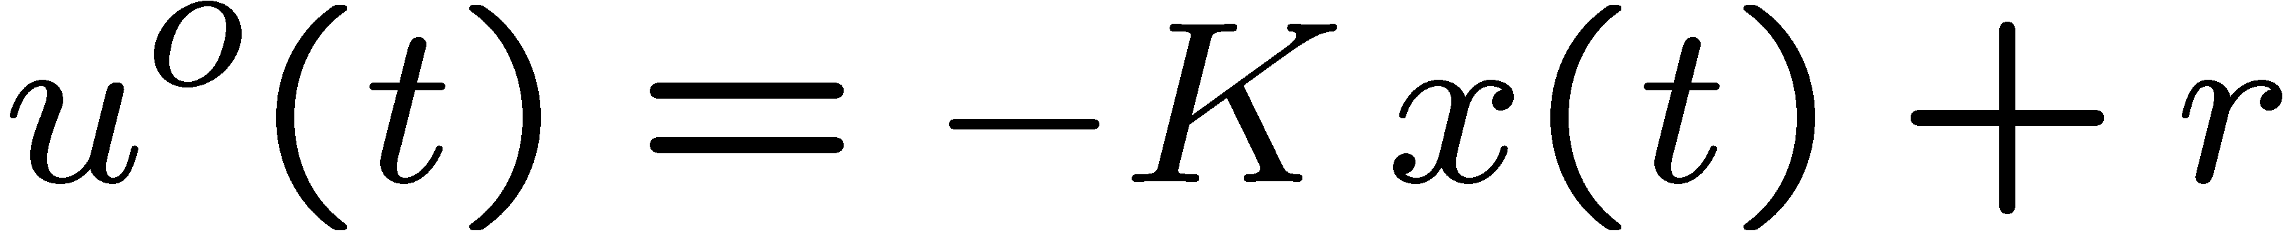

Stationary LQR
Cost:
Optimal control:
Where the gain is obtained from the solution of the steady state LQR

Slide 16
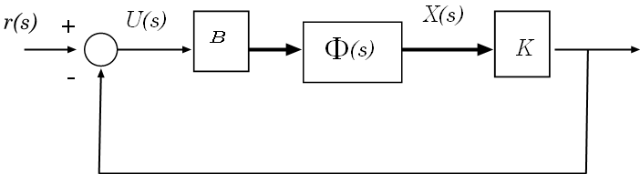

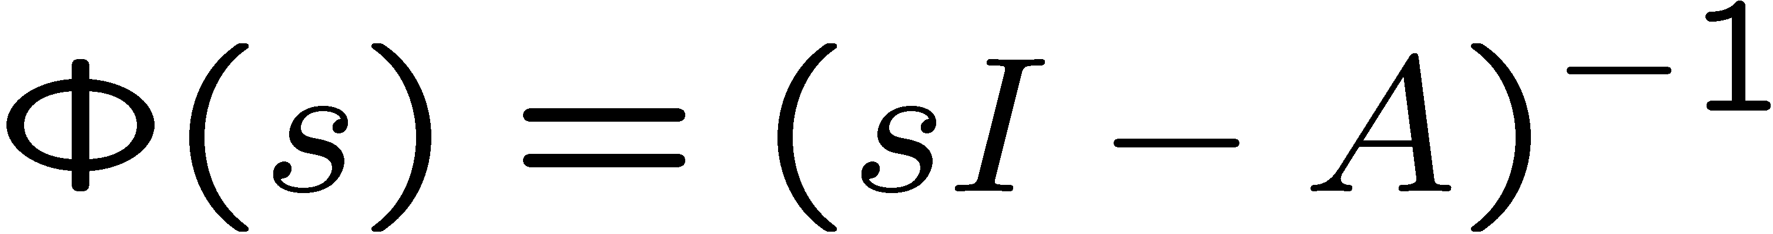


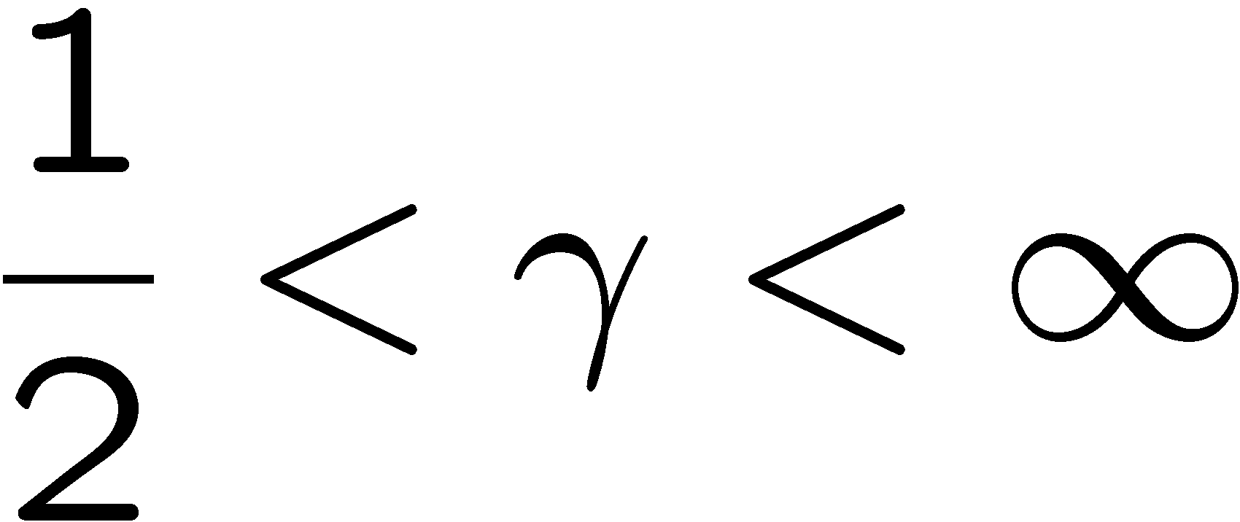
LQR robustness properties
Close loop system
is stable for:
Phase Margin ≥ 60º

Slide 17
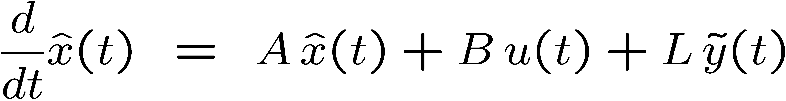
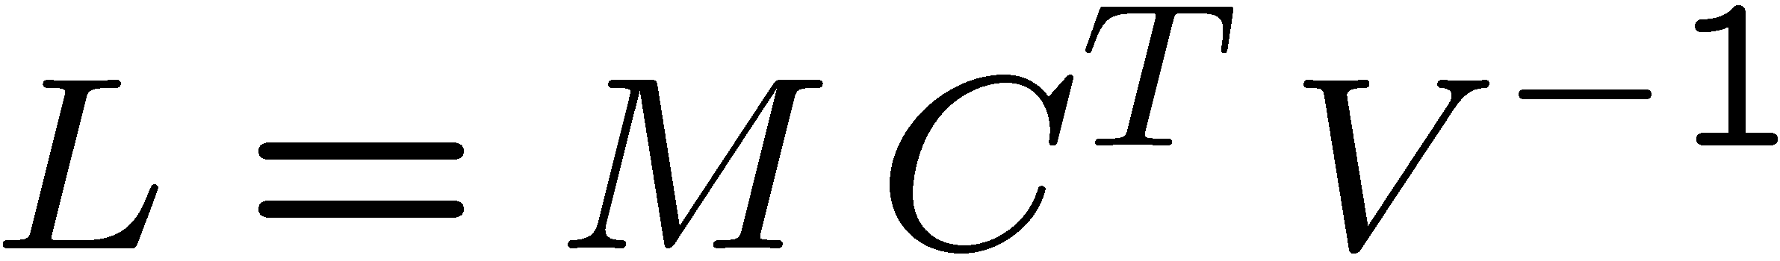
Stationary Kalman Filter
Kalman Filter Estimator:

Slide 18
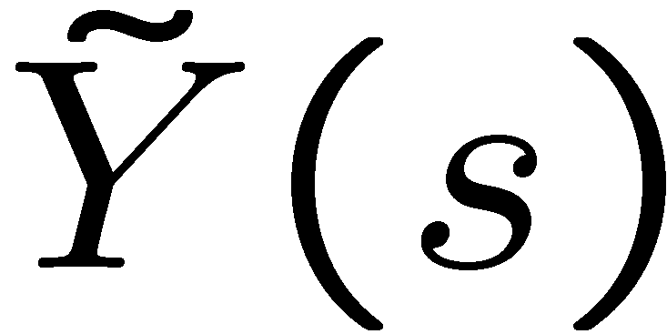
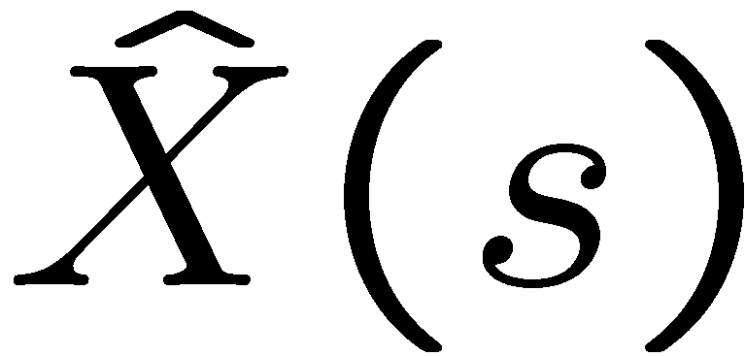


KF dual robustness properties
Close loop system
is stable for:
Phase Margin ≥ 60º

Slide 19
“Fictitious” KF robustness properties
Close loop system
is stable for:
Phase Margin ≥ 60º

Slide 20
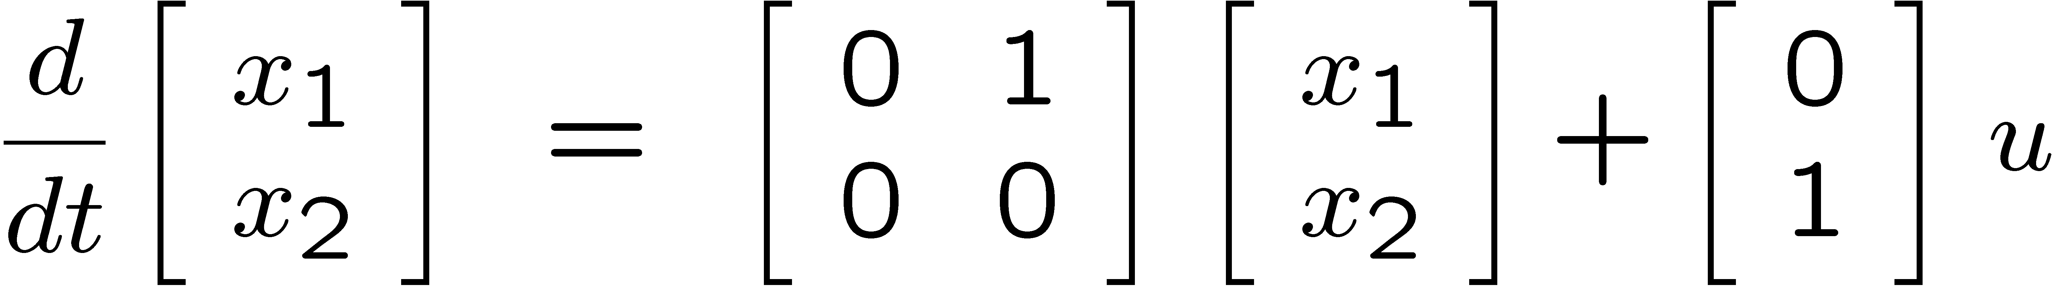
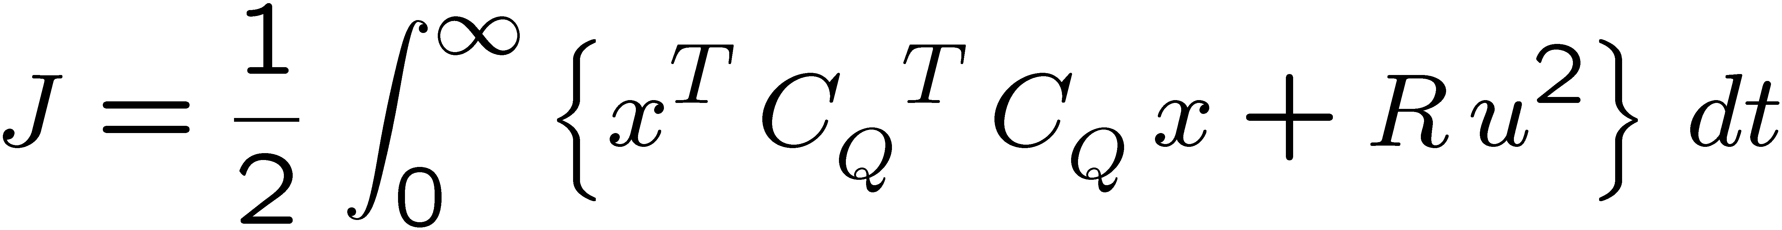
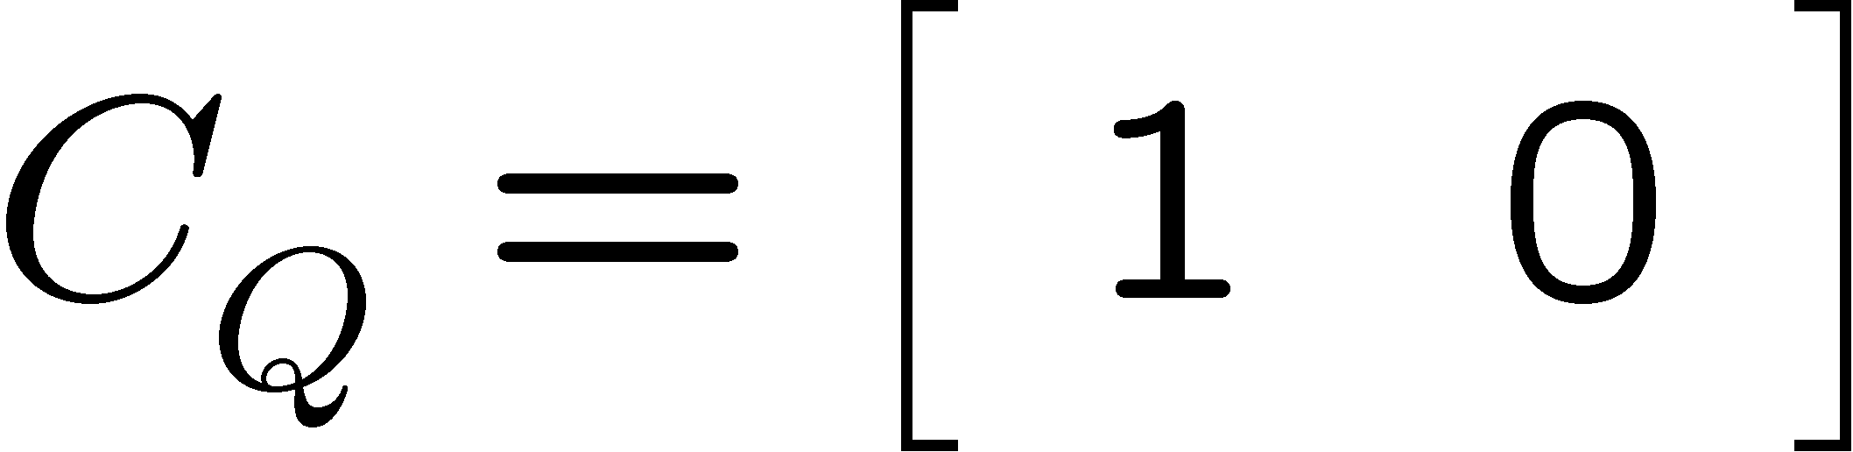

LQR example 1
Double integrator (example in pp ME232-143):
with
Only position is penalized

Slide 21
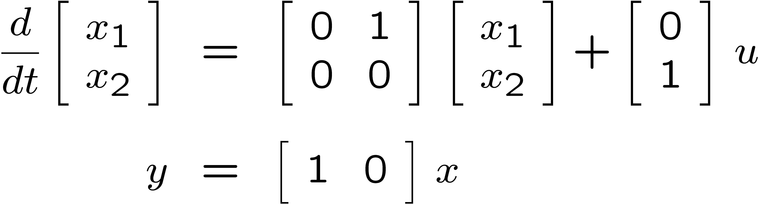
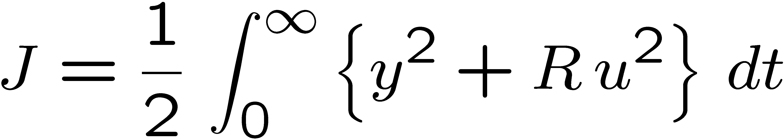
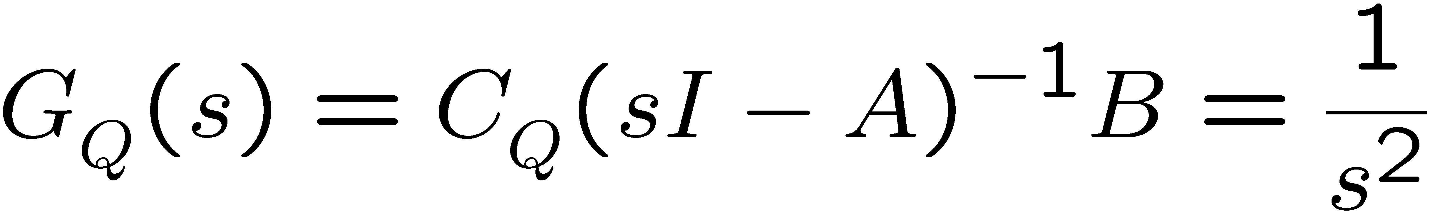
LQR example 1
Double integrator (example in pp ME232-143):

Slide 22
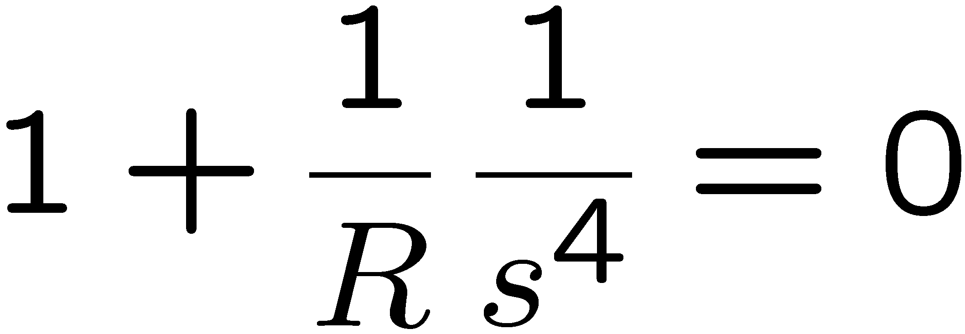


LQR example 1 close loop poles
Double integrator (example in pp ME232-143):

Slide 23



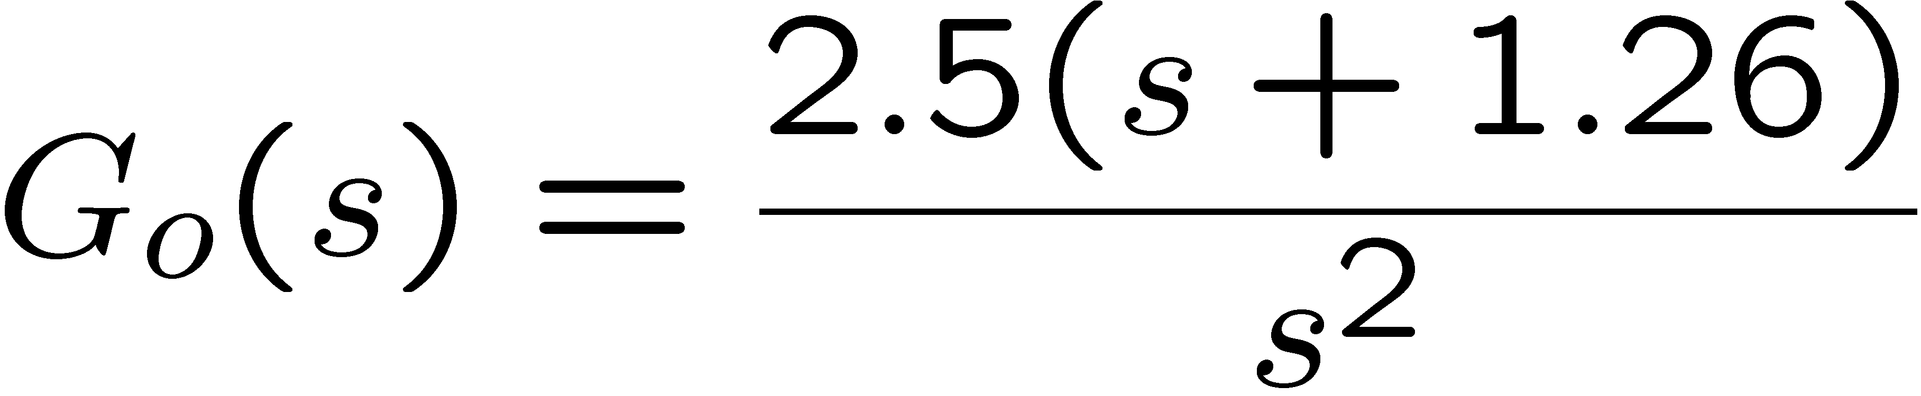

LQR example 1 margins

Slide 24
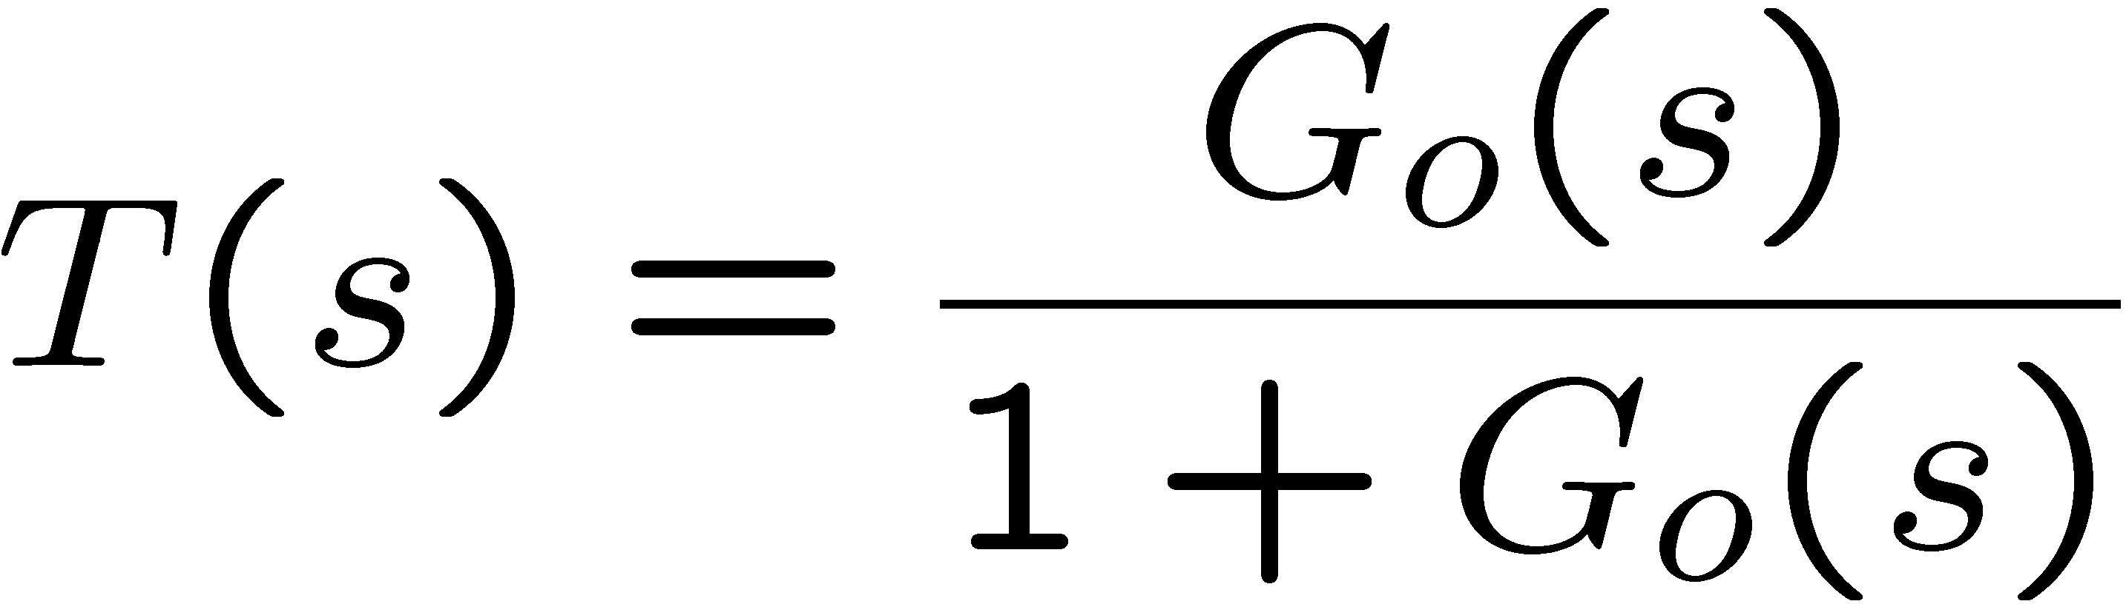
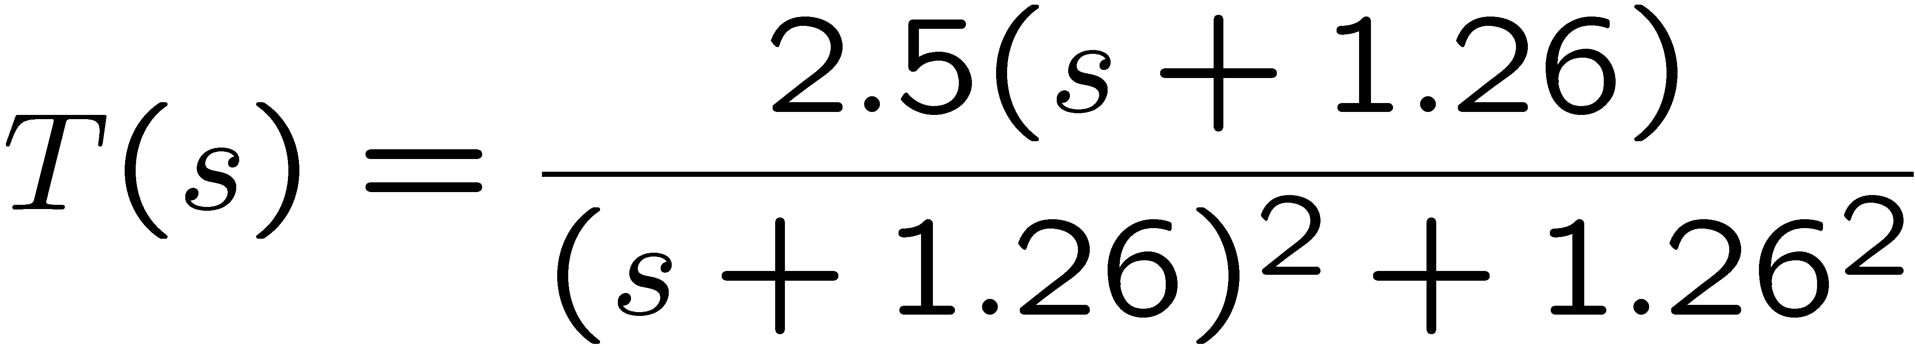
LQR example T(s)

Slide 25
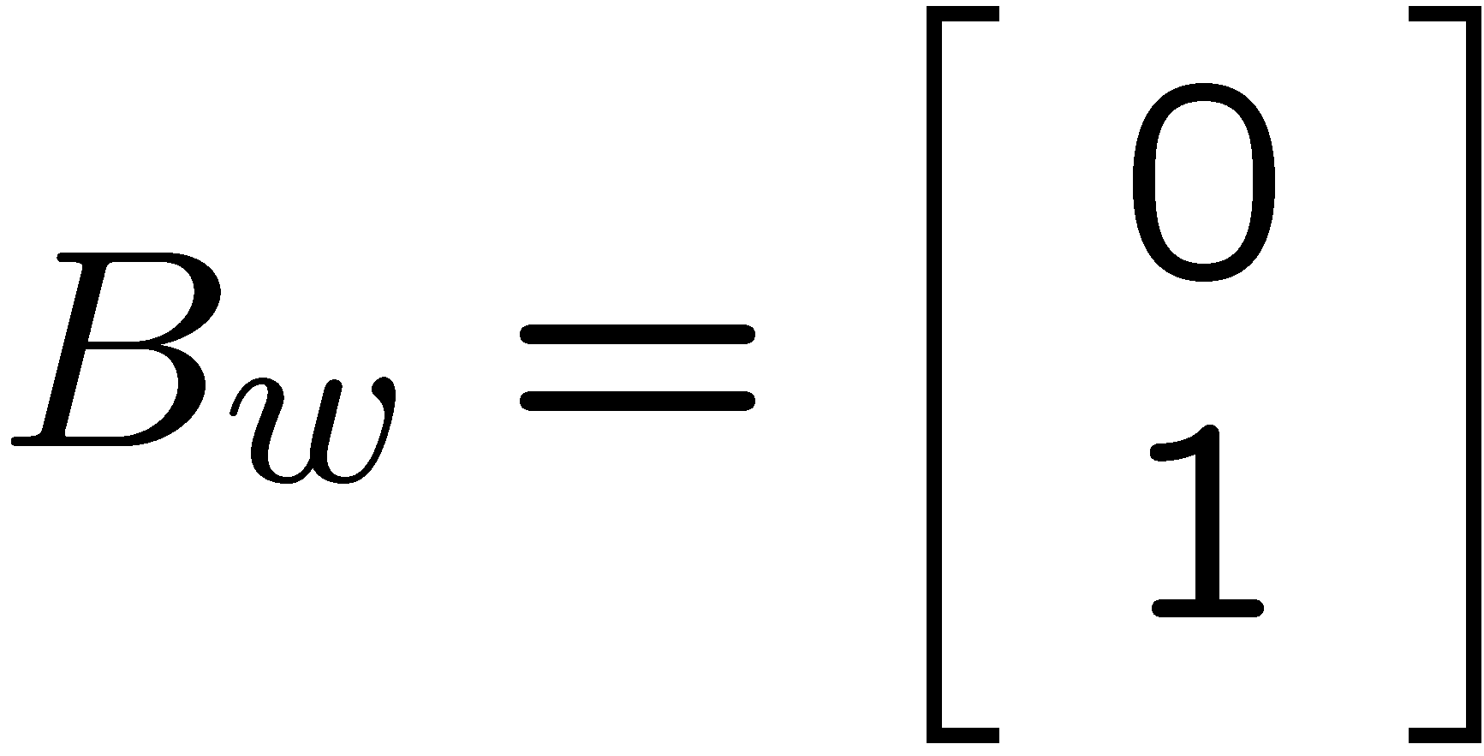



Fictitious KF Feedback Loop example 1
Controller design parameters B_{w}, W, V are chosen
KF return difference equality = LQR return difference equality

Slide 26


Fictitious KF example 1 margins

Slide 27
LQR example 1 margins

Slide 28
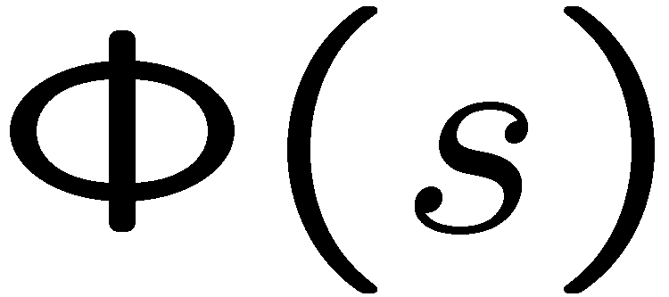
Stationary LQG

Slide 29
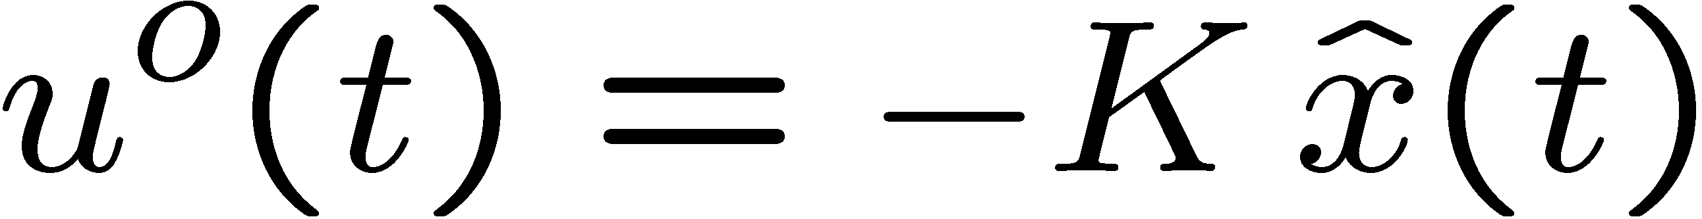
Stationary LQG
Cost:
Optimal control:
Where the gain is obtained from the solution of the steady state LQR

Slide 30
Stationary LQG
Kalman Filter Estimator:

Slide 31





Stationary LQG Compensator
-

Slide 32

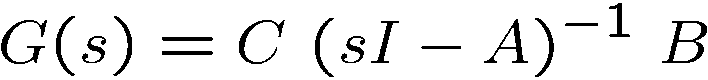
LQG Loop Transfer

Slide 33





LQG Robustness Margins?
-
Unfortunately, there are no guaranteed robustness
margins results for a general LQG controller

Slide 34
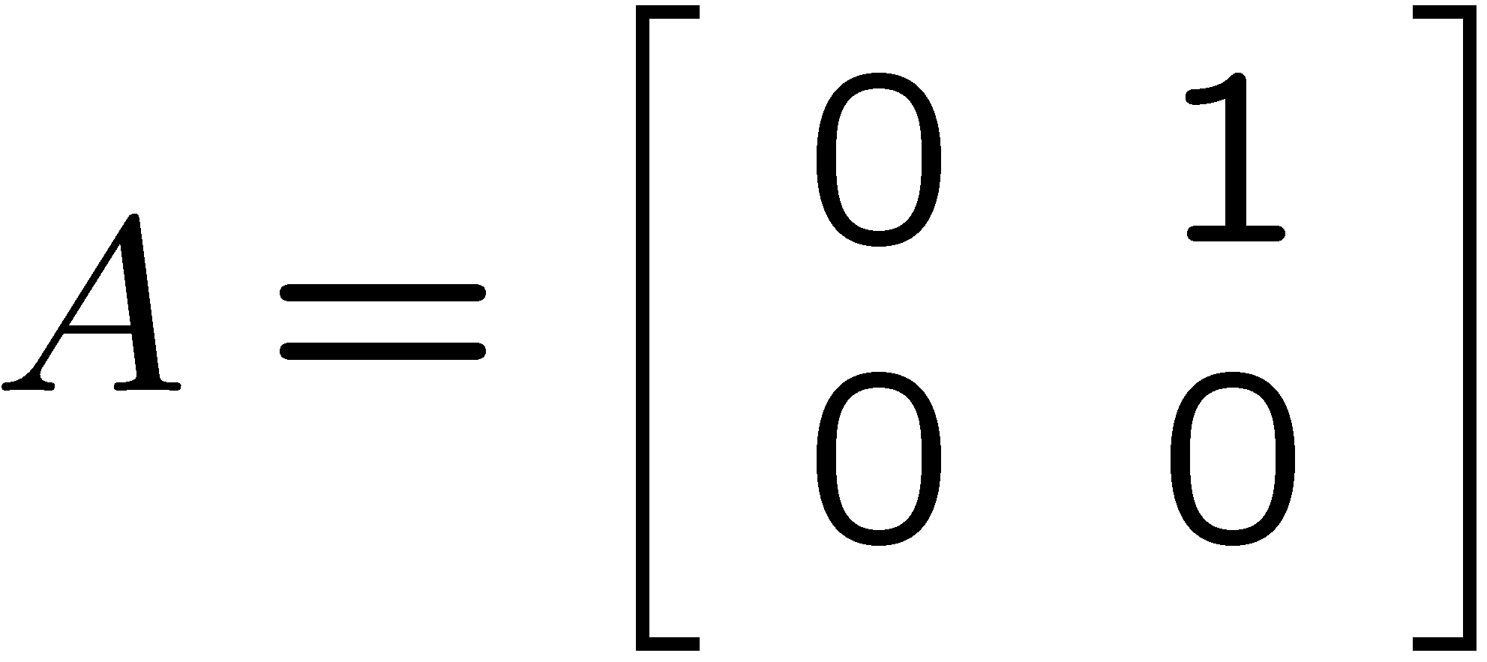
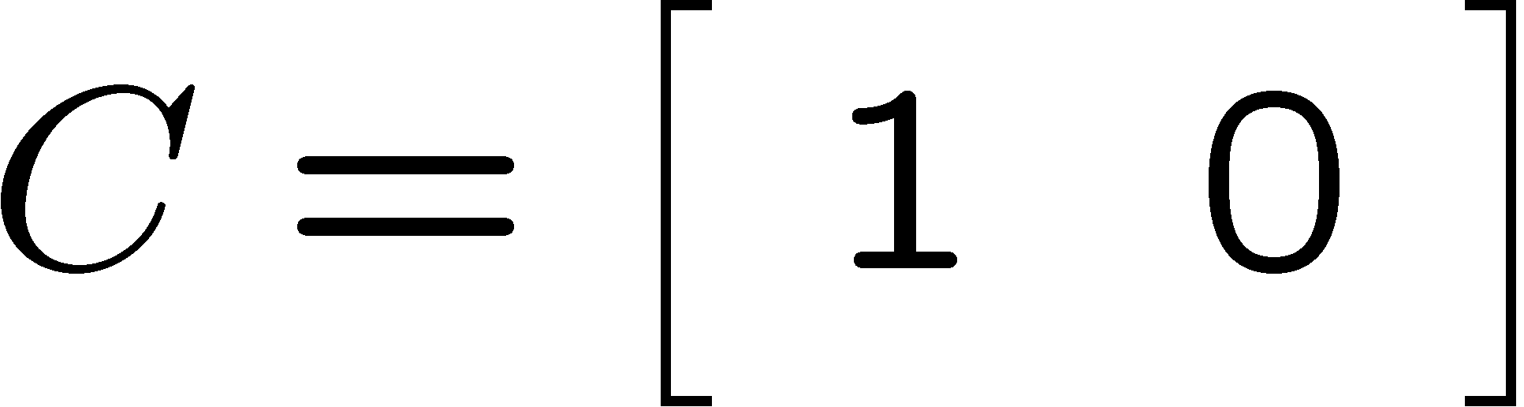
Example -1 Double integrator

Slide 35
LQG example 1
Double integrator (example in pp ME232-143):
with

Slide 36



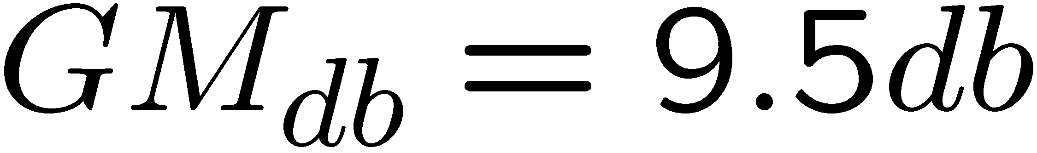

LQG example 1 margins
-
Margins
could be much worst!

Slide 37
LQR example 1 margins

Slide 38
Fictitious KF Feedback Loop example 1

Slide 39
LQG – Loop Transfer Recovery
LQG-LTR was developed by Prof. John Doyle (when he was a M.S. student at MIT).
`Guaranteed margins for LQG regulators,'' J. Doyle, IEEE Trans. on Auto. Control (T-AC), August, 1978.
``Robustness with observers,'' J. Doyle and G. Stein, IEEE T-AC, August, 1979.

Slide 40
John Doyle
Other important contributions in Robust Control
`State-space solutions to standard H2 and H∞ optimal control problems,'' J. Doyle, K. Glover, P. Khargonekar, and B. Francis, IEEE T-AC, August, 1989 (Outstanding Paper Award Winner and Baker Prize Winner).
``Analysis of feedback systems with structured uncertainty (μ),''
J. Doyle, IEE Proceedings, V129, Part D, No.6, November, 1982.

Slide 41
LQG – Loop Transfer Recovery
LQG-LTR is a robust control design methodology that uses the LQG control structure
LQG-LTR is not an optimal control design methodology.
LQG-LTR is not even a stochastic control design methodology.
A fictitious Kalman Filter is used as a robust control design methodology.
Output noise intensity and input noise vector
(V & B_{w}) are used as design parameters – not true noise parameters.

Slide 42
Stationary LQG Compensator
-

Slide 43


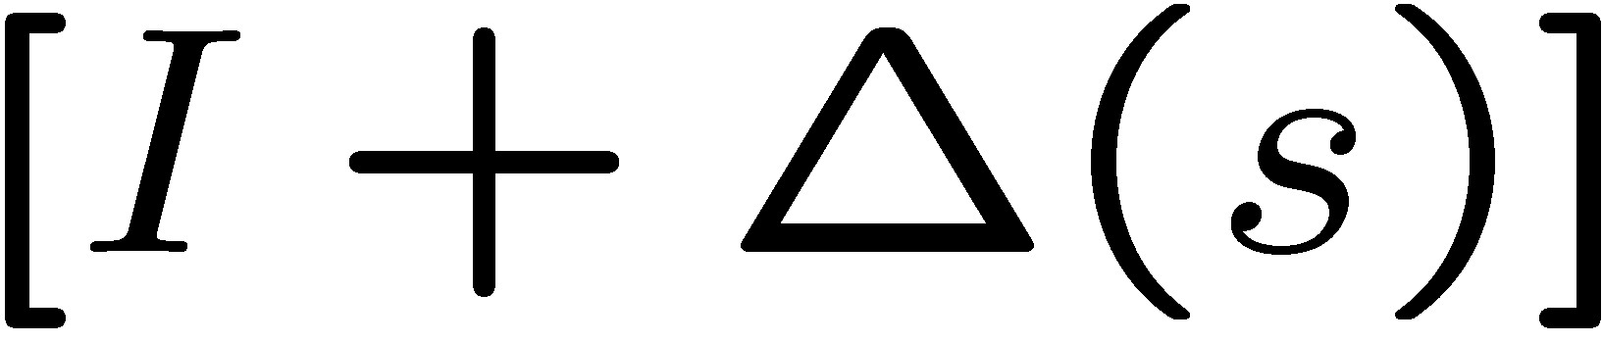

LQG-LTR Method 1
How to make an LQG compensator structure robust to unmodeled output multiplicative uncertainties
is a multiplicative uncertainty which is stable and bounded, i.e.

Slide 44


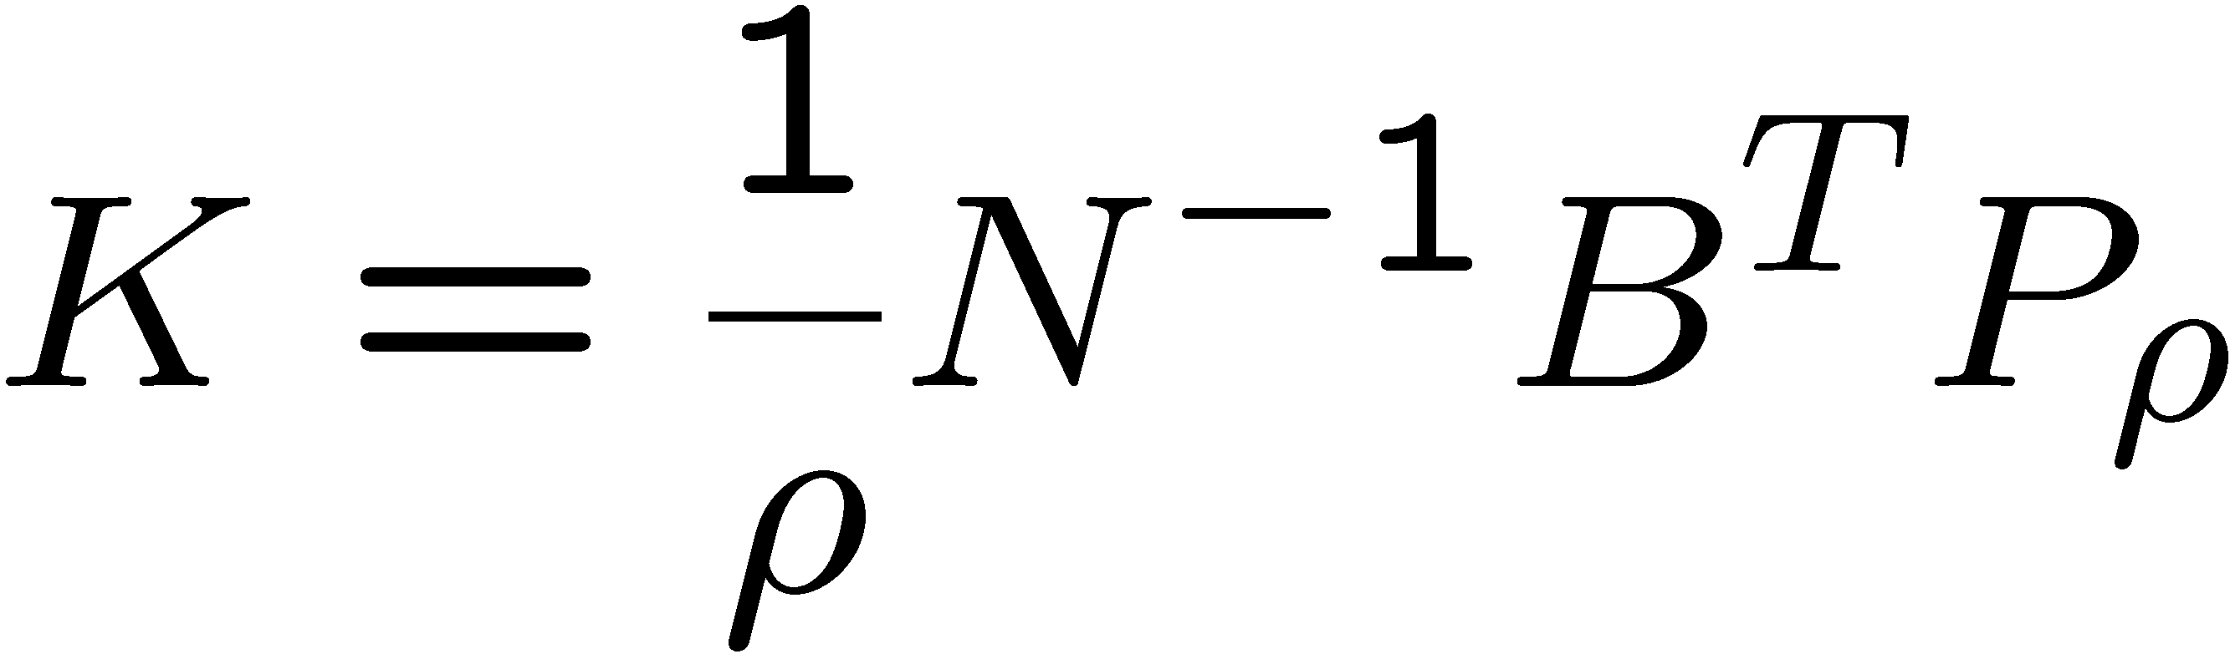
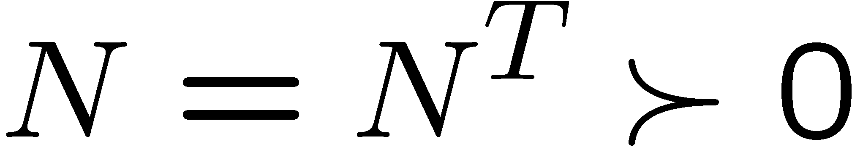

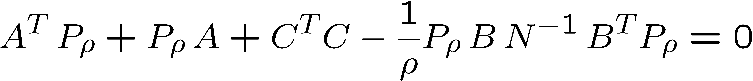
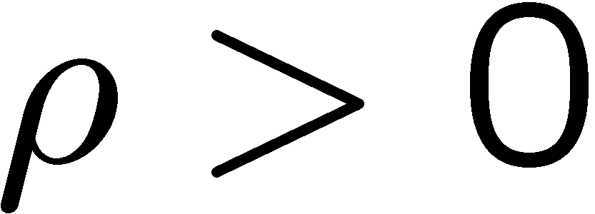
LQG-LTR Theorem 1
Let where
And let be the state feedback gain that is obtained as follows
make LQR weight: C_{Q} = C

Slide 45


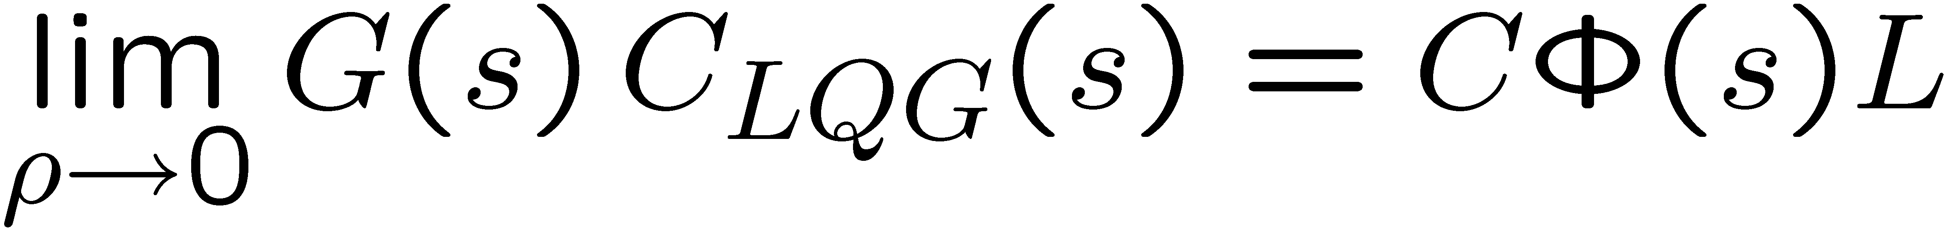
LQG-LTR Theorem 1
-
Under the assumptions in the previous page
If is square and has no unstable zeros, then point-wise in s

Slide 46
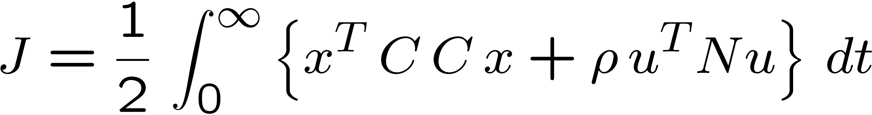
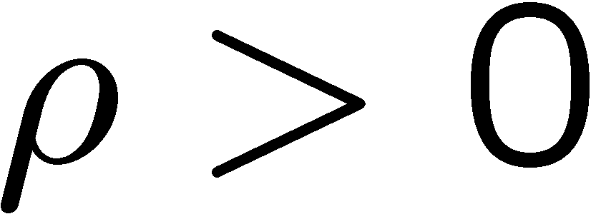
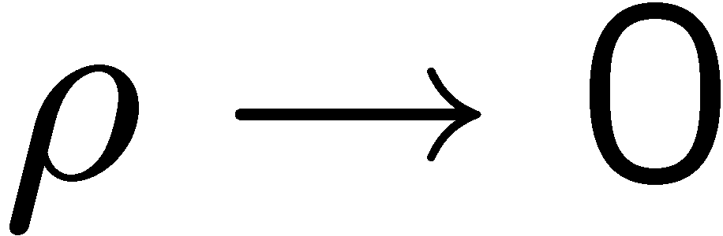
LQG-LTR Theorem 1
is the state feedback solution of the following LQR
C is the state output matrix in:
which is made very small, i.e.
“cheap” control LQR

Slide 47

LQG-LTR Method 1
“cheap” control LQR
: C_{Q} = C

Slide 48



LQG-LTR-Method 1
Make it approximate
(point-wise in s)

Slide 49
Fictitious KF is the target system
Since the LTR procedure achieves:
We need to determine the observer feedback L so that the target system has desirable properties
More on this later

Slide 50
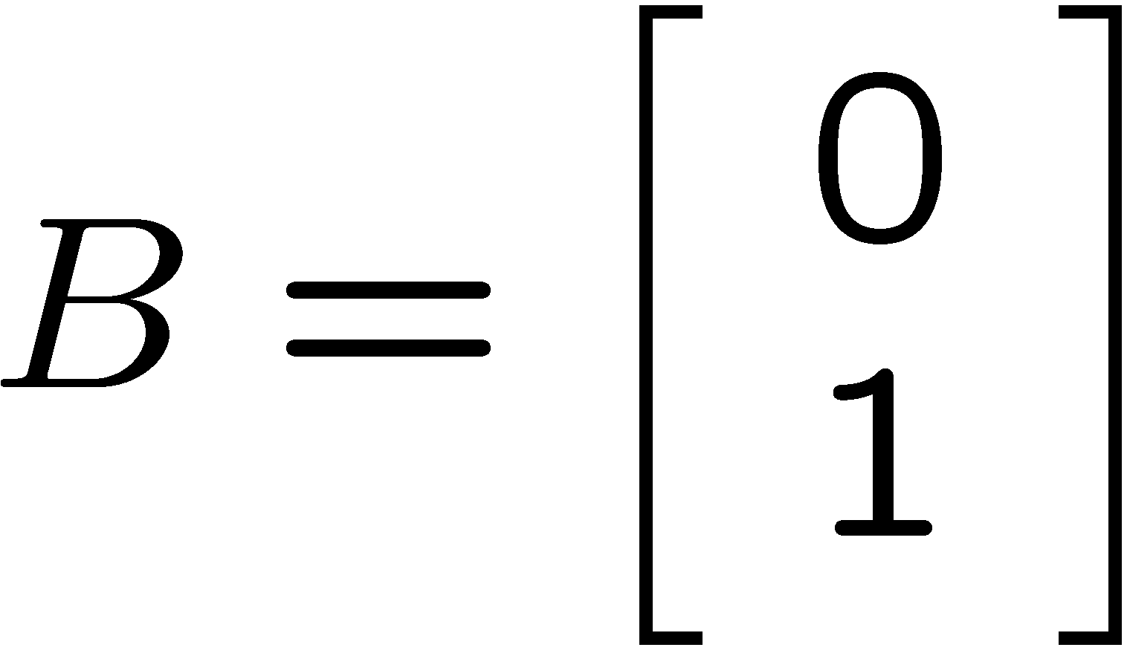

Example -1 Double integrator
no unstable zeros

Slide 51


Design fictitious KF Target System
Design Parameters:
ratio adjusts
gain crossover
frequency

Slide 52


LTR procedure for computing
1) For a small compute:
where P_{ρ} is the solution of
2) Check if
otherwise, decrease and repeat the process.

Slide 53
LQG-LTR-Method 1
Make it approximate
(point-wise in s)

Slide 54





LQG-LTR KF example 1

Slide 55



Fictitious KF design parameters
Select B_{w}, W, and V as design parameters to shape the open loop transfer function

Slide 56





Fictitious KF Feedback Loop
Sensitivity and Complementary sensitivity Transfer Functions:

Slide 57







Simplify fictitious noise covariance description
only the ratio
W/V
is important
µ: measurement noise
standard deviation
KF gain L is calculated by:

Slide 58


Simplify fictitious noise covariance description
KF gain L is calculated by:
Return difference equality:

Slide 59



Fictitious KF Feedback Loop Design
affects zeros of
G_{w}(s)
Design parameters:
Fictitious input noise input vector:
Fictitious output noise standard deviation:
(affects bandwidth of close loop system)
Design equation: (return difference equation)
i^{th} singular value

Slide 60




Fictitious KF Feedback Loop Design
Designer-specified shapes:
(generally at low frequency)
When
use B_{w} to place zeros of G_{w}(jω)

Slide 61




Fictitious KF Feedback Loop Design
2. High frequency attenuation:
As
(gain Bode plot has -20 db/dec slope)

Slide 62



Fictitious KF Feedback Loop Design
3. Well-behaved crossover frequency :
Sensitivitiy and complementary sensitivity TFs never become too large (even in the vicinity of the gain crossover frequency)

Slide 63




Fictitious KF Target Design
Goal: “Shape” the fictitious KF open loop transfer function
Design parameters:
places zeros of
adjusts gain crossover frequency of

Slide 64







Example 1 – double integrator

Slide 65





Example 1: selection of B_{w}
-40 db/dec
-20 db/dec
sets the location of the zero

Slide 66

Example 1: selection of B_{w}
In this example we will set
-40 db/dec
B_{w1} = 0

Slide 67





Example 1: selection of µ
µ: adjusts gain crossover
frequency of
In this example we will set

Slide 68
Example 1: selection of µ
Designer-specified shapes:
(low frequencies)

Slide 69
Example 1: selection of µ
2. High frequency attenuation:
(gain Bode plot has
-20 db/dec slope)

Slide 70


Example 1: selection of µ
3. Well-behaved crossover
frequency:

Slide 71


Example-2: Unstable Plant
-40 db/dec
no unstable zeros

Slide 72



Example-2: I-action
Introduce I-action to achieve 0 steady-state error to constant reference input
Define I-action extended system
integrator dynamics to implement I-action

Slide 73



Example-2: I-action
Define I-action extended system

Slide 74





Example-2: I-action
I-action extended system

Slide 75



Example-2: selection of B_{w}
Design parameter:
We can “place” two zeros of G_{w}(s)
remember that, at low frequencies,

Slide 76



Example-2: selection of B_{w}
Example:
Place two zeros of G_{w}(s)
at

Slide 77




Example-2: selection of µ
e
e
e
Example:
Designer-specified shapes:
(low frequencies)
for

Slide 78






Example-2: selection of µ
e
e
e
Example:
-20 db/dec
2. High frequency attenuation:

Slide 79


Example-2: Fictitious KF Design
e
e
e
Example:
3. Well-behaved crossover frequency:
step response of T(s)

Slide 80



Example-2: selection of B_{w}
e
e
e
Close loop poles: As
Symmetric root locus:
2 close loop poles converge to the zeros of G_{w}(s)
The reminder pole goes to -∞

Slide 81



Example-2: selection of B_{w}
e
e
e
Return difference:
fictitious KF
close loop poles
Symmetric root locus:
We have the freedom to specify the location of the zero polynomial B_{w}(s)

Slide 82


Example-2:Fictitous KF Target Design
Open loop zeros

Slide 83



Example-2: LQG-LTR recovery
e
e
e
e
e
e
e
Use on extended system (including integrator dynamics)
Keep decreasing until

Slide 84






Example-2: LQG-LTR
-
Keep decreasing until

Slide 85
Example-2: LQG-LTR
-
Keep decreasing until
Step Responses
target
LQG-LTR

Slide 86
LQG-LTR Method 2
How to make an LQG compensator structure robust to unmodeled input multiplicative uncertainties
is a multiplicative uncertainty which is stable and bounded, i.e.

Slide 87




LQG-LTR Theorem 2
Let where
And let be the Kalman Filter feedback gain that is obtained as follows

Slide 88


LQG-LTR Theorem 2
-
Under the assumptions in the previous page
If is square and has no unstable zeros, then point-wise in s

Slide 89


LQG-LTR Theorem 2
is the Kalman Filter gain solution of the following filtering problem
which is made very small, i.e.
“noiseless” output measurement

Slide 90

LQG-LTR Method 2
“noiseless” output measurement

Slide 91
More on LQG-LTR
LTR Theorem Proof: Read ME233 Class Notes, pages LTR-3 to LTR- 5
(also back of these notes)
Fictitious Kalman Filter Design Techniques: Read ME233 Class Notes, pages LTR-6 to LTR- 9
Stein and Athans “The LQG/LTR Procedure for Multivariable Feedback Control Design,” IEEE TAC. Vol. AC-32. NO. 2, Feb 1987

Slide 92
Outline
Continuous time LQR stability margins
Continuous time Kalman Filter stability margins
Fictitious Kalman Filter
LQG stability margins
LQG-LTR

Slide 93



LQG-LTR Theorem 1
Assume that:
where
The feedback gain K is satisfies
If is square and has no unstable zeros, then point-wise in s

Slide 94


Notation
For convenience, we define:

Slide 95
Linear Algebra Result
We often use results like:
which can be easily verified by multiplying left and right by the appropriate matrices:

Slide 96
LQG-LTR – Theorem 1 Proof
Proof: The result is obtained in 4 steps:
Step 1: Alternate expression for the LQG compensator
where

Slide 97

Proof of Step 1

Slide 98


LQG-LTR – Theorem 1 Proof
Step 2: Let be given by
where P_{ρ} is the solution of
( LTR procedure for computing )

Slide 99


LQG-LTR – Theorem 1 Proof
If has no unstable zeros
Then as
where T is unitary, i.e.

Slide 100

Lemma: maximally achievable accuracy of LQR
To proof step 2 we use the following lemma from:
Kwakernaak, H. and Sivan, R. “The maximally achievable accuracy of linear optimal regulators and linear optimal filters.” IEEE Transactions on Automatic Control, vol.AC-17, no.1, Feb. 1972, pp. 79-86. USA.
Let P_{ρ} be the solution of the following algebraic Riccati equation
where and is square.
Then
has no unstable zeros if and only if

Slide 101


Sketch of proof of step 2
Rewriting the Riccati equation
and utilizing
results in
Thus,

Slide 102
LQG-LTR - Proof
Step 3: If is square and has no unstable zeros, then as
where

Slide 103
Proof of Step 3
substitute:
0

Slide 104
LQG-LTR – Theorem 1 Proof
Step 4: If is square and has no unstable zeros, then as
where

Slide 105
Proof of Step 4

Slide 106
Proof of Step 4

Slide 107


LQG-LTR Theorem 2
Let:
where
The feedback gain L is satisfies
If is square and has no unstable zeros, then point-wise in s

Slide 108
Proof LQG-LTR Theorem 2
Start with LQG-LTR Theorem 1
Apply LQG – KF duality

