Slide 1
ME 233 Advanced Control II Continuous-time results 5 Frequency-Shaped Linear Quadratic Regulator
(ME233 Class Notes pp.FSLQ1-FSLQ5)

Slide 2
Outline
Parseval’s theorem
Frequency shaped LQR cost function
Implementation

Slide 3
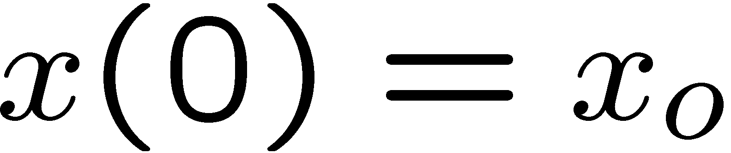
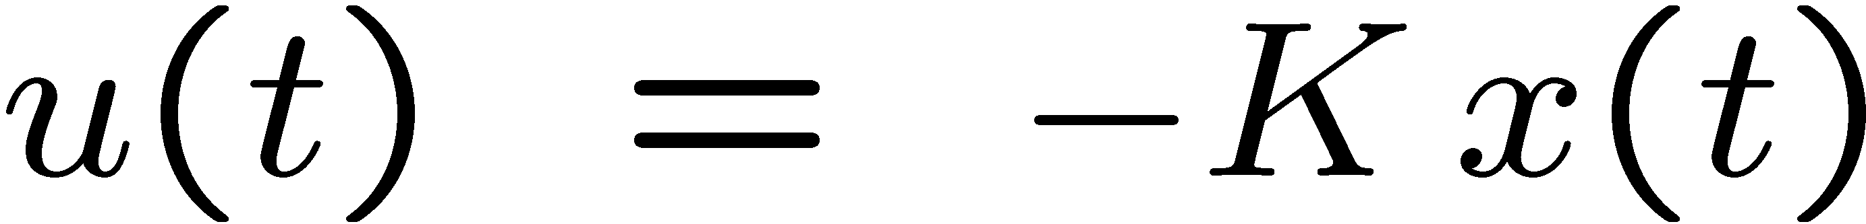
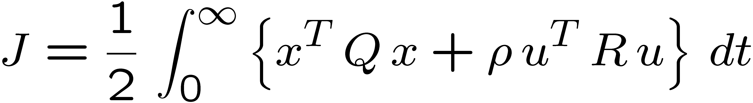
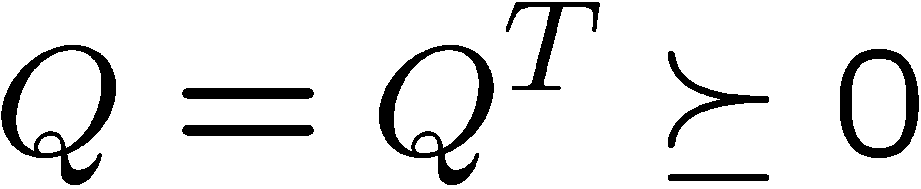
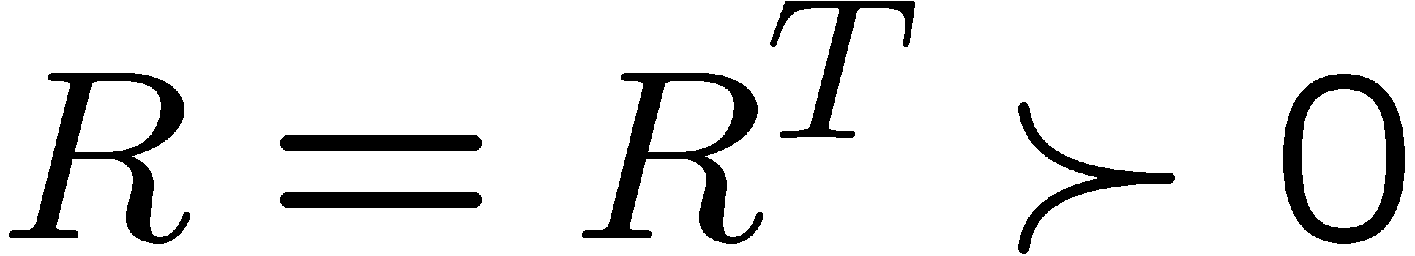
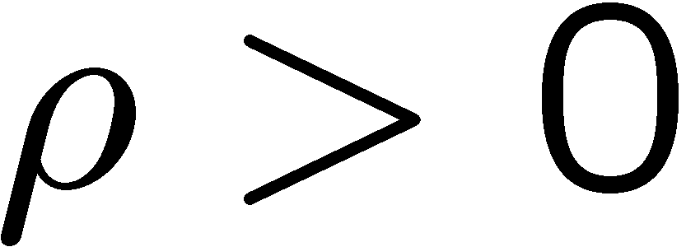
Infinite Horizon LQR
nth order LTI system:
Find the optimal control:
which minimizes the cost functional:

Slide 4
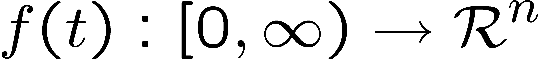
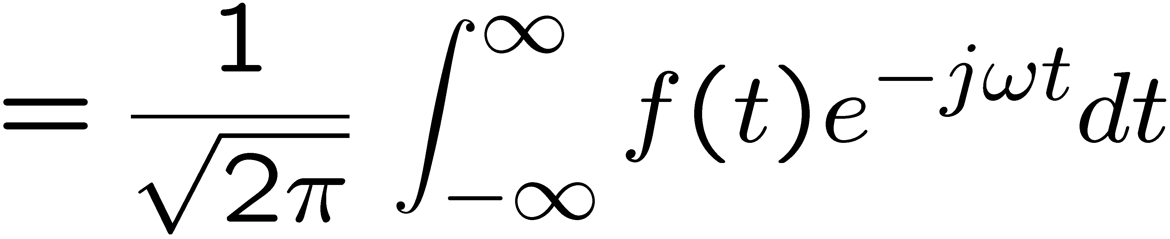
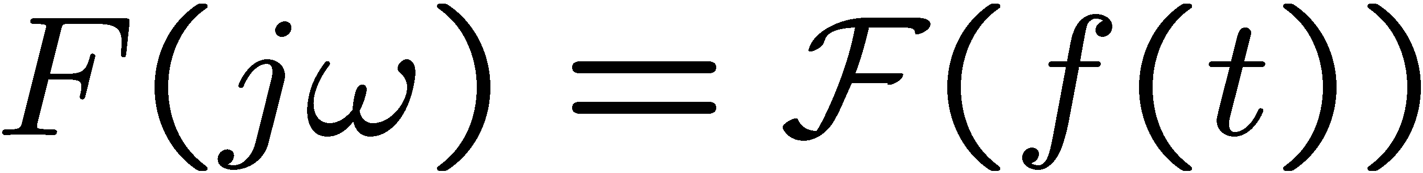
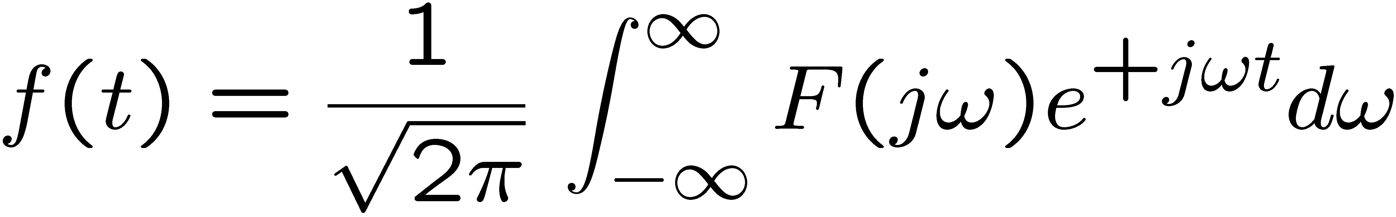
Parseval’s theorem
Let
Its (symmetric) Fourier transform is defined by
and

Slide 5
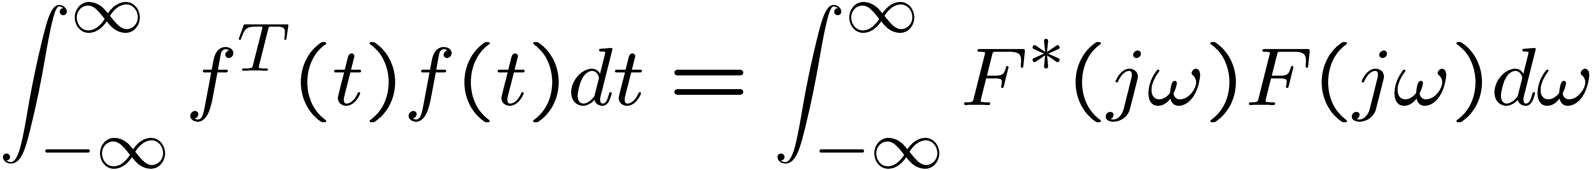
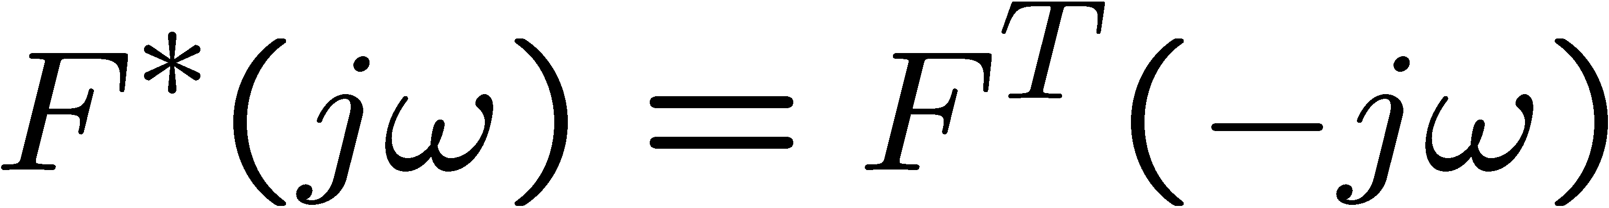
Parseval’s theorem
where
(complex conjugate transpose)

Slide 6
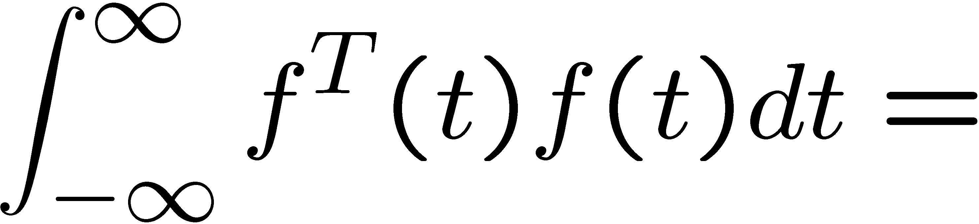
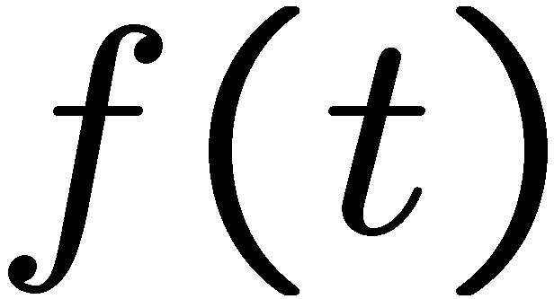
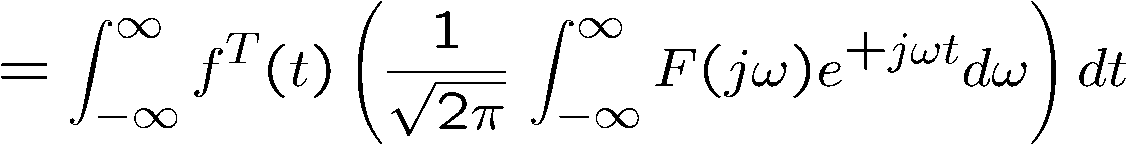
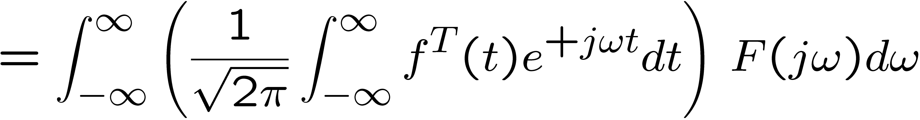
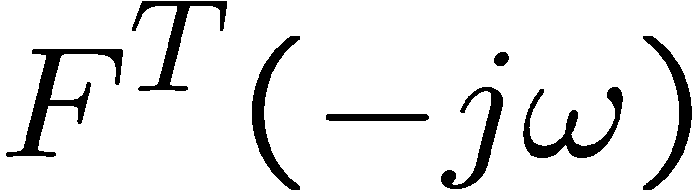
Parseval’s theorem
Proof:

Slide 7
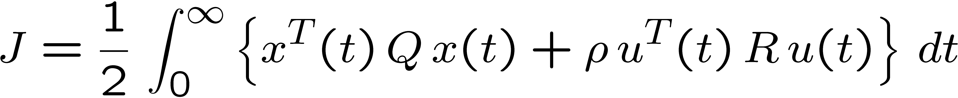


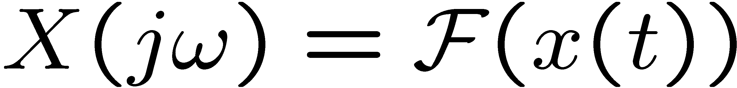
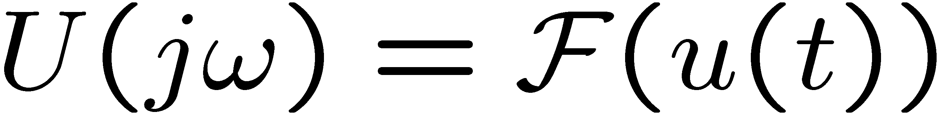
Frequency Cost Function
By Parseval’s theorem, the cost functional:
with
is equivalent to

Slide 8
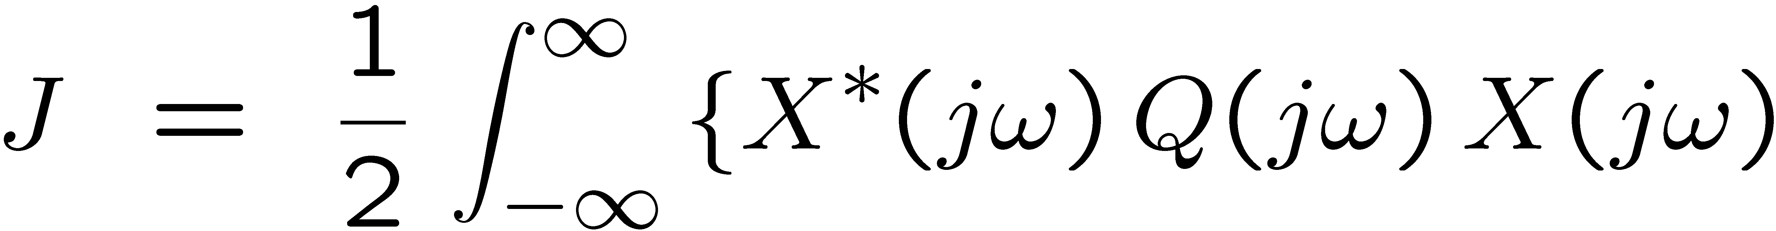
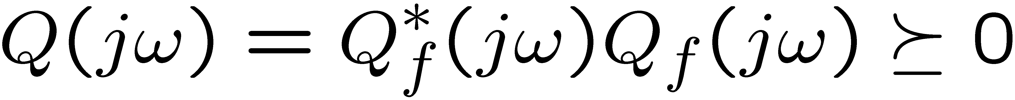
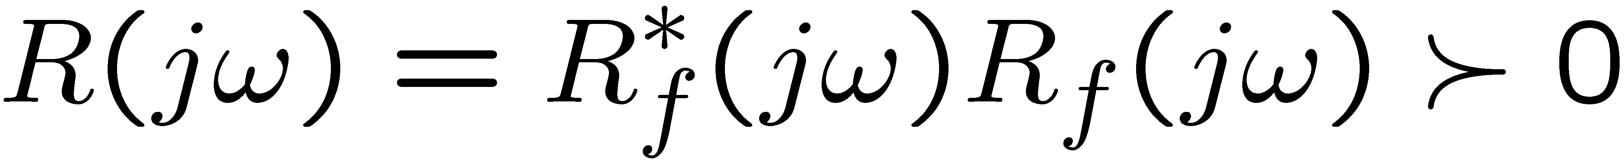
Frequency-Shaped Cost Function
Key idea: Make matrices Q and R functions of frequency
where

Slide 9
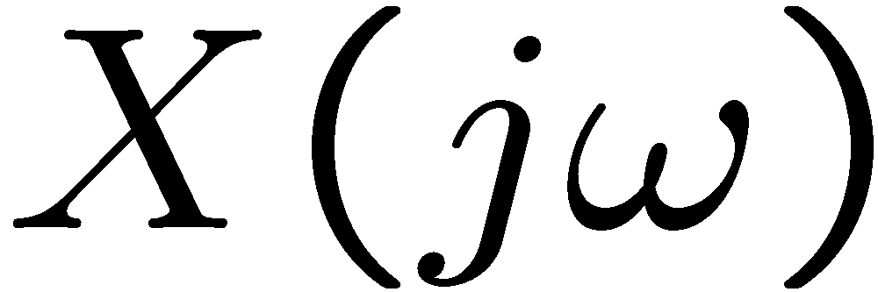
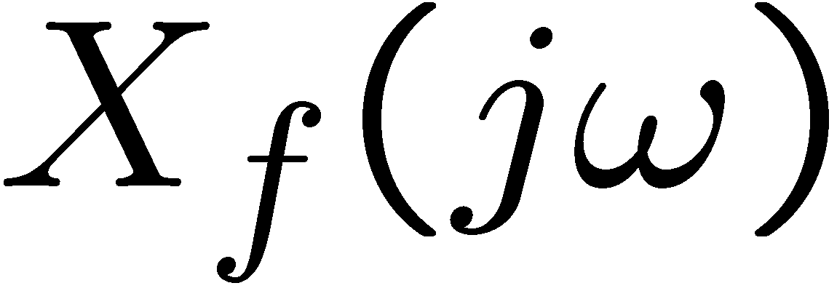
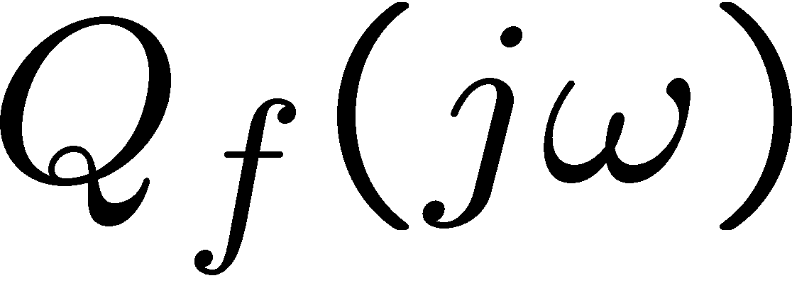

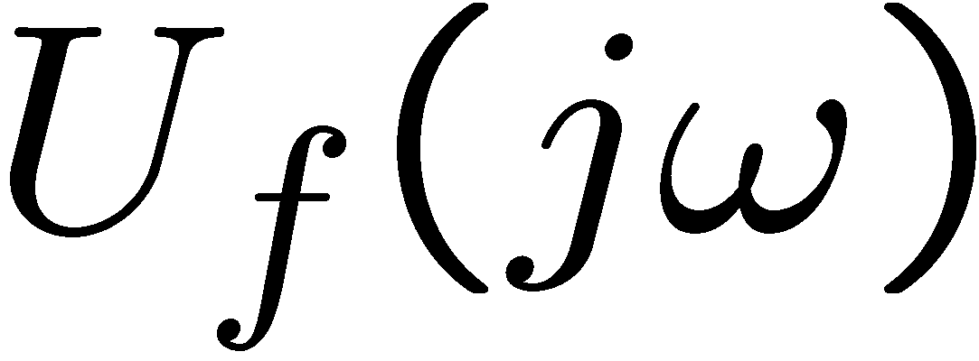
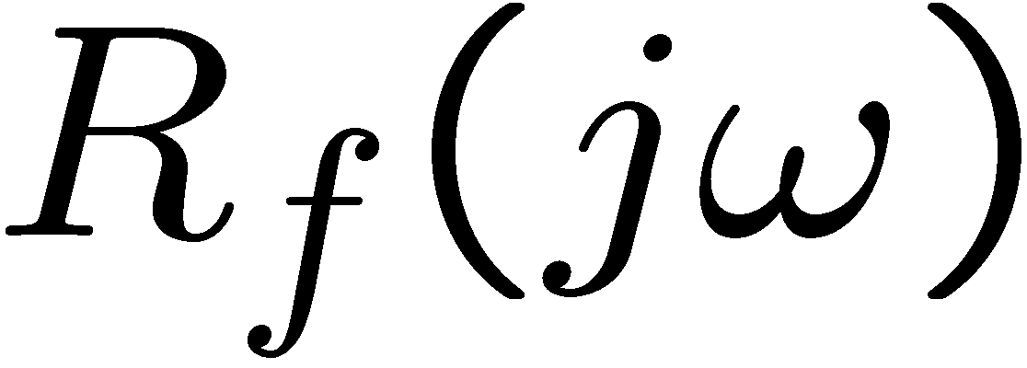
Frequency-Shaped Cost Function
Define the state and input filters
state filter
input filter

Slide 10
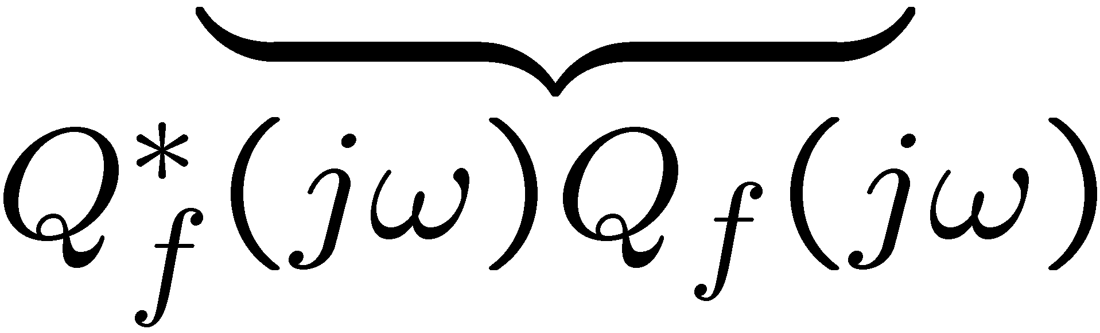
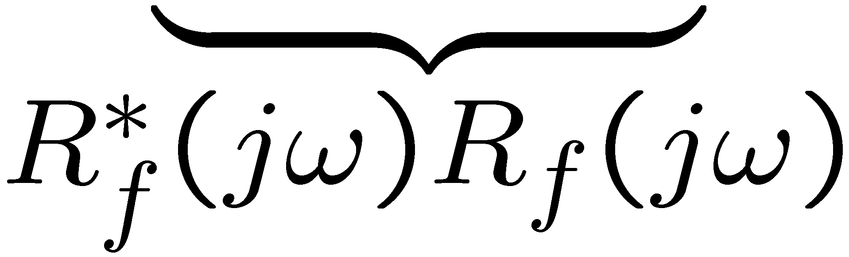
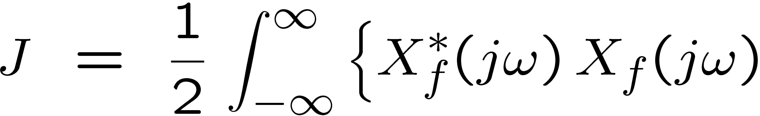
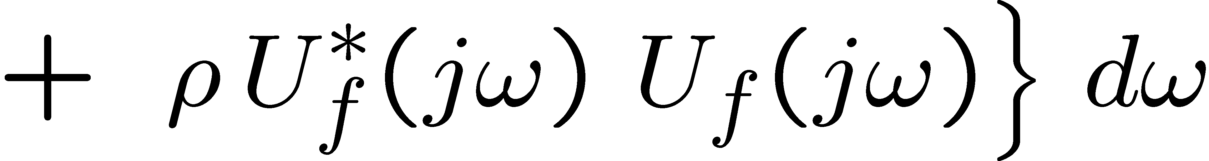
Frequency-Shaped Cost Function
can be written

Slide 11
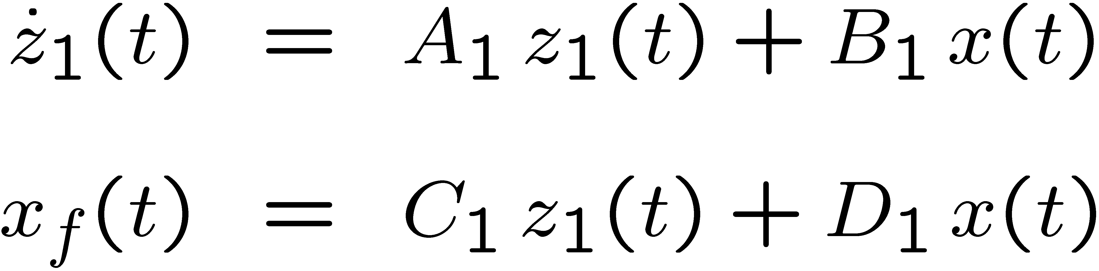
Realizing the filters using LTI’s
can be realized by
so that
is causal or strictly causal.

Slide 12
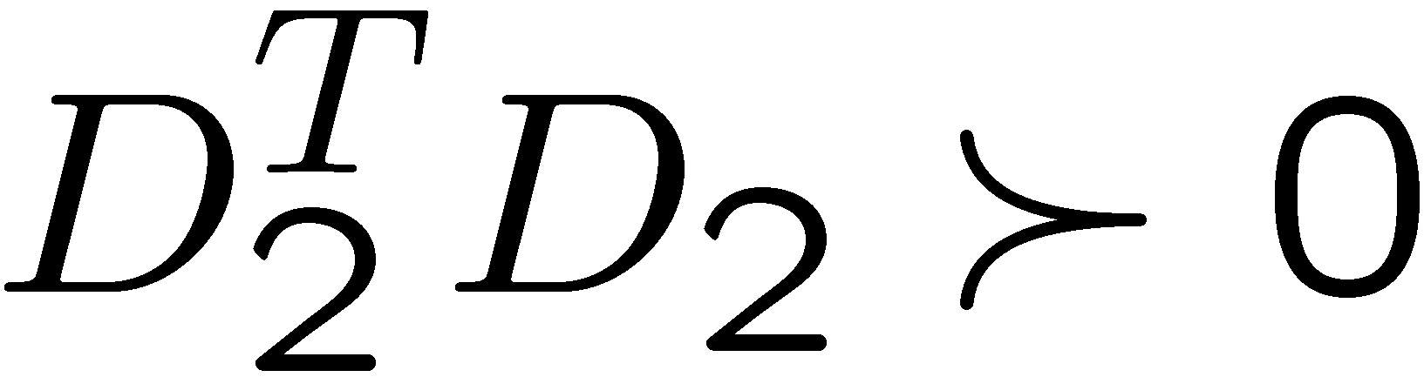
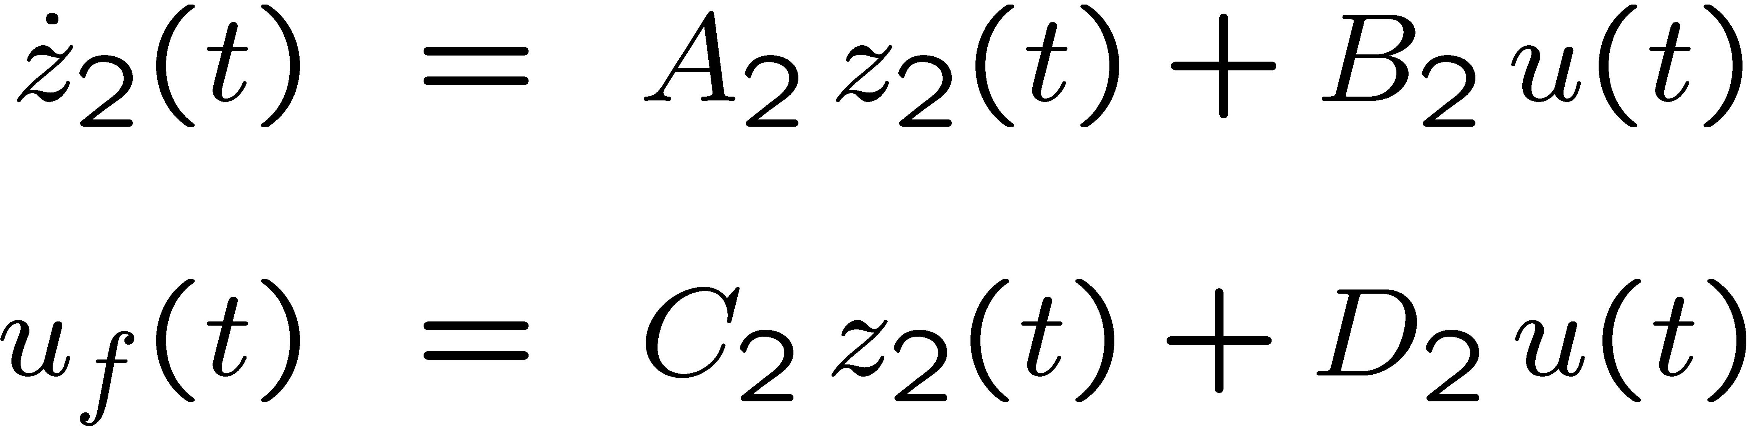
Realizing the filters using LTI’s
can be realized by (with )
so that
is causal (but not strictly causal).

Slide 13


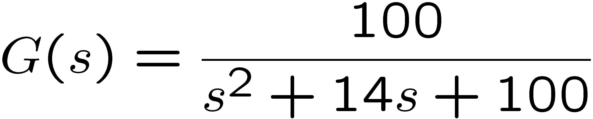
Example Hard Disk Drive
Consider a simplified model of a voice coil motor and suspension
uncertainty
nominal model
actual plant
high-frequency resonance
modes are neglected in the
nominal model
nominal model

Slide 14
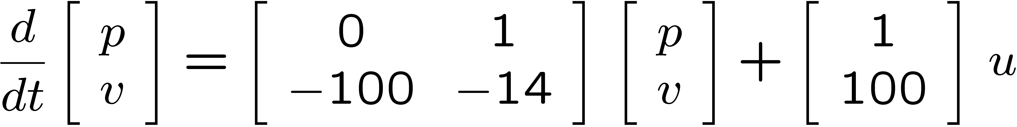
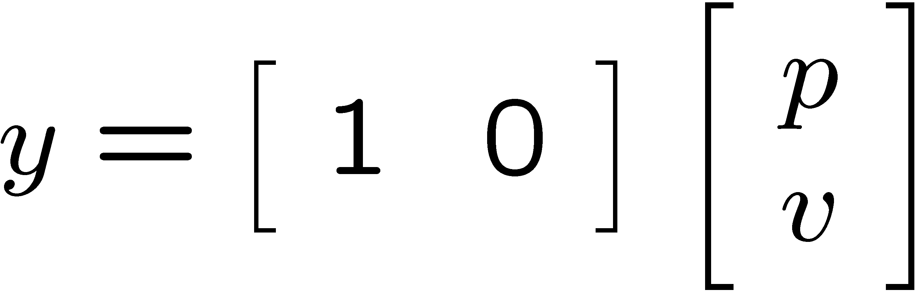
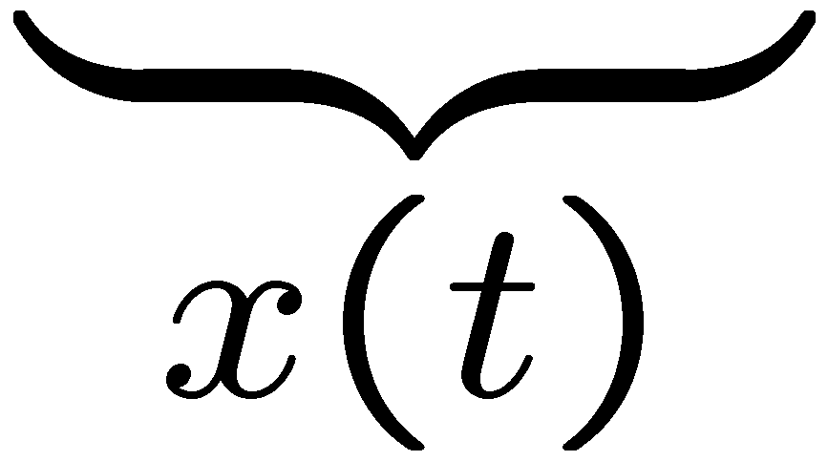
Example Hard Disk Drive
uncertainty
nominal model
actual plant
nominal model
output is position

Slide 15
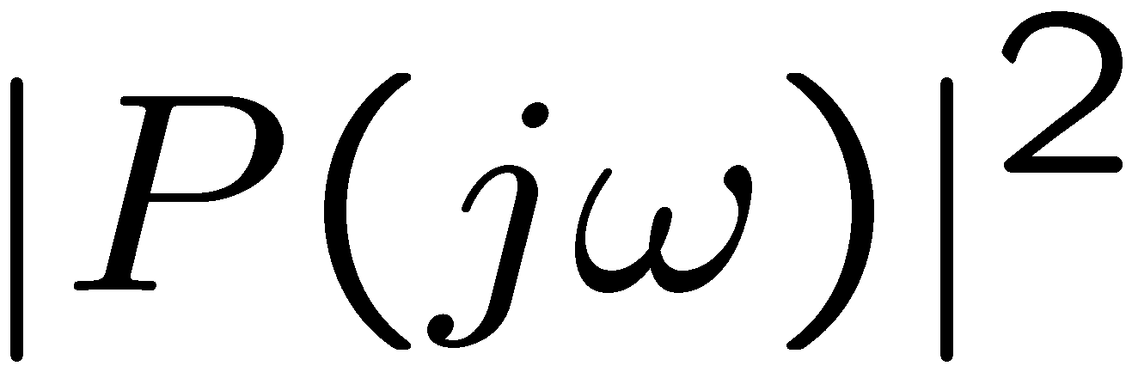
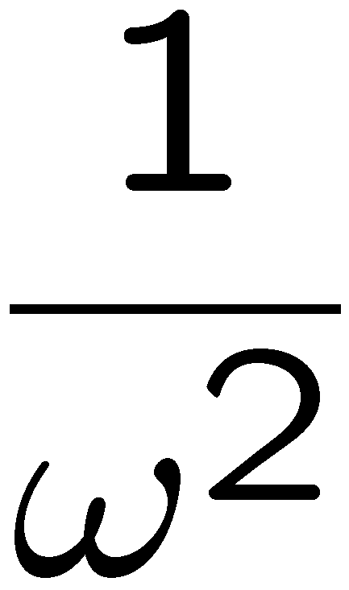
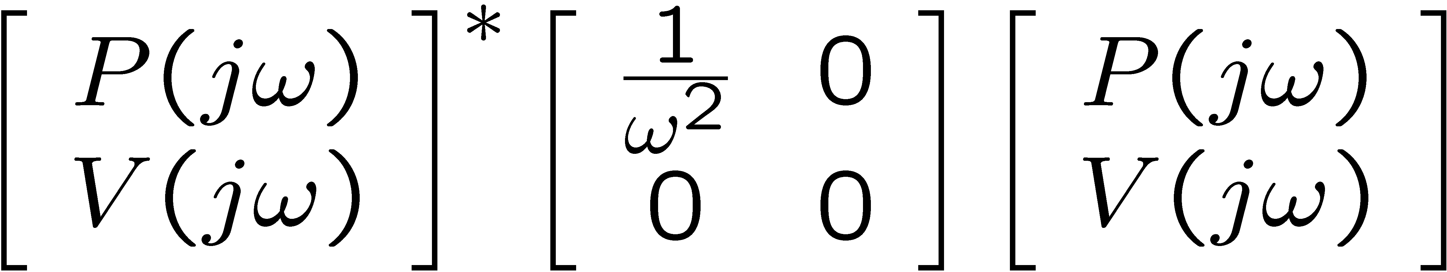
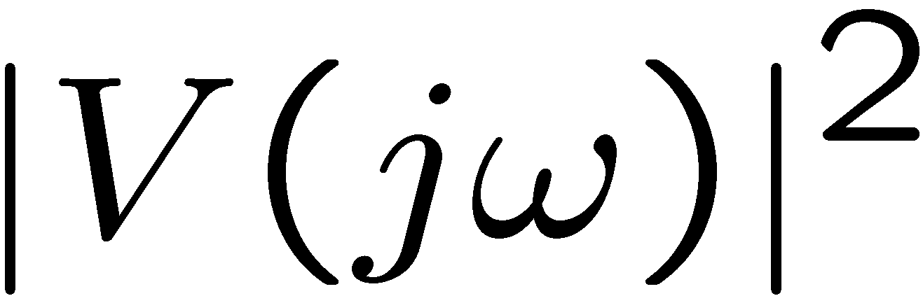

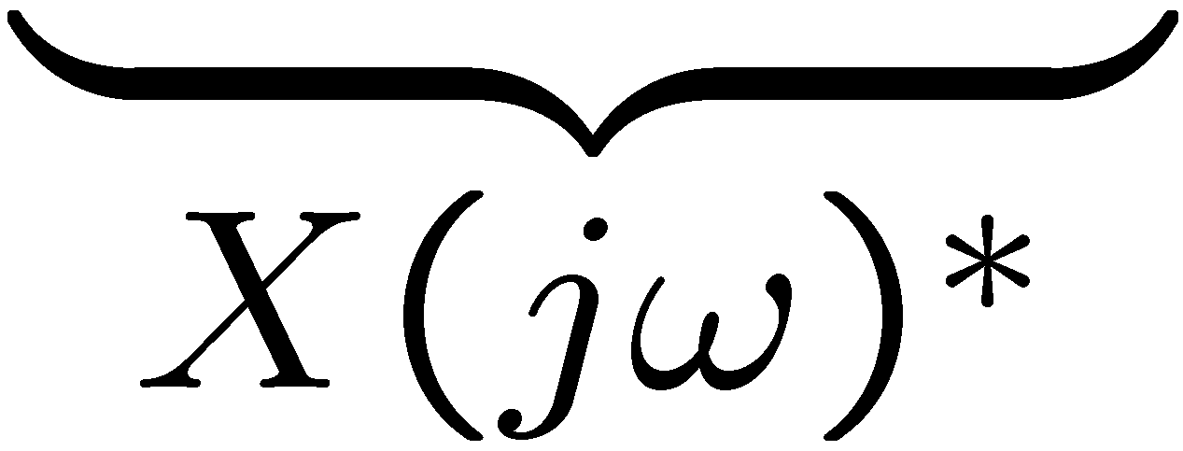
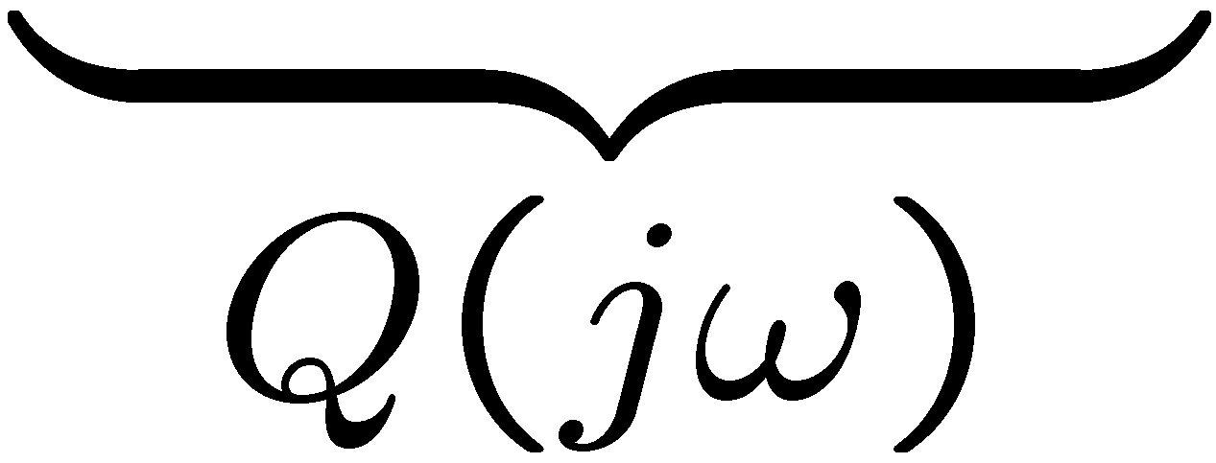
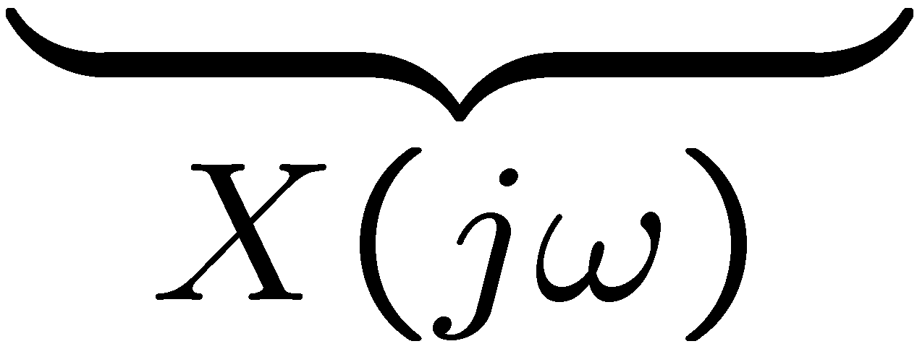
Example: Frequency State Weight Q(jω)
we want zero steady state (i.e. dc)
position
set position cost function weight
to go to ∞ as ω → 0
Example
Set weight on to
Set weight on to

Slide 16
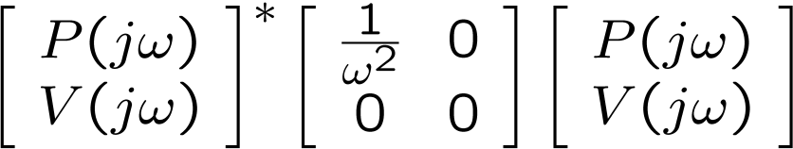
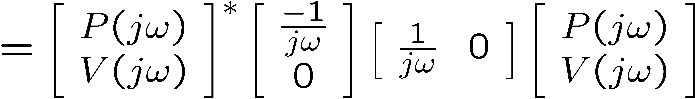
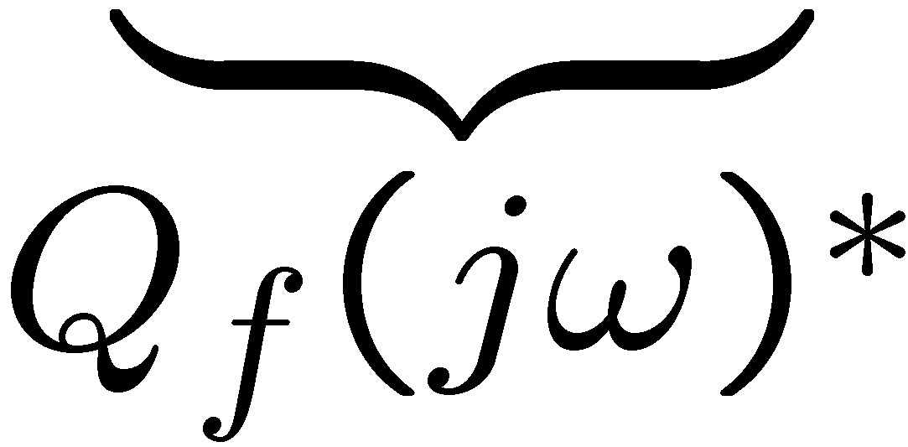
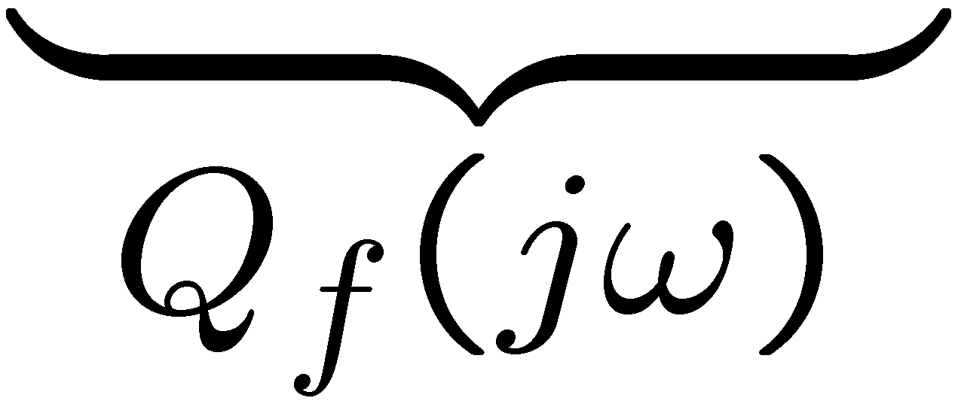


Example: Frequency State Weight Q(jω)
set position weight
to go to ∞ as ω → 0
Example

Slide 17








Example: Frequency State Weight Q(jω)
state space realization
Example
state space realization

Slide 18





Example Hard Disk Drive
weights:
nominal model
FS-LQR is a dynamic
state feedback
sufficient condition for robustness

Slide 19



Example Hard Disk Drive
weights:
potential
lack of robustness

Slide 20

Example: Frequency Control Weight R(jω)
increase control penalty
at high-frequencies
Example

Slide 21









Example: Frequency Control Weight R(jω)
Example
state space realization

Slide 22

Example: Frequency Control Weight R(jω)
Example
sufficient robustness
condition is satisfied

Slide 23


Cost Function Realization
is equivalent to

Slide 24



Cost Function Realization
we know that,
state space realization
state space realization

Slide 25

Cost Function Realization
Plus:
define extended state

Slide 26




Cost Function Realization
We can combine state equations and output as follows:

Slide 27



Extended System Dynamics

Slide 28







Extended System Cost
results in

Slide 29






Extended System Cost
where

Slide 30





Extended System Cost
where

Slide 31

Extended System LQR
Given the extended dynamics
Find the optimal control:
which minimizes the cost extended functional:

Slide 32







Extended LQR Solution
where
Then
There exists a
stabilizing optimal
control shown in the
next page
is stabilizable
is detectable

Slide 33


Extended LQR Solution
Optimal Control:
where
and

Slide 34

Implementation
Control

Slide 35




















Block Diagram

Slide 36
Equivalent Block Diagram

Slide 37




FSLQR with reference input
For simplicity, lets assume a scalar output
Assume that we want to design a FSLQR that will achieve asymptotic output convergence to a reference input

Slide 38



FSLQR with reference input
Assume that the reference input r(s) satisfies
Where A_{r}(s) has root in the imaginary axis

Slide 39





Reference input examples
Assume that r(t) = r_{o}
Assume that

Slide 40

FSLQR with reference input
Define the reference frequency weight
Where
A_{r}(s) is the denominator of r(s)

Slide 41
Frequency-Shaped Cost Function
with
used for achieving

Slide 42
Frequency-Shaped Cost Function

Slide 43





Realizing the filters using LTI’s
can be realized by
such that
denominator of r(s)

Slide 44
Realizing the filters using LTI’s
can be realized by
such that

Slide 45
Realizing the filters using LTI’s
can be realized by
such that

Slide 46





Cost Function Realization
where,

Slide 47
Extended System Dynamics

Slide 48




Extended System Cost

Slide 49


Extended LQR Solution
where
Then
There exists a
stabilizing optimal
control shown in the
next page
is stabilizable
is detectable

Slide 50

Extended LQR Solution
Optimal Control Gain:
where
and

Slide 51









Block Diagram
+

Slide 52








FSLQR with reference input – Block Diagram
where

Slide 53

Block Diagram
Remember that the poles of are A_{r}(s) , and

Slide 54

SISO
The close loop dynamics from r(s) to E(s) will be
of the form

Slide 55


SISO
Therefore, since A_{c}(s) is Hurwitz,

Slide 56





Example Hard Disk Drive
Cost weights:
reference input

Slide 57



Example Hard Disk Drive – Robustness Analysis

Slide 58









Example Hard Disk Drive

Slide 59

FSLQR with reference input – State Estimation
Assume that :
state x(t) is not measurable
only output y(t) is available
Use state observer

Slide 60


FSLQR with reference input – State Estimation
Robustness analysis:

Slide 61






Loop Transfer Recovery
Assume that is square and has no unstable zeros
observer:
observer
gain

Slide 62





Loop Transfer Recovery
Assume that is square and has no unstable zeros
Make it approximate
(point-wise in s)

Slide 63




Example Hard Disk Drive
Bode plots of
target
target

Slide 64



Example Hard Disk Drive

