Slide 1
Midterm 2 Statistics
ME 233: Advanced Control II
Spring 2012

Slide 2
Midterm 2 Statistics
Total Score
Mean | Standard Deviation | Highest Score | Possible Points
66.3 | 21.2 | 99 | 100
Score per Problem
Problem | Mean | Standard Deviation | Highest Score | Possible Points
1 | 23.8 | 6.5 | 30 | 30
2 | 22.9 | 8.9 | 34 | 35
3 | 19.6 | 11.5 | 35 | 35

Slide 3
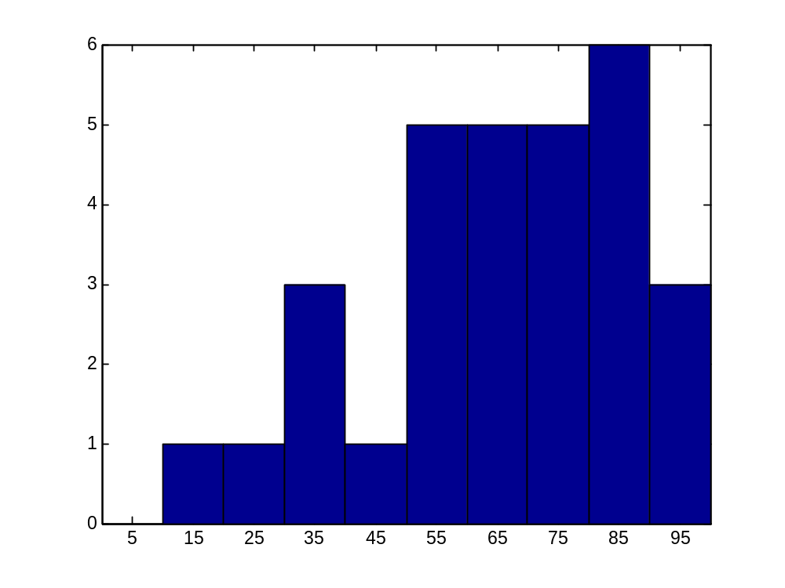
Histogram for total midterm score

Slide 4
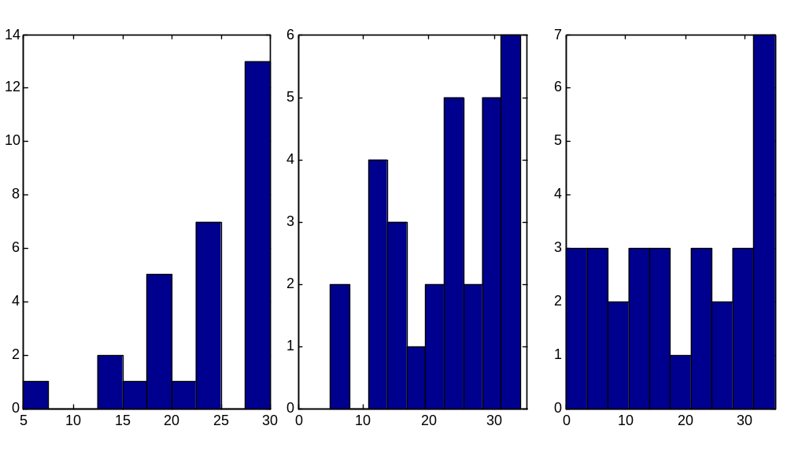
Histogram for each problem score
Problem 1
Problem 2
Problem 3

