Slide 1
Berkeley AIML Capstone EDA and Project : USD/JPY Exchange Rate Prediction Using LSTM with Economic Indicators
A Data-Driven Approach to Forecasting Currency Movements
Mrudang Majmudar
Notes:
Image: https://pixabay.com/illustrations/technology-artificial-intelligence-3762547/

Slide 2








Project Overview
Objective
03
Data Sources
04
Data Processing/
Visualization
05-07
Feature Engineering
09
Model Selection/
Hyperparameter Tuning
10
Training and Testing
11
Model Evaluation
12
Key Findings / Future Exploration
13
Notes:
Image: https://pixabay.com/illustrations/brain-web-network-programming-4927267/

Slide 3
OBJECTIVE
In Capital Markets, Electronic Trading, FX, and Rates are key businesses. Research has shown that FX and Rates are highly correlated trading asset classes. For this project, we plan to apply AI/ML techniques to predict USD/JPY Exchange rates using other currency pairs and key economic indicators as features.

Slide 4
DATA SOURCES Yahoo Finance, FRED from Jan 2010 to Today
EUR/USD
GBP/USD
USD/JPY
Treasury Yields
10Y
30Y
FX Rates
Economic Indicators
US Interest Rate
Inflation Rate
Un-Employment Rate
GDP Growth Rate

Slide 5




Data Processing
Forward Fill
Forward Fill economic indicators to align with daily FX and Treasury Data
Lagged Features
5-Day lag to capture temporal dependencies
Alignment
US Interest has more data points than the other indicators use it as the base
Cleaning
Align All features data set to the same length, drop null values

Slide 6
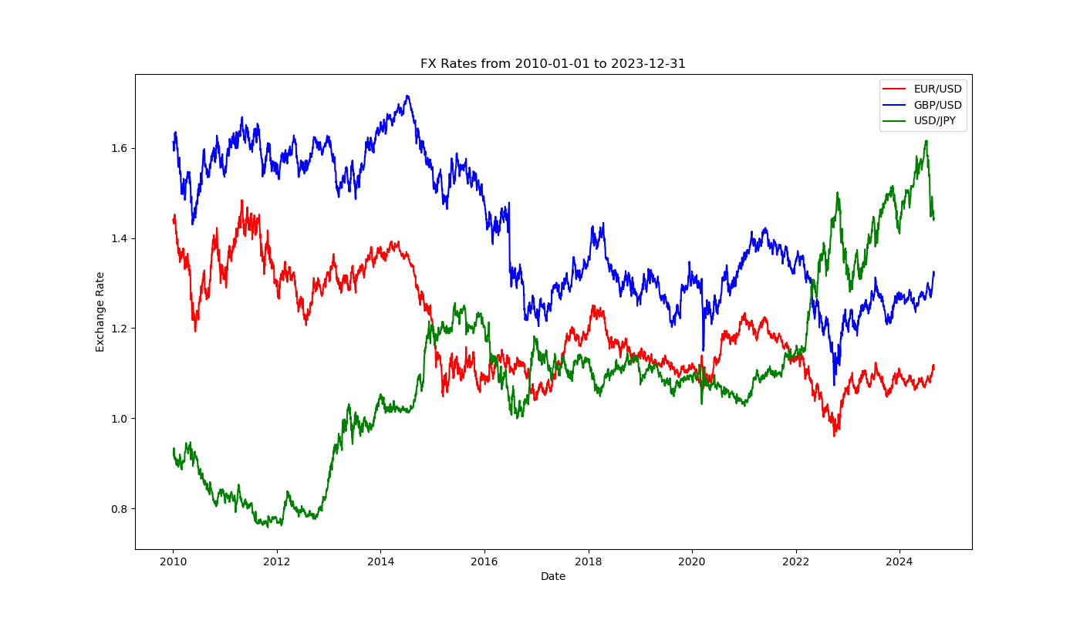
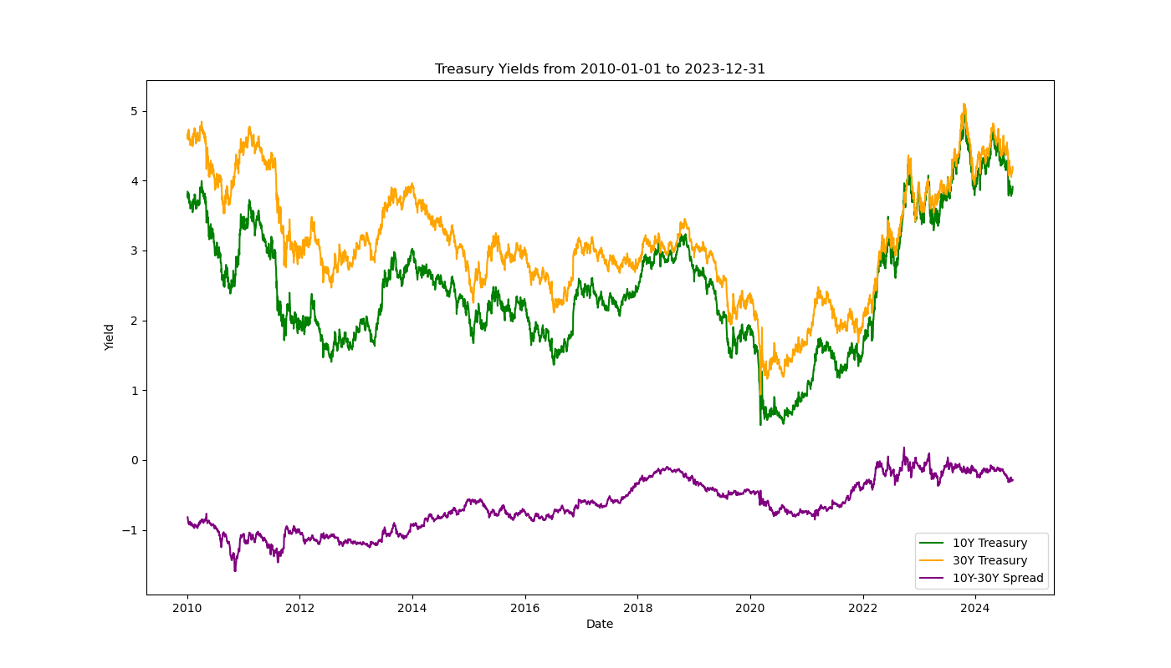
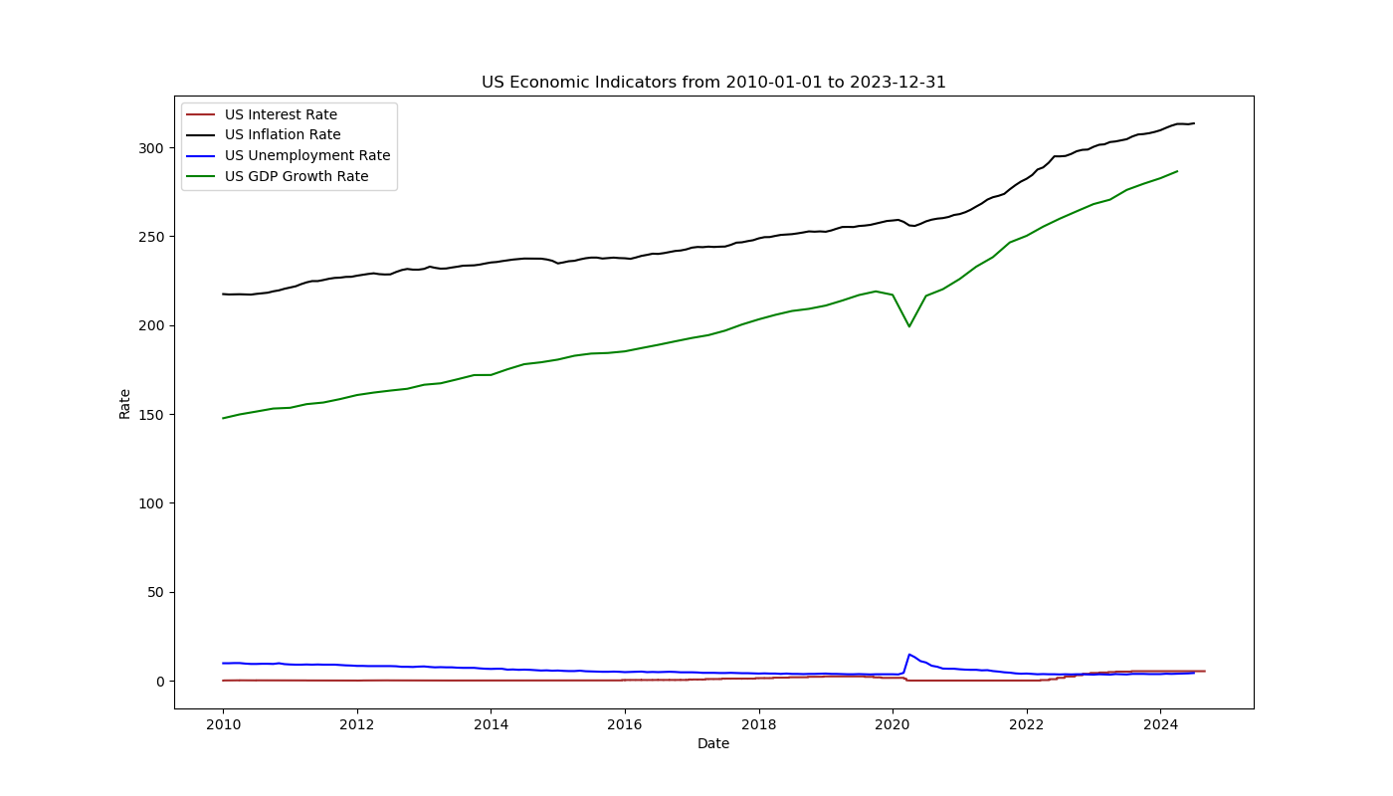
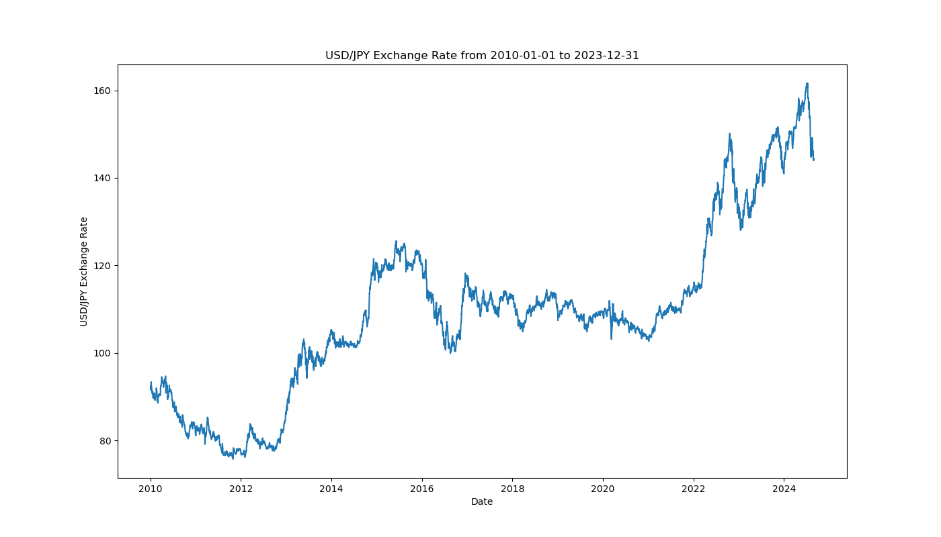
Data Visualization

Slide 7
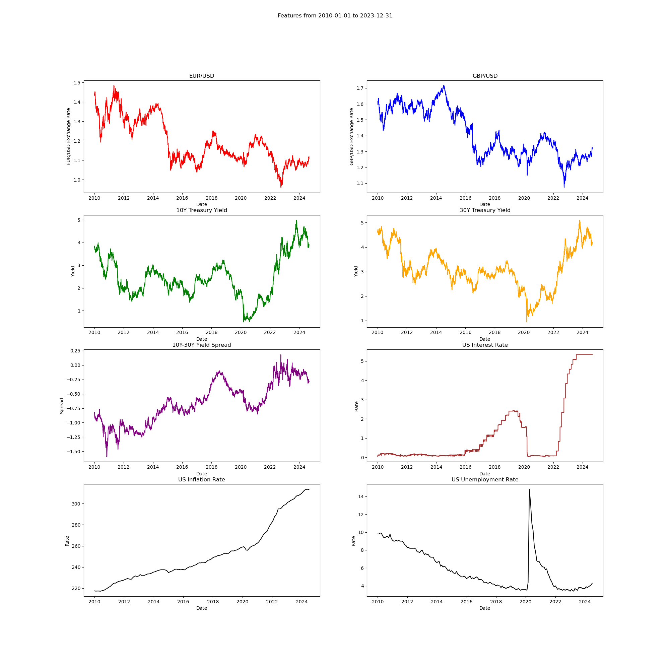
Data Visualization Cont…

Slide 8
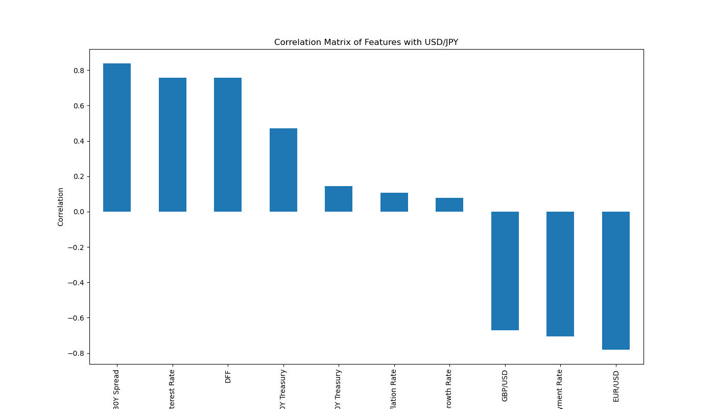
Correlation matrix

Slide 9

Feature Engineering
Lagged Features
Add new features
Create Lagged features for FX, Treasury Yields, economic indicators
Calculated 10Y-30Y yield spread as additional feature

Slide 10



Model Selection Hyperparameter tuning
LTSM- Long Short –Term Memory
Model Architecture
Chose LTSM due its strength in time-series prediction
1-2 LSTM layers with dropout and dense output layers
Tuning
Tuning
Used GridSearchCV with time-series cross-validation
Tuned parameters LSTM units, dropout rate, number of layers, optimizer, batch-size, epochs

Slide 11
Model Training Testing
Training
Testing
Evaluation
Data Up to 2023
2024 up to today
Predicted USD/JPY rates vs actual rates for 2024

Slide 12
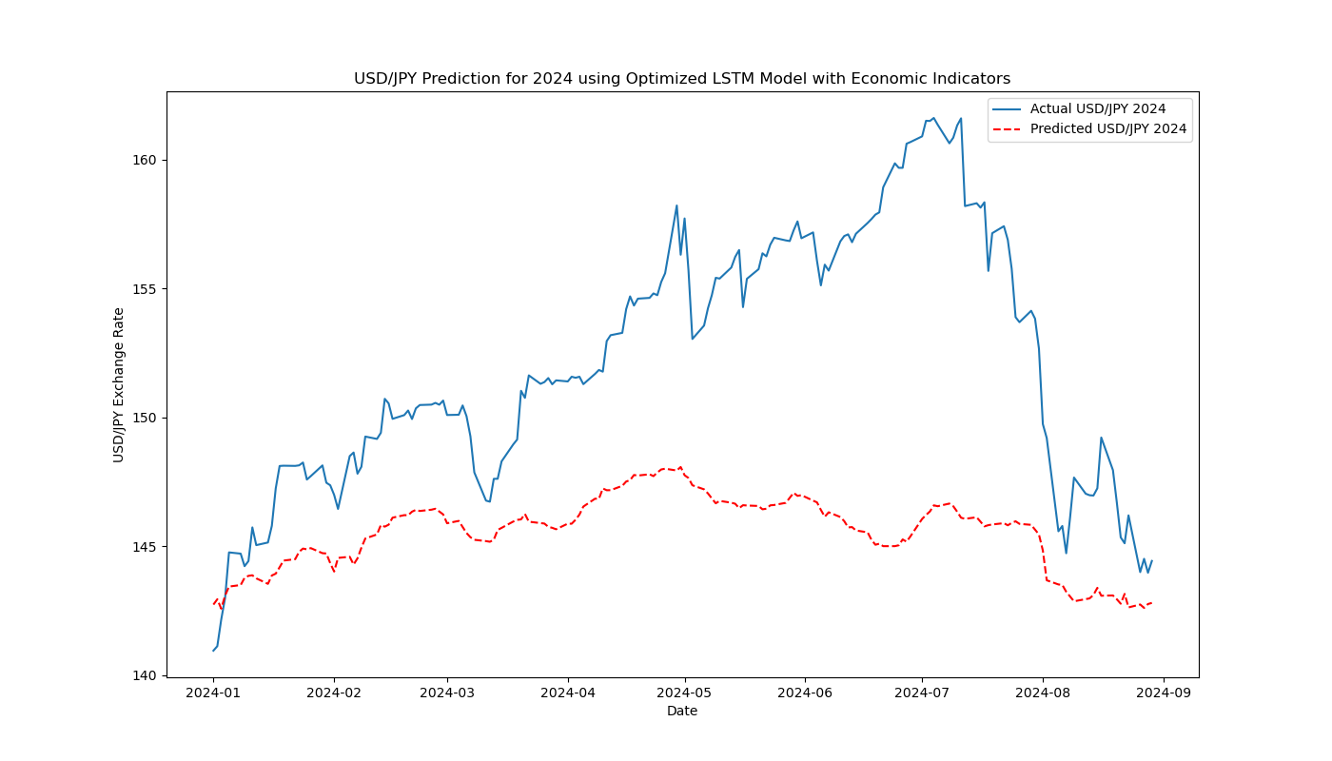
Model Evaluation

Slide 13
Key Findings, Future Work
Key Findings
Model Performed well it was able to find the overall trend of USD/JPY
Actual Raw predictions were off from actual USD/JPY values
But that could be because of data scaling
Inclusion of economic indicators made model predict better trend
Future work improvement
Add additional global economic indicators
Add other financial instruments or correlated currency pair
Use alternate lag structures
Experiment with complex models like GRU or Transformer models.
Extend this framework , incorporate trading volumes and generate trading signals

Slide 14
THANK YOU
Mrudang Majmudar
Notes:
Image: https://pixabay.com/illustrations/brain-network-5870352/

