Slide 1



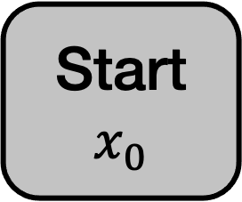
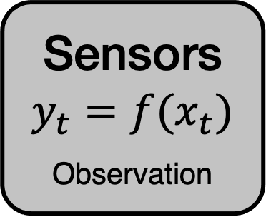

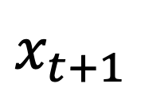
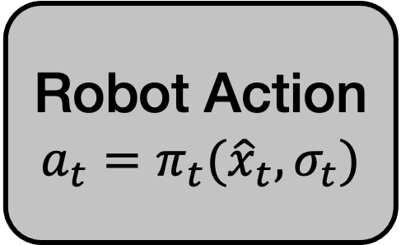
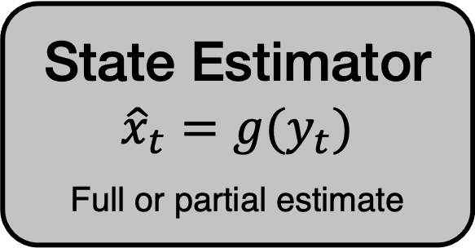


System Confidence Estimator
$$σ_{t}=h({\hat{x}}_{t},y_{t},\text{•})$$
Meta-Policy Selector
$$π_{t}=d({\hat{x}}_{t},σ_{t},\text{•})$$
Sensors
$$y_{t}=f(x_{t})$$
Observation
State Estimator
$${\hat{x}}_{t}=g(y_{t})$$
Full or partial estimate
Robot Action
$$a_{t}=π_{t}({\hat{x}}_{t},σ_{t})$$
Start
$$x_{0}$$
End
$$x_{t+1}$$
Interactive Perception Policy 1
$$π_{IP,1}$$
Interactive Perception Policy n
$$π_{IP,n}$$
Task Policy 1
$$π_{task,1}$$
Task Policy m
$$π_{task,m}$$
…
…

