Slide 1
EM Algorithm
Jur van den Berg

Slide 2
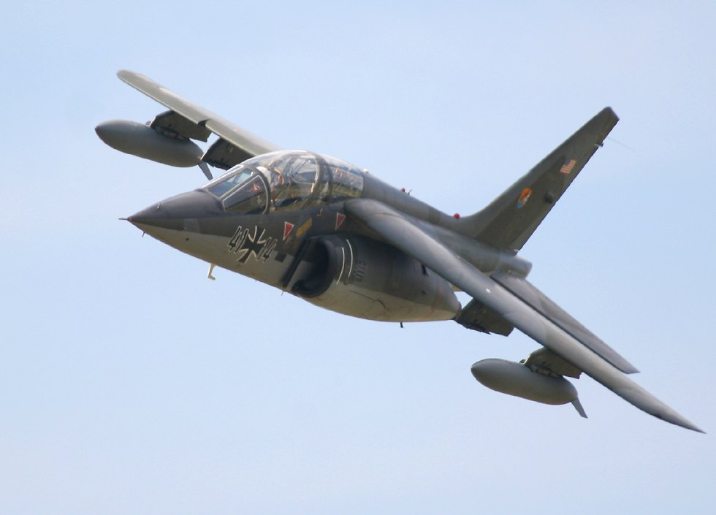
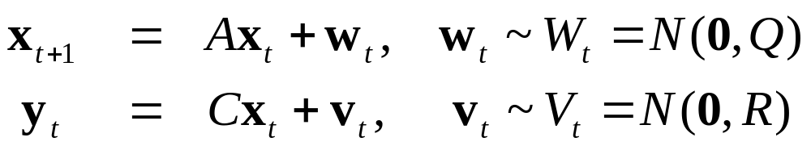

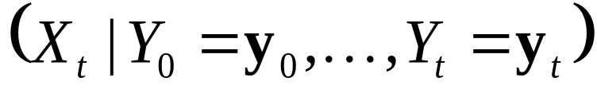
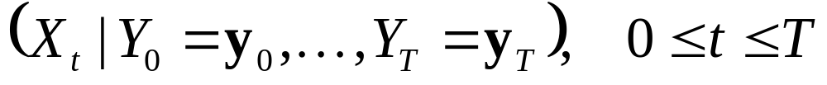
Kalman Filtering vs. Smoothing
Dynamics and Observation model
Kalman Filter:
  Compute
  Real-time, given data so far
Kalman Smoother:
  Compute
  Post-processing, given all data

Slide 3
EM Algorithm
Kalman smoother:
  Compute distributions X₀, …, X_{t}
  given parameters A, C, Q, R, and data y₀, …, y_{t}.
EM Algorithm:
  Simultaneously optimize X₀, …, X_{t} and A, C, Q, R
  given data y₀, …, y_{t}.

Slide 4
Probability vs. Likelihood
Probability: predict unknown outcomes based on known parameters:
  p(x | θ)
Likelihood: estimate unknown parameters based on known outcomes:
  L(θ | x) = p(x | θ)
Coin-flip example:
  θ is probability of “heads” (parameter)
  x = HHHTTH is outcome

Slide 5
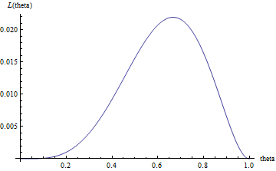
Likelihood for Coin-flip Example
Probability of outcome given parameter:
  p(x = HHHTTH | θ = 0.5) = 0.5⁶ = 0.016
Likelihood of parameter given outcome:
  L(θ = 0.5 | x = HHHTTH) = p(x | θ) = 0.016
Likelihood maximal when θ = 0.6666…
Likelihood function not a probability density

Slide 6
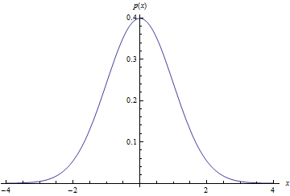
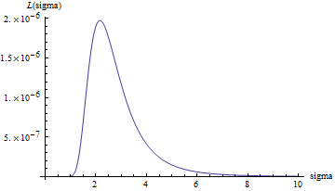
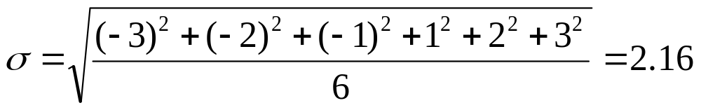
Likelihood for Cont. Distributions
Six samples {-3, -2, -1, 1, 2, 3} believed to be drawn from some Gaussian N(0, σ²)
Likelihood of σ:
Maximum likelihood:

Slide 7
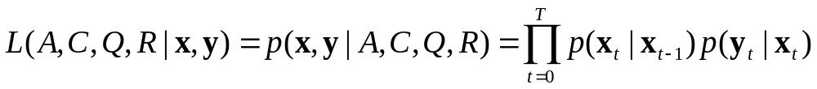

Likelihood for Stochastic Model
Dynamics model
Suppose x_{t} and y_{t} are given for 0 ≤ t ≤ T, what is likelihood of A, C, Q and R?
Compute log-likelihood:

Slide 8
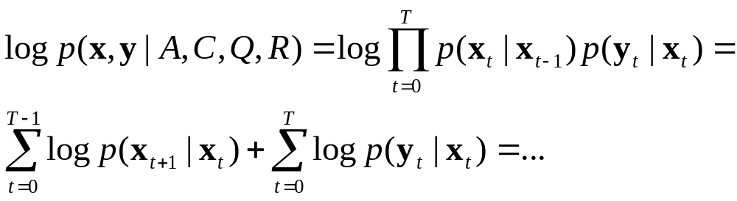
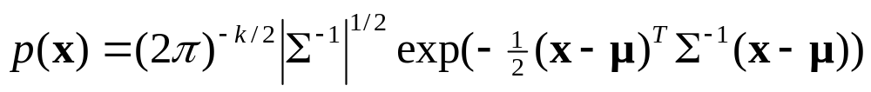


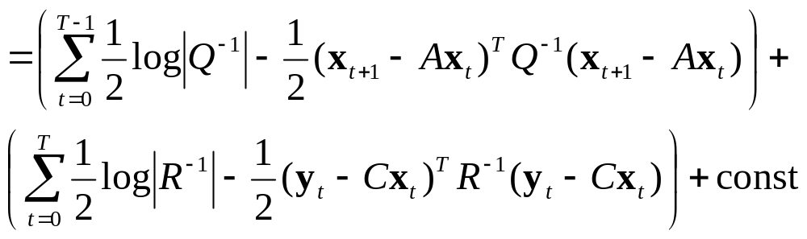
Log-likelihood
Multivariate normal distribution N(μ, Σ) has pdf:
From model:

Slide 9
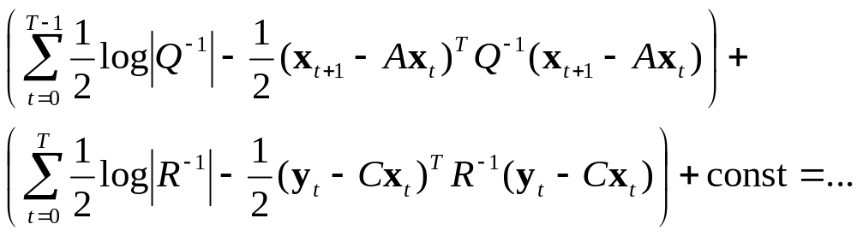
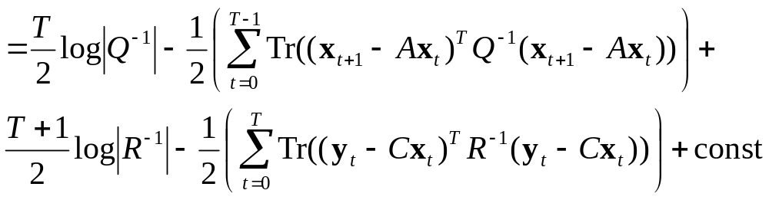
Log-likelihood #2
a = Tr(a) if a is scalar
Bring summation inward

Slide 10
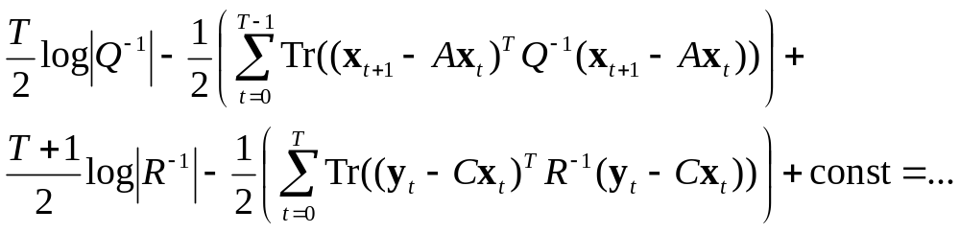
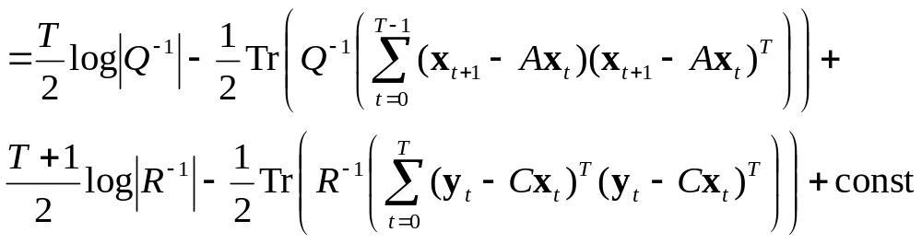
Log-likelihood #3
Tr(AB) = Tr(BA)
Tr(A) + Tr(B) = Tr(A+B)

Slide 11
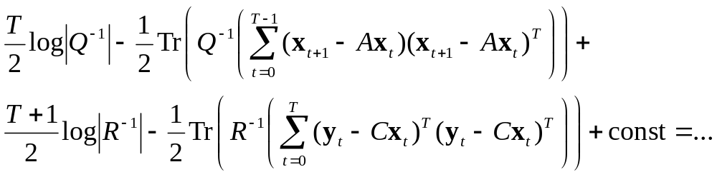
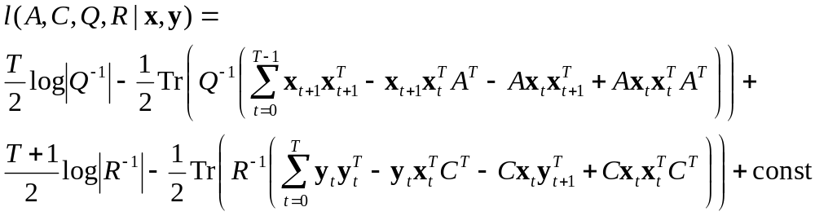
Log-likelihood #4
Expand

Slide 12
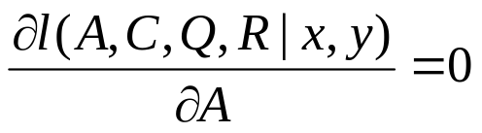
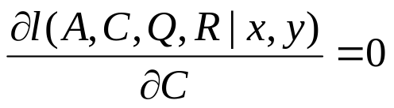
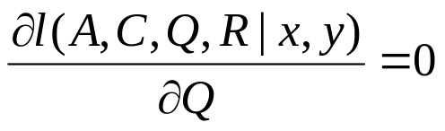

Maximize likelihood
log is monotone function
  max log(f(x)) ⬄ max f(x)
Maximize l(A, C, Q, R | x, y) in turn for A, C, Q and R.
  Solve for A
  Solve for C
  Solve for Q
  Solve for R

Slide 13

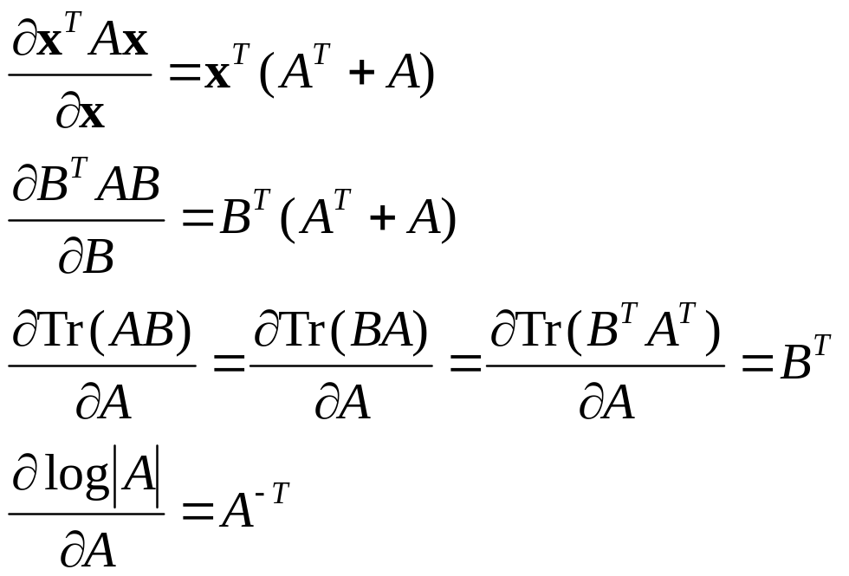
Matrix derivatives
Defined for scalar functions f : R^{n*m} -> R
Key identities

Slide 14
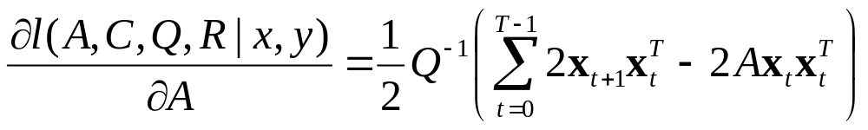
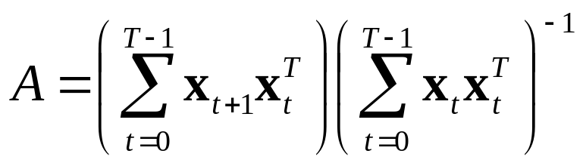
Optimizing A
Derivative
Maximizer

Slide 15
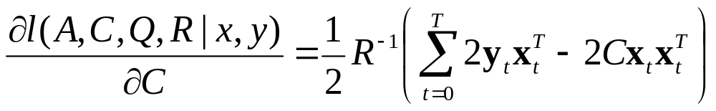
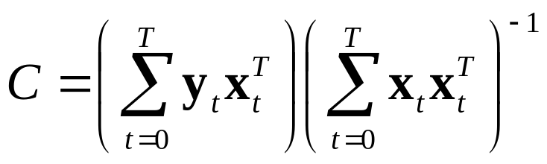
Optimizing C
Derivative
Maximizer

Slide 16
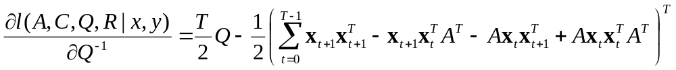
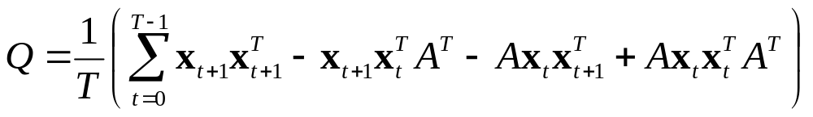
Optimizing Q
Derivative with respect to inverse
Maximizer

Slide 17
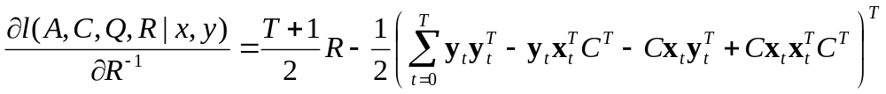
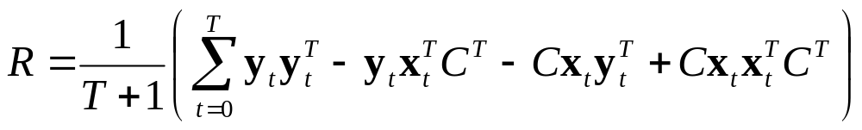
Optimizing R
Derivative with respect to inverse
Maximizer

Slide 18
EM-algorithm
Initial guesses of A, C, Q, R
Kalman smoother (E-step):
  Compute distributions X₀, …, X_{T}
  given data y₀, …, y_{T} and A, C, Q, R.
Update parameters (M-step):
  Update A, C, Q, R such that
  expected log-likelihood is maximized
Repeat until convergence (local optimum)

Slide 19
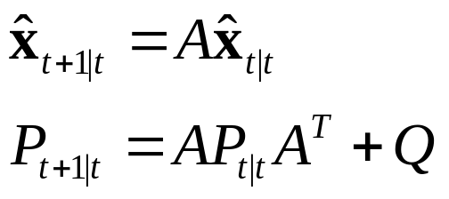
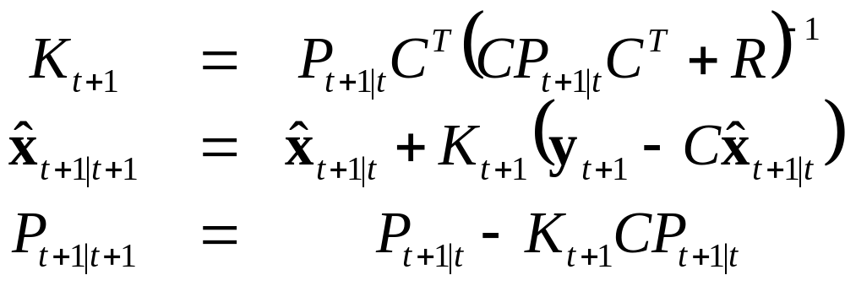
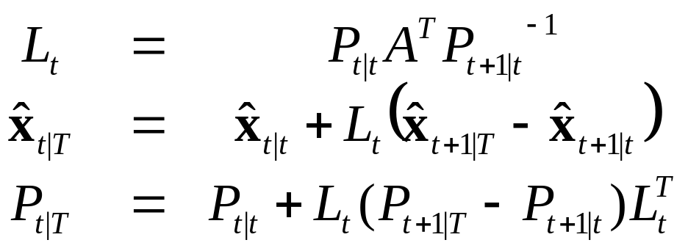
Kalman Smoother
for (t = 0; t < T; ++t) // Kalman filter
for (t = T – 1; t ≥ 0; --t) // Backward pass

Slide 20
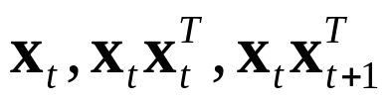
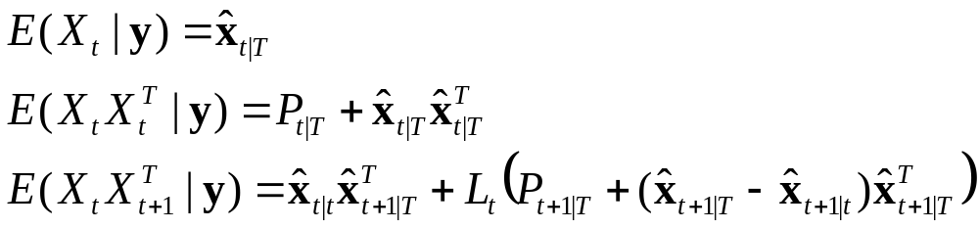
Update Parameters
Likelihood in terms of x, but only X available
Likelihood-function linear in
Expected likelihood: replace them with:
Use maximizers to update A, C, Q and R.

Slide 21
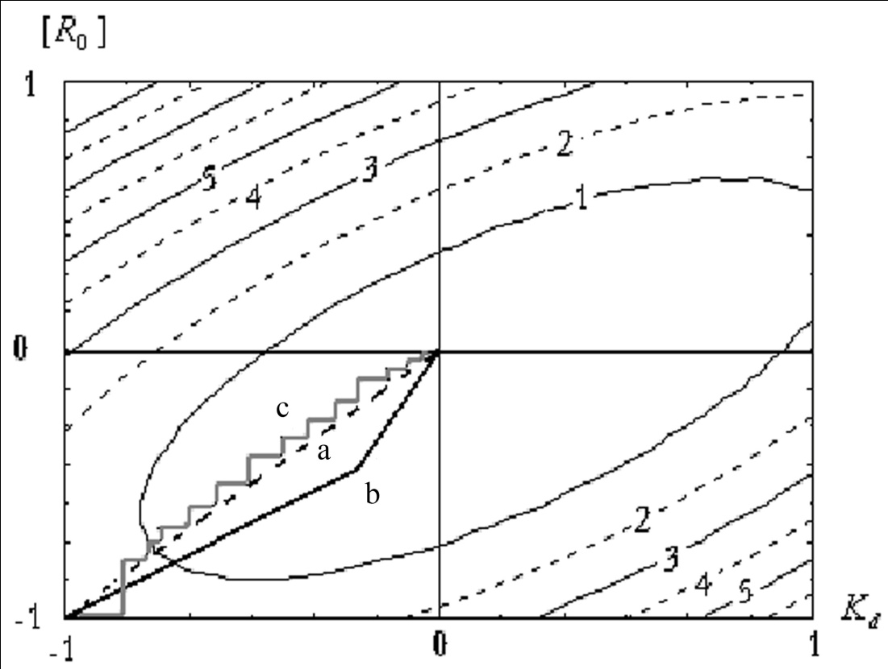
Convergence
Convergence is guaranteed to local optimum
Similar to coordinate ascent

Slide 22
Conclusion
EM-algorithm to simultaneously optimize
state estimates and model parameters
Given ``training data’’, EM-algorithm can be used (off-line) to learn the model for subsequent use in (real-time) Kalman filters

Slide 23
Next time
Learning from demonstrations
Dynamic Time Warping

