Slide 1
Kalman Smoothing
Jur van den Berg

Slide 2

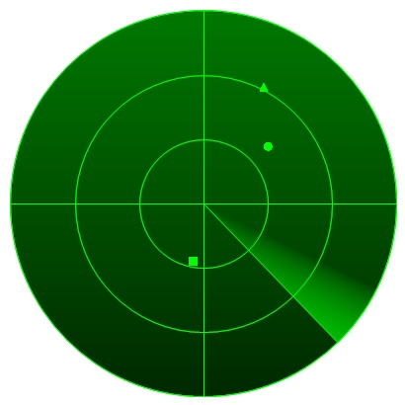
Kalman Filtering vs. Smoothing
Dynamics and Observation model
Kalman Filter:
Compute
Real-time, given data so far
Kalman Smoother:
Compute
Post-processing, given all data

Slide 3
Kalman Filtering Recap
Time update
Measurement update:
Compute joint distribution
Compute conditional
X₀
X₁
X₂
X₃
X₄
X₅
…
Y₁
Y₂
Y₃
Y₄
Y₅

Slide 4
Kalman filter summary
Model:
Algorithm: repeat…
Time update:
Measurement update:

Slide 5
Kalman Smoothing
Input: initial distribution X₀ and data y₁, …, y_{T}
Algorithm: forward-backward pass (Rauch-Tung-Striebel algorithm)
Forward pass:
Kalman filter: compute X_{t+1|t} and X_{t+1|t+1} for 0 ≤ t < T
Backward pass:
Compute X_{t|T} for 0 ≤ t < T
Reverse “horizontal” arrow in graph

Slide 6
Backward Pass
Compute X_{t|T} given
Reverse arrow: X_{t|t} → X_{t+1|t}
Same as incorporating measurement in filter
1. Compute joint (X_{t|t}, X_{t+1|t})
2. Compute conditional (X_{t|t} | X_{t+1|t} = x_{t+1})
New: x_{t+1} is not “known”, we only know its distribution:
3. “Uncondition” on x_{t+1} to compute X_{t|T} using laws of total expectation and variance

Slide 7
Backward pass. Step 1
Compute joint distribution of X_{t|t} and X_{t+1|t}:
where

Slide 8
Backward pass. Step 2
Recall that if
then
Compute (X_{t|t}|X_{t+1|t} = x_{t+1}):

Slide 9
Backward pass Step 3
Conditional only valid for given x_{t+1}.
Where
But we don’t know its value, but only its distribution:
Uncondition on x_{t+1} to compute X_{t|T} using law of total expectation and law of total variance

Slide 10
Law of total expectation/variance
Law of total expectation:
E(X) = E_{Z}( E(X|Y = Z) )
Law of total variance:
Var(X) = E_{Z}( Var(X|Y = Z) ) + Var_{Z}( E(X|Y = Z) )
Compute
where

Slide 11
Unconditioning
Recall from step 2 that
So,

Slide 12
Backward pass
Summary:

Slide 13
Kalman smoother algorithm
for (t = 0; t < T; ++t) // Kalman filter
for (t = T – 1; t ≥ 0; --t) // Backward pass

Slide 14
Conclusion
Kalman smoother can in used a post-processing
Use x_{t|T}’s as optimal estimate of state at time t, and use P_{t|T} as a measure of uncertainty.

Slide 15
Extensions
Automatic parameter (Q and R) fitting using EM-algorithm
Use Kalman Smoother on “training data” to learn Q and R (and A and C)

