Slide 1
Learning from Demonstrations
Jur van den Berg

Slide 2
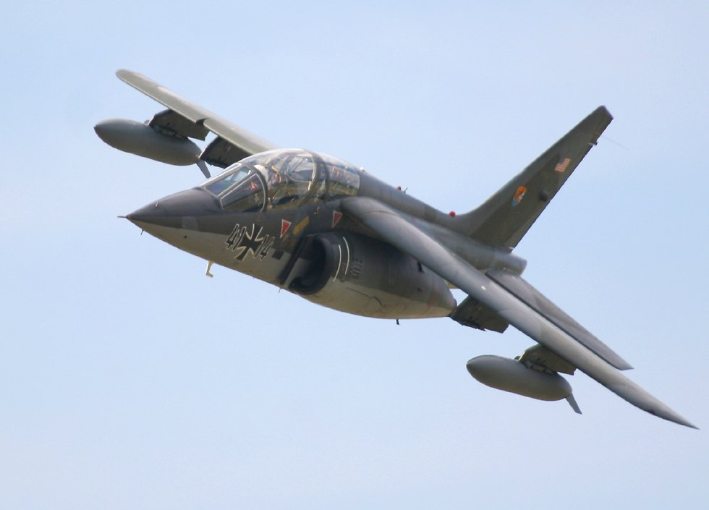
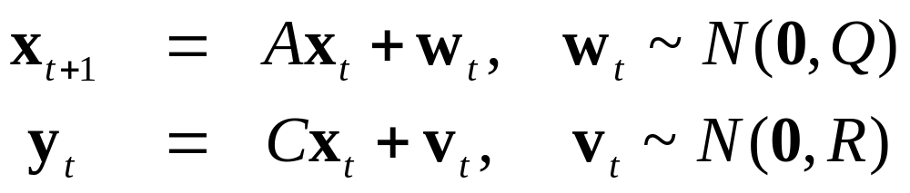
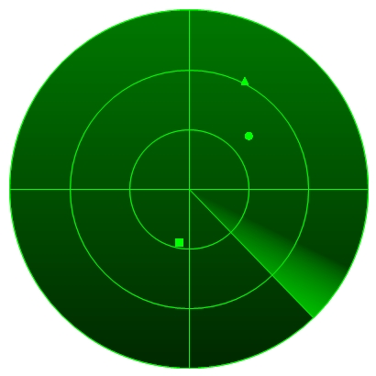
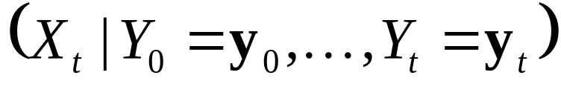
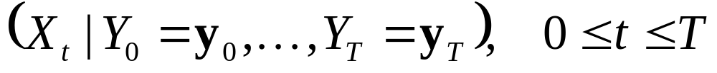
Kalman Filtering and Smoothing
Dynamics and Observation model
Kalman Filter:
  Compute
  Real-time, given data so far
Kalman Smoother:
  Compute
  Post-processing, given all data

Slide 3
EM Algorithm
Kalman smoother:
  Compute distributions X₀, …, X_{t}
  given parameters A, C, Q, R, and data y₀, …, y_{t}.
EM Algorithm:
  Simultaneously optimize X₀, …, X_{t} and A, C, Q, R
  given data y₀, …, y_{t}.

Slide 4
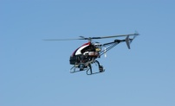
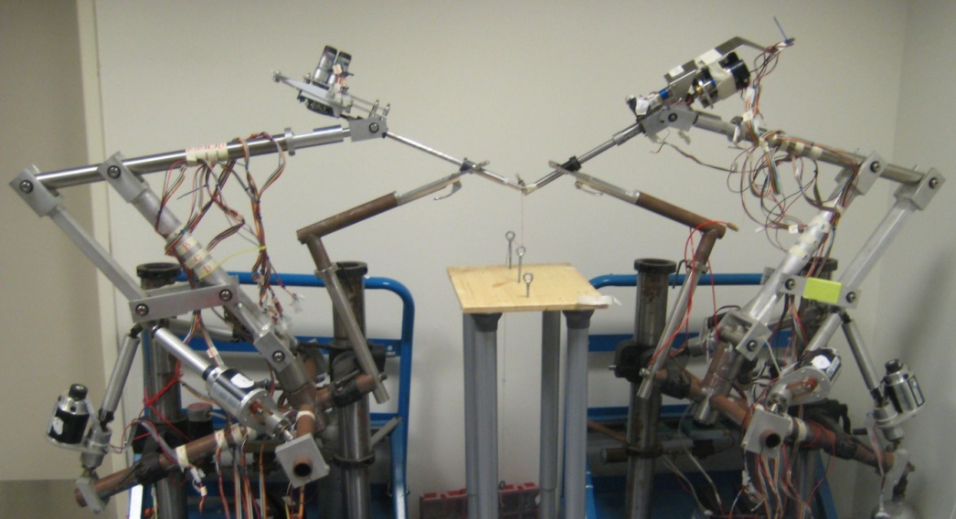
Learning from Demonstrations
Application of EM-algorithm
Example:
  Autonomous helicopter aerobatics
  Autonomous surgical tasks (knot-tying)

Slide 5
Motivation
Learning an ideal “trajectory” of system
Human provides demonstrations of ideal trajectory
Human demonstrations imperfect
Multiple demonstrations implicitly encode ideal trajectory
Task: infer ideal trajectory from demonstrations

Slide 6
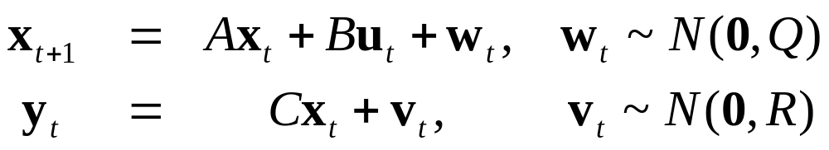
Acquiring Demonstrations
Known system dynamics (A, B, Q)
Observations with known sensors (C, R)
  Inertial measurement unit
  GPS
  Cameras
Use Kalman smoother to optimally estimate states x along demonstration trajectory

Slide 7
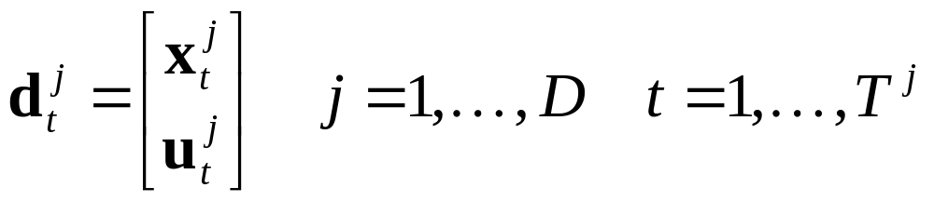
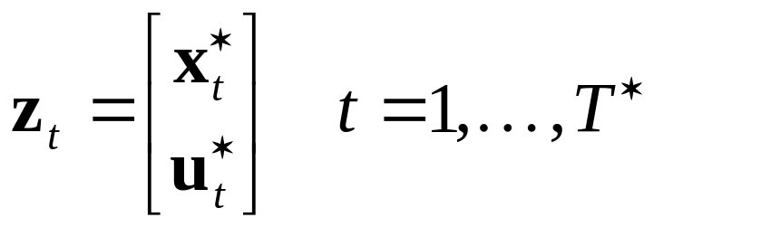
Multiple Demonstrations
D demonstration trajectories of duration T^{j}
Hidden ideal trajectory z of duration T*

Slide 8
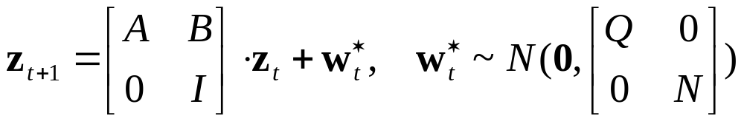
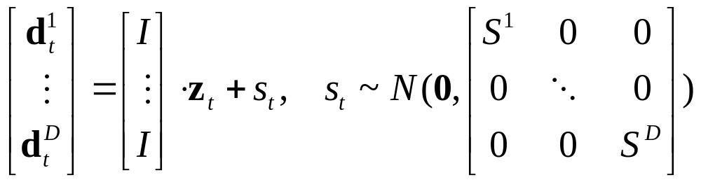
Model of Ideal Trajectory
Main idea: use demonstrations as noisy observations of hidden ideal trajectory
Dynamics of hidden trajectory
Observation of hidden trajectory

Slide 9
Inferring Ideal Trajectory
  Dynamics model: Parameter N controls smoothness; A, B, Q known
  Observation model: Parameters S encode relative quality of demonstrations
  Use EM-algorithm with Kalman smoother to simultaneously optimize z and S (and N).
    Initialize S with identity matrices

Slide 10
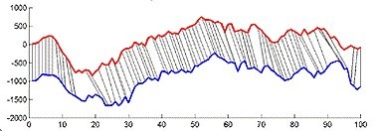
Time Warping
But, this assumes demonstrations are of equal length and uniformly paced
Include Dynamic Time Warping into EM-algorithm
Such that demonstrations map temporally

Slide 11
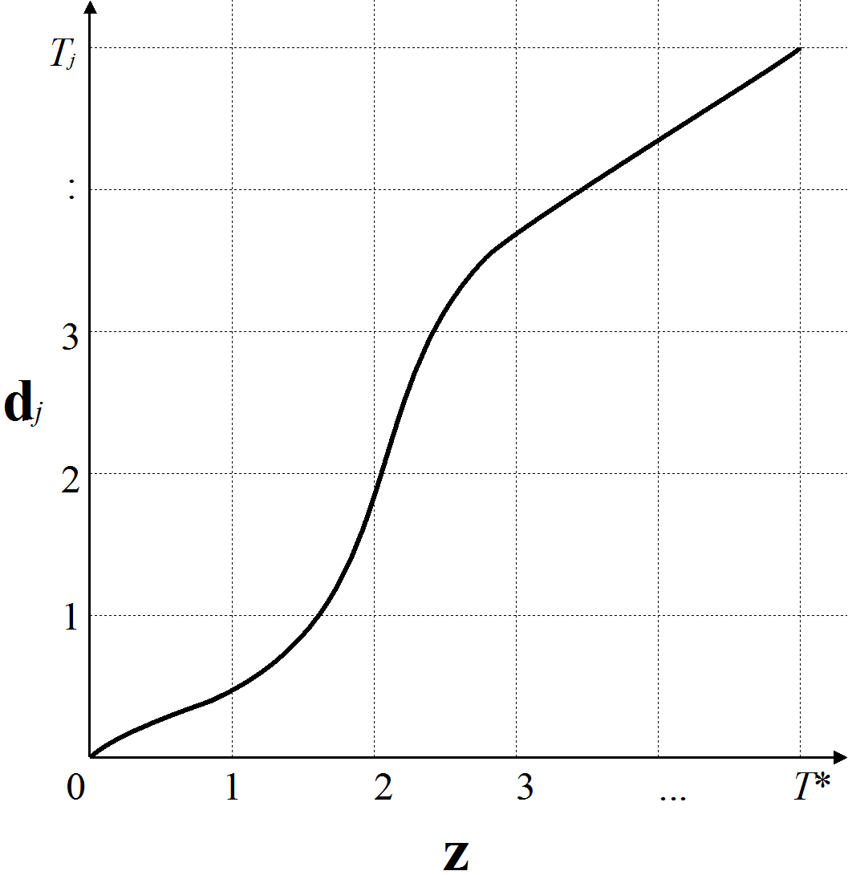
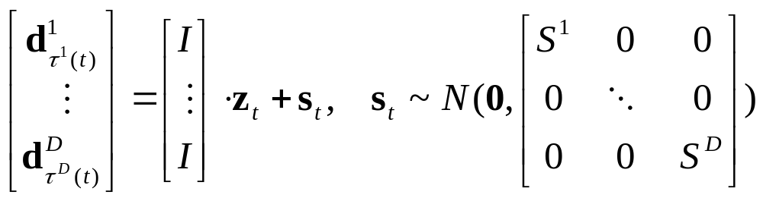
Time Warping
For each demonstration j,
we have function τ^{j}(t)
Maps time t along z
to time τ^{j}(t) along d^{j}
Adapted observation
model:

Slide 12
Learning Time Warping
τ^{j}(t) is (initially) unknown
Assume (initially):
  T* = (T¹ + … + T^{D}) / D
  τ^{j}(t) = (T^{j} / T*) t
Adapted EM-algorithm:
  Run Kalman smoother with current S and τ
  Optimize S by maximizing likelihood
  Optimize τ by maximizing likelihood
  (Dynamic Time Warping)

Slide 13
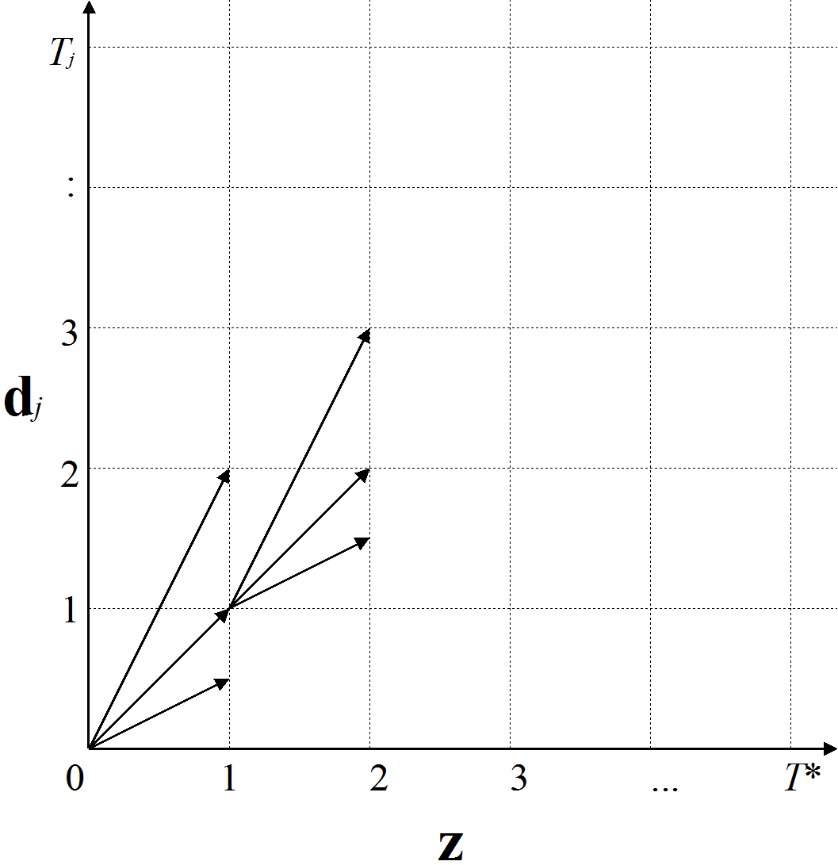
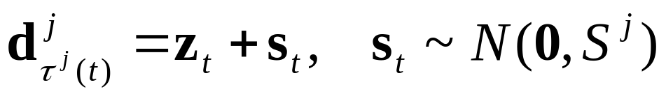
Dynamic Time Warping
Match demonstration j with z
Assume that demonstration moves locally
  twice as slow as z
  same pace as z
  twice as fast as z
Dynamic Programming
to find optimal “path”
Cost function: likelihood of

Slide 14
Example: Helicopter Airshow
Thesis work of Pieter Abbeel
Unaligned demonstrations:
  Movie
Time-aligned demonstrations:
  Movie
Execution of learnt
trajectory
  Movie

Slide 15
Example Surgical Knot-tie
ICRA 2010 Best Medical Robotics Paper Award
Video of knot-tie

Slide 16
Conclusion
Learning from demonstrations
Includes Dynamic Time Warping into
EM-algorithm

