Slide 1
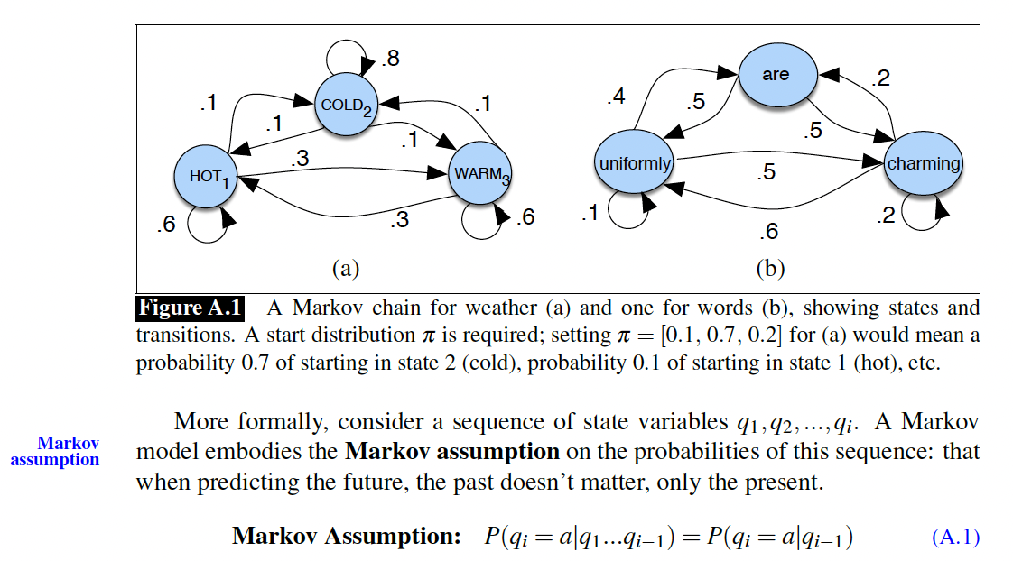
Markov Chains

Slide 2
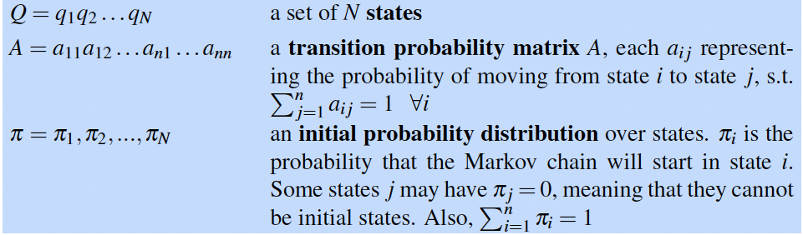
Markov Chains

Slide 3
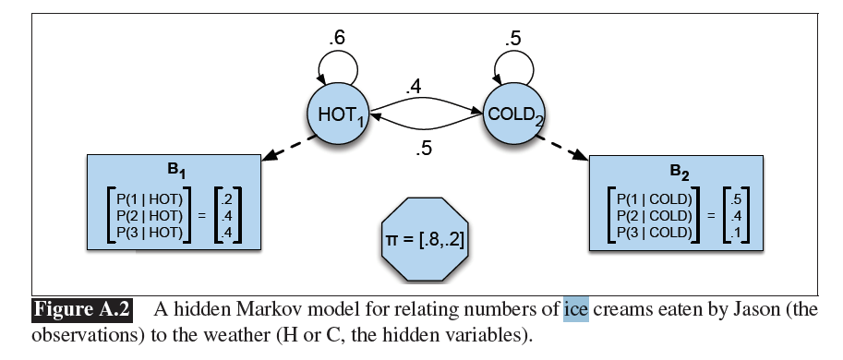
The Weather-Ice Cream HMM

Slide 4
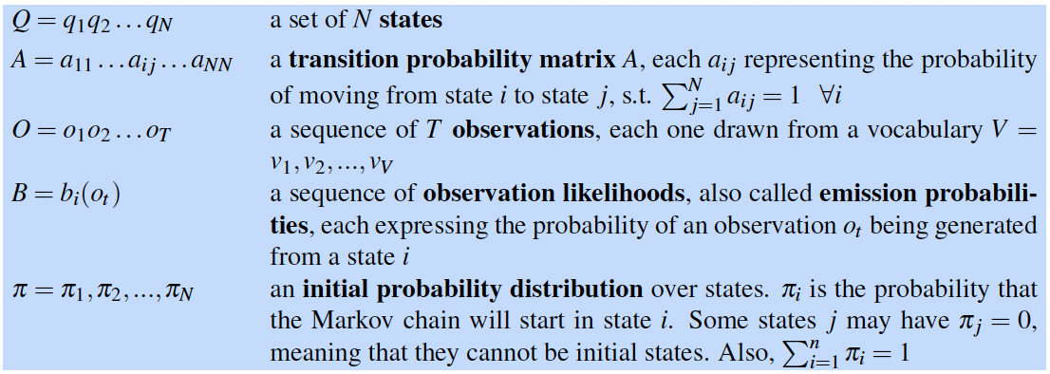
Hidden Markov Models

Slide 5
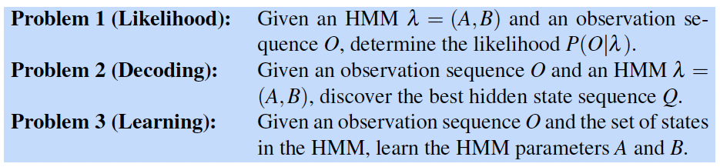
The three problems for HMMs

Slide 6
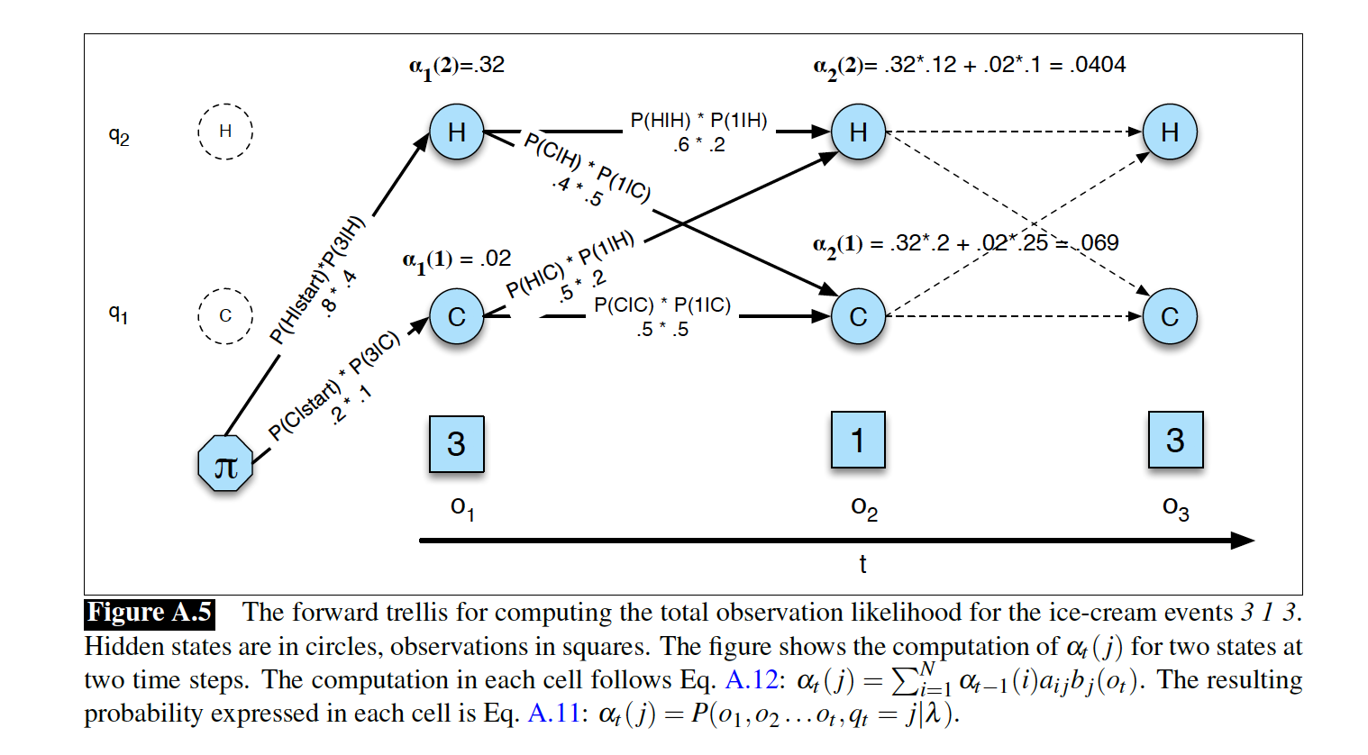

Slide 7
Probabilistic Graphical Models
Also known as Bayes Nets or Belief Nets
Judea Pearl of UCLA got a Turing award for his work on these
Special cases of these were known before e.g. Hidden Markov Models

Slide 8
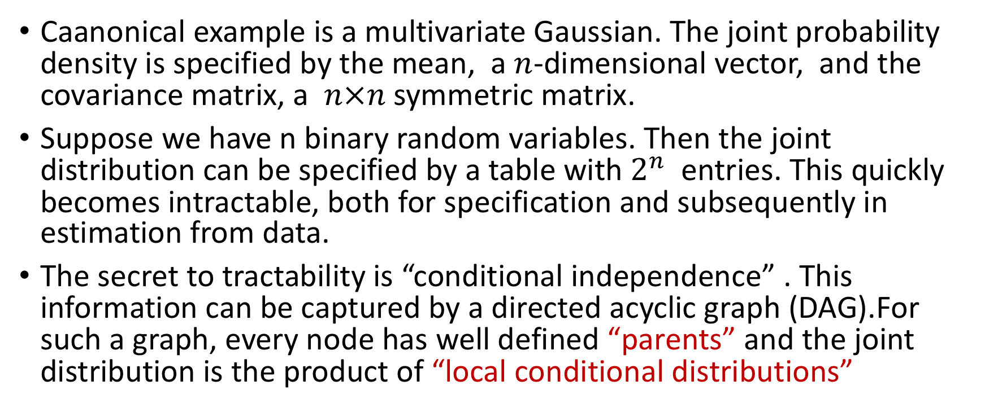
Joint probability distributions
Caanonical example is a multivariate Gaussian. The joint probability density is specified by the mean, a $n$-dimensional vector, and the covariance matrix, a $n×n$ symmetric matrix.
Suppose we have n binary random variables. Then the joint distribution can be specified by a table with $2^{n}$ entries. This quickly becomes intractable, both for specification and subsequently in estimation from data.
The secret to tractability is “conditional independence” . This information can be captured by a directed acyclic graph (DAG).For such a graph, every node has well defined “parents” and the joint distribution is the product of “local conditional distributions”

Slide 9
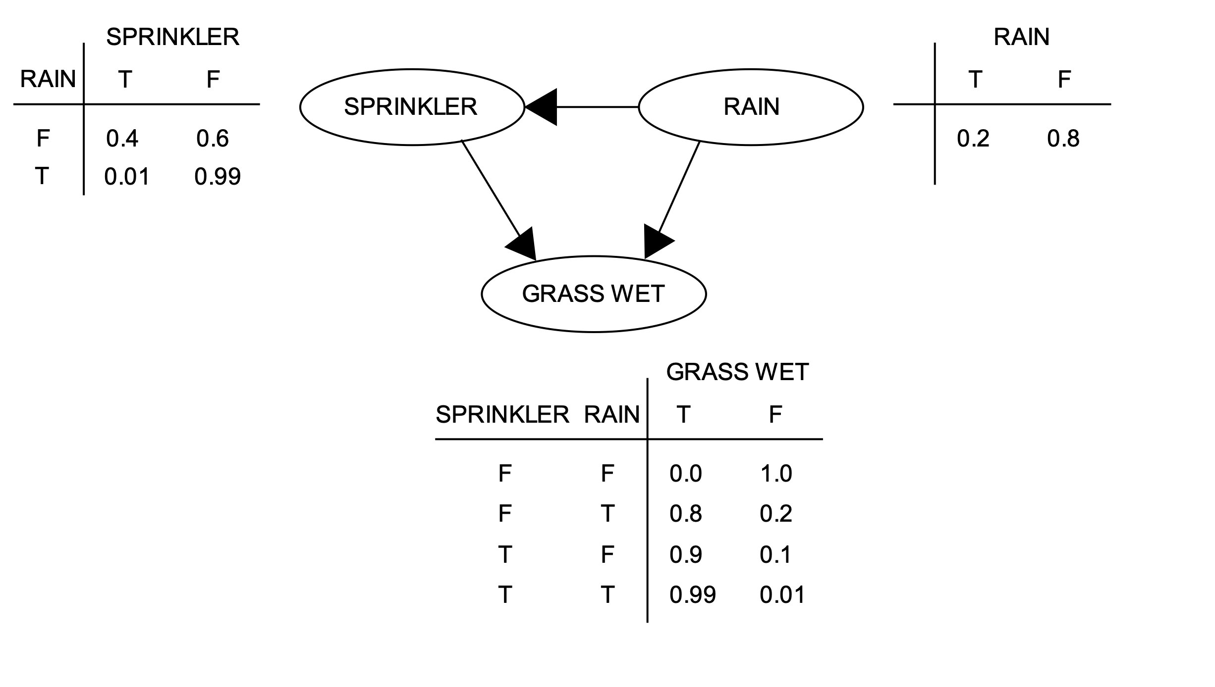
P(R,S,G) = P(R) P( S|R) P(G|S,R)

Slide 10
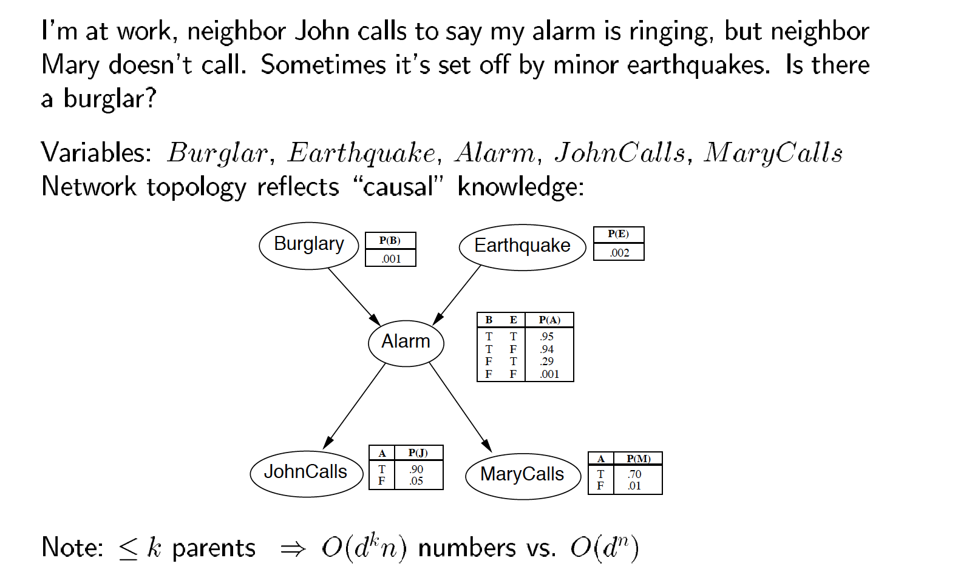
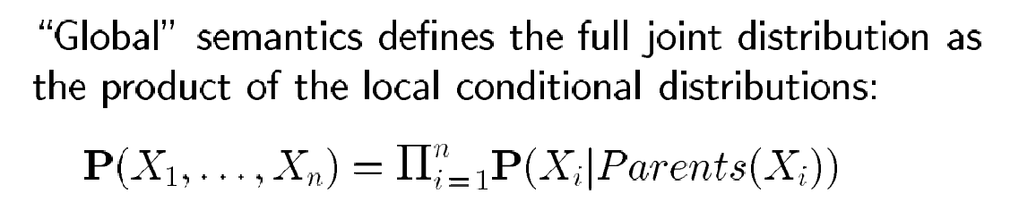

Slide 11























Slide 12
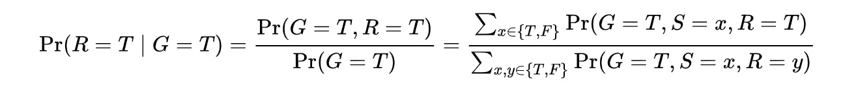
Given the joint probability distribution we can answer various questions
What is the probability that it is raining, given that the grass is wet?

Slide 13
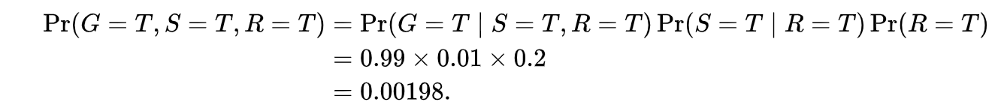
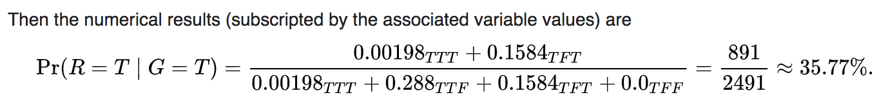
We can calculate the probability of any case using the joint probability distribution e.g.

Slide 14
The Weather-Ice Cream HMM (Source: Jurafsky HMM handout)
This is a stochastic automaton, not a DAG, but we can rewrite it as a DAG

Slide 15







DAG representation for the weather-ice cream model
We use $q_{1}$, $q_{2}$, $q_{3}$to denote the hidden states on day 1, 2, 3 etc.
We use $o_{1}$, $o_{2}$, $o_{3 }to$denote the observations on day 1, 2, 3 etc.
The $q_{i} can take one of two values \left\{hot,cold\right\}$
The $o_{i} can be one of three values \left\{1,2,3\right\} (number of ice−creams)$

Slide 17
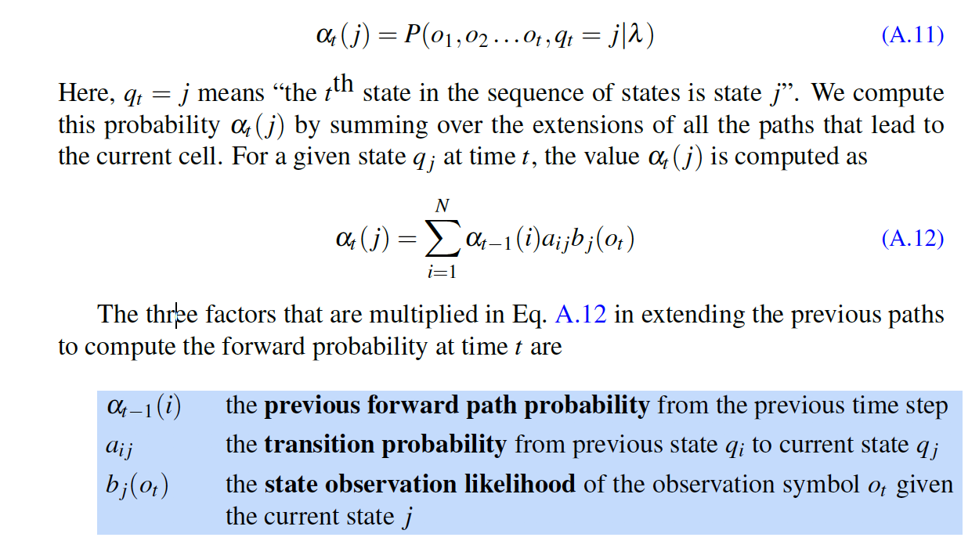

The $α$ update algorithm

Slide 18
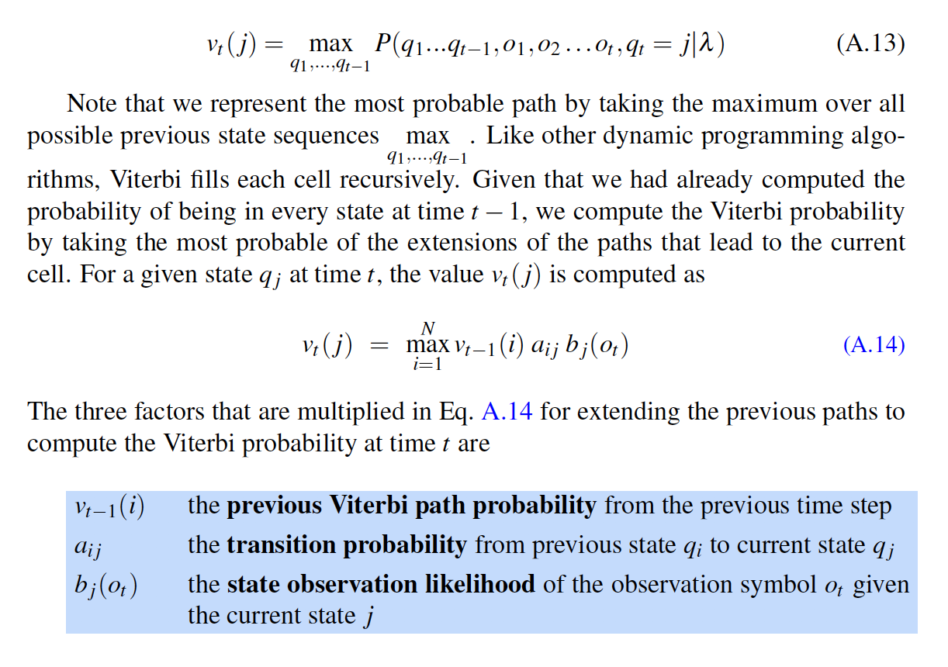
The Viterbi Algorithm: Sum replaced by Max

Slide 19
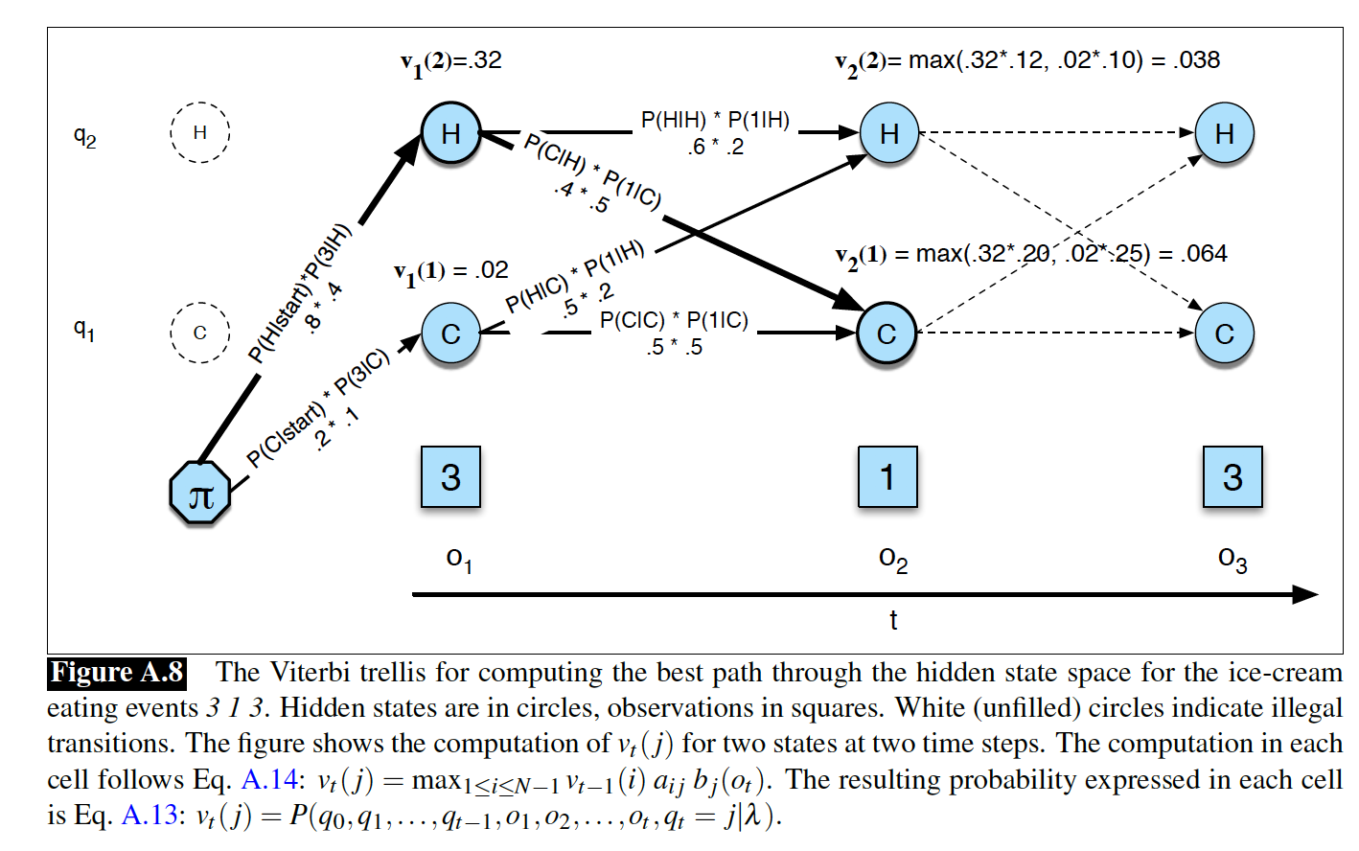

Slide 20
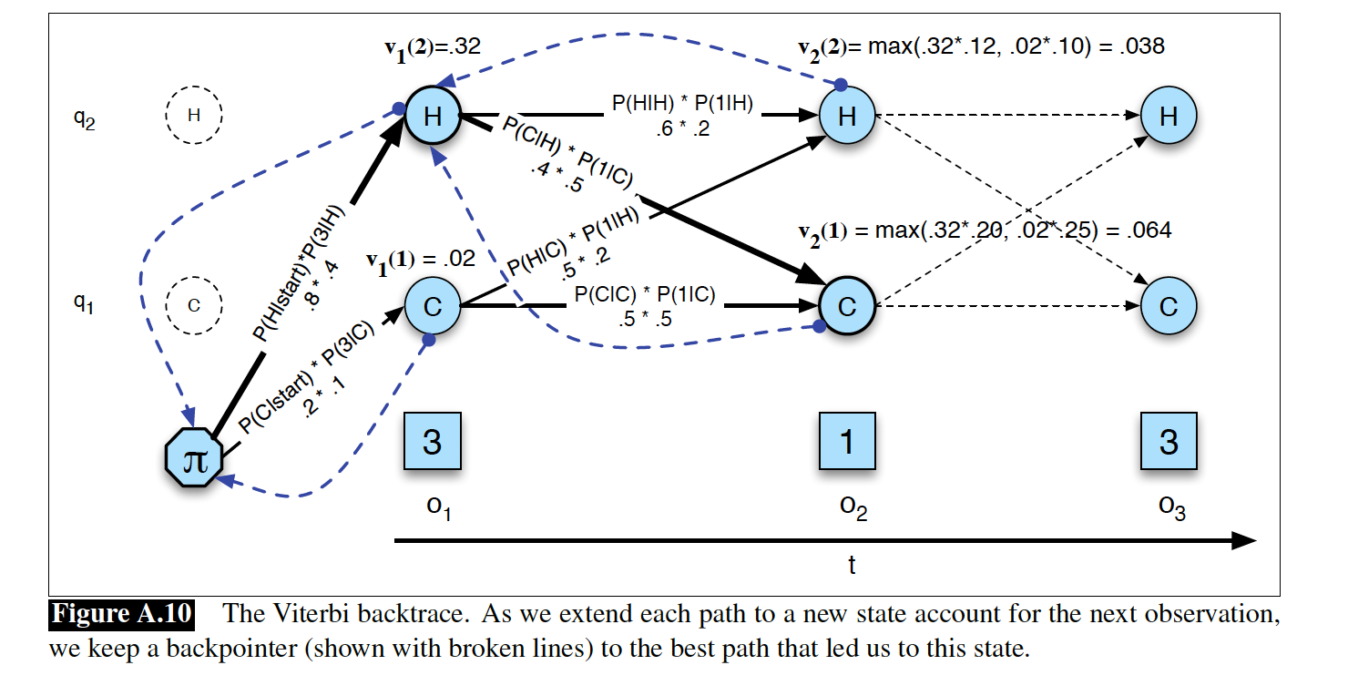
The Viterbi backtrace

