Slide 1


San Jose Earthquakes
Concessions Pricing Strategy
Kevin Wu | Nitin Manivasagan | Haoran Guo | Alex Heuer

Slide 2
Concessions Overview
Biggest sellers in biggest categories
Canned Soda
20 oz Bottled Water (43% of sales, 167,346 in revenue)
20 oz 7Up (16% of sales, 61,515 in revenue)
20 oz RC Cola (13% of sales, 50,601 in revenue)
A&W Rootbeer (7%, 28626)
Hot Dogs
Stadium Dog (64% of sales, 1258,394 in revenue)
Bratwurst (13%, 32886)
Polish Sausage (9%, 22824)
Linguica (8%, 19998)
Liquor
Premium Liquor (16% of sales, 54,180 in revenue)
Call Liquor (9%, 31842)
Jameson (7%, 24929)
Ketel One (7%, 23148)
Don Julio (6%, 22232)
Snacks
Bavarian Pretzel (62% of sales, 126,287 in revenue)
Kettle Corn (17%, 35476)
Peanuts (12%, 23575)

Slide 3
Recommendation
DECREASE BEER PRICES
INCREASE PRICES OF OTHER ITEMS
Assuming 20K attendance, 80% drinking age, 50% of those who purchase beers, avg 1 beer/person, we have 8000 potential bottles/cans sold
As of 2017, 6000 bottles/cans sold
Assume we can capture half of remaining potential sales, ~1000
Therefore, to break even, 15% price reduction in beer prices
Other inelastic items:
Hot dogs
Canned soft drinks
Snacks
Fried food
Possible to increase prices without losing too much revenue
We recommend that San Jose Earthquakes decrease beer prices by up to 15% and increase prices of other items to increase revenues

Slide 4
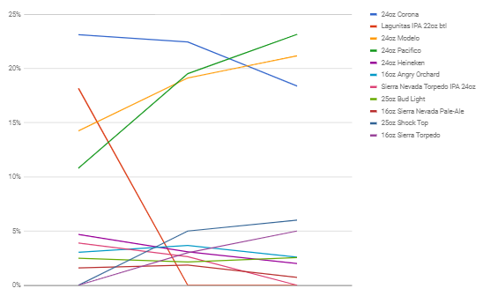
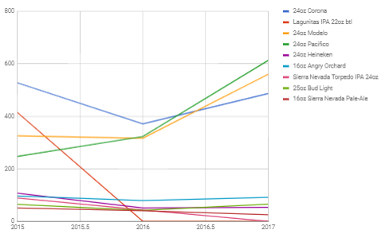
Canned Beer Analysis
Canned Beer Revenues
2015 – 2016:
5.25% overall increase in beer prices
33% drop in revenue
2016 – 2017:
1.23% increase in beer price
39% increase in revenue
Percent Share of Total Amount of Canned Beer
Canned Beer Trends
Overall Revenue
2015: $26,000
2016: $21,000
2017: $35,000
Dropping Lagunitas in 2016 significantly decreased revenues
Make points more prominent
Quantity Fluctuations in Canned Beer

Slide 5
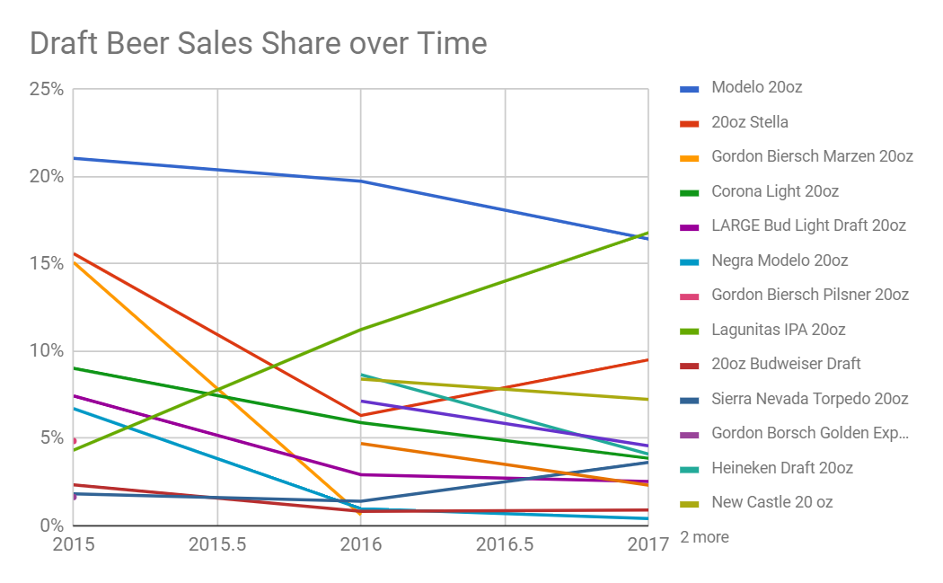
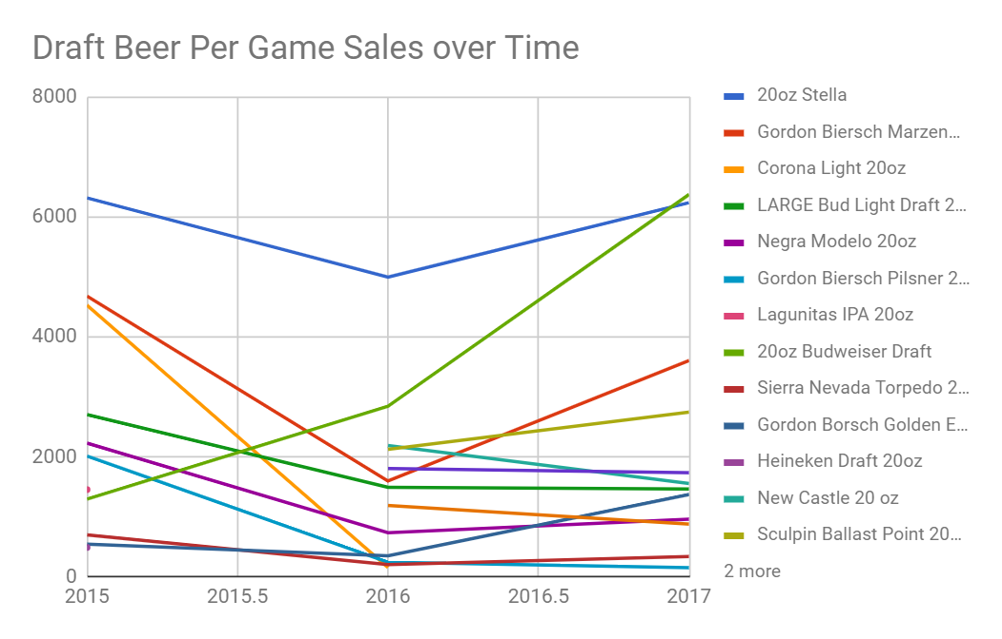
Draft Beer Analysis
2015-2016:
3% price increase
19% revenue decrease
2016-2017:
4% price increase
33% revenue increase
Lagunitas was added as a sponsor and several varieties of Lagunitas were newly added as draft beers in 2016. This resulted in a large spike in Lagunitas sales while Stella, and Gordon Biersch Marzen had huge decreases.
Overall Per Game Sales:
2015: $30,000
2016: $25,000
2017: $38,000

Slide 6
Price Changes
The five most important price points were $14.00, $13.25, $12.50, $11.25, and $10.00. Nearly all the canned and draft beers were sold at these price points.
Based on a 15% decrease that we believe will be beneficial, these prices become $11.9, $11.26, $10.63, $9.56, and $8.50.
Using basic psychological pricing (rounding to the nearest quarter, increasing price up to .75 from .50), these prices become $11.75, $11.25, $10.75, $9.75, and $8.75, respectively.

Slide 7
Risks and Mitigations
1
2
Risk: Possible Loss of Revenue
Mitigation: Selective automation and CSR campaign
Risk: Miscommunication of price decrease
Mitigation: Good marketing campaign to get words get

Slide 8
Appendix
Calculated % change in price/% change in revenue to be -0.06 by averaging the difference between 15-16 and 16-17, but that would yield an increase in revenues even with a price increase, which doesn’t make sense, so this was our approach given limited data.

