Slide 1
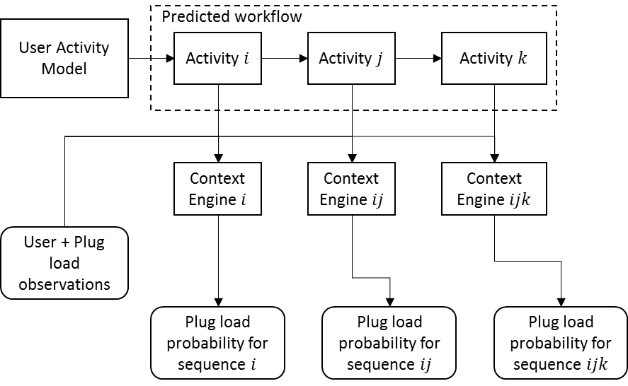
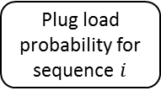





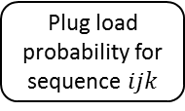

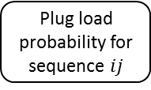
User Activity Model
Predicted workflow
Activity $i$
Activity $j$
Activity $k$
Context Engine$i$
Context Engine $ij$
Context Engine $ijk$
User + Plug load observations
Plug load probability for sequence $i$
Plug load probability for sequence $ij$
Plug load probability for sequence $ijk$

Slide 2
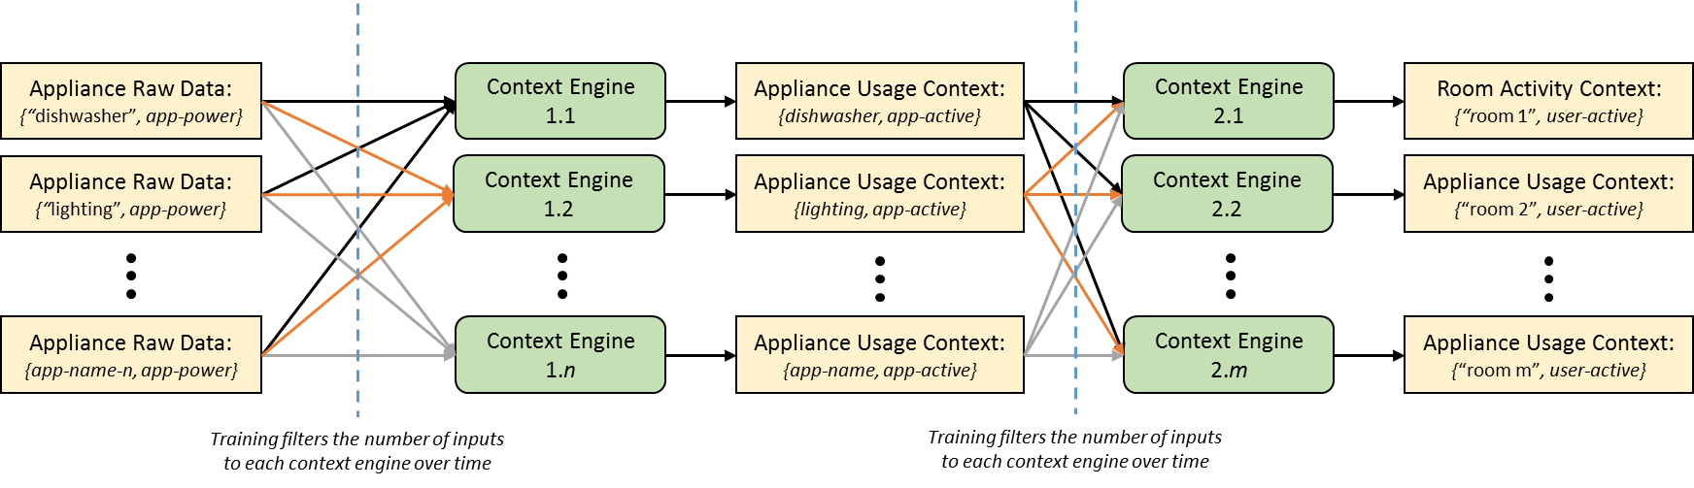
Appliance Raw Data:
{“dishwasher”, app-power}
Context Engine 1.1
Appliance Usage Context:
{dishwasher, app-active}
Context Engine 2.1
Room Activity Context:
{“room 1”, user-active}
Appliance Raw Data:
{“lighting”, app-power}
Context Engine 1.2
Appliance Usage Context:
{lighting, app-active}
Context Engine 2.2
Appliance Usage Context:
{“room 2”, user-active}
Appliance Raw Data:
{app-name-n, app-power}
Context Engine 1.n
Appliance Usage Context:
{app-name, app-active}
Context Engine 2.m
Appliance Usage Context:
{“room m”, user-active}
Training filters the number of inputs to each context engine over time
Training filters the number of inputs to each context engine over time

