Slide 1
Chapter 8
The Enhanced Entity-Relationship (EER) Model

Slide 2
Chapter 8 Outline
Subclasses, Superclasses, and Inheritance
Specialization and Generalization
Constraints and Characteristics of Specialization and Generalization Hierarchies
Modeling of UNION Types Using Categories

Slide 3
Chapter 8 Outline (cont’d.)
A Sample UNIVERSITY EER Schema, Design Choices, and Formal Definitions
Example of Other Notation: Representing Specialization and Generalization in UML
Class Diagrams
Data Abstraction, Knowledge Representation, and Ontology Concepts

Slide 4
The Enhanced Entity-Relationship (EER) Model
Enhanced ER (EER) model
  Created to design more accurate database schemas
    Reflect the data properties and constraints more precisely
  More complex requirements than traditional applications

Slide 5
Subclasses, Superclasses, and Inheritance
EER model includes all modeling concepts of the ER model
In addition, EER includes:
  Subclasses and superclasses
  Specialization and generalization
  Category or union type
  Attribute and relationship inheritance

Slide 6
Subclasses, Superclasses, and Inheritance (cont’d.)
Enhanced ER or EER diagrams
  Diagrammatic technique for displaying these concepts in an EER schema
Subtype or subclass of an entity type
  Subgroupings of entities that are meaningful
  Represented explicitly because of their significance to the database application

Slide 7
Subclasses, Superclasses, and Inheritance (cont’d.)
Terms for relationship between a superclass and any one of its subclasses
  Superclass/subclass
  Supertype/subtype
  Class/subclass relationship
Type inheritance
  Subclass entity inherits all attributes and relationships of superclass

Slide 8
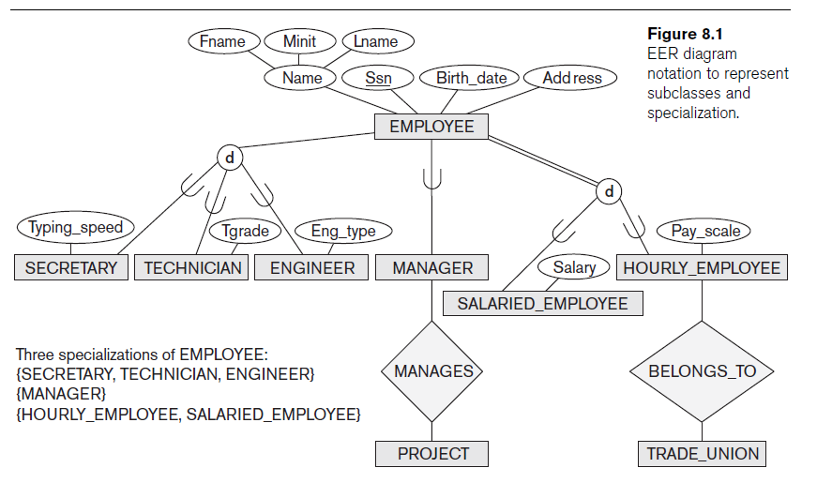

Slide 9
Specialization and Generalization
Specialization
  Process of defining a set of subclasses of an entity type
  Defined on the basis of some distinguishing characteristic of the entities in the superclass
Subclass can define:
  Specific attributes
  Specific relationship types

Slide 10
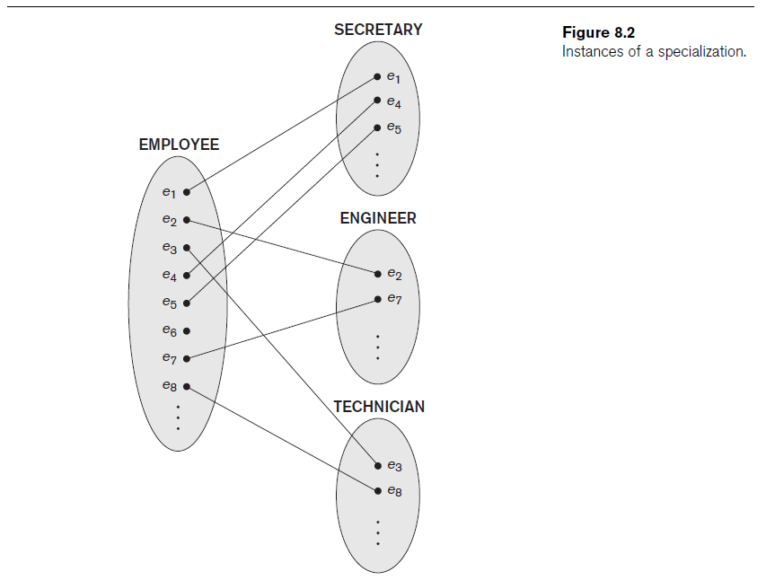

Slide 11
Specialization and Generalization (cont’d.)
Certain attributes may apply to some but not all entities of the superclass
Some relationship types may be participated in only by members of the subclass

Slide 12
Generalization
Reverse process of abstraction
Generalize into a single superclass
  Original entity types are special subclasses
Generalization
  Process of defining a generalized entity type from the given entity types

Slide 13
Constraints and Characteristics of Specialization and Generalization Hierarchies
Constraints that apply to a single specialization or a single generalization
Differences between specialization/
generalization lattices and hierarchies

Slide 14
Constraints on Specialization and Generalization
May be several or one subclass
Determine entity subtype:
  Predicate-defined (or condition-defined) subclasses
  Attribute-defined specialization
  User-defined

Slide 15
Constraints on Specialization and Generalization (cont’d.)
Disjointness constraint
  Specifies that the subclasses of the specialization must be disjoint
Completeness (or totalness) constraint
  May be total or partial
Disjointness and completeness constraints are independent

Slide 16
Specialization and Generalization Hierarchies and Lattices
Specialization hierarchy
  Every subclass participates as a subclass in only one class/subclass relationship
  Results in a tree structure or strict hierarchy
Specialization lattice
  Subclass can be a subclass in more than one class/subclass relationship

Slide 17
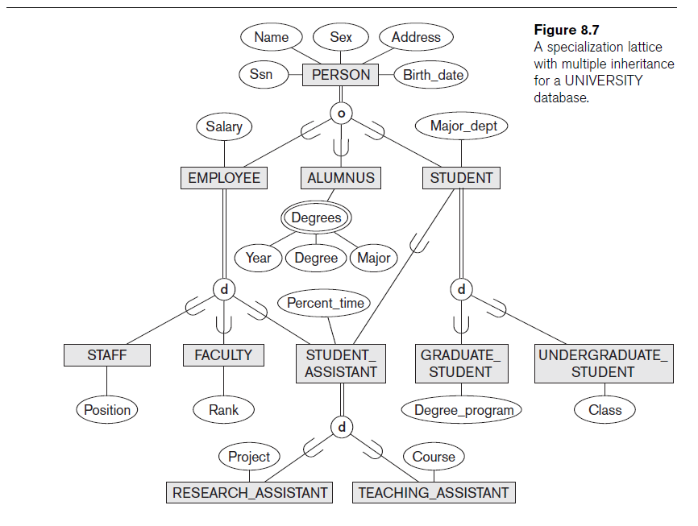

Slide 18
Specialization and Generalization Hierarchies and Lattices (cont’d.)
Multiple inheritance
  Subclass with more than one superclass
  If attribute (or relationship) originating in the same superclass inherited more than once via different paths in lattice
    Included only once in shared subclass
Single inheritance
  Some models and languages limited to single inheritance

Slide 19
Utilizing Specialization and Generalization in Refining Conceptual Schemas
Specialization process
  Start with entity type then define subclasses by successive specialization
  Top-down conceptual refinement process
Bottom-up conceptual synthesis
  Involves generalization rather than specialization

Slide 20
Modeling of UNION Types Using Categories
  Union type or a category
  Represents a single superclass/subclass relationship with more than one superclass
  Subclass represents a collection of objects that is a subset of the UNION of distinct entity types
  Attribute inheritance works more selectively
  Category can be total or partial
Some modeling methodologies do not have union types

Slide 21
A Sample UNIVERSITY EER Schema, Design Choices, and Formal Definitions
The UNIVERSITY Database Example
  UNIVERSITY database
    Students and their majors
    Transcripts, and registration
    University’s course offerings

Slide 22
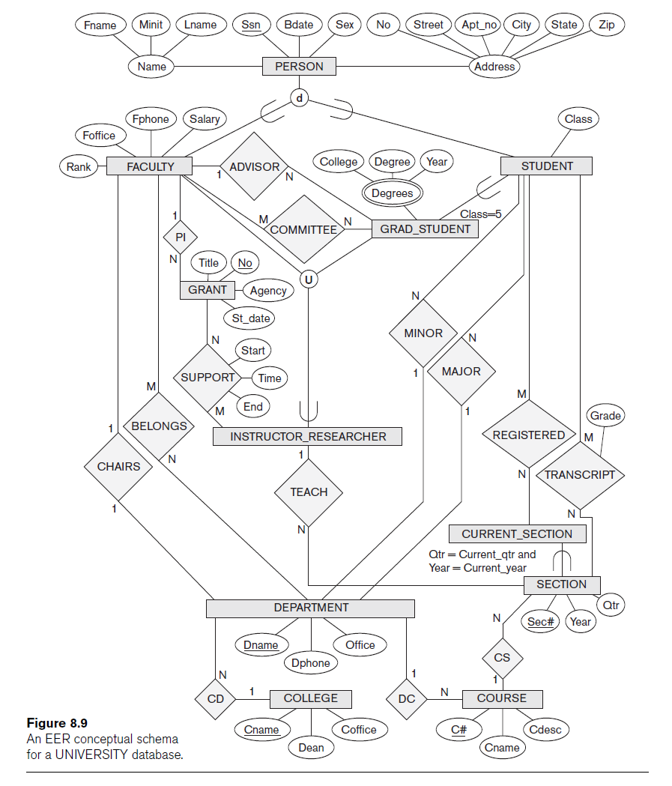

Slide 23
Design Choices for Specialization/Generalization
Many specializations and subclasses can be defined to make the conceptual model accurate
If subclass has few specific attributes and no specific relationships
  Can be merged into the superclass

Slide 24
Design Choices for Specialization/Generalization (cont’d.)
If all the subclasses of a specialization/generalization have few specific attributes and no specific relationships
  Can be merged into the superclass
  Replace with one or more type attributes that specify the subclass or subclasses that each entity belongs to

Slide 25
Design Choices for Specialization/Generalization (cont’d.)
Union types and categories should generally be avoided
Choice of disjoint/overlapping and total/partial constraints on specialization/generalization
  Driven by rules in miniworld being modeled

Slide 26
Formal Definitions for the EER Model Concepts
Class
  Set or collection of entities
  Includes any of the EER schema constructs of group entities
Subclass
  Class whose entities must always be a subset of the entities in another class
Specialization
  Set of subclasses that have same superclass

Slide 27
Formal Definitions for the EER Model Concepts (cont’d.)
Generalization
  Generalized entity type or superclass
Predicate-defined
  Predicate on the attributes of is used to specify which entities in C are members of S
User-defined
  Subclass that is not defined by a predicate

Slide 28
Formal Definitions for the EER Model Concepts (cont’d.)
Category
  Class that is a subset of the union of n defining superclasses
Relationship type
  Any class can participate in a relationship

Slide 29
Example of Other Notation
Representing specialization and generalization in UML class diagrams
  Basic notation
    See Figure 8.10
  Base class
    Root superclass
  Leaf classes
    Subclasses (leaf nodes)

Slide 30
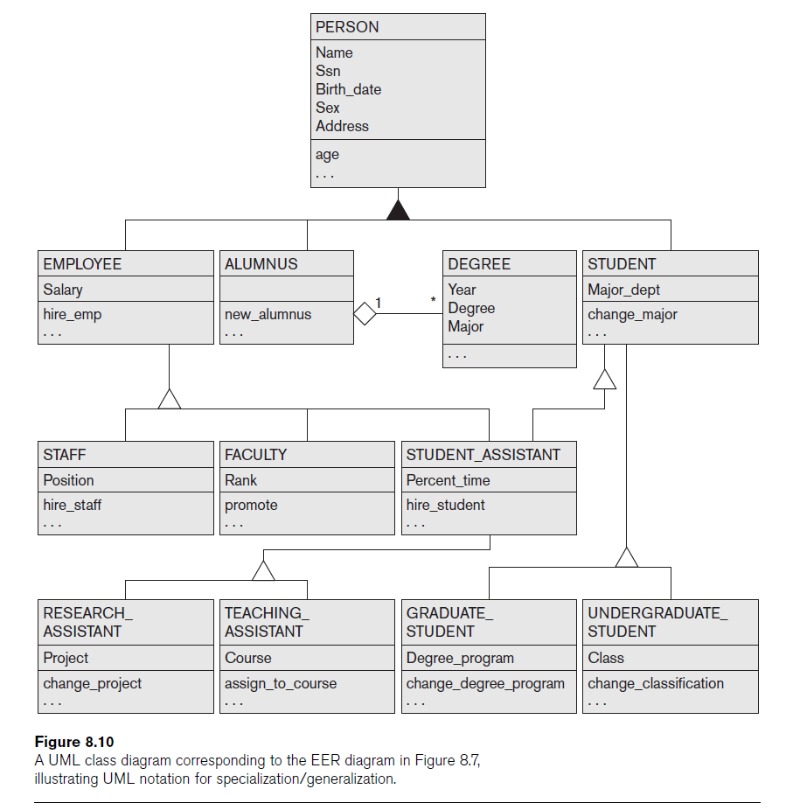

Slide 31
Data Abstraction, Knowledge
Representation, and Ontology Concepts
Goal of knowledge representation (KR) techniques
  Accurately model some domain of knowledge
  Create an ontology that describes the concepts of the domain and how these concepts are interrelated
Goals of KR are similar to those of semantic data models
  Important similarities and differences

Slide 32
Classification and Instantiation
Classification
  Systematically assigning similar objects/entities to object classes/entity types
Instantiation
  Inverse of classification
  Generation and specific examination of distinct objects of a class

Slide 33
Classification and Instantiation (cont’d.)
Exception objects
  Differ in some respects from other objects of class
    KR schemes allow such class properties
One class can be an instance of another class (called a meta-class)
  Cannot be represented directly in EER model

Slide 34
Identification
Abstraction process
Classes and objects are made uniquely identifiable by means of some identifier
Needed at two levels
  To distinguish among database objects and classes
  To identify database objects and to relate them to their real-world counterparts

Slide 35
Specialization and Generalization
Specialization
  Classify a class of objects into more specialized subclasses
Generalization
  Generalize several classes into a higher-level abstract class
  Includes the objects in all these classes

Slide 36
Aggregation and Association
Aggregation
  Abstraction concept for building composite objects from their component objects
Association
  Associate objects from several independent classes
Main structural distinction
  When an association instance is deleted
    Participating objects may continue to exist

Slide 37
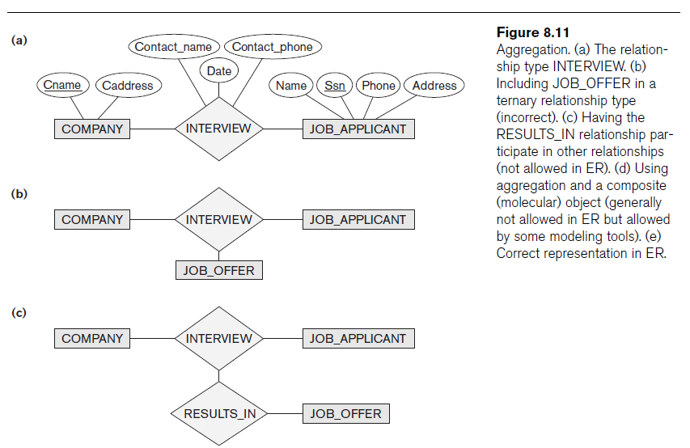

Slide 38
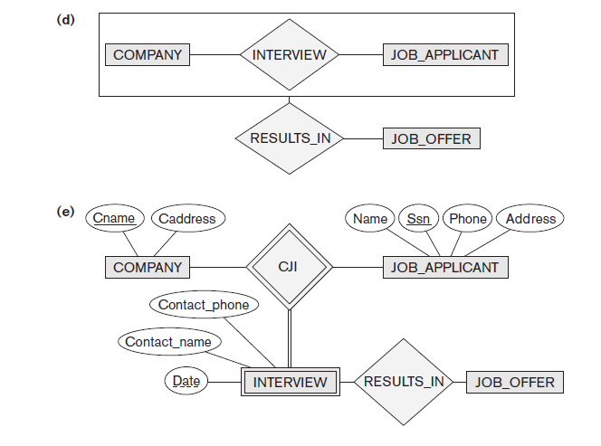
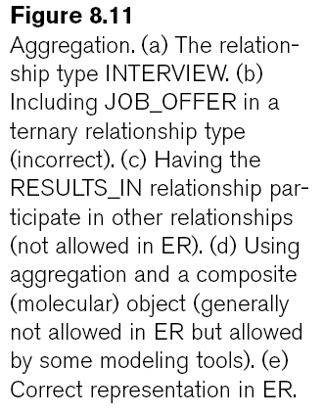

Slide 39
Ontologies and the Semantic Web
Documents contain less structure than database information does
Semantic Web
  Allow meaningful information exchange and search among machines
Ontology
  Specification of a conceptualization
Specification
  Language and vocabulary terms used to specify conceptualization

Slide 40
Summary
Enhanced ER or EER model
  Extensions to ER model that improve its representational capabilities
  Subclass and its superclass
  Category or union type
Notation and terminology of UML for representing specialization and generalization

