Slide 6
Titelmasterformat durch Klicken bearbeiten Titelmasterformat durch Klicken bearbeiten
Erste Ebene
Zweite Ebene
Dritte Ebene
Vierte Ebene

Slide 7
Thesis Outline
Introduction
Related Work
Overview and Background
Hardware Architechture
Power managment Methods
Roofline Model
Refined Roofline Model
Memory and Cache Latency Explained
Imporve Roofline Model with Higer Accuracy
Sampling method
Implementation and Experiment
Evaluation
Roofline Model Power saving
Slowdown
Conclusion

Slide 8
Titelmasterformat durch Klicken bearbeiten Titelmasterformat durch Klicken bearbeiten
Bildtitel oder ggf. Beschreibung

Slide 9
Benchmark
Memory Intensive Benchmark
Stream_DRAM
Size is enough for DRAM testing, meaning problem size > L3 cache size
CG CLASS=C
Irregular memory access and communication
MG CLASS=B
Multi-Grid on a sequence of meshes, long- and short-distance communication, memory intensive

Slide 10
Benchmark
Compute Intensive Benchmark
Stream_L3
Total memory required = 20.6 MiB, meaning it is suitable for L3 cache testing
EP Embarrassingly Parallel

Slide 11
Memory Intensive Benchmark
Comparison
Default
Constant core and uncore frequency
CoreFreq = 2.8GHz UncoreFreq = 3.0 GHz
Sampling
Dynamicaly changes core and uncore freqency
Observation:
Core/Uncore Freq , PKG power, Energy and time

Slide 12
Memory Intensive Programs
Stream_DRAM
CoreFreq/Hz
Runtime/s

Slide 13
Memory Intensive Programs
Stream_DRAM
PKG power/W
Runtime

Slide 14
Memory Intensive Programs
MG CLASS=B
CoreFreq/Hz
Runtime

Slide 15
Memory Intensive Programs
MG CLASS=B
PKG Power/W
Runtime

Slide 16
Memory Intensive Programs
CG CLASS=C
CoreFreq/GHz
Runtime

Slide 17
Memory Intensive Programs
CG CLASS=C
PKG power/W
Runtime

Slide 18
Comput Intensive Programs
Stream_L3
UncoreFreq/Hz
Runtime

Slide 19
Comput Intensive Programs
Stream_L3
PKG Power/W
Runtime

Slide 20
Comput Intensive Programs
EP
UncoreFreq/Hz
Runtime

Slide 21
Comput Intensive Programs
EP
PKG Power/W
Runtime

Slide 22
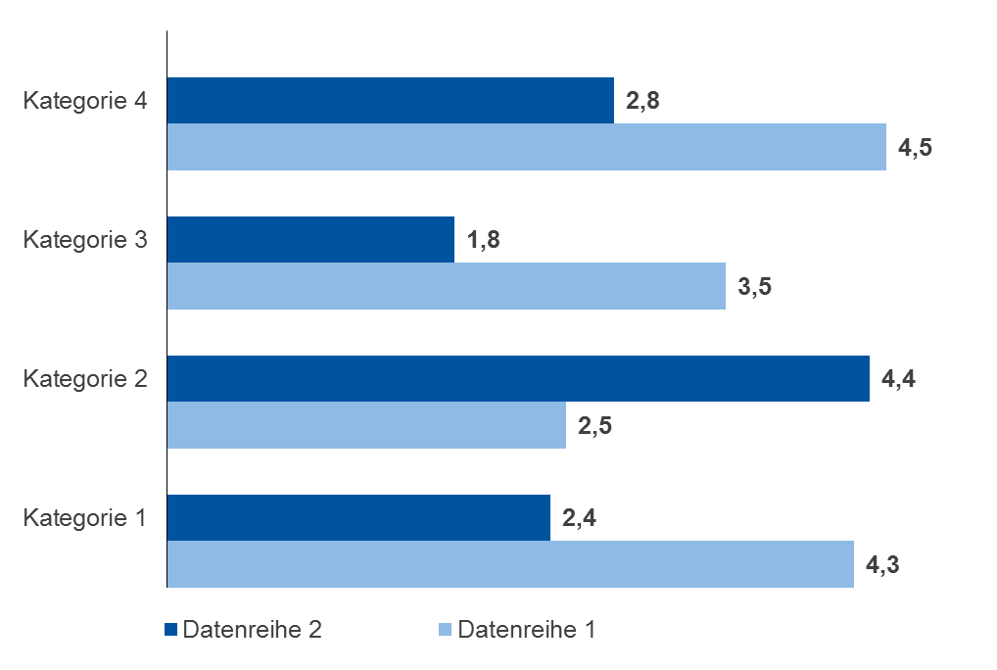
Titelmasterformat durch Klicken bearbeiten Titelmasterformat durch Klicken bearbeiten
Text durch Klicken hinzufügen

Slide 23
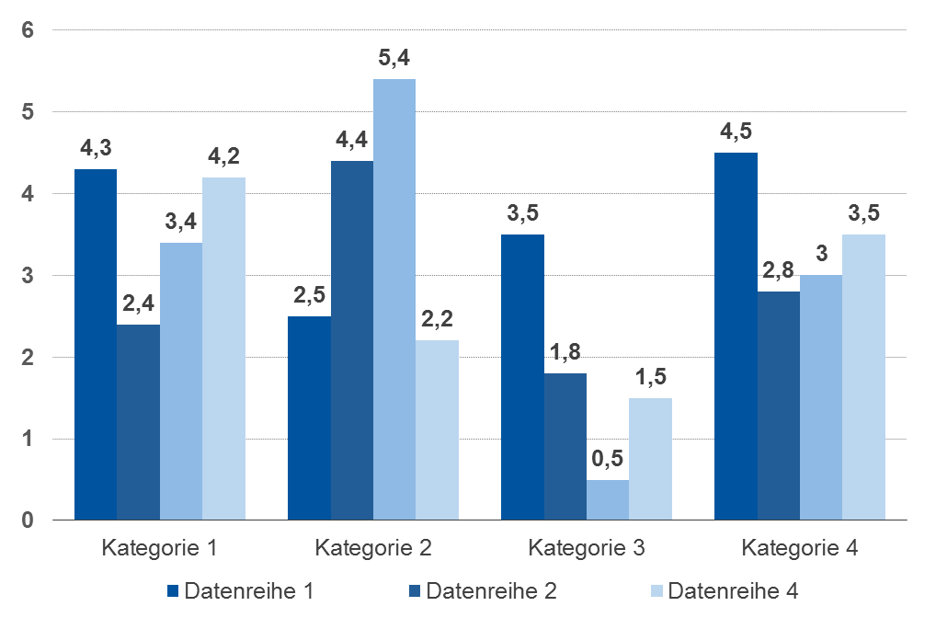
Titelmasterformat durch Klicken bearbeiten Titelmasterformat durch Klicken bearbeiten
Text durch Klicken hinzufügen

Slide 24
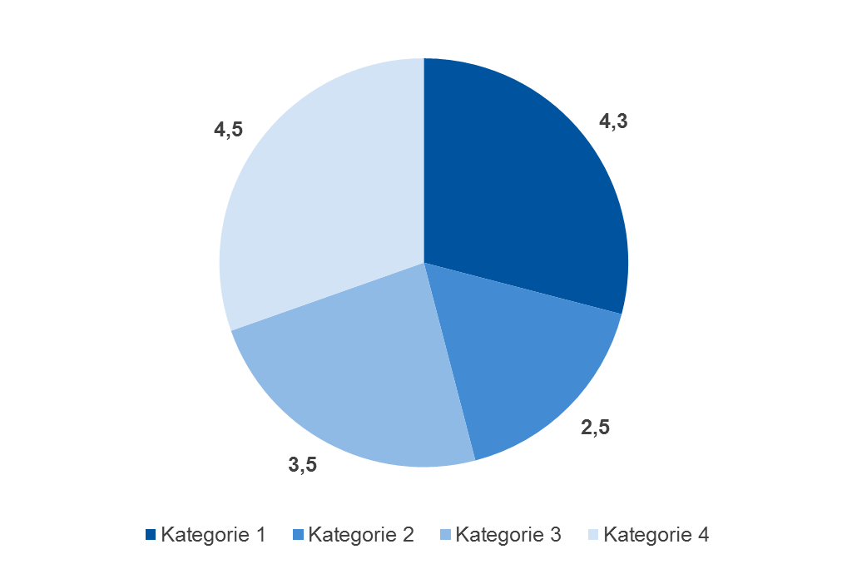
Titelmasterformat durch Klicken bearbeiten Titelmasterformat durch Klicken bearbeiten
Text durch Klicken hinzufügen

