Slide 1
A Deep Dive into Memory Access: Extended Roofline for Power Management
Presentation of Bachelor Thesis
First examiner: Prof. Dr. Matthias Müller
Second examiner: Prof. Dr. Martin Schulz
Adviser: M. Sc. Bo Wang
Lehrstuhl für Hochleistungsrechnen (Informatik 12), IT Center, RWTH Aachen
Lehrstuhl für Rechnerarchitektur & Parallele Systeme. Technische Universität München
Liangkun He, 27.07.2021
Notes:
Hello everyone I‘m going to talk about power and energy optimization for supercomputers. In this work, I implemented the Roofline model on a HPC system with multiple levels of memory hierarchy to identify the performance bottlenecks of different applications. Based on the performance bottlenecks it modify the clock frequency of the processor during runtime to reduce the power consumption and try not to downgrade the performance in the mean time. The traditional Roofline model visualizes the performance bottlenecks as either compute-bound or memory-bound. In this work, I analyzed the memory accesses further and extended the Roofline model with the latency bottleneck.

Slide 2
Outline
Motivation
Background
Roofline Model
Extended Roofline Model
Implementation
Evaluation
Summary
Notes:
Today’s outline begins with the motivation and the scientific backgrounds. After that I will talk about the Roofline model and explain how extended roofline model works. Then I will talk about implementations and followed by evaluations. Last but not the least, the summary which includes conclusion and future work.

Slide 3
Motivation
Supercomputer’s power consumption is significant
Fugaku is the top one supercomputer. It consumes 28.3MW to deliver 415.53 Pflops/s [1]
Large power consumption brings many problems
High energy cost
Heats dissipation
High carbon dioxide emissions
Exascale supercomputer (1ExaFlop/s=10³ PFlop/s)
Next generation supercomputers that yet to come
Performance tuning
Power consumption cannot exceed the power budget
Performance and power consumption optimizations are important
[2]
Notes:
The computing speed of supercomputers has grown quickly recent years. Faster computers always have greater power consumptions. Fugaku is now the top one supercomputer in the world. It operates at 28 mega watt to deliver more than 400 peta flops per second. Supercomputers with such a huge power consumption costs not only tons of energy but also has challenging heats dissipation problems. It also generates a large amount of carbon dioxide which is bad for the environment. The exascale computer is the next generation supercomputers that yet to come. It will be at least 1000 time faster than current peta scale systems. Clearly, we cannot allow the power comsumption to increase a thousand time anymore. As a result, performance tuning is very important. We need to optimize the performance and power consumption to maintain the power budget.

Slide 4
Motivation
Study the processor architecture
Core vs. uncore
Different components of a processor have their individual frequency
Implement the Roofline model based on the sampling approach
Identify the execution patterns of an application for each sampling intervals
Compute bound or memory bound
Modify each component’s frequency respectively during runtime to optimize the performance and power consumption
Propose the time interval analysis method
Analyse the activities of CPU and memory for each sampling intervals
Extend the Roofline model with the latency bottleneck
Evaluate the implementation on different benchmarks
Contribution
Notes:
This work makes the following contributions. First, I study the processor architecture. Modern processors consist of different components namely core and uncore. Each component has its individual clock frequency. Then I implement the Roofline model based on the sampling approach. There are previous works that using the profiling approach. I use the Roofline model to identify whether the application is compute bound or memory bound and change each components’ frequency respectively to optimize the performance and reduce power consumption. I also propose a method called time interval analysis. It analyses the CPU and memory’s activities for each sampling intervals. Combining the Roofline model with this method, it is able to detect the latency bottleneck. Finally, I evaluate the implementation on different benchmarks.

Slide 5
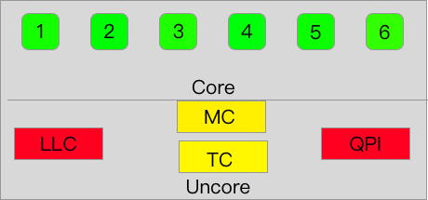
Background
Compute-intensive
DRAM Power
Processor Architechture
Core and Uncore
ALU,FPU,L1 & L2 Cache
DRAM:
Main Memory
Package Power
Memory controller
Power control unit
PCU
Last level cache
Quick path interconnection
Non-compute-intensive
Notes:
Let’s take a look at a processor. The processor consists of 2 components namely core and uncore. Core contains arithmetic logic unit(on integer number), floating point unit, and upper level caches. It is responsible for all computational works. Uncore on the other hand, is responsible for non computational works. The MC is responsible for the data transfer with memory. The LLC is a small but fast memory that integrated in the uncore so that the core can fetch the data faster. The power control unit monitor the power consumption and temperature of the processor. The QPI is responsible for communications between sockets. The package power is the total power consumption of the core and uncore.

Slide 6
Background
Running Average Power Limit(RAPL)
Set power cap for processors in a time interval
Keep the core or uncore frequency low to make sure they do not exceed the power cap
RAPL is not aware of the execution patterns of the running application
Compute intensive or memory intensive
For memory intensive application such as Stream benchmark, RAPL may reduce the uncore frequency and thus lower the performance
…
Notes:
RAPL is the easy way to limit the power consumption. It sets a power cap for processors in a time interval to make sure they do not exceed the power budget. However, RAPL does not know when it is compute bound or memory bound. For example, if a memory bound benchmark like stream is running, RAPL may as well reduce the uncore frequency which has negative impact on performance.

Slide 7
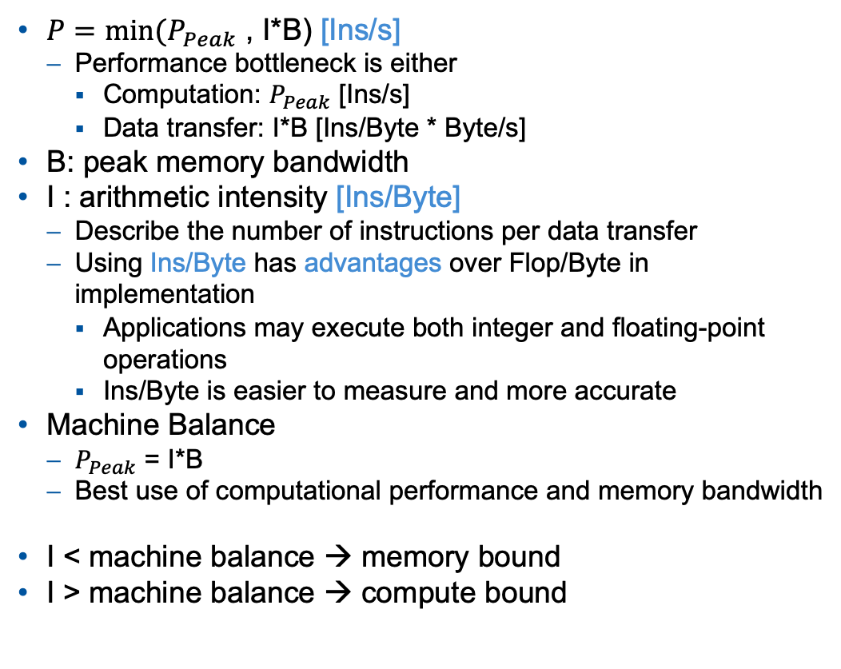
Roofline Model
$P=min⁡(P_{Peak}$ , I*B) [Ins/s]
Performance bottleneck is either
Computation: $P_{Peak}$ [Ins/s]
Data transfer: I*B [Ins/Byte * Byte/s]
B: peak memory bandwidth
I : arithmetic intensity [Ins/Byte]
Describe the number of instructions per data transfer
Using Ins/Byte has advantages over Flop/Byte in implementation
Applications may execute both integer and floating-point operations
Ins/Byte is easier to measure and more accurate
Machine Balance
$P_{Peak}$ = I*B
Best use of computational performance and memory bandwidth
I < machine balance → memory bound
I > machine balance → compute bound
attainable ins/s
Peak ins/s
I*B
Memory bound
Compute bound
Machine balance
arithmetic intensity (ins/byte)
Notes:
That’s why I choose roofline model as the basic approach. The Roofline model determines the performance bottleneck as either the computation or the data transfer. If the performance is bounded to the computation, the maximal performance is P_peak. The unit is instruction per second. If the bottleneck is data transfer, the maximal performance is I times B. B is the peak memory bandwidth, the unit is Byte per second. I is the arithmetic intensity, the unit is instruction per byte. It is the number of instructions executed per data transfer. Both of them are upper limit. The maximal attainable performance is therefore the minimum of them.
The traditional Roofline model uses the unit Flop/s for performance and flop/byte for intensity. In this work, I use instruction per second and instruction per byte because applications may not 100% execute floating point operations. They could use both integer and floating point operations. Instruction per byte is easier to measure and more accurate for most apps.
If we draw the Roofline model we have this figure. The x-axis… the y-axis… If the intensity is low, on the left side of the knee point, the application is memory bound. If the intensity is higher than the reflection point, it’s compute bound. This point is called machine balance where the p_peak equals I*B. Meaning that the app makes best use of all the resources. It makes use of full computational performance and full memory bandwidth.
For memory bound applications, we can reduce the core frequency and keep uncore frequency higher. For compute bound apps, we keep the core frequency high and lower the uncore frequency respectively.

Slide 8
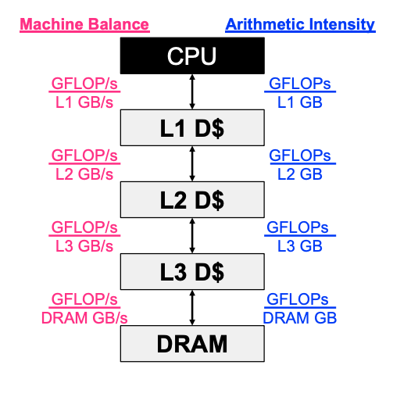
Roofline Model
Memory hierarchy
Cache
Small but fast memory that are integrated in the processor
Each level has its own bandwidth hence diffenrent machine balances
The amounts of data that transfered between memory levels are different hence different arithmetic intensities
[3]
Notes:
Today's supercomputers have different levels of memory hierarchy. Processors' speed is way faster than the main memory. In order to fill the gab between processors and the main memory, the cache is introduced. Processors always look into upper-level-caches first (usually the L1 and L2 cache). They are located in the core and way faster. If there are any cache misses, it will check the lower levels respectively. Since each level has different bandwidth, they certainly have different machine balances. Applications have locality in each level, so the amount of data transfer for each level is also different, as a result, we have to calculate the arithmetic intensity for each level.

Slide 9
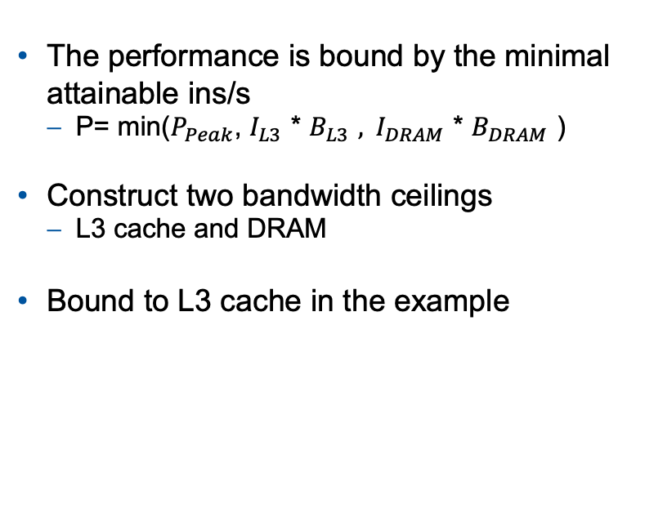
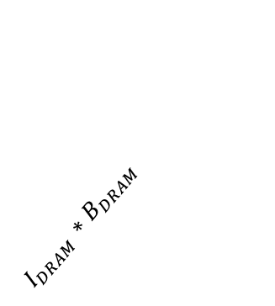
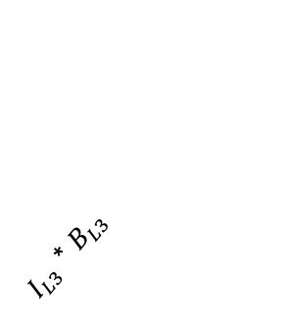
Roofline Model
This work focuses on L3 cache and DRAM levels
The performance is bound by the minimal attainable ins/s
P= min($P_{Peak}$, $I_{L3 }$* $B_{L3 }, I_{DRAM }\text{* }B_{DRAM }$)
Construct two bandwidth ceilings
L3 cache and DRAM
Bound to L3 cache in the example
Attainable ins/s
$I_{L3 }$* $B_{L3 }$
$I_{DRAM }\text{∗ }B_{DRAM }$
Balance L3
Balance DRAM
arithmetic intensity (ins/byte)
Notes:
In this work, I observe two memory levels namely L3 cache and DRAM. In the Roofline equation, I can add the arithmetic intensity depending on which memory level it is. To visualize the hierarchical Roofline, I construct two bandwidth ceilings. One for L3 and the other for DRAM. In this example, the performance is bound to L3 cache.

Slide 10
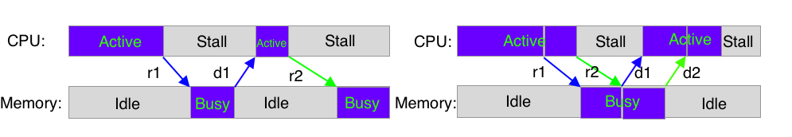
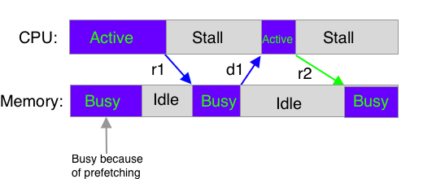
Roofline Model
Assumption
Computation and data transfer between CPU and memory overlap perfectly.(ignore memory latency)
Fact
Memory latency may not be eliminated completely
Out-of-order execution:
Hardware prefetching:
In-order execution
Out-of-order execution
Notes:
The traditional Roofline model assumes the computation and data transfer overlap perfectly. It ignores the potential memory latency. How can it make such assumption. Well, the reason is that modern processors have several ways to reduce the gap between the processor and memory. For example, the out-of-order execution. This figure compares the in order and out of order execution. In in order execution, the processor begins to stall after sending a memory request until the data is available to it. The time when CPU stalls is the memory latency. In out of order execution however, after sending a memory request, the processor can execute other instructions if their resources are already available. It saves those cycles that otherwise will be wasted.
Another technique is hardware prefetching. The prefetching unit predicts the potential data that may be used by the CPU and fetches them from the memory into the cache. (click)
Though the memory latency can be reduced, in reality, it may not be eliminated completely.

Slide 11
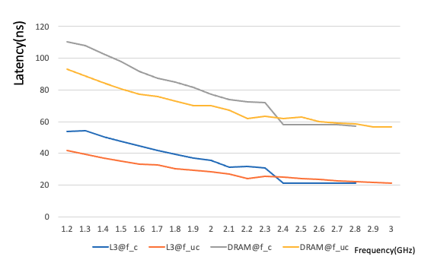
Roofline Model
How core and uncore frequency scaling affects the L3 and DRAM latency
Latency is measured by tinyBench
Latency increases when core/uncore frequency decreases
Notes:
When the memory latency exists, we have to know how the clock frequencies affect the latency. So I measured the latency of L3 cache and DRAM by tinybench. The x-axis shows the frequencies. They are changed in step of 0.1 GHz. The y-axis is the latency. These two curves show the DRAM latency wrt. the core frequency and uncore frequency. Those two curves show the L3 latency wrt. the core and uncore frequency. The conclusion is that the latencies of L3 cache and DRAM increase when the core or uncore frequency is lowered

Slide 12
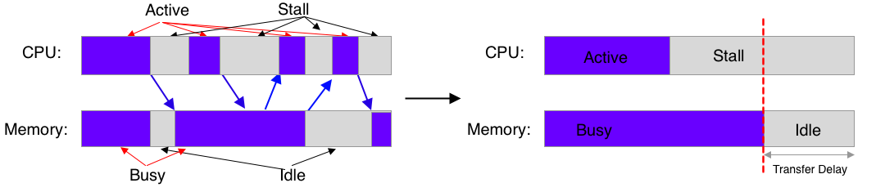




Extended Roofline Model
Time Interval Analysis
Transfer delay: Part of memory latency that cannot be eliminated
Time interval analysis
Calculate the transfer delay based on the activities of CPU and memory in a sampling interval
The summarized activities can be derived from hardware events
$$t_{active}^{cpu}$$
$$t_{Stall}^{cpu}$$
$$t_{Busy}^{mem}$$
Real time activities
$$t_{Idle}^{mem}$$
Summarized activities
Notes:
That's the reason I propose a method called time interval analysis.
First, I would like to define the transfer delay as a part of the memory latency that cannot be hidden. The time interval analysis derives the transfer delay from the CPU and memory activities in a sampling interval. For example, the figure on the left simulates real time activities of CPU and memory during a time interval. The purple blocks of CPU represent the time frames when it is active, the grey blocks represent the time frames when it stalls. The purple blocks of memory are the time when it is busy, the grey blocks are the time it is idle. The arrows in between represent the memory requests and data transfers. To collect the time information, I summarized the activities together. And we have the figure on the right side. Now the purple block of CPU is the total time the processor is active. The grey blocks of CPU is the total time the processor stalls. The purple block of memory is the total time the memory is busy. The grey block of memory is the total time it is idle. Those time information can be derived from hardware events.

Slide 13

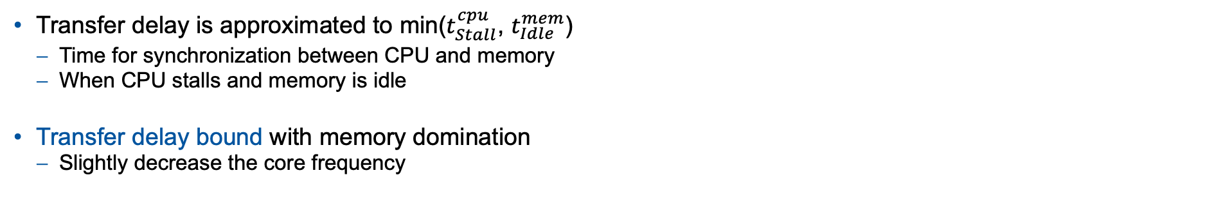



Extended Roofline Model
Transfer delay is approximated to min($t_{Stall}^{cpu}$, $t_{Idle}^{mem}$)
Time for synchronization between CPU and memory
When CPU stalls and memory is idle
Transfer delay bound with memory domination
Slightly decrease the core frequency
$$t_{active}^{cpu}$$
$$t_{Stall}^{cpu}$$
$$t_{busy}^{mem}$$
Real time activities
$$t_{Idle}^{mem}$$
Summarized activities
Notes:
Since the transfer delay is a part of memory latency that cannot be eliminated, it usually happens in the synchronization between the CPU and memory. During that time, both CPU and memory are not doing anything which means the CPU stalls and the memory is idle. So we can find the transfer delay by comparing the time when CPU stalls and the time when memory idle. The transfer delay is approximated to the minimum of them. In this case, the transfer delay is approximated to the time when memory is idle. The performance is bound to transfer delay.
If we look at this area, we find that the memory is dominating because the memory busy time is greater than the CPU active time. In this case, if we decrease the core frequency, the transfer delay will increase respectively which means it will take more time to finish the task and therefore downgrade the performance. The best move is actually not changing the core frequency at all. But if we have a tolerance for a small amount of performance downgrading, we can reduce the core frequency slightly and achieves power saving.

Slide 14
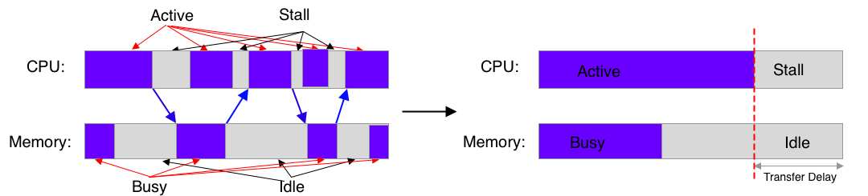

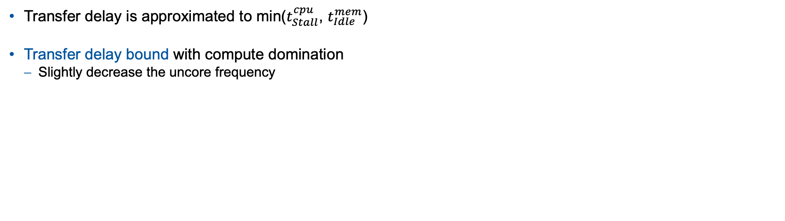



Extended Roofline Model
Transfer delay is approximated to min($t_{Stall}^{cpu}$, $t_{Idle}^{mem}$)
Transfer delay bound with compute domination
Slightly decrease the uncore frequency
$$t_{active}^{cpu}$$
$$t_{Stall}^{cpu}$$
$$t_{busy}^{mem}$$
$$t_{Idle}^{mem}$$
Notes:
This is another example for transfer delay bound. This time the CPU active time is greater than the memory busy time which means the CPU dominates this area. So I slightly decrease the uncore frequency.

Slide 15
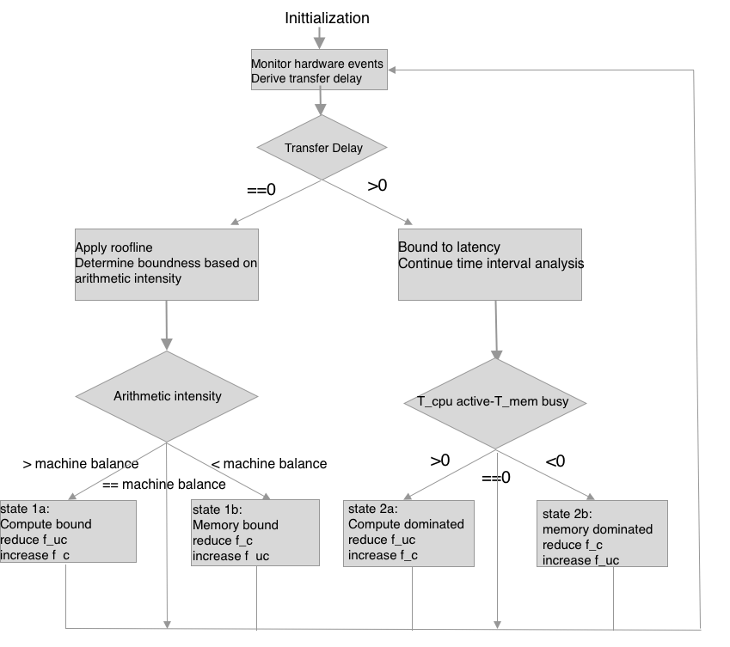
Implementation
Extended Roofline Model based on sampling method
Sampling interval: 0.3s
Less over head
Detects some applications that vary from compute bound to memory bound.
Initiation
Core and uncore frequency is set to maximum
Measure hardware events
Core/uncore frequency, instructions, cycles, data transfer of LLC and DRAM, PKG energy and power…
Derive the transfer delay, CPU active and memory busy time, arithmetic intensities…
If transfer delay approximates to zero → Roofline
If transfer delay > 0 → Continue time interval analysis
slightly
slightly
Notes:
This work is based on sampling method
Sampling interval is set to 0.3 second. Shorter intervals have greater overhead. Some applications vary from compute bound to memory bound. For intervals longer than 0.3 second, it may not detect the phase change.
It first initializes the core and uncore frequency to maximum which is the same as the default setting. For each sampling interval, it collects the hardware events including... and derives the time information that needed for time interval analysis.
If the transfer delay approximates to zero, the Roofline model is applied to compare the intensity with machine balance. If intensity >... <///
If the transfer delay is greater than zero,

Slide 16
Implementation
Hardware Platform and Tools for Measuring Hardware Events
Haswell Intel (R) Xeon (R) processor E5 v3 @ 2.3GHz
Core frequency: 1.2 GHz ~ 2.8 GHz
Uncore frequency: 1.2 GHz ~ 3.0 GHz
L3 cache: 45 MB
DRAM: 32 GB
Perf
Measuring core events and DRAM read/write
Lack uncore support
Libmsr
Measuring uncore activities: LLC read/write
Notes:
The extended Roofline model is implemented on node that contains a Haswell processor. fc fuc...
Perf and Libmsr are the tools to measure hardware events. Perf measures the core and DRAM activities using the performance counter. But it lacks uncore support. That’s why we need libmsr to measure uncore activites.

Slide 17
Evaluation
Benchmarks
Stream (to evaluate the boundary cases)
Stream_L3 : LLC intensive
Total memory required = 20.6 MiB < L3 cache size: suitable for L3 cache testing
Stream_DRAM : DRAM intensive
Total memory required >> L3 cache size: suitable for DRAM testing
NAS Parallel Benchmarks
Memory intensive: Conjugate Gradient(CG) Multi-Grid (MG) Fourier Transform (FT)
Compute intensive: Embarrassingly Parallel (EP)
LLC intensive: SP
Different execution patterns: BT
Notes:
The model is evaluated on two sets of benchmarks namely Stream and NAS parallel benchmarks. The stream is used for the boundary cases without transfer delay. I compiled two stream program with different problem sizes. One for L3 cache testing, the other one for DRAM testing. The NAS Parallel benchmarks have programs that have different types for intensities. They evaluate the model in more realistic situations.

Slide 18
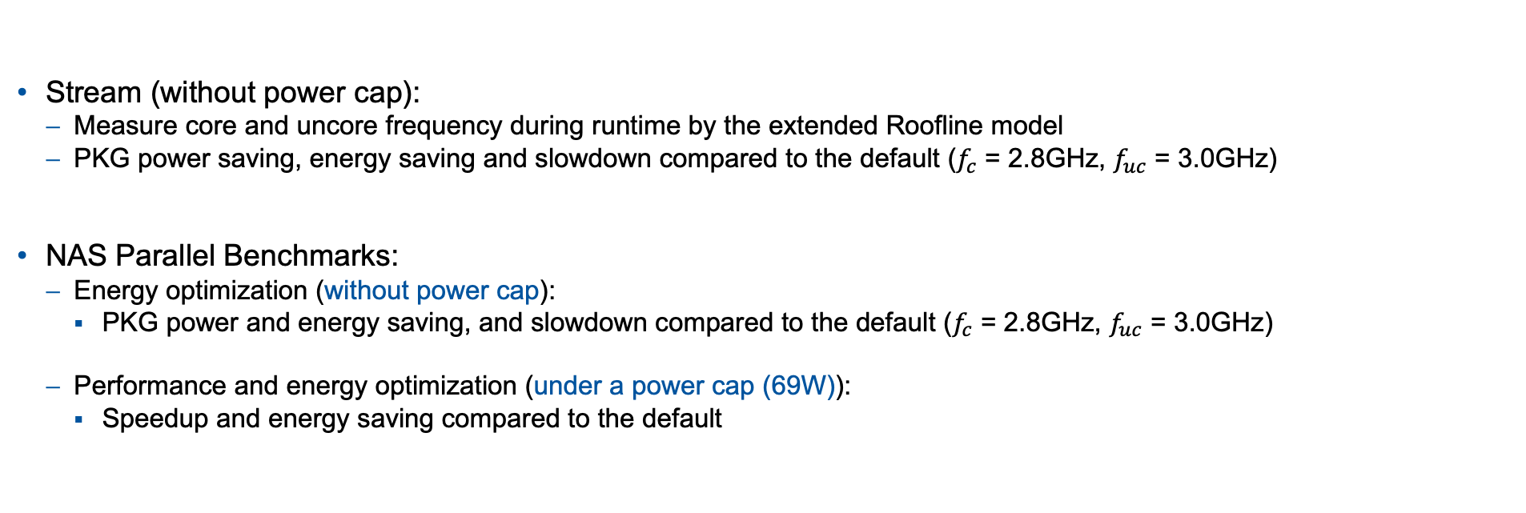
Evaluation
Stream (without power cap):
Measure core and uncore frequency during runtime by the extended Roofline model
PKG power saving, energy saving and slowdown compared to the default ($f_{c}$ = 2.8GHz, $f_{uc}$ = 3.0GHz)
NAS Parallel Benchmarks:
Energy optimization (without power cap):
PKG power and energy saving, and slowdown compared to the default ($f_{c}$ = 2.8GHz, $f_{uc}$ = 3.0GHz)
Performance and energy optimization (under a power cap (69W)):
Speedup and energy saving compared to the default
Notes:
For Stream benchmark I did not set power cap. The core and uncore frequencies are recorded during runtime. I observe the PKG power saving, energy saving and slowdown compared to the default setting.
For NAS Parallel benchmarks, I evaluate in two perspectives. The first one does not have power cap. I observe the PKG power saving , energy saving, and slowdown compared to the default.
The second one contains a power cap of 69 Watt. I observe the speedup and energy saving compared to the default.

Slide 19
Stream
UncoreFreq/Hz
CoreFreq/Hz
runtime
Notes:
The figures show the core and uncore frequency during runtime.
The y axis shows the frequency and the x axis shows the runtime.
Stream DRAM is a typical memory bound program, the core frequency is reduced linearly and stays at the minimum. Stream L3 is balanced for most of the time, its frequency stays constant.
The figure on the right is the uncore frequency, both are almost constant.

Slide 20
Stream
PKG Power, energy saving, and slowdown [%] wrt. default
[%]
For DRAM
up to 40% of PKG power or energy saving with less than 5% slowdown
For L3 Cache
Marginal impacts on L3 cache
Notes:
This figure shows pkg power saving, energy saving and slowdown with respect to default. The red columns are evaluations on DRAM For DRAM streaming, it achieves up to 40% of PKG power or energy saving with an acceptable slowdown that less than 5%. For L3 streaming, the method did not change the frequency much, so the power and energy consumption are similarly to the default.

Slide 21
NAS Parallel Benchmarks
BT’s execution patterns (no power cap)
Frequency[Hz]
Bounds to transfer delay but varies from compute domination to memory domination
Core frequency: 2.3 ~ 2.8 GHz
Uncore frequency : 2.2 ~ 3.0 GHz
Notes:
This figure shows both core and uncore frequency of BT benchmark. The execution patterns of BT change during runtime. It varies from compute domination to memory domination which leads to server spikes in the figure. The core frequency varies from 2.8 to 2.3GHz, the uncore frequency varies from 2.2 to 3.0 GHz meaning that it only changes the frequencies slightly due to the transfer delay.

Slide 22
NAS Parallel Benchmarks
PKG power saving, slowdown and PKG energy saving [%] wrt. default (no power cap)
Up to 13% PKG power saving
Slowdown under 4% for most benchmarks
Worst case 6.5%
Up to 9.4% energy saving
Notes:
This figure shows the power saving, slowdown and PKG energy saving with respect to the default. It does not have a power cap. For the groups on the left and right sides, the higher the columns the better results. For the group in the middle, the lower the columns the better the results. It saves up to 13% of PKG power across all benchmarks. The slowdown is within 4% for most benchmarks except the MG. One of the reason is that the sampling interval is not small enough for MG. The pkg energy saving is up to 9.4%.

Slide 23
NAS Parallel Benchmarks
Speed up and energy saving [%] wrt. default under a power cap:69W
Up to 6.2% speedup
Up to 5.9% energy saving
Notes:
This figure shows the evaluation under a power cap of 69 Watt. Two groups of columns represent the speedup and energy saving comparing to the default. It achieves up to 6.2% speedup compared to the default. The overall energy saving is between 1.2 % to 5.9%

Slide 24
Summary
Implement the Roofline model based on the sampling approach
Extend the Roofline model with the time inteval analysis method
Charachterize different performance bottlenecks: compute-, memory- or transfer delay-bound
The Extended Roofline achieves:
Without power cap:
Up to 13% package power saving and 9.4% energy saving
2.5% ~ 6.5% slowdown
Under power cap:
Up to 6.2% speedup and 5.9% energy saving
Future Works:
Sampling by instructions
Sampling by instructions triggers the interrupts only if there are program activities
More accurate and less overhead
Notes:
Summary : roofline power management

Slide 25
Thanks for your attention

Slide 26
Citation
[1] https://www.top500.org/lists/top500/
[2] https://techwireasia.com/2020/06/japans-fugaku-is-the-worlds-fastest-supercomputer/
[3] https://crd.lbl.gov/assets/Uploads/ECP18-Roofline-1-intro.pdf

