Slide 1
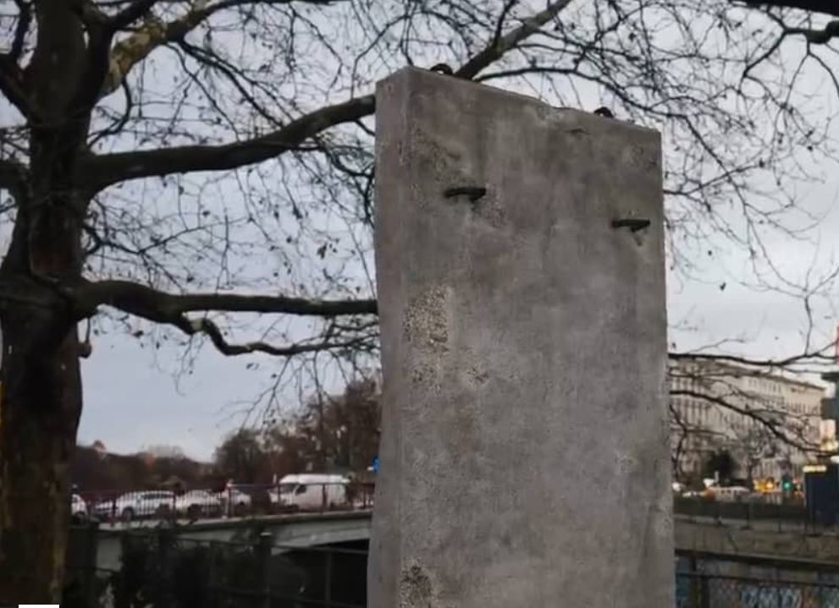
mauAR.

Slide 2
Status Quo

Slide 3

http://www.mauer-fotos.de/

Slide 4
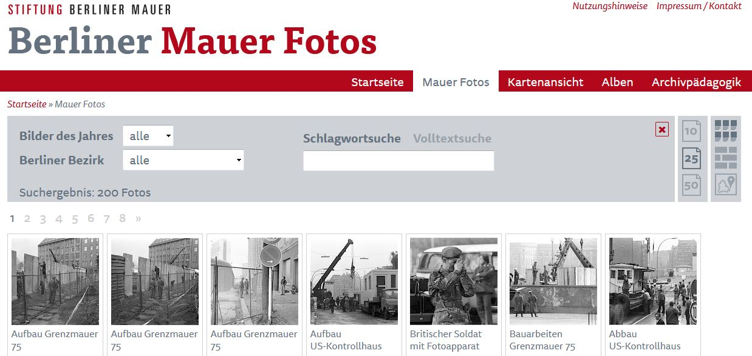
http://www.mauer-fotos.de/fotos/

Slide 5
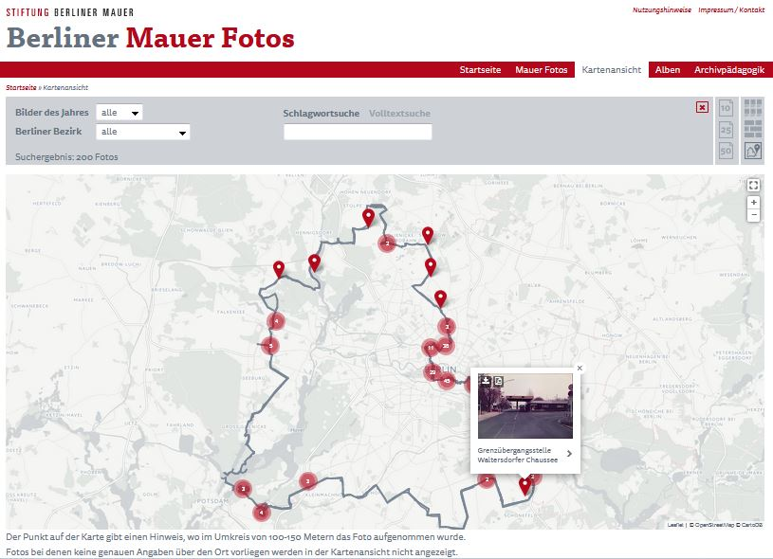

Slide 6
Our Idea: AR App
What‘s that?

Slide 7
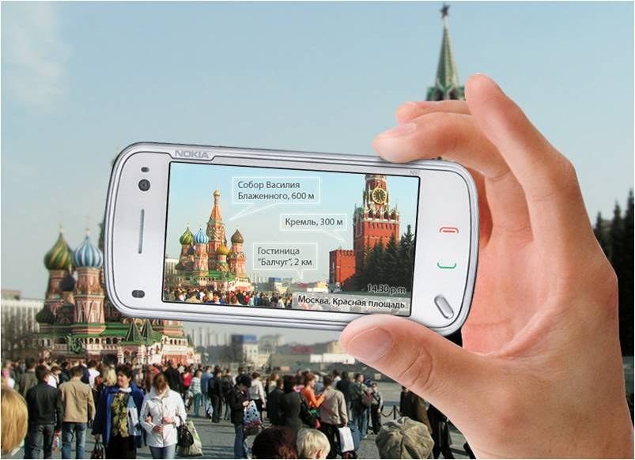

https://en.wikipedia.org/wiki/Augmented_reality
Notes:
Argmented reality explained
image source: https://www.wikidata.org/wiki/File:Poiskovik.jpg
<Foliennummer>

Slide 8
AR App
How to?

Slide 9

https://developer.apple.com/arkit/
Notes:
Using Apple ARKit for developing AR applications
Image source: http://www.redmondpie.com/measurekit-ios-11-arkit-app-takes-augmented-reality-measurements-to-the-next-level/
<Foliennummer>

Slide 10

https://www.apple.com/de/swift/
Notes:
Using Swift to develop iOS applications
Image source: https://www.ihash.eu/2015/12/apple-releases-swift-open-source/
<Foliennummer>

Slide 11
AR App
Demo

Slide 12
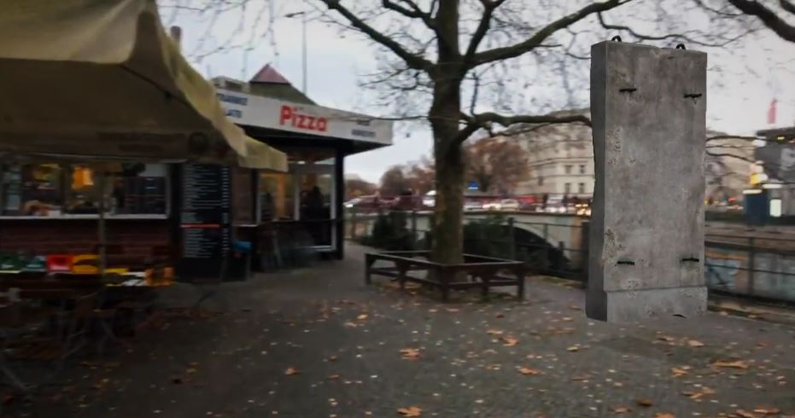
https://vimeo.com/244351218

Slide 13
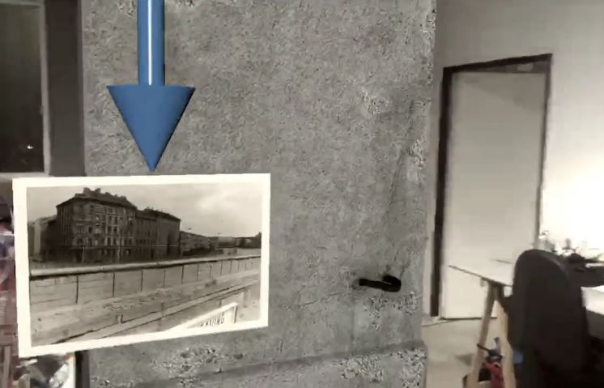
https://vimeo.com/244372296

Slide 14
AR App
Screen flow

Slide 15
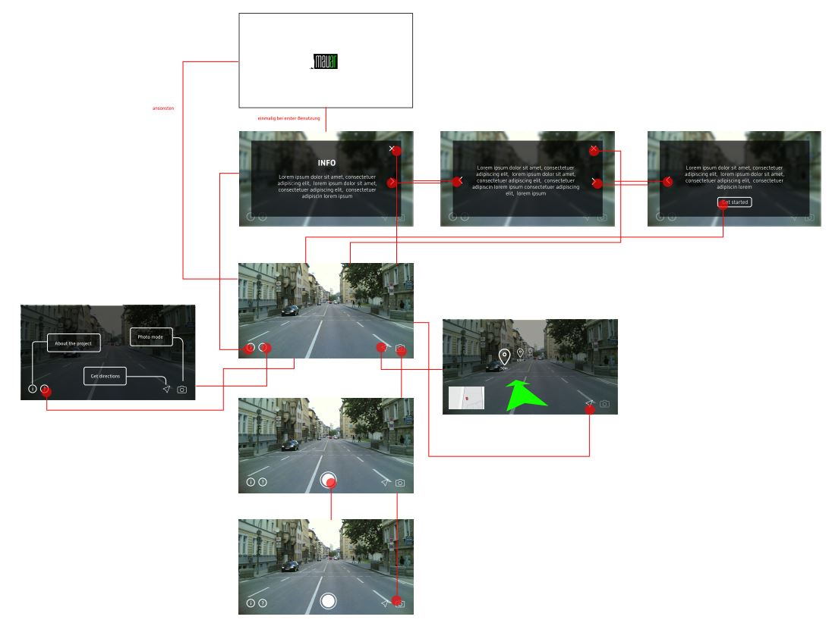

Slide 16
Data transformation
Position data

Slide 17
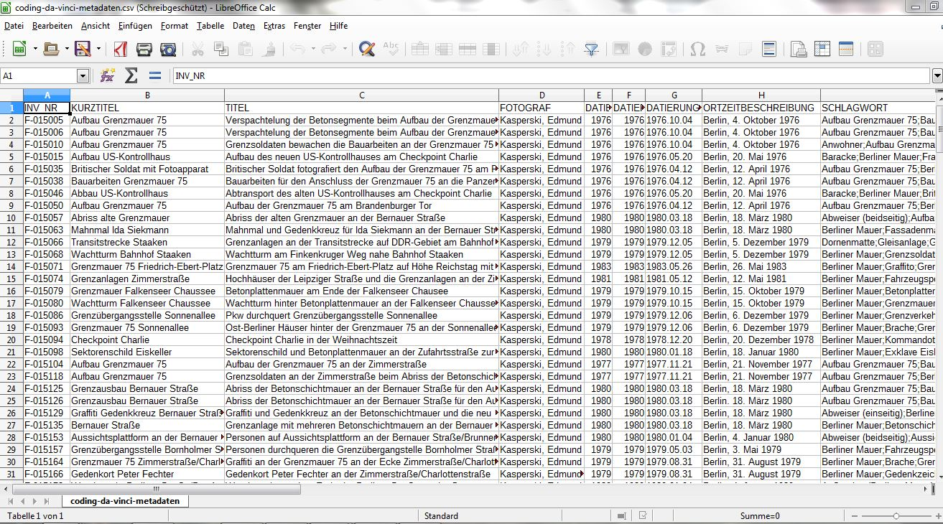
Input
http://www.mauer-fotos.de/site/assets/files/31020587/coding-da-vinci-metadaten.csv
Notes:
The initially provided CSV describing the meta data of the available Mauer photos from www.mauer-fotos.de
<Foliennummer>

Slide 18
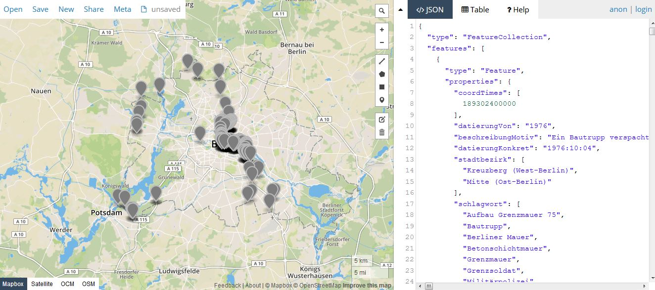

Generated
http://geojson.io/ + https://github.com/BerlinerMauAR/de.cdv.mauar.backend/blob/master/docs/mauar_photos.geojson

Slide 19
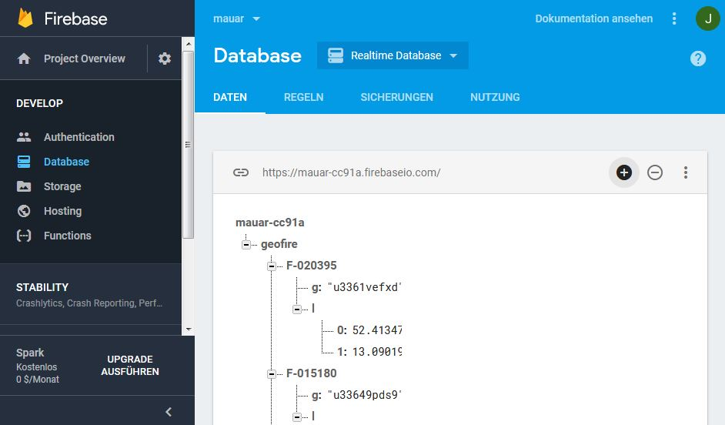
Generated
https://console.firebase.google.com/project/mauar-cc91a/database/mauar-cc91a/data/

Slide 20
Data transformation
Setting photo meta data

Slide 21
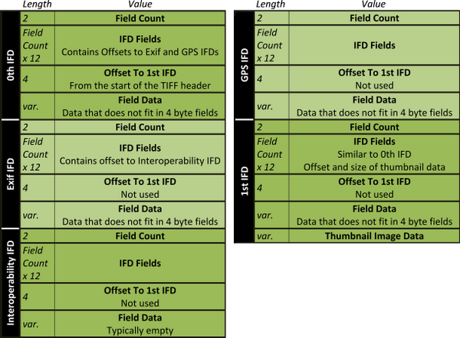

Batch processed
column in CSV | meta data standard | vendor | tag name
TITEL | EXIF | Microsoft | XPTitle
FOTOGRAF | EXIF | Microsoft | XPAuthor
FOTOGRAF | EXIF | Adobe | Artist
BESCHREIBUNG_MOTIV | EXIF | Microsoft | XPSubject
DATIERUNGKONKRET | EXIF | Adobe | DateTimeOriginal
DATIERUNGKONKRET | XMP | Adobe | DateTimeOriginal
DATIERUNGKONKRET | XMP | Adobe | CreateDate
STRASSENNAME_MOTIV | EXIF | Microsoft | XPComment
STRASSENNAME_MOTIV | EXIF | Adobe | UserComment
SCHLAGWORT | EXIF | Microsoft | XPKeywords
GEOKOORDINATEN_MOTIV | EXIF | Adobe | GPSLongitude
GEOKOORDINATEN_MOTIV | EXIF | Adobe | GPSLatitude
LIZENZ | EXIF | Adobe | Copyright
https://de.wikipedia.org/wiki/Exchangeable_Image_File_Format
Notes:
Image sources: https://www.codeproject.com/Articles/43665/ExifLibrary-for-NET , https://play.google.com/store/apps/details?id=com.mikufu_works.exifviewer&hl=de
<Foliennummer>

Slide 22
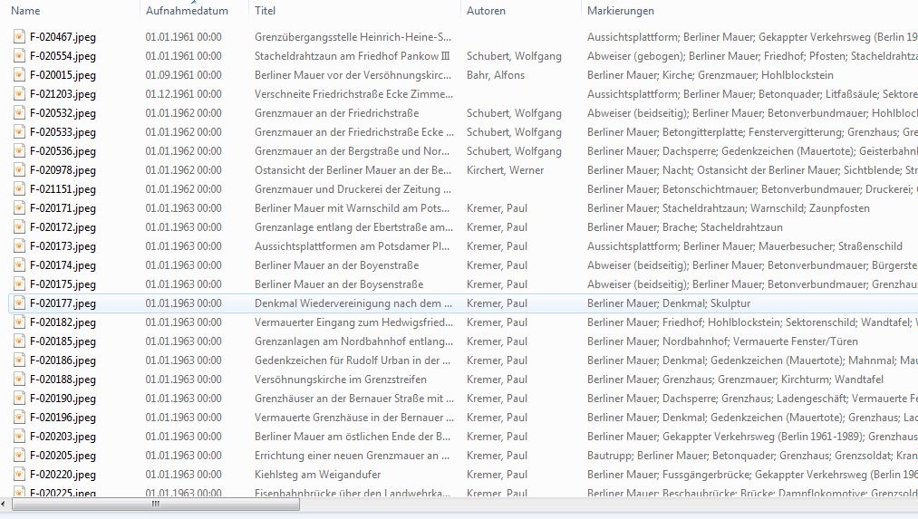
Photos enriched with meta data
E.g. visible and usable in Windows Explorer but also in Mobile EXIF data viewers

Slide 23
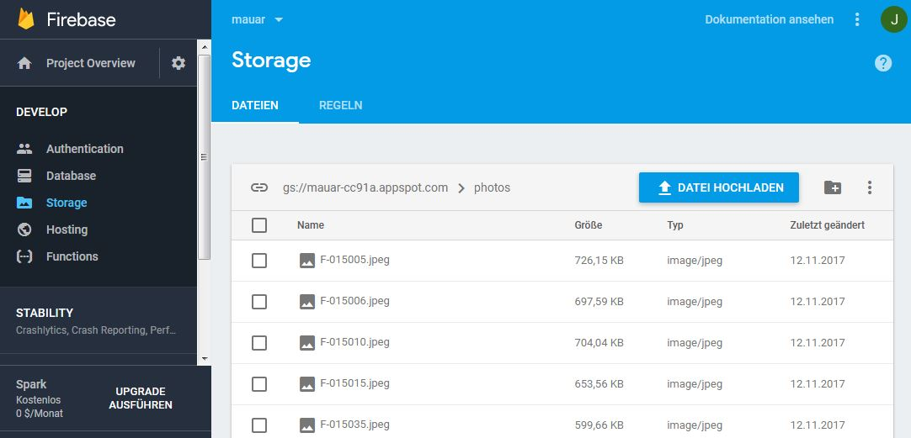
Enriched photos uploaded
https://console.firebase.google.com/project/mauar-cc91a/storage/mauar-cc91a.appspot.com/files/photos/

Slide 24
Interaction with Firebase via API
Only download photos for your current position

Slide 25


Realtime
Database
Query locations of
available photos in certain
radius of current position
Download photos
for retrieved
location ids
GeoFire
Web / Mobile Client
https://github.com/firebase/geofire

Slide 26
Example use case: Map
Using firebase resources via Javascript API

Slide 27
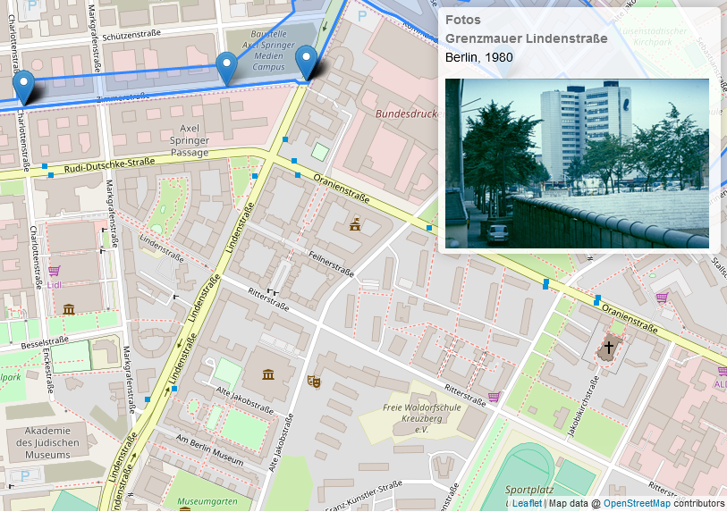
https://berlinermauar.github.io/de.cdv.mauar.backend/

Slide 28
Outlook / Upcoming features
Share comments to photos with other users
Users can drag the photo shown in augmented reality to the correct position and by this can upload the missing view angle to the server, so that next user will see the photo in the right direction
Provide thematical routes along the path of the Berlin Wall (e.g. by using description and tags contained within the photos)

Slide 29
Related projects
Apps zum Mauerfall
Time Traveller - Die Berliner Mauer
Mauerschau
Stadtgeist Karlsruhe
Leipzig 1953 + Leipzig '89

Slide 30
Links
Official site
Hackdash project site
GitHub project site

