Slide 1
React Hooks
Toby Wang, Bamboo
10, 2019

Slide 2
Agenda
Pain points and solutions
useState hook
useEffect hook
Use your own hook
Suggestions & known issues
Q & A

Slide 3
1
Pain points and solutions

Slide 4
Side effects and pure function
Terminologies and examples
  Pure function is deterministic, given an input, it always returns the same output.
  A function is said to have 'side effect’ if it tries to modify anything outside its body.
  Side effect is a general concept and not react-specific.
  Side effect examples:
    Make network calls.
    Modify DOM.
    Modify global variables.
    Update React states.

Slide 5
Reusing stateful logic is difficult – case 1
Related logic scattered among different lifecycle methods
componentDidMount() {
if (typeof window !== "undefined" && window.eventEmitter) {
window.eventEmitter.on("addToDss", this.props.handleDssAction);
}
}
componentWillUnmount() {
if (typeof window !== "undefined" && window.eventEmitter) {
window.eventEmitter.off("addToDss", this.props.handleDssAction);
}
}

Slide 6
Reusing stateful logic is difficult – case 2
Meaningless binds, verbose class syntax
class MuniLatestActivity extends Component {
constructor(props) {
super(props);
this.handleCheckboxClick = this.handleCheckboxClick.bind(this);
this.fetchSaleList = this.fetchSaleList.bind(this);
this.buildOrgsStr = this.buildOrgsStr.bind(this);
this.handleMultiOrgClick = this.handleMultiOrgClick.bind(this);
this.state = {
withdrawnRatings: false,
affirmation: true,
showDrawers: false,
drawersType: null,
drawersSaleDetail: {},
drawersDesc: null,
drawersOrgs: null
};
}
State object is huge, hard to split and reuse state logic.

Slide 7
Main solutions
  Mixins.
    Deprecated in the early stage of React.
  Inheritance.
    Inheritance requires defining a base class, which is not suitable for most reusing scenarios.
    No interface and multiple inheritance in es6.
  Higher-Order Components(HOC).
  React Hooks.

Slide 8
Higher-Order Components(HOC)
HOC is a function that takes a component and returns a new component.
Problems
  HOC will introduce a component wrapper and it deepens the component hierarchy.
    Deep component hierarchy is hard to maintain.
  Not easy to use.
    Inner component refs must be forwarded to wrapper component using React.forwardRef.
    Static methods defined in inner component must be reregistered in wrapper component.

Slide 9
HOC examples
Accept old component
export const withLang = (StyledComponent) => {
const LangWrapper = React.forwardRef((props, ref) => {
const getLocale = (value) => new Language(value);
return (
<Context.Consumer>
{
(value) => {
return (
<StyledComponent ref={ref} {...props}
language={getLocale(value)}/>
);
}
}
</Context.Consumer>
);
});
return LangWrapper;
};
Get locale from language context
Return new component

Slide 10
HOC examples
  In Neptune:
  export default withStyle(baseTheme, { name: 'ResearchModule' })(withLang(ResearchModule));
  In CV2 Widgets:
export default connect(mapStateToProps, mapDispatchToProps)(MuniLatestReports);

Slide 11
React Hooks
Hooks are functions that let you use React features from function components.
Key features
  New feature since React v16.8.
  Let you use state and other React features without writing a class.
  Extract stateful logic easily. A more flexible and efficient way to organize codes.
  100% backwards-compatible.

Slide 12
2
useState hook

Slide 13
useState syntax
import React, { useState } from "react";
export default function YourFunctionComponent() {
const [valid, setValid] = useState(true);
return (
<button onClick={() => setValid(!valid)}>
Toggle Valid
</button>
);
}
Initial state value
State variable
Setter function to update state value

Slide 14
Use multiple state variables
It's highly recommended to split big state object into smaller ones, each of them has its own state variable and setter function.
import React, { useState } from "react";
export default function YourFunctionComponent() {
const [valid, setValid] = useState(true);
const [age, setAge] = useState(18);
const [fruit, setFruit] = useState("apple");
const [todos, setTodos] = useState([{ text: "Learn Hooks" }]);
return (
<div>
<button onClick={() => setValid(!valid)}>Toggle Valid</button>
<button onClick={() => setAge(age++)}>Add Age</button>
<button onClick={() => setFruit(fruit)}>Set Fruit</button>
<button onClick={() => setTodos(todos)}>Set Todos</button>
</div>
);
}

Slide 15
A interesting question..
  When re-rendering function components, will the state variables be re-initiated? Why?

Slide 16
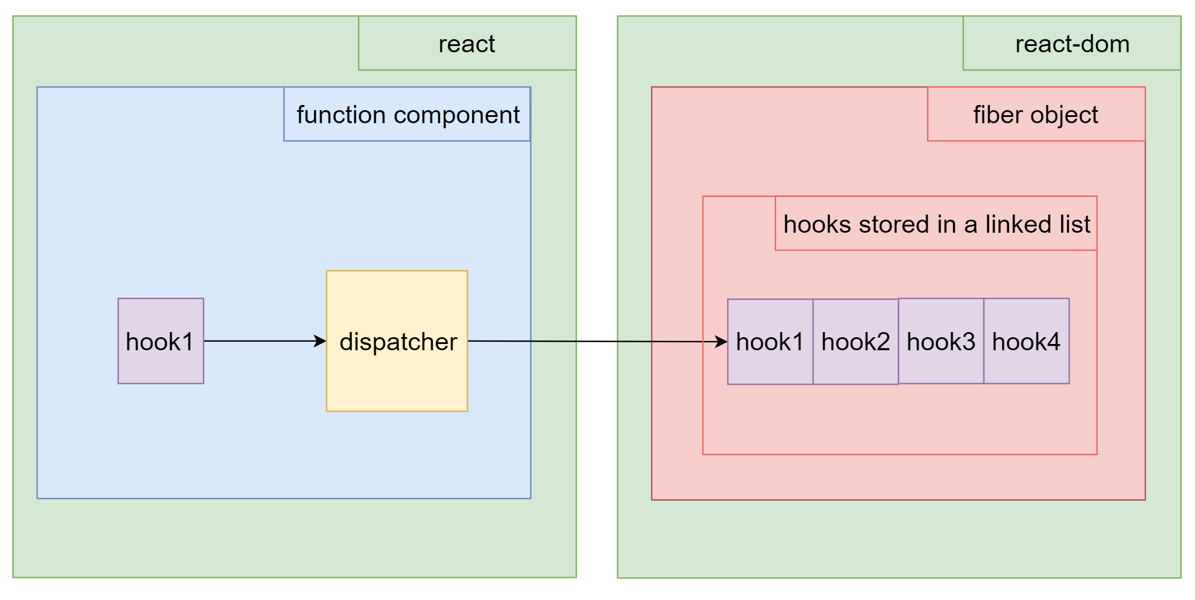
Hooks under the hood
Hooks are stored as a linked list on the fiber's memoizedState field.

Slide 17
3
useEffect hook

Slide 18
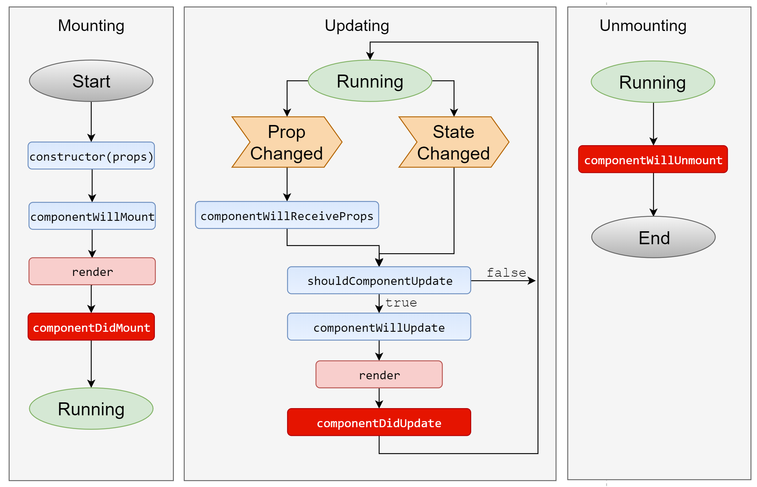
useEffect in React lifecycle
useEffect

Slide 19
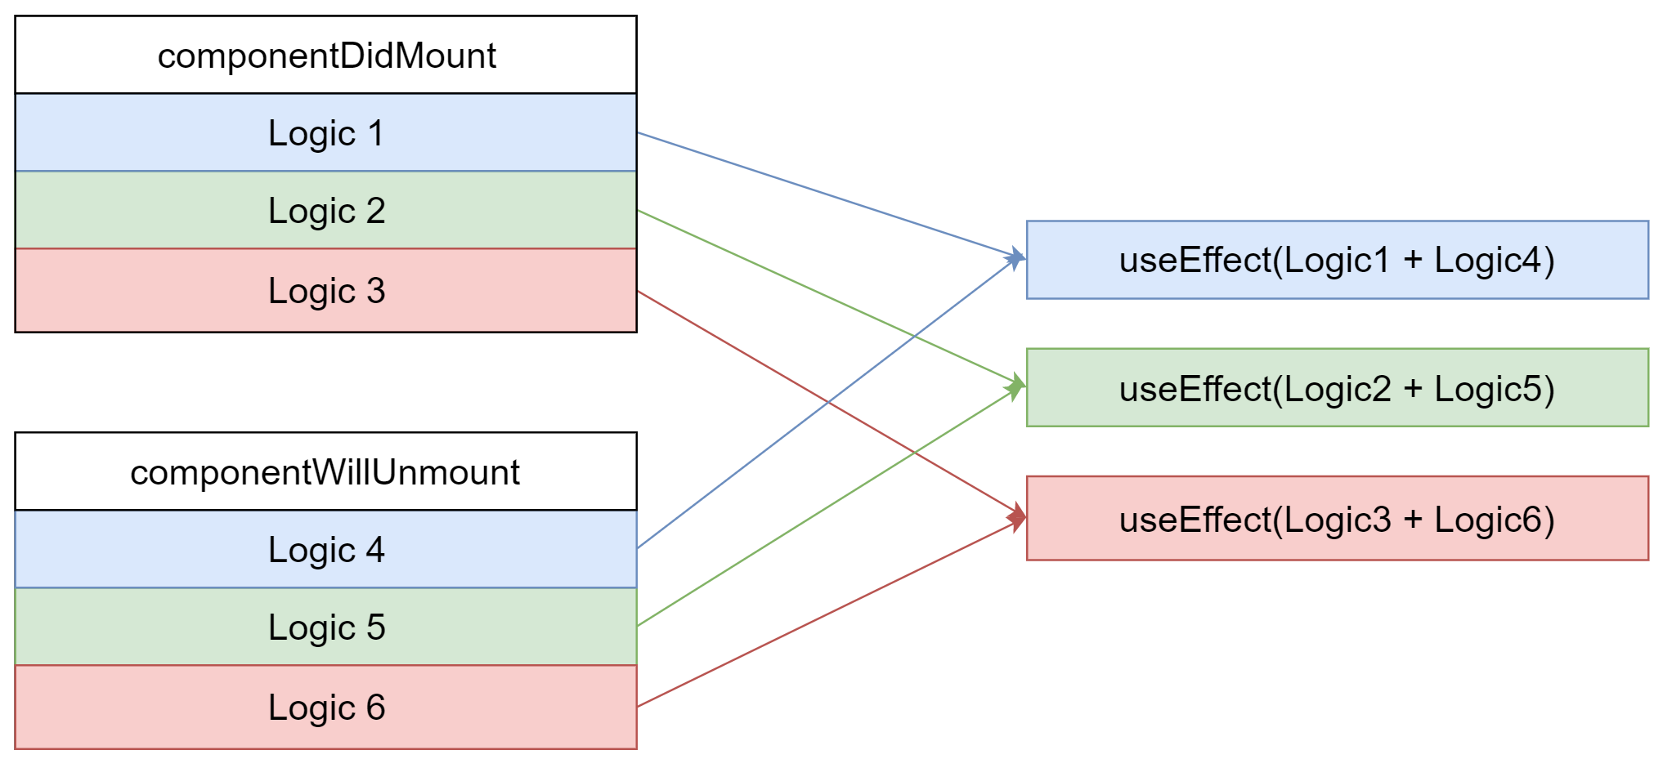
Separate concerns
Related logic is combined into one hook function.

Slide 20
useEffect syntax
Cleanup function is optional and will be executed in ‘componentWillUnmount’
import React, { useEffect } from "react";
export default function YourFunctionComponent() {
const firstParam = () => {
const intervalID = setInterval(() => {
console.log("executed.");
}, 1000);
return function cleanup() {
clearInterval(intervalID);
};
};
const secondParam = [];
useEffect(firstParam, secondParam);
return <div></div>;
}
Second param is optional and used for performance optimization.
First param is a required function that will be executed when ‘componentDidMount’ and ‘componentDidUpdate’

Slide 21
Second parameter, dependency array
Second parameter value could be one of the 3 types.
Null(default) | Empty Array | Values
useEffect runs on every invocation of component | useEffect runs only on first invocation of components | useEffect runs only when any of array values change
componentDidMount + componentDidUpdate | componentDidMount | componentDidMount + shouldComponentUpdate && componentDidUpdate

Slide 22
4
Use your own hook

Slide 23
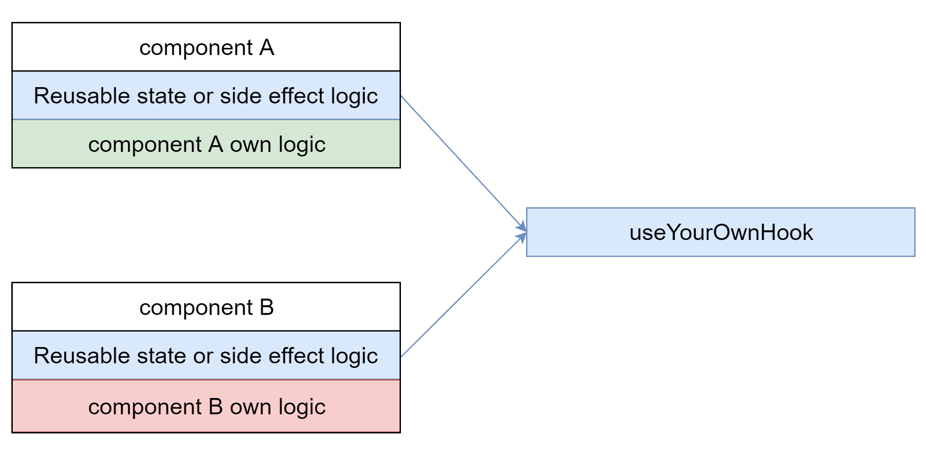
Extract reusable logic

Slide 24
Component A: FriendStatus.js
import React, { useState, useEffect } from 'react';
function FriendStatus(props) {
const [isOnline, setIsOnline] = useState(null);
useEffect(() => {
function handleStatusChange(status) {
setIsOnline(status.isOnline);
}
ChatAPI.subscribeToFriendStatus(props.friend.id, handleStatusChange);
return () => {
ChatAPI.unsubscribeFromFriendStatus(props.friend.id, handleStatusChange);
};
});
if (isOnline === null) {
return 'Loading...';
}
return isOnline ? 'Online' : 'Offline';
}
export default FriendStatus;
Reusable effect logic

Slide 25
Component B: FriendListItem.js
import React, { useState, useEffect } from 'react';
function FriendListItem(props) {
const [isOnline, setIsOnline] = useState(null);
useEffect(() => {
function handleStatusChange(status) {
setIsOnline(status.isOnline);
}
ChatAPI.subscribeToFriendStatus(props.friend.id, handleStatusChange);
return () => {
ChatAPI.unsubscribeFromFriendStatus(props.friend.id, handleStatusChange);
};
});
return (
<li style={{ color: isOnline ? 'green' : 'black' }}>
{props.friend.name}
</li>
);
}
export default FriendListItem;
Reusable effect logic

Slide 26
Custom hook: useFriendStatus.js
import React, { useState, useEffect } from 'react';
function useFriendStatus(friendID) {
const [isOnline, setIsOnline] = useState(null);
useEffect(() => {
function handleStatusChange(status) {
setIsOnline(status.isOnline);
}
ChatAPI.subscribeToFriendStatus(friendID, handleStatusChange);
return () => {
ChatAPI.unsubscribeFromFriendStatus(friendID, handleStatusChange);
};
});
return isOnline;
}
export default useFriendStatus;
Extracted effect logic

Slide 27
Tips
  Custom hook function name must starts with ‘use’, otherwise the eslint plugin ‘eslint-plugin-react-hooks’ won’t check your custom hook codes.
  Each call to a custom hook gets isolated state.

Slide 28
5
Suggestions & known issues

Slide 29
Suggestions
  No plan to migrate class components to function components.
  Strongly suggest using Hooks in your new component.
  Refactor existing HOCs with Hooks.

Slide 30
Known issues
  Only one react package is allowed when rendering in server side.
  If you add ref to a function component, the ref.current is null by default.
  use ‘React.forwardRef’ + ‘useImperativeHandle’ expose inner ref or inner functions.

Slide 31

  Q & A

Slide 32
Toby Wang
Shenzhen, Kerry Plaza 13F
toby.wang@moodys.com
moodysanalytics.com

Slide 33
© 2019 Moody’s Corporation, Moody’s Investors Service, Inc., Moody’s Analytics, Inc. and/or their licensors and affiliates (collectively, “MOODY’S”). All rights reserved.
CREDIT RATINGS ISSUED BY MOODY'S INVESTORS SERVICE, INC. AND ITS RATINGS AFFILIATES (“MIS”) ARE MOODY’S CURRENT OPINIONS OF THE RELATIVE FUTURE CREDIT RISK OF ENTITIES, CREDIT COMMITMENTS, OR DEBT OR DEBT-LIKE SECURITIES, AND MOODY’S PUBLICATIONS MAY INCLUDE MOODY’S CURRENT OPINIONS OF THE RELATIVE FUTURE CREDIT RISK OF ENTITIES, CREDIT COMMITMENTS, OR DEBT OR DEBT-LIKE SECURITIES. MOODY’S DEFINES CREDIT RISK AS THE RISK THAT AN ENTITY MAY NOT MEET ITS CONTRACTUAL FINANCIAL OBLIGATIONS AS THEY COME DUE AND ANY ESTIMATED FINANCIAL LOSS IN THE EVENT OF DEFAULT OR IMPAIRMENT. SEE MOODY’S RATING SYMBOLS AND DEFINITIONS PUBLICATION FOR INFORMATION ON THE TYPES OF CONTRACTUAL FINANCIAL OBLIGATIONS ADDRESSED BY MOODY’S RATINGS. CREDIT RATINGS DO NOT ADDRESS ANY OTHER RISK, INCLUDING BUT NOT LIMITED TO: LIQUIDITY RISK, MARKET VALUE RISK, OR PRICE VOLATILITY. CREDIT RATINGS AND MOODY’S OPINIONS INCLUDED IN MOODY’S PUBLICATIONS ARE NOT STATEMENTS OF CURRENT OR HISTORICAL FACT. MOODY’S PUBLICATIONS MAY ALSO INCLUDE QUANTITATIVE MODEL-BASED ESTIMATES OF CREDIT RISK AND RELATED OPINIONS OR COMMENTARY PUBLISHED BY MOODY’S ANALYTICS, INC. CREDIT RATINGS AND MOODY’S PUBLICATIONS DO NOT CONSTITUTE OR PROVIDE INVESTMENT OR FINANCIAL ADVICE, AND CREDIT RATINGS AND MOODY’S PUBLICATIONS ARE NOT AND DO NOT PROVIDE RECOMMENDATIONS TO PURCHASE, SELL, OR HOLD PARTICULAR SECURITIES. NEITHER CREDIT RATINGS NOR MOODY’S PUBLICATIONS COMMENT ON THE SUITABILITY OF AN INVESTMENT FOR ANY PARTICULAR INVESTOR. MOODY’S ISSUES ITS CREDIT RATINGS AND PUBLISHES MOODY’S PUBLICATIONS WITH THE EXPECTATION AND UNDERSTANDING THAT EACH INVESTOR WILL, WITH DUE CARE, MAKE ITS OWN STUDY AND EVALUATION OF EACH SECURITY THAT IS UNDER CONSIDERATION FOR PURCHASE, HOLDING, OR SALE.
MOODY’S CREDIT RATINGS AND MOODY’S PUBLICATIONS ARE NOT INTENDED FOR USE BY RETAIL INVESTORS AND IT WOULD BE RECKLESS AND INAPPROPRIATE FOR RETAIL INVESTORS TO USE MOODY’S CREDIT RATINGS OR MOODY’S PUBLICATIONS WHEN MAKING AN INVESTMENT DECISION. IF IN DOUBT YOU SHOULD CONTACT YOUR FINANCIAL OR OTHER PROFESSIONAL ADVISER.
ALL INFORMATION CONTAINED HEREIN IS PROTECTED BY LAW, INCLUDING BUT NOT LIMITED TO, COPYRIGHT LAW, AND NONE OF SUCH INFORMATION MAY BE COPIED OR OTHERWISE REPRODUCED, REPACKAGED, FURTHER TRANSMITTED, TRANSFERRED, DISSEMINATED, REDISTRIBUTED OR RESOLD, OR STORED FOR SUBSEQUENT USE FOR ANY SUCH PURPOSE, IN WHOLE OR IN PART, IN ANY FORM OR MANNER OR BY ANY MEANS WHATSOEVER, BY ANY PERSON WITHOUT MOODY’S PRIOR WRITTEN CONSENT.
CREDIT RATINGS AND MOODY’S PUBLICATIONS ARE NOT INTENDED FOR USE BY ANY PERSON AS A BENCHMARK AS THAT TERM IS DEFINED FOR REGULATORY PURPOSES AND MUST NOT BE USED IN ANY WAY THAT COULD RESULT IN THEM BEING CONSIDERED A BENCHMARK.
All information contained herein is obtained by MOODY’S from sources believed by it to be accurate and reliable. Because of the possibility of human or mechanical error as well as other factors, however, all information contained herein is provided “AS IS” without warranty of any kind. MOODY'S adopts all necessary measures so that the information it uses in assigning a credit rating is of sufficient quality and from sources MOODY'S considers to be reliable including, when appropriate, independent third-party sources. However, MOODY’S is not an auditor and cannot in every instance independently verify or validate information received in the rating process or in preparing the Moody’s publications.
To the extent permitted by law, MOODY’S and its directors, officers, employees, agents, representatives, licensors and suppliers disclaim liability to any person or entity for any indirect, special, consequential, or incidental losses or damages whatsoever arising from or in connection with the information contained herein or the use of or inability to use any such information, even if MOODY’S or any of its directors, officers, employees, agents, representatives, licensors or suppliers is advised in advance of the possibility of such losses or damages, including but not limited to: (a) any loss of present or prospective profits or (b) any loss or
damage arising where the relevant financial instrument is not the subject of a particular credit rating assigned
by MOODY’S.
To the extent permitted by law, MOODY’S and its directors, officers, employees, agents, representatives, licensors and suppliers disclaim liability for any direct or compensatory losses or damages caused to any person or entity, including but not limited to by any negligence (but excluding fraud, willful misconduct or any other type of liability that, for the avoidance of doubt, by law cannot be excluded) on the part of, or any contingency within or beyond the control of, MOODY’S or any of its directors, officers, employees, agents, representatives, licensors or suppliers, arising from or in connection with the information contained herein or the use of or inability to use any such information.
NO WARRANTY, EXPRESS OR IMPLIED, AS TO THE ACCURACY, TIMELINESS, COMPLETENESS, MERCHANTABILITY OR FITNESS FOR ANY PARTICULAR PURPOSE OF ANY CREDIT RATING OR
OTHER OPINION OR INFORMATION IS GIVEN OR MADE BY MOODY’S IN ANY FORM OR
MANNER WHATSOEVER.
Moody’s Investors Service, Inc., a wholly-owned credit rating agency subsidiary of Moody’s Corporation (“MCO”), hereby discloses that most issuers of debt securities (including corporate and municipal bonds, debentures, notes and commercial paper) and preferred stock rated by Moody’s Investors Service, Inc. have, prior to assignment of any rating, agreed to pay to Moody’s Investors Service, Inc. for ratings opinions and services rendered by it fees ranging from $1,000 to approximately $2,700,000. MCO and MIS also maintain policies and procedures to address the independence of MIS’s ratings and rating processes. Information regarding certain affiliations that may exist between directors of MCO and rated entities, and between entities who hold ratings from MIS and have also publicly reported to the SEC an ownership interest in MCO of more than 5%, is posted annually at www.moodys.com under the heading “Investor Relations — Corporate Governance — Director and Shareholder Affiliation Policy.”
Additional terms for Australia only: Any publication into Australia of this document is pursuant to the Australian Financial Services License of MOODY’S affiliate, Moody’s Investors Service Pty Limited ABN 61 003 399 657AFSL 336969 and/or Moody’s Analytics Australia Pty Ltd ABN 94 105 136 972 AFSL 383569 (as applicable). This document is intended to be provided only to “wholesale clients” within the meaning of section 761G of the Corporations Act 2001. By continuing to access this document from within Australia, you represent to MOODY’S that you are, or are accessing the document as a representative of, a “wholesale client” and that neither you nor the entity you represent will directly or indirectly disseminate this document or its contents to “retail clients” within the meaning of section 761G of the Corporations Act 2001. MOODY’S credit rating is an opinion as to the creditworthiness of a debt obligation of the issuer, not on the equity securities of the issuer or any form of security that is available to retail investors.
Additional terms for Japan only: Moody's Japan K.K. (“MJKK”) is a wholly-owned credit rating agency subsidiary of Moody's Group Japan G.K., which is wholly-owned by Moody’s Overseas Holdings Inc., a wholly-owned subsidiary of MCO. Moody’s SF Japan K.K. (“MSFJ”) is a wholly-owned credit rating agency subsidiary of MJKK. MSFJ is not a Nationally Recognized Statistical Rating Organization (“NRSRO”). Therefore, credit ratings assigned by MSFJ are Non-NRSRO Credit Ratings. Non-NRSRO Credit Ratings are assigned by an entity that is not a NRSRO and, consequently, the rated obligation will not qualify for certain types of treatment under U.S. laws. MJKK and MSFJ are credit rating agencies registered with the Japan Financial Services Agency and their registration numbers are FSA Commissioner (Ratings) No. 2 and 3 respectively.
MJKK or MSFJ (as applicable) hereby disclose that most issuers of debt securities (including corporate and municipal bonds, debentures, notes and commercial paper) and preferred stock rated by MJKK or MSFJ (as applicable) have, prior to assignment of any rating, agreed to pay to MJKK or MSFJ (as applicable) for ratings opinions and services rendered by it fees ranging from JPY125,000 to approximately JPY250,000,000.
MJKK and MSFJ also maintain policies and procedures to address Japanese regulatory requirements.

