Slide 1
React Hooks
Oct, 2019

Slide 2
Agenda
React Hooks At a Glance
Main Hook: useState
Main Hook: useEffect
Main Hook: useRef
Use Your Own Hook
useReducer/useContext/useMemo/useCallback
Q & A

Slide 3
1
React Hooks At a Glance

Slide 4
What is ‘React Hooks’?
New feature since React v16.8.
Hooks are functions that let you “hook into” React features from function components.
Let you use state and other React features without writing a class.
A more flexible and efficient way to organize codes.
100% backwards-compatible.

Slide 5
The pain points in classes
It’s difficult to reuse stateful logic between components.
Cohesive logic is distributed across different lifecycle methods.
The class syntax is a bit verbose.
Poor support for ahead-of-time compilation, such as Prepack.

Slide 6
2
Main Hook: useState

Slide 7
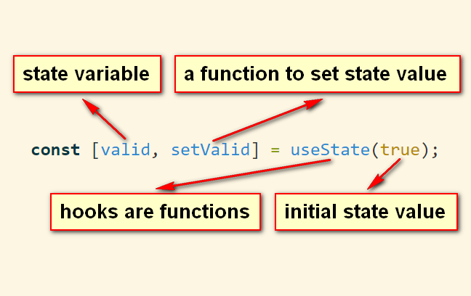
useState syntax

Slide 8
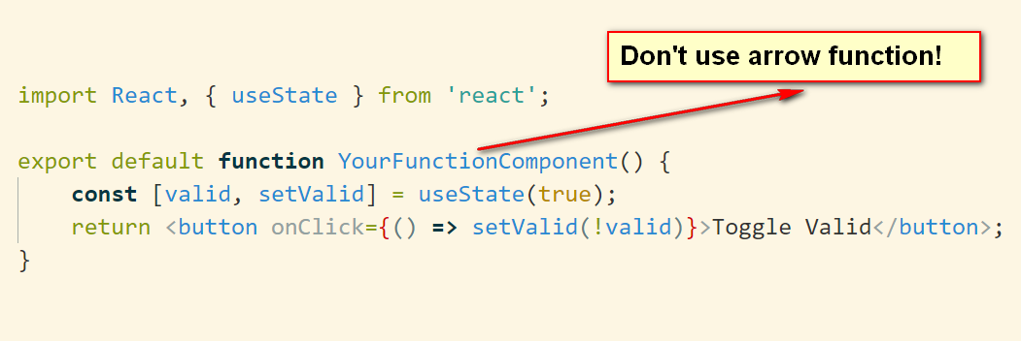
An short example

Slide 9
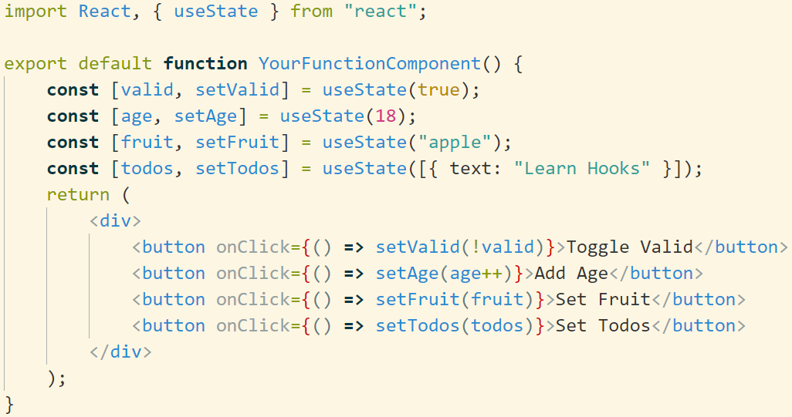
Use multiple state variables
It's highly recommended to split big state object into smaller ones, each of them has its own state variable and setter function.

Slide 10
A interesting question..
When re-rendering function components, will the state variables be re-initiated? Why?

Slide 11
What benefits do we have by using state hook?
Increased Maintainability.
Increased Reusability - State logic can be easily extracted and reused in multiple components.

Slide 12
3
Main Hook: useEffect

Slide 13
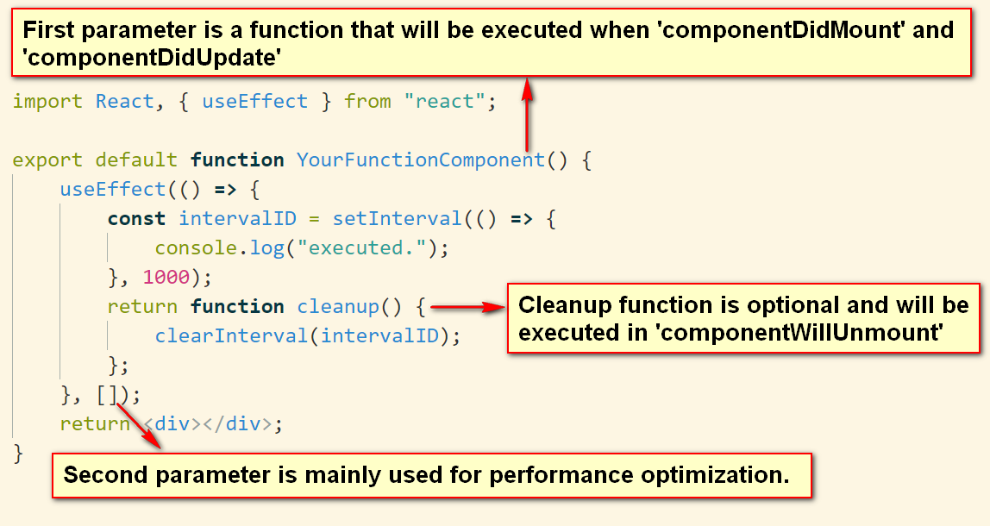
useEffect syntax
Notes:
You can think 'useEffect' as a combination of 'componentDidMount', 'componentDidUpdate', 'componentWillUnmount'.

Slide 14
useEffect second parameter, dependency array
Null(default)
useEffect runs on every invocation of component
Empty Array
useEffect runs only on first invocation of components
Values
useEffect runs only when any of array values change
componentDidMount
+
componentDidUpdate
componentDidMount only
componentDidMount
+
shouldComponentUpdate && componentDidUpdate

Slide 15
What benefits do we have by using effect hook?
Separate Concerns - Related logic is combined into one hook function.
Increased Maintainability.
Increased Reusability - Side effect codes can be reused by extracting reusable codes and defining customized hooks.

Slide 16
4
Main Hook: useRef

Slide 17
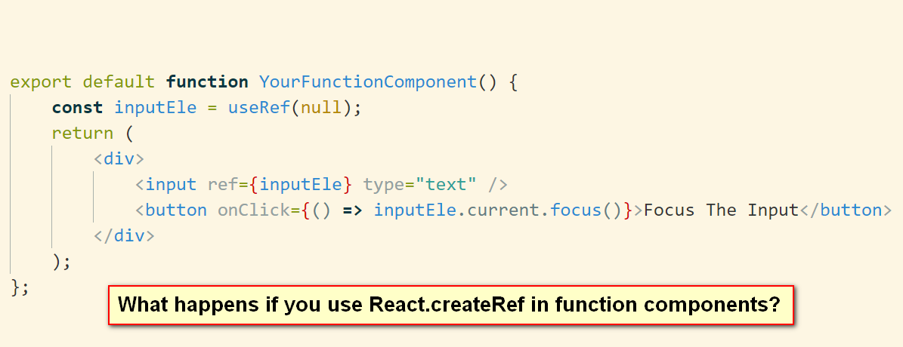
useRef syntax

Slide 18
Tips when using useRef
If you add ref to a function component, the ref.current is null by default.
If you need to expose inner ref or inner functions to caller, use ‘React.forwardRef’ + ‘useImperativeHandle’ in your function component.
useRef can be used to store class instance fields, but we recommend using 'useState' instead.

Slide 19
5
Use Your Own Hook

Slide 20
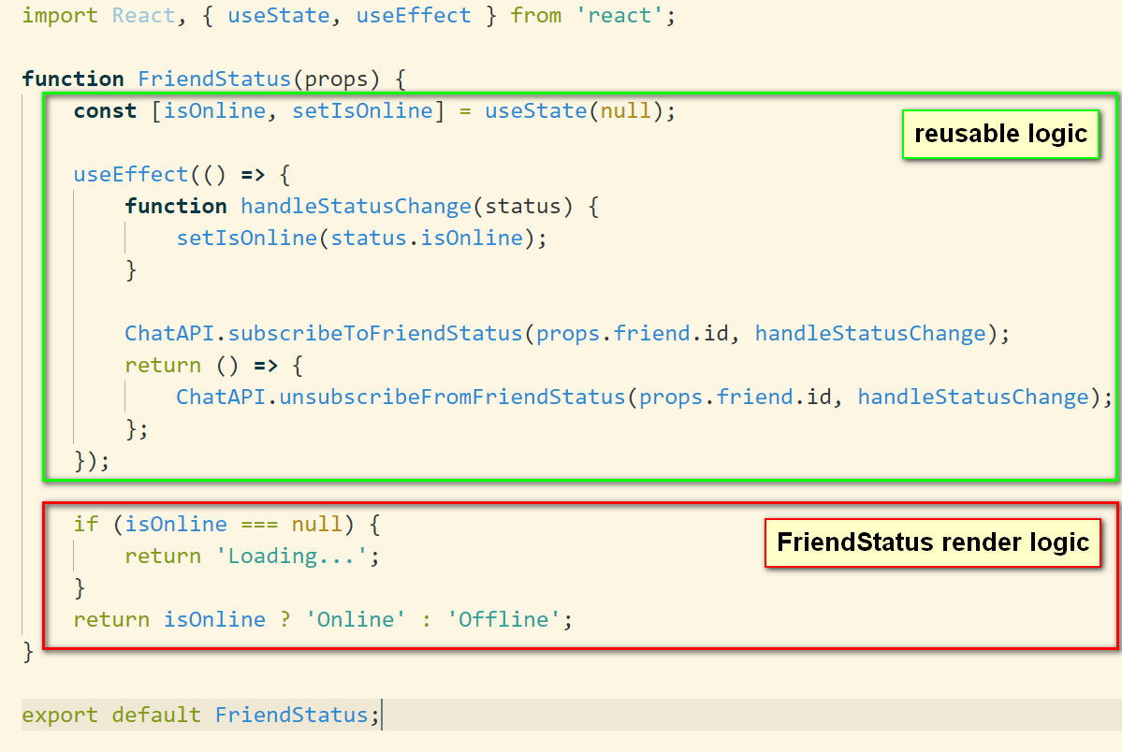
FriendStatus.js

Slide 21
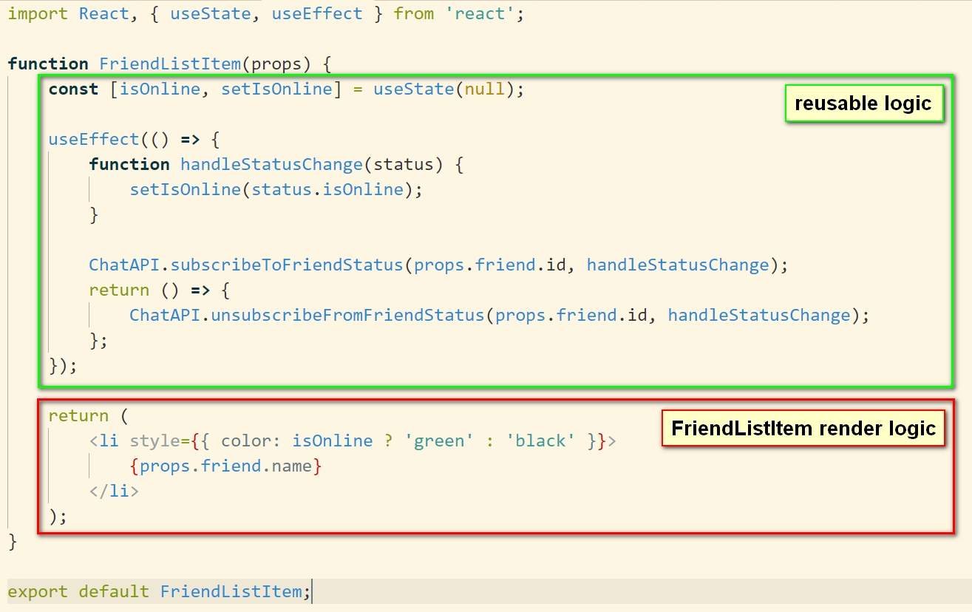
FriendListItem.js

Slide 22
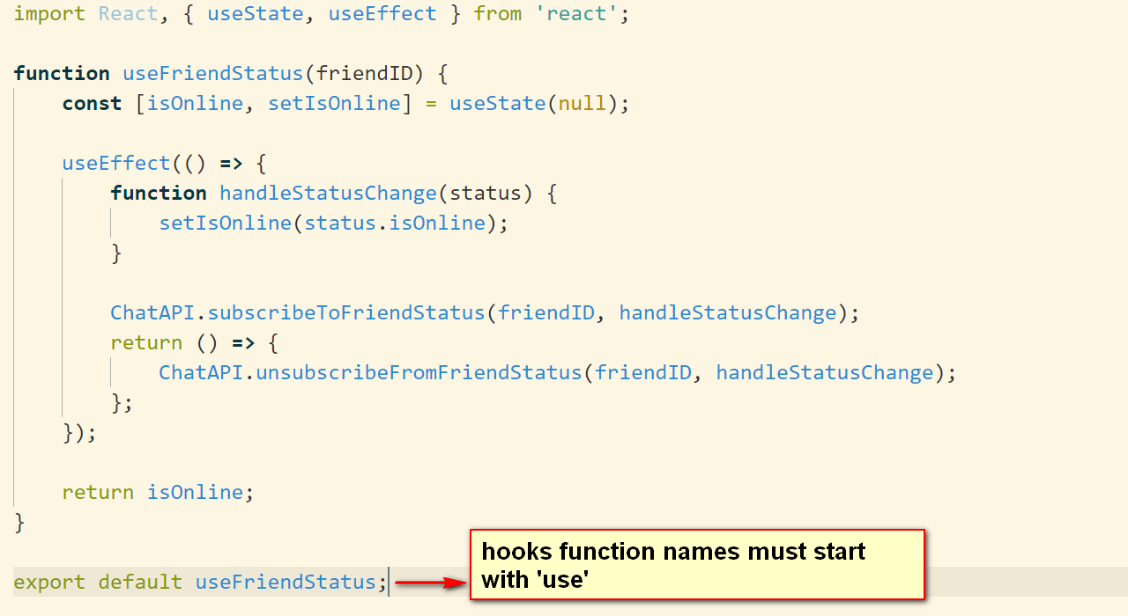
Custom hook: useFriendStatus.js

Slide 23
6
useContext/useReducer useMemo/useCallback

Slide 24
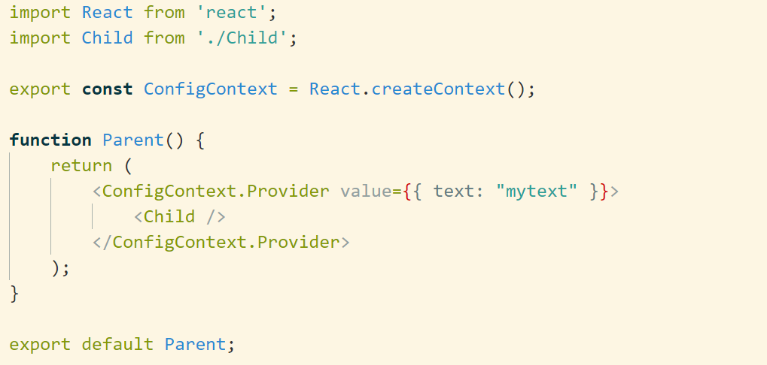
useContext: Context Provider

Slide 25
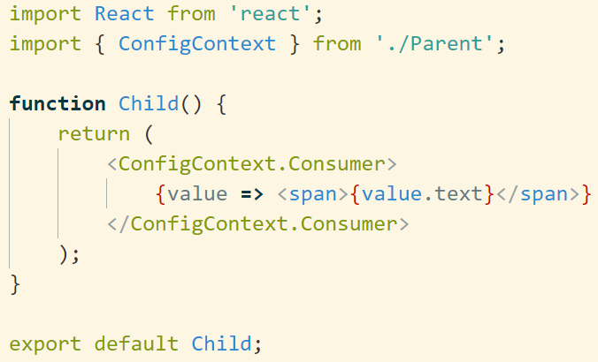
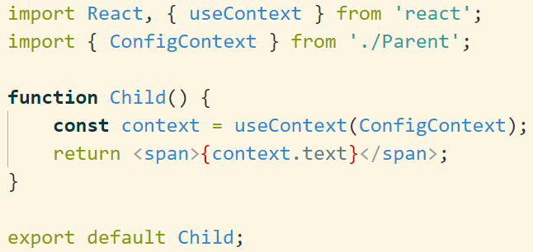
useContext: Context Consumer
Old Way(Context.Consumer):
New Way(useContext):

Slide 26
useReducer
An alternative to useState.
'useReducer' and 'useContext' provides a new choice on state management.
To embrace hooks, Redux supports ‘useStore’, ‘useSelector’ and ‘useDispatcher’ now.

Slide 27
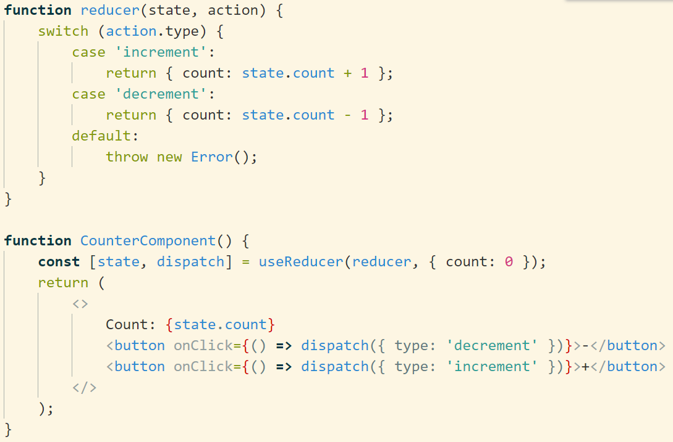
useReducer example

Slide 28
useMemo and useCallback
useMemo and useCallback is a mechanism of performance optimization.
Memoization is an optimization technique used primarily to speed up computer programs by storing the results of expensive function calls and returning the cached result when the same inputs occur again.

Slide 29
useMemo and useCallback synax
useMemo:
useCallback:
useCallback(fn, deps) is equivalent to useMemo(() => fn, deps).

Slide 30

  Q & A

