Slide 1
TestNG
Testing framework for Java language
Team memebers:
Bahi ALI berlnty Kerlos Gehad Mohsen Yasmine Alaa

Slide 2
TestNG
TestNG is a testing framework inspired from Junit AND Nunit but introducing some new functionalities that make it more powerful and easier to use.

Slide 3
TestNG functionalities:
Annotations
Flexible test configuration.
Supported by variety of tools and plug-ins (Eclipse, IDEA, Maven, ..etc.).
Support for parameters.
Support for data-driven testing (with @DataProvider).
Default JDK functions for runtime and logging (no dependencies).

Slide 4
Annotations
@BeforeSuite | The annotated method will be run before all tests in this suite have run
@AfterSuite | The annotated method will be run after all tests in this suite have run
@BeforeTest | The annotated method will be run before any test method belonging to the classes inside the <test> tag is run
@AfterTest | The annotated method will be run after all the test methods belonging to the classes inside the <test> tag have run
@BeforeGroups | The list of groups that this configuration method will run before. This method is guaranteed to run shortly before the first test method that belongs to any of these groups is invoked
@AfterGroups | The list of groups that this configuration method will run after. This method is guaranteed to run shortly after the last test method that belongs to any of these groups is invoked
@BeforeClass | The annotated method will be run before the first test method in the current class is invoked
@AfterClass | The annotated method will be run after all the test methods in the current class have been run
@BeforeMethod | The annotated method will be run before each test method
@AfterMethod | The annotated method will be run after each test method
@DataProvider | Marks a method as supplying data for a test method. The annotated method must return an Object[][] where each Object[] can be assigned the parameter list of the test method. The @Test method that wants to receive data from this DataProvider needs to use a dataProvider name equals to the name of this annotation
@Parameters | Describes how to pass parameters to a @Test method
@Test | Marks a class or a method as part of the test

Slide 5
Tests
Dependency test.
Parameterized test.
Group test.
Priority test.
Exception test.

Slide 6
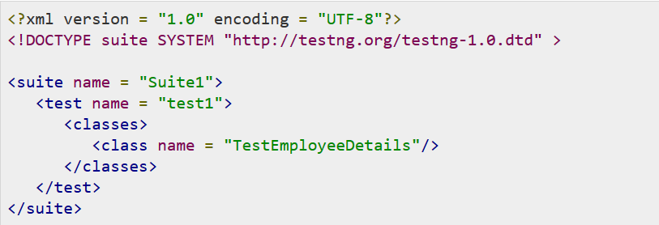
Xml Configuration file

Slide 7
Test Results
HTML and an XML report.
Listeners These classes are notified at runtime by TestNG when the test starts, finishes, fails, skips, or passes.
Reporters These classes are called when the whole suite run ends. The object containing the information of the whole test run is passed to this class when called.
Notes:
TestNG, by default, generates a different type of report for its test execution. This includes an HTML and an XML report output. TestNG also allows its users to write their own reporter and use it with TestNG. There is also an option to write your own loggers, which are notified at runtime by TestNG.
There are two ways to generate a report with TestNG −
Listeners − For implementing a listener class, the class has to implement the org.testng.ITestListener interface. These classes are notified at runtime by TestNG when the test starts, finishes, fails, skips, or passes.
Reporters − For implementing a reporting class, the class has to implement an org.testng.IReporter interface. These classes are called when the whole suite run ends. The object containing the information of the whole test run is passed to this class when called.

Slide 8
Demo

Slide 9

Thank you

