Slide 1

SIGNALR
Created By Berna D.

Slide 2
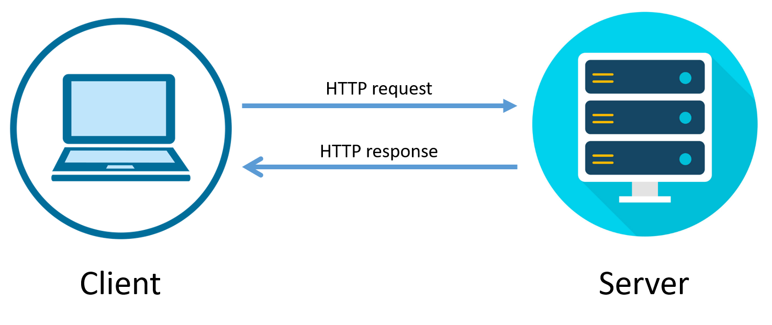
Web Application Communication
Flow:
In this case, it looks like is not possible to create a real-time experience on the Web!
Clients must request to the server before getting a response from the Server or the same process is valid within the server. The server does not react client if any request does not reach the client.
This communication is stateless which explains why the previous request was not remembered by the server side. (Unless using cookies, session, or something like that).
This communication is one-way.
But
SignalR comes into the play right away!
*http: It is a standard protocol used to communicate from the client to the server
*real-time experience: Any changes that were made are reflected in the data immediately. There is no need to make a request.

Slide 3
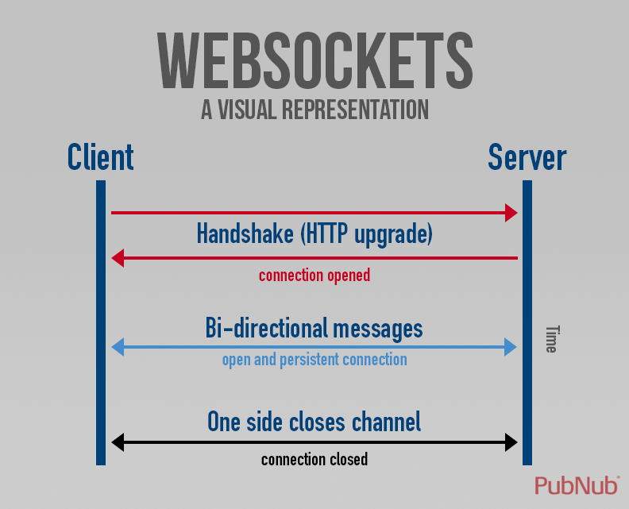
What is SignalR?
What is WebSocket?
SignalR is an open-source .Net library that enables real-time, bi-directional web communication from server to clients. Using SignalR, you can write server-side code that can communicate with the clients instantly.
SignalR uses various technologies to handle real-time communication from server to client such as:
WebSocket
Event Source
Forever Frame
Long Polling
Websocket is a stateful protocol.
WebSocket uses HTTP as the initial transport mechanism, but keeps the TCP connection alive after the HTTP response is received so it can be used to send messages between the client and server.

Slide 4
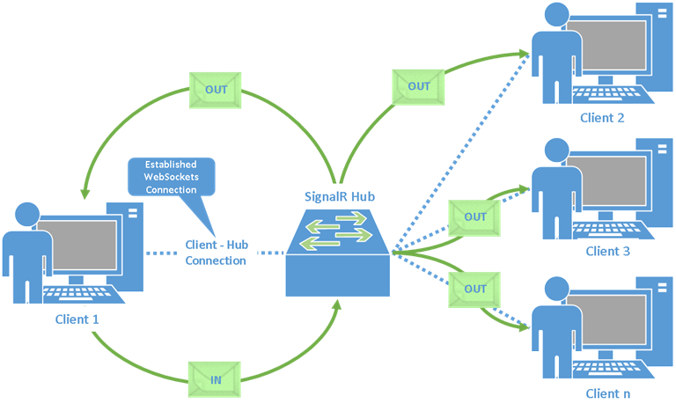
How Does SignalR Work?
SignalR hub is essentially a class, and all clients subscribed to a method defined in it will receive messages transmitted through the relevant Hub.
Clients could be any type of web browser, device, or system.

