Slide 1
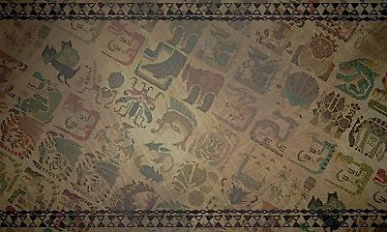
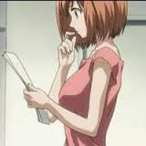

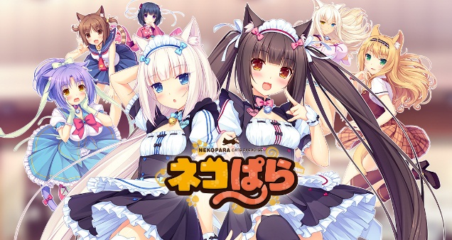

About
The Hunters guild is a great place to stay when you are searching for friends. its place where you can meet up with other hunters who happen to be on the same both as you so why not join the Guild and start your adventure with your newly appointed comrades in arms!!
Copyright owners and special thanks to!
NEKOWORKS AND CAPCOM
Characters belong to:
Nekoworks : Nekoparadise
Design and icons: CAPCOM

