Slide 1

Data Engineering Pipeline for Sales Analytics
Bernadine Pierre
FOIL, November 2025

Slide 2

Problem & Solution
Business Challenge
Solutions Approach
The organisation struggles with inconsistent data quality that blocks effective analytics and decision-making.
Built an automated ETL pipeline using aligned technologies, delivering production-ready infrastructure in just minutes.
Fragmented data sources
Automated ingestion from UCI repository
Manual quality checks
Star schema optimised for queries
Limited analytical capabilities
Built-in quality controls
Key Achievement: Production-ready pipeline delivered in minutes.

Slide 3
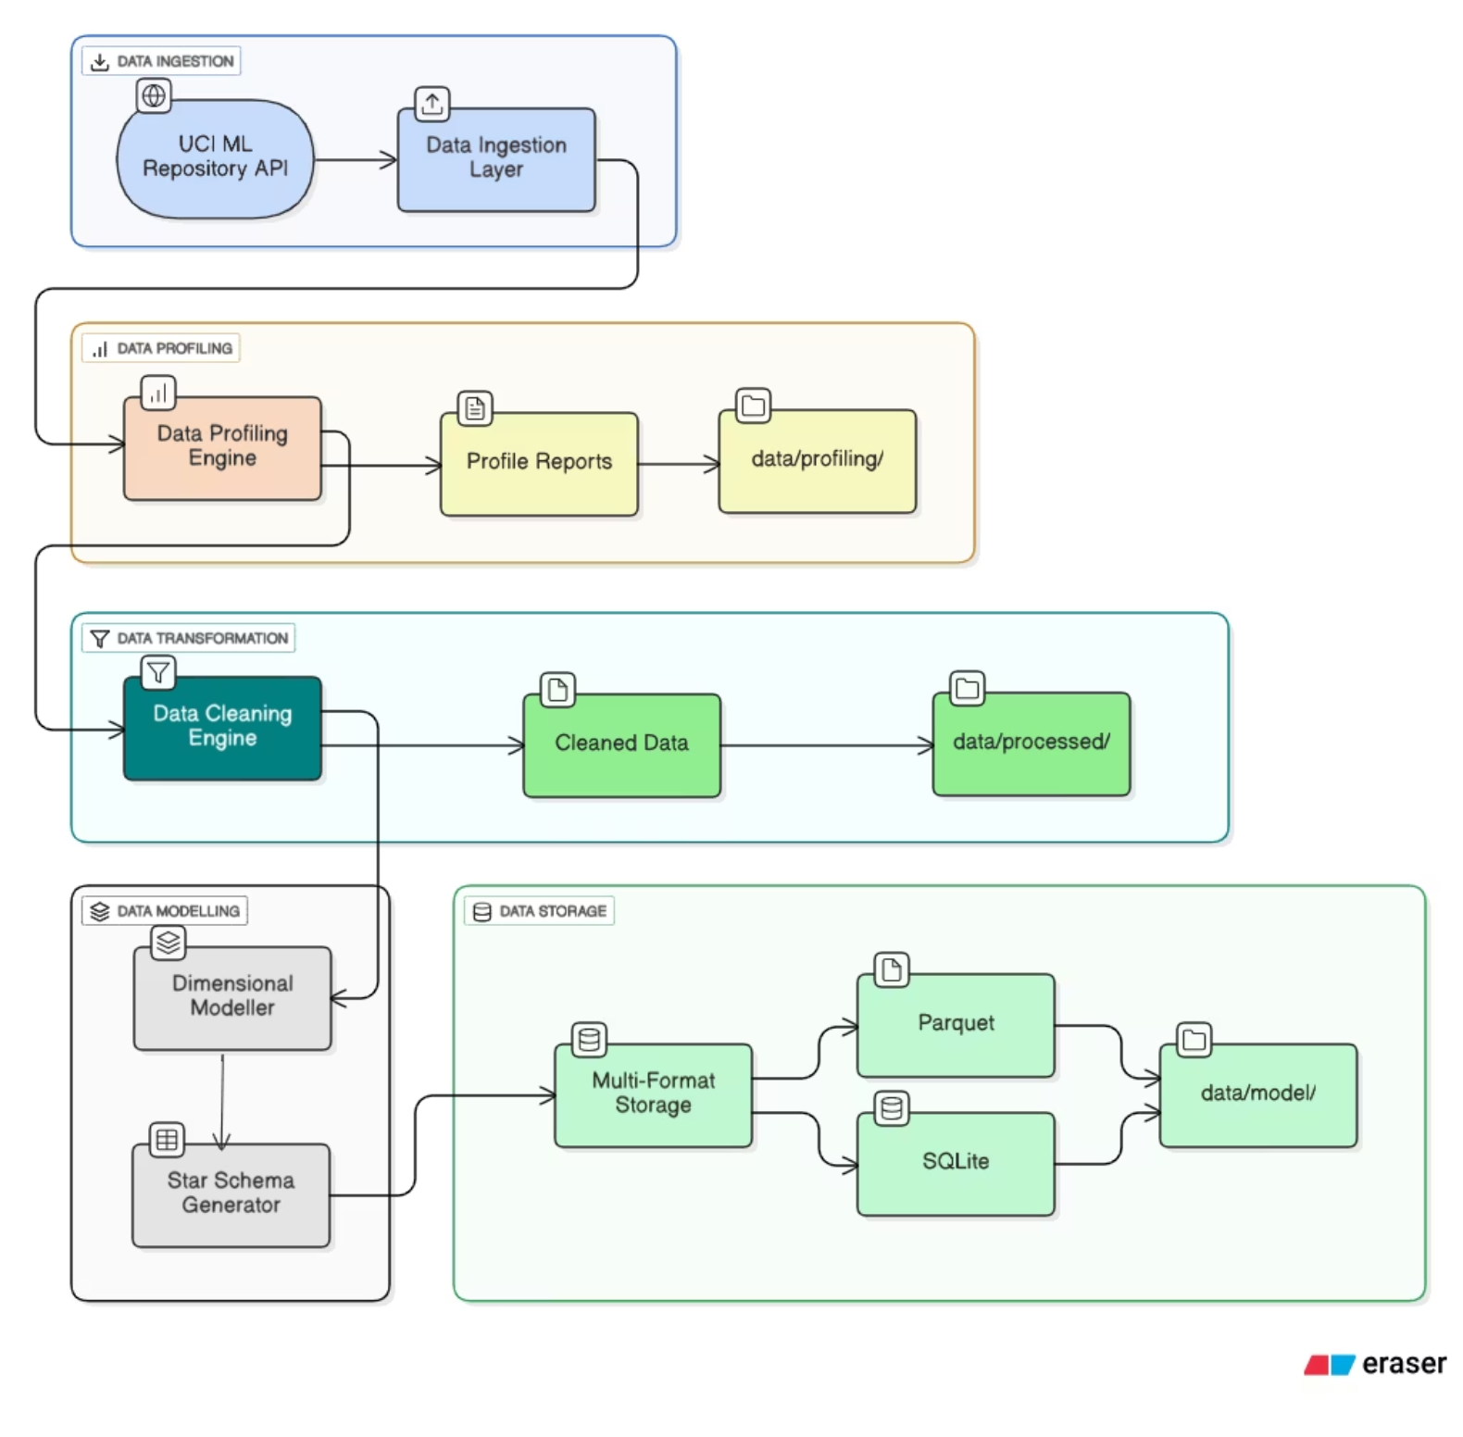



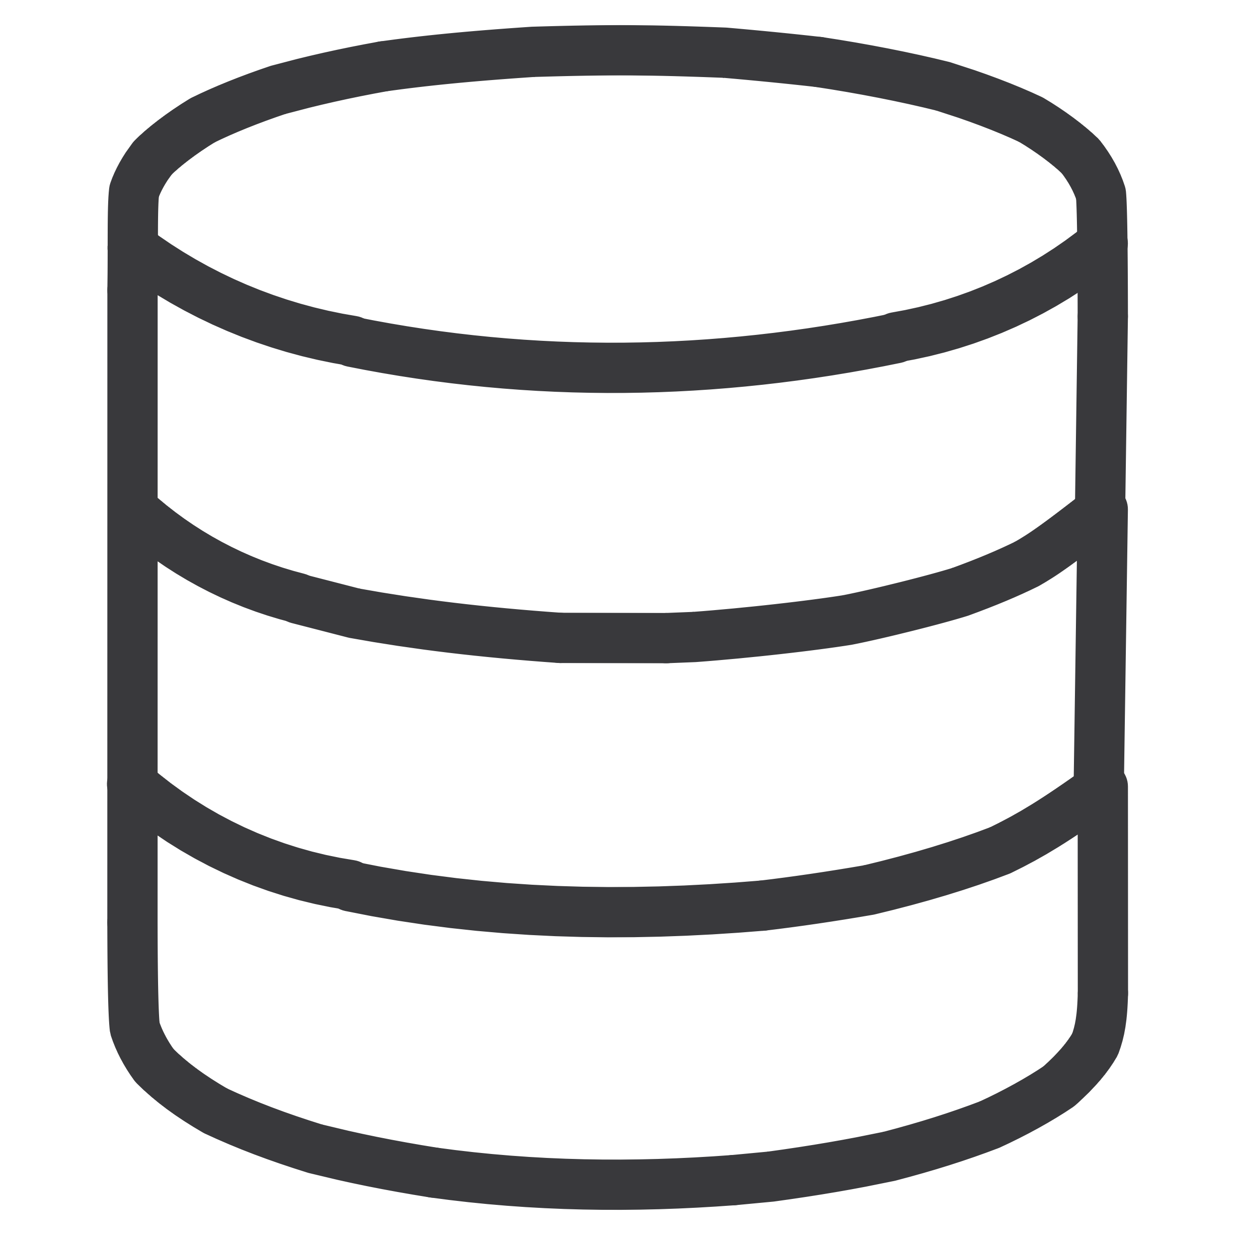
Pipeline Architecture
Ingestion
Profiling
Cleaning
Modelling

Slide 4
Data Quality & Business Logic
542K
9,288
24.9%
Transactions Processed
Cancellations Flagged
Missing CustomerIDs

Slide 5
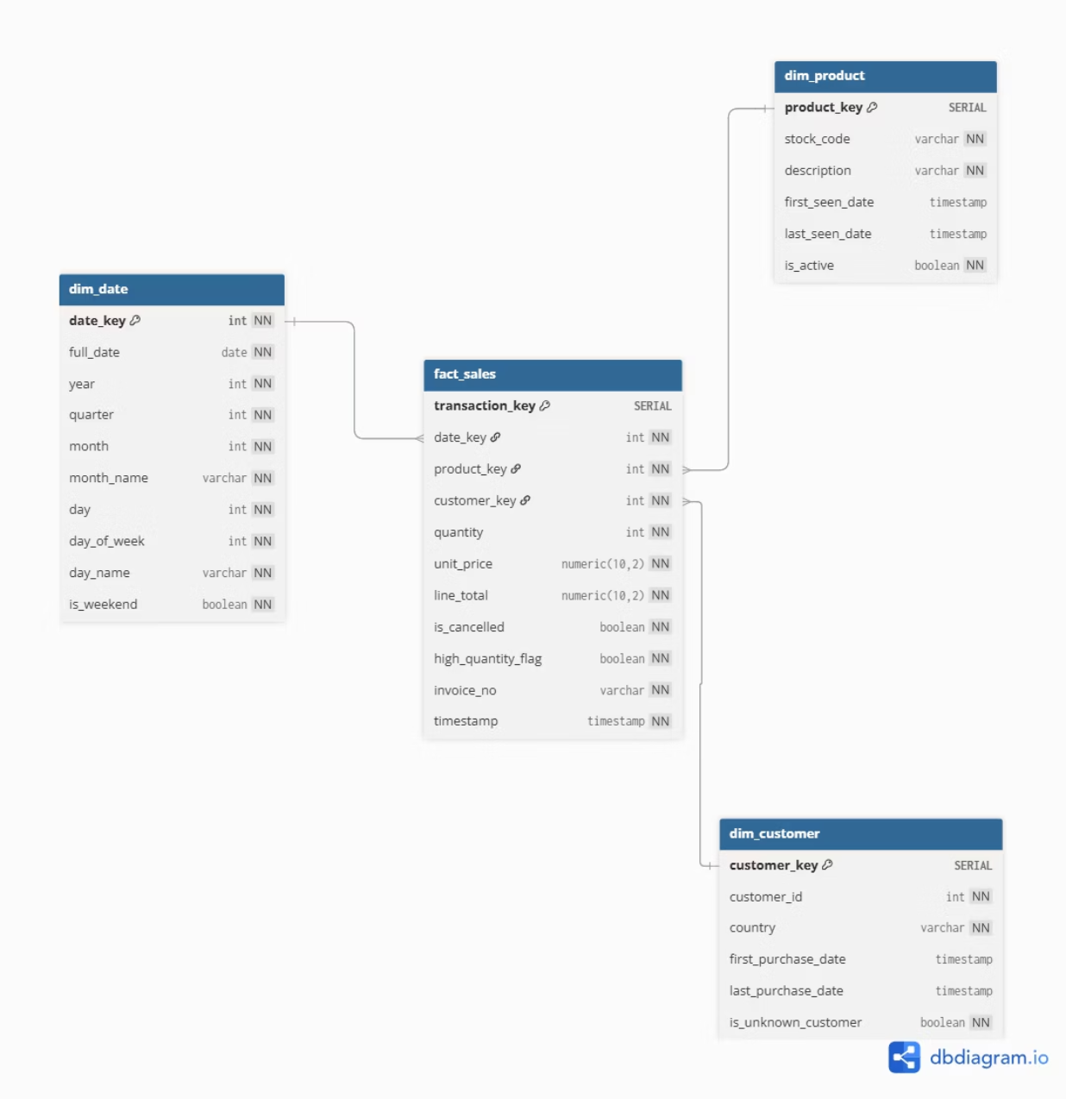
Star Schema & Analytics Capabilities
Dimensional Model
Fact Sales
Dim Date
Dim Product
Dim Customer

Slide 6
Demo & Future Enhancements
Live Demonstration
Roadmap
01
Azure Data Factory
Execute Pipeline
Enterprise orchestration with scheduling and monitoring
Run the automated ETL process
python src/main_pipeline.py
Azure Synapse
Scalable analytics platform for growing data volumes
02
Review Profile Report
Quality Monitoring
Examine automated data quality metrics and validation results
Real-time alerting and automated anomaly detection
03
Query Database
Incremental Loading
Demonstrate analytical queries against the dimensional model in SQLite
Efficient updates processing only changed records
From raw data to actionable insights. This pipeline demonstrates enterprise-ready data infrastructure that scales with business needs.

