Slide 1
JavaScript

Slide 2
What Is JavaScript?
“The programming language of the world’s largest open system.”
–Douglas Crockford
Notes:
What is JavaScript?
What system is he talking about?

Slide 3

Architect
clivelimpkin.com/
Notes:
Despite that..
When your system architect looks at JavaScript, he may see this.
A big pile of stuff that’s just going to slow things down.

Slide 4
Speed v Performance
Time to interactivity
Interaction responsiveness
Perceived performance
Notes:
Customer acceptance starts with the front-end.
The most important thing to consider is their perception of performance.

Slide 5
Server v Client
Threading
Caching
Streaming
Notes:
Architects should know that proper use of JavaScript can:
reduce server round trips
reduce load on the database
improve performance
Streaming: Initially load minimal content, AJAX the rest
Threading: Content pre-fetching, web workers, AJAX
Caching: HTML5 storage features, Cookies

Slide 6
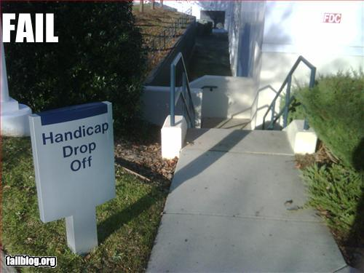
Designer
Notes:
When your designer looks at JavaScript he might see this.

Slide 7
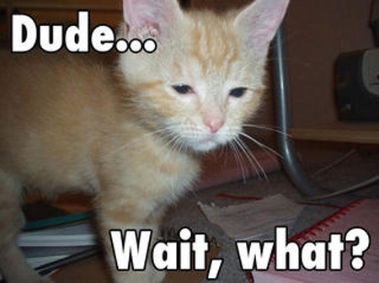
Accessibility
“In many cases, JavaScript can be used to increase accessibility.” –webaim.org
Notes:
WebAIM's top goal is to help make the web more accessible to individuals with disabilities.

Slide 8
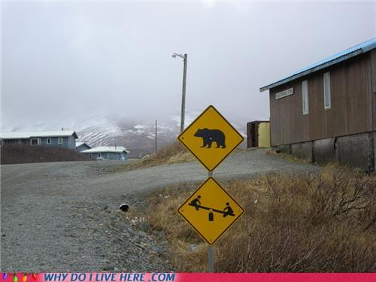
Administrator
Notes:
When your system administrator looks at heavy JavaScript usage, they might see this.
Some sort of crazy mash-up that’s, at best, a horrible idea.

Slide 9
XSS
“The vulnerabilities are required by Web Standards.
The consequences of standards behavior, not bugs”
--Douglas Crockford
Notes:
Security notes:
Cross-site Request Forgery (CSRF) 1988, predates JavaScript
XSS invented in 1996
Ads/mash-ups are self-inflicted XSS attacks.
CSRF – cross-site request forgery
Use SSL
Use POST (and server variable)
Check referrer
Use challenge tokens

Slide 10
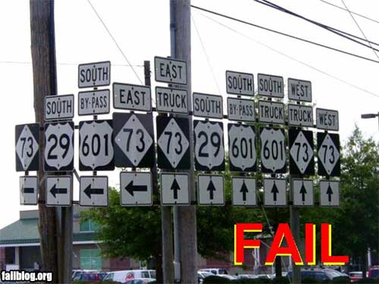
Developer
Notes:
When the developer looks at JavaScript, they see this.
Small investment
Document Object Model (DOM)
Browser Object Model (BOM)

Slide 11

JavaScript Is…
“The world’s most misunderstood programming language”
–Douglas Crockford
Notes:
Why are developers so confused?
Preconceptions
Misinformation
“Bad parts”
How could this happen?

Slide 12



History
Sun and Netscape release JavaScript™
Microsoft releases JScript
ECMA standardizes ECMAScript
Notes:
JavaScript March 1996 – v1.0
Bring interactivity to the browser (like hypercard)
Made syntax “look like Java”
Simplified to appeal to beginners
Jscript August 1996
ES – Oct 1998
European Computer Manufacturers Assoc.
ECMAScript – title of ECMA-262 specification
ES 1st-2nd (1998)
ES 3rd edition (2000)
ES 5th edition (2009)
ES Harmony (6th edition?)
Note:
Do other “modern” languages have a standard?
No: PHP, Ruby, Java (specification yes, not standardized), Perl
Yes: C, C++, C#, SQL

Slide 13

Scripting Language
Claim: JavaScript is just a scripting language, not a “real programming language” like Java
Notes:
That lead to several misconceptions.

Slide 14



Interpreted v Compiled
Interpreted (traditional JavaScript):
Run-time evaluation
Dynamic binding, reflection, polymorphism
Compiled (traditional Java):
Faster execution (when already downloaded)
Terrible for client-side execution
Modern trends toward just-in-time (JIT) compilation
Notes:
Java’s HotSpot is just-in-time compilation derived from research into Self

Slide 15
Type Casting
Claim: JavaScript will never have the power of a true programming language, like Java, because it lacks strong types

Slide 16
Weak v Strong Typing
You have to test values anyway
Strong typing:
More work
Less adaptable
Modern trends toward dynamic typing
Notes:
Java’s generics and C#’s dynamic type are examples of strongly typed languages trying to be more like JavaScript.

Slide 17
Object-oriented
Claim: JavaScript is object-based, not object-oriented, like Java, because it lacks classical inheritance

Slide 18

Classes v Prototypes
Prototypes (Rosch, 1970’s) evolved from classes (Aristotle 350’s BCE)
Classical JavaScript possible
Classification difficult
Notes:
In a way, JavaScript’s own origins demonstrate prototypal inheritance. Without a standard (read class) to follow, JScript became another instance of “ECMAScript” by inheriting everything from another instance—JavaScript™.
Information Architecture (IA) = all based in semiotics (study of sign processes: semantics, syntactics, pragmatics) = Classification (Ontology, or grouping) and Taxonomy (a scheme to name the groups)
Very resistant to change = very fragile.
Really helps to be orthogonal (balanced vectors) as well
Orthogonal IA takes time, patience, deep understanding of subject

Slide 19
Macro Language
Claim: JavaScript is a procedural (imperative) language only good for writing browser “macros”

Slide 20
Functional v Procedural
“JavaScript masquerades as a procedural language until you're ready to take it to the next level.” –Patrick Hunlock
“…the world’s most popular functional programming language.” –Douglas Crockford
Based on Self and Scheme
Notes:
Self = prototypes, Scheme = functional

Slide 21
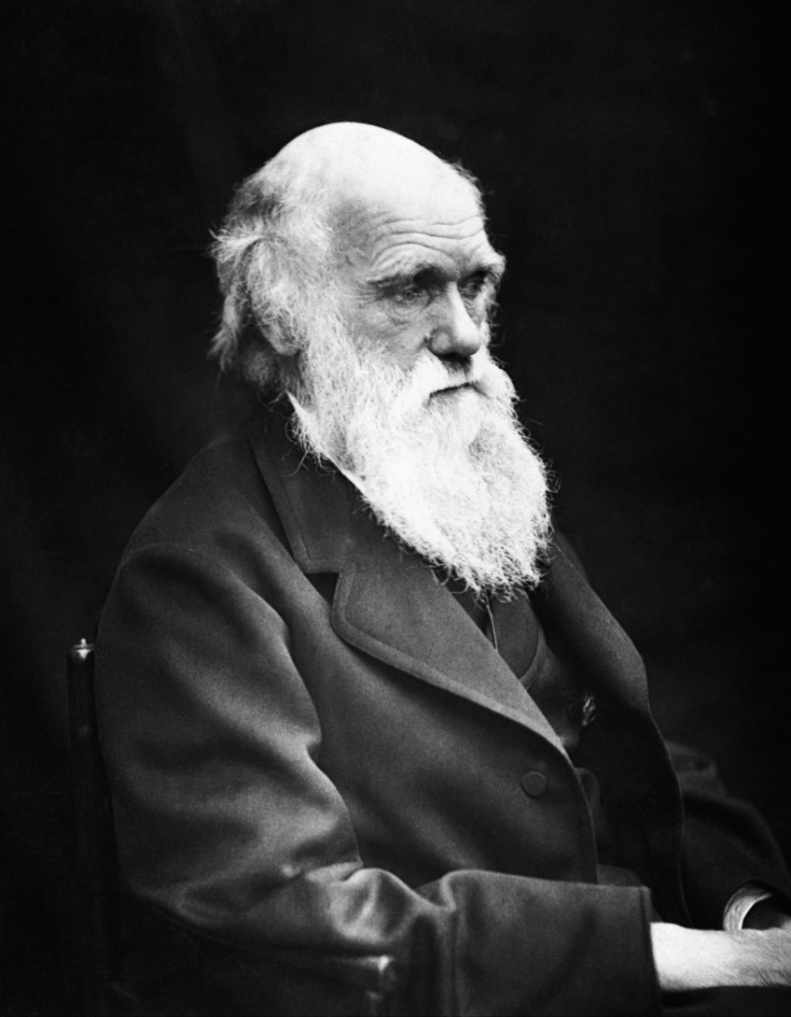
Evolution
AJAX
Libraries
JSON
Beyond the browser
Notes:
JavaScript should have died, but it thrived and even evolved because of its:
Simple, familiar syntax
Expressiveness
Flexibility
AJAX starts in 1999 as Microsoft creates XMLHTTP ActiveX control in IE5.
Implemented on large scale in 2002, patented 2003, standardized 2006.
JSON.org launched in 2002, Yahoo! adoption in 2005 for web services.

Slide 22
Beyond the Browser
Embedded scripting (OpenOffice, PDF)
Consumer electronics
VM APIs (mobile and desktop)
Compiled to machine code (V8)
Server-side execution (SSJS)
Database (NoSQL with JSON)
Notes:
Consumer electronics like high-end remote controls

Slide 24
Resources
JavaScript, The Good Parts
Douglas Crockford, javascript.crockford.com
Even Faster Web Sites
Steve Souders, stevesouders.com
YUI Theatre
developer.yahoo.com/yui/theater/
GoogleTechTalks
youtube.com/user/GoogleTechTalks

