Slide 1
The Respiratory System

Slide 2
The Respiratory System
Respiration is the processes used by an organism to generate metabolic energy by the oxidative breakdown of food. It is made of two processes:
External Respiration: ventilation, gas exchange
Internal respiration: oxygen utilization by the
tissues
The respiratory system is made up of:
respiratory tract
associated muscles

Slide 3
diaphragm
intercostal muscles
centres in the brain (medulla oblongata) that
control and facilitate the process of respiration
There are two lungs within the thorax
Each lung is surrounded by a double membrane
called the pleura
Functions of the respiratory system
to ventilate the lungs thereby adding oxygen
and removing carbon dioxide from the
circulating blood

Slide 4
provides a route for water loss and heat
elimination
enhances venous return
contributes to the maintenance of normal acid-
base balance
enables speech, singing, and other
vocalizations
defends against inhaled foreign matter
removes, modifies, activates or inactivates
various materials passing the pulmonary
circulation
serves as an organ of smell. This function is
performed by the nose

Slide 5
Respiratory Tract
It may be defined as the organs and tissues through which air is passed into and out of the body to allow the necessary gaseous exchanges to take place. This includes:
the upper airways
nasal cavity
mouth
pharynx
larynx
the lower airways
trachea

Slide 6
primary bronchi enter the lungs
secondary bronchi
tertiary bronchi
bronchioles
terminal bronchioles
respiratory bronchioles
alveolar ducts
alveoli
There are about 23 divisions between the
trachea and alveolar sacs
each division makes the air passages narrower,
but increases the number of airways
Lungs

Slide 7
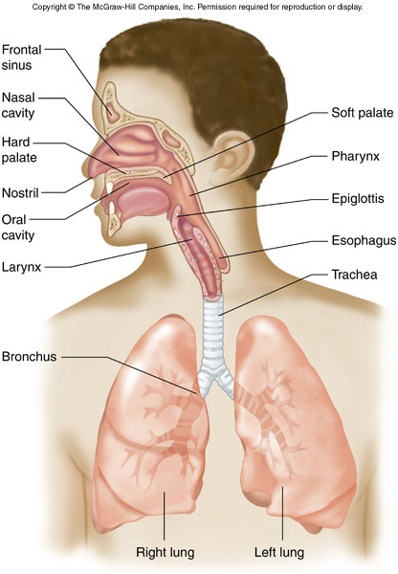
geometrically

Slide 8
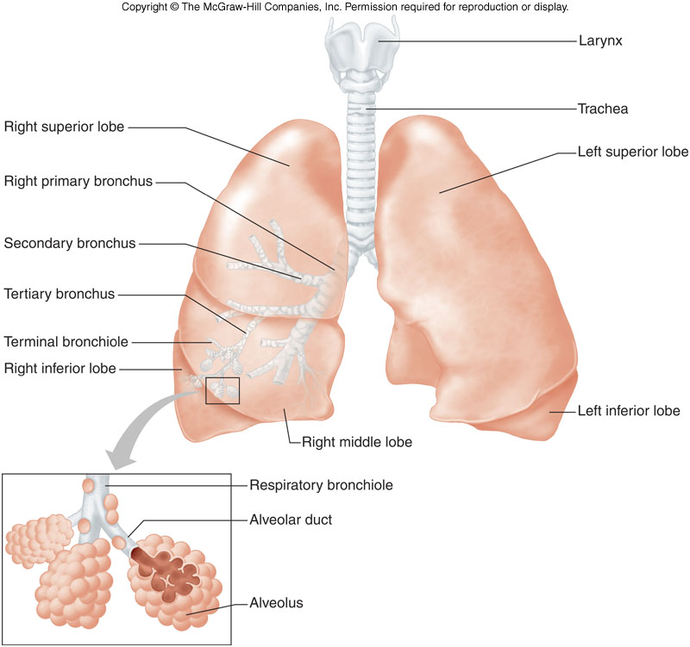

Slide 9
Alveoli
The alveoli resemble a froth rather than individual bubbles and they share common walls
they are basically polygonal in shape; ie, the
walls are flat
the alveoli have a structure specialised for
efficient gaseous exchange:
Walls are extremely thin
Each alveolus is lined by a single layer of epithelial cells formed by two cell (pneumocytes) types:
Alveolar type I cells
are extremely flattened

Slide 10
form the bulk (95%) of the surface of the
alveolar walls
Alveolar type II cells
simple cuboidal cells typically found at
alveolar wall junctions (septa)
they form small bulges on the alveolar walls
they secrete pulmonary surfactant
(made up of phospholipids, proteins, and
ions (especially Ca²⁺), which keep surface
tension in the alveoli low)
cover 5% of the gas exchange surface
They have a large surface area in relation to
volume

Slide 11
Both lungs contain about 300,000,000
alveoli having a total surface area of about
70 m²
moist surfaces in which gases dissolve
They are surrounded by numerous capillaries
Only about 0.2 µm separate the alveoli from
the capillaries due to the extremely thin walls
of both structures
macrophages are found in and around the
alveoli

Slide 12
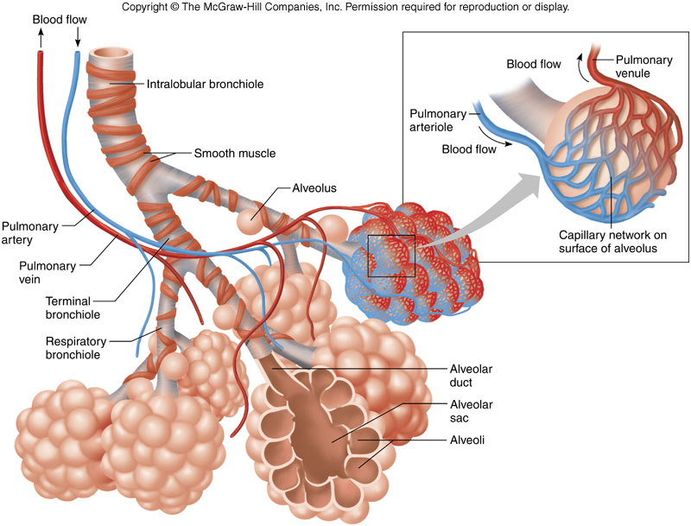

Slide 13
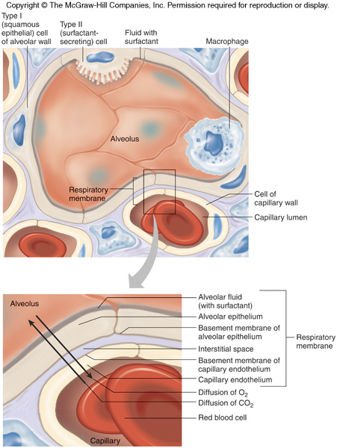

Slide 14
Mechanics of Respiration
Air tends to move from a region of high pressure
to a region of low pressure.
Three pressures determine airflow and volume
of the lungs:
Atmospheric Pressure (P_{ATM}): Barometric
pressure, normally about 760 mm Hg at sea
level
Alveolar/intrapulmonary Pressure (P_{ALV}): The
pressure in the lung
Pleural/intrathoracic Pressure (P_{PLU}): The
pressure in the pleura, between the lung and
thoracic wall, normally about 756 mm Hg

Slide 15
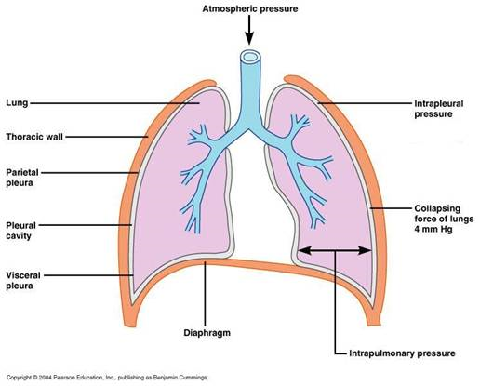

Slide 16
breathing essentially consists of two phases:
inspiration (inhalation)
expiration (exhalation)
Inspiration
It is an active process, it involves the contraction of the inspiratory muscles
Before:
primary respiratory muscles are relaxed
no movement of air
alveolar pressure equals atmospheric
pressure
pleural pressure is -5 cm H₂O

Slide 17
Onset:
primary respiratory muscles contract
diaphragm contracts and flattens
increasing the vertical dimension of thoracic
cavity
external intercostals muscles contract while
internal intercostals muscles relax
raise ribs and sternum upwards and outward
increased front- to-back dimension of
thoracic cavity
expansion of the thorax increases causes
the intrapleural pressure to fall to about – 8
cm H₂O

Slide 18
the resultant transmural pressure ensures
that the lungs stretch to fill the enlarged
thorax
the result is a greater volume of space in the
lungs and therefore less air pressure
the external air pressure is now relatively
greater and air is drawn into the lungs
Forced inspiration
In addition to the diaphragm and the external intercostal muscles accessory muscles like scaleneus and sternocleidomastoid contract to increase the volume of the thoracic cavity

Slide 19
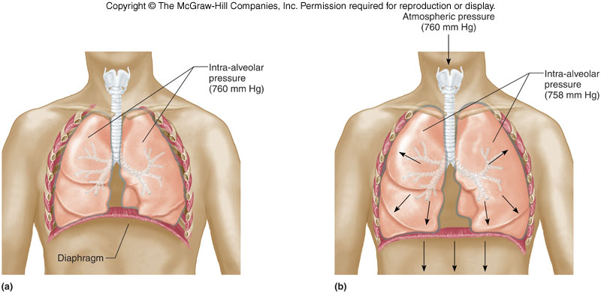

Slide 20
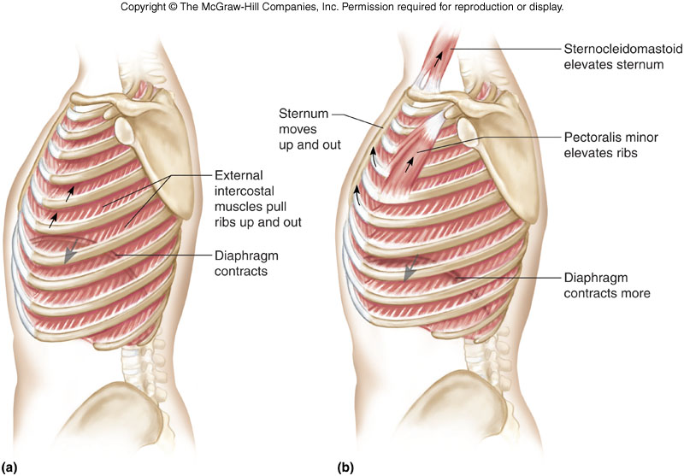

Slide 21
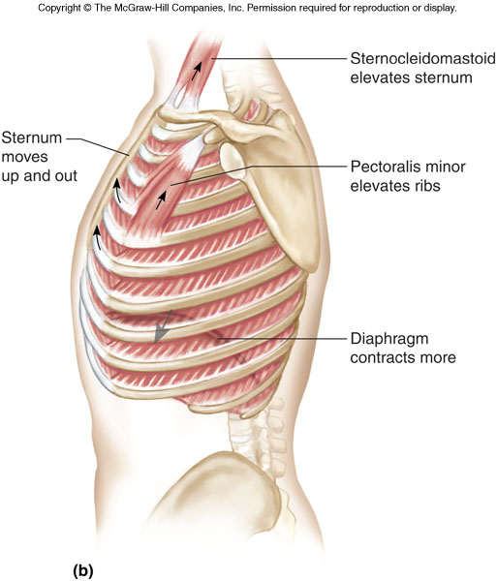

Slide 22
Expiration
It is a passive process
diaphragm relaxes and arches upwards
external intercostals muscles relax
ribs move downwards and inwards
sternum moves down to original position
volume of thoracic cavity decreases
lungs are compressed
lung-volume decreases due to its natural
elasticity
air pressure inside lungs increases as the
volume decreases
air pressure within the lungs is now higher

Slide 23
than atmospheric pressure
air is forced out of lungs to the exterior
Forced Expiration
It is an active process, it involves the contraction of the expiratory muscles in addition to the relaxation of the diaphragm and the external intercostal muscles
internal intercostals muscles contracts
muscles in the abdomen also contract
these further decrease the size of the thoracic
cavity

Slide 24
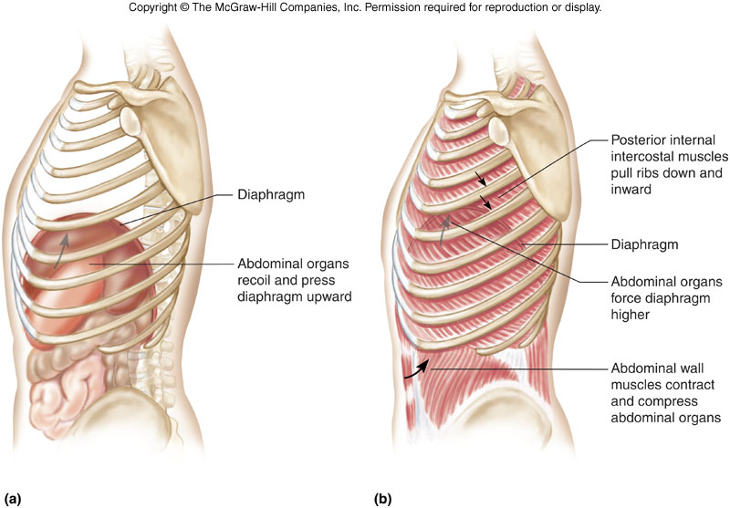

Slide 25
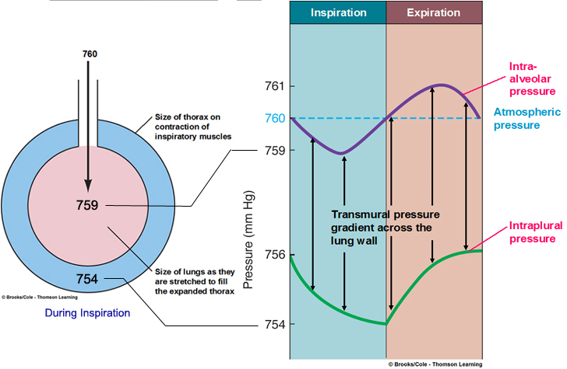

Slide 26
Inspired air contains approx:
79% nitrogen
20% O₂
0.04% CO₂
Water vapour/Trace Gases
Expired air contains approx:
79% nitrogen
16% O₂
4% CO₂
Water vapour/Trace Gases

Slide 27
Lung Volumes
The average pair of human lungs can hold
about 6 litres of air, but only a small amount of
this capacity is used during normal breathing
The total lung capacity depends on the person's
age, height, sex, race, and the degree of
physical activity
Spirometry is a method for measuring lung
volumes during ventilation
Lung volumes refer to physical differences in
volume
lung capacities represent different combinations
of lung volumes

Slide 28
Tidal volume (TV): the volume of air moved in
and out of the respiratory tract during each
ventilatory cycle (≈ 500 ml)
Inspiratory reserve volume (IRV): the
maximum volume of air that can be inhaled
above the tidal volume (≈ 3000 ml)
Inspiratory Capacity (IC): the maximum volume
of air that can be inspired at the end of a
normal quiet expiration (≈ 3,500 ml)(IRV + TV)
Expiratory reserve volume (ERV): the
additional volume of air that can be forcibly
exhaled below the tidal volume (≈ 1000 ml)
Vital capacity (VC): the maximal volume of air

Slide 29
that can be forcibly exhaled after a maximal
inspiration. VC = TV + IRV + ERV (≈ 4,500 ml)
Residual volume (RV): that volume of air
remaining in the lungs after a maximal
expiration. It cannot be expired no matter how
vigorous or long the effort. RV = FRC - ERV
(≈ 1200 ml)
Functional residual capacity (FRC): the volume
of air remaining in the lungs at the end of a
normal expiration. FRC = RV + ERV (≈ 2,200
ml)
Total lung capacity (TLC): the volume of air in
the lungs at the end of a maximal inspiration

Slide 30
TLC = FRC + TV + IRV = VC + RV
Forced expiratory volume 1 (FEV₁): the
volume of air that is forcefully exhaled in one
second
Forced vital capacity (FVC): the volume of air
that can be maximally forcefully exhaled Ratio of FEV₁ to FVC (FEV₁/FVC) - expressed as a percentage.
Normal FEV₁/FVC ~ 80%
Peak expiratory flow rate (PEFR) - the peak
flow rate during expiration

Slide 31
Clinical significance of spirometry
Two types of lung disorders can be identified by spirometry measurements:
obstructive lung disorders (eg bronchitis and
asthma
these are clinically identified by a decrease
in expiratory flow rates, the anatomical basis
of which is airway narrowing
restrictive lung disorders
clinically identified by decreased lung
volumes

Slide 32
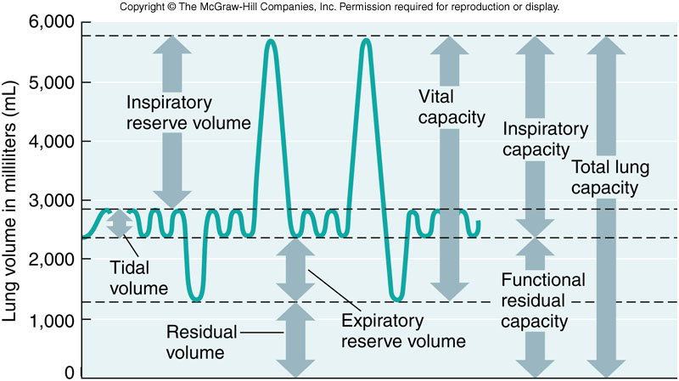

Slide 33
Pulmonary/minute Ventilation
Is the total amount of air passing in and out of the lungs within a minute
Pulmonary ventilation = tidal volume (500 ml) x
respiratory rate (12)
pulmonary ventilation can be divided into
alveolar ventilation and dead space ventilation
alveolar ventilation is the portion of the tidal
volume that reaches the alveoli (500-150 ml)
dead space is the part of tidal volume that does
not exchange gas (150 ml)

Slide 34
alveolar ventilation = (tidal volume – dead space)
x respiratory rate
physiologic dead space is the sum of normal
anatomic dead space and alveolar dead space
anatomic dead space is the portion of the tidal
volume that remains in the conducting airways
alveolar dead space is the volume of gas in
unperfused alveoli

Slide 35
Work of Breathing
It is the product of pressure change across the lung and volume of gas moved. During inspiration, most of the work is done to
expand the lungs against its elastic forces
(lung compliance work)
overcome the viscosity of the lung and chest
wall structures (chest wall compliance),
overcome airway resistance during the
movement of air into the lungs (air flow
resistance)
no work is done during expiration since it is a
passive process caused by elastic recoil of the

Slide 36
lung and chest recoil
Lung Compliance
It is an index of distensibility of the lungs
may be defined as change in lung volume per
unit change in pressure (ΔV/ΔP)
varies within the lung according to the degree of
inflation
it is affected by:
elastic fibers in the alveoli
due to the presence of large quantities of
elastin interspersed with a little collagen
and their geometric arrangement in the

Slide 37
lungs
pulmonary surfactant in the alveolar fluid
its main function is to lower the surface
tension between air and alveolar fluid
prevents alveolar collapse at end of the
expiration
increases compliance of lungs
mitigates the forces that tend to close the
small airways
The patency of the alveoli is maintained by the
tension through the matrix of connective
tissue in opposition to the tendency of the

Slide 38
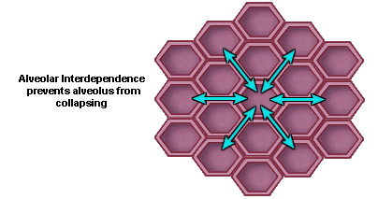
walls to recoil
surface tension of the thin layer of fluid that
lines the walls

Slide 39
lack of surfactant results in
increased surface tension of the alveolus
areas of atelectasis
alveoli filled with fluid
In premature births, lack of surfactant causes
infant respiratory distress syndrome
A similar condition can exist in adults and is
called adult respiratory distress syndrome
(ARDS)
High Compliance
The lungs have trouble deflating because they
have lost their elasticity. There is great difficulty in

Slide 40
exhaling but not inhaling
Causes include:
Emphysema
Low Compliance
There is great difficulty in inhaling, expanding the lung. Occurs with overproduction of collagen
Causes include:
pulmonary fibrosis as in Restrictive Lung
Disease
lack of surfactant as in Infant Respiratory
Distress Syndrome (IRDS)

Slide 41
Chest Wall Compliance
The lungs are covered by smooth membranes called pleurae which have two layers:
a visceral layer which sticks closely to the
outside surface the lungs
a 'parietal' layer which lines the inside of the
chest wall (ribcage)
the pleural space is usually extremely thin, and
filled with a small amount of fluid
the chest wall is naturally larger than the lungs
the normal relationship of the chest and lungs is
such that the lungs keep trying to collapse
(elastic recoil) while the chest wall keeps trying

Slide 42
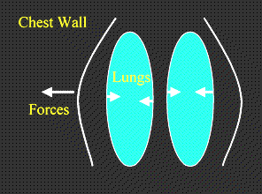
to expand
the chest wall and lungs cannot assume their
natural positions because of the negative
pressure created in the intrapleural space.

Slide 43
Collapse (pneumothorax) of part or all of a lung as a result of collection of air or gas in the chest or pleural space can occur
spontaneously in a healthy person
lungs compromised by
trauma
asthma
bronchitis
emphysema

Slide 44
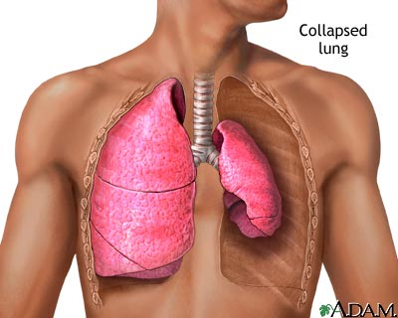

Slide 45
Air Flow Resistance
Resistance to air flow is a major contributor to work of breathing. Resistance to air flow is caused by two forms of resistances: These are:
airway resistance
tissue resistance
Airway Resistance
Flow may be
laminar
turbulent
Resistance is determined mainly by radius
Highest resistance always occurs in the

Slide 46
nose and nasopharynx
The terminal bronchioles have low
resistance because they have the highest
total cross-sectional area
it is affected by autonomic nervous activity
Sympathetic activity causes bronchodilation
via β2-Receptors
Parasympathetic activity causes
bronchoconstriction via cholinergic receptors
Histamine: produces very strong
bronchoconstriction at low doses
Various noxious stimuli, such as smoke and
foreign chemicals, produce bronchoconstriction

Slide 47
via irritant receptors on the bronchial smooth
muscle. This reflex arc is carried by the
parasympathetic system
low CO₂ in the airways also produces
bronchoconstriction
TISSUE Resistance
Tissue resistance varies with lung volume
it decreases as lung volume increases
Transpulmonary pressure exerts a
distending force and keeps airways from
collapsing

Slide 48
Gaseous Exchange
The physiology of respiration involves exchange of gases in lungs and tissues and their transport from lungs to the tissues and vice versa
it requires
ventilation
circulation
gas exchange occurs by diffusion as a result of:
difference in partial pressure at the semi-
permeable membrane of the alveoli
the thickness of the respiratory membrane
surface area of the respiratory membrane
diffusion coefficient of the particular gas

Slide 49
Partial pressure of Gases
Gas | Alveolar | Deoxygenated blood | Oxygenated blood
O₂ | 105 mmHg | 40 mmHg | 100 mmHg
CO₂ | 40 mmHg | 44 mmHg | 40 mmHg
Gas Transport
O₂ Transport
Oxygen is transported round the body via the blood. It is either
dissolved in the plasma (1.5% of all oxygen in
the blood)
bound to hemoglobin (98.5% of all oxygen in
the blood)

Slide 50
Dissolved O₂
it is equal to (PO₂) x (0.003) Vol-%
0.003 is the solubility of O₂ in plasma
Thus normal dissolved O₂ content =
(0.003)(P_{O2} of 100 mm Hg) = 0.3 mL
generally insignificant at normal PO₂
can become significant in hyperbaric conditions
(very high P_{O2})
dissolved O₂ is directly proportional to P_{O2} of
blood

Slide 51
Bound O₂
it is equal to the hematocrit x (1.34) x (Hb-
Saturation)
hematocrit = Hemoglobin concentration of
blood (g Hb/dL blood) ≈ 15 g/ dL of blood
1.34 = O₂ Carrying-Capacity of Hb (mL O₂/g Hb
Hb)
Hb-Saturation = The percent of hemoglobin
that is O₂-bound (%)
does not contribute to the P_{O2} of blood
Hemoglobin
Hemoglobin is found in the red blood cells of the

Slide 52
body
Each red blood cell (RBC) contains
approximately 280 million hemoglobin molecules
The main function of hemoglobin is to transport
O₂ from the lungs to the tissues and then
transport CO₂ back from the tissues to the lungs
One hemoglobin molecule has the ability to
transport up to 4 O₂ molecules
There are two forms of hemoglobin:
oxyhemoglobin, which is saturated with
O₂ molecules
deoxyhemoglobin, which is desaturated with
O₂ molecules

Slide 53
Hemoglobin is a globular protein consisting of 4
subunits: 2 α globins and 2 β globins
Each subunit consists of a polypeptide chain
binding an iron containing heme group
Heme consists of a ferrous ion (Fe²⁺) chelated
in a porphyrin ring
O₂ binds directly to the Fe²⁺ in the heme moiety
housed within the helical structure of the globin
polypeptide.
4 O₂ molecules can bind to each hemoglobin
molecule
Hb is saturated when it is carrying the
maximum load of O₂

Slide 54
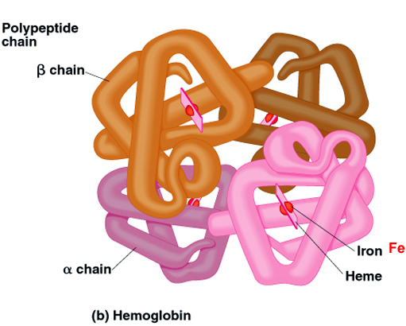
The binding of O₂ and Hb is directly affected by
partial pressure of O₂

Slide 55
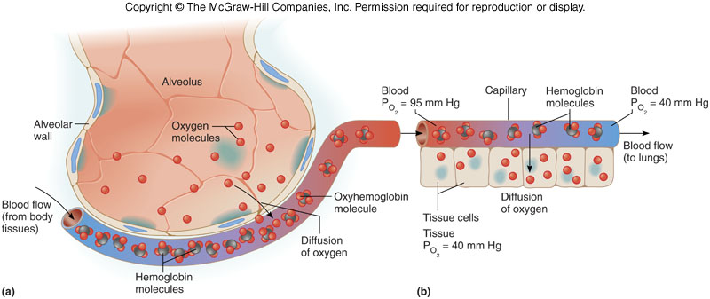

Slide 56
O₂-Hb Dissociation curve
The relationship between O₂ levels and
hemoglobin saturation is indicated by the
O₂-Hb dissociation (saturation) curve
sigmoid, due to the fact that each O₂ that binds
to Hb increases the attraction of Hb for the next
oxygen (up to full saturation)
curve flattens at higher P_{O2} since relatively few
binding sites remain
shape determines
alveolar P_{O2} necessary to saturate Hb
oxygen loading (lungs) occurs over steep
portion of curve

Slide 57
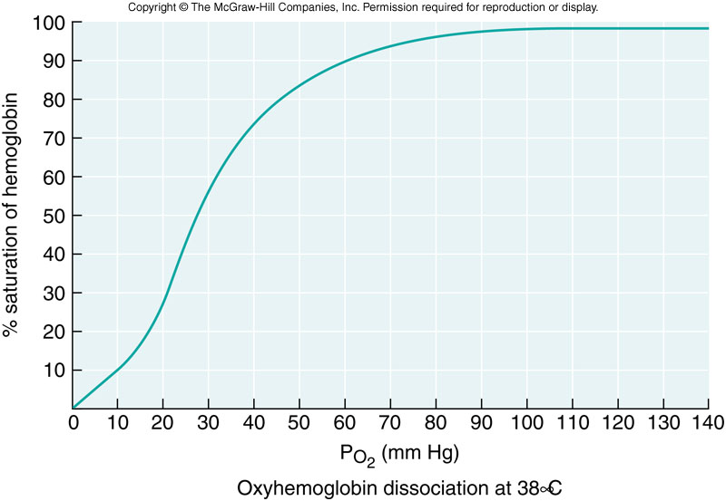
tissue P_{O2} necessary to release O₂ from Hb
oxygen unloading (tissues) occurs over
steep portion of curve

Slide 58
Factors affecting the O₂-Hb Dissociation curve
Curve is not constant but can shift (increase/decrease Hb-O₂ affinity) with changes in physiological conditions
pH
when H⁺ combines with Hb, Hb-O₂ attraction
is reduced (noncompetitive inhibition)
H⁺ ⇑ ⇒ Right shift of dissociation curve
P_{CO2}
when CO₂ combines with Hb, Hb-O₂
attraction is reduced (noncompetitive
inhibition)
P_{CO2} ⇑ ⇒ Right shift of dissociation curve

Slide 59
Declining pH (increased acidity) results in the increase of O₂ unloading. Dissociation curve shift due to CO₂ and reduced pH is known as the Bohr effect
Blood temperature
increased temperature reduces Hb-O₂
attraction
temperature ⇑ ⇒ Right shift of dissociation
curve
Diphosphoglycerate (DPG)
When present, binds to Hb, interfering with
O₂ uptake
DPG ⇑ ⇒ Right shift of dissociation curve

Slide 60
DPG produced in red cell in response to
hypoxemia due to a number of conditions
including
chronic exposure to high altitude
anemia
right-to-left shunts
Thyroid hormones
growth hormone
androgens
Molecular species of Hb:
fetal Hb binds O₂ more tightly (less sensitive
to DPG) then adult Hb
enables fetal Hb to better compete with

Slide 61
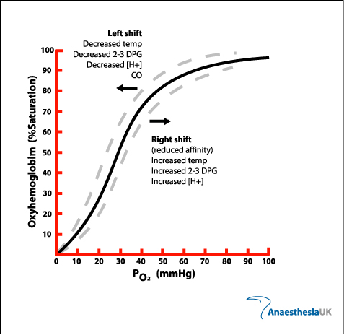
maternal Hb for O₂ in the placenta

Slide 62
Carbon Monoxide and O₂ Carriage
CO is mainly a product of civilization (fires,
exhausts, neon illuminating gases, tobacco)
CO is colorless, tasteless and odorless
CO lowers oxygen content without altering PaO₂
CO favorably competes with O₂ oxygen for the
same Fe²⁺ binding sites on Hb and blocks O₂
uptake
CO has an oxygen binding affinity that is about
240 times higher than that of oxygen
combination of CO and Hb forms
carboxyhemoglobin (COHb).
exposure to CO reduces the O₂ binding to Hb

Slide 63
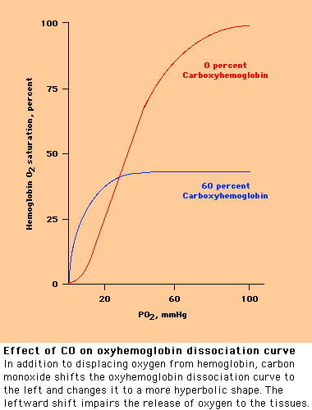
it also decreases the unbinding of O₂ from Hb
CO shifts the O₂ dissociation curve to the left

Slide 64
Myoglobin
Myoglobin consists of a single alpha helix
protein chain with 153 amino acids and one
heme group
stores oxygen in the muscle cells
has a stronger affinity for O₂ then hemoglobin
facilitates the transport of oxygen to the
mitochondria for oxidative phosphorylation
Myoglobin can take up one O₂ –molecule
Myoglobin displays a hyperbolic-shaped O₂ –
binding curve
myoglobin provides an important source of O₂
for exercising muscle

Slide 65
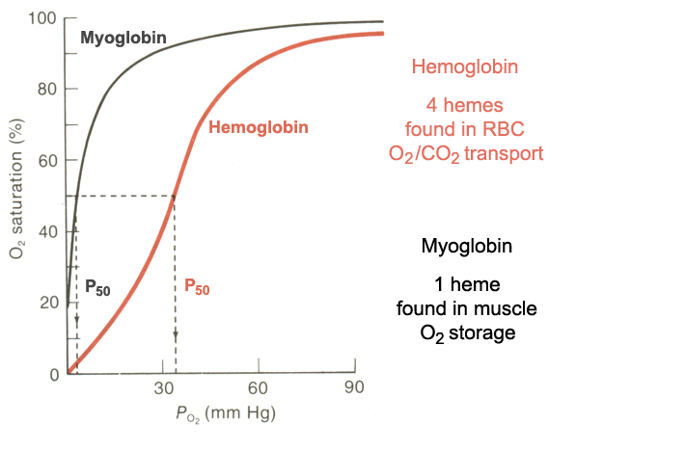

Slide 66
CO₂ Transport
CO₂ builds up in the peripheral tissues and
diffuses out, across the capillary wall into the blood. The blood carries the CO₂ back to the lungs for elimination.
CO₂ is carried in the blood in 3 ways, as:
dissolved in the blood plasma
carbamino compounds, especially
carbaminohaemoglobin
HCO₃⁻
Dissolved CO₂
CO₂ is about 20 times as soluble in plasma as

Slide 67
O₂
the amount dissolved depends on the P_{CO2}
at normal P_{CO2} about 10% of CO₂ is transported
in this form
Carbamino compounds
CO₂ in the blood combines with the amino acids
of the globin portion of the Hb molecule as
carbaminohemoglobin (HbCO₂)
HbCO₂ formation is enhanced as O₂ dissociates
from Hb
CO₂ does not compete the O₂ for binding to iron
about 20% of CO₂ is transported in this form

Slide 68
HCO₃⁻
In the tissues:
CO₂ reacts with water, forming carbonic acid,
which immediately breaks down to HCO₃⁻ and
H⁺: CO₂ + H₂O ⇔ H₂CO₃ ⇔ H⁺ + HCO₃⁻
This reaction is slow in plasma, but more than
10 000 times faster in the erythrocytes because
of the presence of the enzyme carbonic
anhydrase which catalyses the hydration of CO₂
to H₂CO₃
HCO₃⁻ diffuses out of the RBC in exchange for
Cl⁻ (chloride shift) to balance the loss of negative
charges from the RBC

Slide 69
H⁺ ions in the RBC are buffered by Hb
The binding of H⁺ with Hb weakens the bond
between O₂ and hemoglobin. This leads to the
unloading of O₂ to the tissues
formation of reduced hemoglobin (HHb)
leads to the uptake of more CO₂ from the
tissues
This phenomenon of O₂ unloading leading to
CO₂ and CO₂-generated H⁺ loading in the blood
near the tissues is called the Haldane effect
In the lungs all reactions occur in reverse
HCO₃⁻ enters red blood cells in exchange for

Slide 70
Cl⁻
HCO₃⁻ combines with H⁺ to form H₂CO₃
H₂CO₃ breaks down into CO₂ and H₂O
CO₂ then diffuses into the alveoli and out of the
body with the next exhalation

Slide 71
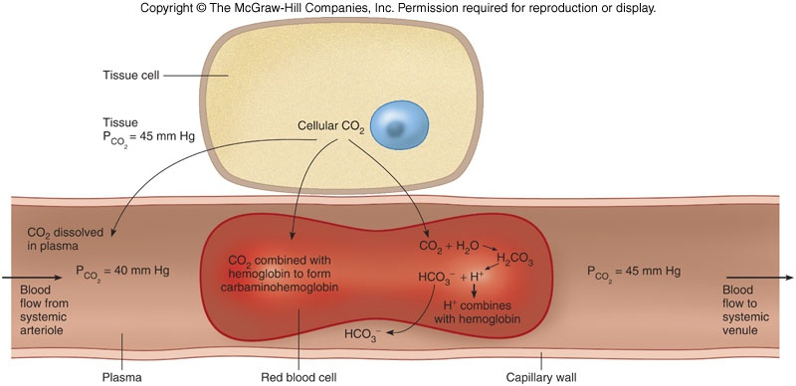

Slide 72
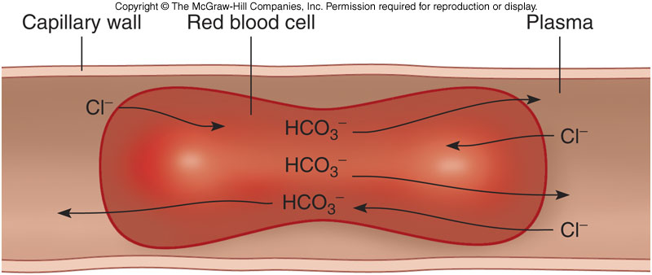

Slide 73
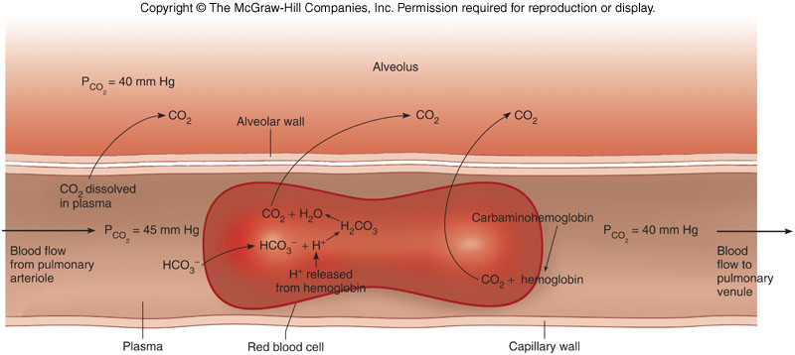

Slide 74
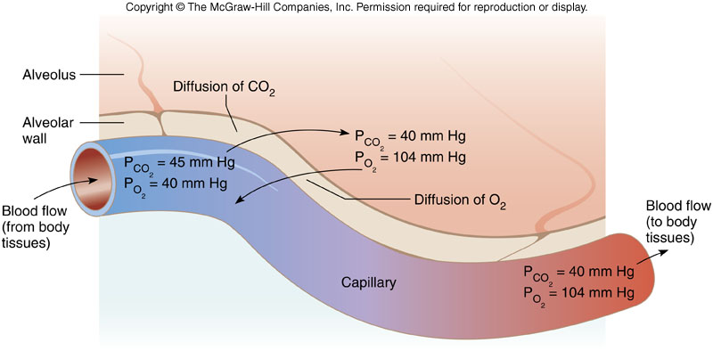

Slide 75
Ventilation/perfusion balance
The ratio of alveolar ventilation (V) to pulmonary blood flow (Q)
Theoretically, the ratio of ventilation to perfusion
in any one alveolus can range from 0 to ∞
In the upright position the normal V/Q ratio of
the entire lung is 0.8
both ventilation and perfusion increase from top
to bottom of lung because of
gravity
lack of rigidity of the airways
perfusion increases by a greater amount

Slide 76
Apex of lung:
Relatively less air and less blood go to the apex
V_{A}/Q = 3.0
While both ventilation and blood supply are
less at apex, the blood supply is relatively less than ventilation, resulting in a higher overall V_{A}/Q ratio
Base of lung:
Relatively more air and more blood go to the
base of the lung, primarily due to gravity
V_{A}/Q = 0.5
While both ventilation and blood supply

Slide 77
are greater at base, the blood supply is
relatively greater than the ventilation, resulting
in a lower overall V_{A}/Q Ratio
Middle of lung:
In the middle of the lung near the hilus, the V_{A}/Q ratio almost closely approximates 1

Slide 78
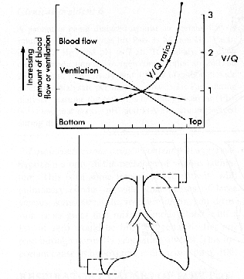

Slide 79
Ventilation/perfusion mismatch
Disturbance of this distribution can lead to V/Q mismatch
For an area of low V/Q ratio the blood flowing
through it will be incompletely oxygenated,
leading hypoxemia
the hypoxaemia can normally be corrected
by increasing the FiO₂
an area of lung receiving no perfusion will have
a V/Q ratio of (infinity) and is referred to as
alveolar dead-space
area of lung receiving no ventilation, owing to
airway closure or blockage, will have a V/Q ratio

Slide 80
of zero and the area is designated as shunt
there is marked arterial hypoxemia
adequate oxygenation can only be re-
established by restoring ventilation to these
areas using measures which clear blocked
airways and reinflate areas of collapsed lung

Slide 81
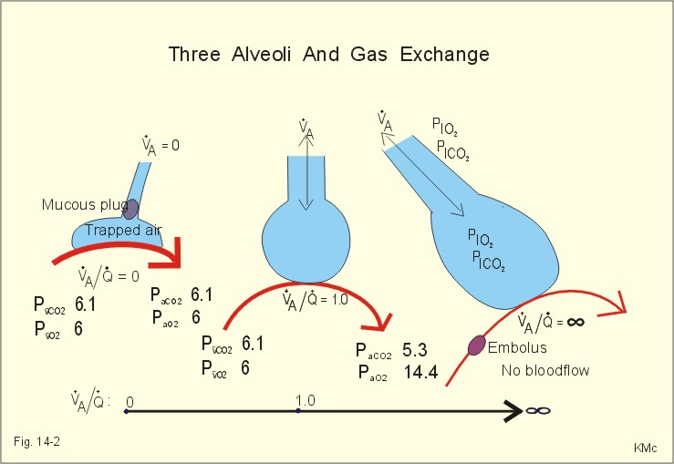

Slide 82
Compensation of V /Q mismatch
Low P_{AO2} in poorly ventilated alveoli, causes
arteriolar constriction, which redistributes
bloodflow to well-ventilated alveoli
Low P_{ACO2} exists in alveolar regions with a high
ventilation-perfusion-ratio. Low values constrict
the small airways leading to these alveoli. Their
reduced ventilation results in redistribution of
gas to alveoli with better blood flow

Slide 83
Control of respiration
Breathing is an involuntary process
factors that control breathing are:
neural
chemical
Neural control
Respiratory centers in the brain primarily control
involuntary breathing. These are the:
Medullary respiratory center
pontine respiratory centers

Slide 84
Medullary respiratory center
Respiratory rhythmicity center - sets the pace for respiration
consists of interacting neurons that fire either
during inspiration (I neurons) or expiration (E
neurons)
consists of two important groups of neurones
dorsal respiratory group (DRG)
ventral respiratory group (VRG)
Dorsal respiratory group (DRG)
located in or near the tractus solitarius
mainly inspiration (I neurons)

Slide 85
their neurons stimulate neurons that innervate
inspiratory muscles (diaphragm and external
intercostals) to bring about inspiration
Ventral respiratory group (VRG)
composed of both inspiratory and expiratory
neurons
includes the nucleus retroambigualis, nucleus
ambiguus (expiratory) , nucleus para-
ambigualis (inspiratory), and Bötzinger complex
has interconnections with the DRG
especially important during active respiration

Slide 86
Pontine respiratory center
They modulate the activities of the medullary
respiratory center
consists of two important centers
Apneustic center
Pneumotaxic center
Apneustic center
located in the caudal half of the pons
stimulate I neurons causing strong, sustained
inspiratory movements (apneusis)

Slide 87
Pneumotaxic center
located in the rostral half of the pons
send impulses to the apneustic center and the
DRG inhibiting the apneustic center and the
inspiratory center in the medulla respectively
The hypothalamus and the cortex frequently
modulate centers in the pons and medulla and
modify respiration
ordinary activities such as speaking, laughing,
crying, eating, defecation, coughing and
sneezing can affect the respiratory center and
modify respiration

Slide 88
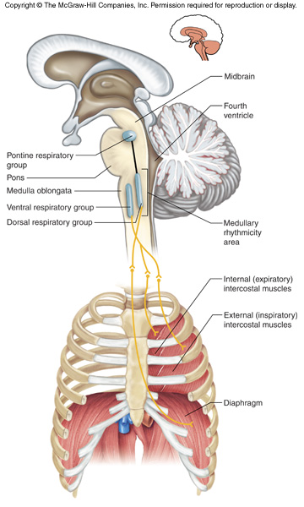

Slide 89
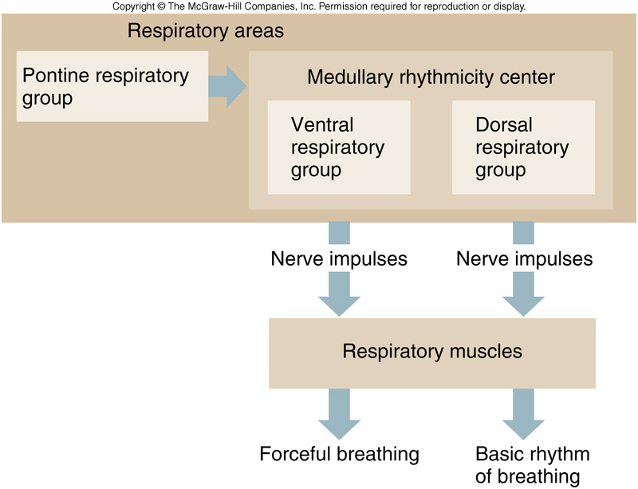

Slide 90
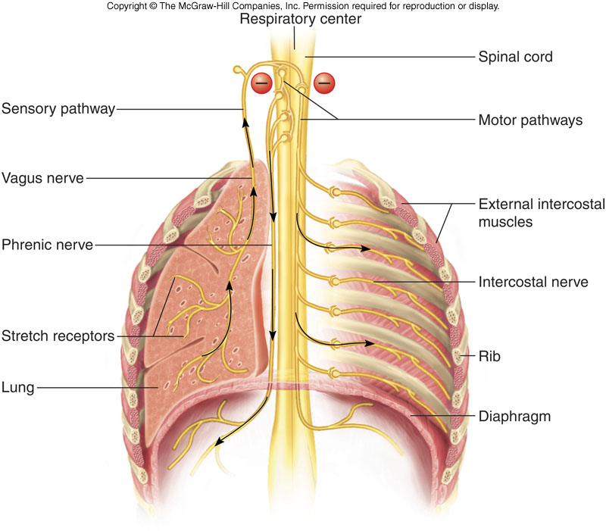

Slide 91
stimuli such as touch, temperature, and pain
can also affect the respiratory center and
modify respiration
Pulmonary reflexes
There are other reflexes that affect breathing. These include:
Hering-Breuer reflexes
Irritant and juxtacapillary receptors
muscle and joint reflexes
Chemical control
it is mediated by chemoreceptors sensitive to
changes in the arterial concentrations of P_{O2},

Slide 92
P_{CO2}, and H⁺
Two sets of chemoreceptors are involved:
central
peripheral
Central chemoreceptors
located in the medulla
communicate with the DRG
their response to P_{CO2} is about 70-80%
They are sensitive to pH in the surrounding CSF
directly and arterial P_{CO2} indirectly
Low pH increases chemoreceptor firing rate
which stimulate central controllers to increase

Slide 93
ventilation
Peripheral chemoreceptors
located in aortic (aortic arch) and carotid bodies
(bifurcation of the carotid arteries)
have inherently high metabolic rate
are stimulated by a steep decrease in arterial
P_{O2} and an increase in H⁺ (P_{CO2} and Lactic acid
in exercising muscles concentration)
Low PO₂ increases chemoreceptor firing which
increase ventilation
They give inputs to the medulla
Their response to P_{CO2} 20%

Slide 94
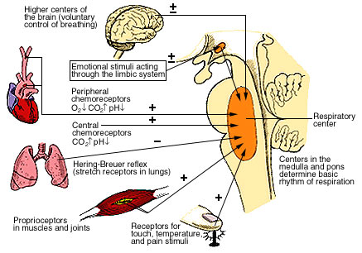

Slide 95
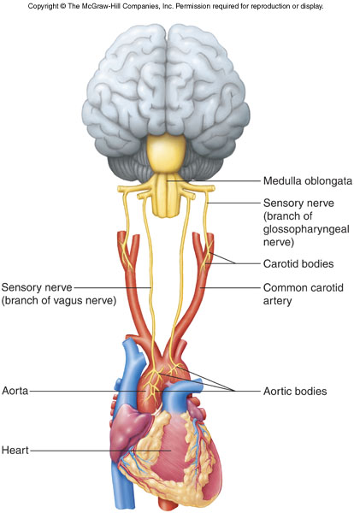

Slide 96
Hypoxia
Hypoxia is decreased supply of oxygen to the tissues. Hypoxemia is defined as a decrease in arterial P_{O2}.
Hypoxia is caused by
A reduction in partial pressure of oxygen
Inadequate oxygen transport
The inability of the tissues to use oxygen
There are four general types of hypoxia: these
are
Hypoxic hypoxia
Anemic hypoxia

Slide 97
Stagnant/ischemic/circulatory hypoxia
Histotoxic hypoxia
Hypoxic hypoxia
It is reduction of O₂ entering the blood. It is the most common type of hypoxia and it is characterized by low arterial P_{O2} and accompanied by inadequate Hb saturation
Causes include:
reduction of P_{AO2} and/or C_{aO2}
reduced gas exchange area
lung diseases
abnormal hemoglobin

Slide 98
Anemic hypoxia
It is the reduction in the O₂-carrying capacity
of the blood. It is caused by
a decrease in circulating rbcs
inadequate amounts of Hb in rbcs
CO poisoning
Stagnant/ischemic/circulatory hypoxia
It is a to deficiency in O₂ due to poor circulation
Histotoxic hypoxia
It is the inability of tissues to utilize O₂. Causes include cyanide poisoning

Slide 99
High Altitudes
Atmospheric pressure declines with increasing
altitude
P_{O2} also falls: eg P_{O2} < 60 mm Hg at 3040 m
This causes hypoxic hypoxia
hypoxemia
% Hb saturation in arterial blood declines
people suffer from acute mountain sickness on
ascent to high mountain areas

Slide 100
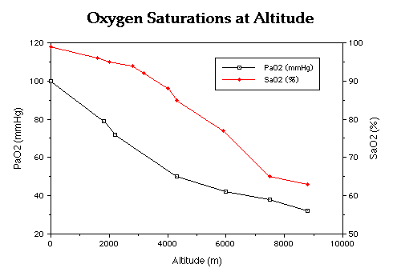

Slide 101
Acute mountain sickness
A sickness associated with a rapid ascent to
altitudes above 3000 m
develops 8-12 h after arrival and may last for
4-8 days
it is attributable to hypoxia and the resultant
hypocapnia-induced alkalosis
it is also associated with cerebral edema
Symptoms include:
headache
irritability
nausea
fatigue

Slide 102
loss of appetite
insomnia
rapid heart rate
vomiting
dizziness
Mountain sickness can be treated with the
diuretic acetazolamide
Adaptive adjustments include:
hyperventilation
polycythemia
increased production of 2.3-DPG
increased number of capillaries in tissues

Slide 103
increased number of mitochondria
increased number of myoglobin
increased content of tissue cytochrome
oxidase

Slide 104
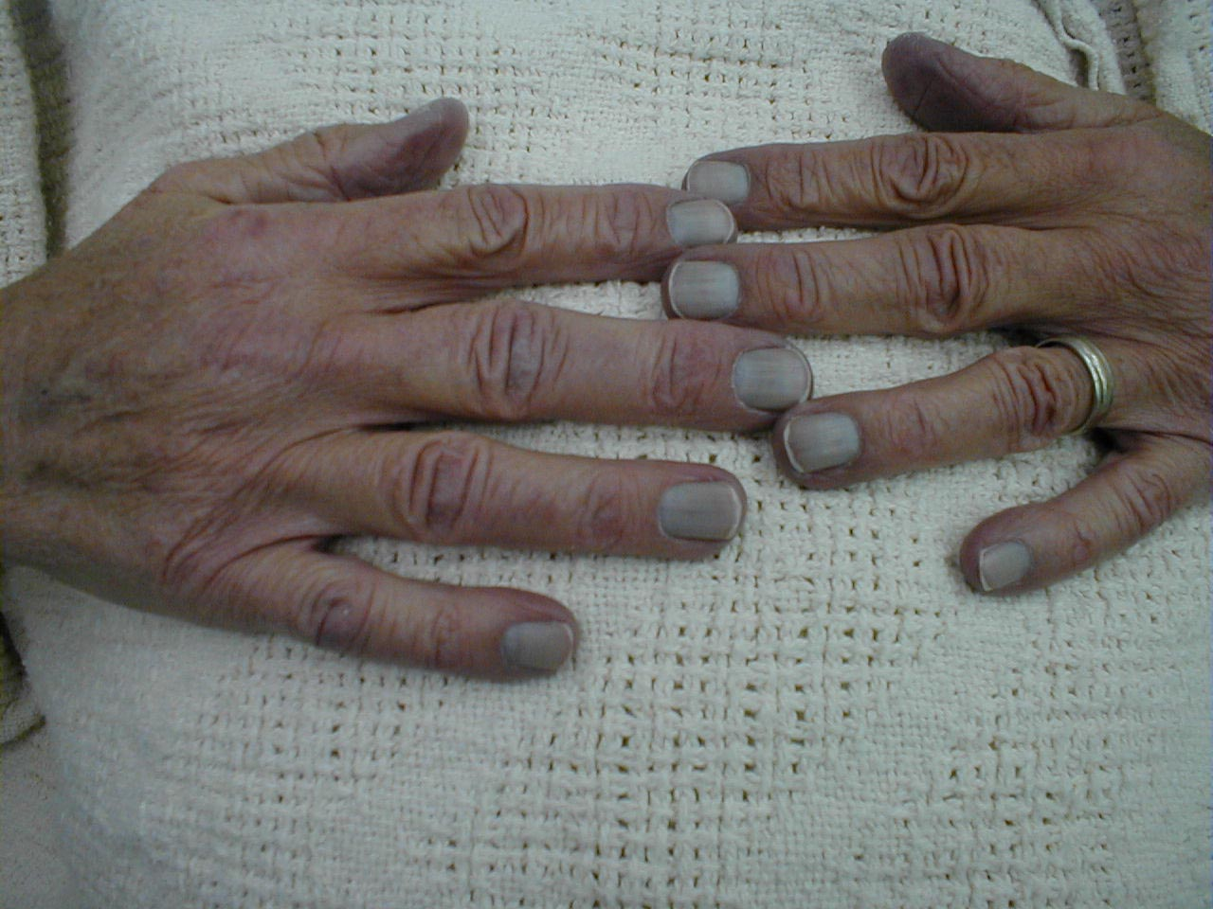

Cyanosis
Cyanosis is a bluish or purplish tinge to the skin and mucous membranes caused by accumulation of more than 5 g/dL of reduced/unoxygenated hemoglobin in the capillaries.

Slide 105
Cyanosis may be
central
peripheral
Central cyanosis
There is decreased arterial O₂ saturation or an abnormal Hb derivative. Both skin and mucous membranes are affected.
Decreased arterial O₂ saturation may arise
as a result of
Decreased atmospheric pressure eg high
altitude

Slide 106
Impaired pulmonary function
Alveolar hypoventilation
Ventilation/perfusion imbalance
Impaired O₂ diffusion
Anatomic shunts
Certain types of congenital heart diseases
eg tetralogy of Fallot
Pulmonary arteriovenous fistulas
Multiple small intrapulmonary shunts

Slide 107
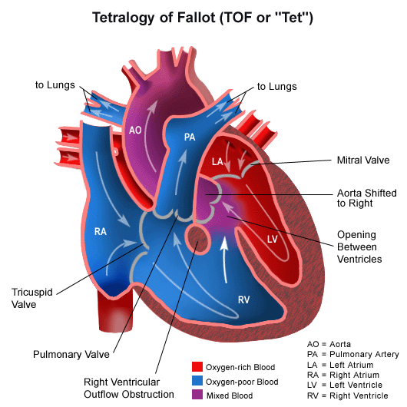

Slide 108
Hb abnormalities
Methemoglobin
Sulfhemoglobin
Peripheral cyanosis
It is due to the slowing of blood flow to an area and abnormally great extraction of normally saturated arterial blood. Occurs at fingers and toes. Causes include
Reduced cardiac output
Cold exposure
Redistribution of blood flow from extremities
Arterial obstruction

Slide 109
Venous obstruction
Drowning
It is a process resulting in primary respiratory impairment from submersion in a liquid medium
The term, strictly speaking, should only be applied if death occurs. Individuals who inhale water but are resuscitated have experienced a ‘near drowning’ situation
prevents oxygen from reaching the body tissues
i.e. it causes hypoxia.
Types:
Blue or Dry Drowning

Slide 110
White or Wet Drowning
Blue or Dry Drowning
No water enters the lungs as a result of a
epiglottal spasm, which seals off the trachea
water may enter the stomach
Hypoxia will occur and, unless breathing is
restored, anoxia will result followed by death
White or Wet Drowning
water enters the lungs
There are two types:
Seawater Drowning

Slide 111
Freshwater Drowning
Seawater drowning
Water is removed from the blood by osmosis
leading to haemoconcentration
This can put a great strain on the heart
Freshwater Drowning
more severe situation
Water rapidly enters the bloodstream by
osmosis, causing haemodilution
the red blood cells to burst and heart fibrillation
develops, leading to rapid death from hypoxia or

Slide 112
heart attack
Treatment
Clear the airway, and apply Expired Air Resuscitation (EAR)

