Slide 1
Multiple Scattering
L
x₀
θ₀
MP
When protons pass through a slab of material they suffer millions of collisions with atomic nuclei. The statistical outcome is a multiple scattering angle whose distribution is approximately Gaussian. For protons, this angle is always small so the projected displacement in any measuring plane MP is also Gaussian. The width parameter of the angular distribution is θ₀ . The corresponding displacement, x₀ , can easily be measured by scanning a dosimeter across the MP. The task of multiple scattering theory is to predict θ₀ given the scattering material and thickness, and the incident proton energy.

Slide 2
Molière Theory
Many statistical processes obey the Central Limit Theorem: the random sum of many small displacements is a Gaussian distribution. However, the displacements must all be small , in a sense that can be made mathematically precise. Scattering from the screened Coulomb field of the atomic nucleus does not obey the CLT because the single scattering cross section falls off only as 1/θ⁴ , too slowly. Therefore the angular distribution is approximately Gaussian for small angles but eventually tends to a ‘single scattering tail’ ≈ 1/θ⁴ .
All this was well understood by many investigators who worked on multiple scattering in the 1920’s and 30’s but it was Molière who in 1947 published the definitive theory, uniting the Gaussian region with the large-angle region in a precise and elegant way. He computed the distributions of both the space and projected angles for arbitrarily thick targets as well as compounds and mixtures, and produced numerical results long before the general availability of digital computers. His numerical evaluations were later improved somewhat by Bethe, who considered the overall Molière theory to be good to 1%.
His name notwithstanding, Molière was German. In his first paper, he derives an accurate formula for single scattering in the screened Coulomb field of the nucleus. The second, which uses that formula to compute multiple scattering, was his ‘Habilitationsschrift’ (a published work that qualified one to join the faculty) at the University of Tübingen. He thanks Prof. Heisenberg for his interest and advice.

Slide 3
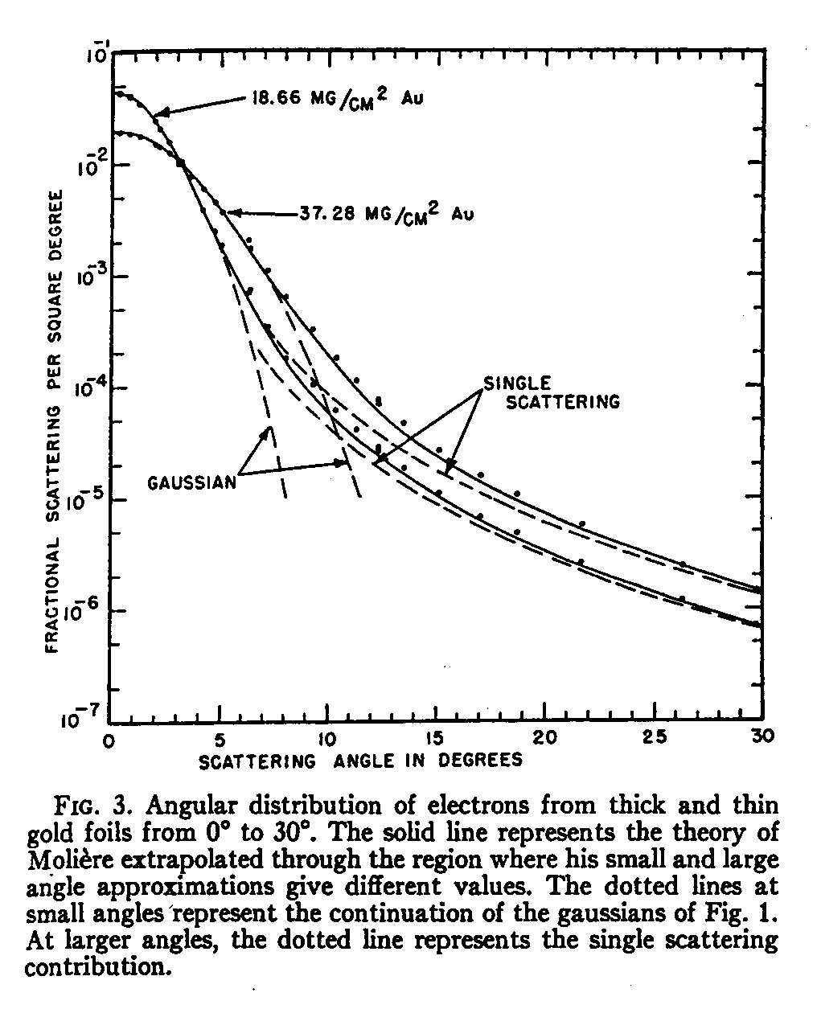
An Early Measurement with Electrons
Hanson et al., ‘Measurement of multiple scattering of 15.7 MeV electrons,’ Phys. Rev. 84 (1951) 634-637 studied electron scattering by thin and thick foils of Be and Au. They also gave a formula for computing the width of the best Gaussian fit to the exact theory (‘Hanson’s formula’ below). Their overall measurements agree well with Molière not only in the small angle (Gaussian) region but also in the single scattering tail. The theoretical transition between the two regions was improved by Bethe later on.

Slide 4
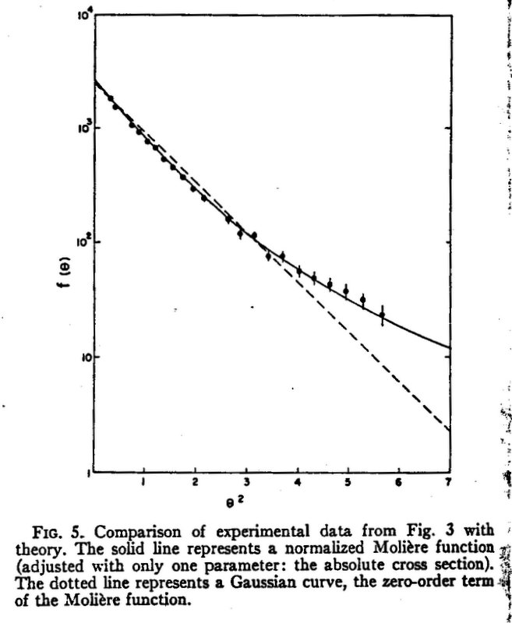
The First Measurement with Protons
H. Bichsel, ‘Multiple scattering of protons,’ Phys. Rev. 112 (1958) 182-185 bombarded targets of Al, Ni, Ag and Au with protons ranging from 0.77 to 4.8 MeV from a Van de Graaff accelerator. His detector was a tilted nuclear track plate. He fitted his measurements with the Molière form at the appropriate B, adjusting only the characteristic angle θ₀ . The results agreed with theory to ±5%. Bichsel went on to become a leading expert in range-energy and straggling theory and modeling the Bragg peak.
place

Slide 5
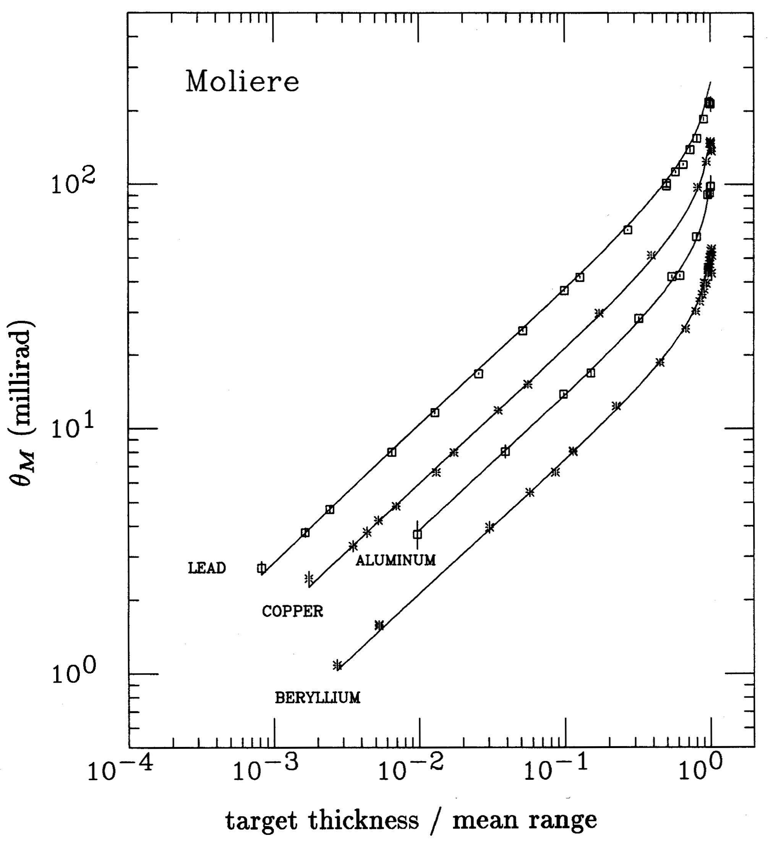
Comprehensive Test of Molière Theory
Gottschalk et al., ‘Multiple Coulomb scattering of 160 MeV protons,’ Nucl. Instr. Meth. B74 (1993) 467-490. Molière theory predicts the multiple scattering angle correctly over the periodic table, three decades of normalized target thickness and over two decades of angle. Compounds and mixtures (not shown) are also covered. The theory has no empirical parameters!

Slide 6
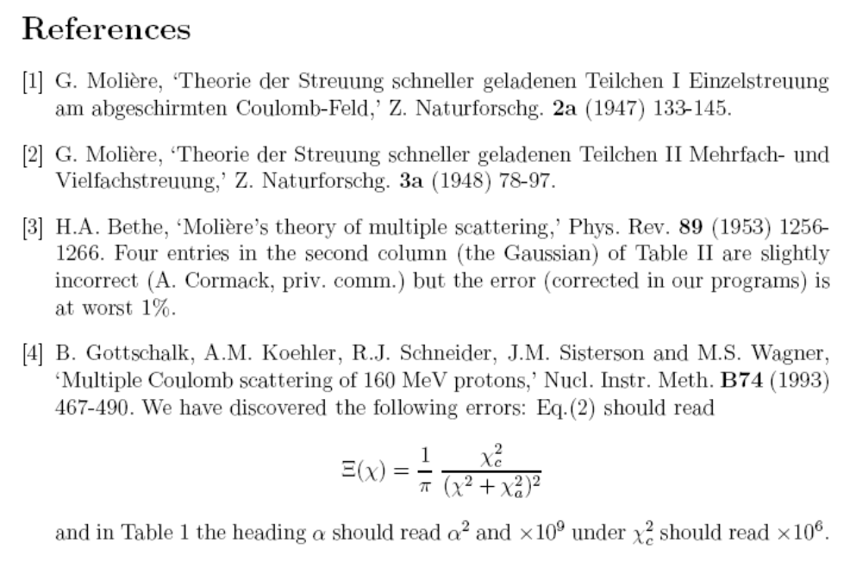

Slide 7
‘But it’s in German!’
Although Molière starts his paper by considering thin elementary targets, presumably for clarity, he later covers thick scatterers as well as compounds and mixtures. Both generalizations are very important for proton beam line design and dose algorithms. Early workers in the field, such as Bichsel and Scott, were well aware of these generalizations.
However, Bethe’s 1953 paper (in English) didn’t include those aspects. His remark ‘Lewis⁵ has shown how the energy loss can be taken into account ...’ seems odd because Molière also shows it. In any event, Bethe was interested in other aspects of the theory, and made a number of improvements.
Some English-speaking readers apparently thought Bethe’s review was comprehensive and assumed that Molière theory only applied when the energy loss was small. ‘Effective energy’ fixes were used. Molière’s original papers were always cited, of course!

Slide 8
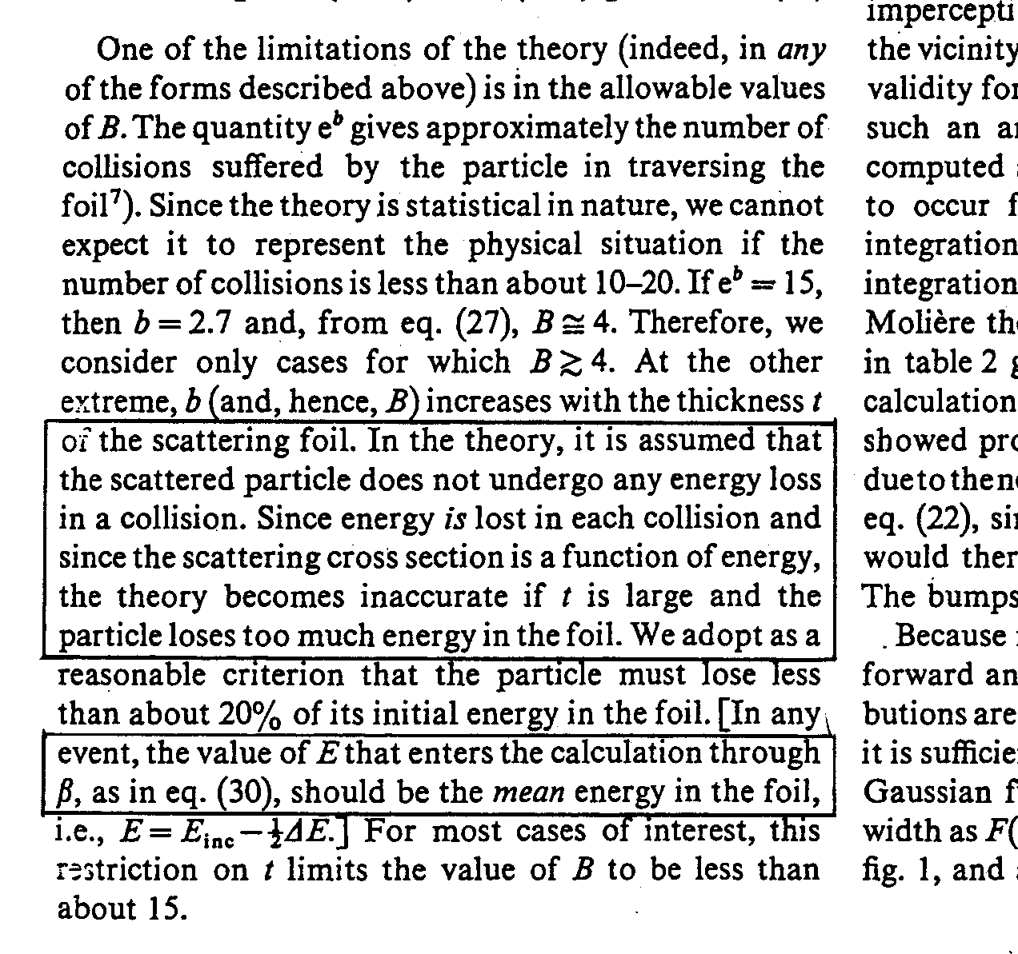
Caveat Emptor
This paper by two well-known theorists manages to make two mistakes in the same paragraph. Molière theory does cover energy loss, and if a single kinematic factor is used in simpler theories, it should be the geometric not the arithmetic mean of the incoming and outgoing values.

Slide 9
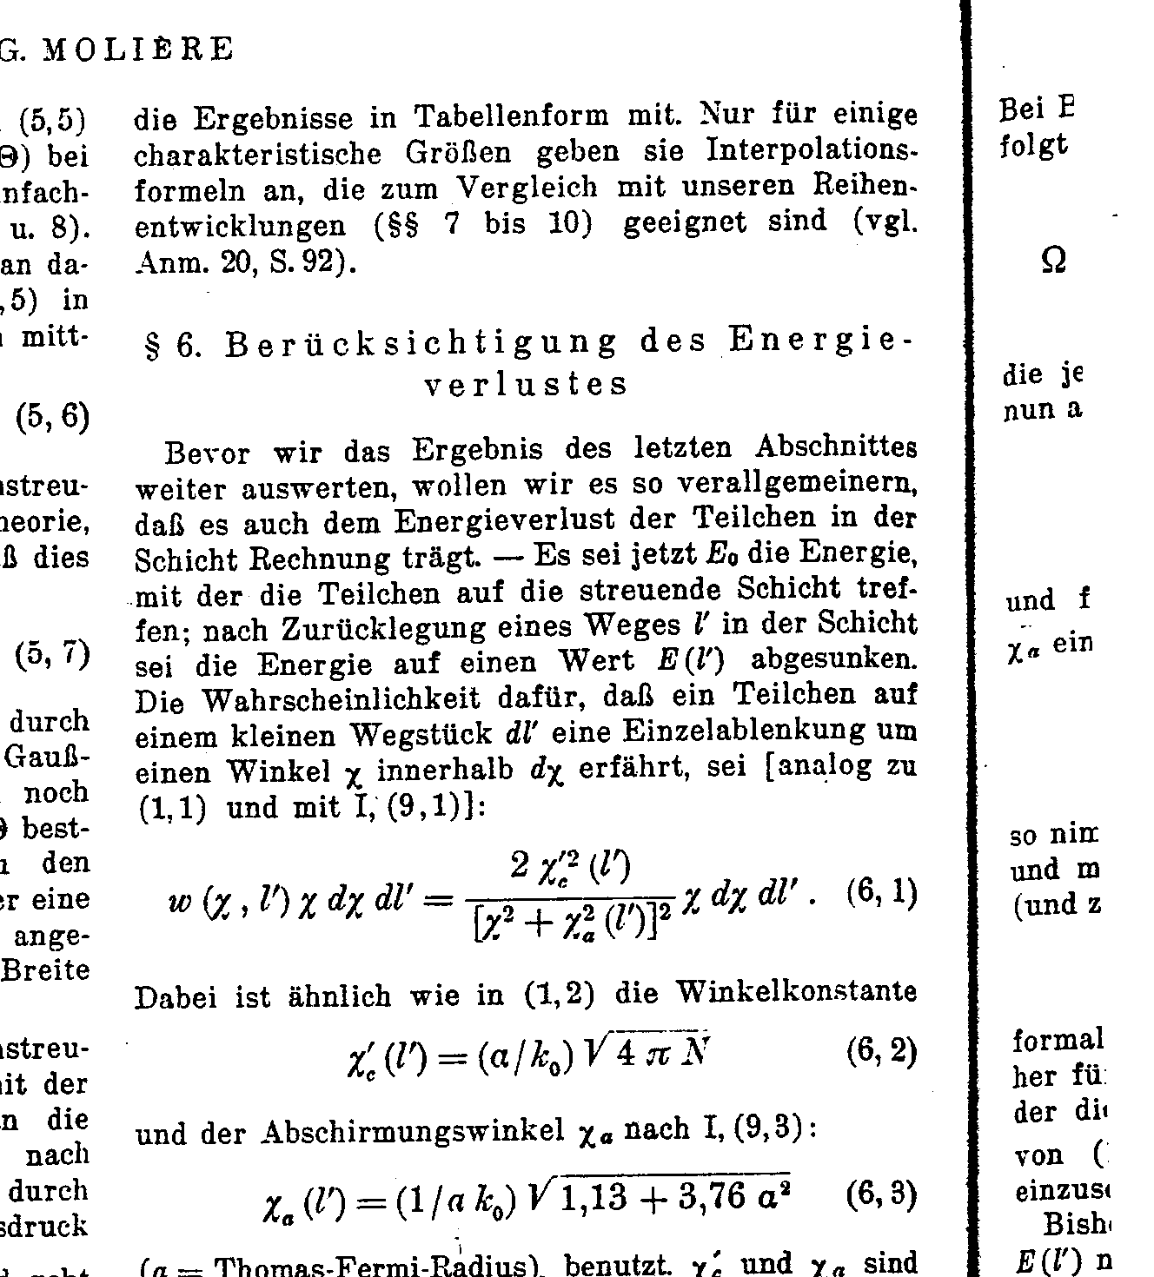
Nevertheless ...

Slide 10
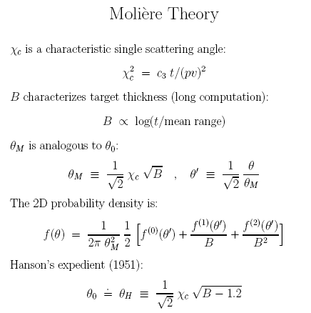

Slide 11
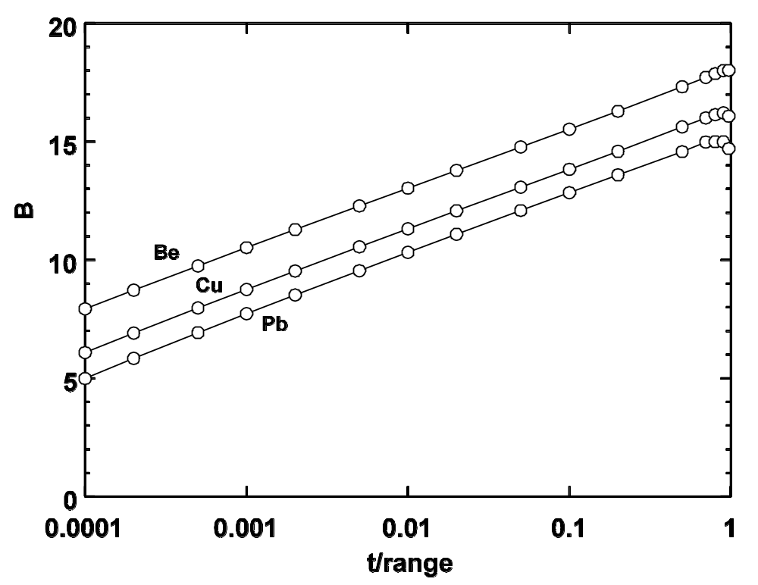
Physical Interpretation of B
Molière’s reduced target thickness B is proportional to the logarithm of the normalized target thickness (t/range) as this graph (Gottschalk et al. 1992, Table 1) shows. The constant of proportionality depends on the target material. Molière’s b is identified by him as the natural logarithm of the effective number of collisions in the target.

Slide 12
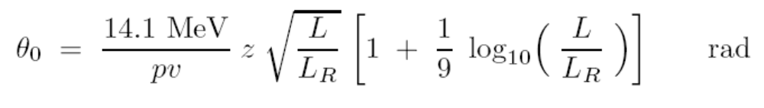
The Gaussian Approximation
In Molière theory we first find, by a lengthy computation, a single scattering parameter χ_{C} and a dimensionless target thickness parameter B. The quantity χ_{C}√B, a characteristic multiple scattering angle, is the scale factor in a PDF which consists of three terms in powers of 1/B . The first is a Gaussian.
Hanson et al. (Phys. Rev. 84 (1951) 634) were the first to observe that the best Gaussian approximation is obtained, not by retaining just Molière’s first term, but by using a Gaussian whose σ is a bit narrower, θ₀ = χ_{C}√(B-1.2) . This approach still requires the entire Molière computation.
Later, V.L. Highland (NIM 129 (1975) 497-499) fitted Molière/Bethe/Hanson theory and found
This simple formula circumvents the Molière calculation and is often used as a proxy for Molière theory in the Gaussian approximation. The scattering material is entirely represented by its radiation length L_{R} , which we can look up or calculate from the chemical composition. Highland’s formula may be generalized to thick targets by integration but we must take the correction factor [ ] outside the integral.

Slide 13
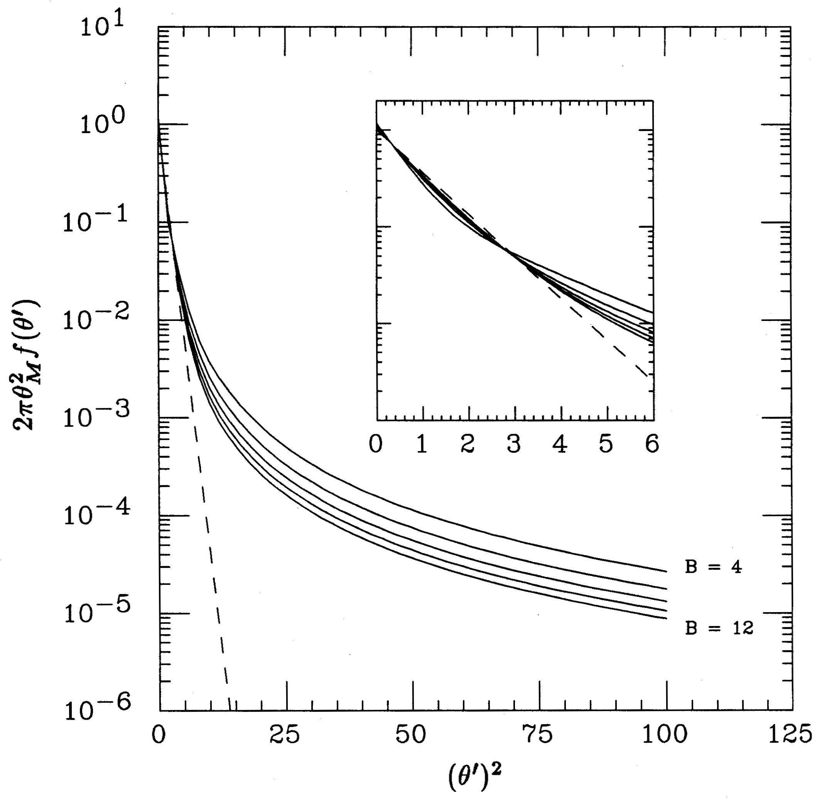
Gaussian Approximation (cont.)
Molière angular distribution for various values of B , plotted so a Gaussian becomes a straight line. Shows the relative insensitivity to B , the slow approach to single scattering, and the large deviation from a Gaussian at larger angles. Inset: the dashed line is Molière’s Gaussian term. The distribution at small angles is well approximated by a Gaussian, but one with a somewhat smaller characteristic width.

Slide 14
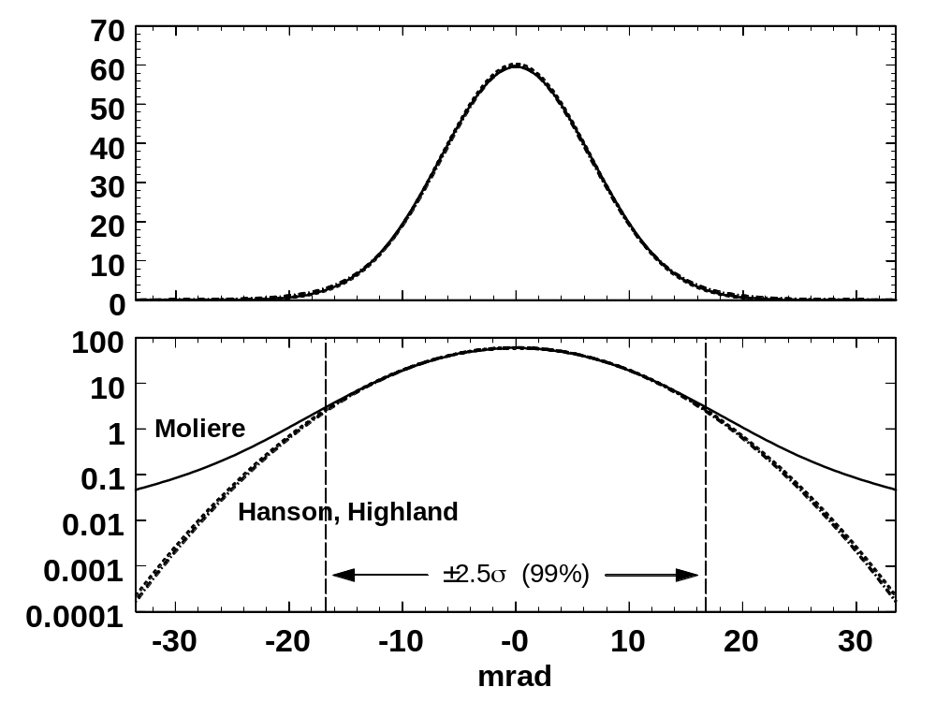
Gaussian Approximation (cont.)
Projected angle distributions for 158.6 MeV protons on 1 cm of H₂O (σ ≈ 6.7 mrad). On a linear plot the Molière/Fano distribution is indistinguishable from Gaussians using the Molière/Fano/Hanson or Highland θ₀. However, it peels away at 2.5σ , and at 5σ is more than 100× higher.
We need the correct distribution only if we are looking for rare anomalous events, not if we are estimating the resolution of a spectrometer.

Slide 15
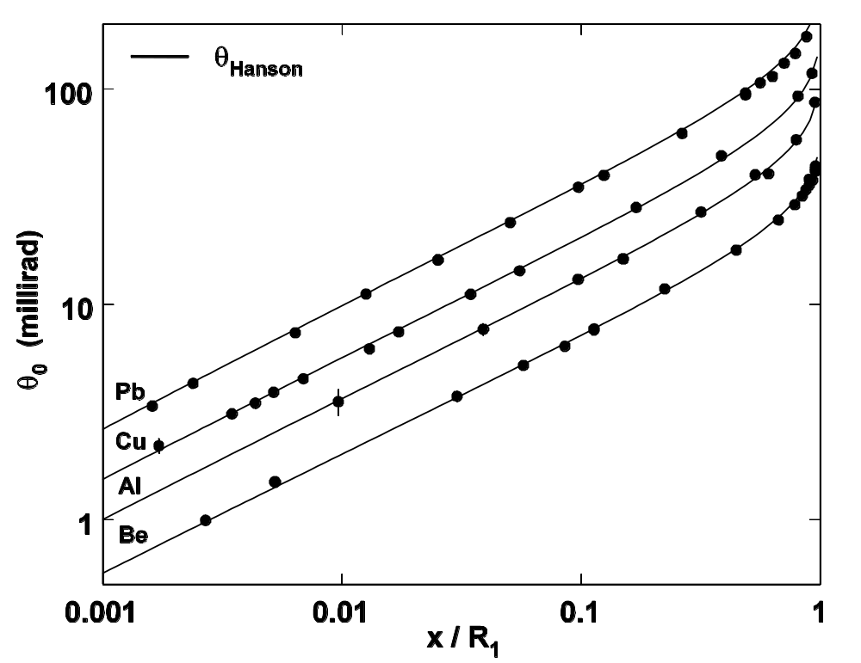
Molière/Fano/Hanson (θ_{Hanson})
Same paper as before, but measurements are fit with a Gaussian. We regard Molière/Fano/Hanson as the gold standard in the Gaussian approximation, and will try to construct a scattering power which, when integrated over target thickness, will reproduce it.

Slide 16

Generalized Highland (θ_{Highland})
Same data, Gaussian fit. Agreement of this simple formula is almost as good as θ_{Hanson} (full calculation). (Be is slightly high because Highland fitted Molière/Bethe/Hanson instead of Molière/Fano/Hanson.)

Slide 17
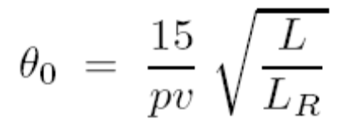
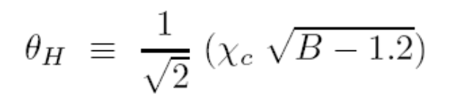
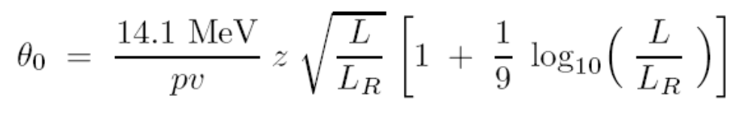
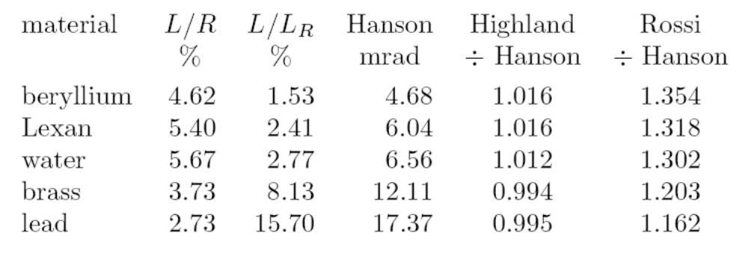
Comparison of Approximate Formulas
Rossi 1941:
Hanson 1951:
Highland 1975:
For 160 MeV protons incident on 1 g/cm² of each material:

Slide 18
Highland’s Formula for Thick Targets
Unlike the full Molière theory, Highland’s formula as originally given applies only to thin targets, as shown by the telltale factor pv. We extended it to moderately thick and very thick targets. In the first case it is frequently good enough to replace pv by its geometric mean : pv → p₁v₁p₂v₂ where 1,2 refer to the incoming and outgoing proton. For very thick targets, however, it is necessary to integrate over the target thickness, assuming, of course, that the proton range-energy relation is known.
Notice that we have taken the logarithmic correction factor out of the integral. It is evaluated for the target as a whole. Without this step (if we think of evaluating the integral numerically) the answer would get ever smaller as dt′ became smaller. Other arbitrary measures could be used, such as fixing the integral step size. This is the one we prefer, and the one used in comparing Highland’s formula with data in our paper.
Because of the way the integrand depends on depth, it is efficient to divide the target by equal ratios rather than equal steps when evaluating the integral numerically.

Slide 19
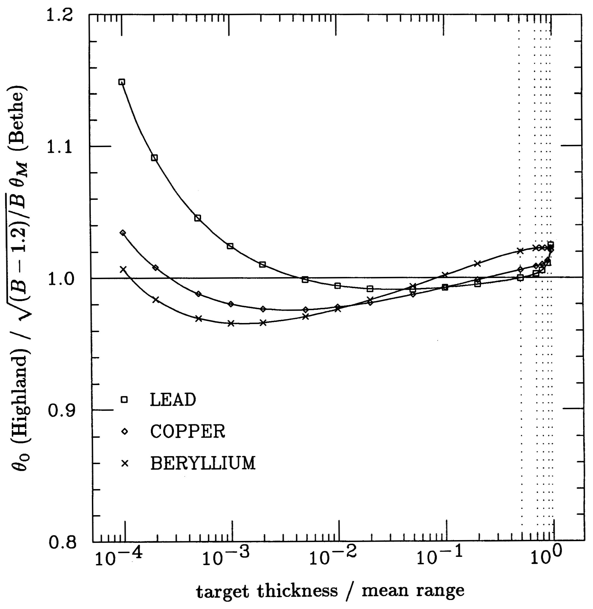
Accuracy of Highland’s Formula
This shows the accuracy of Highland’s formula, as generalized to thick targets by us., as a parameterization of Hanson’s formula applied to the Bethe form of Molière theory. It is good to ±5% as claimed by Highland except for the thinnest points for lead, which are outside his allowed range.

Slide 20
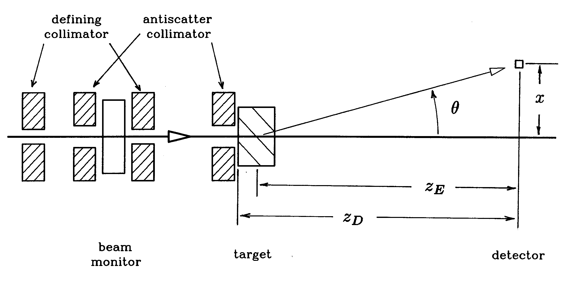
The HCL Experiment 1967-1987
A well collimated beam of protons scattered in the target and fell on a measuring plane where the transverse dose distribution was measured by a diode. The data were fit to obtain θ_{M} and θ₀ and the corresponding ‘air’ (target out) angle was subtracted in quadrature. In converting to angle, the virtual source position was obtained from theory. Over 20 years, 115 different thicknesses and materials were measured with steadily more automated methods but the same basic principle.

Slide 21
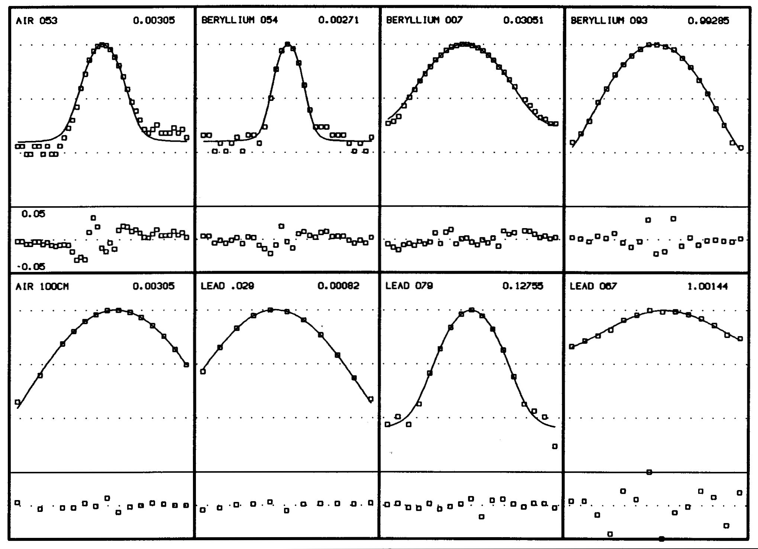
Typical Data and Fits
Top: air run and thin through thick Be runs. Bottom: air run an thin through thick Pb runs. Top right each frame: normalized target thickness. Main frame: measured data in a semilog plot. Bottom window each frame: fit residual in a linear ±5% window.

Slide 22
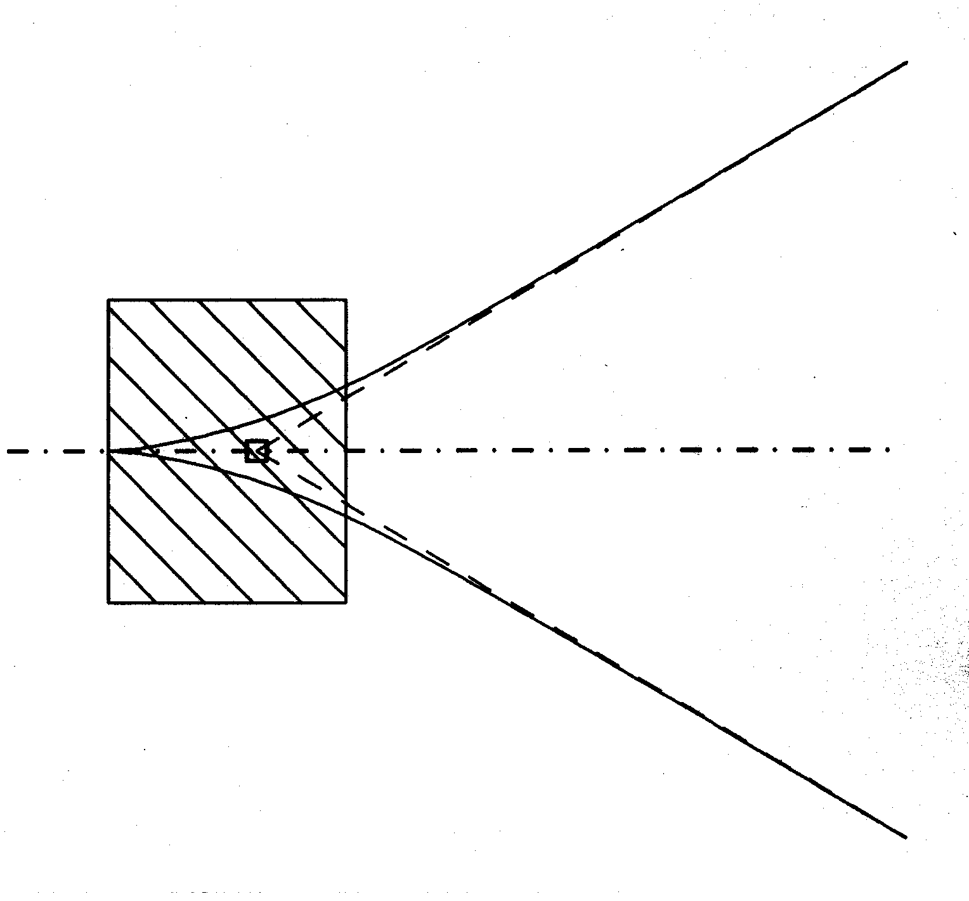
The Virtual Point Source
Because of the rather short throw in the HCL experiment (to conserve signal), it was necessary, especially for the thicker targets, to estimate where the protons were coming from. We called this the ‘effective origin’ of scattered particles. The proper term per ICRU Report 35 (1984) is ‘virtual point source’. The diagram suggests how it may be calculated. First, we need an expression for the size parameter of the scattered beam as a function of z. Then we extrapolate from two sufficiently distant points. Details may be found in the paper and will be covered in a later lecture.

Slide 23
Overview of HCL Results
This graph shows the sweep of Molière theory. With no empirical parameters it predicts the characteristic multiple scattering angle from Be to Pb over three decades of normalized target thickness and two decades of multiple scattering angle.

Slide 24
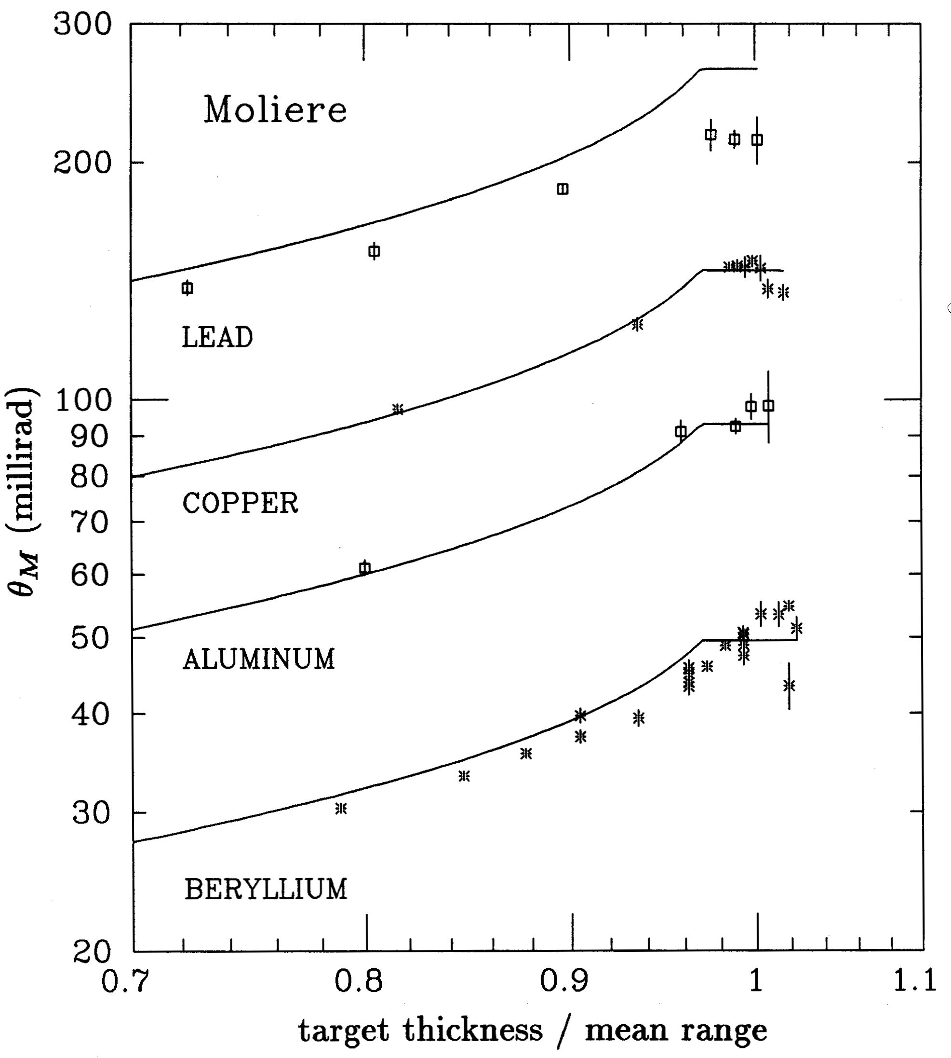
Behavior Near End-of-Range
At the Bragg peak, because of range straggling, there is no longer any strong correlation between depth and proton energy, and the multiple scattering angle appears to saturate.

Slide 25
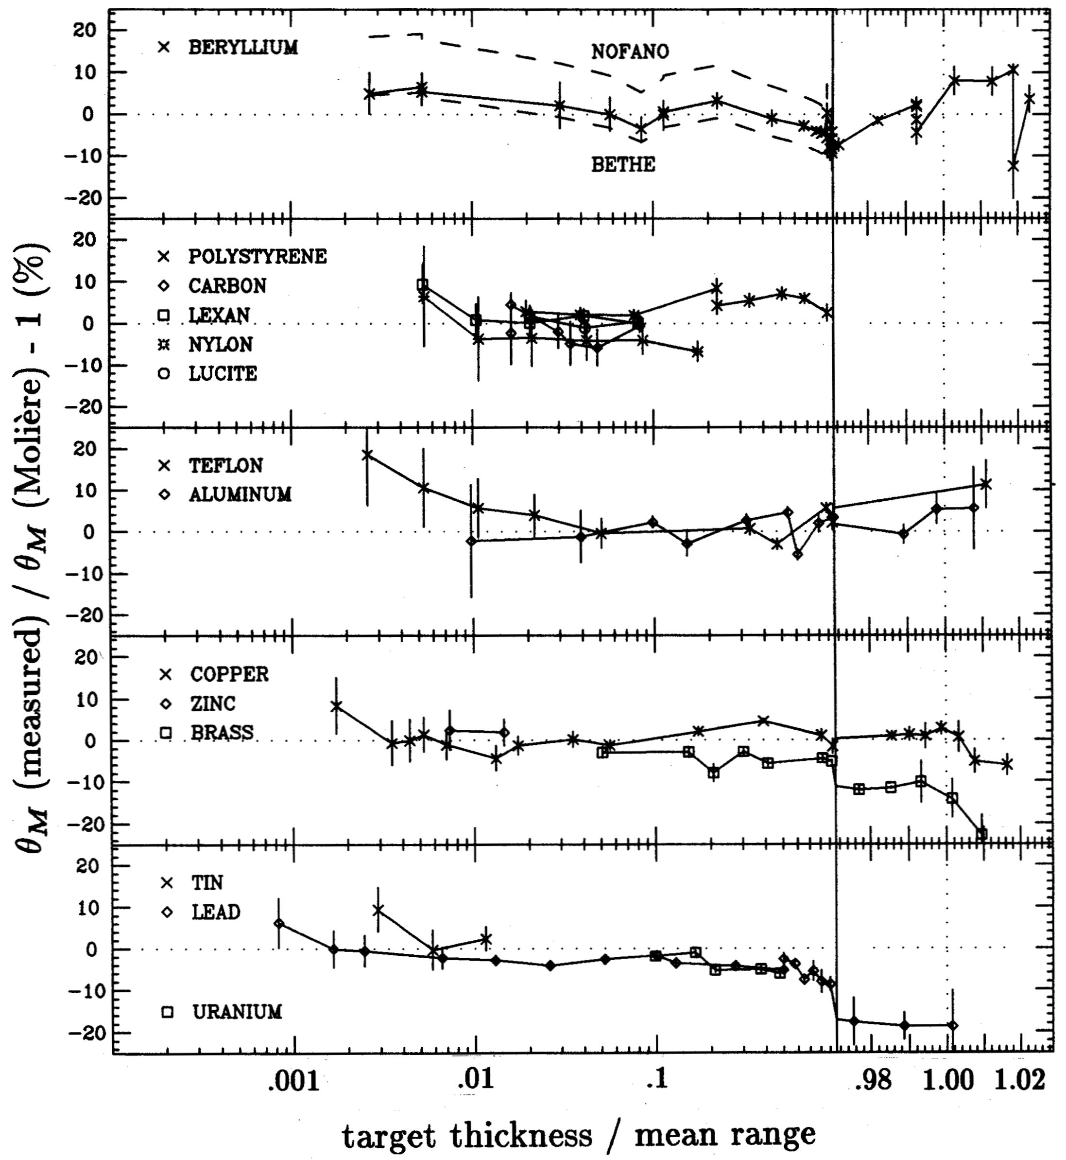
A Closer Look
This graph compares the HCL results to Molière theory on a linear scale in a ±25% window. We use the ‘Fano correction’ for scattering by atomic electrons throughout, but it only matters for Be. The region (target > 0.97× mean range) is separated and plotted to a different scale. Excluding those points, the mean error overall is –0.5 ±0.4% with an rms width of 5%. The same comparison for Highland’s formula (not shown) gives –2.6 ±0.5% with a width of 6%. The Lynch and Dahl formula gives very similar results.

Slide 26
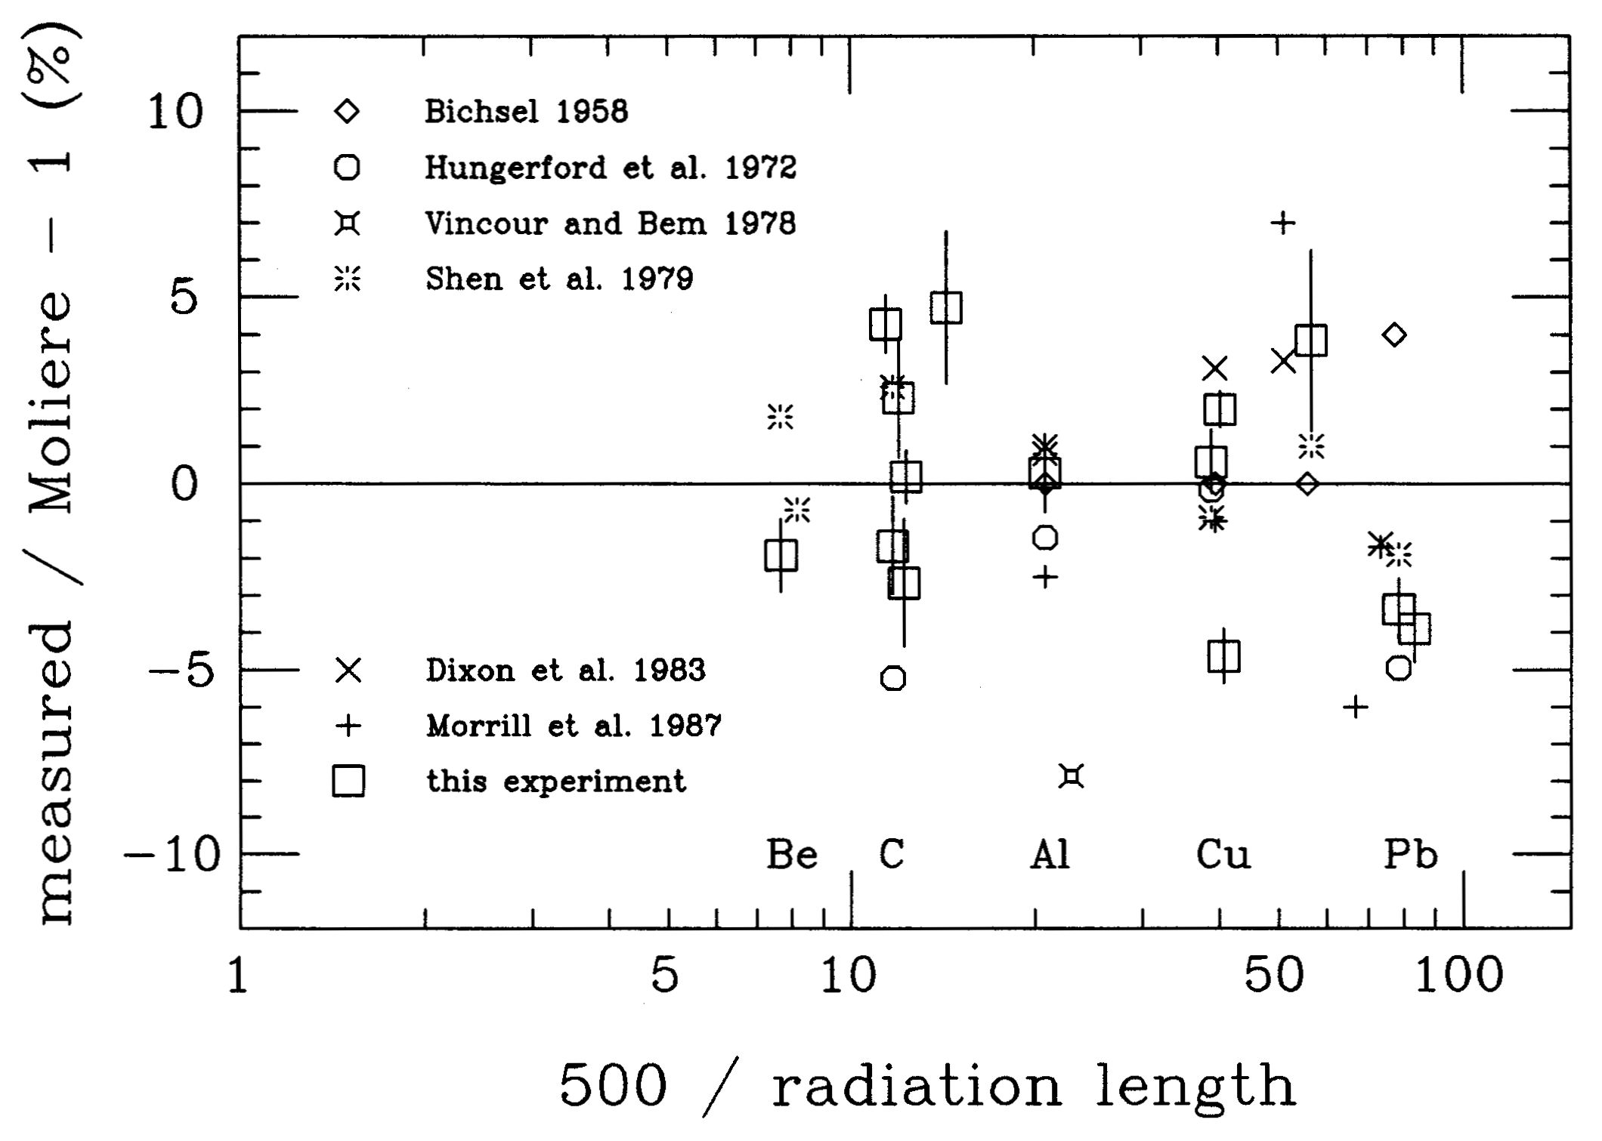
Grand Summary
We reviewed and in some cases reanalyzed the six previous proton studies. Some of those claimed Molière’s theory was wrong, others were not aware of his generalization to thick targets. The summary, above, is plotted to an arbitrary abscissa with each experiment averaged over everything but target material. The experiments ranged from 1 MeV to 200 GeV. The mean is –0.3 ±0.5% (!) with an rms spread of 3%.

Slide 27
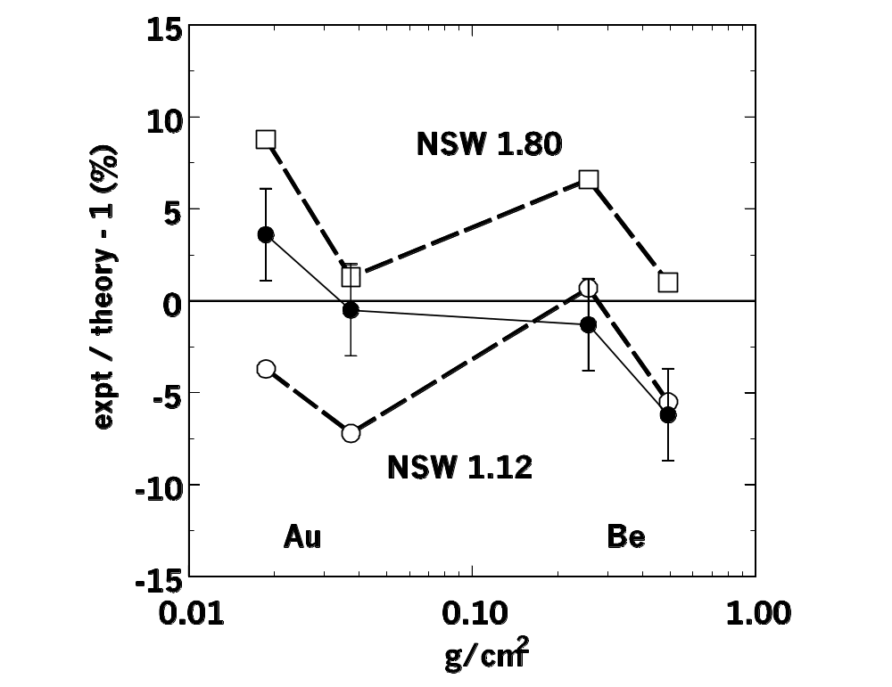
A Competing Theory
The theory of Nigam, Sundaresan and Wu (NSW) is claimed by them to be more correct on theoretical grounds and to give better agreement with the electron data of Hanson et al., where they used only two of the four measurements. NSW theory is of the Molière form but more complicated, and has an empirical parameter. This graph shows the comparison with all of Hanson’s data as computed by Scott (Rev. Mod. Phys. 35 (1963) 231). NSW theory is worse for either value of their parameter.

Slide 28
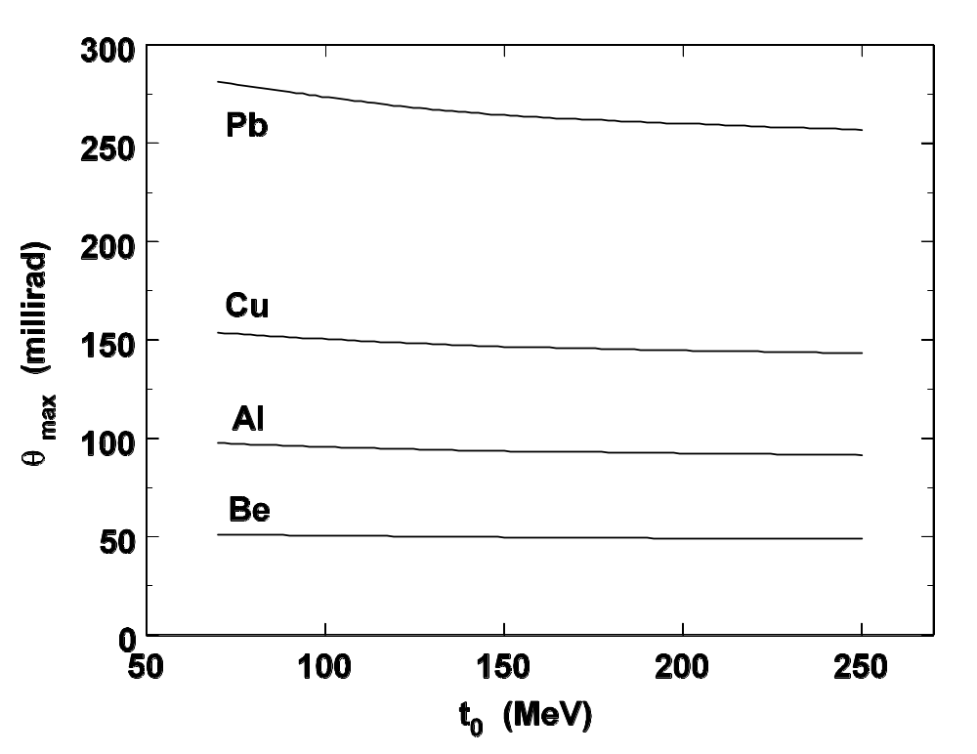
A Curious Fact
... first drawn to my attention by Andy (who else?) is that the maximum scattering angle from any material, the angle which obtains at (0.97× mean range), is very nearly independent of incident energy. Looking at Pb, it’s impossible to get more than 280 mrad ≈16^{O} from protons, justifying the small angle approximation.

Slide 29
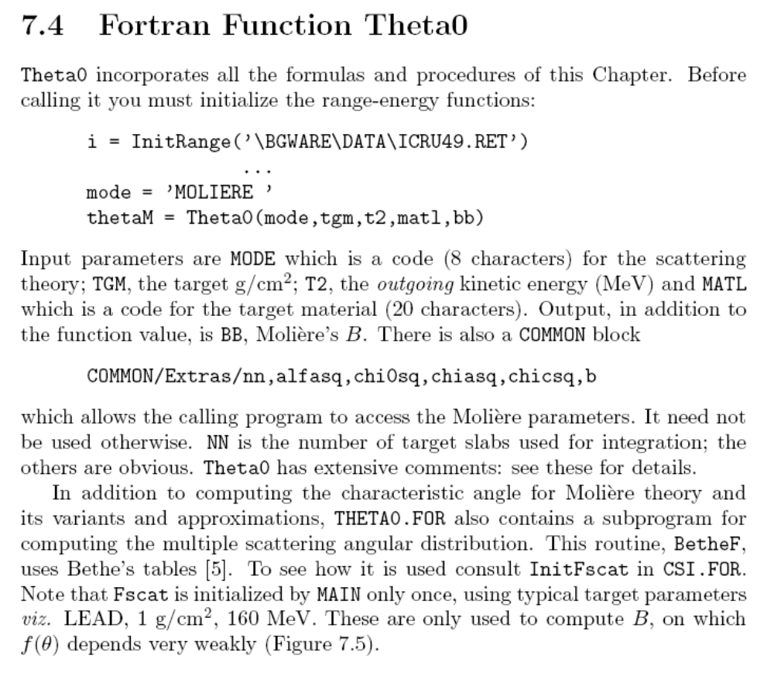

Slide 30
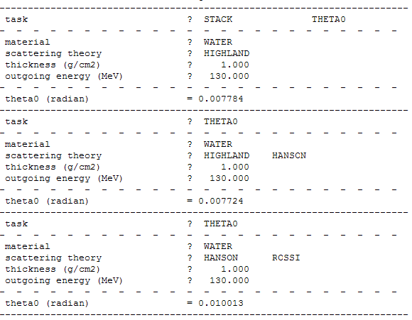

Slide 31

Combining Scatterers
In beam line design we frequently need to compute the net multiple scattering angle from (say) a sheet of plastic followed by a sheet of lead, or some even more complicated set of ‘homogeneous slabs’.
Molière theory does not apply to a sheet of plastic followed by a sheet of lead. (It would apply to a fine mixture of plastic and lead!) However, we can find each characteristic angle by itself (taking energy loss into account) and add them in quadrature:
That this procedure is, strictly speaking, incorrect is easily seen. Divide a scatterer made of a single material into halves. Their quadratic sum will always be too small by ~3%, as can also be seen directly from Highland’s formula. The error is worse, the more you divide the scatterer.
Nevertheless, addition in quadrature works well enough in practice, perhaps because in common engineering situations one of the slabs will dominate.
A better method suggested by Lynch and Dahl (Nucl. Instr. Meth. B58 (1991) 6-10) is not practical for beam line design, essentially because it does not allow us to compute slabs separately. The entire issue of mixed slabs is rather complicated, and will be covered later.

Slide 32
Summary
The Molière theory of multiple scattering applies to compounds and mixtures, and target thicknesses up to ~97% of the mean range. It has no adjustable parameters. It is at least accurate as available experiments (a few percent).
Highland’s approximation to the characteristic angle of the best Gaussian fit is nearly as good as Hanson’s formula based on the full theory, and far easier to evaluate. For thick targets, it must be integrated. For targets of intermediate thickness one can replace pv by (p₁v₁p₂v₂)^{1/2}.
In beam line design, finite slabs can be combined to sufficient accuracy by adding their characteristic angles in quadrature.
High-Z materials (lead) scatter far more than low-Z materials (water, plastic). We will make use of this to design contoured scatterers compensated for energy loss or range modulators compensated for scattering angle.

