Slide 1
Beam Line Design Programs
A beam line design program uses given facility resources (incident energy and throw) and clinical requirements (dose uniformity, field size, depth and modulation) and attempts to design beam line elements (modulator and second scatterer) to meet the requirements. We have written and distributed two such programs.
NEU designs single- or double-scattering systems with an upstream modulator. It was tested at HCL and used to design the standard IBA nozzle, components for M.D. Anderson and IUCF and, most recently, proposed components for the compact proton system under development at Still River Systems. A User Guide is available.
Unlike NEU, LAMINATE is a prescription translation program. It designs absorber sequences for single scattering systems that use given lead and plastic slabs in binary sequence of thickness. To achieve the highest accuracy in depth, it uses the measured water equivalent of each slab in a final step. It is used in the STAR neurosurgery beam at the Burr Center. A variant LAMPRI is used at MPRI.
If you plan to use or adapt these programs, please note the Disclaimer of Warranty (next slide).
© 2007 B. Gottschalk. This material is previously unpublished except as noted.

Slide 2
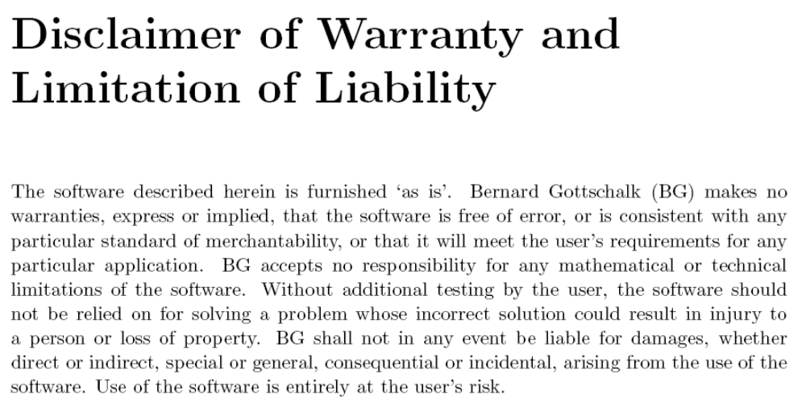

Slide 3
NEU
stands for ‘Nozzle with Everything Upstream’, also a play on the German ‘new’.
NEU is file-driven, not interactive. It is written in the ‘QuickWin’ version of Visual Fortran. A Windows executable is distributed along with the source code. If you create your own version the Disclaimer of Warranty applies even more.
Because NEU solves a complex task, the input is complex. It is supplied by an ASCII (text) file NEU.INP (fragment shown in next slide). In any given run many of the input quantities are not used, and some may be changed, but they are all required as placeholders. Each run performs a task defined by the possible combinations of the first two lines: design a mod and a second scatterer, design one but use a predefined version for the other, design nothing.
Each run has a design stage followed by a playback stage. Playback reads back the modulator and second scatterer files written during design to ensure that even file generation errors will be detected. However, it uses beam energy, element positions, and so forth from the current NEU.INP . ‘No-design’ runs are used to see how predesigned beam elements will work at (for instance) a slightly different beam energy. Computed dose distributions may be compared with measured data.

Slide 4
Fragment of NEU.INP
'DESIGN.MOD' (filename or DESIGN).MOD
'DESIGN.CON' (filename or DESIGN).(ANN or CON) or ' '
'MIXED.RET' range-energy table in \BGWARE\DATA\
'MOLIERE' MOLIERE or HIGHLAND scattering theory
'IBA231.BPK' Bragg peak file in \BGWARE\DATA\
'MARQUARDT' MARQUARDT or GRID or RANDOM
'NONE' measured data file or 'NONE'
--------- eight elements: mat'l, upstream z (cm), thickness (g/cm2) --------
' ' -2 -999 1: prescat mat'l,z,g/cm2 or blank
' ' -999 -999 2: preabs ditto
'LEAD' -999 -999 3: S1 A mat'l (simple scatterer)
'LEXAN' 0 -999 4: S1 B mat'l,z
' ' -999 -999 5: postscat mat'l,z,g/cm2 or blank
' ' -999 -999 6: postabs ditto
'LEXAN' -999 .12 7: S2 A mat'l,z,MIN g/cm2
'LEAD' 50 -999 8: S2 B ditto (use for ANN)
----------------------- major design parameters ----------------------------
250 230 0 throw (cm), energy (MeV), beam theta0 (mrad)
12 99 20 design radius (cm), d100, m100 (cmW)
2.5 -1 1 dose +/-%; step factor (- unlocks); cm/file unit
0 zoom (cm), added to z(1-6)
0 0 0 depth linear,quad coefft; transv quad coefft (%)
The first block defines the task, files to be used, and certain software switches. The second block defines materials, thicknesses and positions of beam line elements. The third block defines important numerical parameters such as throw and beam energy.

Slide 5
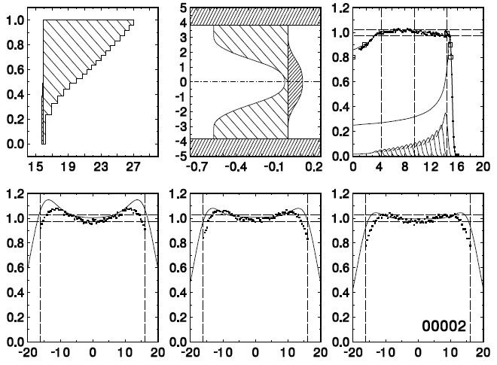
The First ‘Upstream Everything’ System
The first upstream modulator double scattering system, a proof of principle for the IBA nozzle. Experimental data were taken at HCL in 1990 with serious help from Miles Wagner. The current (2006) version of NEU was used here. Dose distributions are not meant to be acceptable; the dished appearance means S1 is too strong (throw is too great). However, excellent agreement is obtained with the depth-dose and fair agreement with the transverse doses. The same data normalization was used for all.

Slide 6
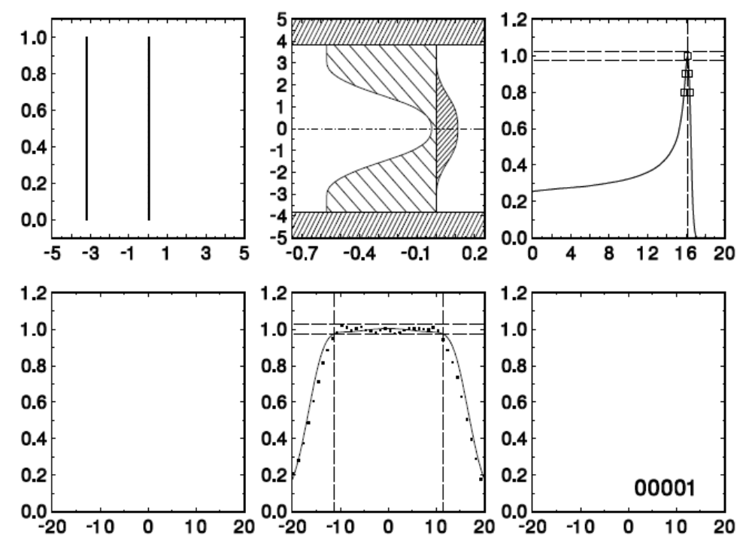
Same S2, Different S1 (no Modulation)
When the same contoured compensated S2 was used with the correct S1, a flat dose distribution was obtained. This was the ‘contoured’ beam used with downstream modulators for about 12 years at HCL. The falloff of the open double scattered beam can be thought of as the penumbra of the collimator surrounding S2. Its w₅₀ is predicted well, but the gradient is overestimated by NEU.

Slide 7
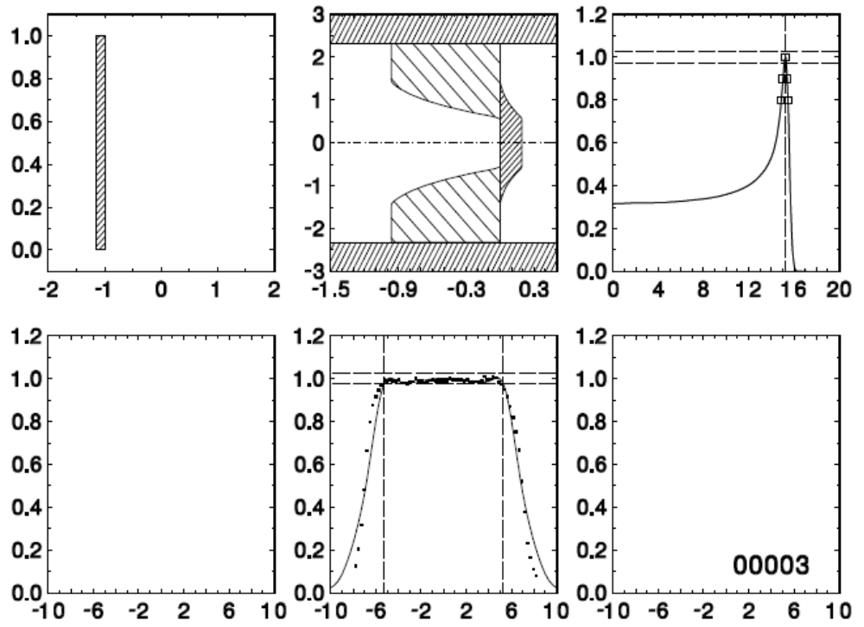
Siebers Profile, Neurosurgery Beam
The Siebers profile second scatterer used in the short-throw HCL neurosurgery beam. w₅₀ is still well predicted but now the gradient is underestimated. This petite second scatterer is now used in non-clinical runs at the Burr Center, where Ethan Cascio has adapted it, using NEU, to various radii and various energies. He also confirmed NEU’s efficiency prediction of 48% (E. Cascio, Proc. 2007 IEEE NSREC Data Workshop).

Slide 8
NEU Comments
There is a detailed User Guide, neu.pdf in BGdocs.zip at my website.
NEU will, if you wish, optimize the generic second scatterer profile. Nowadays we hardly ever do this because for many years we have not been able to improve our design very much. See the sample run in the User Guide for a good generic profile (‘contoured MPRI 18AUG03’). The Siebers profile (sample run 3) gives slightly better efficiency and slightly less energy loss, but it seemed to us a little less adaptable to different energies.
Mainly, NEU scales up the generic S2 to match the physical requirements and designs S1 (the modulator) from scratch. The order of doing things for different design tasks is all-important and accounts for the complexity of the main program. For instance, NEU must have a physical S2 on hand before it can design a modulator, because it needs proton energy both in and out. The logic is further complicated because S1 may include both pre- and post- scatterers and degraders, that is, it may consist of up to 6 slabs.
NEU automatically generates file numbers and a catalog text file which can be commented after the fact, making it easier to document large projects.
NEU’s design/playback structure makes it rather robust because the complex solution of the design (inverse) problem is immediately followed by a far simpler computation of the forward problem. As long as the latter remains correct, errors in the former will probably be uncovered, as will any attempt to design something impossible.

Slide 9
Catalog File for Big Projects
CPO2 STUDIES: single scattering at 250cm 230MeV:
24 17APR06 D__G 201 250 230.0 6.1 20.4 20.4 5.0 4.7 2572
25 17APR06 D__G 201 250 230.0 3.0 28.4 28.4 4.9 4.7 719
26 17APR06 D__G 201 250 230.0 9.1 12.7 12.7 5.0 4.6 4963
27 17APR06 D__G 201 250 230.0 8.6 3.1 3.1 4.6 4.2 3120
28 17APR06 D__G 201 250 230.0 3.2 3.1 3.1 4.6 4.5 456
run date code pts throw engy radius d100 m100 unif effi gp/Gy
122D cm MeV cm cmW cmW % %
Base run for dose vs. gp studies (PSI neutron paper):
29 27APR06 DDCM 201 250 177.0 12.7 16.4 16.4 3.6 48.1 1237
30 28APR06 DDCM 201 150 177.0 4.0 19.2 10.2 2.9 45.8 105
31 01MAY06 DDCM 201 150 177.0 4.5 18.9 3.9 3.0 46.3 92
Use zoom and energy change to make smaller fields from NEU00029:
32 08MAY06 GGC_ 201 200 170.0 10.3 15.1 15.1 2.5 46.4 830
33 08MAY06 GGC_ 201 150 157.0 8.3 12.6 12.6 3.3 48.3 519
Reproduce Binns & Hough plug-plus-annulus:
34 16MAY06 GGA_ 201 700 200.0 10.6 24.5 0.0 4.4 18.7 536
Use ShowBeamline with BEAMPICT.INP to show neutron production points:
35 18MAY06 DDCG 201 250 175.0 15.5 14.1 7.0 2.9 46.1 1313
ShowBeamLine example. Set 'SKIP' in BEAMPICT.INP to 'NOSKIP', then run NEU
to try this out:
36 22MAY06 DDCG 201 250 175.0 15.5 14.1 7.0 2.9 46.1 1313
Fragment of NEU catalog file. The single line giving the run number, date and vital statistics of each run is added only after the last <Enter>, archiving that number. That makes it easy to abort undesired runs. The comments were added after the fact as notes and aids to memory.

Slide 10
Limitations of Double Scattering
Neither scatterers or degraders are ideal. Scatterers use up some energy, and degraders do some scattering. Not every configuration one might wish for can actually be realized.
To be more specific, for a given incident energy T and throw L there are limitations on what field radius r, depth d and modulation m can be had. These limitations are best visualized by a plot of r vs. d. NEU has an auxiliary program CPO2 that constructs such plots.
The next slide shows an example. T = 230 MeV, L = 250 cm and S2 is placed 50 cm downstream of S1. The boundary lines represent the minimum and maximum possible r(d). Each point represents an actual NEU run. The degree of filling represents the maximum relative modulation m/d ; solid black means any modulation is possible. The number above each symbol is the dose rate in Gy/min for 1 nA incident on S1.
The maximum field size is limited by the unavoidable energy loss in S1/S2, larger if more scattering is required. The minimum (at fixed energy) arises because, as we make S1 thicker to consume more energy, it eventually overscatters, spoiling dose uniformity. That also limits the relative modulation for small r.

Slide 11
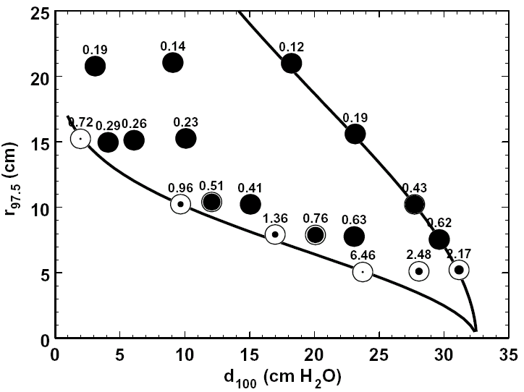
Realizable r(d) when double scattering 230 MeV protons with L = 250 cm and S2 at 50 cm. Symbols represent NEU test runs. The degree of filling represents maximum available m/d. Numbers are Gy/min for 1 nA on S1.

Slide 12
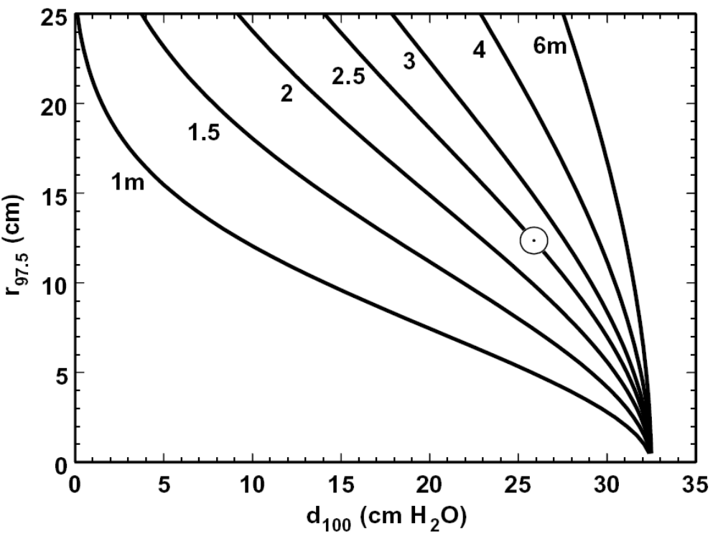
This plot, also from CPO2/NEU, shows the maximum r (d; L) for 230 MeV protons and various throws as labeled. The empty circle shows the base NEU run. S2 was at 0.2 × throw. The NEU writeup explains how to use CPO2.

Slide 13
LAMINATE
Unlike NEU, which designs hardware to be fabricated, LAMINATE is a ‘prescription translation’ program which deploys predefined hardware to fill the requirements (depth, modulation and dose) of a field. A modified version of the program in \BGware is integrated with the STAR radiosurgery treatment planning program at the Burr Center to pass those parameters seamlessly.
In the gantry rooms, depth is fine tuned by adjusting the beam energy. STAR, however, uses a fixed energy beam whose range is measured every day, so LAMINATE proceeds as follows. First, using nominal energies, design a ‘virtual modulator’ ignoring the quantization of steps. For each step, replace the lead by the nearest combination of lead slabs and find their total measured water equivalent. Add the nearest combination of Lexan slabs, again by their measured water equivalent. This gives second priority to scattering (which isn’t fussy) and gets around small errors in the range-energy tables by using measured water equivalents, as should always be done in similar cases.
LAMINATE also simulates a beam monitor IC of given pad radius, computing how many monitor counts should be delivered for each step as well as the corresponding incident protons, which can be measured upstream as a check.

Slide 14
How LAMINATE Works
The desired field radius r₉₅ , depth d₉₀ , modulation m₉₀ and dose at mid-SOBP D are given. Beam energy and current are fixed. Field is to be generated by single scattering with combinations of binary weighted Pb and Lexan scatterers or ‘lollipops’. The task is to define the combinations in the sequence, and the total beam through each.
(loop) Find the # mod steps to get desired m₉₀ , water equivalent pullback/step. Use binary degrader routine to get ideal thicknesses of Pb and Lexan.
With actual lollipops arranged in logical order (thick → thin), find by successive approximation the available lollipops that best approximate the ideal, using measured water equivalent thicknesses.
Convert to mechanical order.
Compute z₀ for each step. Use linear algebra (see lecture on modulators) to find incident gigaProtons per step for desired dose at mid-SOBP. Fit SOBP to obtain d₉₀, m₉₀ and D actually obtained.
m₉₀ is slightly wrong! Compute a step size correction factor and loop (once).
Use D = Φ×(S/ρ) to find the charge collected per step by the monitor IC (active volume and location along the beam line are known) and from that, the MU/step.

Slide 15
Lollipop Table for LAMINATE
mtl cm pos cmW
'LEAD' .2438 .0 1.403
'LEAD' .1219 .8 .702
'LEAD' .0610 1.6 .351
'LEAD' .0305 2.4 .176
'LEAD' .0152 3.2 .088
'LEXAN' 10.0000 23.2 11.500
'LEXAN' 5.0000 15.3 5.750
'LEXAN' 2.5000 11.3 2.875
'LEXAN' 1.2500 9.2 1.438
'LEXAN' .6250 8.0 .719
'LEXAN' .3125 7.2 .359
'LEXAN' .1563 6.4 .180
'LEXAN' .0781 5.6 .090
'LEXAN' .0391 4.8 .045
'LEXAN' .0195 4.0 .022
The ‘lollipop table’ used by LAMINATE, in logical order (thickest first). The mechanical order is given by the ‘pos’ column and can be anything; the program will take care of it. It’s OK to use water equivalence for lead here because the lead is first and always sees nearly the full beam energy, but we must be careful to measure the water equivalent at that energy. The stopping power ratio (S/ρ)_{Lexan}/(S/ρ)_{water} is independent of energy (both are light materials) and so is the measured water equivalent.

Slide 16
LAMINATE Input File
22.698 today's d80 (cmW)
15 10 desired d90,m90 (cmW)
1 desired dose (Gy)
----------------------------------- choices and files ------------------------------------
'LGP' software switch: dump/skip LollyFile, Geometry, Preview
'HIGHLAND' scattering theory: 'MOLIERE', 'HIGHLAND', 'HANSON'
'MIXED.RET' range-energy table in \BGWARE\DATA
'IBA184.BPK' Bragg peak file in \BGWARE\DATA
'HCLLOLL.DAT' lollipop data file, in working directory
'NONE.DAT' measured data file or NONE.DAT, in working directory
0 0 0 transverse scan depths in tank (.LE.0: compute)
0 run # increment (0 to overwrite output files)
-------------------------------------- beam line -----------------------------------------
450 200 z at mid SOBP, mid beam mon (cm) (mid 1st lolly = 0)
5 2.5 desired radius (cm), uniformity (+/-%)
37.6 1 ion chamber nC/(Gy*cm3); MU per ion chamber nC
1 1 mon IC radius,gap (cm)
3 1 beam nA, step change time (sec)
-------------------------------- computation and graphics --------------------------------
15 15 10000 Q steps, PHI steps, lookup table
15 20 # steps, infty mult norm integral
1.00 const term in formula for # of steps
.9 .03 correction coeffts for last weight
------------------------------------ SOBP fit (BSfit) ------------------------------------
'T' Terse or Verbose
'G' fit method: GridParab (preferred), Marquardt, None
10 .01 passes, convergence on rms (%)
.5 10 reduction factor, initial lambda
.1 .01 delta x,y (best may depend on G,M)
10 2 3 0 0 pts/segment (5 entries, MAX pts for seg1)
8 1 deriv smoothing rms, # passes
.015 .1 .5 rms/avg < p1 -> 2 seg; distal cut; power
.05 .015 AB/AC < p1 -> 2 segs; rms/max > p2 -> add point
LAMINATE input file, which is also dumped to the output file. Items in the first block are default values for prompts, so they may be changed without editing the input file.

Slide 17
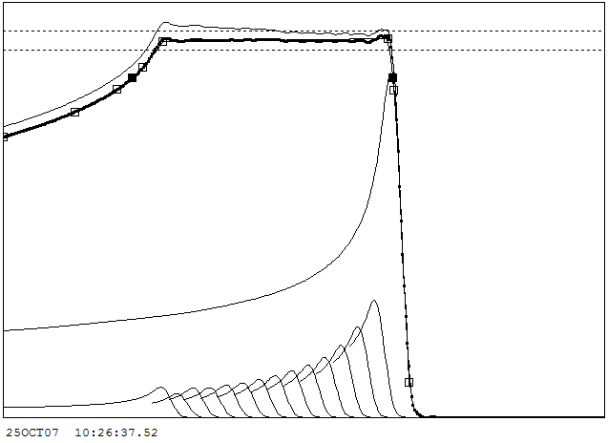
LAMINATE Graphics
Real-time graphic output, showing the SOBP, component Bragg peaks, a broken spline fit, and the 90% points. The light line would obtain if the fluence used in the calculation were not corrected for the change in virtual source as the sequence is executed.

Slide 18
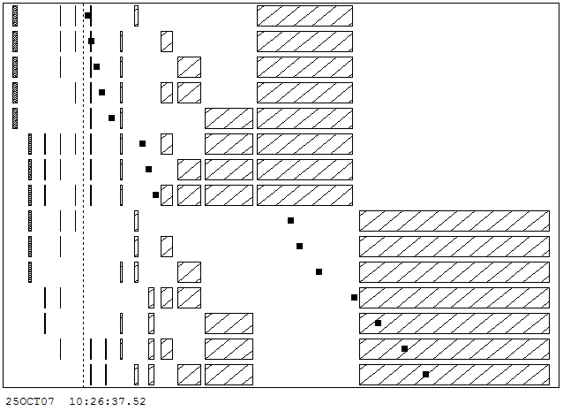
LAMINATE Lollipop Sequence
Real-time graphic output showing the lollipops used for each step and the virtual source (full squares) for that step. Note the jump of a few cm at the major binary transition of Lexan.

Slide 19
============================================================================================
\BGware\LAMINATE\LAM00001.OUT 25OCT07 10:26:37.52
============================================================================================
============================================================================================
# nin inBeamM g/cm2_1 cmW_t gP MeV mRad z0 cm MU
1 6 | ||X X X 3.286 7.619 343.5 146.5 33.1 3.9 118.25
2 7 | ||X X X X 3.286 8.248 119.3 143.0 33.5 4.0 40.69
3 6 | | X X X X 3.113 8.879 92.4 139.4 33.6 4.3 31.99
4 7 | |X X XX X 2.940 9.510 73.1 135.8 33.5 4.6 25.92
5 5 | X X XX 2.767 10.140 61.6 132.1 33.8 5.1 22.09
6 9 ||||X X X XX 2.595 10.773 49.2 128.3 32.5 6.7 19.73
7 8 ||| X X XXX 2.422 11.404 44.0 124.5 32.7 7.1 17.85
8 9 || |X X XXXX 2.248 12.035 39.6 120.5 32.8 7.4 16.36
9 5 | || X X 1.902 12.646 36.1 116.6 33.5 14.6 15.77
10 5 | | X X X 1.730 13.277 33.5 112.5 33.8 15.0 14.73
11 5 | XX X X 1.384 13.910 30.8 108.2 33.7 16.0 14.09
12 6 || XXX X 1.039 14.543 27.2 103.8 33.1 17.9 13.45
13 5 | X X X X 0.692 15.175 26.8 99.2 33.3 19.1 13.67
14 8 | XXX XX X X 0.346 15.786 21.4 94.7 33.2 20.6 11.47
15 7 XX XX XX X 0.000 16.419 27.5 89.8 33.6 21.7 15.15
============================================================================================
22.698 1.000 today's d80 (cmW), desired dose (Gy)
5.000 field radius (cm)
15.000 10.000 desired d90,m90 (cmW)
--------------------------------------------------------------------------------------------
14.893 9.963 d90,m90 (cmW)
0.4213 AB/AC
0.696 1.000 fit rms (%), SOBP dose (Gy)
0.105 0.743 SOBP slope (%/cmW), entrance dose (Gy)
0.628 0.933 mod step (cmW), step factor
0.994 avg/central fluence at mon
55 15 beam time, change time (sec)
============================================================================================
Fragment of the LAMINATE output file. The ‘MU’ column shows the monitor units to be delivered to each step for a flat SOBP. gP shows the corresponding number of protons into the system, where they can be measured as a check with a second IC. Note the treatment time estimate.

Slide 20
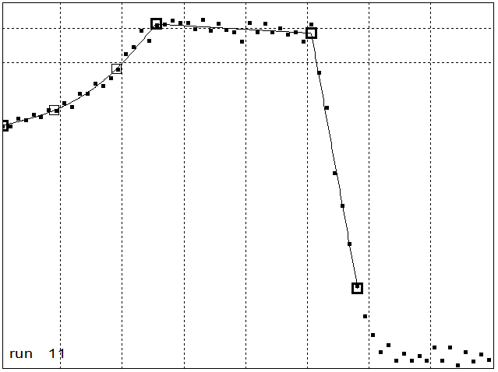
STAR Beam QA
The beam is checked daily with a ‘constancy check’ sequence that uses all but one of the lollipops. This is a measurement of that SOBP with a multi layer ionization chamber (MLIC), which takes the same time as one treatment. The same measurement with a single IC in a water tank would take forever, because we are using lamination, and would be subject to long-term drifts.

Slide 21
Summary
We have discussed some of the features and methods of two programs, NEU and LAMINATE, that are distributed (with a Disclaimer of Warranty) in BGware. Each uses almost all the basic physics and computational techniques we have discussed: stopping, scattering, Bragg peak, broken spline fit, binary degraders, stacks, modulators, and double scattering (NEU only).
It would be useless to try to describe the workings of these programs in any detail during a lecture. If you need to know, you’ll just have to delve into the source code. It’s usually best to start with the subroutines and work backwards.
The trend nowadays is towards interactive programs with Windows-based forms. Self-commented text files, however, have much to recommend them as input. When combined with automatic run numbering, dumping the input to the output, and keeping some sort of catalog, they make it easy to keep track of long-term projects.

