Slide 1
Ionization Chambers
Air-filled plane-parallel ionization chambers (PPIC’s) are commonly used to measure incident beam current, to monitor accumulated dose and terminate irradiation at the prescribed dose, or to scan the transverse dose distribution for QA. Small PPIC’s (‘Markus’ chamber) are used in water phantoms to measure the depth-dose, as are small thimble chambers.
The authority on IC’s in radiotherapy is Boag (‘Ionization chambers,’ in “The Dosimetry of Ionizing Radiation,” ed. K.R. Kase, B.E. Bjarngard and F.H. Attix, Academic Press (1987) 169-243), from whom our formulas are adapted.
Large and small PPIC’s are commercially available, but a given application may have specific mechanical requirements. For that reason, and because an air filled PPIC (especially a large one) is not hard to build, PPIC’s are often designed and built in-house. Therefore we begin with a schematic picture of a monitor PPIC designed for use in a proton beam, and list some design tips.
For beam QA we frequently use PPIC’s whose electrodes are segmented to provide, in one shot, a complete transverse scan. As a case study, we’ll describe a large segmented air PPIC that was used at HCL, both to monitor dose to the patient and to measure transverse dose flatness in a beam steering loop.

Slide 2
Plane-Parallel IC (Beam Monitor)
signal out
vent
baseplate
flange
signal standoff
window
●
HV plane
signal pad
HV standoff
guard
●
vent
HV in

Slide 3
Design Tips
Baseplate: think of one end as carrying the entire inside assembly and even connectors and vents if possible. The rest is a passive cover. That makes machining more accurate and assembly easier.
Flange: holds the window to the case. The entire IC should be air-tight to exclude humidity, so O-rings should be used between the window and case.
Window: should be slack (so P will equal the ambient value), conductive to complete the electrostatic shield, and impermeable to humidity. Aluminized Mylar is good.
Signal pad: normally should either be larger than the beam (integral chamber) or much smaller (dose sampling chamber). Output is harder to interpret for in-between sizes
Guard: this conducting ring serves three purposes. It makes the electric field uniform at the edge of the signal pad. It intercepts surface current paths from HV to signal (though that would not be a problem here). Finally, it defines the potential of the unused part of the signal plate. Large floating insulating surfaces should be avoided as they collect static which can cause erratic operation.
Signal standoff: connects to the grounded baseplate, not the HV plane. That would create a surface path between HV and signal.
Vents: after assembly, and occasionally during operation, it may be necessary to flush the IC with dry air. There should be two valved gas vents in opposite corners.

Slide 4
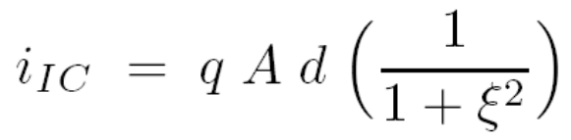


Output Current
We assume the geometry shown ealier. Beam traverses the IC, ionizing atoms to produce positive ions and free electrons. The electrons rapidly attach themselves to other atoms, so after a short time the current at any given point consists of + ions drifting towards the - electrode and – ions drifting towards the + electrode. (The rapid attachment of electrons is usually beneficial in a beam line environment because ions are much less susceptible to the influence of stray magnetic fields.) The current from the IC is
where A is the effective area, d is the gap and q is the charge liberated per unit volume per second by the radiation. ξ is a measure of the ions lost to recombination, which we’ll ignore for the moment (ξ² = 0). q is given by
where e = 1.602 × 10⁻¹⁹ C is the quantum of charge, ρ = 0.00129 g/cm³ is the density of standard air, W ≈ 34.3 eV is the average energy expended per ion pair and is the dose rate. Combining these equations and values, assuming A = 1 cm², d = 1 cm, = 1 Gy/sec and working through the conversions we find, in practical units

Slide 5

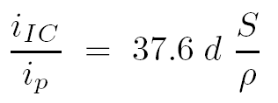
Output Current (continued)
if Ad is in cm³ and dose rate is in Gy/sec. This form is useful if the dose rate is essentially constant over A (a small PPIC in a big beam). If on the other hand we assume a beam that is uniform over A and zero elsewhere we obtain
for the current multiplication of the PPIC, with d in cm and S/ρ in MeV/(g/cm²). Absent recombination, this holds whatever the shape of the beam as long as it is fully contained in A. If there is recombination it will be worse, the smaller the beam.
The neurosurgery beam monitor chambers at HCL had two gaps adding up to d = 0.25″ which gives a multiplication of 110 at 160 Mev (S/ρ (air) = 4.608 MeV/(g/cm²)). The measured value was 104. Perhaps d was slightly less than its nominal value.
It is good design practice to observe one or the other limit: A much smaller than the beam, in which case it can be regarded as sampling the local value of the dose, or much larger (‘integral chamber’) in which case it measures total beam current. Intermediate cases are more difficult to interpret, and do not tell us anything simple.

Slide 6
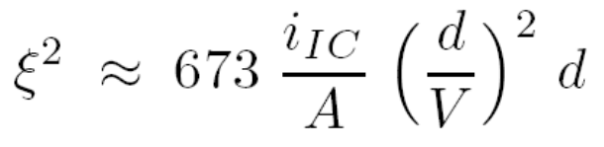
Recombination
When a positive and a negative ion meet going their opposite ways, they may recombine, reducing the output current. This is not as likely as it might seem, because of conservation laws that have to be obeyed in a ‘sticking’ collision, but it does happen. Boag has an extensive discussion.
Recombination is undesirable not because of the lost signal (it usually happens when we have more than enough signal anyway) but because the lost signal is unstable. It depends on beam focusing, time structure and high voltage applied to the PPIC, all making for a poor beam monitor.
Slightly reworking the PPIC formula for ‘general’ recombination given by Boag, we find for normal air and ξ² « 1 (small recombination)
(nA, cm, V). i_{IC}/A is an estimate of the instantaneous output current density. One can test experimentally for recombination by looking for HV dependence or better, rate dependence of output. The best remedy, obviously, is decreasing the gap. With careful design it is possible, though not easy, to obtain a 1 mm gap in a medium size PPIC such as a cyclotron output monitor. Since we will in addition want fairly large V, we must also worry about sparking and surface leakage paths.

Slide 7
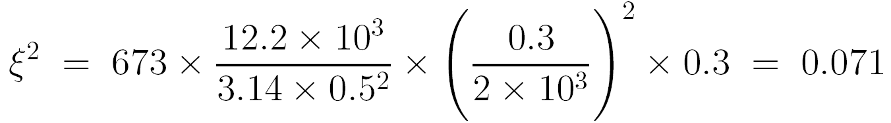
Recombination (continued)
For a numerical example, suppose a cyclotron output monitor PPIC operates at a maximum beam current of 300 nA at 232 MeV, has a 3 mm gap and 2 KV bias. Also suppose that the effective beam radius is 0.5 cm (it takes a rather careful measurement to determine this accurately). The mass stopping power of air for 232 MeV protons is 3.608 MeV/(g/cm²). The current multiplication, from a previous formula, is 37.6 × 0.3 × 3.608 = 40.7 so the ion chamber current is 12.2 × 10³ nA = 12.2 μA. The formula gives
which is « 1 so the formula is valid. ≈ 7% of the current is lost to recombination, which is tolerable if the cyclotron output current is constant or if procedures that depend on beam current , such as beam current modulation, are always defined at the same current. It would not be difficult to build a similar chamber with a 2 mm gap which would reduce recombination (2/3)⁴ ≈ 5×.
If a machine other than a CW cyclotron is used, it is the instantaneous current density that matters, so the duty factor must be taken into account. However, PPIC’s have ion collection times on the order of 100 μsec so beam time structure shorter than that can be ignored. See Boag for details.

Slide 8
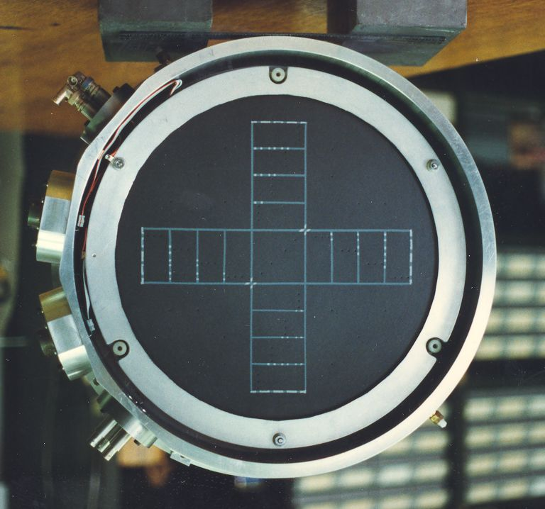
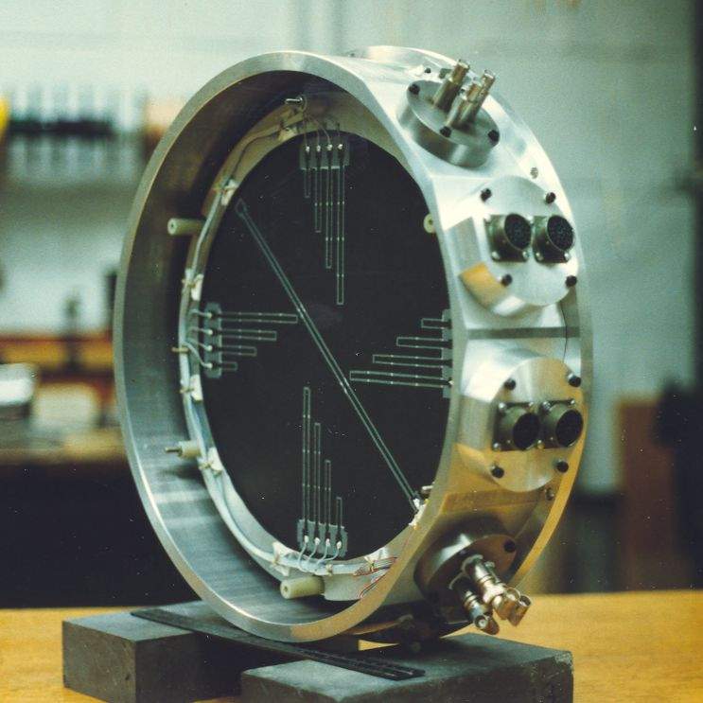
Case Study: Combined Dose and Flatness Monitor
At HCL in 1995 we decided to replace the Room 2 (large field) beam monitor IC with one that would sample the center of the beam as a dose monitor and provide dose flatness data for a closed-loop beam centering system. The left-hand photo shows the central ‘dose’ pad flanked by ‘flatness’ pads, 8 in each direction. Two complete planes existed providing a redundant dose measurement and spare flatness pads. The patterns were created by spraying a conductive coating onto masked 0.003″ stretched matte artist’s Mylar.
The right-hand photo shows the lead-out traces on the field-free side of the assembly, connected by pin-pricks filled with conductor. The assembly was hermetic to exclude humidity. Sealed multi-pin connectors were made by hand from commercial components.

Slide 9
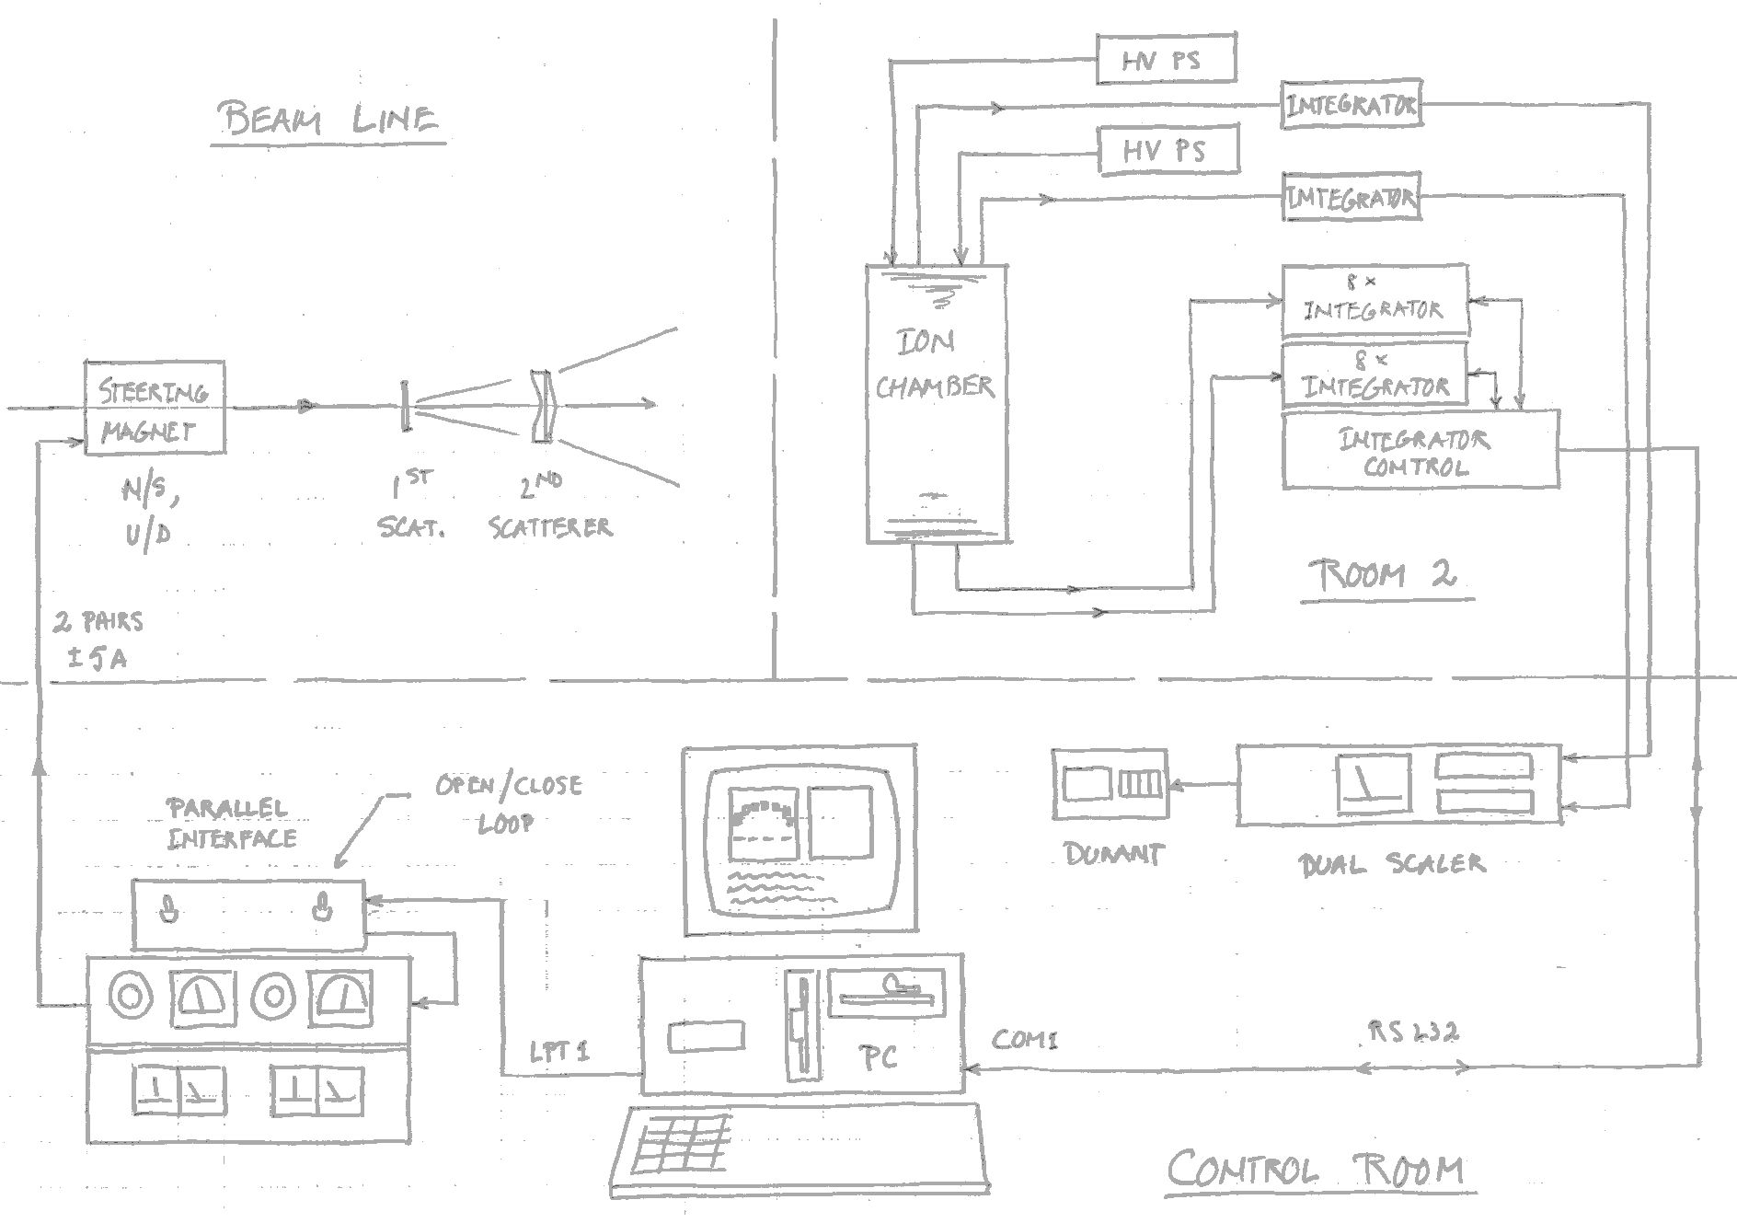
Block Diagram of Beam Monitor and Steering System

Slide 10
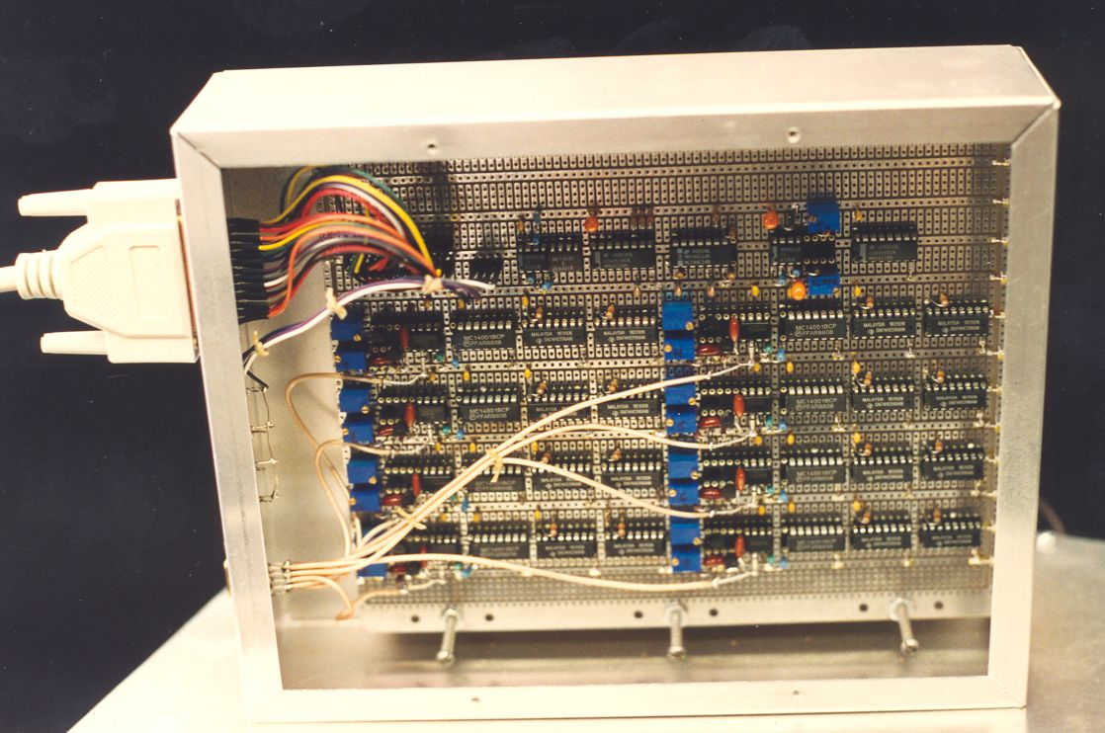
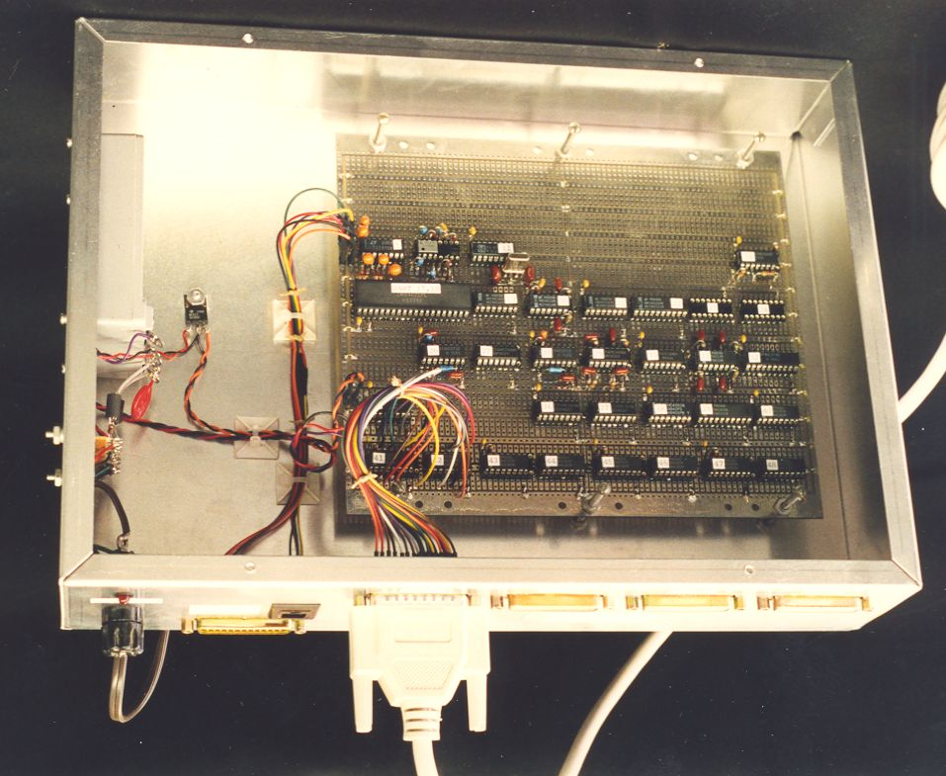
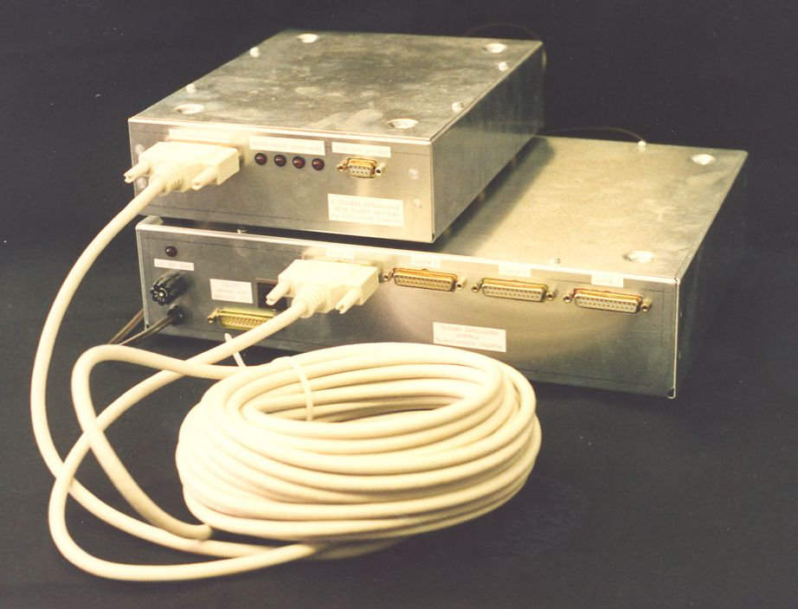
Current Integrator Array Electronics
Clockwise from above: 8-channel 10 pC/ct recycling integrator; integrator control and RS-232 interface to computer; assembled electronics showing only one of two octal integrators. This equipment was in the treatment room near the ionization chamber, connected with group-shielded multiwire cable. A modular phone cord provided RS-232 communication with the 286 PC in the control room.

Slide 11
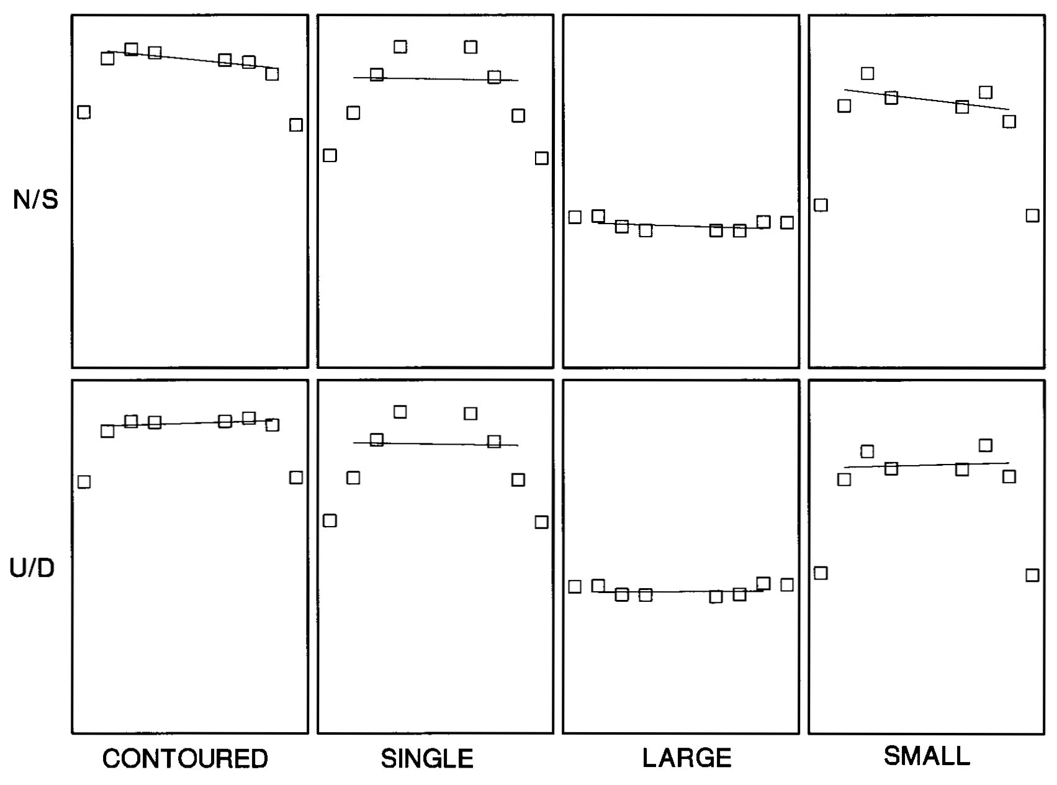
Real-Time Display for the Cyclotron Operator
Characteristic patterns obtained with four standard beams in Room 2. The 286 computer ran a QuickBasic program on a one-second cycle. The 16 integrators were read and reset. While they were accumulating the next data set, the PC fit a line to the central region. The slope error integral was fed back to a pair of trim magnet supplies via the PC’s parallel port. The loop was closed permanently except when the signal fell below threshold. Thus the starting settings were those at the end of the last treatment. If the PC could not flatten the dose it beeped to alert the operator. N/S and U/D patterns, fits and threshold were displayed.

Slide 12
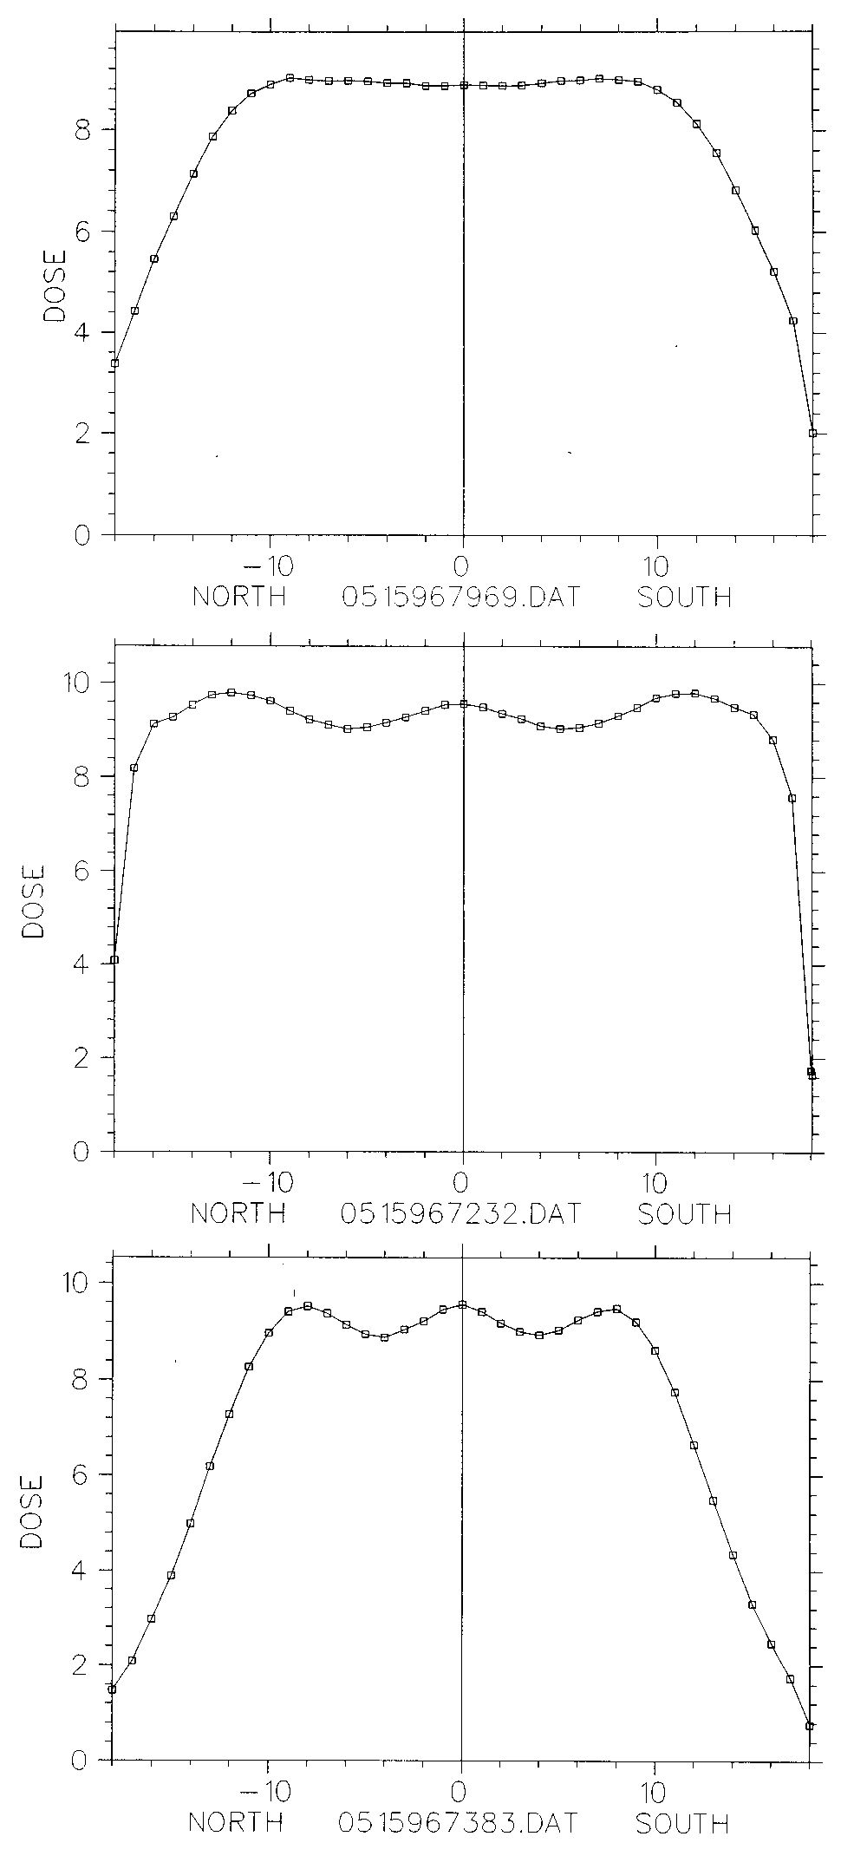
The Bottom Line
CONTOURED
N/S dose scans taken with the ‘Oilcan’ dosimeter while the steering system held the dose flat.
LARGE
SMALL

Slide 13
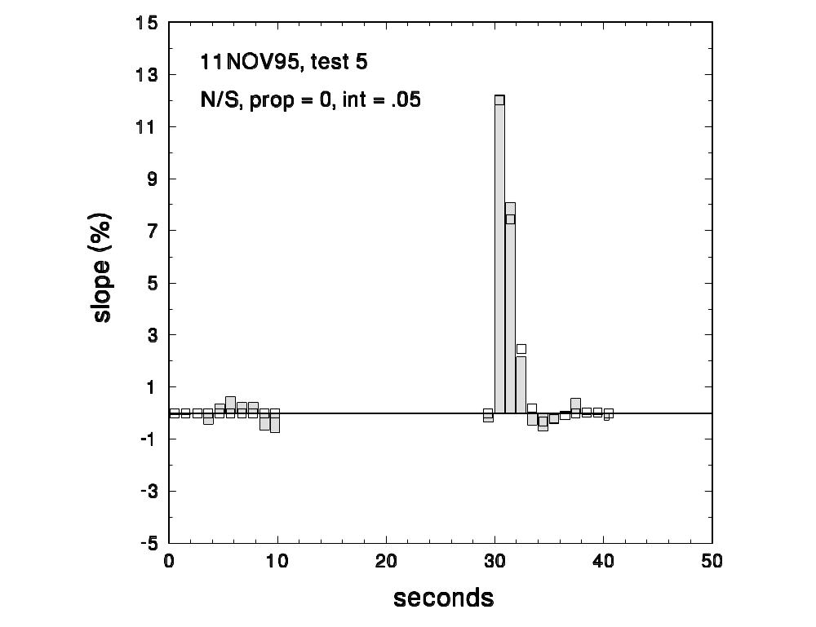
Settling Time
An auxiliary program analyzes the fitted slope history. This shows system response to a deliberate 12% step perturbation, far greater than anything normal. Even then, the system settles in 3 sec, 1/20 of a normal treatment. Bars = measured data, squares = predicted response. (Digital feedback systems lend themselves to exact analysis.)

Slide 14
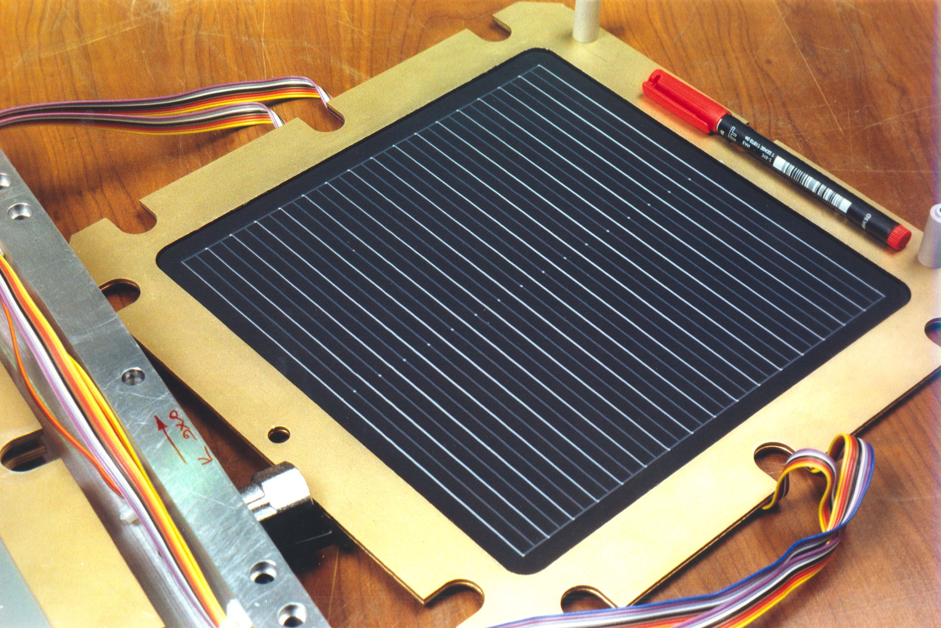
An Alternative: Strips
The segmented IC in the standard IBA nozzle uses 32 strips instead of pads, with another 32 orthogonal. The dosimetry pad has to be on a separate plane. A Monte Carlo study showed this would also work, and it cuts down on the electronics.

Slide 15
Summary
We have described the construction of an air-filled plane-parallel ionization chamber (PPIC) with some design tips. Simple formulas give the output of the PPIC as a function of dose rate if the active area is much smaller than the beam, or the multiplication if the active area contains the beam completely.
At high currents or low accelerator duty factors, recombination of ions reduces the measured current in a way that tends to be unstable. We gave a formula for estimating this, but the PPIC design should render recombination negligible under normal operating conditions if at all possible. If not, one can consider other filling gases such as helium (D.M. Ritson, “Techniques of High Energy Physics,” Interscience (1971)) or other beam detection techniques such as secondary emission monitors (SEM’s).
As a case study, we discussed a large segmented PPIC used at HCL both as a beam monitor and to measure transverse dose flatness in a beam-steering feedback system. The standard IBA nozzle also uses active beam steering but the principle (discussed in the Double Scattering lecture) is somewhat different. Among other things, the segmented IC uses ‘strip’ rather than ‘pad’ geometry.

