Slide 1
MultiLayer Faraday Cups (MLFC’s)
The MLFC is simply a stack of conducting sheets separated by insulating sheets. Either may be regarded as the ‘active’ element. The conducting sheets are connected to an integrator array of the sort described in connection with MLIC’s. The current to be detected is fairly large (nA, not pA) so demands on the integrator are lower. However, protons are positive, so the integrator, if unipolar, must sink current.
Even though it is known that secondary electrons are emitted at each interface between conductor and insulator, and even though protons stop in insulator as well as conductor, the MLFC measures the total charge entering, as well as its range distribution, perfectly. A simple electrostatic argument shows why.
MLFC’s are usually used as range verifiers. Even a relatively crude device can detect changes as small as 0.1mm H₂O equivalent. However, they have other uses. They can detect low energy beam contamination from slit scattering or beam scraping, can be an aid in beam alignment, and can measure nuclear reactions to test Monte Carlo models.
We will describe the construction and performance of several MLFC’s, touch on data analysis, and give some design and construction guidelines.
© 2007 B. Gottschalk. This material is previously unpublished except as noted.

Slide 2
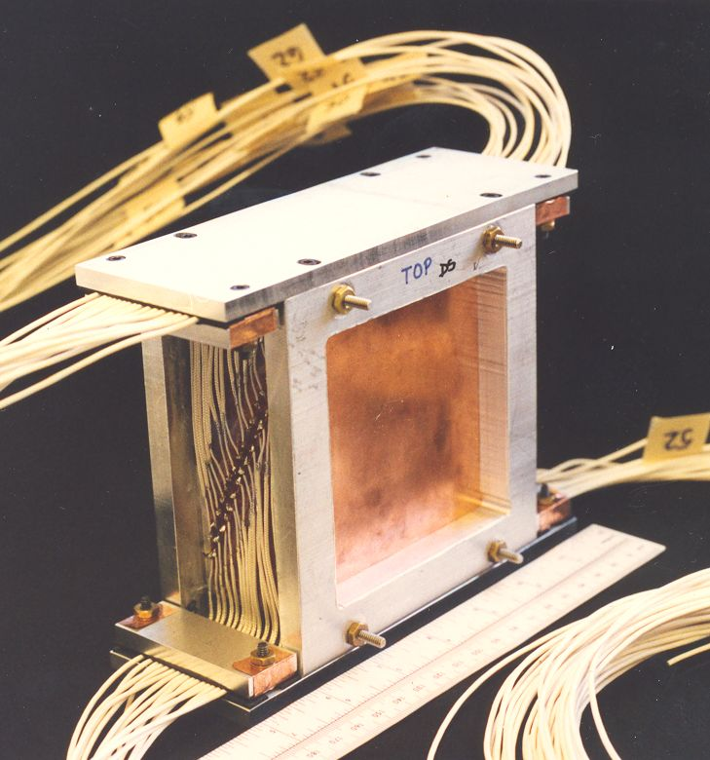
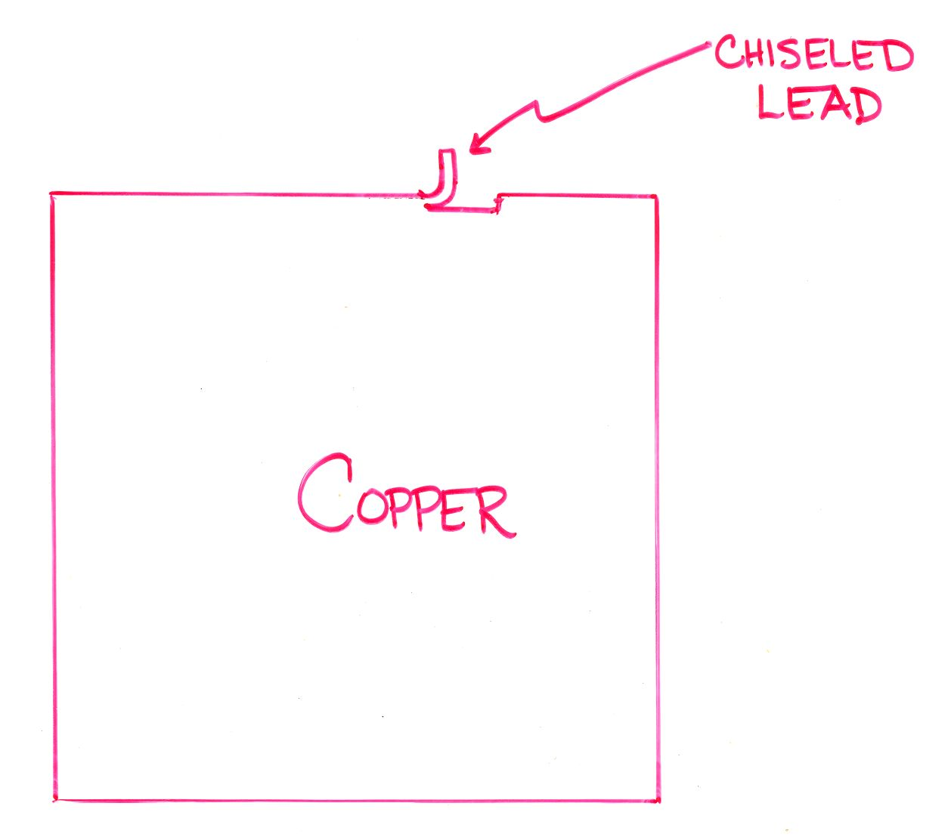
The First MLFC
was skillfully constructed at HCL in 1995 by Rachel Platais, a cyclotron operator on ‘research time’, under our direction. 66 × 0.476 g/cm² copper plates (2 shields and 64 active) were each separated by 2 × 0.0005″ Kapton sheets: about 2% of the energy loss was in Kapton. Readout was by our standard 64 channel integrator and scanning ADC interfaced to a laptop via RS-232. The MLFC worked immediately and too well. Total charge corresponded to 96% of the beam current even though it was well known that there would be copious secondary electron emission by the Kapton.

Slide 3
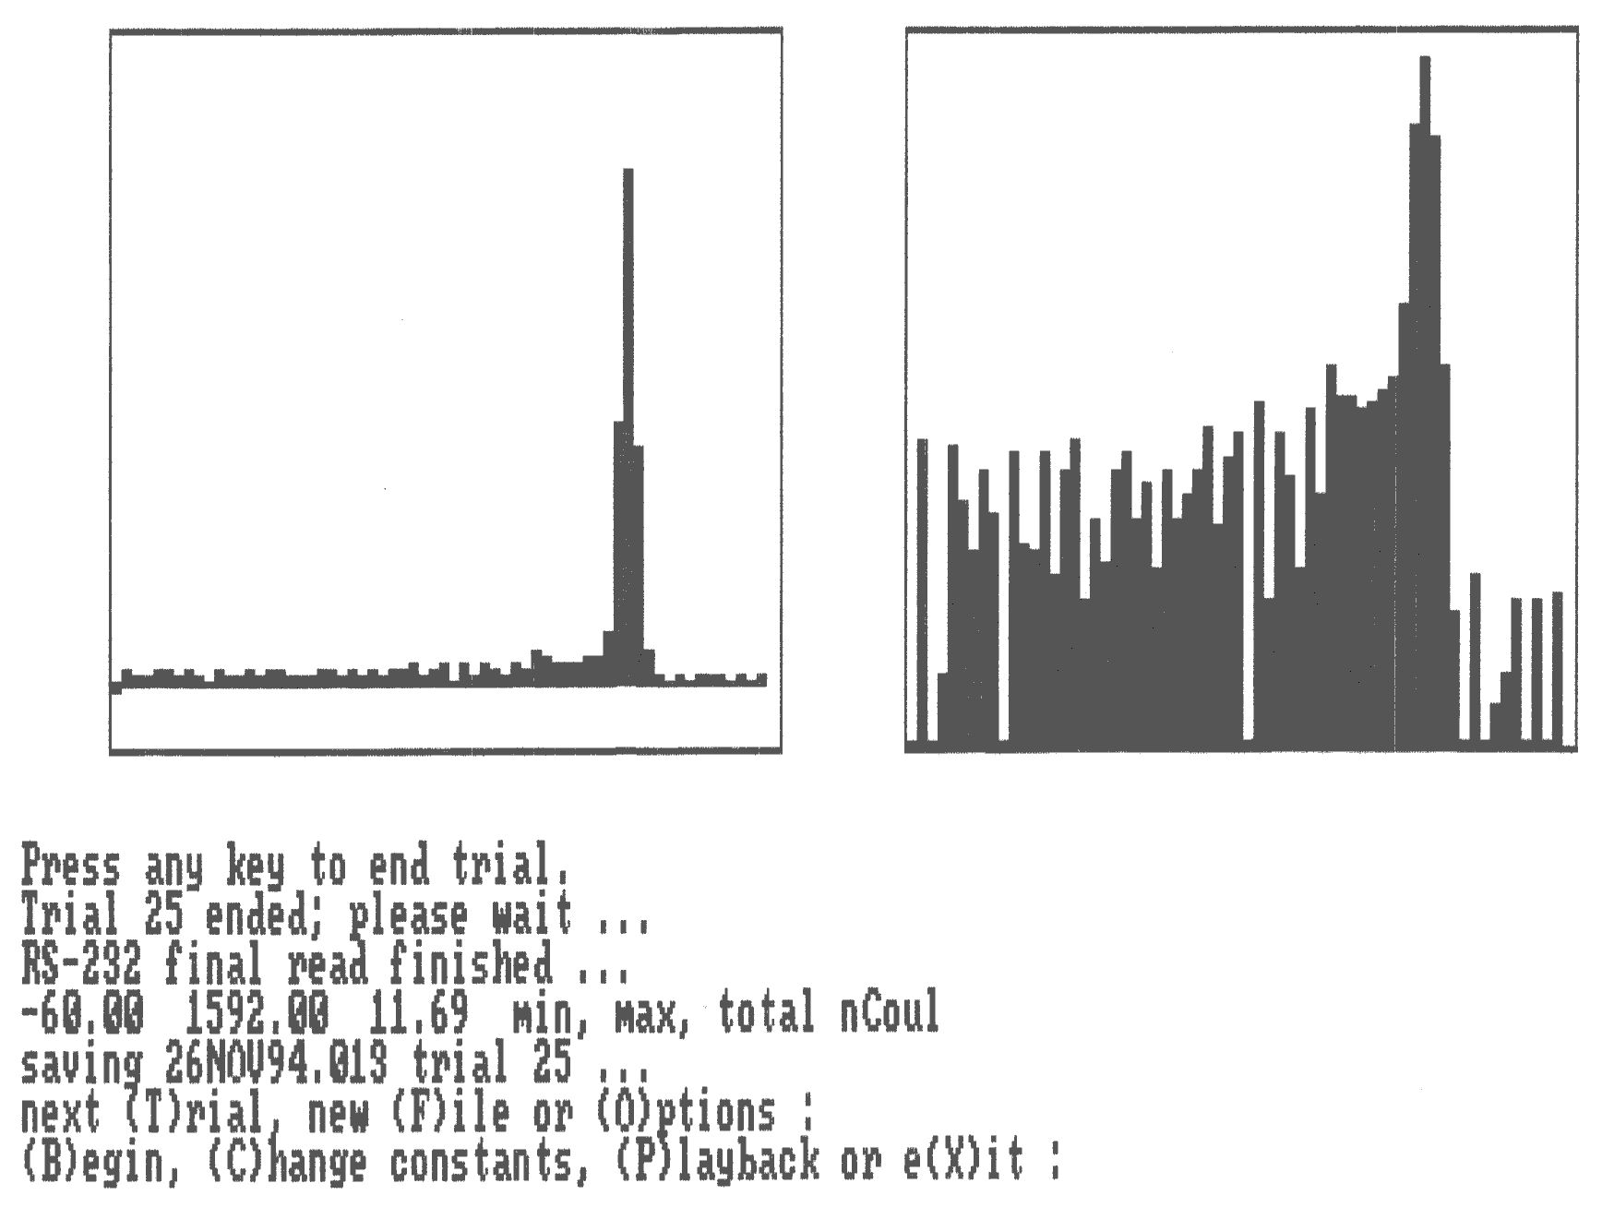
Online end-of-run display of a very early MLFC trial by the Bondwell laptop computer (2 floppies, no hard drive, QuickBasic running under early DOS). Left = linear, right = logarithmic.

Slide 4
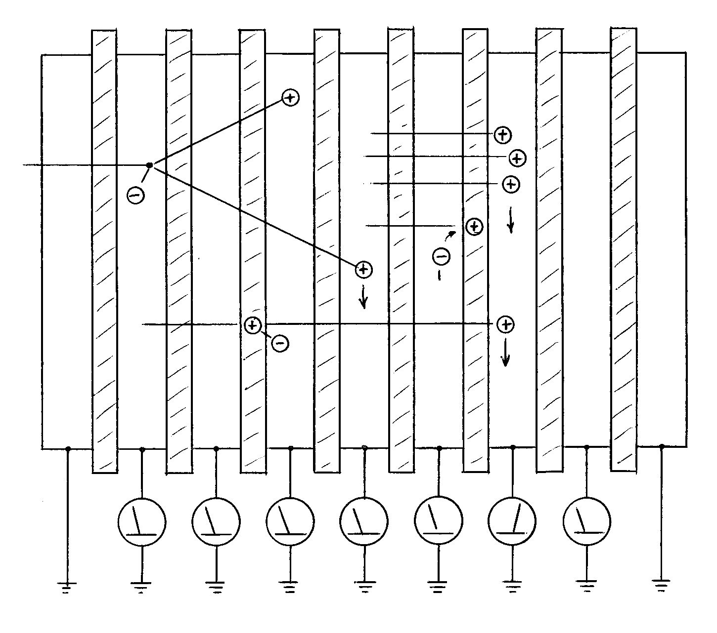
The Mystery Explained
C
B
A
Why the device works so well is explained by simple electrostatics. A) Proton knocks an electron out of Kapton before stopping. Electron is essentially ‘bound’ to the positive vacancy left behind, so does not contribute to measured current. B) Proton stops in Kapton. It induces a mirror charge in the facing conductor, so it is counted anyway. C) Proton has a nuclear reaction. Net charge in MLFC still +e. Therefore the MLFC counts all the charge entering and only the charge entering. ‘Internal’ processes in insulator and conductors have no effect.

Slide 5
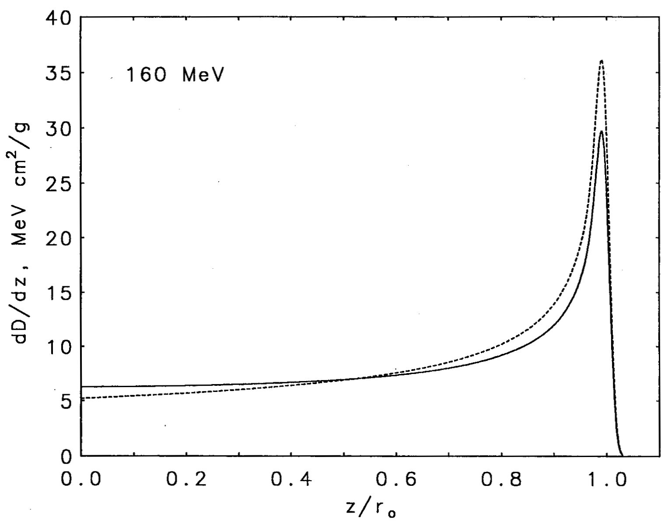
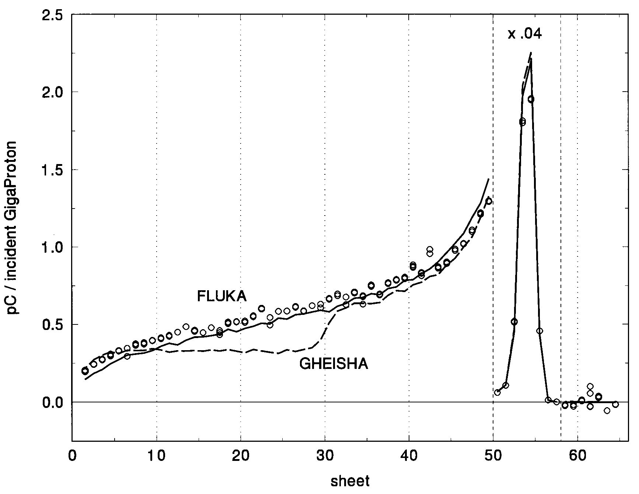
Using the MLFC to Test Monte Carlo Models
Monte Carlos are often used in proton radiotherapy but many MC’s are not well tested at proton therapy energies. The Bragg peak (left, Berger NISTIR 5226 (1993)) is relatively insensitive to nuclear reactions: the difference shown is from turning them off entirely. In a MLFC, by contrast, the signal before the EM peak is entirely from nuclear secondaries (right, Gottschalk, Platais and Paganetti, Med. Phys. 26 (1999) 2597). The first hint is that the integral of that part is 20% of the total, just as predicted from the non-elastic reaction cross section. 100% acceptance, and the fact that we measure charge not dose make this an unambiguous test of whether a MC predicts the number and range distribution of nuclear secondaries correctly. For instance, the graph shows that the (default) Gheisha model of Geant3 is poor. The comparison of MC with experiment is absolute: no normalization.

Slide 6
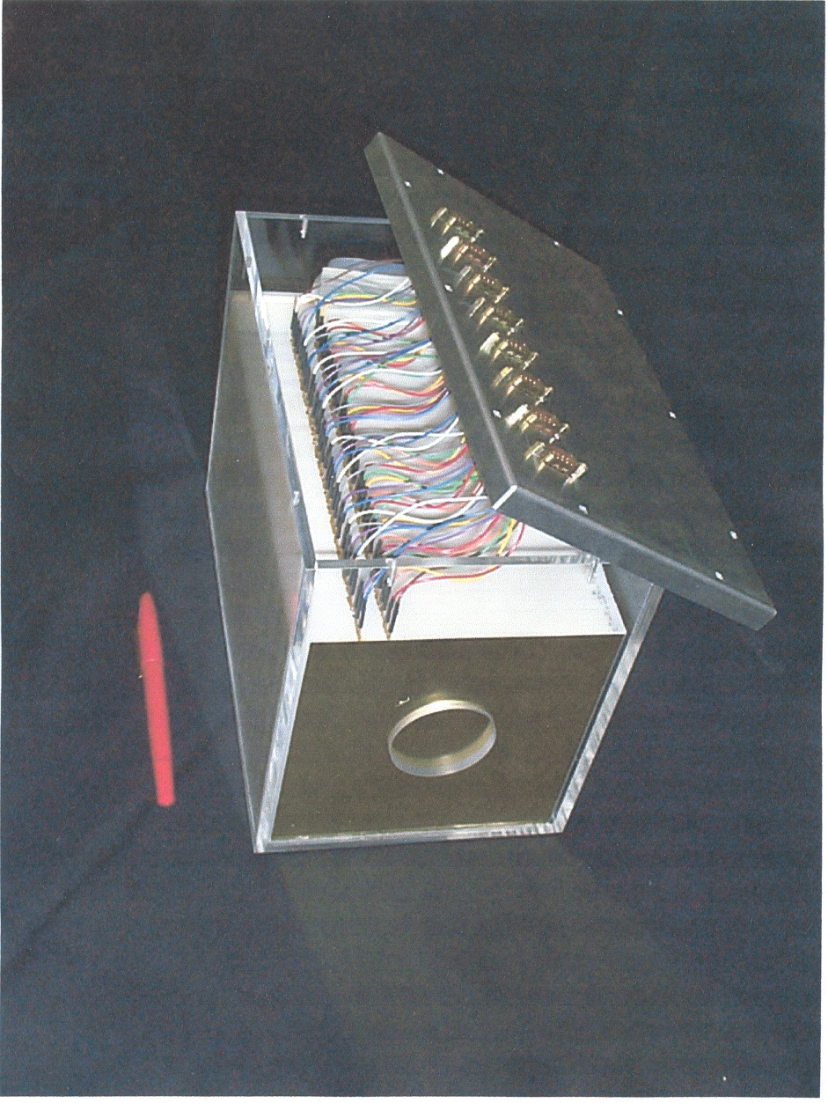
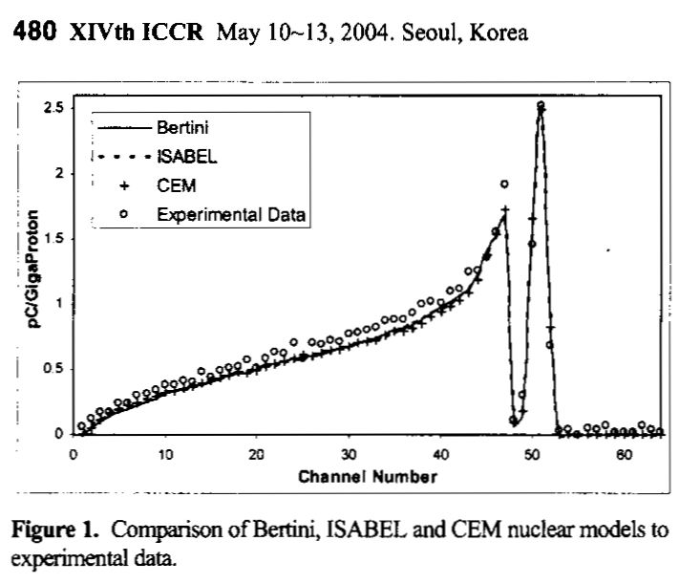
The Same, for Light Elements
The preceding test was in copper, not a very interesting material for proton radiotherapy. We built a MLFC with CH₂ plates separated by thin brass collectors a) to see if it would work and b) since it did, to generate nuclear secondary distributions for a more relevant material (carbon). The right-hand graph (Mascia et al., Proc. XIVth ICCR (2004) Seoul, Korea) shows that two different MC’s look good. We had previously tested Geant3 and Geant4 (Paganetti et al., Med. Phys. 30 (2003) 1926) against the same data.

Slide 7
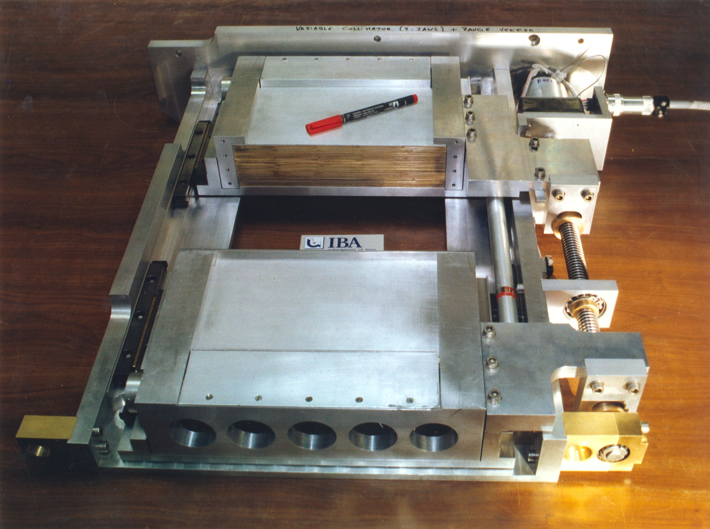
A MLFC range verifier (RV) is built into two opposing jaws of the 4-jaw collimator of the IBA proton nozzle. It consists of 2mm brass plates. The opposite jaw has an additional 1mm for depth offset to improve total resolution. The next few slides will give some results for this RV. For details see B. Gottschalk, ‘Calibration of the NPTC Range Verifier,’ IBA technical note (2001), RVcal.pdf on our Web directory.

Slide 8
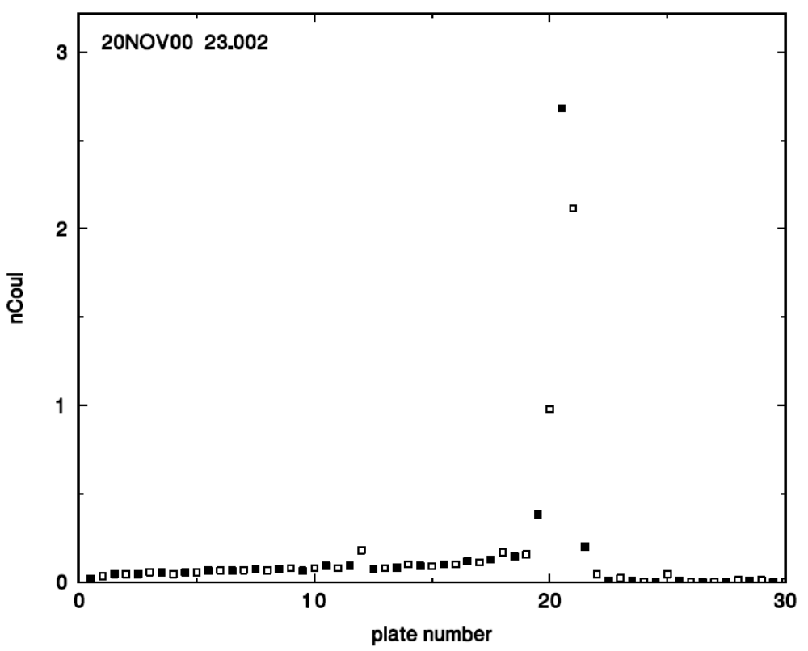
Preliminary Analysis
Measurements in the next few slides were taken around 2000 with the help of Yves Jongen and other IBA staff. Most data were taken with the RV jaws closed. First, data from the two jaws are merged and corrected for beam imbalance between the jaws. The mean of the peak is then computed by a straightforward 2-stage process based directly on the counts. (Fitting with a binned Gaussian takes much longer and is less accurate.)

Slide 9
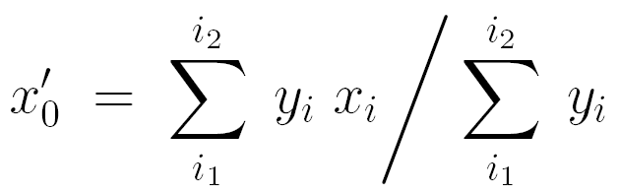
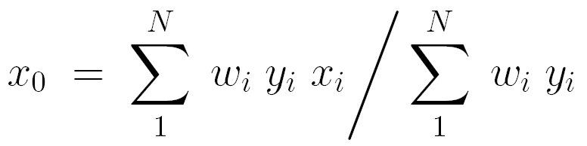
Finding the Centroid x₀
Given MLFC data from a monoenergetic beam, what is the most precise definition of the measured range, that is, the centroid of the charge (y) vs. sheet number (x) distribution? One’s first thought might be to fit y(x) with a Gaussian, suitably binned to account for the fact that only 3-4 channels have significant signal. It turns out that a far simpler two-pass method is better. First, find the 4 contiguous channels (i₁→ i₂) with the largest total signal. Compute a provisional mean x₀′ the normal way:
Compute non-integral limits for a new span x_{a} → x_{b}:
where Δx is a non-integral span parameter, say 3.0 sheets. Now compute, for each bin within the span, weights w_{i} which are 1 if the bin is completely within the span, suitably prorated if partly in, and 0 otherwise (see next slide). Finally, compute
The ‘4’ initial channels and Δx are parameters which may have to be changed for another MLFC with different granularity. After trying and giving up the fitting technique, we have used this simple method for all MLFC analyses.

Slide 10
Finding the Centroid x₀ (Graphical)
y
w
x
x_{a}
x₀′
x₀
x_{b}
If the beam is polyenergetic (e.g. range modulated) things are much more complicated. We have not been able to develop a good automatic algorithm, nor have we been able to use such MLFC data for more than a rough check on the modulation.

Slide 11
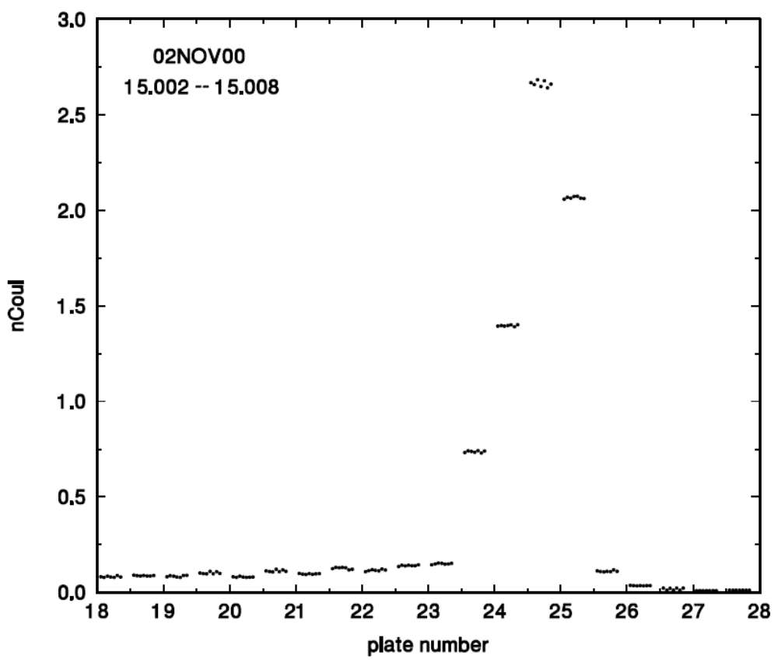
Experimental Error in MLFC Measurements
Because we refer to individual channel data as ‘counts’ it is tempting to think that the reproducibility (random error) has something to do with the square root of the ‘counts’. That is completely wrong: each datum is a quantized charge measurement and its error is approximately 0.6 ΔQ or a fraction of a ‘count’. This graph shows seven successive measurements. The net result is that a precise MLFC measurement takes far less time (integrated beam current) than you might think!

Slide 12
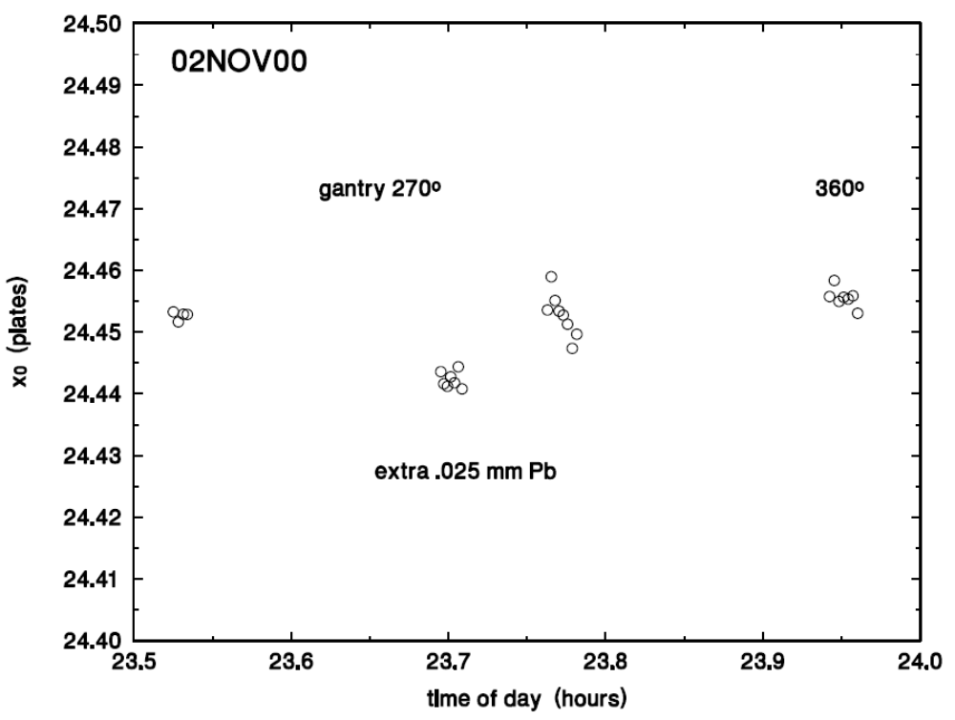
MLFC Resolution
Now that we have a well-defined analysis method, what is the range resolution of the system? The RV was exposed several times to a single scattered beam. Then a 0.025mm Pb foil (0.12mm H₂O equivalent) was added; then removed; then the gantry angle changed by 90° to see if that matters. The RV resolution, with the aid of the 1mm brass plate offset, is about 1% of the thickness (11mm H₂O equivalent) of its brass plates!

Slide 13
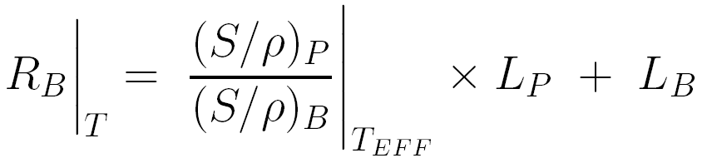
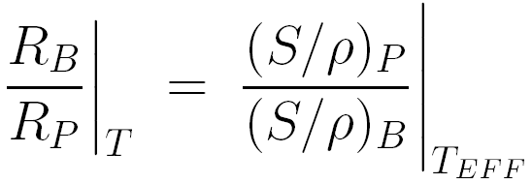
Brass Equivalent of Polyethylene
The IBA RV consists of 2mm brass plates separated by 2 × 0.025mm polyethylene. We would at times like to regard it as measuring ‘range in brass’, which means we need to find a way of computing the brass equivalent of polyethylene. Let B stand for brass, P for polyethylene, R be range, L be thickness in g/cm² , and T be the incident energy. We would like to find the equivalent range in brass by applying
where the tabulated stopping power ratio is evaluated at an unknown T_{EFF} intermediate between T and 0. The formula must hold even if L_{B} = 0, therefore L_{P} = R_{P} , so we seek T_{EFF} such that
A little work with range-energy tables using LOOKUP leads to T_{EFF} = 0.52 × T. In other words, convert polyethylene to brass using the stopping power ratio at 0.52 times the energy incident on the RV. This is a purely numerical result having to do with the shape of the dependence of R on T; it cannot be ‘proven’ analytically. It applies to any two materials and any ratio of thicknesses, as long as the stack is finely divided.

Slide 14
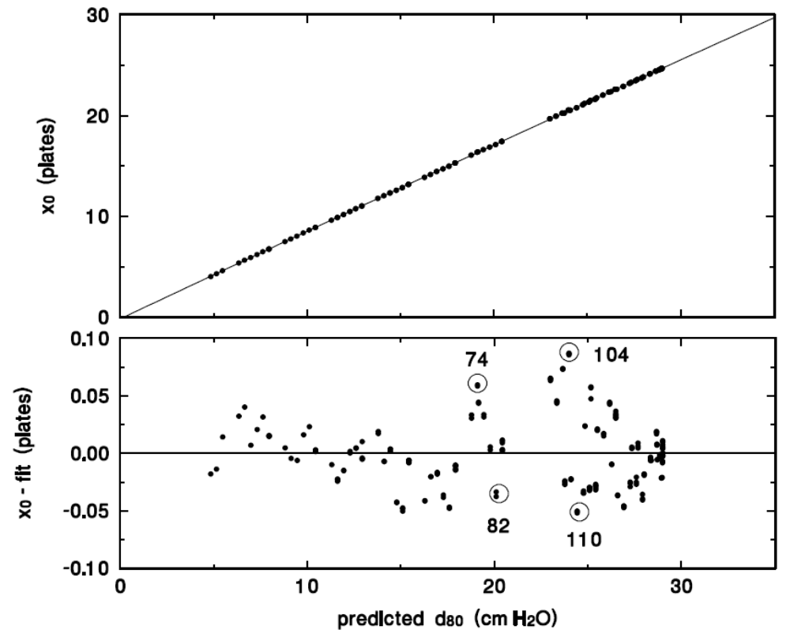
MLFC Linearity
The range of protons entering the RV was changed by using many different combinations of the ‘lollipop’ degraders. For each, the range in water was computed and compared with the mean stopping point, still measured in interpolated ‘plates’. The residual error (lower graph) shows a systematic trend (explained later) and some outlier runs that were checked more closely.

Slide 15
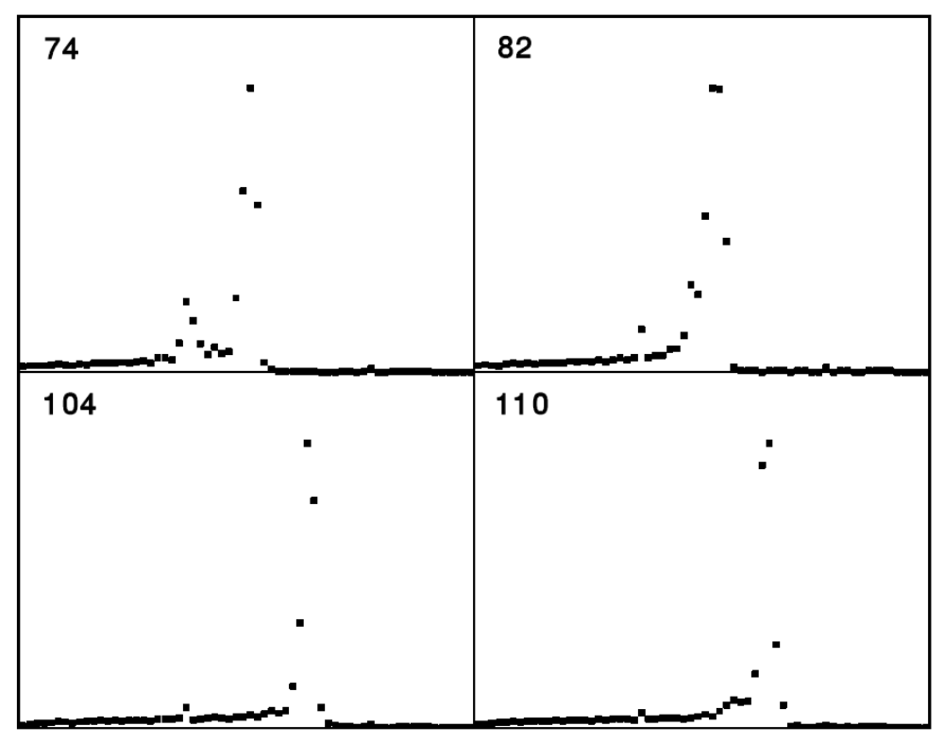
Beam Scraping
?
Most of the outlier runs showed evidence of beam scraping: some protons were losing energy in things they weren’t supposed to hit. Much of this was eventually traced to the lollipop frames and fixed by opening them up. A MLFC is a good diagnostic device particularly in the early commissioning phase. The long tail to the left is not scraping but nuclear reactions in the MLFC.

Slide 16
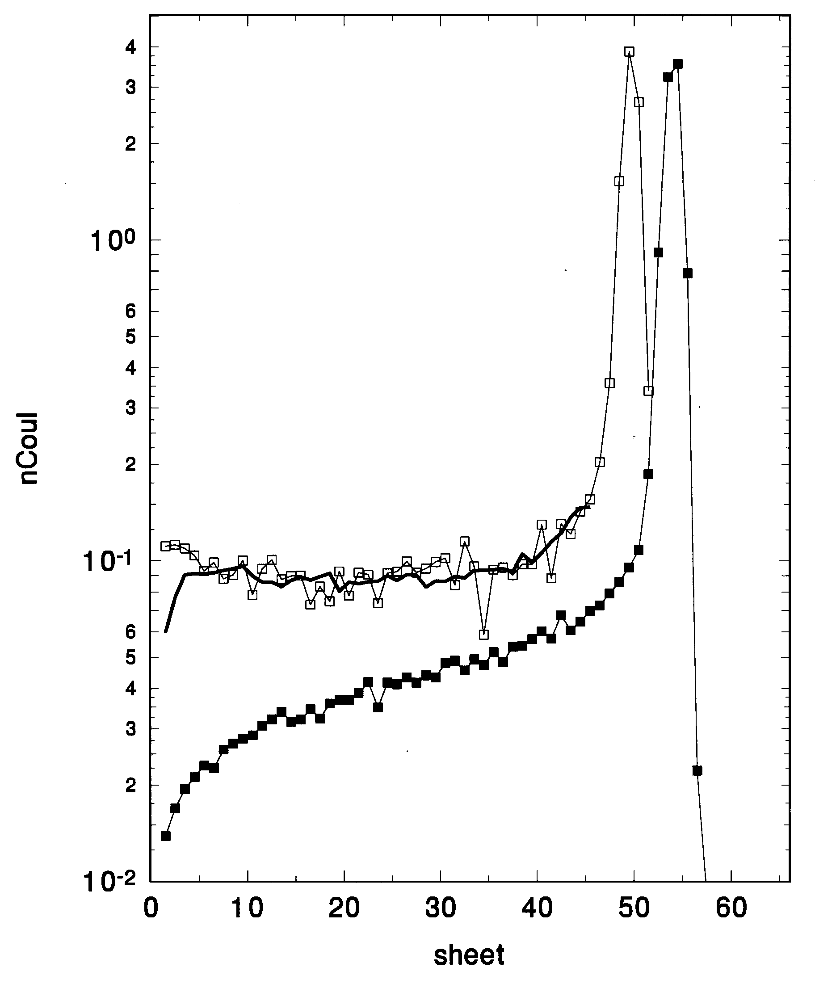
Beam Contamination
Besides scraping, another source of beam contamination is slit scattering. Details of this MLFC experiment were given in the lecture on slit scattering. Note that the signal from nuclear reactions (arrow) is always present. The Monte Carlo (bold line) computes the additional signal from slit scattering.

Slide 17
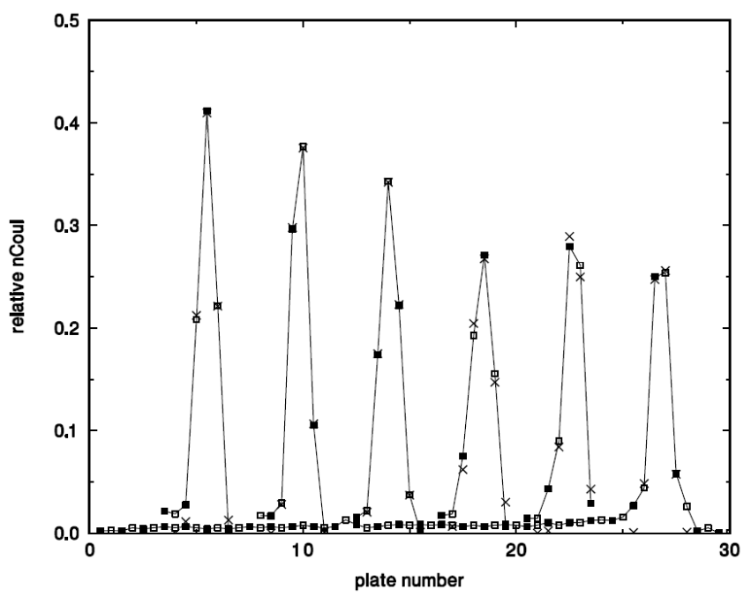
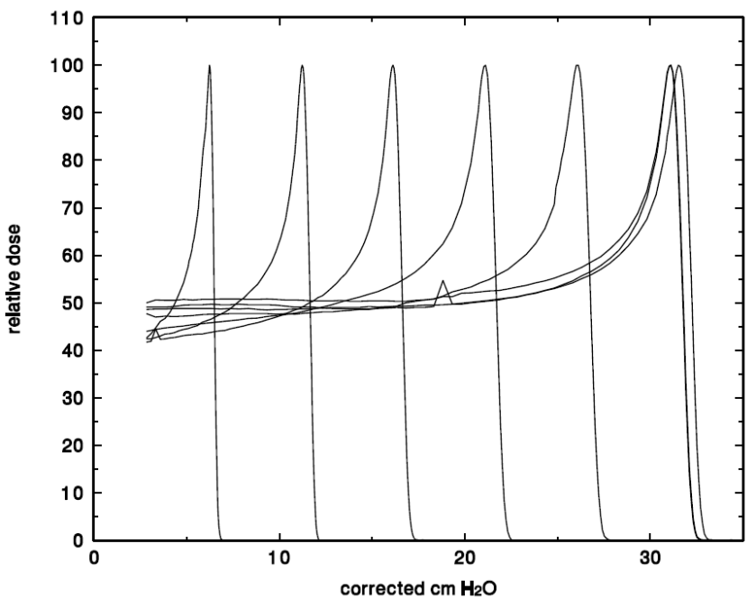
RV Calibration
To calibrate the RV we exposed it to 7 different beam energies using the ESS (Energy Selector System) of the NPTC facility. After each, a water tank Bragg peak measurement was done as soon as possible (the tank stayed set up). The range at isocenter was predicted from the known thicknesses of all beam line components including air.

Slide 18
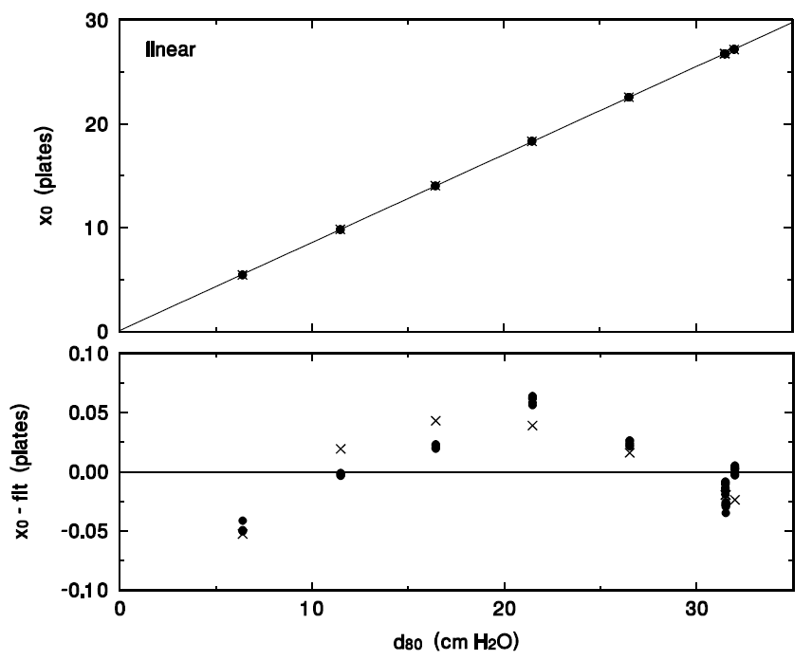
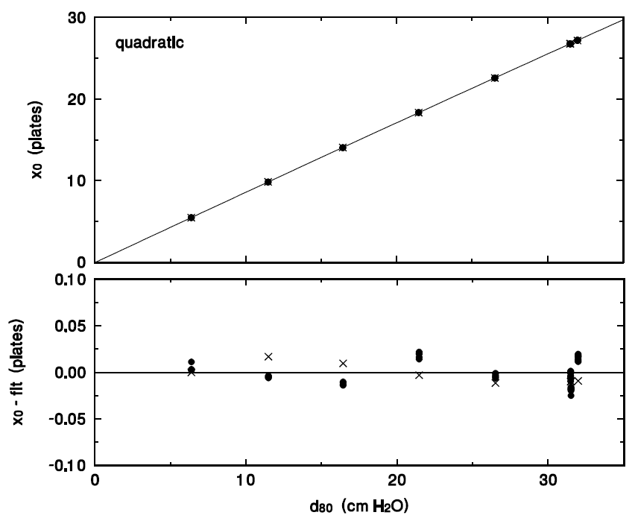

RV Calibration (continued)
RV-measured range (in ‘plates’) is plotted against d₈₀ from the water tank scans. The theoretical value of ‘plates’ is also plotted (×). The residual from a linear fit (lower left) shows a small but significant trend, which agrees in magnitude and general shape with the expectation from theory. A quadratic fit (right) gets us down to experimental error. The physical interpretation of the small non-linearity is that range in brass is not exactly proportional to range in water: the stopping powers vary differently with energy.

Slide 19
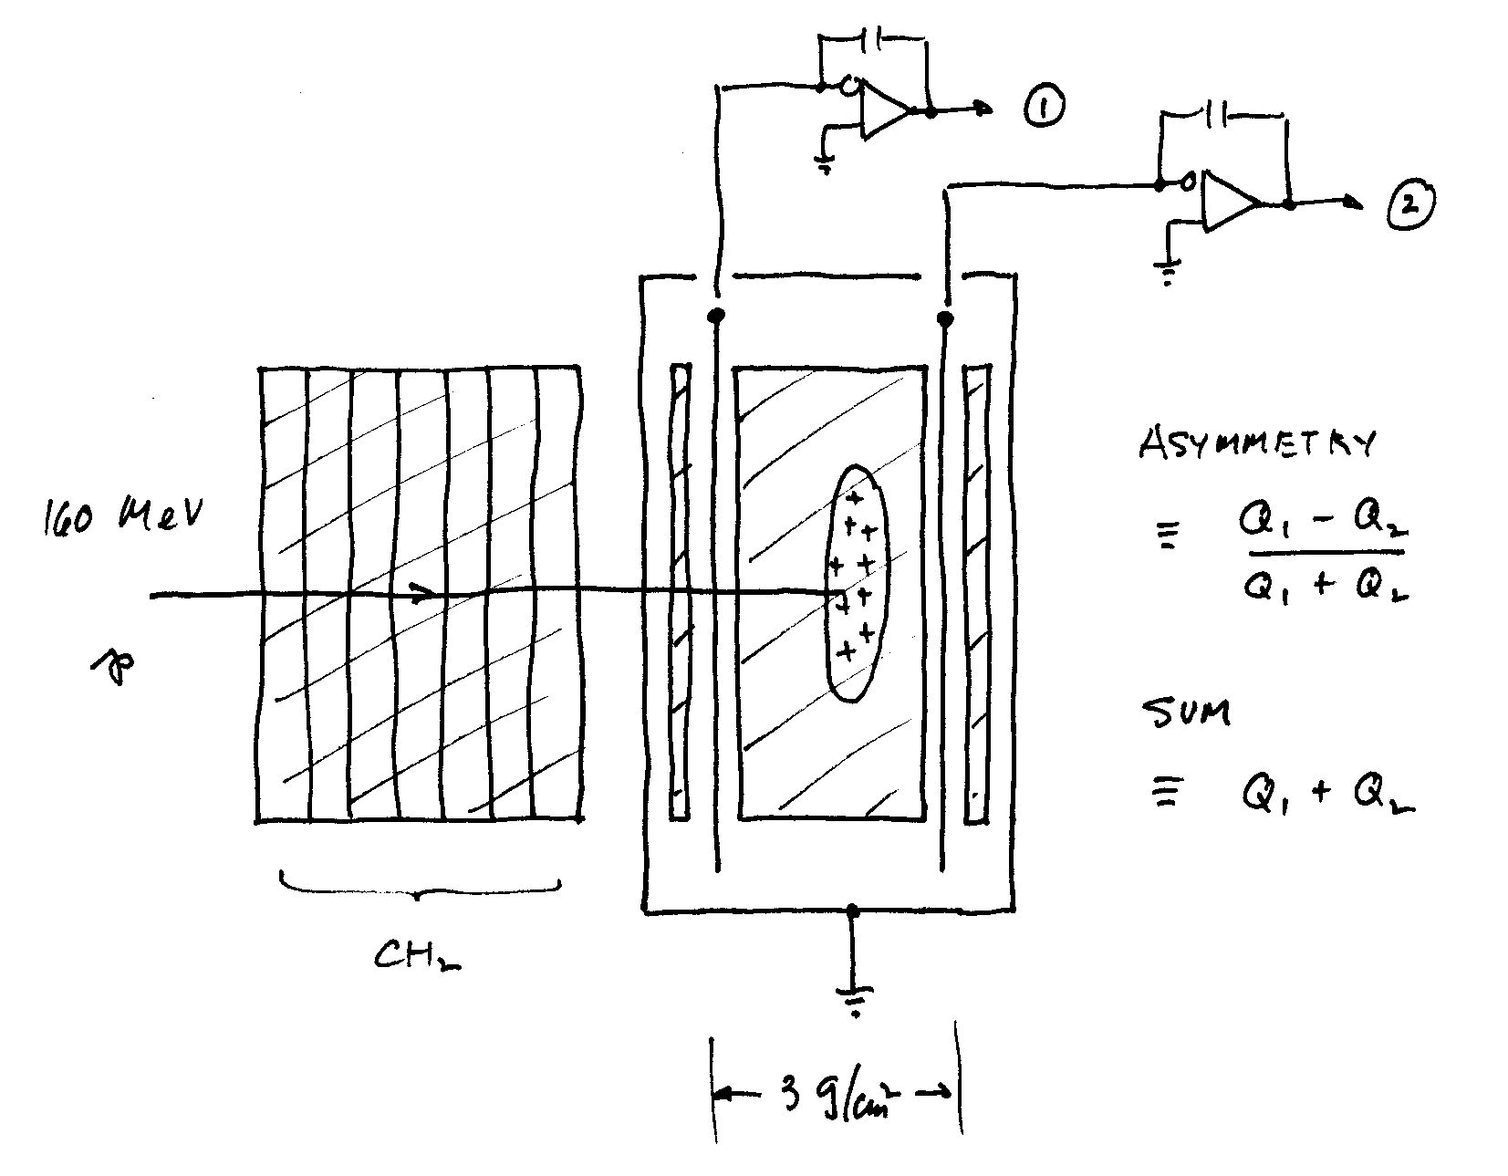
Charge Division Chamber
This simple arrangement gives some insight into the operation of insulating MLFC’s and may conceivably be useful as a simple beam energy monitor if it is known that nothing else is changing. A thick insulating slab (say CH₂) is flanked by conducting readout sheets.

Slide 20
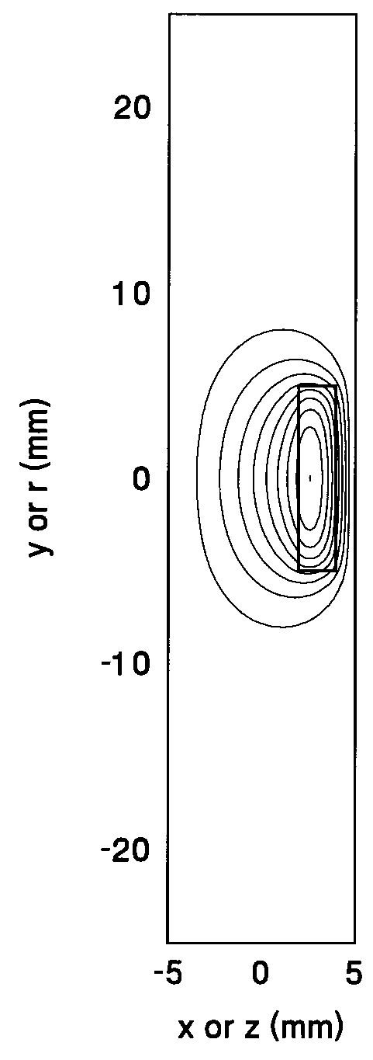
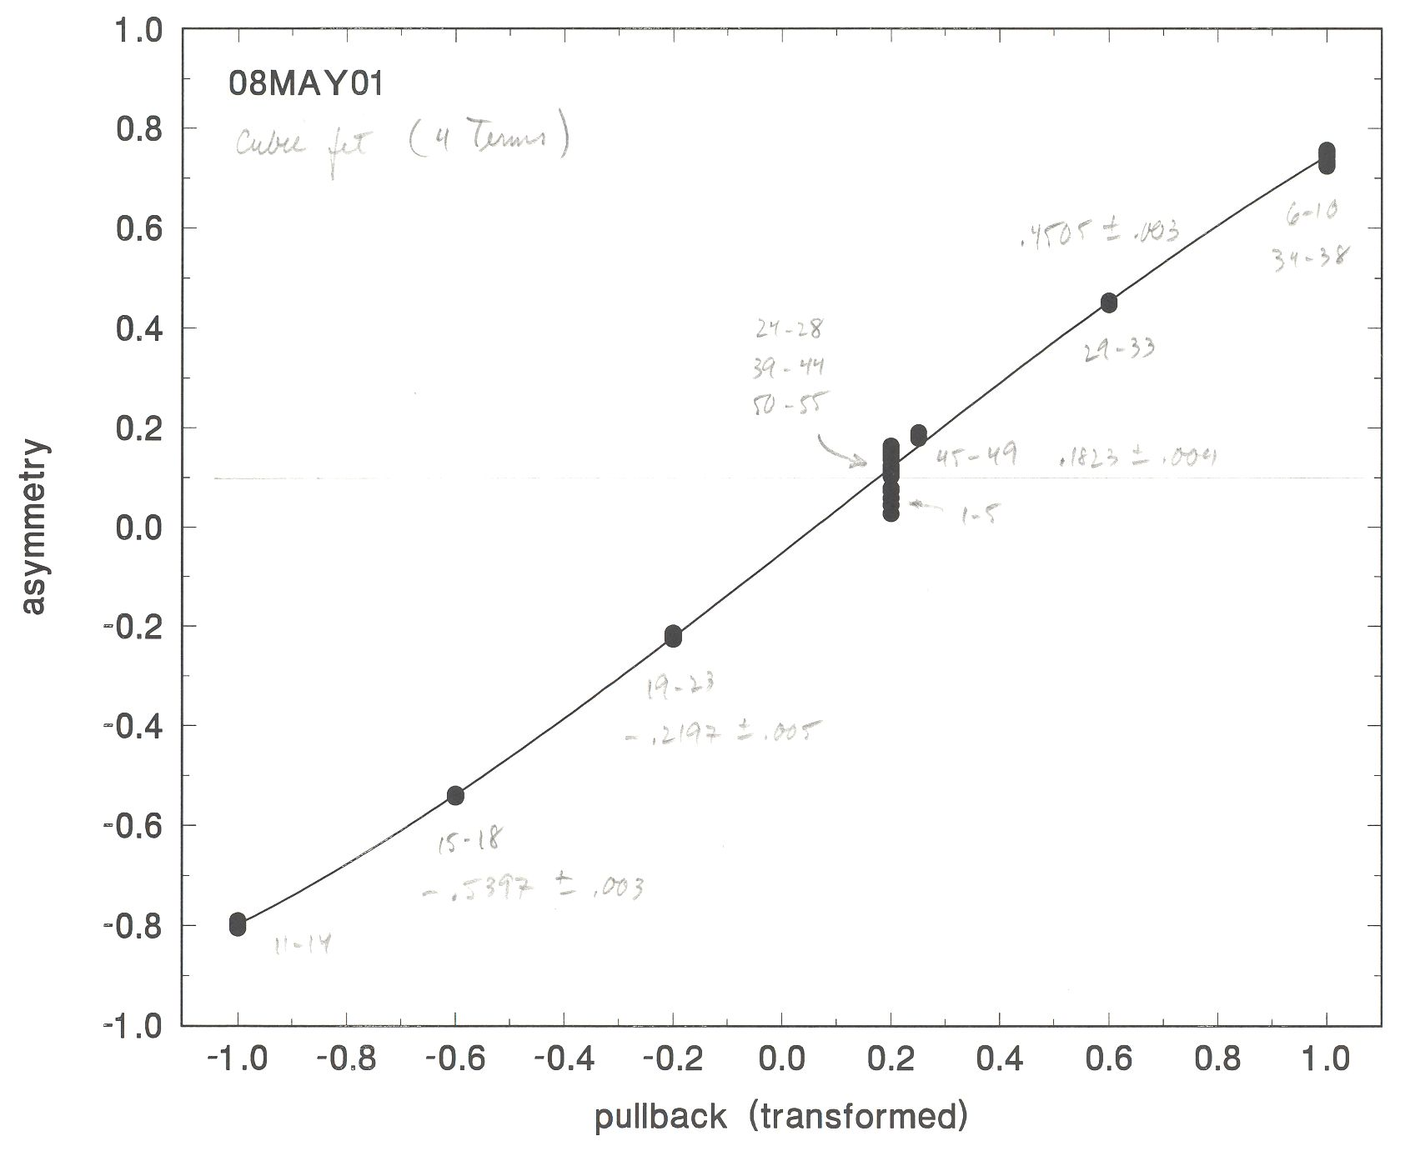
Charge Division Chamber (continued)
Electrostatic analysis predicts that the induced charge asymmetry (Q₂-Q₁)/(Q₂+Q₁) should be proportional to range and it is, until the charge begins to overlap the plates. The poor repeatability at 0.2 is just initial settling down. These results suggest that an insulating-plate MLFC might have better range resolution for the same granularity.

Slide 21
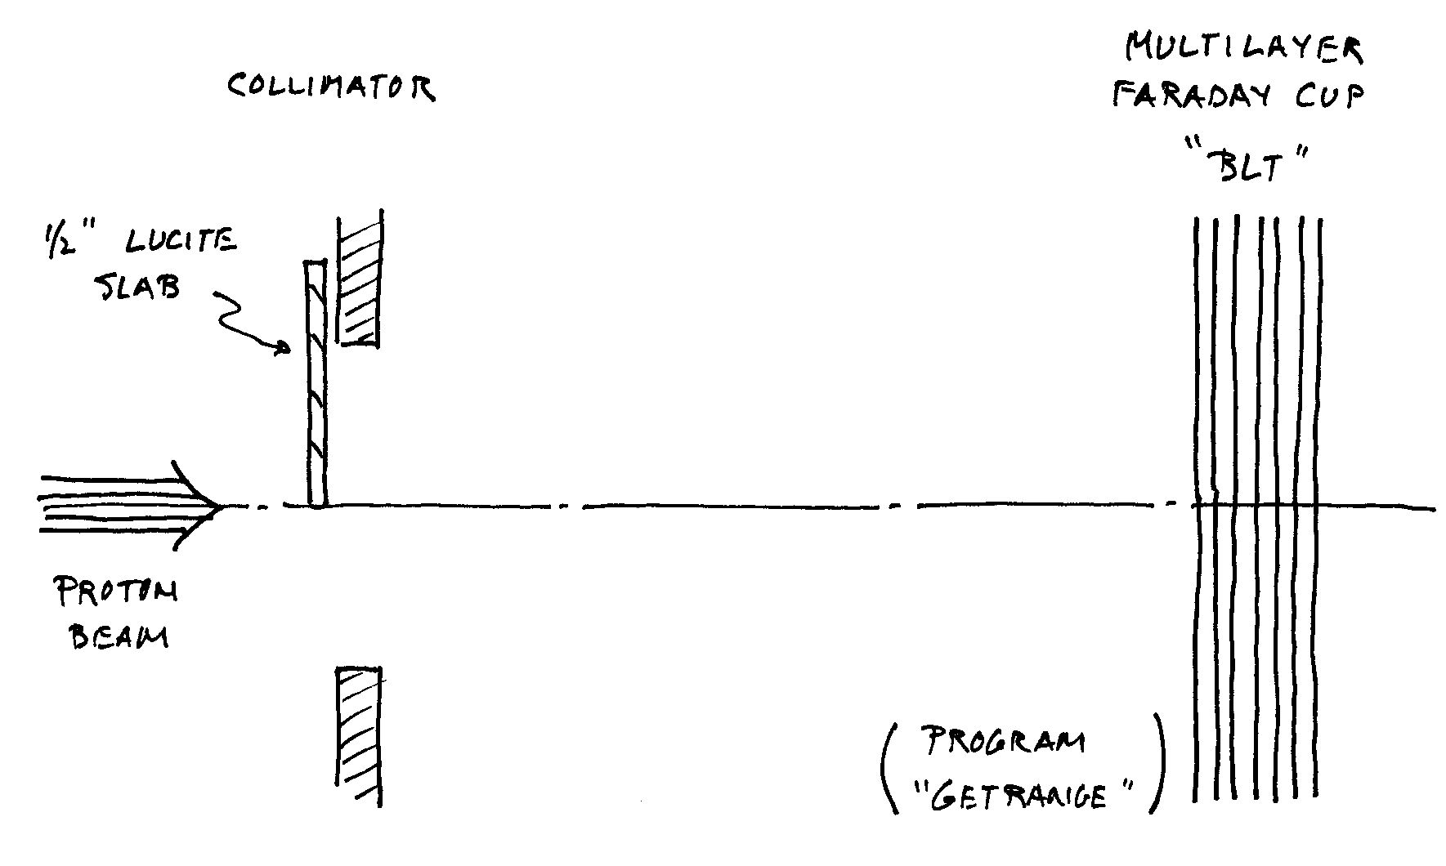
MLFC as a Beam Alignment Tool
Accurate alignment of a mechanical track with the proton beam centroid is a very common experimental problem. Film or a diode cross is the first step, but this technique can improve accuracy. A MLFC anywhere downstream will tell you whether the edge of the Lucite degrader is moving accurately down the beam line.

Slide 22
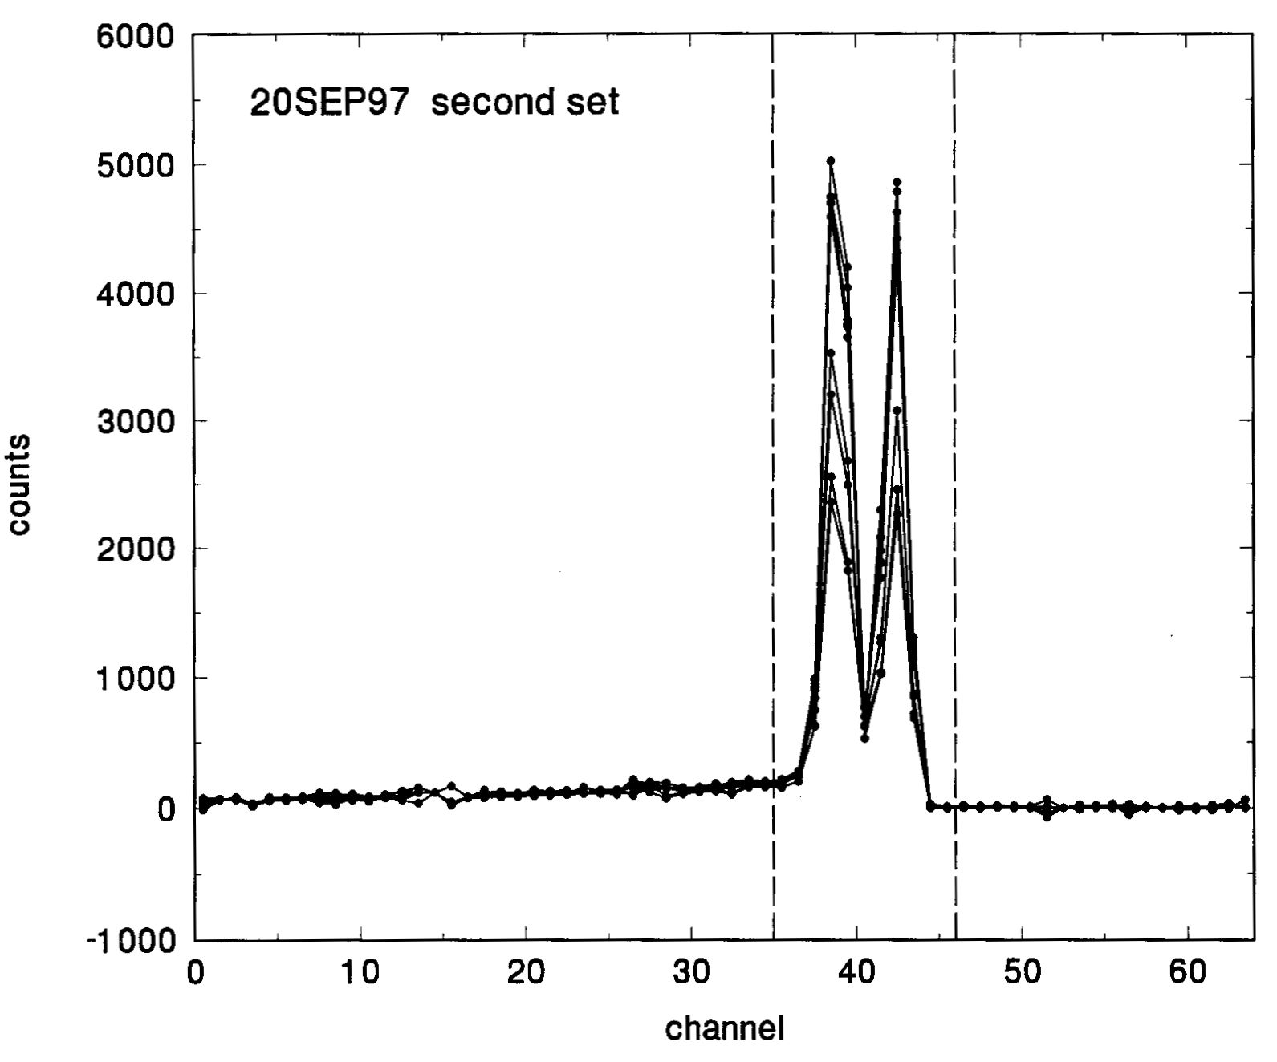
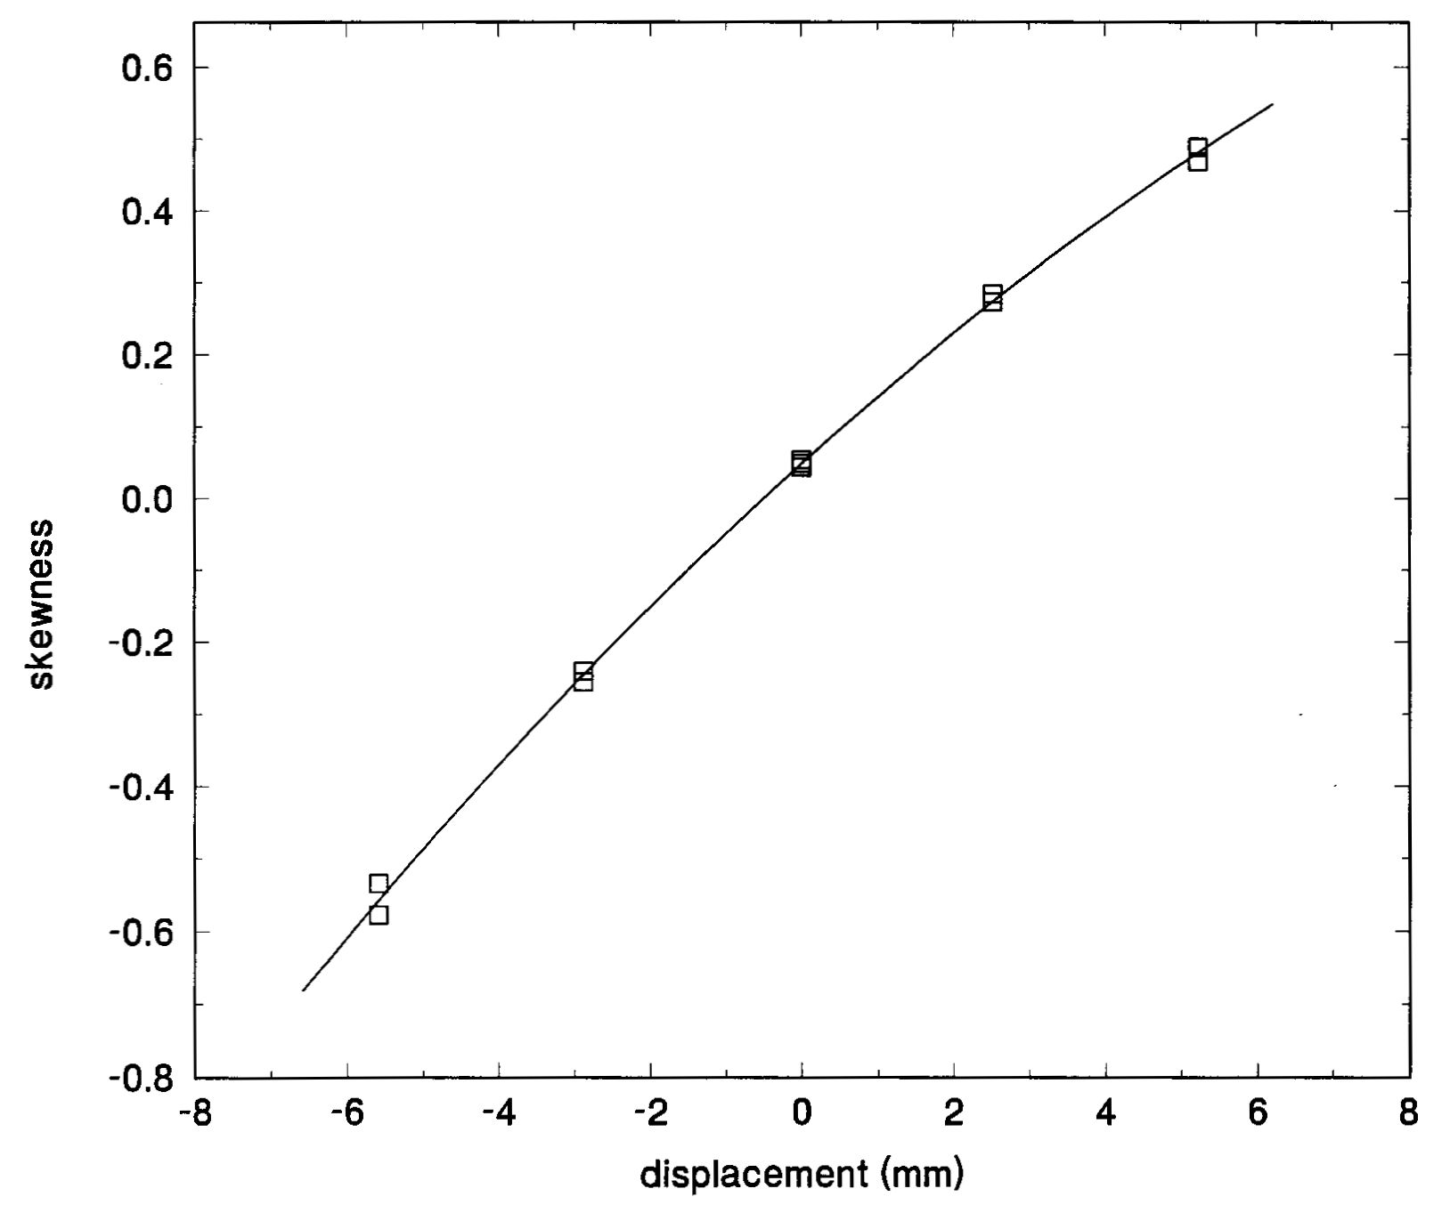
Beam Alignment (continued)
Two peaks are detected and the signal sharing between them is a measure of the centering of the edge. In this experiment a bending magnet was changed slightly to deflect the beam. Movement of charge from one peak to the other can be analyzed various ways. The right-hand graph shows the change in skewness of the two peaks (considered as one) vs. beam displacement. Sub-millimeter displacements of the centroid can be resolved easily.

Slide 23
Design and Construction Tips
Unlike the MLIC, with its complicated series of tradeoffs, the MLFC is basically simple. The main challenge is connecting to the plates, which are close together. The solution for the copper MLFC was shown. The CH₂ MLFC plates were connected by soldering square pins to the thin brass collector plates and cutting grooves into the CH₂ to clear them. Connecting may take some ingenuity but is not fundamentally difficult.
There is no need to make the insulating sheets as thin as possible. Protons stopping in them will be counted anyway. The insulator can be at least 0.002″ thick to eliminate plate-to-plate shorts. Avoid excessive force during assembly because extreme pressure will cause spurious currents. Remember to provide a way to ground all plates temporarily.
MLFC’s can be designed to use only part of the beam, as we have seen with the IBA 4-jaw collimator. As another example, the Burr Center single scattered STAR beam has an MLFC with a hole to transmit the central part of the beam while using the outer part to monitor the range. Clearly, protons should not stop anywhere in the device except the signal plates. For instance, connections must be shielded from stopping protons.

Slide 24
Summary
We have studied a few MLFC’s . They are easy to build for specific applications. The main problem at present is the lack of an appropriate commercial current integrator array.
The range of a monoenergetic beam can be found very accurately by a simple two stage computation even when the peak only extends over 3 to 4 plates. In that case, of course, the energy (or range) spread is measured very badly. A much finer grained MLFC can be used to measure beam energy spread and details of the beam energy distribution (information courtesy Niek Schreuder).
Though the MLFC is most commonly used as a range verifier (RV), we have shown some other applications: beam contamination, beam alignment, testing Monte Carlo models of nuclear interactions.
The MLFC is a simple and rugged device which permits accurate and very fast range verification at normal proton radiotherapy currents.

