Slide 1
Introduction
The cubic spline is a standard mathematical function commonly used to interpolate a data set. (The spline is a pre-CAD draftsman’s tool which can be bent into a smooth shape and subsequently holds that shape.) This lecture breaks our policy of not covering merely mathematical topics because we plan to use the cubic spline in a number of ways, many not found in standard textbooks:
1. As an interpolating function (the normal use) in RANGE;
2. As a fitting function for pristine Bragg peaks (BPW);
3. As a fitting function for data sets with corners (FitDD);
4. As an adjustable smooth curve (contoured scatterer, NEU).
We will describe each of these applications in turn, beginning with a reminder of the difference between interpolation and fitting. We will not explain how to compute the polynomial coefficients that define a given cubic spline. For that, we refer the student to Numerical Recipes.

Slide 2
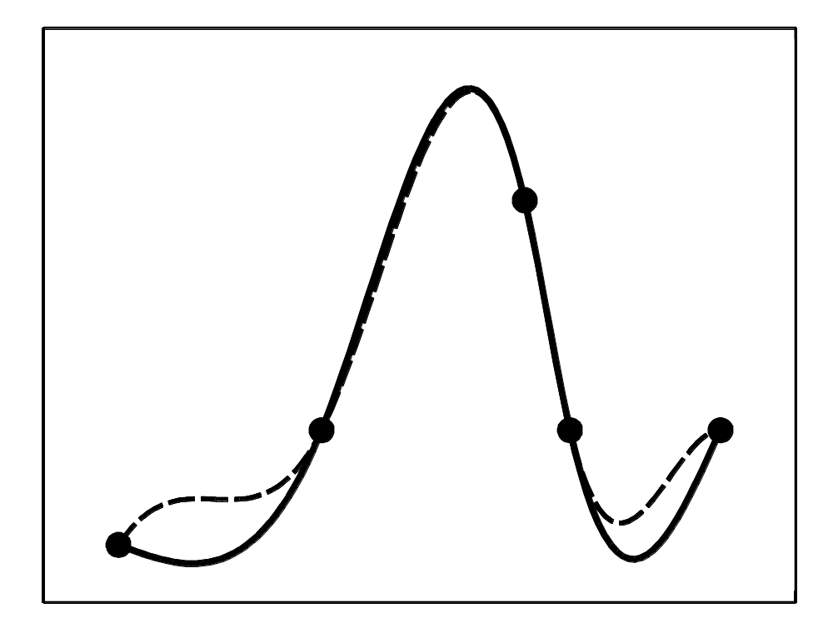
y = a + bx + cx² + dx³
In this example, five arbitrary points (defining four intervals) are joined by a cubic spline. In each interval the four coefficients a...d are different. Their 16 values are fixed by requiring that the curve pass through the points and that its slope be continuous at each point (no ‘corners’). At each endpoint we must therefore either specify the first derivative (dashed line) or require that the second derivative be zero (‘natural’ cubic spline, full line).

Slide 3
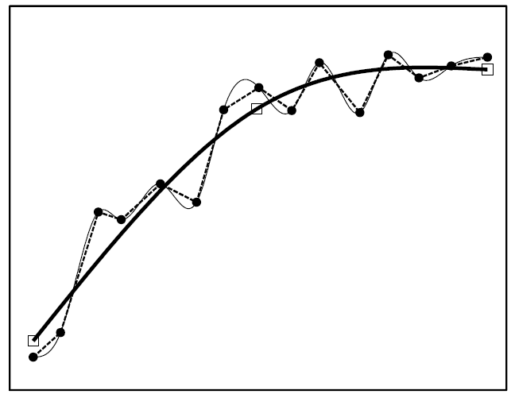
Interpolation vs. Fitting
The solid circles are input data, intentionally noisy. The linear and cubic spline interpolation lines pass through all the given points (illustrating a weakness of spline interpolation). The bold line, however, is a cubic spline fit obtained by adjusting the three points shown as hollow squares for least-squares deviation of the bold line interpolating them (with a cubic spline) from the data points. You will argue (correctly) that a low-order polynomial would do just as well here, but we will soon see cases where any single polynomial ― even high order ― fails of a good fit.

Slide 4
SPLINE.FOR Implementation
This differs slightly from Numerical Recipes’ version. InitSpline sets up scratch array s (second derivatives) to go along with given arrays x and y. InitSpline does a fair amount of computation and should be invoked only when the x, y table changes.
DIMENSION x(n),y(n),s(n)
DATA yp1,ypn/0.,1.E30/
...
i = InitSpline(n,x,y,s,yp1,ypn,xx,klo,khi)
...
ya = Spline(n,x,y,s,yp1,ypn,xa,klo,khi)
yb = Spline(n,x,y,s,yp1,ypn,xb,klo,khi)
yp1 and ypn as given yield y′ = 0 at one end and y″ = 0 (‘natural’ boundary) at the other (the non-physical value 1.E30 serving as a code here). The next line sets ya to the value of the spline at an arbitrary xa and so forth.
One virtue of the cubic spline as a fitting function is that it extrapolates reasonably well just outside the defined region whereas high order polynomials tend to go berserk there.

Slide 5
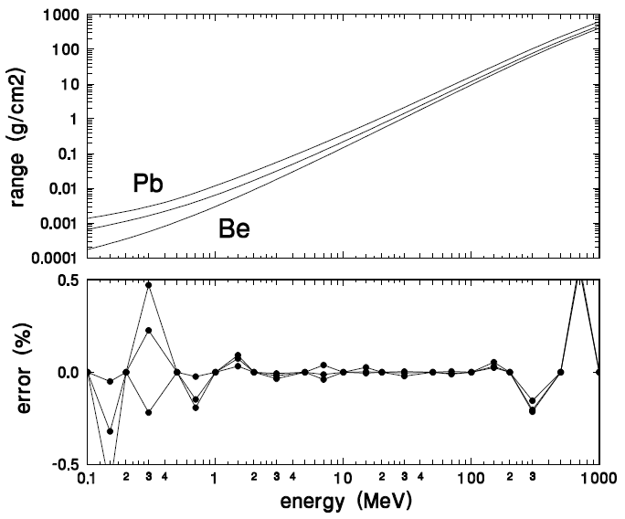
Example: Cubic Spline Interpolation (RANGE)
We express the range-energy relation in any given material by cubic spline interpolation of log(R) as a function of log(T), equivalent to using a variable power law. Only 13 values need be entered from 0.1 to 1000 MeV and, as the lower panel shows, the accuracy is ~0.1% from 3 to 300 MeV.

Slide 6
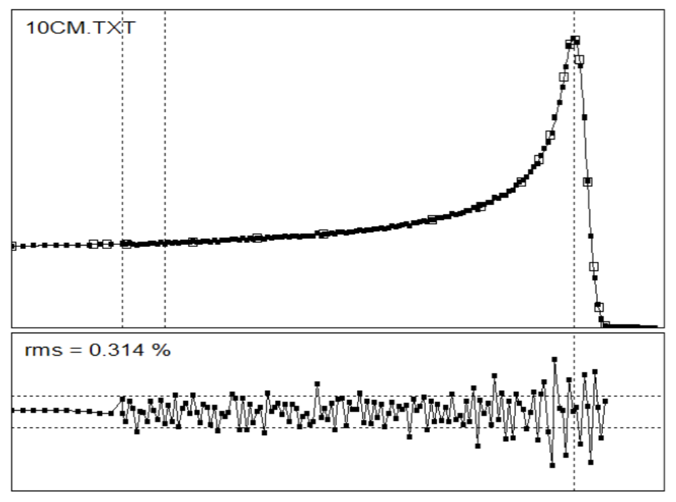
Example: Cubic Spline Fit (BPW)
Bragg peaks are described by a cubic spline fit to measured data (BPW). The adjustable points are the hollow squares. The lower panel shows the accuracy of the fit. The left end (not measured because of wall thickness) is a guess obtained by linear extrapolation. Bragg peaks are extremely hard to fit with polynomials!

Slide 7
BPW Standard Output File
Once the measured Bragg peak has been fit, the fit parameters (namely the hollow squares of the previous slide) can be output in a standard form. In this example only 20 output points are used to characterize 152 raw data points. The distilled version is actually better for most purposes because experimental noise has been averaged out.
put a comment here ...
249.0 cm from source to Bragg peak
20 0.10000E+31 0.10000E+31 # pts, yp1, ypn
0.0000 2.1855 2.7645 3.1580 5.1416 6.8809 8.7197 cm H2O
11.8539 13.2038 14.3375 14.8641 15.1743 15.5595 15.7307
15.8623 15.9955 16.2209 16.3838 16.5357 16.7100
0.2824 0.2860 0.2870 0.2878 0.2954 0.3072 0.3217 rel dose
0.3732 0.4204 0.5041 0.5818 0.6669 0.8650 0.9784
0.9948 0.9272 0.5038 0.2085 0.0663 0.0065
The application using this file must be able to correct the Bragg peak to a standard condition ― the depth-dose that would have been measured under the same circumstances with an infinite source distance ― because the source distance at ‘application time’ will usually not be the same as it was at ‘Bragg measurement time’. To do this, the application needs to know the effective source distance at Bragg measurement time.

Slide 8
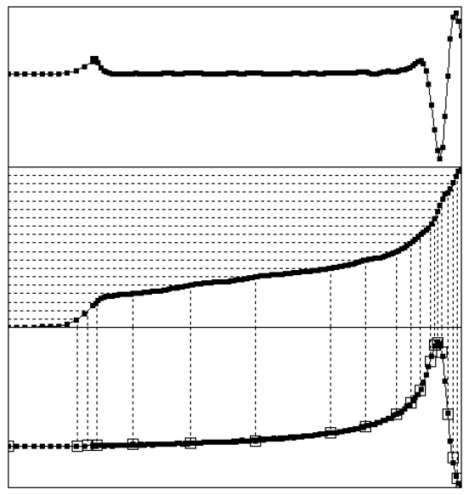
Choosing Initial Points for the Spline Fit
smoothed 2nd derivative
density function
function to be fit
The hardest part of spline fitting is picking initial points. We don’t want uniform spacing, because if we have enough points in the curvy parts we’ll have far too many in the straight parts and the fit will start chasing noise. We project equally spaced points onto a density function which varies most rapidly where the absolute second derivative is greatest. See the FitDD User Guide for details.

Slide 9
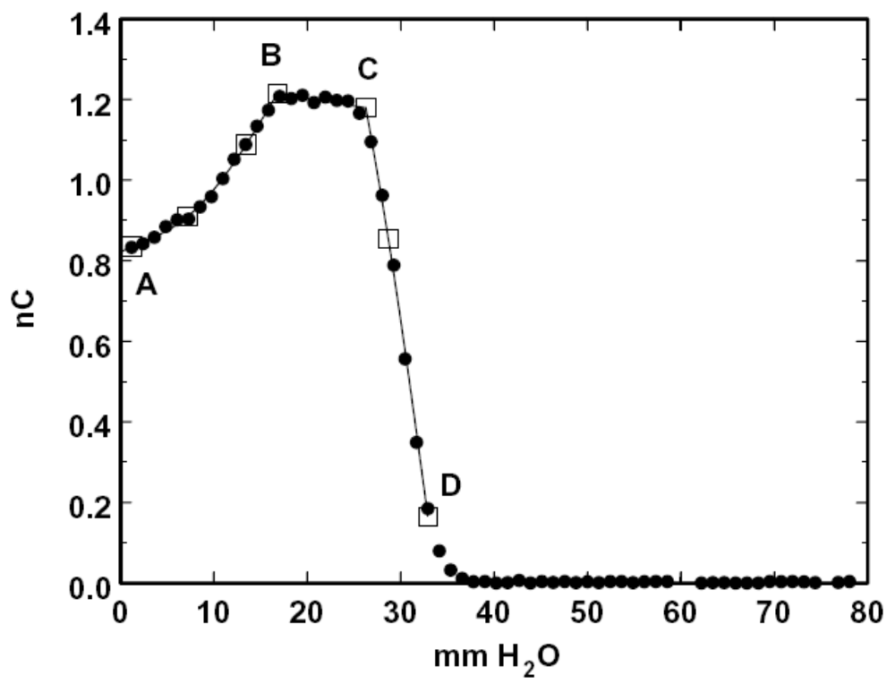
The ‘Broken Spline’ Fit
A broken spline is a set of N connected natural cubic splines, single valued and continuous with a continuous first derivative except at the joints or ‘corners’. During optimization the initial break points migrate to the true corners of the data set. This identifies points such as B and C facilitating subsequent computation of such things as the 100% dose level and d₈₀. As the example shows, a natural cubic spline through 2 points (B and C) is a straight line. See the User Guide to FitDD for details.

Slide 10
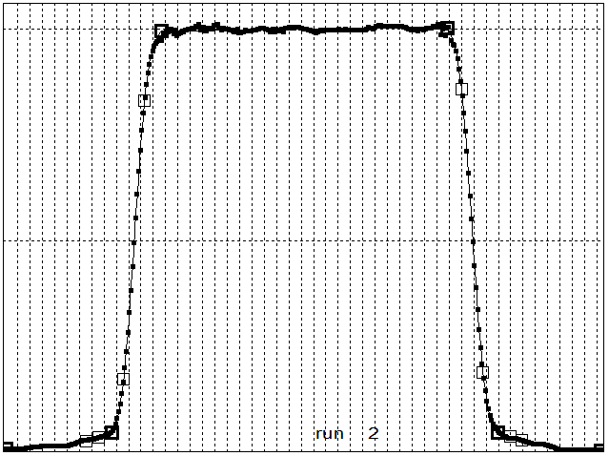
A 5-segment broken spline used to fit a transverse scan. The fitting process itself finds the four corners (bold squares). That in turn makes it easy to define the 100% dose level or the maximum dose yPeak and its position xPeak. Subsequently, the simple statement
xL90 = Rtfp (BSfunc, x1, xPeak, 0.9*d100, kErr)
serves to find the left-hand 90% point (by the method of False Position) because BSfunc is a single continuous function valid over the entire transverse range.

Slide 11
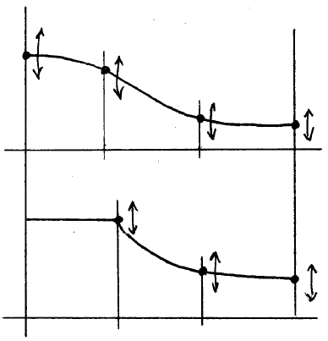
The Cubic Spline as an Adjustable Smooth Curve
The cubic spline is a handy universal adjustable smooth curve. Here it is used to represent what will be, after optimization of the y’s, the generic recipe for a contoured scatterer. The lower curve is a parametrization of the Siebers variant of the contoured scatterer. Contoured scatterers are not Gaussian in profile! Alternative parametrizations of the profile are possible: for instance, the Uppsala group uses a 9-segment distorted cosine curve.

Slide 12
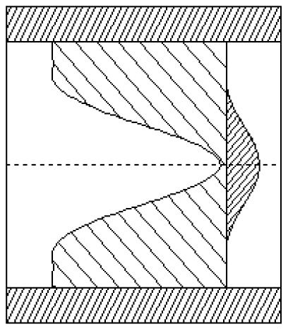
A Compensated Contoured Second Scatterer
And here is the end product (to scale, thickness exaggerated). The profiles of both the lead dome and the energy-compensating plastic plate are cubic splines in thickness v. radius. For accuracy in compensation, far more points are used here than were used in the definition and optimization of the generic shape.

Slide 13
Summary
The cubic spline is a smooth function defined by the set of points through which it passes plus a derivative condition at each end. In each interval it is a cubic polynomial. Numerical Recipes explains how to find the polynomial coefficients. Our routines InitSPLINE and SPLINE are implementations of their method.
We use the cubic spline four ways:
1. As an interpolating function (RANGE);
2. As a fitting function, especially for Bragg peaks (BPW);
3. In a ‘broken spline’ version, as a fitting function (FitDD);
4. As a universal adjustable smooth curve (contoured scatterer, NEU).
The last three uses are uncommon. The cubic spline can have a complicated shape even in a single interval and therefore permits an excellent model independent fit to many kinds of data. A natural cubic spline between only two points degenerates to a straight line, another useful property. Unlike high order polynomials, the cubic spline can be made to extrapolate gracefully.

