Slide 1
Techniques
of
Proton Radiotherapy
Bernard Gottschalk
Harvard University
bgottsch@fas.harvard.edu

Slide 2
Harvard University,
the
Physics Department,
and the
Lab for Particle Physics and Cosmology
(LPPC)
made this course possible by their support.

Slide 3
Double Scattering
Double scattering wastes less energy and fewer protons than single scattering. It is used for large fields or maximum penetration. We’ll survey various techniques, emphasizing the compensated contoured scatterer.
We’ll outline design and compensation methods, using projection, scaling, and the idea of a universal or generic shape. Although some pretty good shapes are known (45% efficiency), global optimization is still elusive and better shapes may exist.
Double scattering is sensitive to beam centering at the second scatterer S2. Active steering (feedback) is usually needed. On the other hand, it is relatively insensitive to beam emittance (shape and divergence) and small problems can usually be corrected by adjusting S1.

Slide 4
Outline
methods: annulus, dual ring, contoured
design procedure: projection, scaling, useful radius
de-scaling: converting back to physical quantities
optimizing the generic shape
beam steering: skewness and all that
summary

Slide 5
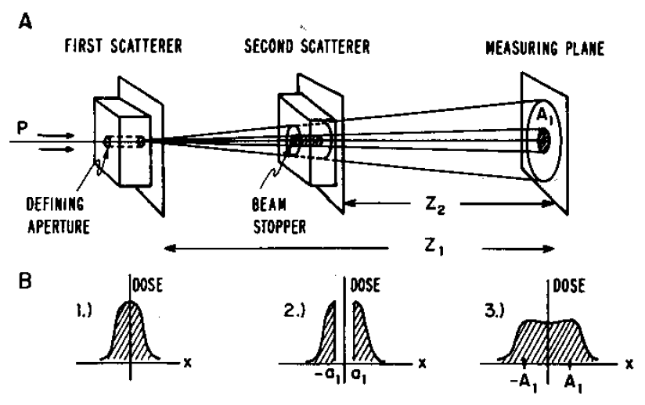
Occluding Ring (Annulus) Method
The first double scattering system was described by Koehler, Schneider and Sisterson (Med. Phys. 4 (1977) 297-301). S2 consists of a beam stopper or ‘occluding ring’ in front of a uniform scatterer. They also described using a rotating permanent magnet for S1 with a uniform S2, but attributed the first use of magnetic pencil beam scanning to Uppsala: ‘highly efficient, if complex’. The method can be generalized to more occluding rings.

Slide 6
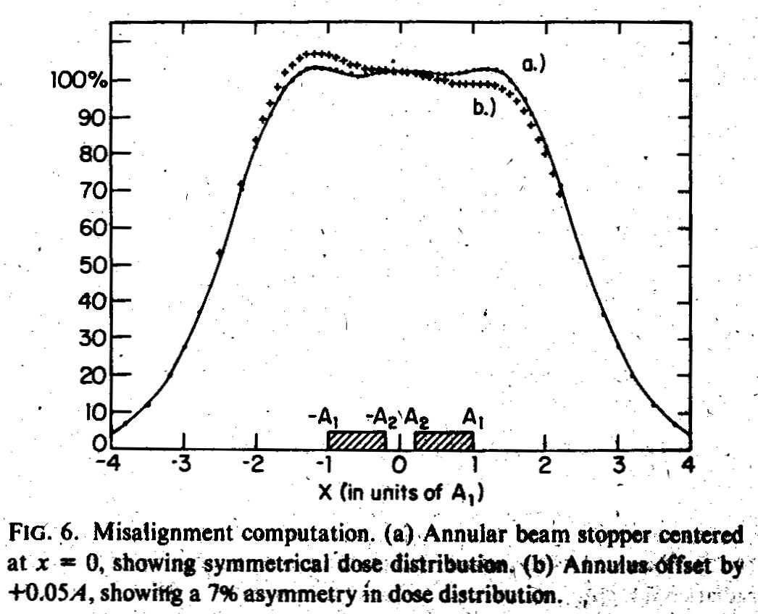
Sensitivity to Beam Mis-Steering on S2
The annulus method shares with all double-scattering methods a sensitivity to beam mis-steering on S2, which causes the Gaussian there to be off center causing a tilted (not displaced!) dose distribution downstream. It is the centering of the projected beam at S2 that matters. An angle error at S2 merely displaces the ‘good’ field by a small amount at isocenter.

Slide 7
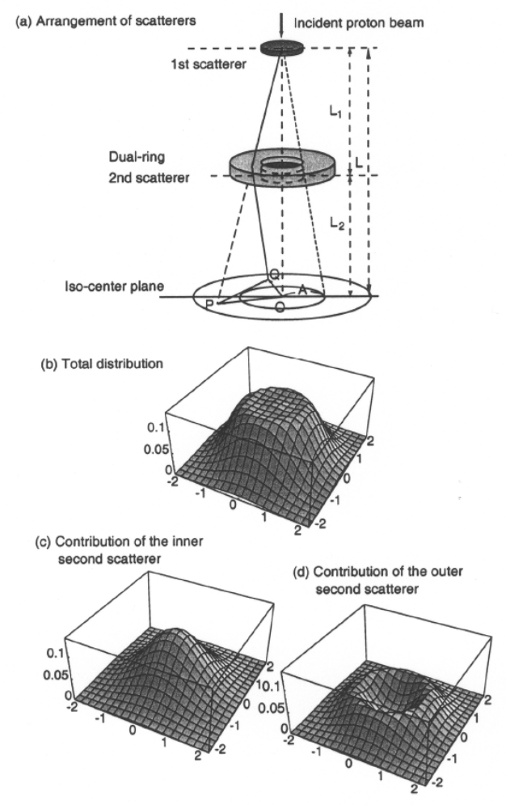
Takada’s Dual-Ring System
Takada (Japan J. Appl. Phys. 33 (1994) 353-359) described a dual-ring system. The inner ring is of material that scatters more strongly. The outer one has less scattering but the same energy loss. Sensitivity to beam problems was studied in a later paper. This method, which can be generalized to more rings, can be regarded as a two step discretization of the compensated contoured scatterer to be described next.

Slide 8
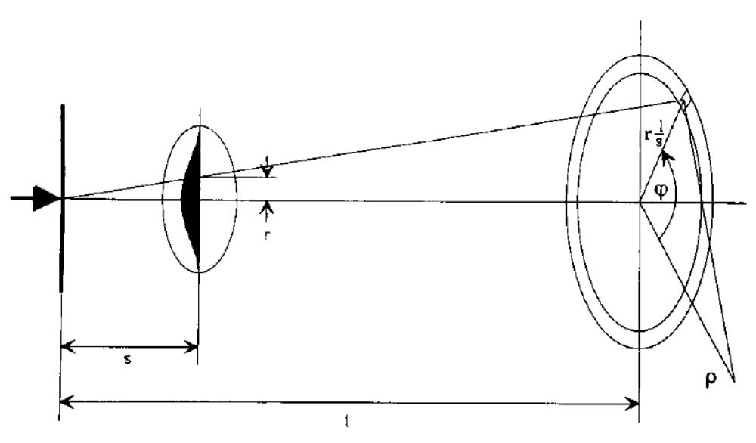
Contoured Scatterer
The contoured scatterer was invented independently at Uppsala and HCL around 1988 and a detailed design procedure was published later (Grusell et al. Phys. Med. Biol. 39 (1994) 2201-2216). S1 forms a Gaussian on S2, which is shaped so that the central part scatters more strongly. The shape can be optimized so the dose distribution in the measuring plane is exactly flat out to some ‘design radius’. Of course, central protons lose more energy, which must be compensated by a complementary plate of plastic.

Slide 9
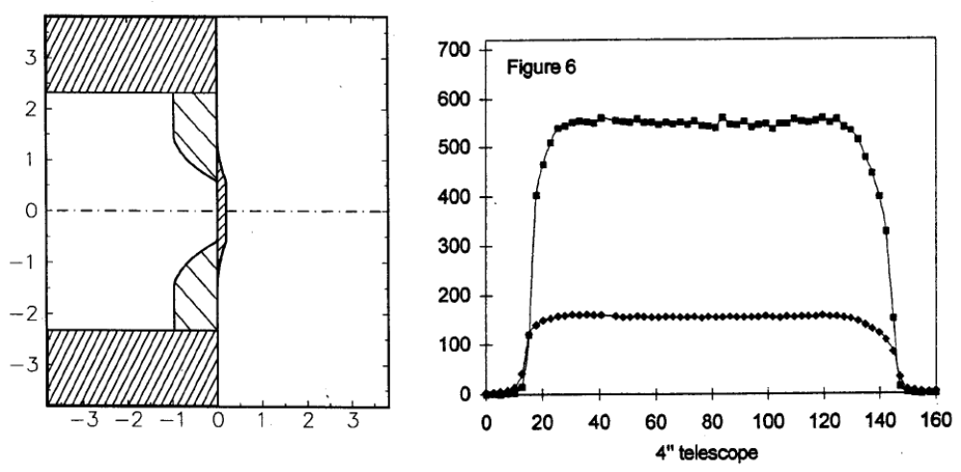
The Siebers Profile
This profile (J.V. Siebers and D.W. Miller, AAPM Annual Meeting (1992) abstract V5) shows that the contour need not be bell-shaped. Flattening it yields a slightly smaller energy loss. This scatterer from the HCL neurosurgery beam is now used in the Burr Center ‘outside user’ beam. Note the resemblance to the Takada dual-ring scheme.

Slide 10
Outline
methods: annulus, dual ring, contoured
design procedure: projection, scaling, useful radius
de-scaling: converting back to physical quantities
optimizing the generic shape
beam steering: skewness and all that
summary

Slide 11
Designing a Contoured Scatterer
Today, the compensated contoured scatterer is the preferred technique for passive beam spreading.
The Uppsala report (Grusell et al.) reads quite differently from the method we will describe but the differences are superficial. The same basic techniques are used: projection onto the measuring plane; their ‘universal radial profile’ which is our ‘generic solution’; scaling (though the choice of scaling variable is different). Grusell’s universal profile is a nine-step deformed cosine whereas ours is a cubic spline.
A major difference is that Grusell’s derivation cites generalized Fermi-Eyges theory whereas ours is based directly on the Preston and Koehler construction. Even here, the difference is more one of style and derivation. The final computations are quite similar.

Slide 12
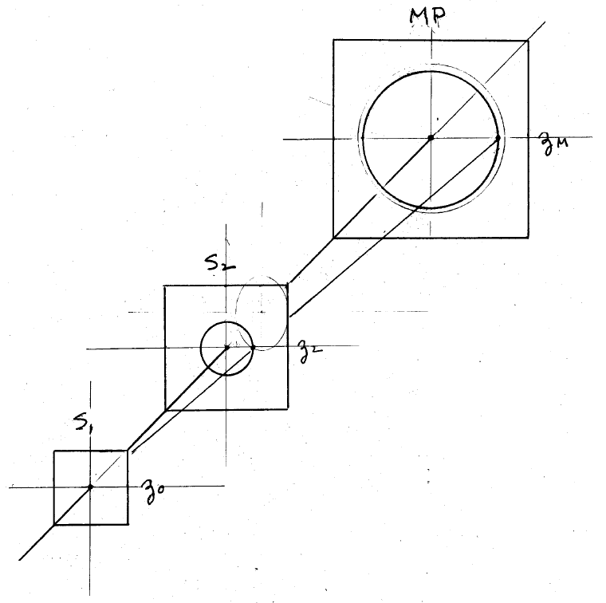
Beam Line Geometry
If nothing else, pictures like this are hard to draw (maybe easier now with Google SketchUp). Therefore, following Preston and Koehler, we’ll focus on the projection of the double scattering event on a ‘measuring plane’ (MP), which can be anywhere along the beam line.

Slide 13
Double Scattering in Projection
S
v
u
q
P
r
t
0
R
t is the displacement vector of the beam (0 for now). u is the projected first scatter and q the projected radius at which the proton hits S2. v is the second scatter which takes the proton to radius r in the MP. R is the maximum radius of the contoured scatterer (collimator radius) projected onto the MP. All quantities of interest in the MP are distances.

Slide 14
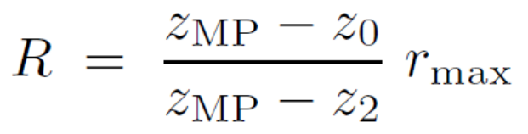
Double Scattering Formalism
Projected first and second scatters u, v and their characteristic (rms) values u₀, v₀ in the measuring plane at z_{m} are related to the corresponding angles via the geometry (distances) of the nozzle :
Projected radii are related to radii at S2 by a magnification factor as though projected by a point light source at z₀ :
The fluence/proton at the field point is a double integral. f is either the Gaussian or the Molière 2D probability density :

Slide 15
Scaling
So far we have discussed projection. To flatten the dose, we need to find some dependence of scattering on projected radius v₀(q) that will render Φ(r) constant out to some design radius. Suppose this has been done. It is obvious from the form of the integral that an optimum solution will remain optimum if all quantities in the MP are multiplied by the same constant. That is equivalent to saying that any one quantity can be taken as unity and the others scaled accordingly.
We choose for this quantity the design radius and define the corresponding solution as the generic solution. In other words the generic solution is any optimum solution for a design radius of 1 cm. Therefore all projected quantities in the generic solution are distances of the order of 1 cm, since either much larger or much smaller distances yield tiny scattering probabilities.
All authors use scaling in one form or another, but they differ in their choice of the magic variable.

Slide 16
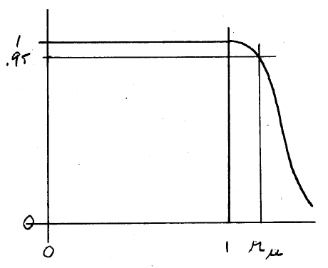
The Useful Radius
We need to define one more scaled quantity in the MP. If optimization succeeds, we will have a dose which is perfectly constant out to 1 cm. However, there is usually a finite tolerance for dose uniformity which means that the dose is acceptable out to a larger scaled radius, say 1.3 cm, which we call the useful radius. It varies from one design to another and must be found numerically.
If we have somehow found a generic solution and its useful radius, we can adapt it to any reasonable real-world situation by ‘unscaling’ it. Any efficient beam line design program works that way.

Slide 17
Outline
methods: annulus, dual ring, contoured
design procedure: projection, scaling, useful radius
de-scaling: converting back to physical quantities
optimizing the generic shape
beam steering: skewness and all that
summary

Slide 18
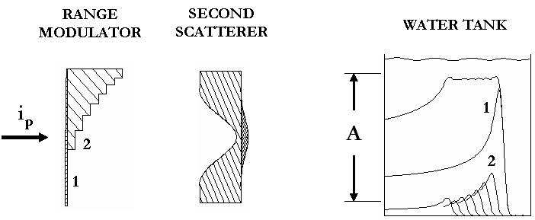
Model System for the Next Slide
Assume we have a satisfactory generic double scattering solution, and that we have actual positions for S1 and S2 relative to the patient. The problem is to find the actual thicknesses of Pb and plastic to realize that solution, if possible.

Slide 19
Back to the Real World
Given a generic solution, energy in, actual distances and a desired SOBP (depth and modulation), design a physical modulator and contoured scatterer.
Multiply all generic quantities by (radius desired/generic useful radius)
Assuming a reasonable z₀, covert the new u₀ and v₀ back to angles by multiplying by the appropriate distance. Convert new r_{i} to radii at S2 by multiplying by the magnification factor. Let j =1 (first mod step).
From depth of penetration for that modulator step, find T into the water tank (out of S2).
If j = 1 : find the thickness of lead at center required for that output energy and the desired scattering at center. Then find lead and Lexan at each radius to r_{max} for desired scattering at that radius and same energy loss as center. S2 is designed. Now (any j) compute energy loss in S2.
Knowing energy in and out of S1 as well as the desired scattering angle. Solve the binary degrader problem to find Pb and Lexan. S1_{j} is designed.
Unless this is the last mod step, increment j and go to 3.
Iterate the whole computation over z₀ (converges quickly).

Slide 20
Outline
methods: annulus, dual ring, contoured
design procedure: projection, scaling, useful radius
de-scaling: converting back to physical quantities
optimizing the generic shape
beam steering: skewness and all that
summary

Slide 21
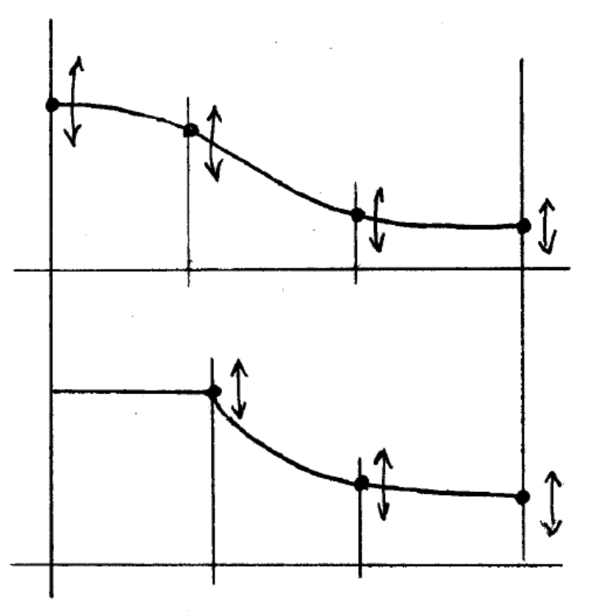
Optimization
First we need to choose a functional form for the scattering profile that we wish to optimize. We use a cubic spline at fixed radii: only the y values are adjusted during optimization. This form can describe either a bell-shaped function (top) or the Siebers variant (bottom).
The program reads starting values for the spline from the input file. If instructed to optimize, it uses either a grid search or the Marquardt algorithm (see Numerical Recipes).

Slide 22
Optimization Goals
Comprehensive optimization would consider at least 5 goals:
dose uniformity: fluence constant out to some radius
efficiency: fluence within useful radius as large as possible
energy loss: total thickness of scatterers as small as possible
compensation: generic solution can be energy compensated
practicality: the physical scatterer is easy to fabricate
Present day techniques (including NEU) only guarantee #1 and even that depends on starting conditions. Other goals must be attained ‘by hand’. For #4, we need a generic solution with max/min ≤ 4/1. Our best generic solution so far (next slide) has 45% efficiency.
Placement of S2 is another variable. Too far upstream: hard to fabricate and sensitive to beam. Too far downstream: larger energy loss, transverse penumbra and unwanted neutron dose to the patient..

Slide 23
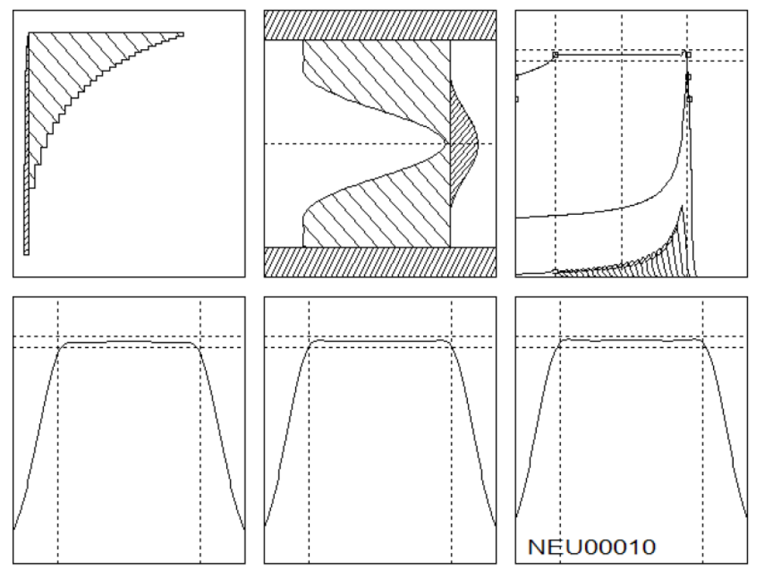
Our Personal Best
A physical scatterer derived from one of our best generic solutions (parameters given in NEU User Guide). Efficiency is 45%, energy loss the lowest we have found so far, but better profiles may exist.

Slide 24
Outline
methods: annulus, dual ring, contoured
design procedure: projection, scaling, useful radius
de-scaling: converting back to physical quantities
optimizing the generic shape
beam steering: skewness and all that
summary

Slide 25
Active Beam Steering
We noted that dose flatness in double scattering is very sensitive to the centering on S2 of the Gaussian from S1. In other words, the beam centroid after scattering in S1 must project to the center of S2. The beam direction at S2 matters much less.
In a gantry it is impractical to reduce mechanical and magnetic errors to the required level. In addition, magnets may drift slightly with time. Therefore active beam steering is needed and the feedback loop should remain active during irradiation.
The error signal is obtained from a large segmented IC. At HCL this IC was near the patient where the transverse dose was already flat, so the measured slope of the flat part of the distribution (ideally 0) was used directly. In the IBA gantry (Burr Center) the IC is near S2 where the dose is not yet flat, so an indirect method is required.

Slide 26
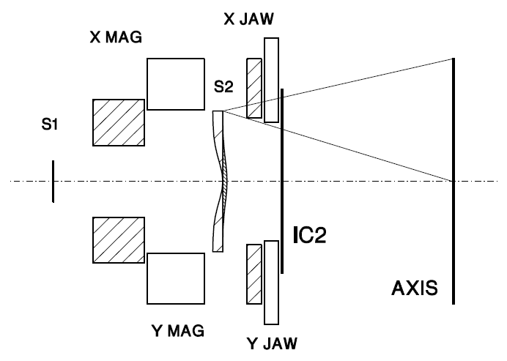
IBA Nozzle Layout
Roughly to scale but transverse dimensions ×10 . IC2 has 32 strips in x and y which measure projected transverse dose fairly close to S2. Before the nozzle was built we did a Monte Carlo study of beam steering possibilities.

Slide 27
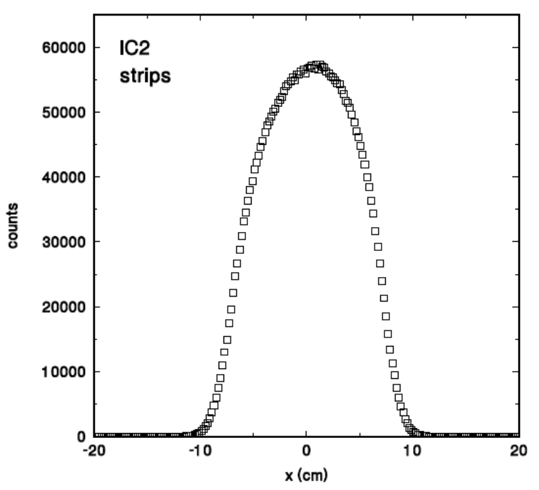
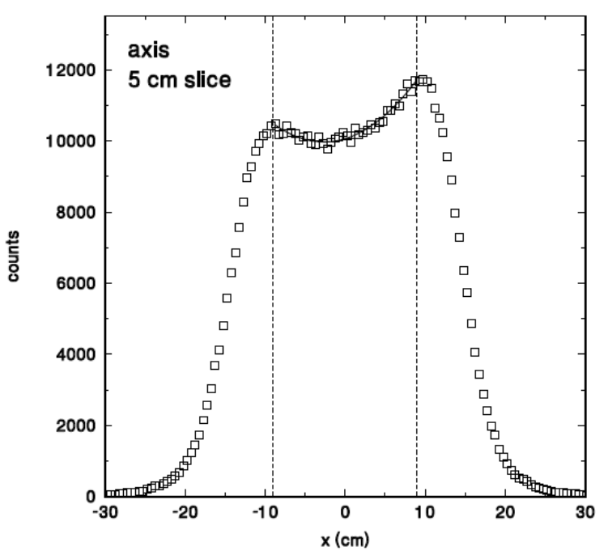
Error Signal
(right) Transverse dose at the patient with a deliberate steering error of just 1 mm at S2, resulting in the overall tilt. At the same time S1 is 20% too strong resulting in the ‘dished’ appearance which we quantify as curv.
(left) Transverse dose at the monitor IC. There is an obvious asymmetry as well as a slight distortion in the curvature. Statistical analysis of this distribution shows its skewness is proportional to tilt and kurtosis is proportional to curv.

Slide 28
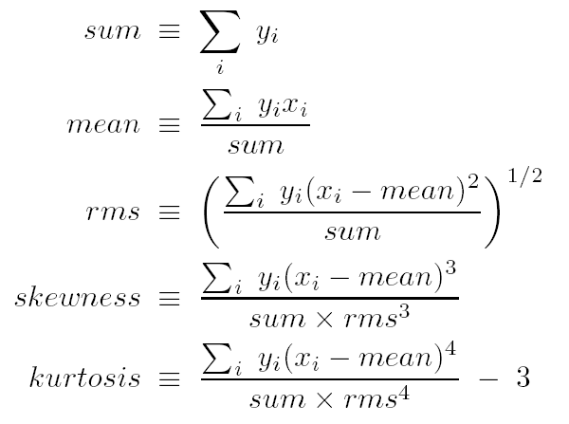
Moments of a Distribution
In case you forgot about skewness and kurtosis , here are the first five moments of a distribution as conventionally defined. Crucially rms, skewness and kurtosis are defined relative to the mean so the IC’s transverse position is relatively unimportant.

Slide 29
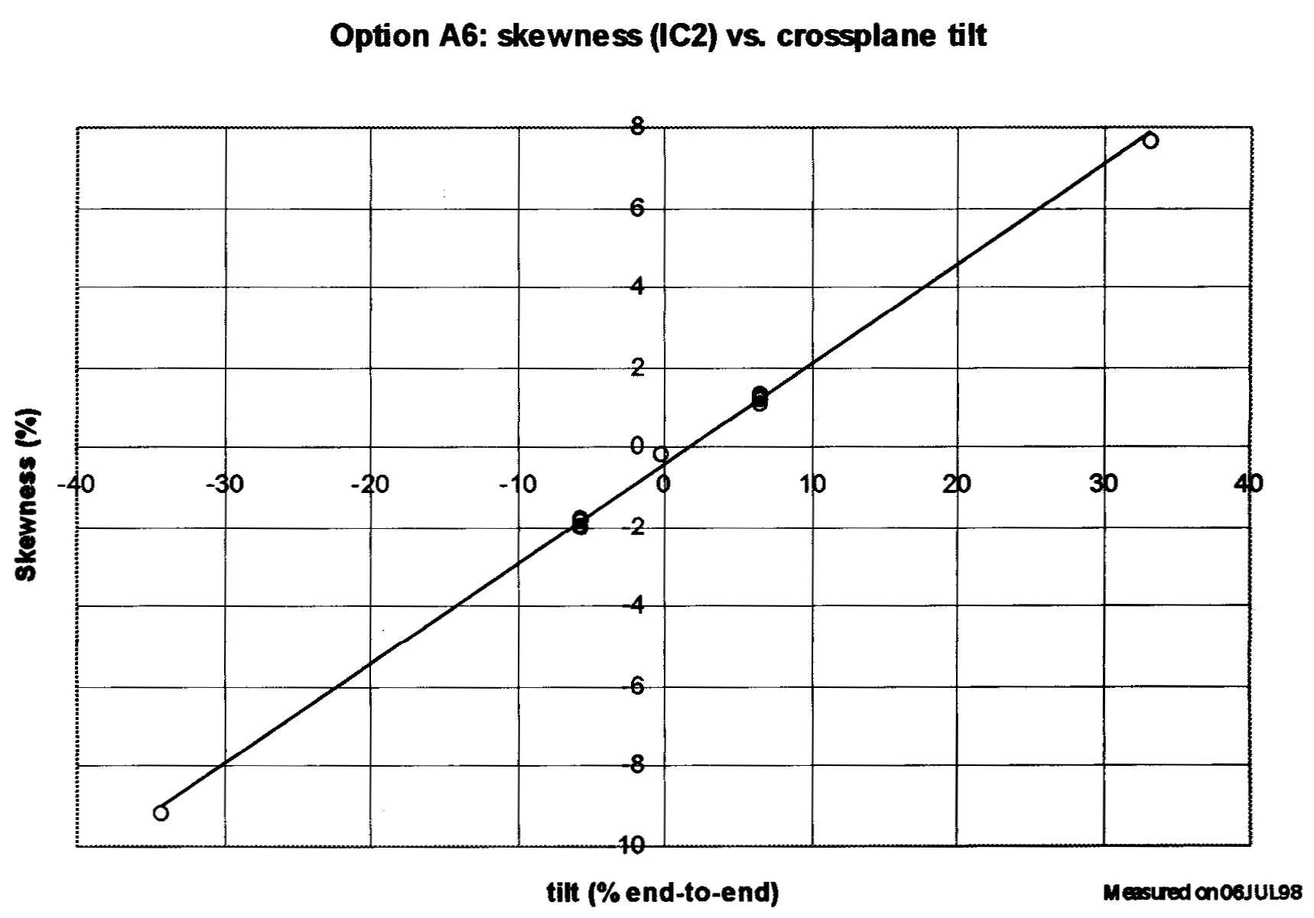
Skewness Proportional to Tilt
The MC study predicted skewness would be proportional to tilt over a wide range and therefore is a good error signal. A subsequent study (D. Prieels, ‘Clinical performance in double scattering,’ IBA technical memo 1999) confirmed this. Kurtosis is less useful because of quantization ‘noise’, but S1 errors are ruled out by the hardware. Since the skewness must be held to ≤1% or so, extremely stable current-measuring electronics is needed for the strip IC.

Slide 30
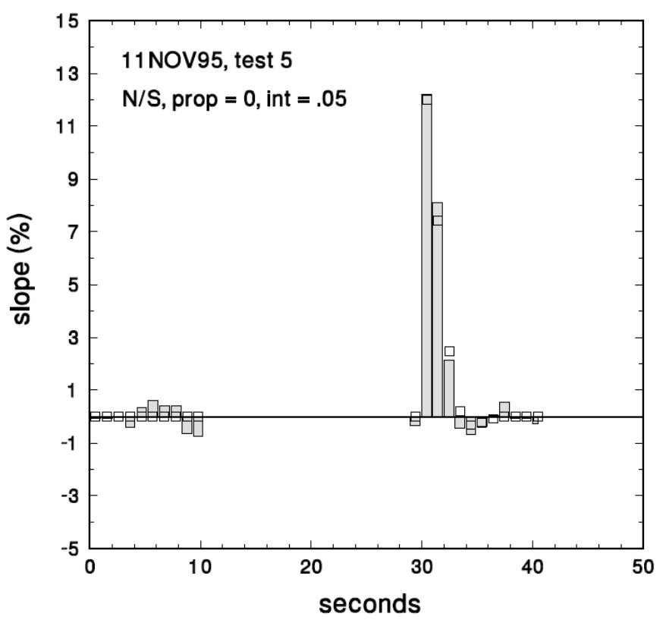
Settling Time (HCL)
Given an error signal, the feedback system itself requires some attention. At HCL the loop was closed except when the detected dose was below some threshold. Thus each treatment started with the final values from the last one.
The bars shows the HCL system response to a 12% (huge) tilt error. Even this is corrected in 3 seconds. The feedback is digital with short time constants so it is easily modeled. Open squares show the predicted response.

Slide 31
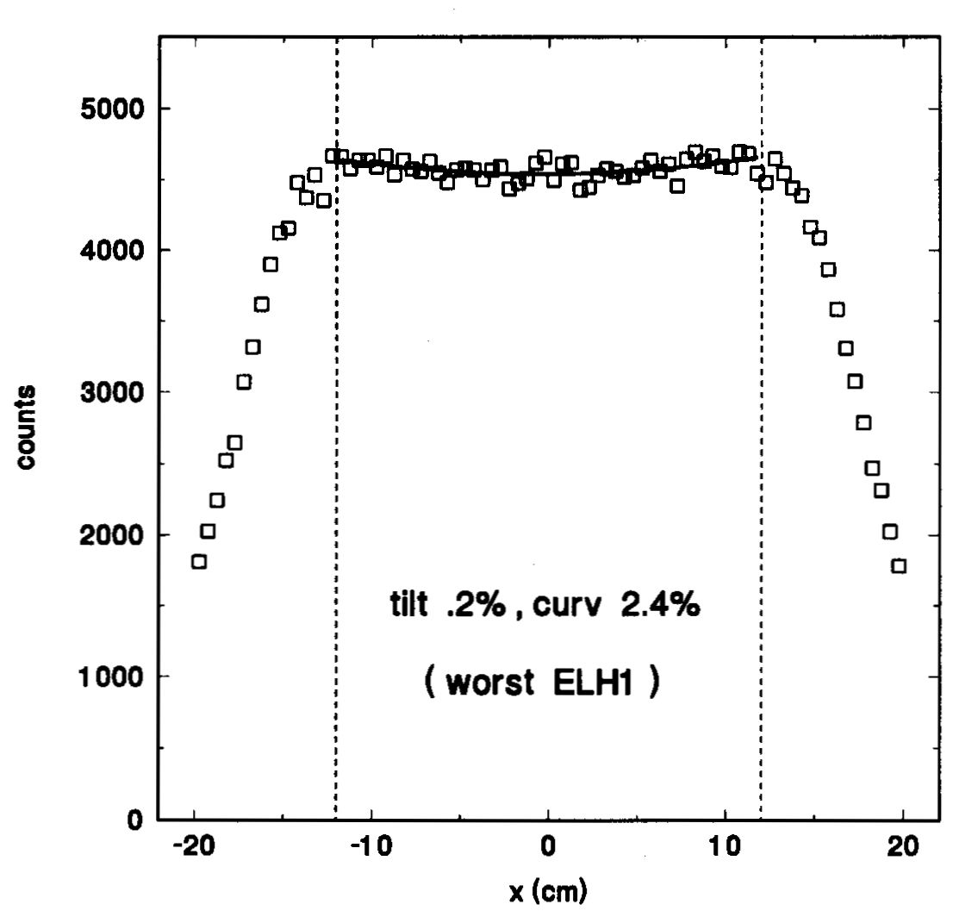
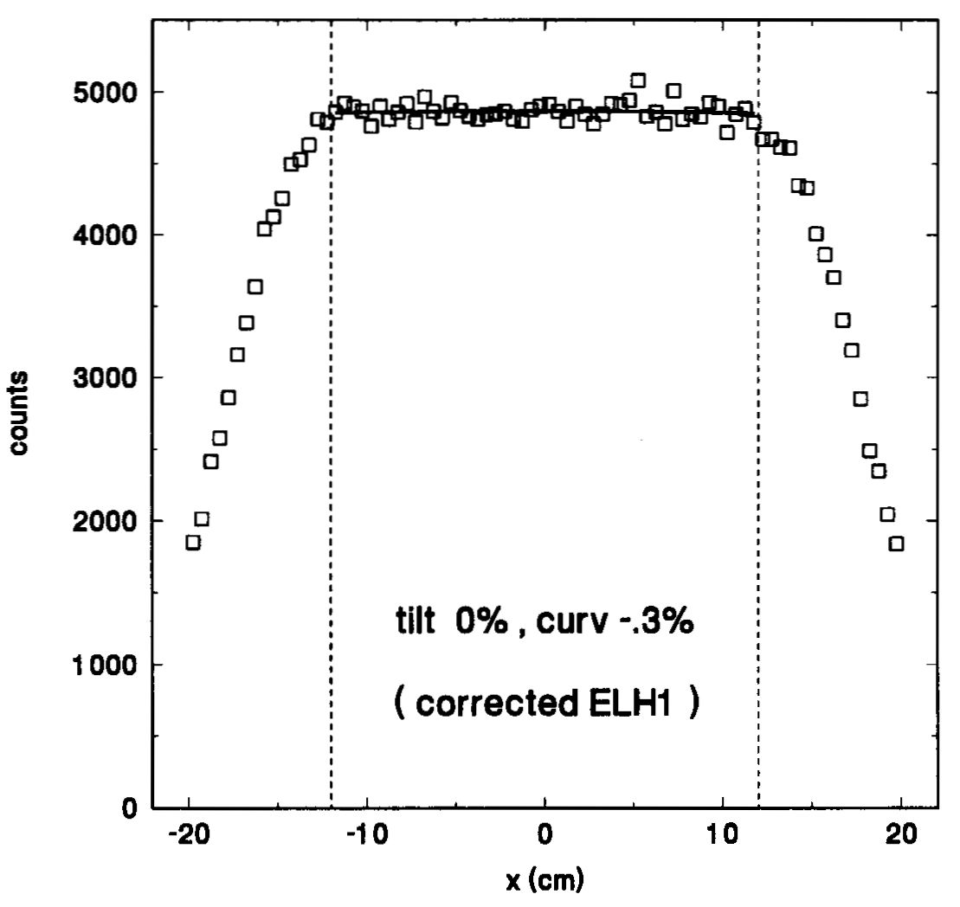
Effect of Beam Emittance
Monte Carlo simulations can also be used to study the effect of other beam parameters (size and divergence at S1). If the beam is divergent the transverse dose will be slightly ‘dished’.
That can be fixed by decreasing S1 or moving it nearer S2. You should always be prepared to make small adjustments to the computed S1.

Slide 32
Outline
methods: annulus, dual ring, contoured
design procedure: projection, scaling, useful radius
de-scaling: converting back to physical quantities
optimizing the generic shape
beam steering: skewness and all that
summary

Slide 33
Summary and a Comment
We have described a variety of double scattering techniques which are more efficient and waste less energy than single scattering. In our opinion, the compensated contoured scatterer is best.
Projection and scaling allow one to define a generic solution which, once found, can be rescaled to any reasonable physical requirement.
The process of finding the ‘best’ generic solution still leaves something to be desired. Some good solutions are known, but better ones may exist.
The sensitivity of double scattering to beam misalignment necessitates an active beam steering system. The Burr Center system has been described here and the HCL system is detailed in the lecture on ionization chambers.
The position of S2 along the beam is a design choice that must be made by hand, with tradeoffs. A given S2 may be moved along the beam line (‘zoom’) to create larger or smaller fields.
Combining scattering and magnetic scanning in the same nozzle forces undesirable tradeoffs. For instance, in the Burr Center nozzle S2 is far downstream, to make room for the scanning magnets. If it were further upstream the lateral penumbra would be sharper, the depth of penetration greater, and unwanted neutron dose to the patient somewhat smaller.

