Slide 1
Lateral Penumbra
Lateral penumbra is a measure of the sharpness of the shadow cast by a patient aperture. It depends on depth in patient, air gap and beam line design, as well as prescribed depth and modulation.
It can be found by Monte Carlo computation (to arbitrary accuracy, in principle) or analytically (to ~10%). The latter method, which is what we will describe, is essentially instantaneous, and is good enough for beam line optimization.
We’ll eventually focus on the effect of the beam line because that’s the part we have some control over. To isolate the effect of the beam line, we’ll measure penumbra in air though, in a clinical situation, depth in the patient has a large and even dominant effect.
Generalized Fermi-Eyges theory can also been used to compute lateral penumbra (Hogstrom et al., Phys. Med. Biol. 26 (1981) 445-459). Our ‘confusion theorem’ is perhaps more intuitive, but the basic approximations are similar.
© 2007 B. Gottschalk. This material is previously unpublished except as noted.

Slide 2
Overview
Although we’ll eventually concentrate on lateral penumbra in air (or in a very shallow field) it’s important never to lose sight of the effect of depth in patient.
To emphasize this we’ll show some early measurements and calculations from HCL (Arduini et al., Med. Phys. 23 (1996) 939). In those calculations, however, the virtual source position and size from double scattering were measured, and the contributions of the modulator and range shifter were computed and included later by a semi-empirical method.
The essence of the present lecture is that the source position and size can, instead, be computed from first principles. A single deterministic calculation includes the entire system: beam, scatterers, range shifter, modulator and even air.
Instead of revisiting the old HCL data we’ll check our newer method against a large set of gantry room commissioning data from the Burr Center (double scattering) as well as recent data from the STAR neurosurgery beam (single scattering).
Except as noted, when we say ‘penumbra’ we mean the 80/20 penumbra, that is, the distance between the 80% and 20% dose levels. Other measures are sometimes used, and the calculation is easily adapted to any of them.

Slide 3
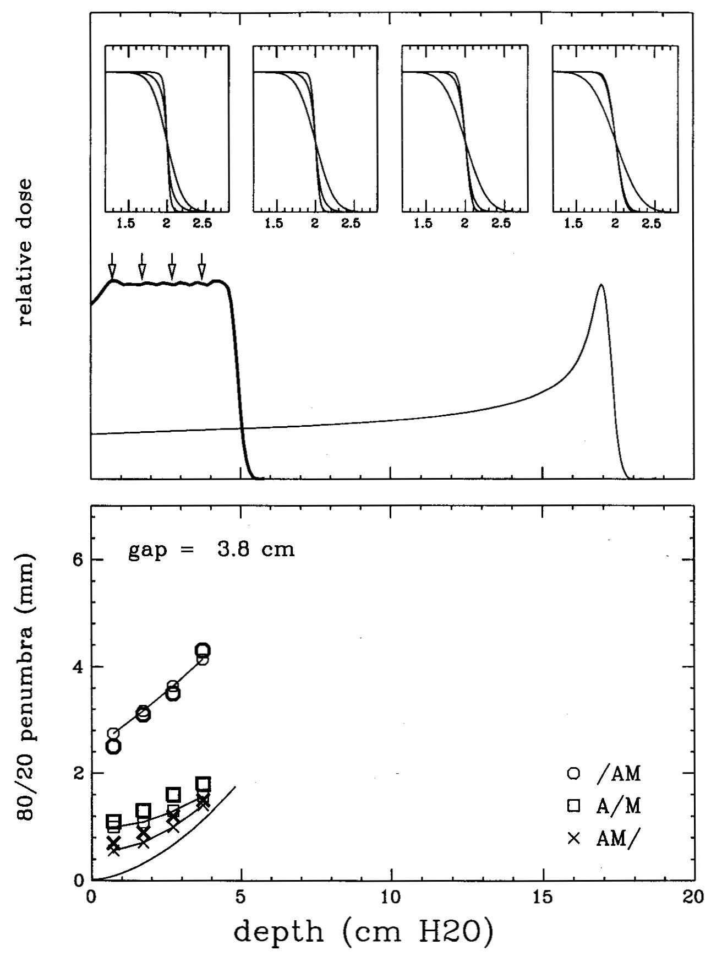
This 1994 experiment at HCL studied the effect of depth in patient, as well as the effect of moving the range shifter and/or modulator upstream. The lines and light symbols are computed, with a measured virtual source position and size from double scattering. The lowest line represents the minimum possible, from scattering in water. The bold symbols are measurements with a diode dosimeter.
/AM = absorber and mod downstream; A/M = abs upstream; mod downstream; AM/ = both upstream.

Slide 4
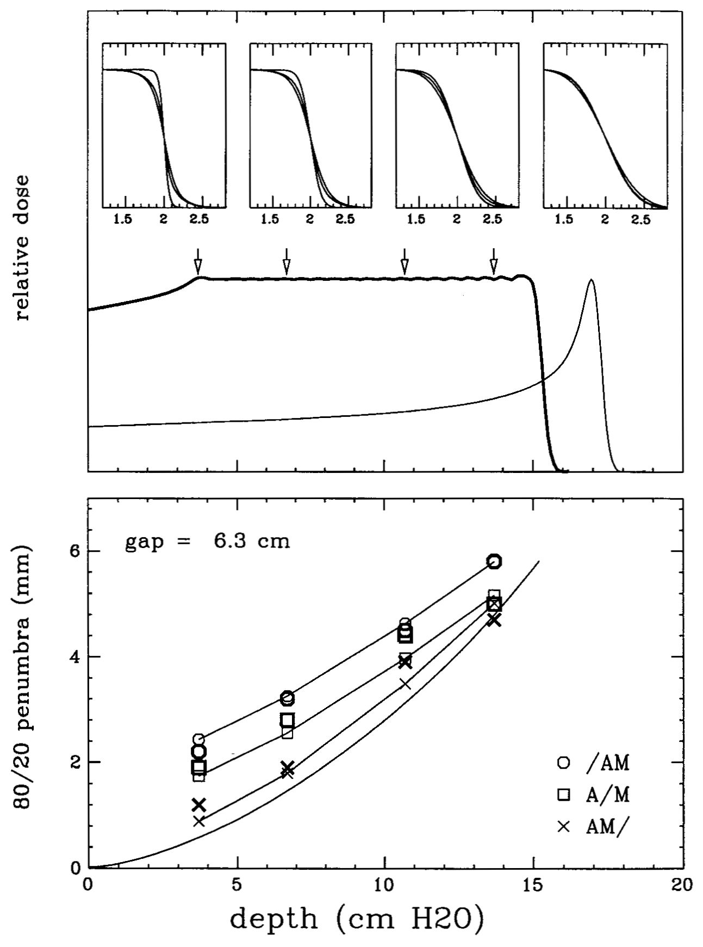
The same with a much deeper field. With both range shifter and modulator upstream, we almost reach the limit.
Moving everything upstream, particularly the range shifter, was constantly stressed at HCL by Andy Koehler, and eventually led to the ‘upstream everything’ design used by IBA.
As we saw in the lecture on stacks, ‘upstream everything’ is better because it minimizes beam size, and therefore emittance growth, on scatterers (Petti et al., Med. Phys. 18 (1991) 513).

Slide 5
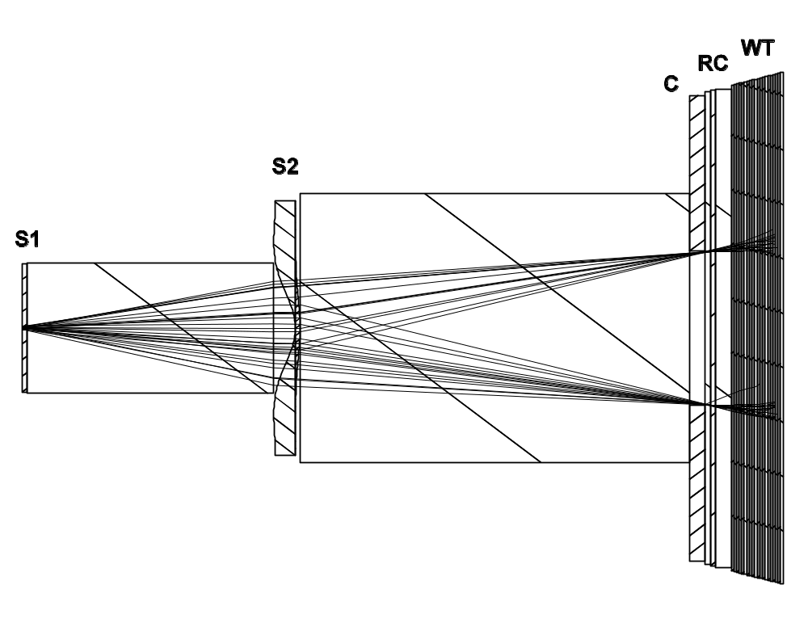
Model Beam Line
Having reviewed some early results, let’s try to compute the penumbra or, equivalently, the virtual source and source size, for a realistic system.
collimator
S2
From 1M events we selected ≈ 30 that passed through 2 mm pinholes at the upper and lower collimator edges. The angular confusion is clearly related to the size of the beam at S2. Also, the ray bundles appear to point back to a well defined virtual source with a finite size.
Notes:
scale aprox NPTC, S2 exaggerated
layout: S1, S2, Coll, Range Comp, air gaps, Water Tank
angular confusion determines penumbra even if no further scattering

Slide 6
Phase Space Diagram (Next Slide)
The next slide shows how penumbra arises and how a contoured scatterer works in the phase space picture. It shows the phase space distribution and its x projection at the entrance to each element. We use an asymmetric patient collimator (‘half-beam block’) to highlight any difference between on-axis and off-axis penumbra.
We assume a perfect beam, so the emittance stays 0 until the entrance to A2 (the second air slab) just after S2 and the collimator surrounding it. That collimator chops off the left and right wings. The x projection resembles an inverted parabola. Barely visible is the fact that S2 induces extra vertical spread near r = 0. Drifting through A2, those protons shear further, filling in the wings and flattening the fluence at C.
Meanwhile, the chopped off edges have themselves sheared, leading to the gentle edges on the fluence distribution at C. That is, the natural falloff of a double scattered dose distribution is just the penumbra of the collimator around S2, the relevant angular confusion being that just behind S2.
The fluence is again chopped, asymmetrically, at C, and it is the shearing of those edges through A3 (the air gap, here made very large on purpose) that constitutes the final penumbra. The final slab of water introduces more scattering and more shear, making the edges still broader.

Slide 7
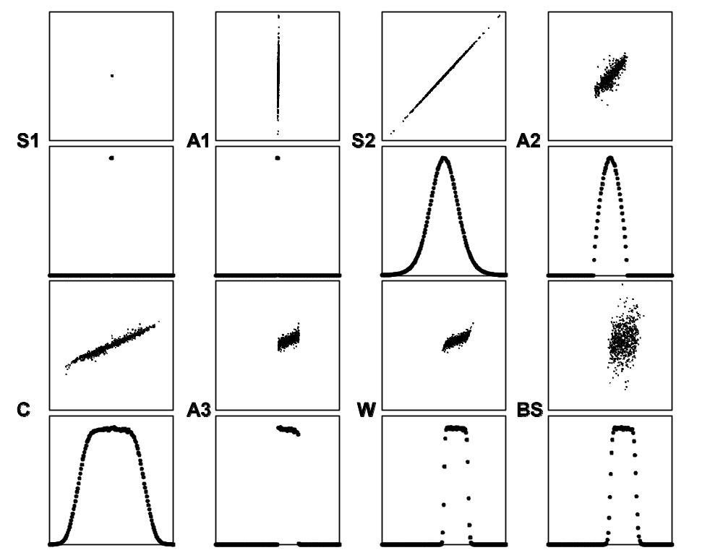

Slide 8
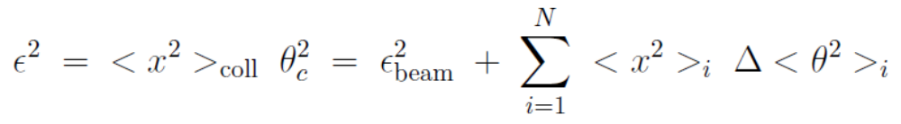
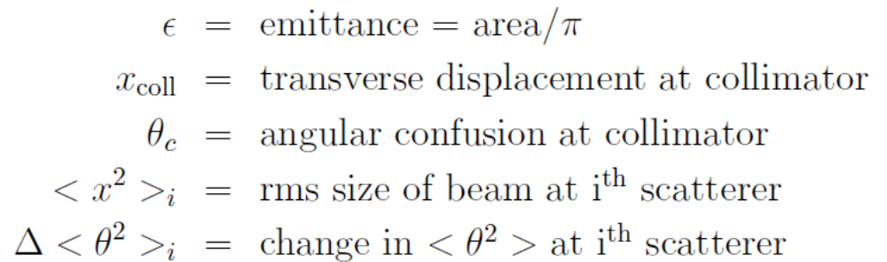
Angular Confusion at the Patient Collimator
In the lecture on transport theory we learned that we could transport the beam up to the collimator (using Fermi-Eyges theory) and then use θ_{C} =(B/A₂)^{1/2} . Let’s instead use a method which is somewhat more physical and gives an insight into the root cause of lateral penumbra. In the transport lecture we also learned that
where
and we have identified the emittance at the collimator as y_{int} × x_{max} of the presumed ellipse. The only unknown is θ_{C} ; everything else can be computed by the ‘slabwise’ method given previously. The equation says that a given scatterer will increase θ_{C} more, the further downstream it is, because the beam on it will be larger. Move scatterers upstream as much as you can!

Slide 9
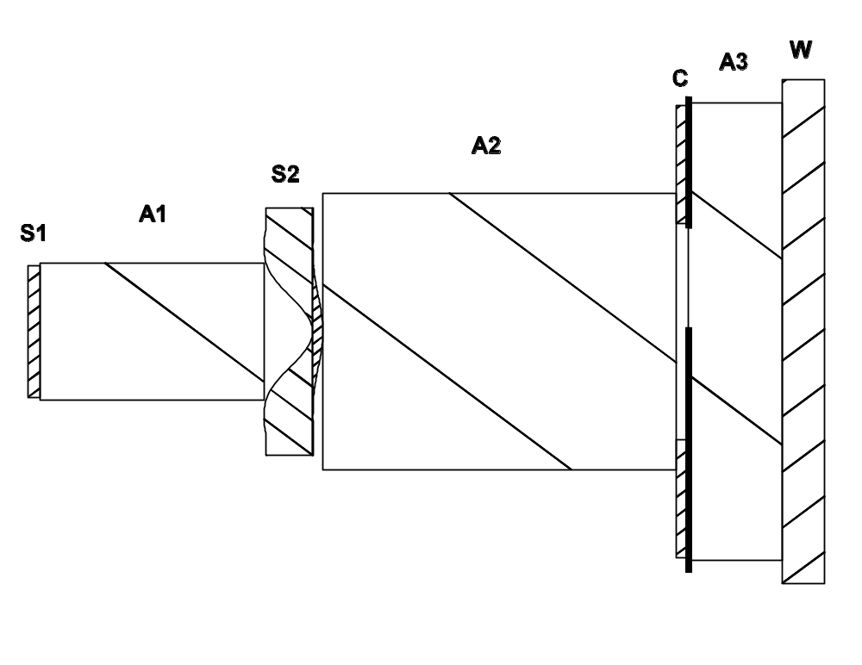
Not a Pure Fermi-Eyges Problem !
We know how to calculate θ_{C} in uniform mixed slab geometry. However, S2 is not uniform, there is a collimator around it, and we need θ_{C} both on and off axis. To proceed we need several approximations, justified only by the success of the calculation. Eventually they may be justified theoretically. We’ll assume the collimator around S2 has no effect, use the central S2 thickness to compute θ_{C}, and assume θ_{C} is the same on and off axis (which is rigorously true for uniform slabs).

Slide 10
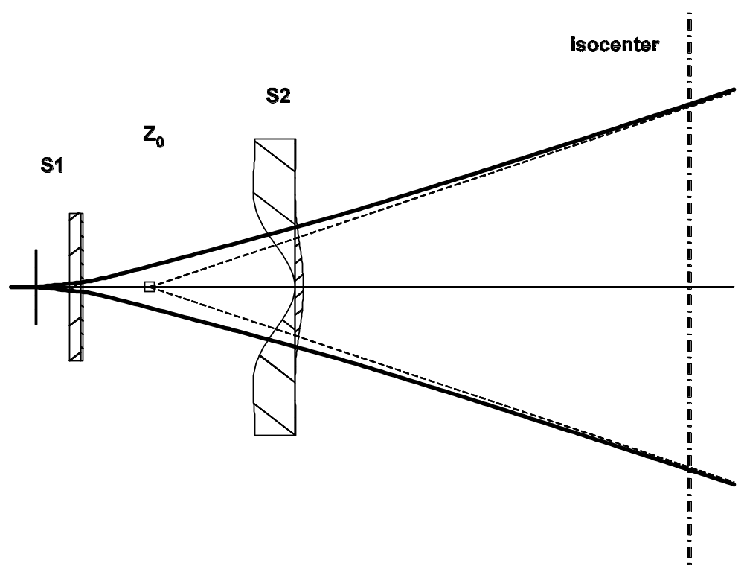
Yet Another Assumption
Besides angular confusion, another ingredient of the penumbra calculation is the effective scattering point of the double scattered beam, which can be found by back projecting the linear portion of the beam envelope as described in an earlier lecture. Here we need another assumption (reasonable, but not proved so far): the correct thicknesses of plastic and lead for S2 are those found at the characteristic radius <x²>^{1/2} of the beam produced by everything upstream of S2.

Slide 11
Collimator Scatter and 3D Effect
So far we have assumed an ideal collimator: no thickness and perfectly absorbing. Real collimators can be 6 cm thick (first two papers), and protons can lose energy and scatter in the brass without stopping (third paper).
R.L. Slopsema and H.M. Kooy, ‘Incorporation of the aperture thickness in proton pencil-beam dose calculations,’ Phys. Med. Biol. 51 (2006) 5441-5453
Kanematsu et al., ‘Extended collimator model for pencil-beam dose calculation in proton radiotherapy,’ Phys. Med. Biol. 51 (2006) 4807-4817
van Luijk et al., ‘Collimator scatter and 2D dosimetry in small proton beams,’ Phys. Med. Biol. 46 (2001) 653-670
The first two papers show that, because of finite thickness effects, penumbra measured off-axis is more likely to agree with an ‘ideal collimator’ prediction.
However, slit scattering and 3D effects are of the same order (as described in a separate lecture) and there is at present no satisfactory analytic theory of the behavior of a real-life collimator. Near the collimator (small air gap) things are complicated, and this may well limit the practical accuracy of any analytic theory of penumbra. Our data are taken far from the collimator, and slit scattering, though visible, probably does not affect the penumbra.

Slide 12
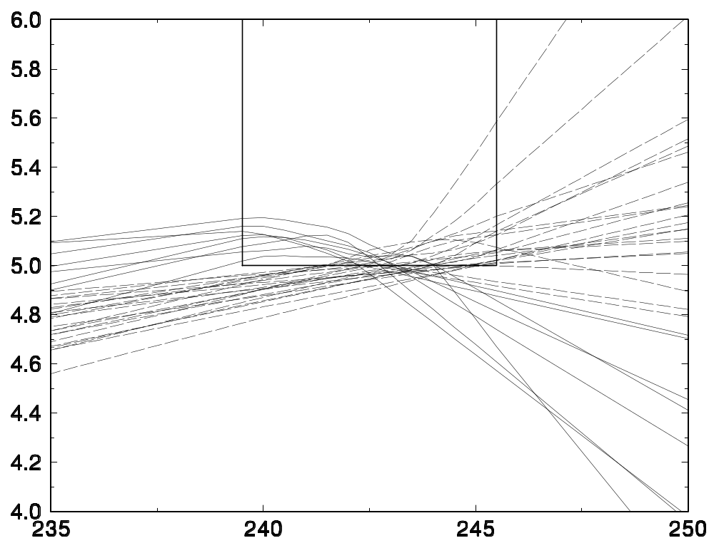
Slit Scattering (a Reminder)
What really goes on at a brass collimator. We’re ignoring all this.

Slide 13
Back to the Problem
collimator
S2
Having collected our ingredients and listed our approximations, we are at last ready to compute penumbra. In this picture S1 is really a modulator, that is, a sequence of N different lead/plastic combinations: in effect, N beam lines. We must do N calculations, find the transverse dose at our test point by adding the doses with appropriate weights, and then find the 80% and 20% points numerically.
Notes:
scale aprox NPTC, S2 exaggerated
layout: S1, S2, Coll, Range Comp, air gaps, Water Tank
angular confusion determines penumbra even if no further scattering

Slide 14
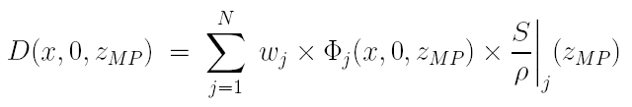
General Formula
To compute the penumbra at z_{MP} in the water tank we need to compute the dose D at a number of transverse points (which we might as well take on the x axis) in the measuring plane. At each point, the dose is a weighted sum over modulator steps (j) of the usual (fluence × mass stopping power):
S/ρ is the effective mass stopping power, at the appropriate depth and modulator pullback, obtained from a measured Bragg peak. For the fluence calculation we’ll assume either a) a round hole of radius R_{C} or b) a ‘half beam block’ extending from x = 0 to W_{C}.

Slide 15

Fluence Behind a Round Hole
The fluence must be computed separately for each modulator step j. We know the virtual source z_{0j}. Project R_{C} to its magnified value R_{MP} in the measuring plane. Project the angular confusion and add, in quadrature, the projected scatter in the range compensator, air, and water, to get a net rms displacement r_{0MP} in the MP. The fluence at x is the integral of contributions from all points P (with coordinates r, θ ) inside the circle:
R_{MP}
r
θ
●
x
We have used symmetry about the x axis. The integrals are performed numerically using Simpson’s Rule. If R_{MP} » r_{0MP}, the 1D approximation applies and the x distribution is given by the error function.

Slide 16
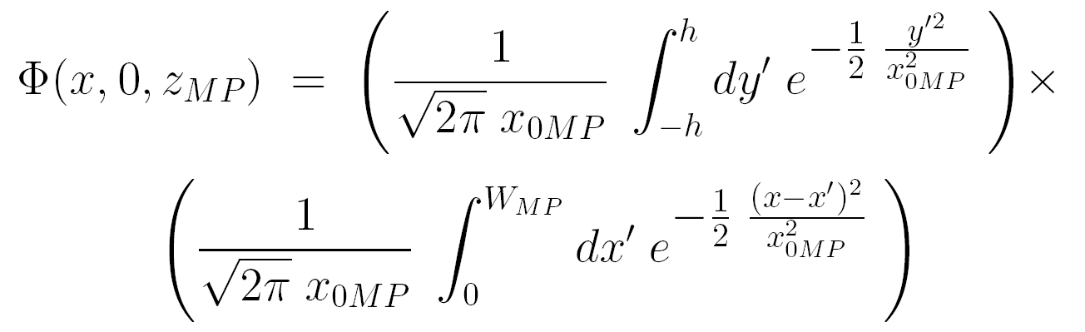
Fluence Behind a Slit
h
The slit is analogous. Projected into the MP the slit extends from –h to h and 0 to W_{MP} . x_{0MP} is the projected rms spread including, in quadrature, projected contributions from angular confusion, range compensator, air and water. The probability of reaching (x, 0) from the source point (x′, y′) is the product of probabilities in x and y so
●
x
-h
0
W_{MP}
If h » x_{0MP} (infinite slit) the first integral is 1. If in addition W_{MP} » x_{0MP}, the error function can be used to evaluate the second integral.

Slide 17
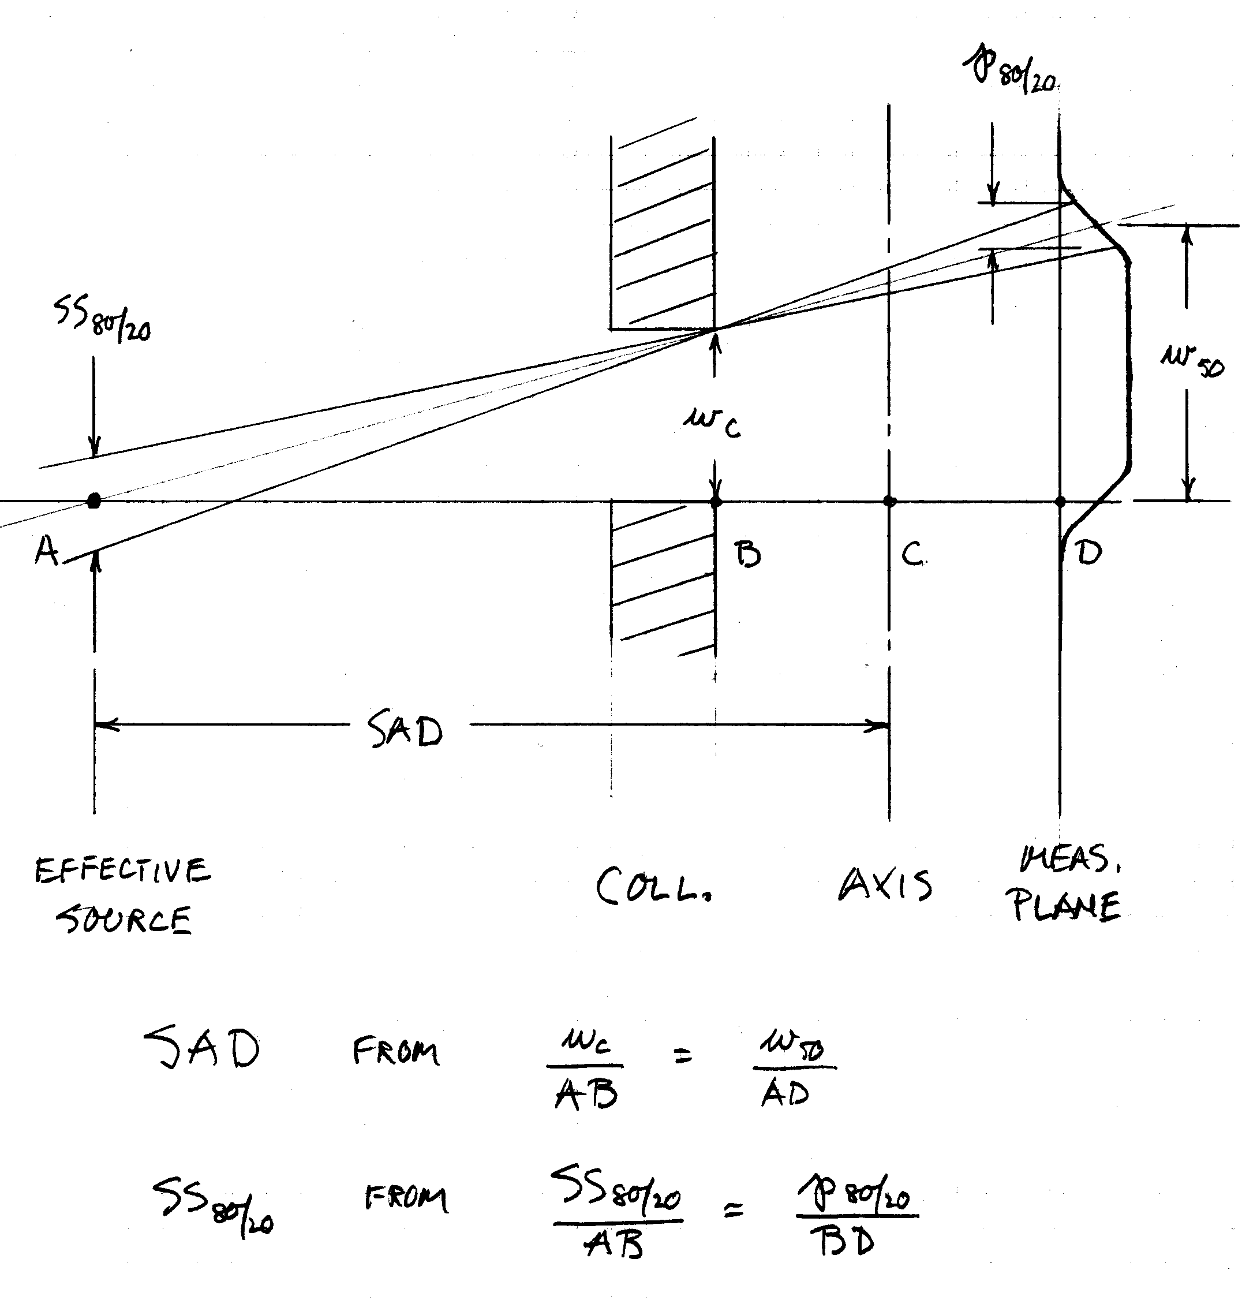
Measurement Geometry
Transverse dose was measured with a very small thimble chamber, in air, with BC = 20 cm (large to magnify penumbra and reduce 3D slit effects) and CD = 0 or 50 cm. Each of 7 options was used with no modulation and full modulation → 28 scans.

Slide 18
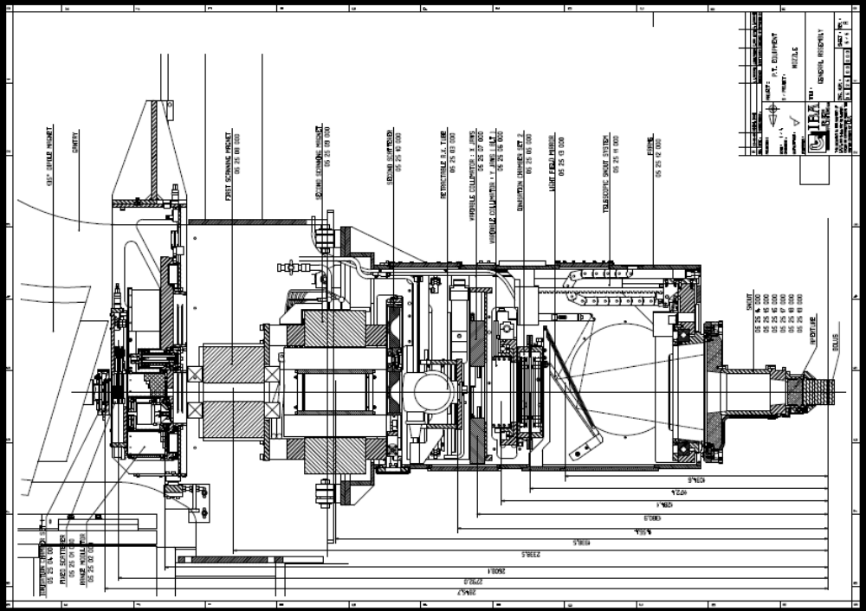
The IBA Nozzle (Burr Center Gantry)

Slide 19
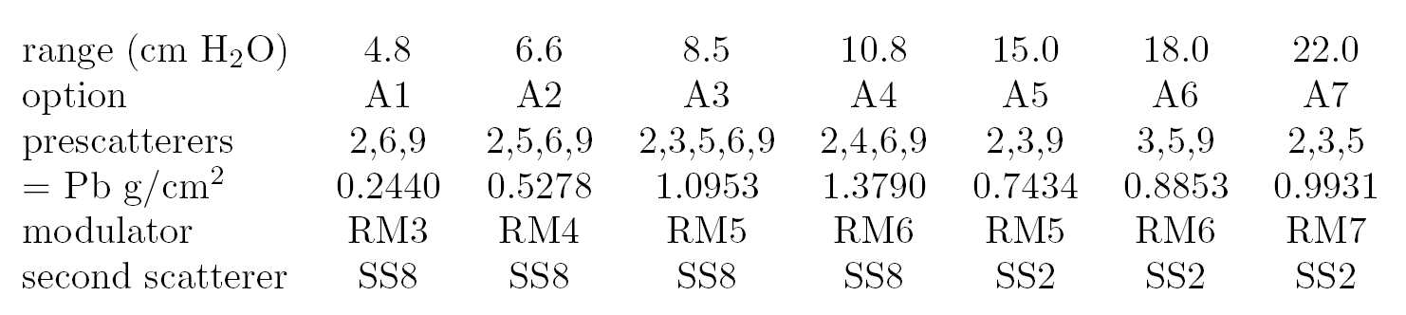
Experimental Settings
Experimental conditions:
7 depth settings or ‘options’
no mod and full mod at each
20 cm and 70 cm from downstream face of collimator for each
Total 7 × 2 × 2 = 28 transverse scans

Slide 20
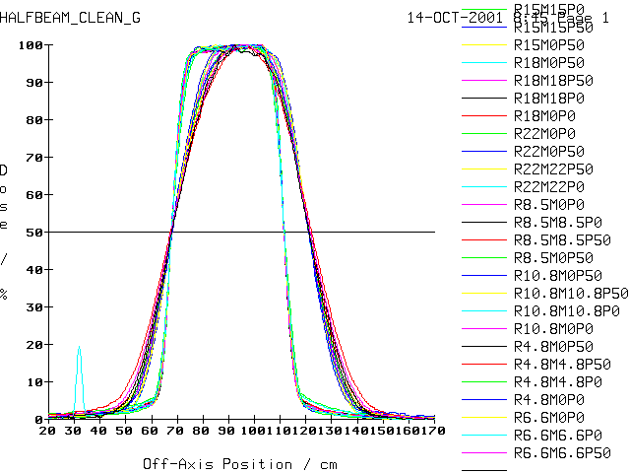
Measure for range of ranges and modulation (see legend on profile graph)
Results
H.M. Kooy, ‘Source size and SAD measurement,’ NPTC tech. note. 1/24/2002

Slide 21
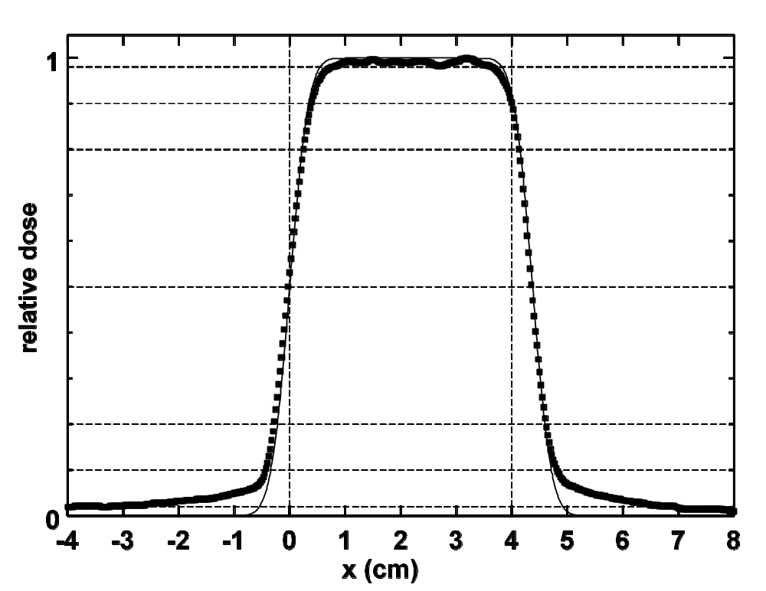
Scan at 20 cm
slit scattering

Slide 22
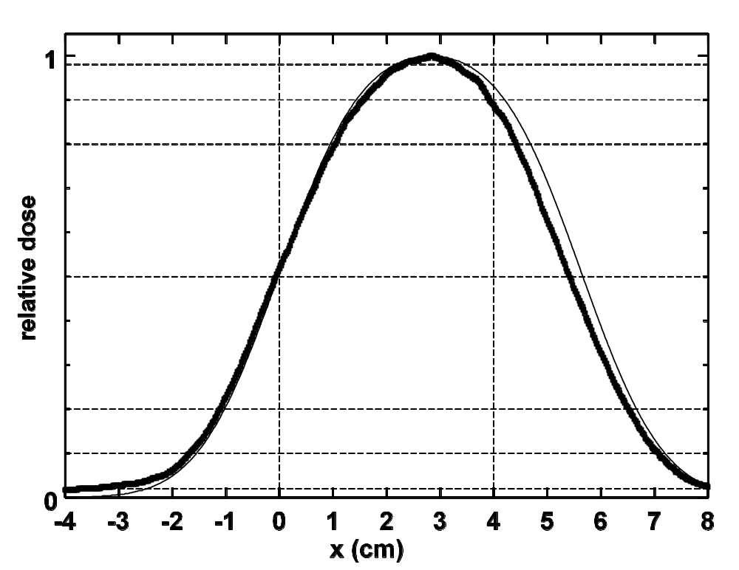
Scan at 70 cm

Slide 23
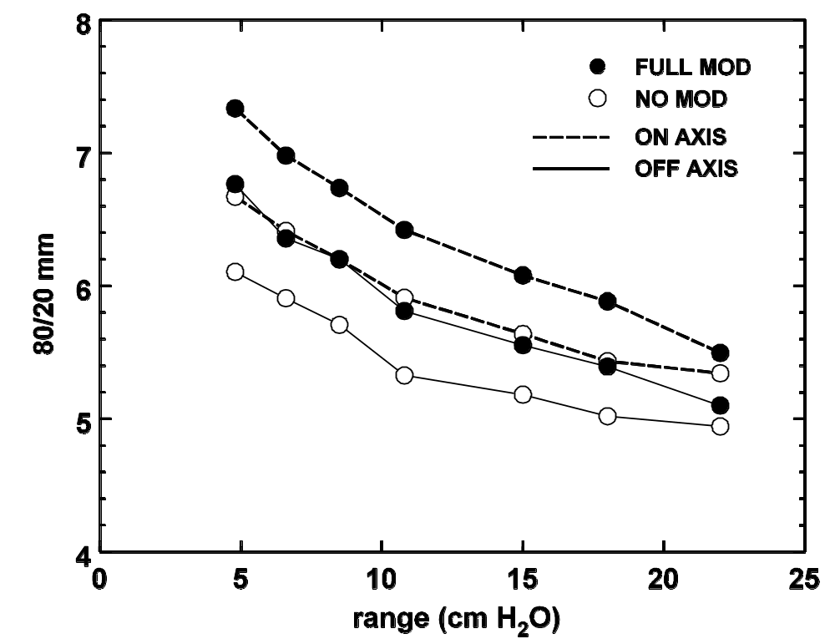
Data Only, at 20 cm

Slide 24
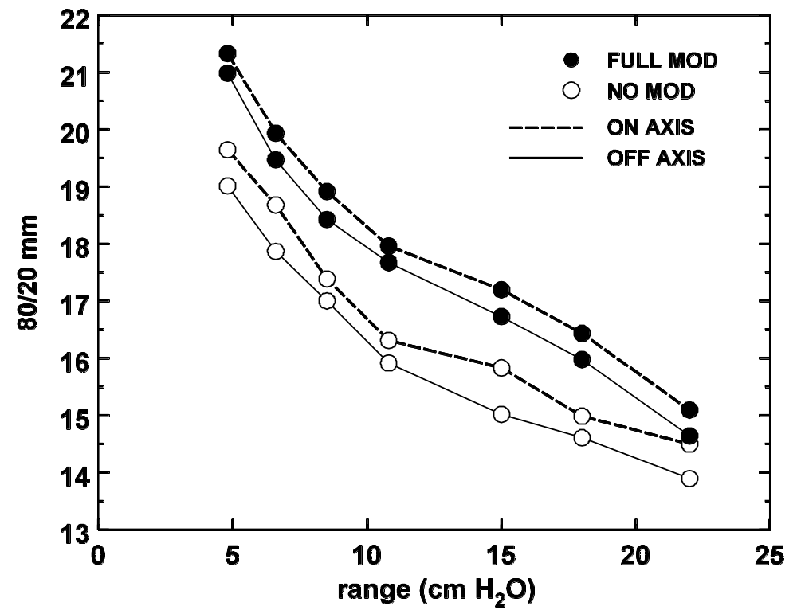
Data Only, at 70 cm

Slide 25
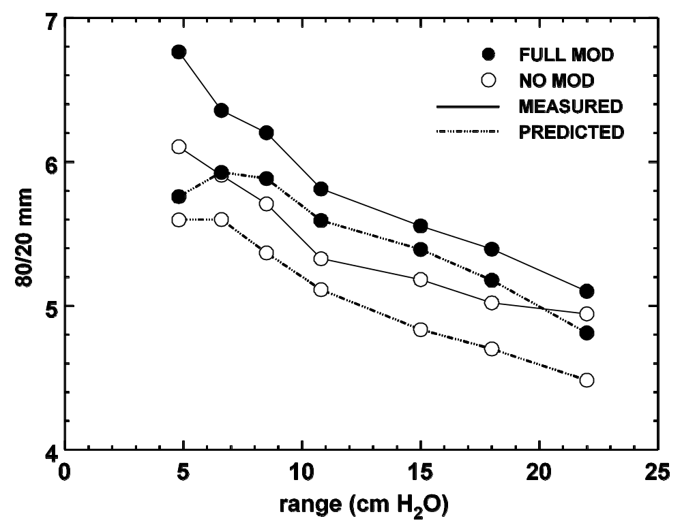
Predicted vs. Measured, 20 cm

Slide 26
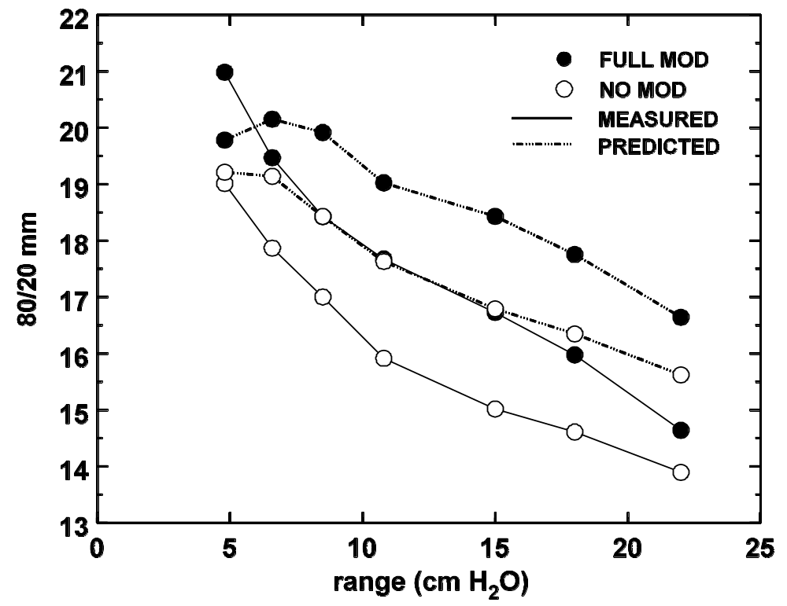
Predicted vs. Measured, 70 cm

Slide 27
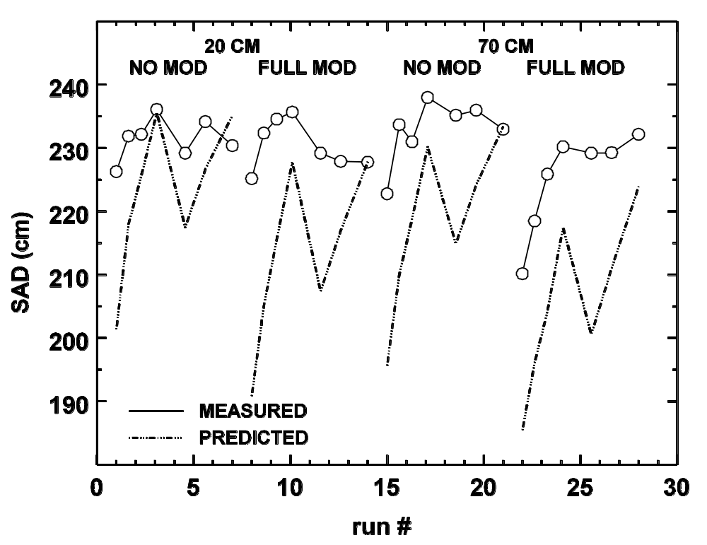
Source-to-Axis Distance

Slide 28
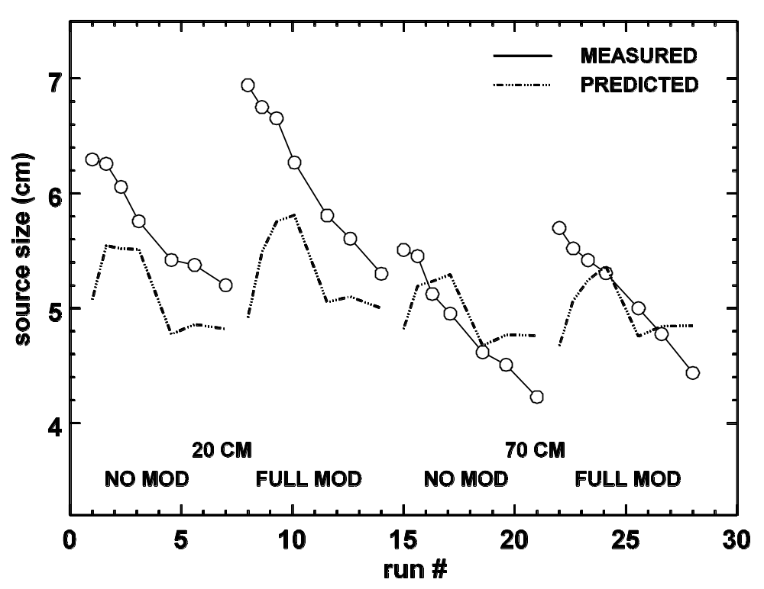
Source Size

Slide 29
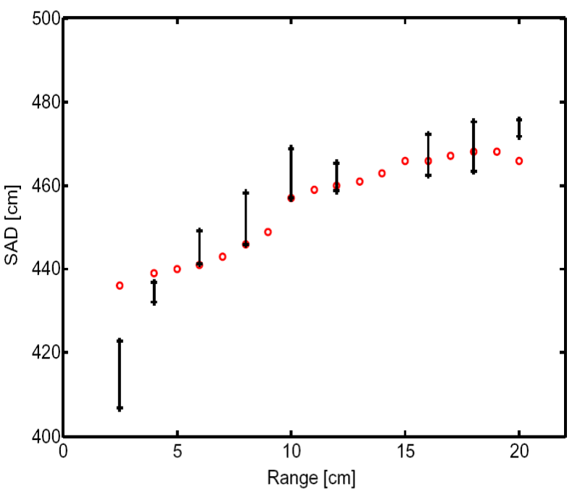
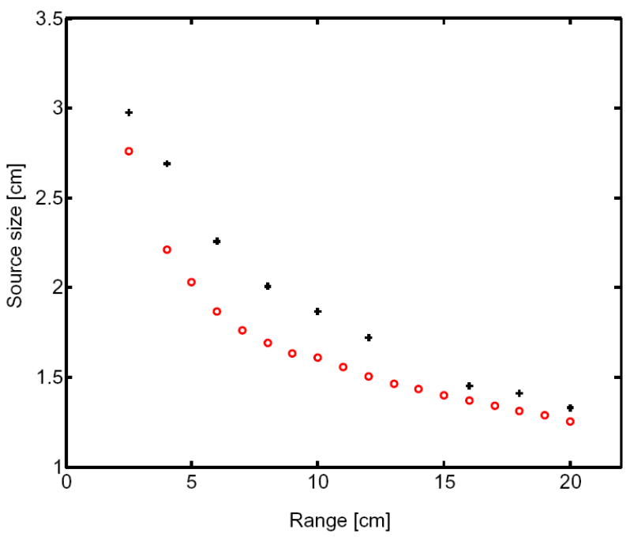
Different Beam, Same Model
SAD and source size measurements (black) and theory (red) in the Burr Center STAR neurosurgery beam. Data and computation courtesy Mark Bangert. Again, agreement is ≈10%. In this single scattered beam, scattering in air has a significant effect.

Slide 30
Summary
The lateral penumbra for an arbitrary beam line can be computed analytically or by Monte Carlo. The first is much faster, and accuracy is adequate for beam line optimization.
Collimator effects (3D and scattering) limit the useful accuracy of an analytic method to ~10%. On the other hand, that’s about as well as we need to know penumbra.
Generalized Fermi-Eyges theory has been used to compute penumbra in electron beams. The ‘confusion theorem’ is equivalent and better identifies the key factors in designing a beam line for good penumbra. Scatterers and degraders should be upstream, where the beam is small, to minimize emittance growth.
Single scattering is best, so good that air becomes an important factor. If double scattering is used, S2 should be as far upstream as possible.
The analytic method agrees with experiment to about 10% for the Burr Center gantry nozzle (double scattering) and the STAR neurosurgery beam (single scattering).

