Slide 1
internal and external neutrons
Hall’s paper
source of external neutrons in scattered beam
modern beam: external ≈ internal ≈ 1 mSv/Gy
many papers; hard to compare
RBE and risk estimates
summary

Slide 2
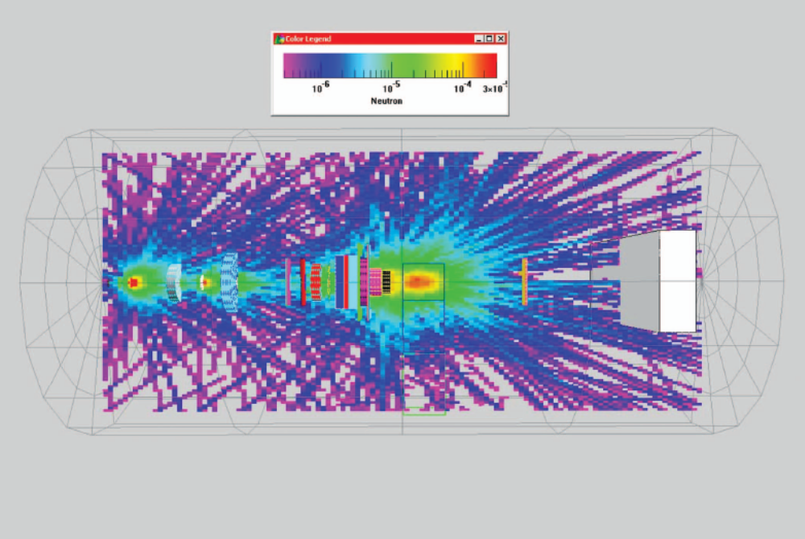
Moyers et al., ‘Leakage and scatter radiation from a double scattering based proton beamline,’ Med. Phys. 35 (2008) 128-144 : fluence for neutrons >10 MeV. Neutrons reaching the patient (green) are mainly from collimators near the patient. Stop protons as far upstream as possible!
External neutrons have a broad transverse spread, therefore dominate unwanted dose far off axis. However, that dose is low .

Slide 3
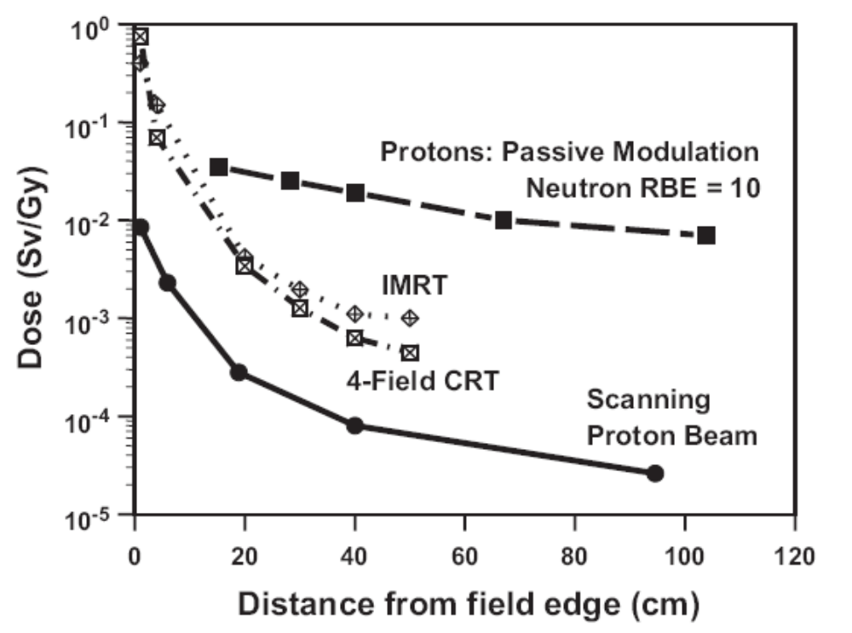
Eric J. Hall, ‘Intensity-modulated radiation therapy, protons, and the risk of second cancers,’ Int. J. Rad. Onc. Biol. Phys. 65 (2006) 1-7. This graph, showing neutrons from passive beam spreading (almost all patients to date) at over 100× those from magnetic scanning, caused considerable controversy.

Slide 4
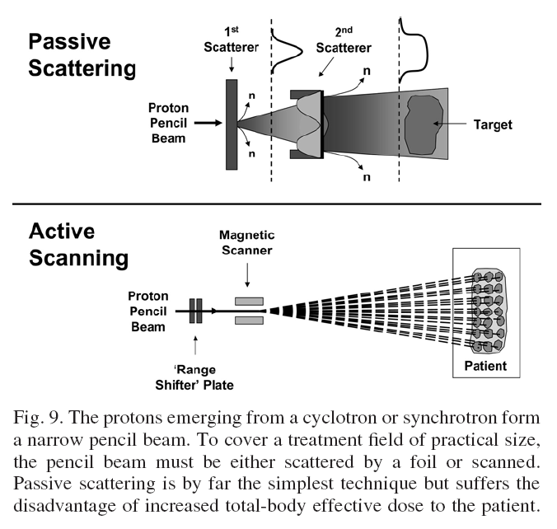
Figure 9 in the Hall paper misses the true origin of neutrons in a scattering system: wherever large numbers of protons lose large amounts of energy. Neutrons are shown coming from the scatterers. The major actual sources, range shifter/modulators and (especially) collimators, are left out entirely. Understanding this is critical to minimizing the external neutrons.
Proton trajectories bending after the magnet can be written off to artistic license. More seriously, the range shifter plates in some scanning systems are between the magnet and the patient, and cause external neutrons.

Slide 5
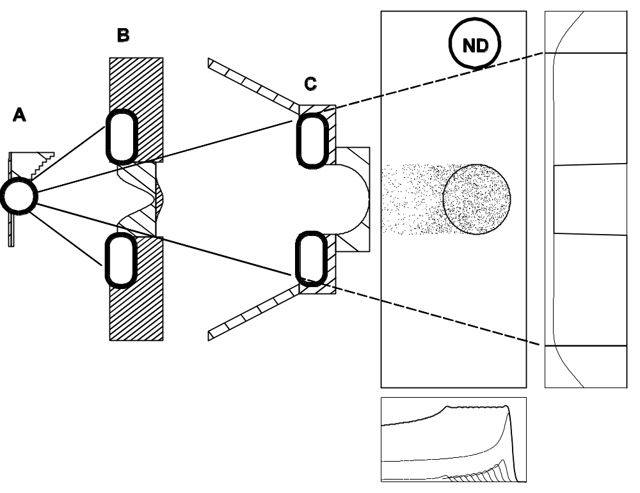
Neutrons arise wherever many protons lose a lot of energy : the range shifter/modulator, the collimator around the second scatterer B and the patient aperture C.
High energy neutrons are forward peaked in a broad cone. Dose falls as 1/r² ; so A and B contribute little. C is by far the most important, as confirmed by several papers.
If we open C to treat a larger field the dose registered by the off axis neutron detector ND decreases, as confirmed by Mesoloras et al. and others.

Slide 6
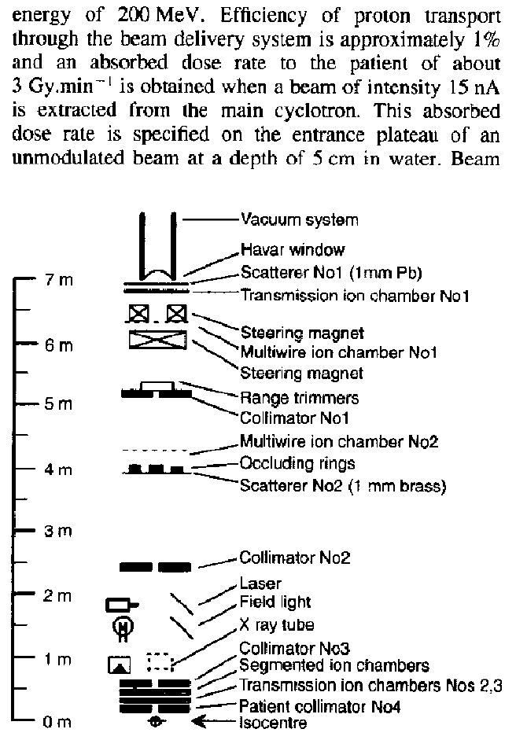
P.J. Binns and J.H. Hough, ‘Secondary dose exposures during 200 MeV proton therapy,’ Rad. Prot. Dosim. 70 (1997) 441 - 444 was the first experiment published. At NAC (Capetown), they measured external neutron dose (no phantom) in a double scattered beam using a Rossi counter. They found 33-80 mSv/Gy depending on transverse position.
Though self consistent, and consistent with later measurements, this widely cited result is not typical of well designed scattered beams. The net efficiency of proton utilization was only 1% (clearly stated in the paper) and the ≈75% of incident protons that miss the second scatterer were stopped far further downstream than necessary.

Slide 7
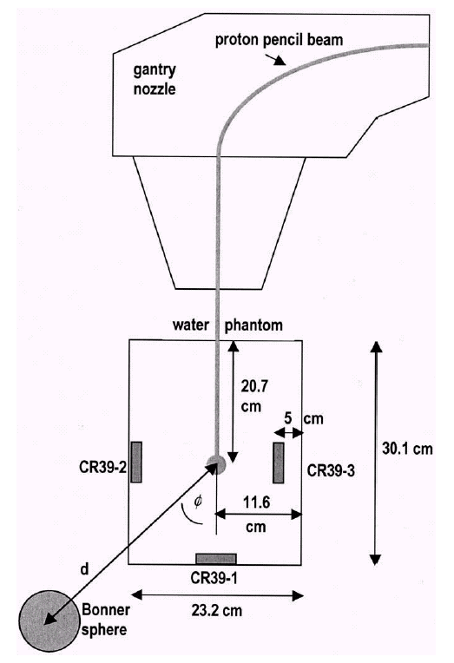
Schneider et al., ‘Secondary neutron dose during proton therapy using spot scanning,’ Int. J. Rad. Onc. Biol. Phys. 53 (2002) 244-251 looked at internal neutrons from a monoenergetic 177 MeV pencil beam. (The real spot scanning beam at PSI has degraders just upstream of the patient.) They measured equivalent neutron dose with a 10" Bonner sphere and with CR-39, and compared it with the FLUKA Monte Carlo.
They found Q ≈ 7 for neutrons in a proton beam, the same as found later by many other authors. However, that only means that everyone is using standard radiation safety numbers, not that 7 is necessarily correct!
The average non-target internal neutron dose is 2 to 4 mSv/Gy for medium to large target volumes, about twice that expected for photons. However, non-target dose for both p and γ is mostly from the primary radiation.

Slide 8
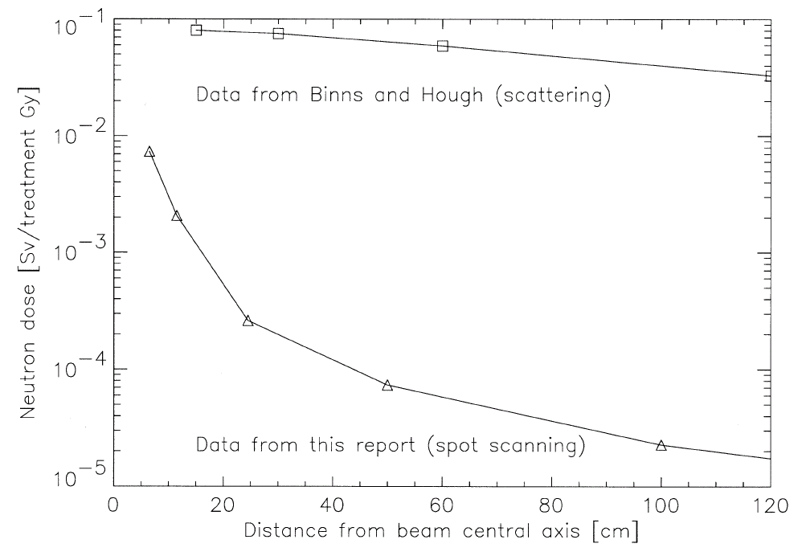
Schneider et al. Figure 3. The external dose is broader than the internal dose because the external source is upstream of the patient. (Think of a garden hose set to spray.) Organs transverse to the target may receive nearly all their dose from external neutrons!
This figure backs up their contention that non-target n dose is at least 10× worse for scattering than scanning. That may be true if the scattering efficiency is 1% and many of the wasted protons are stopped near the patient. However, ε ≈ 40% for an ideal scattering system and 20% for a reasonably optimized one. In modern practice, external n’s are comparable to internal n’s, not 10× greater.
To make the comparison Schneider assumed that 10¹¹ protons corresponded to 1 Gy treatment dose. The next three slides show that, although 10¹¹ is a reasonable figure, the correspondence between treatment dose and number of protons is not unique. Therefore mSv/Gy is not unique either.

Slide 9
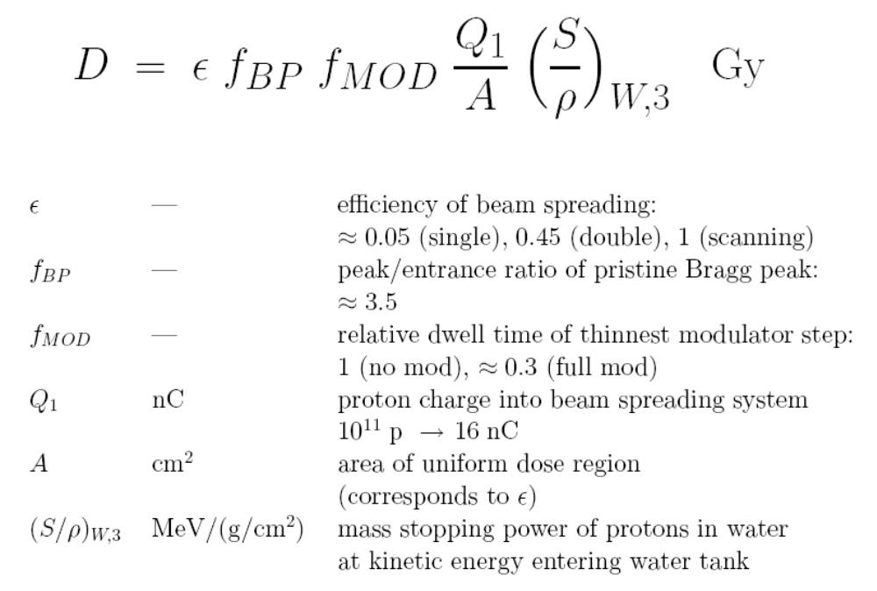

Slide 10
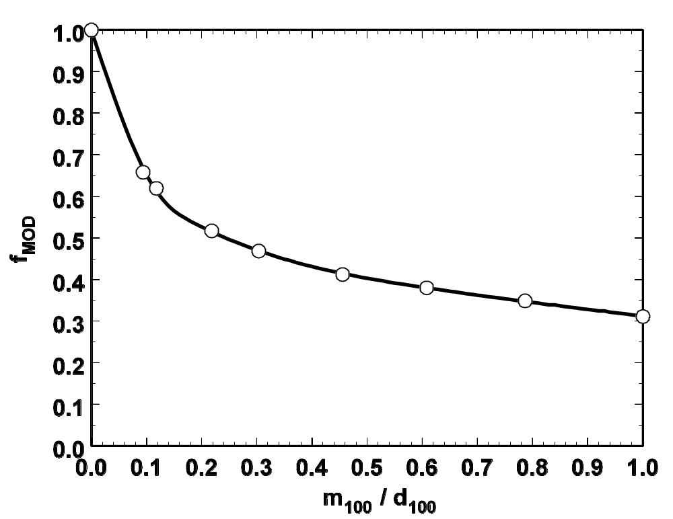
f_{MOD} vs. relative modulation depends mainly on the shape of the Bragg peak and relatively little on details of the scattering system. This graph will be pretty much the same for any system. The main point is that, although dose per proton varies linearly with the inverse area of the design field, its dependence on modulation (the longitudinal extent of the field) is more complicated, and nonlinear.

Slide 11
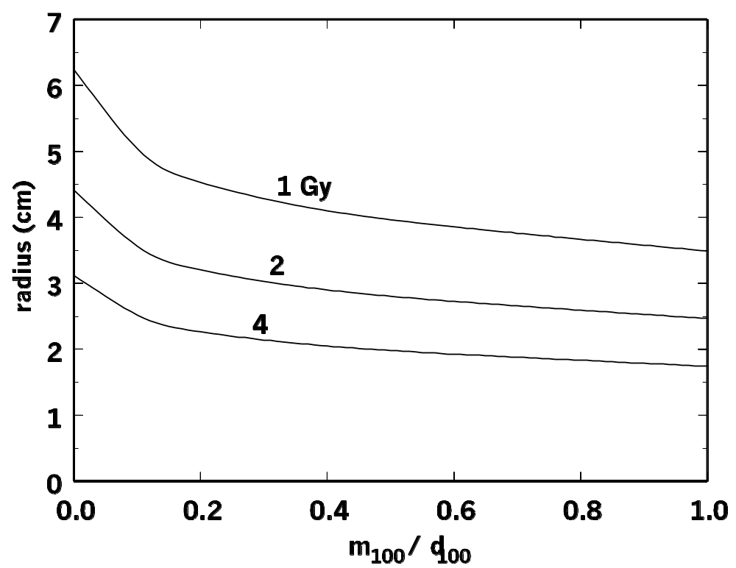
The dose formula says that the treatment dose per 10¹¹ protons depends on field size and relative modulation. All three isodose curves are consistent with 10¹¹ 177 MeV protons: 1 Gy into a 5 cm radius field with little modulation all the way to 4 Gy into 1.7 cm with full modulation. Schneider assumes we are on the top curve. Would external neutrons be the same over that entire curve?

Slide 12
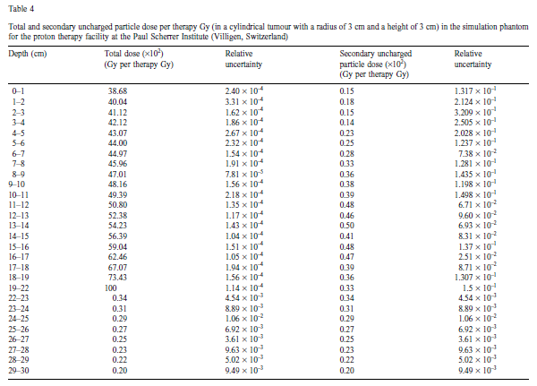
Agosteo et al., ‘Secondary neutron and photon dose in proton therapy,’ Radiotherapy and Oncology 48 (1998) 293-305 . Mostly Fluka MC simulations in three treatment beams: the double scattered beam at NAC, the scanned beam at PSI (including a degrader just upstream of the patient) and the 65 MeV eye beam at Nice, with some activation foil measurements at the last. Results are mostly presented as tables such as this one for PSI. Such a table does not give much of an impression of the data.

Slide 13
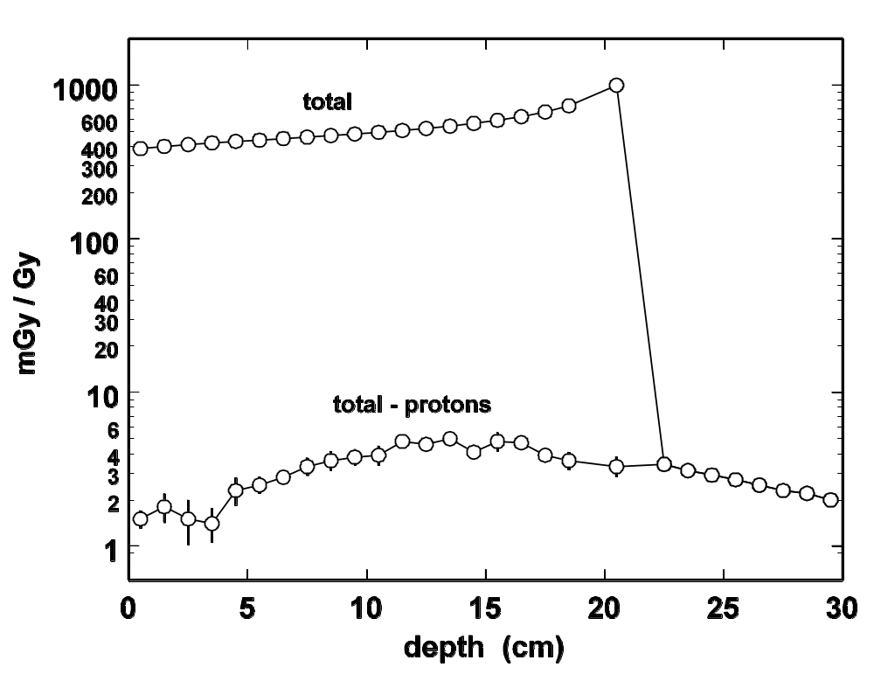
Graph of the previous table: longitudinal distribution of proton and non-proton (neutron plus photon ) physical dose in simulated PSI beam. There is a 4.5 cm polyethylene range shifter just upstream of the patient, which contributes the small entrance n dose. Note the buildup of n dose followed by its exponential decay. n dose is negligible in the volumes receiving protons (target and entrance). In neutron papers the accuracy conveyed by a graph is usually adequate given the simulation, measurement and Q value (RBE) uncertainties.

Slide 14
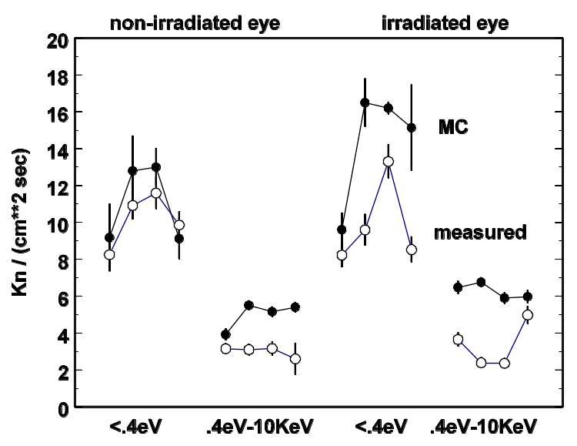
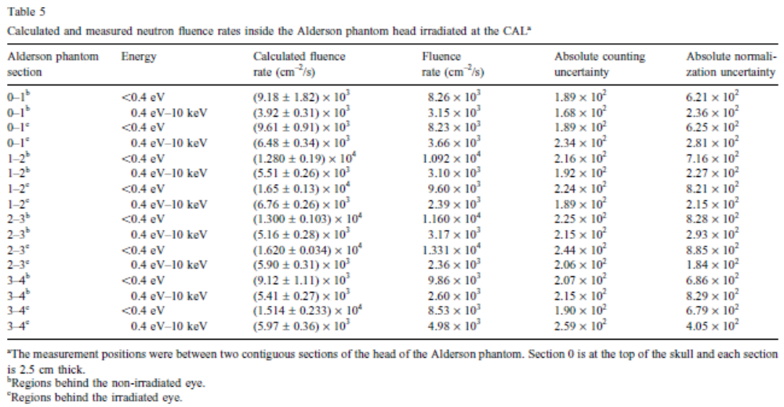
Graph of eye simulations and measurements (Table 5). Agreement was described as ‘satisfactory’. Dose to the optic nerve behind the eye was 0.11 mGy/Gy; to the brain 0.002 mGy/Gy. Using Q = 7 that translates to 0.8 mSv/Gy (nerve) and 0.014 mSv/Gy (brain). Neutron dose is negligible in eye treatments because of the low proton energy.

Slide 15
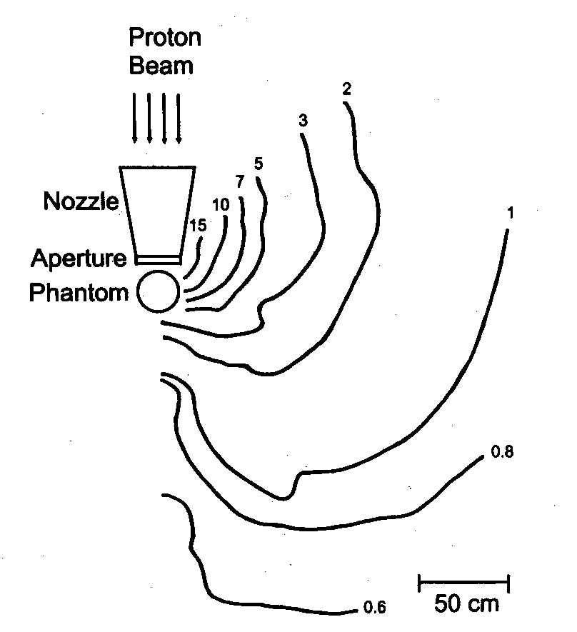
Yan et al. ‘Measurement of neutron dose equivalent to proton therapy patients outside of the proton radiation field,’ Nucl. Instr. Meth. A476 (2002) 429-434, Figure 5. The isodose contours show neutron dose of the order of 1-15 mSv/Gy. However, the experiment used a 5×5 cm hole in the patient collimator while the beam was designed to treat 19.4×19.4 cm (not mentioned in the paper, but known to the beam designer). Therefore the ‘collimator efficiency’ was ≈7% rather than ≈50% for a reasonably matched beam. With this factor of 7, the results are not inconsistent with later papers. It is these data, incorrectly renormalized to a different field size, that Hall used for his comparison.
Table 3 gives the results of a vertical transverse scan which seem to be 10× less than the horizontal scan. This is puzzling because nothing in the setup would suggest such an asymmetry.

Slide 16
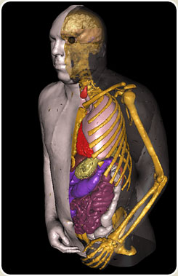
Jiang et al., ‘Simulation of organ-specific patient effective dose due to secondary neutrons in proton radiation treatment,’ Phys. Med. Biol. 50 (2005) 4337-4353 is a Monte-Carlo study (Geant4) using VIP-Man, a very detailed model of human anatomy, as the patient phantom, and an accurate model of the Burr Center scattered beam. It estimates neutron dose to 20 organs and effective dose to the whole body for a 72 Gy lung and a 45 Gy PNS treatment, 3 fields each, and gives lifetime cancer risk estimates.
This is the first in a series of papers by Harald Paganetti’s group at the Burr Center.

Slide 17
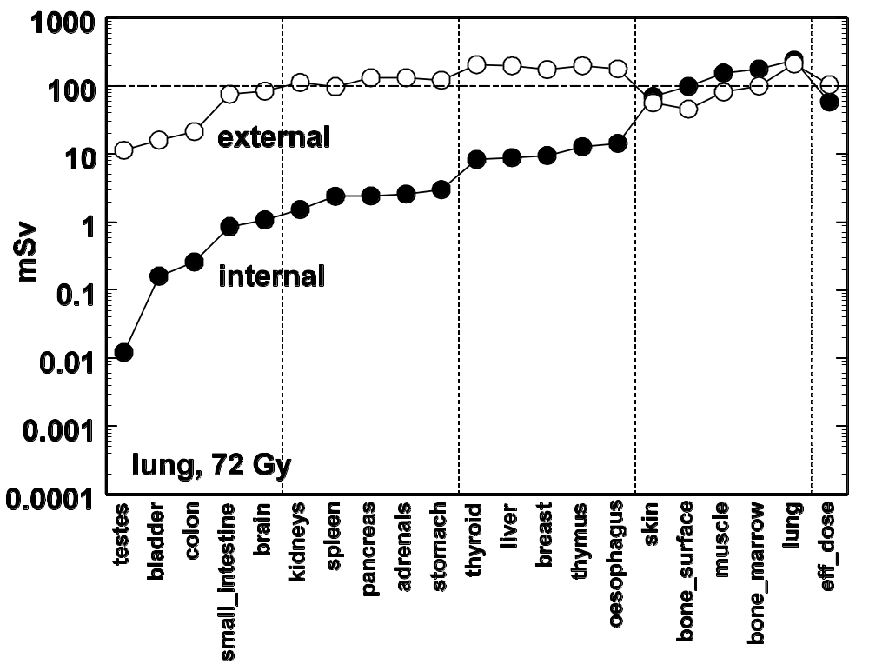
Plot of Jiang et al. Table 6, organs sorted by increasing internal dose, corresponding to proximity to the treated volume. External dose falls more slowly with distance. For testes, external ≈ 1000 × internal but total dose is still small: 0.16 mSv/Gy.

Slide 18
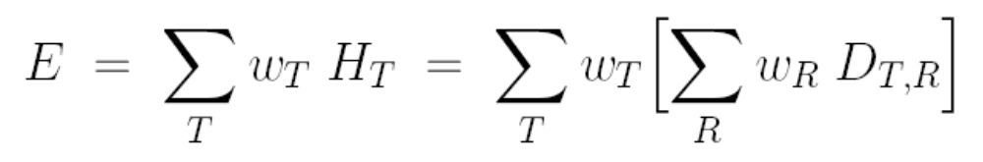
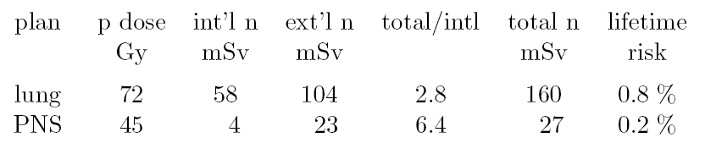
The effective (whole body) dose (ICRP Publ. 60 (1991)) is a sum over equivalent organ doses weighted by tissue weighting factors. Radiation weighting factors were chosen according to the average neutron energy entering each organ, and were clustered around 6 to 7.
The effective dose can be used to estimate very roughly the lifetime risk of a fatal cancer attributable to the exposure. 5%/Sv is widely used for a population of both sexes and mixed ages at exposure (see for instance BEIR VII Table 12-5A). The error is at least a factor of two!

Slide 19
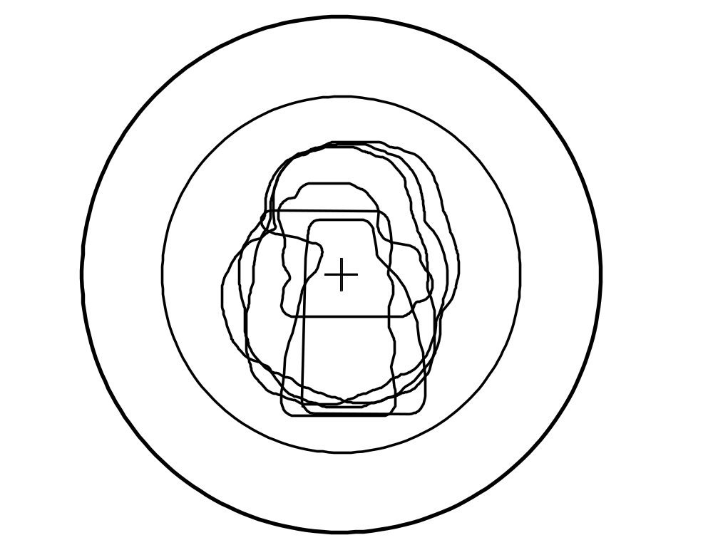
The risk is small and could be made even smaller by better matching the open (design) field size to the required size. External neutrons come mostly from protons that stop in the patient aperture. The large circle is the design field at the Burr Center. The smaller one easily fits all six plans used by Jiang et al. The ratio of areas is 2 so reducing the field size would cut external neutrons ≈ 2×. At the Burr Center this is not easy to do because of the scanning magnets: one of several reasons not to combine scanning and scattering in the same nozzle.

Slide 20
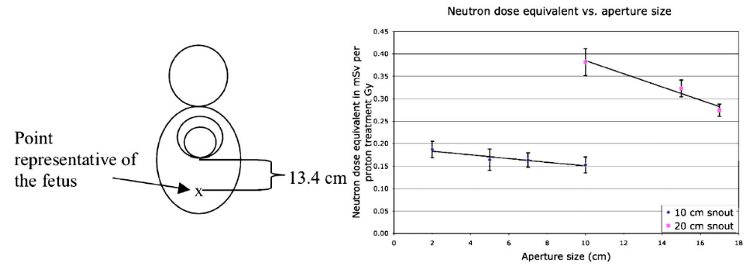
Mesoloras et al. ‘Neutron scattered dose equivalent to a fetus from proton radiotherapy of the mother,’ Med. Phys. 33(7) (2006) 2479-2490. A special case of great importance because of the sensitivity and long life expectancy of the fetus. In a well designed proton snout almost all the dose to the fetus will be from external neutrons. The authors measured the dose with bubble detectors in various configurations.
The scattering nozzle has two configurations, one for 2-10 cm diameter fields and one for 10-20 cm. The graph shows that the fetus dose decreases as the aperture is opened and the dose (at only 13.4 cm from the field edge) is ~0.17 or ~0.34 mSv/Gy for the two snouts. However, the range was only 12 cm H₂O (128 MeV) and the air gap was rather large (15 cm), so results are not inconsistent with other studies.

Slide 21
Summary
In a modern double scattered beam line, external neutron dose ≈ internal ≈1 mSv/Gy or lower depending on distance off axis.
Higher numbers in early papers are from very poor proton utilization. They are not inconsistent with later work.
The corresponding lifetime attributable risk of a fatal second cancer is ≈ 0.4% , with a huge uncertainty, for a population of mixed ages at exposure. Probably much higher for children.
If the average neutron RBE for long-term effects is indeed 25 - 100 (Hall and Brenner) rather than ≈7 (standard radiation safety lore), that poses a problem for scanned as well as scattered beams!
External neutrons have a broader transverse distribution, therefore dominate unwanted dose to organs far off axis. However, the total dose to these is still small.
External neutron dose comes mainly from the patient aperture. If it is a concern (pregnant women, pediatric cases) the open field size should be matched to the target (HCL, MPRI; scanning).
Usually, the unwanted dose from protons far outweighs the unwanted dose from neutrons!

