Slide 1
Current Integrators
In proton radiotherapy, dosimeters are used in two distinct ways: as beam monitors, to end the treatment at the prescribed dose, and for QA, usually in arrays, to measure the lateral or depth dose distribution.
In either case, considerable thought should be given to the electronics that processes the output. Some commercial systems sample the output current, which varies of course with the time structure of the beam. To eliminate very fast variations, the current may be filtered, or data may be smoothed in software, or both. Beam intensity variations during the scan may be canceled by measuring the instantaneous ratio of the ‘field chamber’ current to a ‘reference chamber’ current.
We prefer to integrate the current, measuring the total output charge. That extracts the maximum possible information from the signal and makes filtering, with its somewhat complicated time response, unnecessary. The integration time can be very short if desired. If information about the absolute charge is preserved, a transverse or depth scan using N beam monitor units per point simultaneously measures the monitor’s output factor. Most commercial hardware/software, however, does not work that way.
An array of dosimeters (IC’s or diodes) requires an array of integrators, and that can be more challenging and expensive than the detector itself. There are two kinds of integrators: classical and recycling. Both can be used either singly or in arrays, using either discrete integrated circuits or ASIC’s (Application Specific Integrated Circuit).

Slide 2
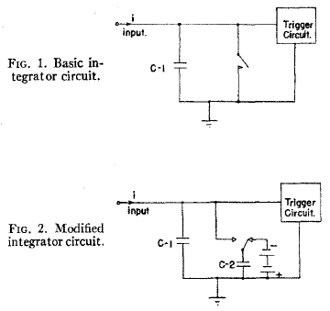
Classical and Recycling Integrators
Classical integrator. When the voltage across C₁ reaches some level, discharge C₁ by closing the switch. During this time, current is lost. Accuracy depends on the stability of C₁ (no problem) and the stability of the threshold level. Residual charge at the end of measurement may be significant.
Recycling or ‘charge-balancing’ integrator or ‘current to frequency converter.’ Subtracts a charge quantum ΔQ and issues an output pulse whenever the voltage on C₁ reaches threshold. Accuracy depends only on the stability of ΔQ. No deadtime. Good fit to control system.
Drawings from Lewis and Collinge, ‘A precision current integrator of medium sensitivity,’ Rev. Sci. Instr. 24 (1953) 1113.
Analogy: measuring flow rate from a faucet with a bucket. Classical : when water reaches a certain level, empty the bucket and increment a counter. You lose water while you empty the bucket. Recycling : when water reaches the level, remove an accurate dipper full of water and increment a counter. You lose no water, and in a long measurement (many counts) only the accuracy of the dipper matters, not exactly when you dip it into the bucket.

Slide 3
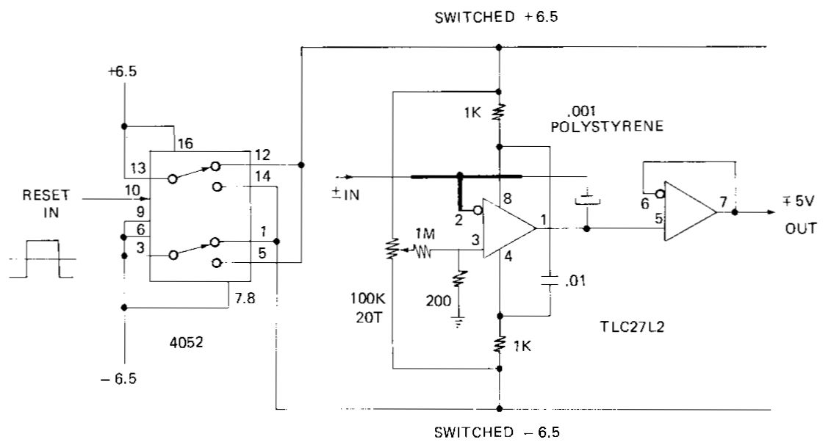
Classical Integrator
From B. Gottschalk, ‘Resetting a current integrator with the supply lines,’ Nucl. Instr. Meth. A297 (1990) 534. Instead of using a relay or transistor, this integrator is reset by reversing the supply lines through current limiting resistors. That effectively puts the capacitor inside a conducting diode bridge. This circuit has a very low parts count which, along with the ‘memory’ provided by the integrating capacitor, makes it ideal for arrays read out by a single scanning ADC.
The input burden, a few μV from ground, makes it ideal for diode arrays as well. This is the array integrator used in the CROSS and MLIC detectors. System sensitivity 2.44 pC/count, range ±5 nC, leakage current ≈ 0.3 pA.

Slide 4
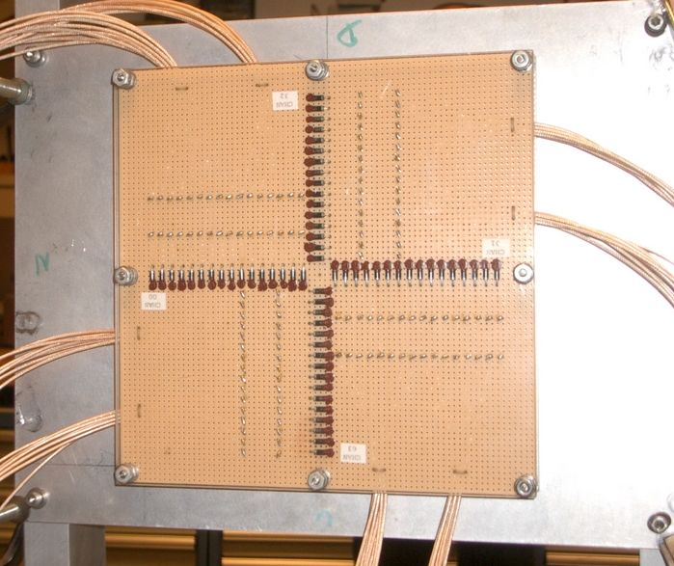
A Diode Array
The 32 × 32 ‘CROSS’ diode array built for QA in the HCL radiosurgery beam and now used for general purposes at the Burr Center. 1N4004 diodes are mounted on perfboard at 0.2″ pitch. Leads not at ground are covered with insulating paint to discourage ion collection. The diodes put out so much signal (130 pC/rad) that they will not reach the 10 Krad damage threshold in the lifetime of the device, so they are not pre-irradiated.

Slide 5
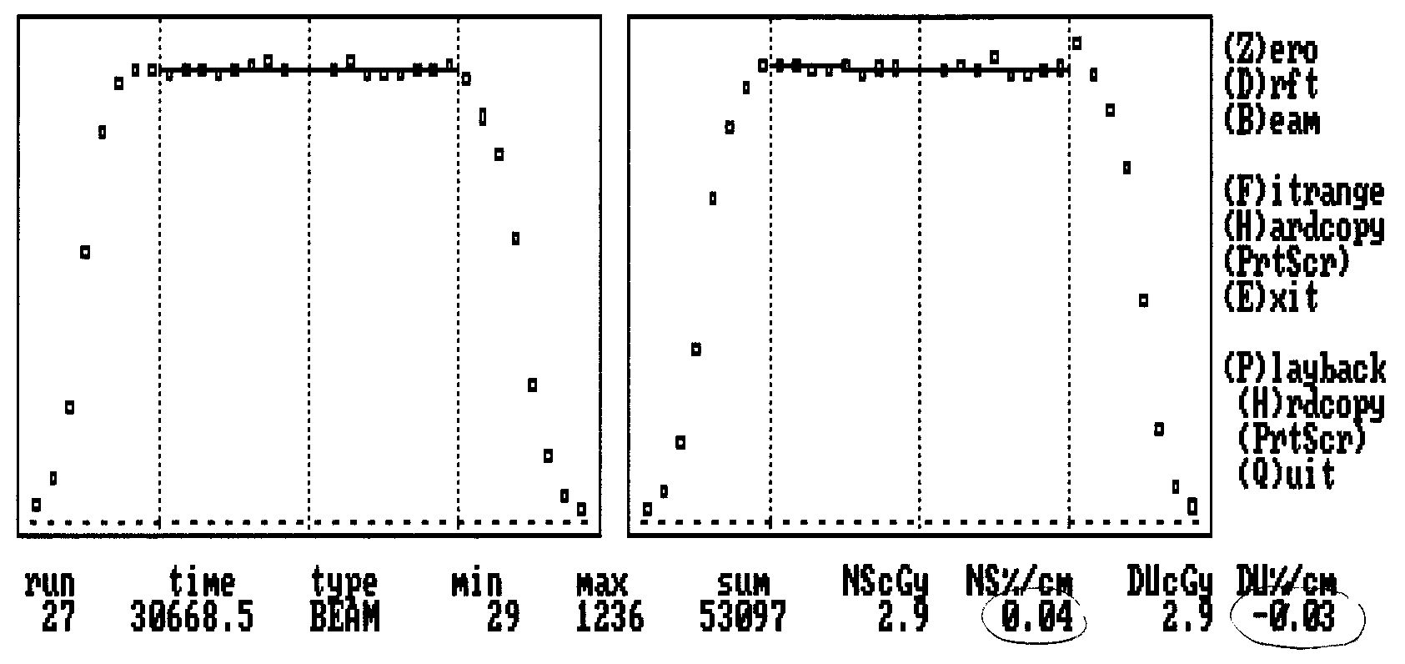
Real-Time Output
On-line displays on the PC running the CROSS array. The measurement shown took two seconds. Array devices take longer to set up than to use so ease of setup should guide the mechanical design. Data should be recorded in a compact and automatically named log file with no operator response needed.
Diodes are recalibrated annually by exposing CROSS to a Gaussian dose distribution at several preset positions. The 64 diode constants and a few parameters for the unknown dose distribution are thus overdetermined, and found by a least-squares fit.

Slide 6
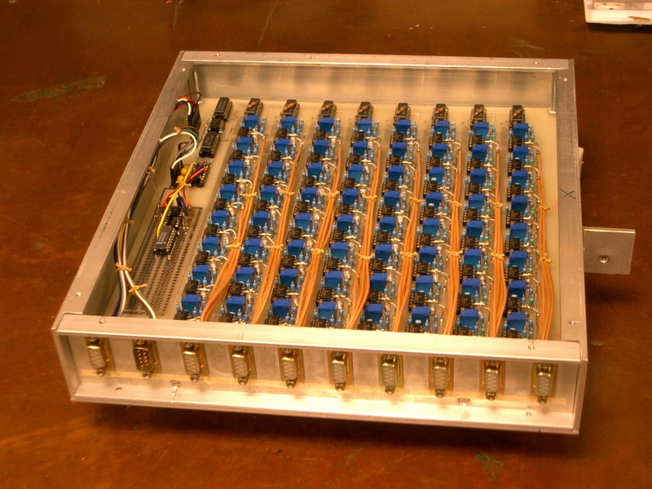
64 Channel Classical Integrator Array
This array is used at the Burr Center for CROSS and MLIC. A second unit houses a scanning ADC to read the integrators and transmit data to a host computer via RS-232.

Slide 7
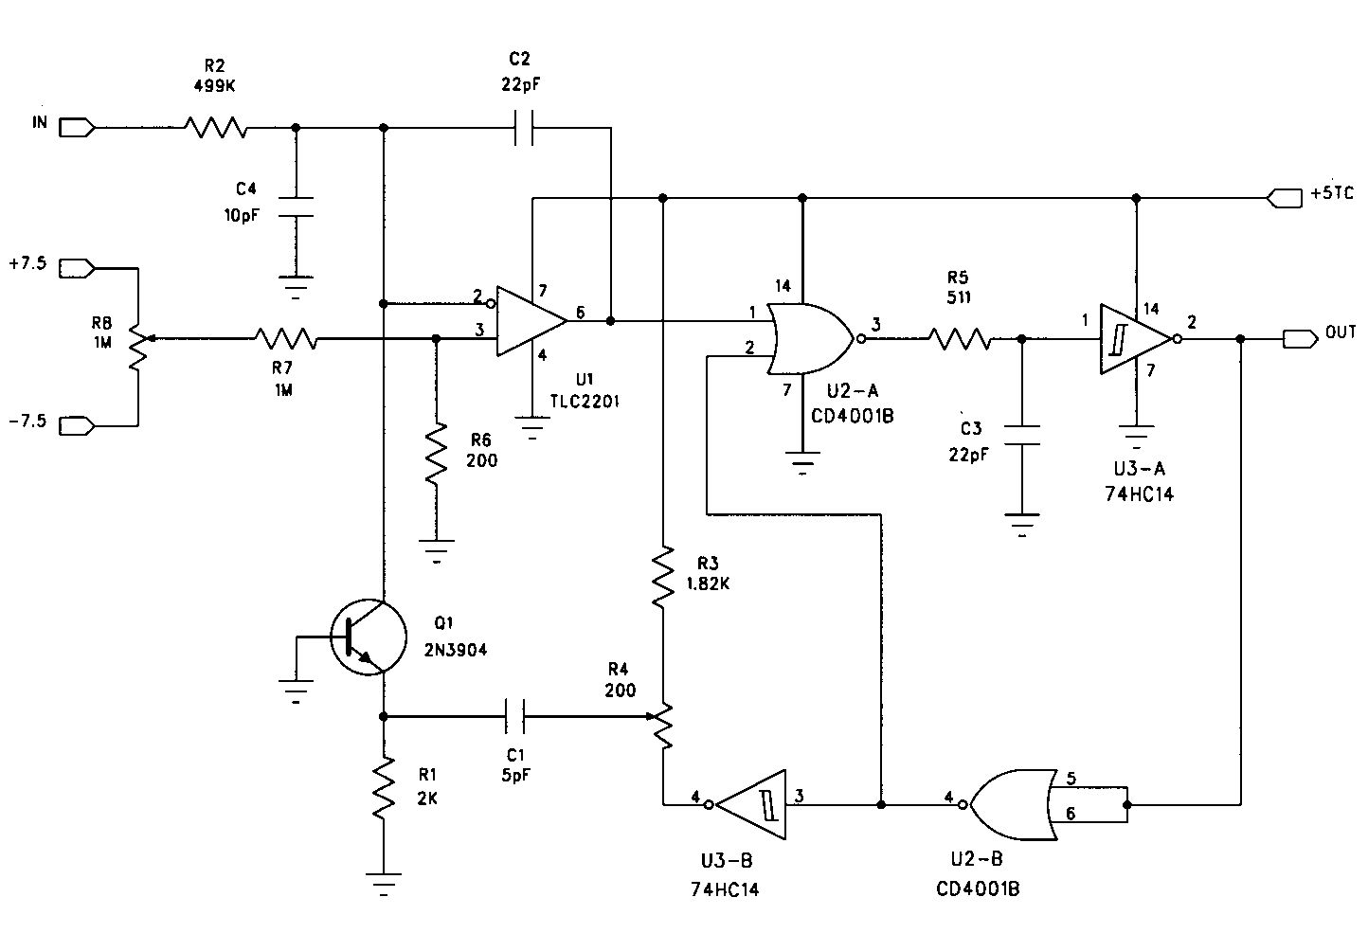
Recycling Integrator
See B. Gottschalk, ‘Charge-balancing current integrator with large dynamic range,’ Nucl. Instr. Meth. 207 (1983) 417. This slide shows an updated version used in the IBA nozzle. ΔQ = 10 pC (R4), max counting rate 2 MHz corresponding to 20 A. Unipolar: sinks current, so it works with proton collectors. Input burden a few ±μA (R8) so it also works with diodes. Leakage ≈0.04 pA. When used as beam monitor, residual charge is negligible.

Slide 8
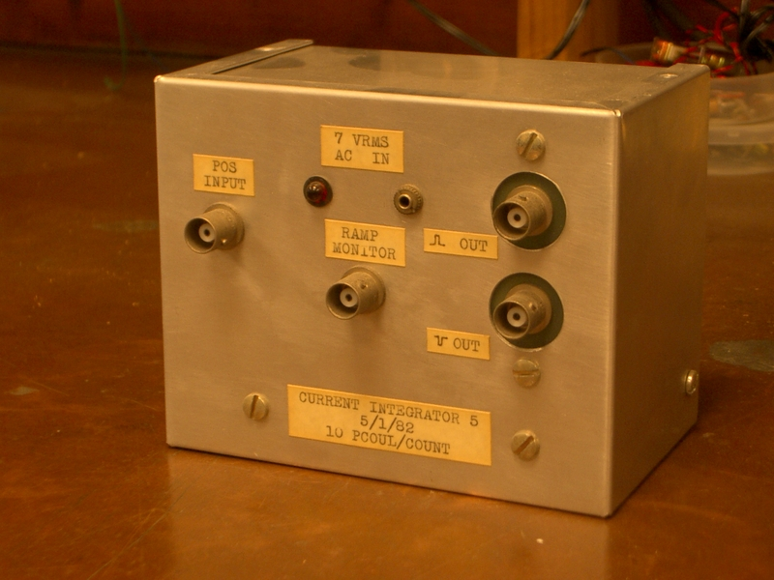
Stand-Alone Recycling Integrator
Single channel line powered recycling integrator used with beam monitor IC’s at HCL and for general purposes at the Burr Center. Sinks charge, puts out a pulse for every 10 pC.

Slide 9
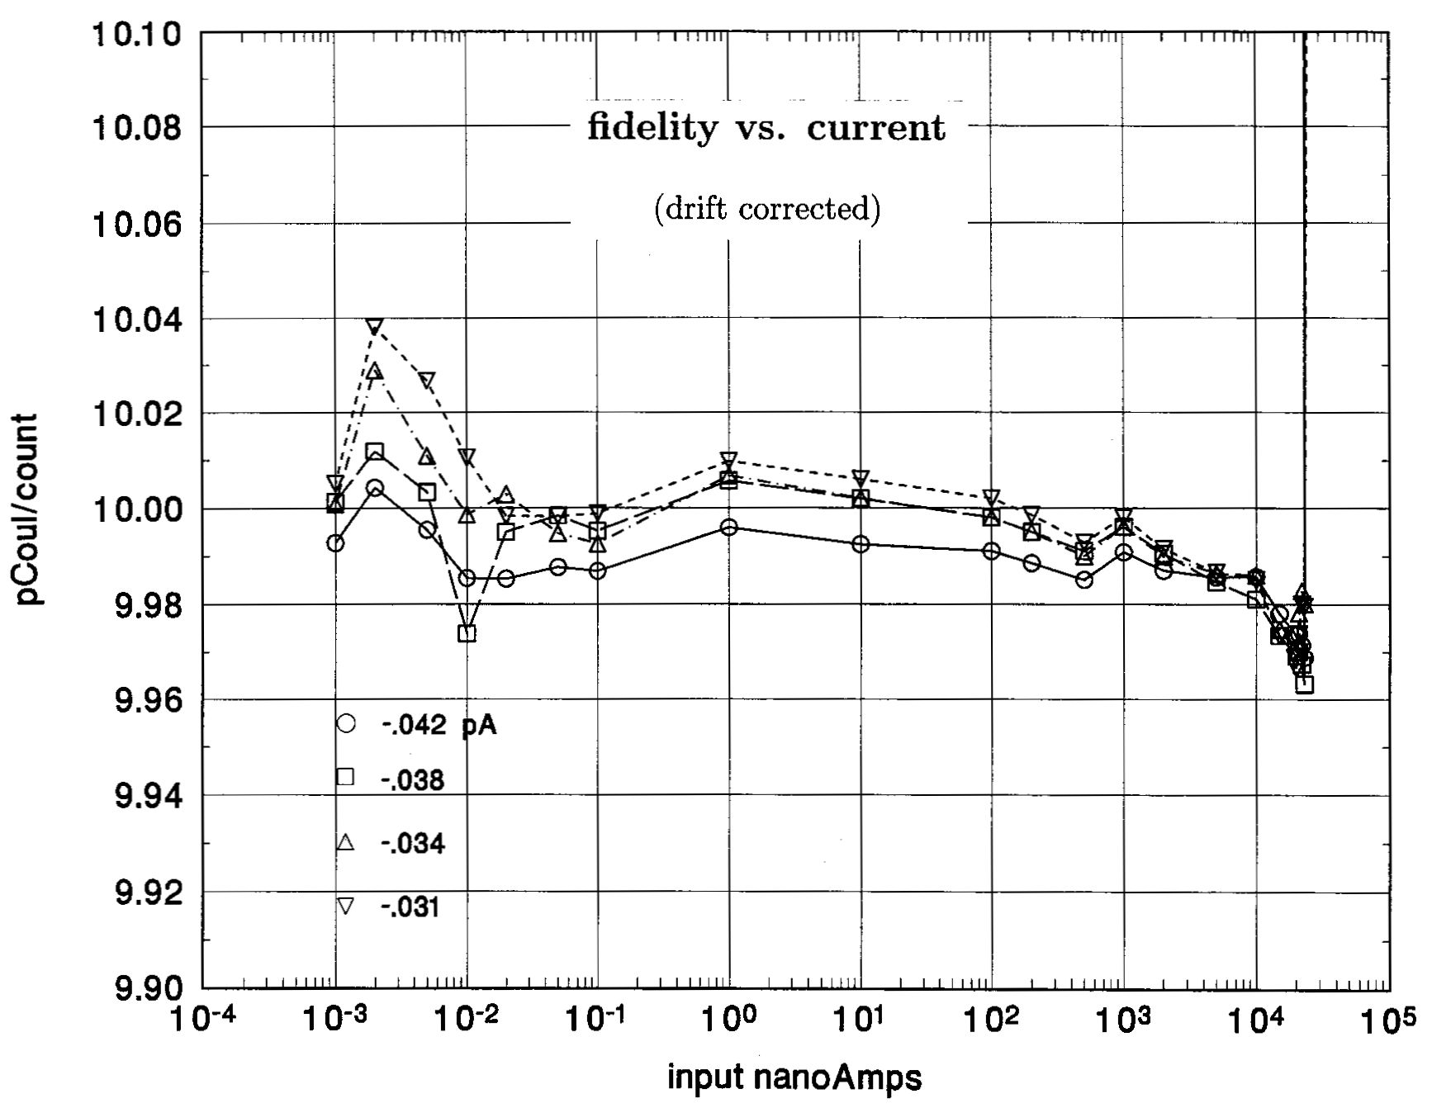
Rate Dependence of Charge Quantum
ΔQ is independent of input current over >7 decades to ±0.2%. Even during a hypothetical high-current accident this circuit will keep track of the dose delivered.

Slide 10
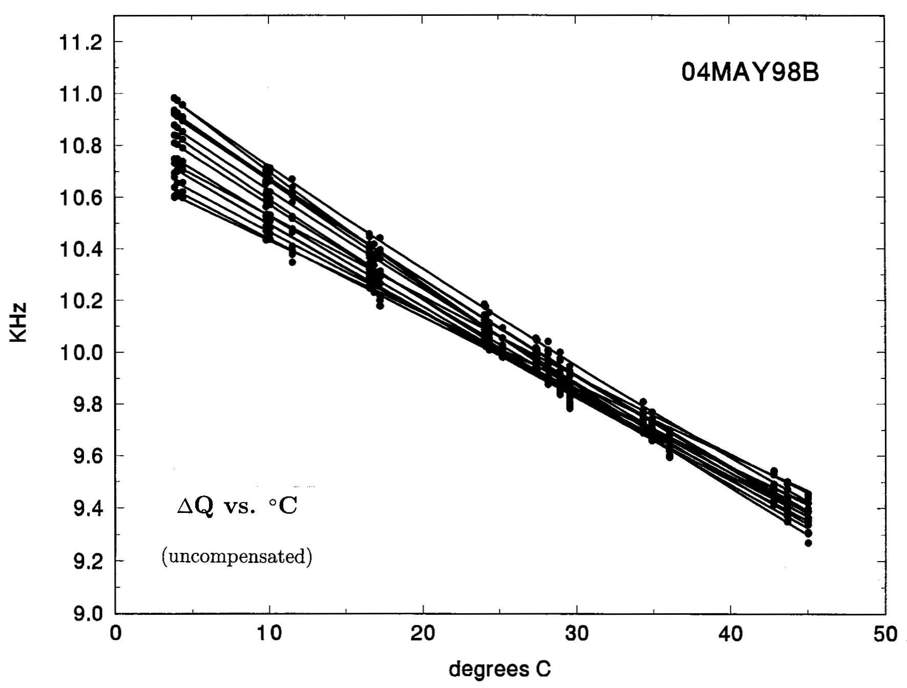
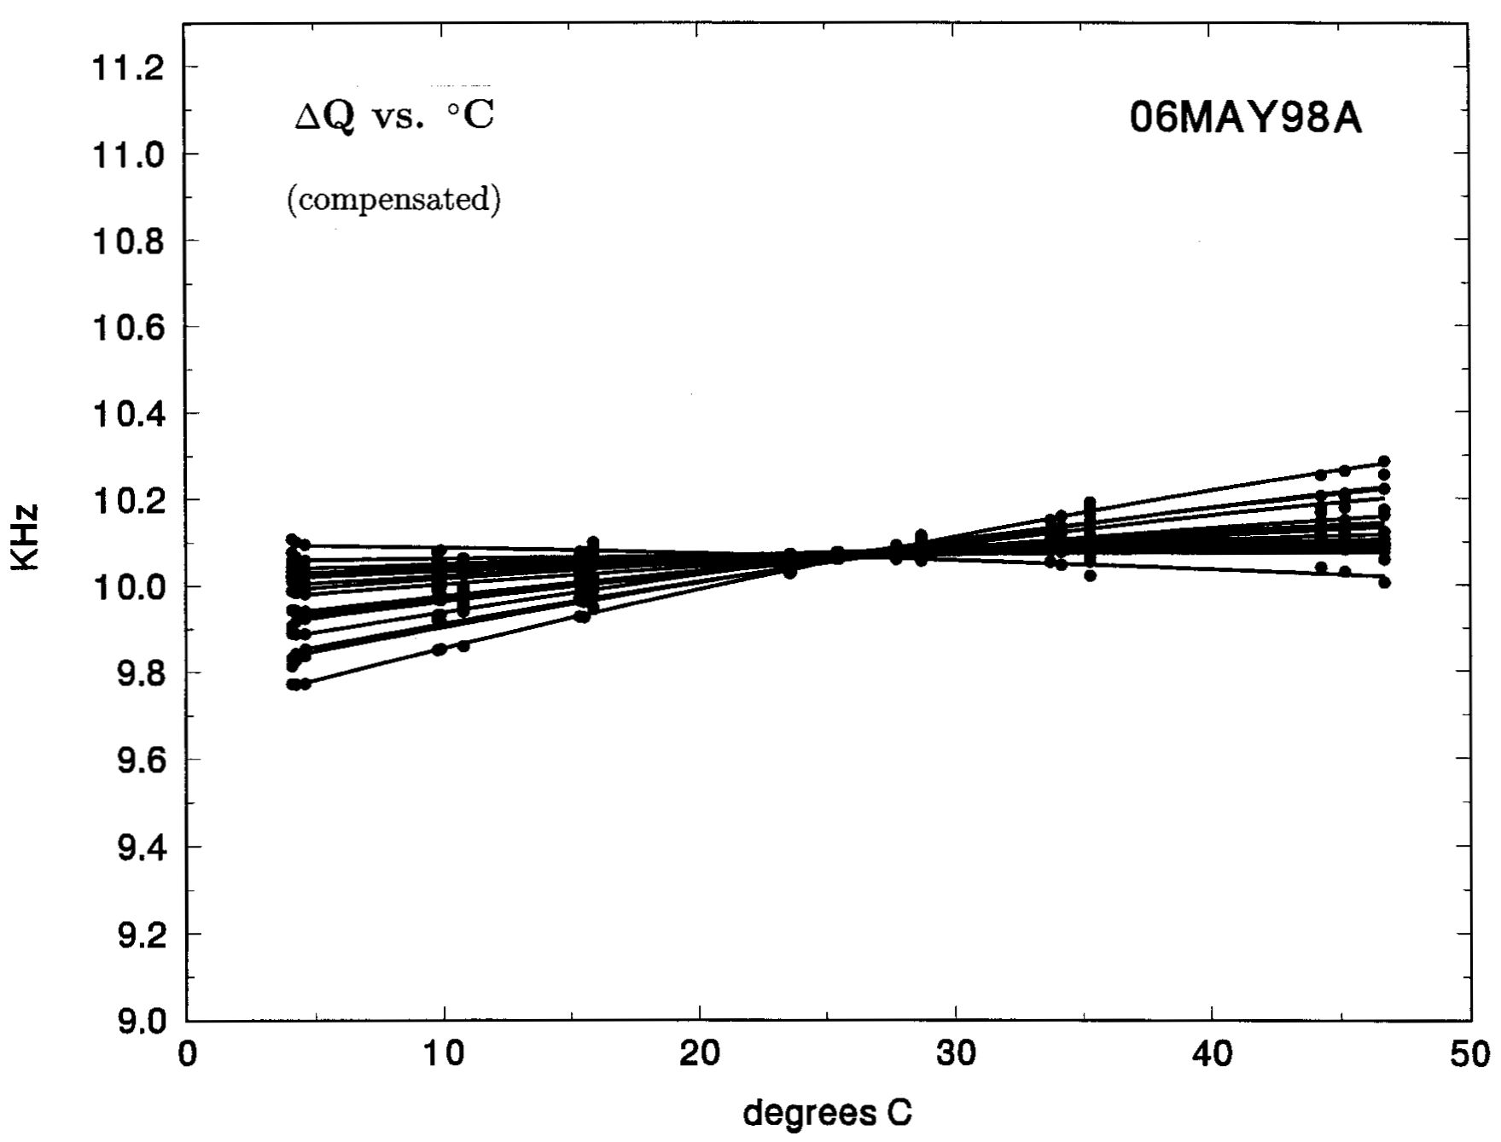
ΔQ Tempco for 16-Channel ICEU Board
Analog circuits always have temperature dependence, which is tricky to measure because the board must be heated or cooled uniformly. Without compensation, the recycling integrator has a temperature coefficient (‘tempco’) of ≈ -0.25%/°C. It can be compensated by varying ‘+5 V’ very slightly. That adjusts ΔQ without significantly affecting circuit operation.
The integrators are packaged 16/board. Though they all have slightly different tempcos, this slide shows that a single compromise setting reduces the net tempco by roughly 5×. The circuits have proved sufficiently stable in about 10 years of service in the IBA nozzle.

Slide 11
General-Purpose Integrator Array: Specs
The future, especially as beam scanning becomes more common, will see greater use of detector arrays: multi-layer IC’s, diode arrays and multi-layer Faraday cups. Frequently the detector itself will be home-built for a specific application, but all such detectors will require current integrator arrays. At present (2008) no fully satisfactory integrator array is commercially available. A general purpose integrator should meet the following specs:
1. Type: for QA, either classical or recycling is acceptable because some dead time is tolerable. For the beam dosimetry monitor, a recycling integrator is required.
2. Polarity: the integrator should be bipolar to allow leakage current of either sign to be measured. If it must be unipolar, it should sink current to work with Faraday cups.
3. Input level: the input should be at ground to simplify guarding of the detector.
4. Input voltage burden: should be adjustable and stable to ≈1μV if integrator is to be used for diode arrays. Other detectors don’t care.
5. Sensitivity: 1 pC/count or better if possible.
6. Range (if classical): ±5 nC.
7. Synchrony: integrators serving the same beam line should be strobed at nearly the same time. Total scan time ≈ 1 msec (≈ 5 μsec/channel) would allow reading ‘on the fly’ (beam on) in many cases.

Slide 12
Summary
QA in a proton therapy facility can be accomplished by current measuring circuitry, but current integrators (reading per accumulated charge) are preferable, and for the dosimetry channel, required.
Two circuit forms are available: classical and recycling. Classical integrators have fewer parts per channel and are potentially less expensive in large arrays, but have some dead time associated with the reset requirement. This should not matter much in QA since it amounts only to wasting a small fraction of beam-on time, but it is not acceptable in the dosimetry channel.
Operation over a wide range of input current should be considered and checked, as well as the temperature coefficient of calibration.
We have discussed specifications for a general-purpose integrator array: bipolar or positive input, input at ground, input voltage burden ≈1μV and stable, small charge quantum, synchronizable to read multiple detectors simultaneously.
It would be useful to budding proton therapy facilities if a general purpose Ethernet based integrator array were offered for sale, with suitable low-level software.

