Slide 1

SUNFORGE Markets (MiD-build deck)
Bernard Henderson, Nicklaus Brooks

Slide 2

Technology Solution
Sunforge Markets is a web-based stock trading platform that allows users to create accounts, manage portfolios, and simulate buying and selling stocks within a database-driven application.

Slide 3

the target audience for our system
Individuals learning how stock trading works
Users practicing market strategies
Trainees learning how stock trading works
Users practicing market strategies
Companies looking for a platform to train stockbrokers
Companies that want flexibility, and admin controls.

Slide 4
Development Tools / Environment
Vscode – Primary editor for writing html/css.
HTML & CSS – the user interface and layout for the platform.
JavaScript – gives functionality to the webpages.
SQL – for the purpose of storing user data.
AWS and python are to be implemented in later, complete builds of the system.

Slide 5
Accomplishments
Function 1: The Create Portfolio function allows a new user to create an account within the system. Once the information is submitted, a user profile and portfolio are created in the system.
Function 2: The View Portfolio function allows users to view their current portfolio within the system. The page displays current cash balance, portfolio value, daily stock changes, the users owned stocks and transaction history.

Slide 6
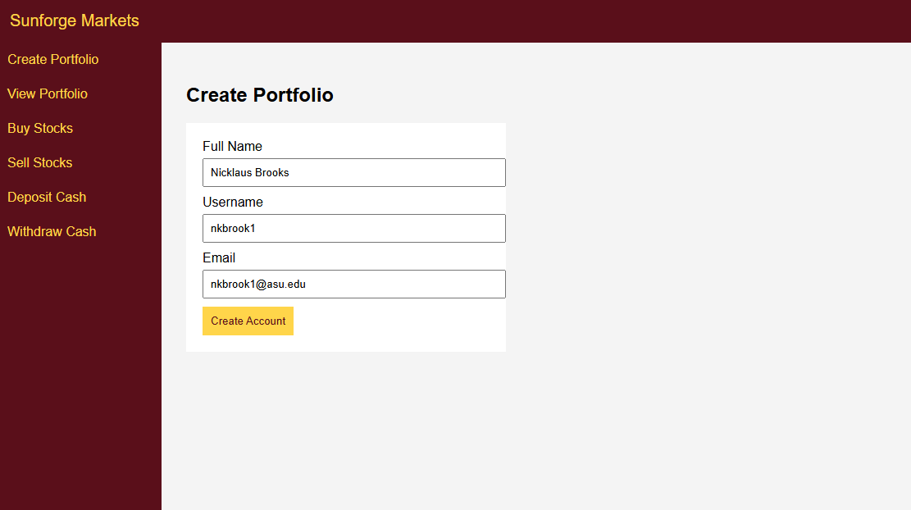
Function 1: Create Portfolio

Slide 7
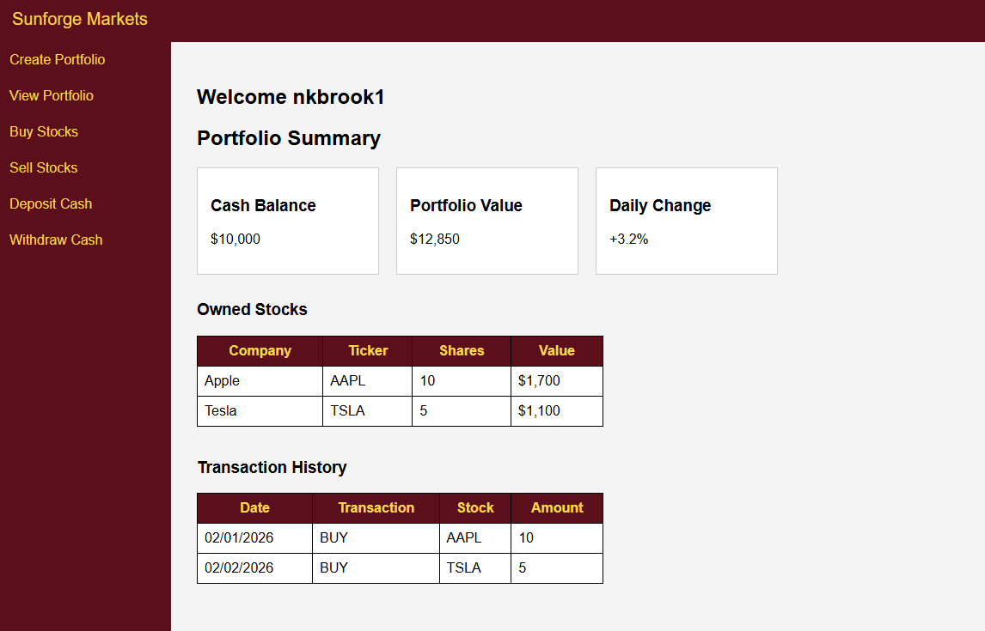
Function 1: view Portfolio

Slide 8
Changes in design
There has been a considerable change in stylization to the actual webpage design and what was previously shown in wireframes. Limitations include my experience with HTML and CSS and not fully being able to bring that original design to life. We first wanted to cater to functionality over design, as the project continues, some future design elements will be implemented.

Slide 9
Problems
On the development/front end side, the change to the interface design was not intentional, only due lack of experience with HTML/CSS and being unable to recreate the original design elements, but functionality has stayed the same.
Since the integration to AWS, and our database has not commenced, the current iteration of the system is hosted entirely locally, and user information is also stored locally using JavaScript.

Slide 10
thank you

