Slide 1

MODCOM INSTITUTE OF TECHNOLOGY PROJECT GUIDE

Slide 2
NAME:YOUR NAME
Project Name

Slide 3
Problem definition/Need
Explain what is the current background situation that led to creating your Data Science, Web, Python/Flask system or Mobile app.
Example
Help in online learning maybe due to the current corona lockdown etc.
Patients travel long distances to access health care, need for technology.
Farmers don’t have a better way to sell their produce and reach customers, Need for Tech.

Slide 4
Solution
Explain how your application will solve the problems highlighted in the problem statement
Using screen shots explain how it works , see next

Slide 5
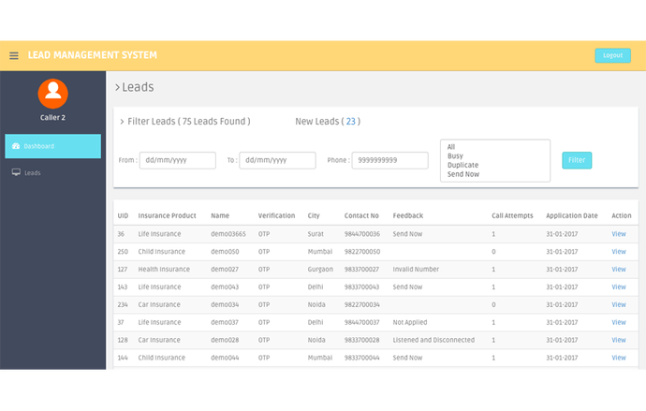
For Python/Web projects, put at least 3 Screenshots explaining the flow of your system. Below is a sample screenshot of a system.

Slide 6
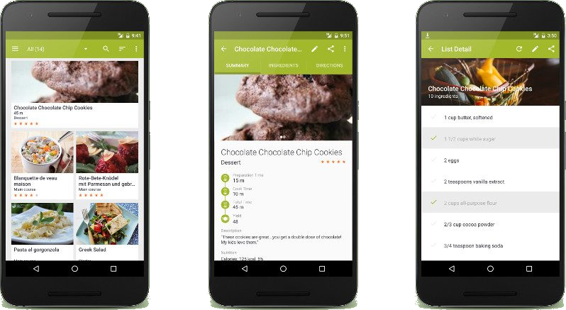
For Android projects, put at least 3 Screenshots
explaining the flow of your Android app. Below is a sample screenshot of an app

Slide 7
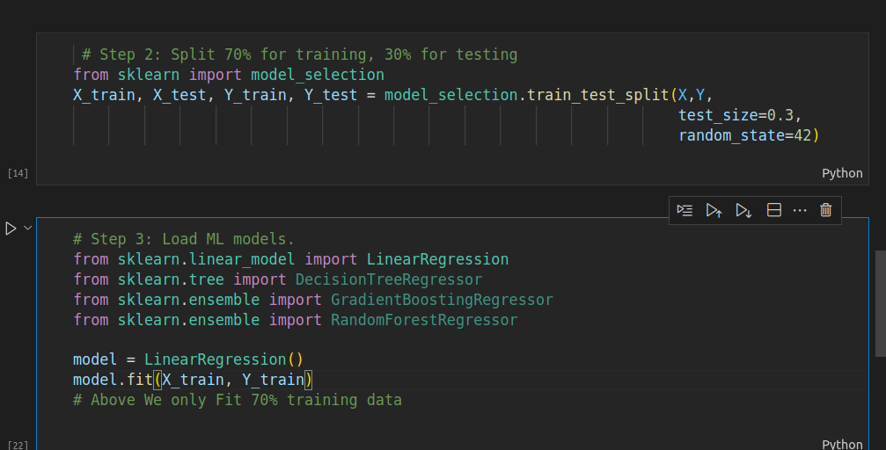
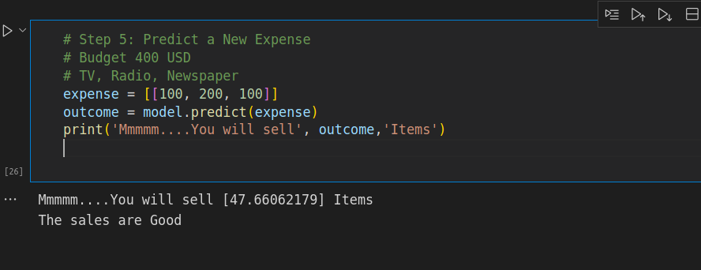
For Data Science, Explain which mode used, what is being predicted etc.
I.e Below I use Linear regression.
The Variable Being Predicted is Sales.
Sample Codes below.

Slide 8
Target Audience
Explain who will be using your system.
I.e doctors, drivers, general public etc.
Explain Any Revenue model you would want to use to make Money. i.e
Subscriptions.
Ads,
Selling Products
Commisions

Slide 9
Conclusion
Conclude your project, Any Future Improvements, Any More additional features you would want to share with us?.

Slide 10
Thank You

