Slide 1
SCAN-N-GO Idea Proposal
Jamie Behan
18406986
Bernard McWeeney
18384466
Shaun Kee
18308546
Consulted Supervisor: Jennifer Foster

Slide 2
Introduction
SCAN-N-GO is a revolutionary application whereby a consumer can enter a retail store, scan a barcode of any product(s) and pay using their phones’ built-in payment system.

Slide 3



Market Rationale
Target Market Size
Customer Segments
Main Value Proposition
3.5 Billion (2020)
7.8 Billion (2027)
Projected
Owners of Retail Stores
Consumers of Retail Stores
Eliminate Queues
Increase Customer Turnover

Slide 4
Our Competitors
Market Validation
Self Service Checkouts
Self Service Scanning Machines
Customer Facing Surveys
Interviews with Owners of Retail Stores

Slide 5


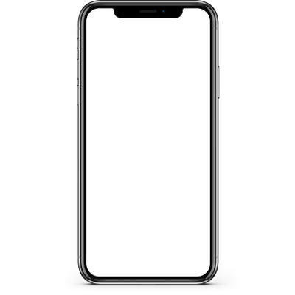

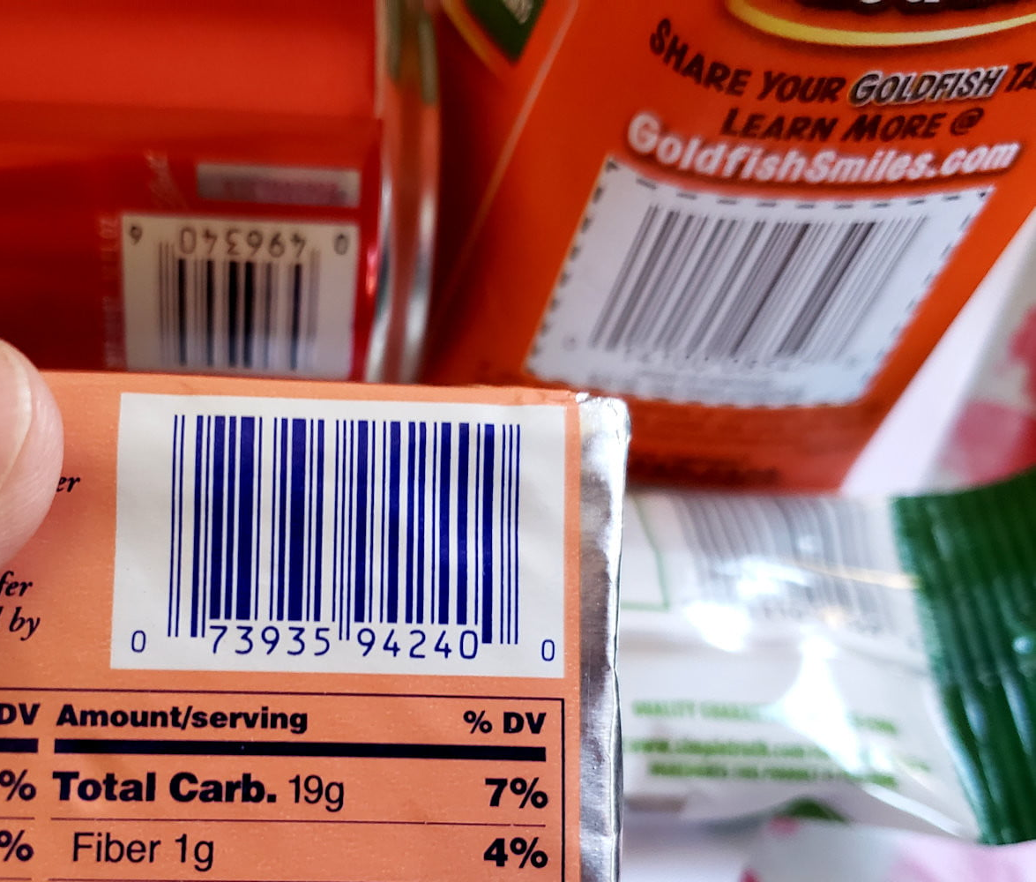
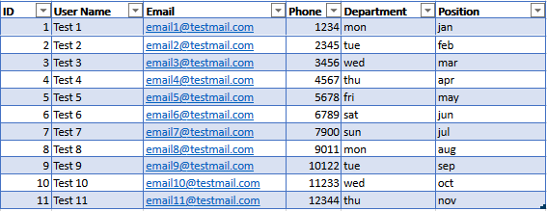


Technical
Delivery
SCAN-N-GO
SCAN-N-GO
Main Menu
- View Users
- View Transactions
- Settings LogOut
Logged in users
- Django Backend (API)
- Javascript Frontend
- HTML5
- CCS3
- Hardware API’s (Camera)
- Django Backend (API)
- Javascript Frontend
- HTML5
- CCS3
€5.95
Retail Store Back End
Front-End

Slide 6
Proposed Timeline of Activities
RESEARCH
SPRINT 1
SPRINT 3
REVIEW
Data Collection & Analysis
Development of Backend Prototype & Testing
Development of Frontend - Administration Prototype & Testing
Review & Prepare for Group Interview & Project Expo
NOV
DEC
JAN
FEB
MAR
APR
MAY
DESIGN & Plan
SPRINT 2
SPRINT 4
Software Design
& Plan Architecture
Development of Frontend -
General User Prototype & Testing
Development time for extra features
& Full Application Testing

Slide 7
Workload Distribution
Shaun Kee
Bernard McWeeney
Technical Leader
Technical Leader
Jamie Behan
Commercial Leader
End User Application
Administration Application
Front-End Developer

