Slide 1
Summer projects
Puppet all the things!

Slide 2
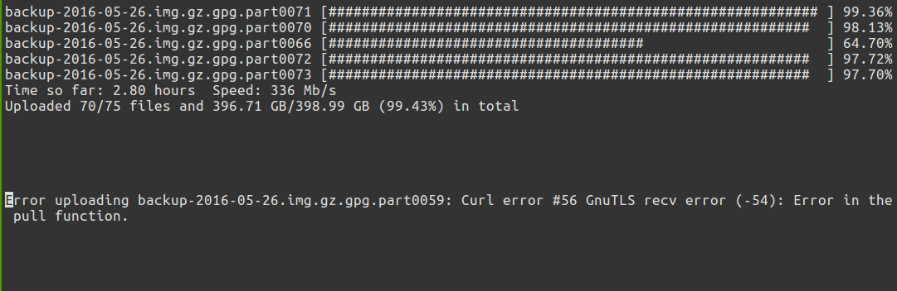
Offsite Box.com backups (rt#3903)
Parallelized file uploads to Box.com
Already had offsite backups, but they cost $, and all students get “unlimited” Box.com storage...

Slide 3
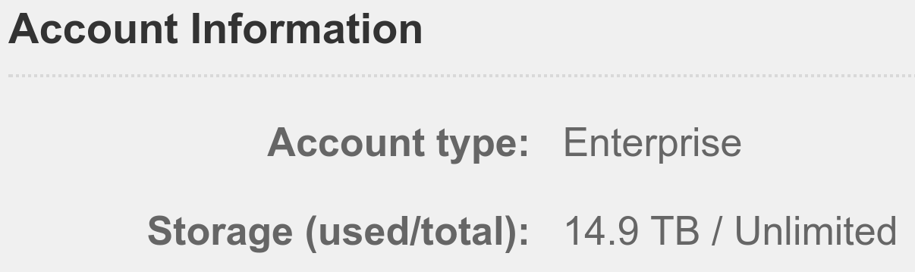
Offsite Box.com backups (rt#3903)
Going well so far,
14.9 TB stored so
far, and growing
rapidly!
Still needs work to be more reliable, like retrying files with a delay, but it's getting there.
Crashed this last week because of our Sunday morning power outage :(

Slide 4
Puppet IRC (rt#3434, rt#4528)
Tons of config (6000+ lines, mostly comments thankfully, but still a lot to go through)
Tried multiple different IRC servers, settled with InspIRCd, relatively new and actually updated
Pretty boring, lots of config, but allows our infrastructure to be rebuild more easily than before and be a lot more predictable.
Still need to add documentation, but it's coming

Slide 5
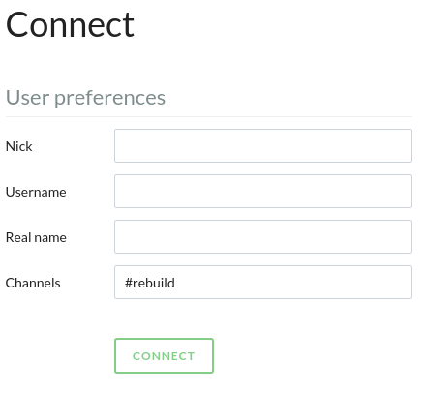
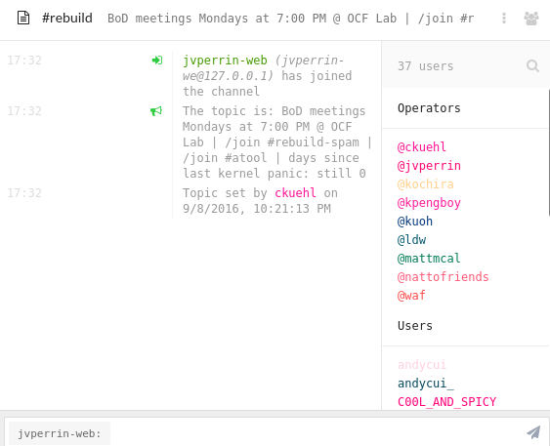
IRC Web Client (rt#4586)
Quick access for anyone to connect and ask questions
Easy public access to OCF staff for quick help (without having to have long email chains back and forth)
Relatively nice to look at

Slide 6
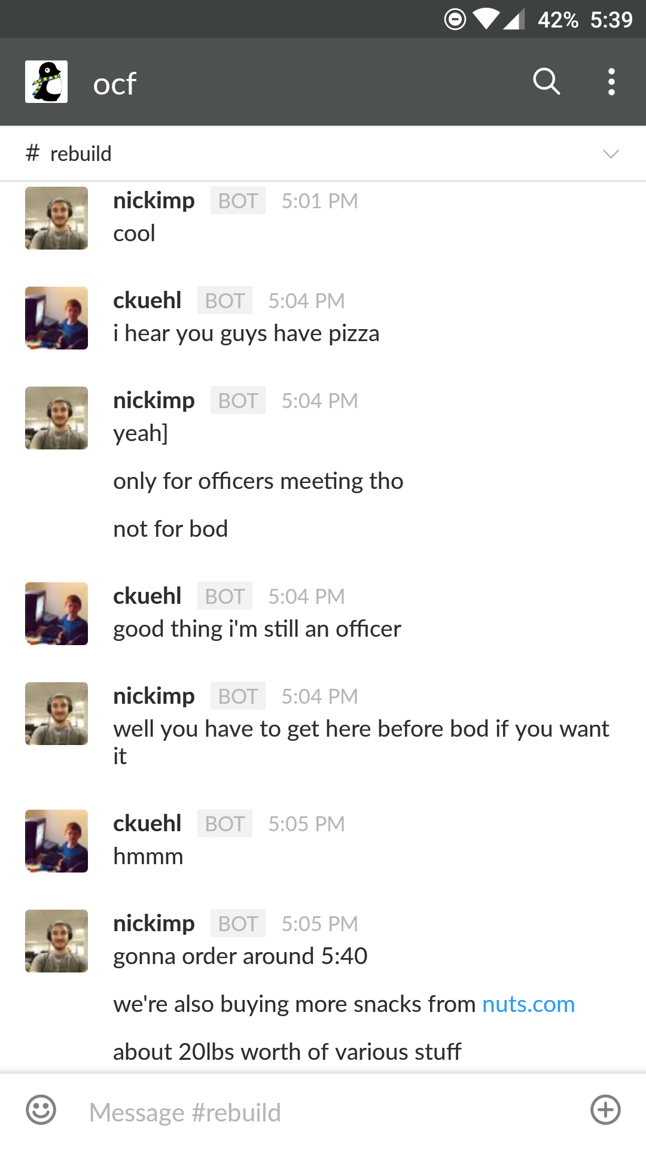
Slack ↔ IRC Bridge (rt#4586)
Mirrors messages from Slack to IRC and vice-versa.
Easier for most people to use than IRC, since a lot of organizations already use Slack
Mobile notifications!
Still has some lingering issues, like creating new users and channels. (rt#5121-5124)

Slide 7
Other small improvements
Cleaned temp files from desktops more reliably (rt#4805)
Improved package backporting using Puppet (rt#3106)
Numerous small things, but none of those really matter

