Slide 1

Group 12

Slide 2
The Team
Dustin Huff – Website
Miguel Ramirez – Website/Application
Mohamed Ait Bella – Application
Anirudh Singh - Application
Jason Portillo – Project manager, API, Database
Bernardin Dezius – Application
Michael Owens – Documentation/Website

Slide 3
General Idea
To develop a website and application for the service industry which helps the employees manage their schedule.
Both the website and application are interconnected since the website is dependent on the application for the availability of the employee and the application is dependent on the website to receive the schedule.

Slide 4
Tools Utilized
WISA stack.
C# API.
Microsoft SQL Database.
Android studio for application design.
Firebase Cloud Messaging
Bootstrap for HTML.
jQuery for JavaScript.
GitHub for file modification and receiving updates in real time.
FileZilla.
Slack for communication.

Slide 5
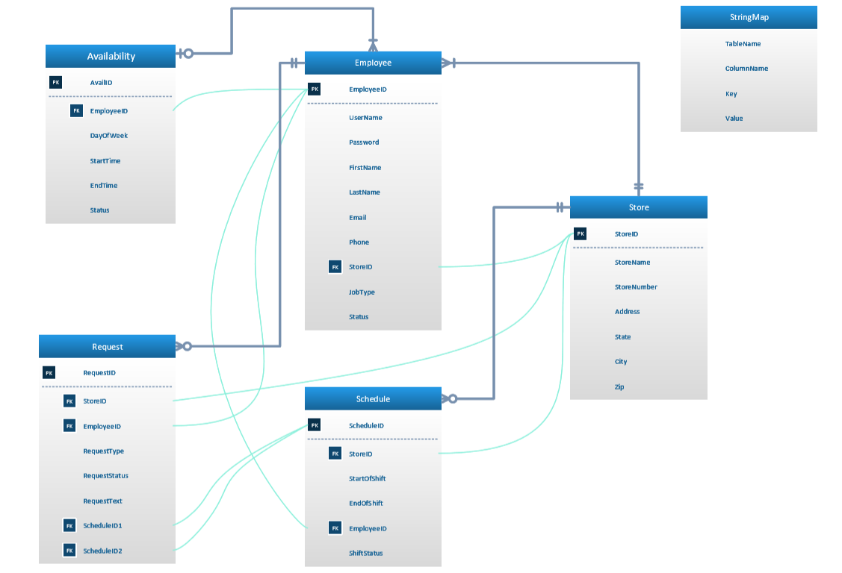
Database Diagram

Slide 6
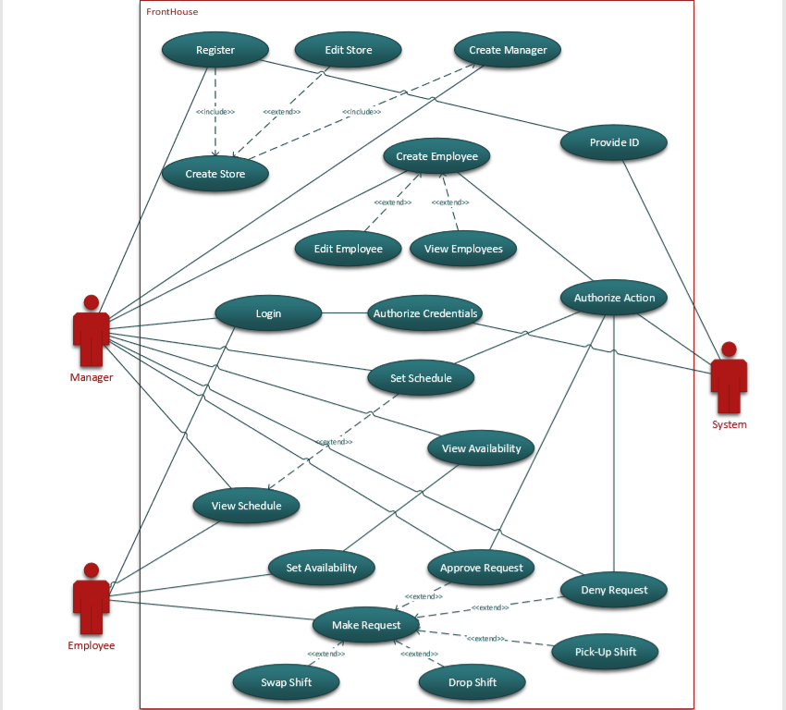
High Level Design UML Diagrams: Use Case

Slide 7
Our Product: The Website
These are the functionality of the website:
Make store
Make manager
Make Employee
Update Employee information
Get Availability
View Schedule
Set Schedule

Slide 8
Our Product: The Application
The employees can set their availability and view the schedule.
Employee’s can also request to pickup, swap, and drop their respective shifts.
The manager can process the employee’s request regarding pickup, swap, and drop shifts.
The application can send and receive notification’s through firebase.

Slide 9
The complete process of our product
First the management is going to use the website to make store, make manager, and make employee.
Next the employee’s will use the credentials given by the manager to login to the application to set their availability.
Now the employee availabilities are stored in the database and can be viewed from the website.
Next the manager can set the schedule based on the availabilities of the employee’s for the current week.
Finally the employee is able to view their schedule from the application and make requests like pickup, swap, and drop shifts.

Slide 10
Stretch Goals
In app messaging for employees to communicate
Enhancing manager abilities (ex delete employees, edit employees)
Allow schedule to be modified by the managers
QOL Changes (ex. Sending notification to employees when schedule is pushed out)
IOS Support

Slide 11
Successes and Failures
Successfully implemented nearly all the same features of $3 app on the App store.
Robust API
Large group issues
Scope too big

Slide 12
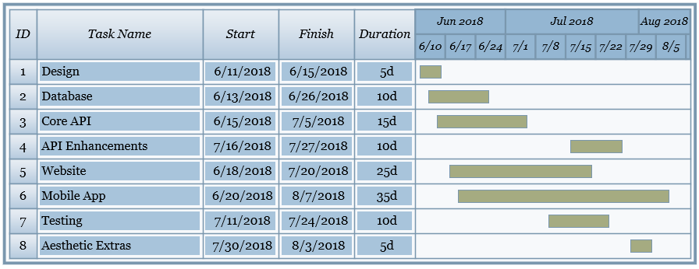
Gantt Chart

Slide 13
Demo

Slide 14
Q&A

